Slide 1
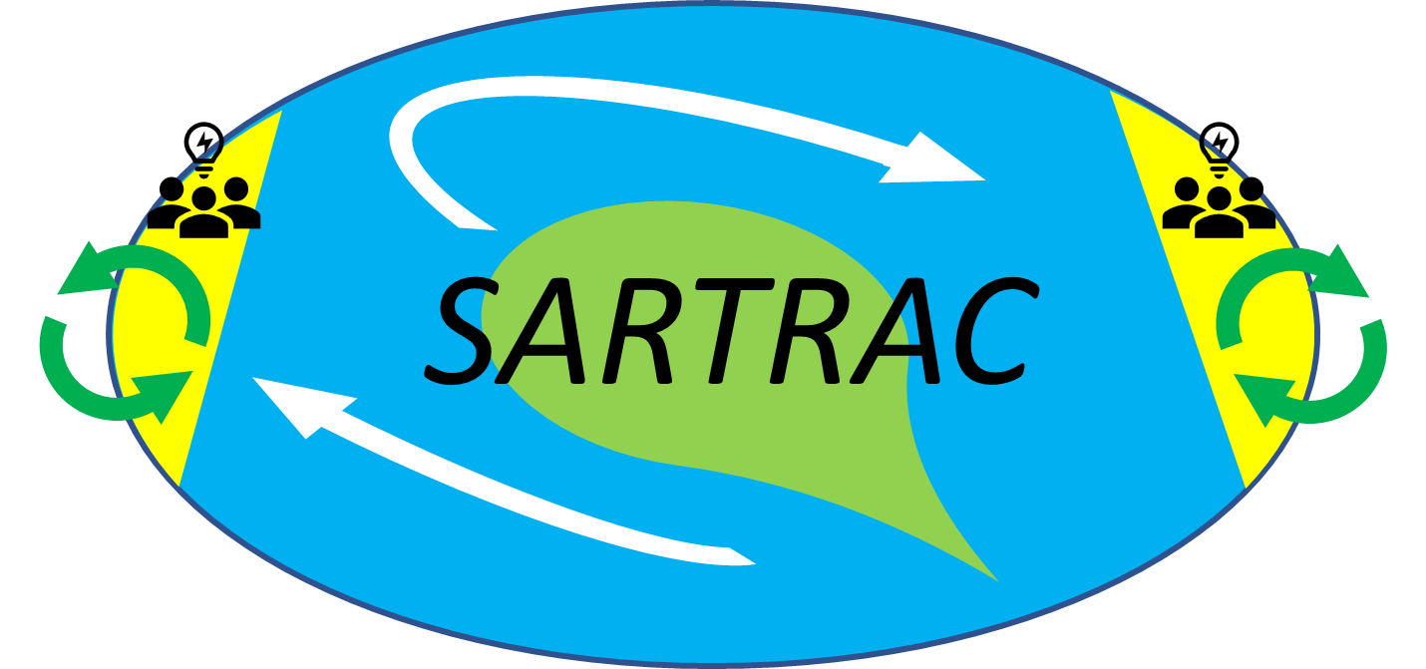
Teleconnected SARgassum risks across the Atlantic: building capacity for TRansformational Adaptation in the Caribbean and West Africa (SARTRAC)
Funded by the Economic and Social Research Council (ESRC), through the Global Challenges Research Fund (GCRF)

Slide 2
SARTRAC Theory of change
What is a Theory of Change?
A Theory of Change (TOC) is a framework to monitor, evaluate and demonstrate impact (a results chain)
TOC underpins SARTRAC research design, it guides our research, communications and engagement activities.
Living document, provides opportunities to reflect and revise activities.
Inputs
Activities
Outputs
Outcomes
IMPACTS

Slide 3
The SARTRAC TOC
The intended IMPACT of SARTRAC is to:
influence sargassum policy and management decisions at the international level and within partner DAC-list countries, notably Jamaica and Ghana.
This long term goal is the starting point for the SARTRAC TOC

Slide 4
Activities | Outputs | ST Outcomes | MT Outcomes | Impact
Develop and maintain a well-functioning research consortium. Align research plans / questions w. national research priorities in Jamaica, Ghana & E. Caribbean Stakeholders’ (national to local) needs analysed to shape research outputs. Regular interactions with all key stakeholders. Data, incl. sargassum drivers, distribution, opportunities and governance, analysed. | Research consortium functions well, i.e. regular meetings, two-way knowledge transfer. Policy relevant, high quality, innovative research. LT sargassum forecast and early-warning system, informed by user-needs and tested by key stakeholders. Co-develop sargassum risk management strategies with key stakeholders Open access database of primary and secondary sargassum evidence. | High-quality / high-impact outputs produced by members. Key stakeholders are aware / supportive of SARTRAC and research. Research users understand evidence produced by SARTRAC to help them build equitable resilience. Strengthened relationship / trust built with all key stakeholders. SARTRAC data used by other sargassum researchers to advance knowledge | SARTRAC consortium trusted as high-quality source of evidence. Research by SARTRAC informs policy and management decisions in partner countries. Widespread use of SARTRAC early-warning system by target stakeholder groups. Co-developed risk management strategy with key stakeholders for sargassum events. SARTRAC research / team engaged in national / international dialogues on sargassum | Strengthened research capacity of all partners. SARTRAC outputs used in policies to create benefits for the poorest. Poorest groups in partner countries use SARTRAC tools to adapt to sargassum events to improve their livelihoods Sargassum risk management strategies implemented by partner country governments SARTRAC research shapes national and international policy to enhance resilience of the poorest.

Slide 5
SARTRAC TOC Assumptions and Indicators
Activities
Outputs
Impacts
ST Outcomes
MT outcomes
ASSUMPTIONS Consortium members are willing and able to participate and contribute to the partnership across all output areas. Research areas continue to reflect national priorities. Stakeholders willing to engage in user-needs analysis Policymakers are willing / able to take part in consultative processes. Staff turnover among research users and policymakers does not interfere with research uptake Members have sufficient human resources to participate in activities. | INDICATORS Number of research products e.g. reports, briefs, working papers, blog posts, tweets Number of papers published (disaggregated by DAC-list members as lead author, open-access, gender of leading author) Number of capacity development events/ opportunities funded or facilitated by SARTRAC Number of interactions where knowledge outputs are disseminated (country / international level) e.g. policymaker meetings, workshops, conference presentation. | INDICATORS Number of citations of SARTRAC work Number of innovative research approaches developed. New research or advice requested from SARTRAC members by policymakers at the national/ international level. Number of unique users to the SARTRAC website and downloads of research outputs from the website | INDICATORS Number of policy decisions or management practice changes that draw on SARTRAC members’ research. Number of policy debates, discussions, discourses referencing SARTRAC research. | INDICATORS Use of SARTRAC early warning system by the poorest affected, e.g. fishers, farmers Changes in national management of sargassum events referencing SARTRAC work Sargassum seasons (at a new high level) are considered normal and manageable.

