Slide 2
Ontology Engineering and Design Patterns
COMP6215 Semantic Web Technologies
Dr Nicholas Gibbins - nmg@ecs.soton.ac.uk

Slide 3
Ontologies
“a formal, explicit specification of a shared conceptualisation” (Gruber)
https://userpages.uni-koblenz.de/~staab/Research/Publications/2009/handbookEdition2/what-is-an-ontology.pdf

Slide 4
Ontologies
Machine understandable
ontology should represent a shared view of the domain
“a formal, explicit specification of a shared conceptualisation” (Gruber)
Representation of concepts and constraints is explicitly defined
modelling the concepts and relations of the domain
https://userpages.uni-koblenz.de/~staab/Research/Publications/2009/handbookEdition2/what-is-an-ontology.pdf

Slide 5
Ontologies
Machine understandable
ontology should represent a shared view of the domain
“a formal, explicit specification of a shared conceptualisation” (Gruber)
The combination of concepts and relationships required to model a knowledge domain in a human and machine understandable format
Representation of concepts and constraints is explicitly defined
modelling the concepts and relations of the domain
https://userpages.uni-koblenz.de/~staab/Research/Publications/2009/handbookEdition2/what-is-an-ontology.pdf

Slide 6
Type of Ontologies
There are four main types of ontologies:
Representation ontologies
General or upper-level ontologies
Domain ontologies
Application ontologies

Slide 7
Representation ontologies
Describe low level primitive representations
Such as semantic web languages
Example ontologies:
OWL, RDF, RDFS
Usual size: small, a few dozens of concepts and relations

Slide 8
Upper-level ontologies
Describe high-level, abstract, concepts
Usually domain independent
Can be used as part of other ontologies
Sometimes part of broad ontologies
Examples:
DOLCE (small upper level ontology)
Cyc: commonsense ontology
Hundreds of thousands of concepts
WordNet: English lexicon
Over 150K concepts
SUMO: Suggested Upper Merged Ontology
Around 10K concepts

Slide 9
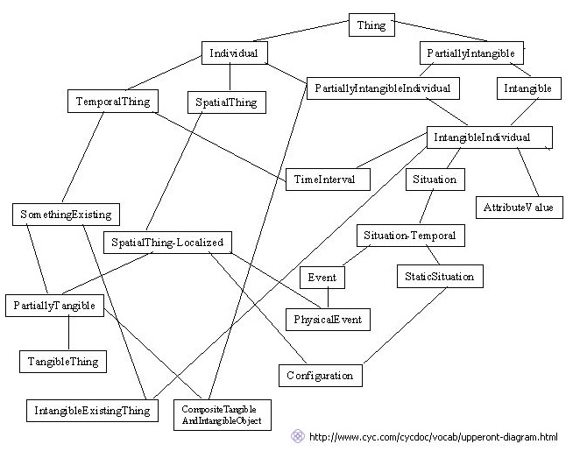
Example: A (tiny) fragment of Cyc

Slide 10
Domain ontologies
Describe a particular domain extensively
Domain dependent by definition
Examples:
GO: Gene Ontology
Roughly 25K concepts
CIDOC CRM: cultural heritage
Roughly 100 concepts
FMA: Foundational Model of Anatomy
Around 75K concepts

Slide 11
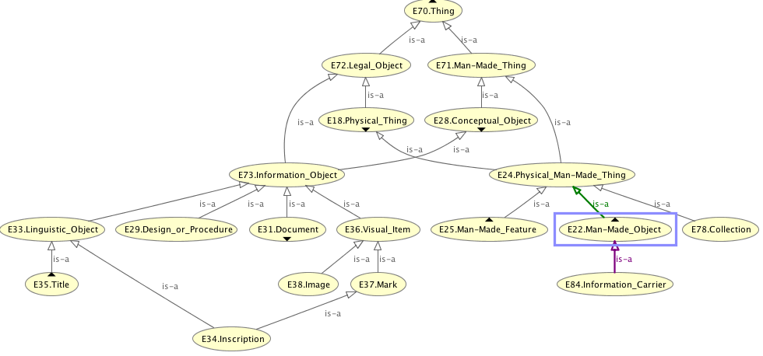
Example: CRM Ontology

Slide 12
Application ontologies
Mainly designed to answer to the needs of a particular application
Scaled and focused to fit the application domain requirements
Examples:
FOAF: Friend of a Friend ontology
about a dozen concepts
ESWC06: for conference metadata
about 80 concepts, including FOAF

Slide 13
Ontology Building Methodologies

Slide 14
Ontology Building Methodologies
No standard methodology for ontology construction
There are a number of methodologies and best practices
The following life cycle stages are usually shared by the methodologies:
Specification - scope and purpose
Conceptualisation - determining the concepts and relations
Formalisation - axioms, restrictions
Implementation - using some ontology editing tool
Evaluation - measure how well you did
Documentation - document what you did
Notes:
If you ask O developers which methodology they use .. They will most likely have no answer!

Slide 15
Specification
Specifying the ontology’s purpose and scope
Why are you building this ontology?
What will this ontology be used for?
What is the domain of interest?
An ontology for car sales probably doesn't need to know much about types and prices of engine oil
How much detail do you need?
Notes:
Let‘s do an office ontology!!!

Slide 16
Specification: Competency Questions
What are the questions you need the ontology to answer?
These are competency questions
Make a list of such questions and use as a check list when designing the ontology
Helps to define scope, level of detail, evaluation, etc.

Slide 17
Specification: Competency Questions
The questions that you REALLY need
You probably don’t need to worry about the questions that “perhaps someone might need to ask someday”
The questions that CAN BE answered
Can you get the necessary data to answer those questions?
Permanent lack of some data may render parts of the ontology useless!

Slide 18
Conceptualisation
Identify the concepts to include in your ontology, and how they relate to each other
Depends on your defined scope and competency questions
Define unambiguous names and descriptions for classes and properties (more on this in Documentation)
Reach agreement (the hard part!)
The best tool to use:

Slide 19
Conceptualisation
Start with pen and paper, diagramming software (e.g. Visio, Mind Maps), or cards/postit notes

Slide 20
Conceptualisation: Reuse
Ontologies are meant to be reusable!
Technology for reusing ontologies is still limited
Always a good idea to check any existing models or ontologies
Check your database models or off-the-shelf ontologies
Check existing ontologies
No need to reinvent the wheel, unless it is easier to do so!
Ontology search engines
Swoogle, Watson, lodlaundromat

Slide 21
What can you reuse?
Databases
Vocabularies
Ontologies
Some much re-used ontologies
For describing persons: FOAF
For describing documents: Dublin Core
For describing social media: SIOC
For describing vocabulary hierarchies: SKOS
For describing e-commerce: Good Relations
For Web metadata: schema.org
...

Slide 22
Formalisation
Moving from a list of concepts to a formal model
Define the hierarchy of concepts and relations
Also note down any restrictions
E.g. NonProfitOrg isDisjoint from ProfitOrg
An email address is unique

Slide 23
Formalisation: Building the Class Hierarchy
Top-down
Start with the most general classes and finish with the most detailed classes
Bottom-up
Start with the most detailed classes and finish with the most general ones
Middle-out
Start with the most obvious classes
Group as required
Then go upwards and downwards to the more general and more detailed classes respectively
Good for controlling scope and detail
Notes:
Noy calls the last one “combination” which is misleading

Slide 24
Formalisation: Middle-Out Approach
Staff
Student
University

Slide 25
Formalisation: Middle-Out Approach
Person
Organisation
Staff
Student
University
Research
Staff
Teaching
Staff
Undergrad
Student
Postgrad
Student

Slide 26
Formalisation: Middle-Out Approach
Person
affiliatedTo
Organisation
worksAt
Staff
Student
University
studiesAt
Research
Staff
Teaching
Staff
Undergrad
Student
Postgrad
Student

Slide 27
Formalisation: Naming Conventions
Not rules, but conventions
Avoid spaces and uncommon delimiters in class and relation names
E.g. use PetFood or Pet_Food instead of Pet Food or Pet*Food
Capitalise each word in a class name
E.g. PetFood instead of Petfood or even petfood
Start names of relations with a lowercase letter
E.g. pet_owner, petOwner
Use singular nouns for classes
E.g. Pet, Person, Shop

Slide 28
Formalisation: Class or Relation?
Is it a class or a relation?
It depends!
If the subclass doesn’t need any new relations (or restrictions), then consider making it a relation
Student
type of study
Full time
Part time
Student
Full Time Student
Part Time Student

Slide 29
Formalisation: Class or Instance?
Is it a class or an instance?
If it can have its own instances, then it should be a class
If it can have its own subclasses, then it should be a class
Student
University
rdf:type
rdf:type
John Smith
studiesAt
Uni of Soton

Slide 30
Formalisation: Transitivity of Class Hierarchy
subClassOf relation is always transitive
Car is a subclass of Vehicle
Vehicle is a subclass of TransportationObject
Any instance of Car is also a TransportationObject
subClassOf is not the same as “part of”
(see meronymy pattern later this lecture)
TransportationObject
rdfs:subClassOf
Vehicle
rdfs:subClassOf
Car
Car
partOf
Wheel

Slide 31
Formalisation: Tidy Your Hierarchy
Avoid subClassOf clutter!
Break down your hierarchy further if you have too many direct subclasses of a class
Staff
Technician
Administrator
Research Fellow
Senior Lecturer
Senior RF
Lecturer
Res. Assistant
Professor

Slide 32
Formalisation: Tidy Your Hierarchy
Avoid subClassOf clutter!
Break down your hierarchy further if you have too many direct subclasses of a class
Staff
Technician
Administrator
Academic
Lecturer
Researcher
Research Fellow
Res. Assistant
Senior Lecturer
Professor
Senior RF

Slide 33
Formalisation: Where to Point my Relation?
Relations should point to the most general class
But not too general
e.g relations pointing to Thing!
And not too specific
e.g. relations pointing to the bottom of the hierarchy
As a rule of thumb, if the domain or range of a relation is a disjunction (union) of classes, some refactoring is probably required

Slide 34
Formalisation: Where to Point my Relation?
Staff
works for
University
Technician
Administrator
Researcher
Academic
Module
teaches
Research Fellow
Lecturer
Res. Assistant
Senior Lecturer
Senior RF
Professor

Slide 35
Formalisation: Where to Point my Relation?
Staff
works for
University
Technician
Administrator
Academic
Module
teaches
Researcher
Lecturer
Research Fellow
Res. Assistant
Senior Lecturer
Senior RF
Professor

Slide 36
Implementation
Choose a language
e.g. RDFS, OWL...
Implement it with an ontology editor
e.g. Protégé, SWOOP, TopQuadrant
Edit the class hierarchy
Add relationships
Add restrictions
Select appropriate value types, cardinality, etc
Use a reasoner to check the consistency of your ontology
e.g. Racer, Pellet, Fact++, HermiT
Best to do this as you go along – easier to trace bugs in your modelling

Slide 37
Evaluation: Verification
Is your ontology correct?
Is it syntactically correct?
Is it consistent?
Implementing the ontology in an ontology editor helps to get the syntax correct
Using a reasoner helps you check that it’s consistent
You can also validate your OWL ontology online:
http://visualdataweb.de/validator/

Slide 38
Evaluation: Validation
Does your ontology successfully do what you set out to do?
Check the ontology against your competency questions
Write the questions in SPARQL or in similar query languages
Can you get the answers you need?
Is it quick enough?
Add additional properties or restructure the ontology to increase efficiency?

Slide 39
Documentation
Documenting the design and implementation rational is crucial for future usability and understanding of the ontology
Rational, design options, assumptions, decisions, examples, etc.
Structured documentation may clarify these assumptions
Douglas Skuce proposed a convention for structured documentation of ontological assumptions in 1995
Conceptual assumptions (C) (long definition, comparing with other classes/properties)
Terminological assumptions (T) (alternative terms used)
Definitional assumption (D) (short definition)
Examples (E)

Slide 40
Structured documentation
Instead of putting C/T/D/E into a single rdfs:comment, structure the metadata using appropriate properties from RDFS and SKOS (import SKOS into your ontology)
Conceptual assumptions (C)
skos:scopeNote, rdfs:comment
Terminological assumptions (T)
skos:prefLabel, skos:altLabel, rdfs:label
Definitional assumptions (D)
skos:definition
Examples (E)
skos:example
Use rdfs:isDefinedBy to indicate if definition is taken from an external source

Slide 41
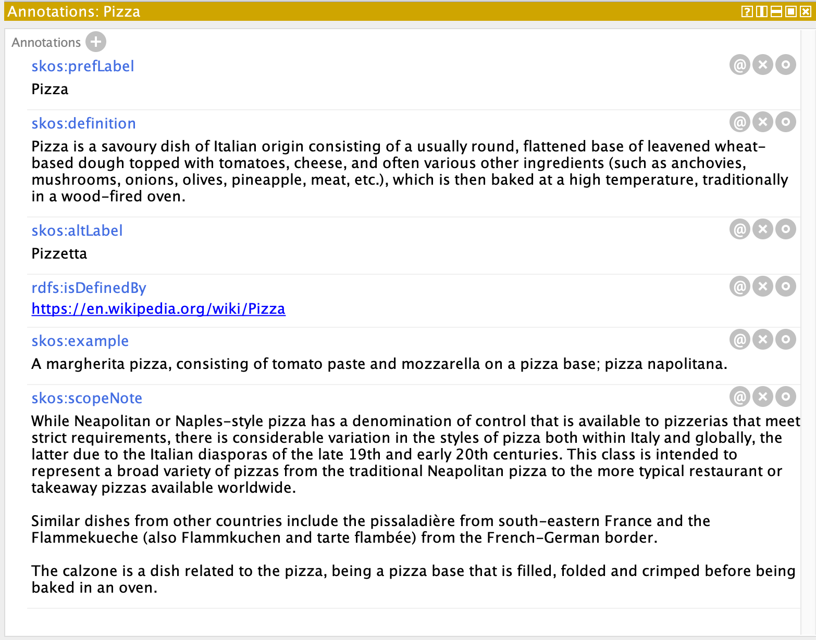

Slide 42
Summary
Ontology construction is an iterative process
Build ontology, try to use it, fix errors, extend, use again, and repeat
There is no single correct model for your domain
The same domain may be modelled in several ways
Following best practices helps to build good ontologies
Well scoped, documented, structured
Reuse existing ontologies if possible
Check your database models and existing ontologies
Reuse or learn from existing representations
(most ontology editing tools don’t yet provide good support for reuse)

Slide 43
Common Pitfalls
Over scaling and complicating your ontology
Need to learn when to stop expanding the ontology
Lack of documentation
For the design rationale, vocabulary and structure decisions, intended use, etc.
Redundancy
Increase chances of inconsistencies and maintenance cost
Using ambiguous terminology
Others might misinterpret your ontology
Mapping to other ontologies will be more difficult

Slide 44
Ontology Design Patterns

Slide 45
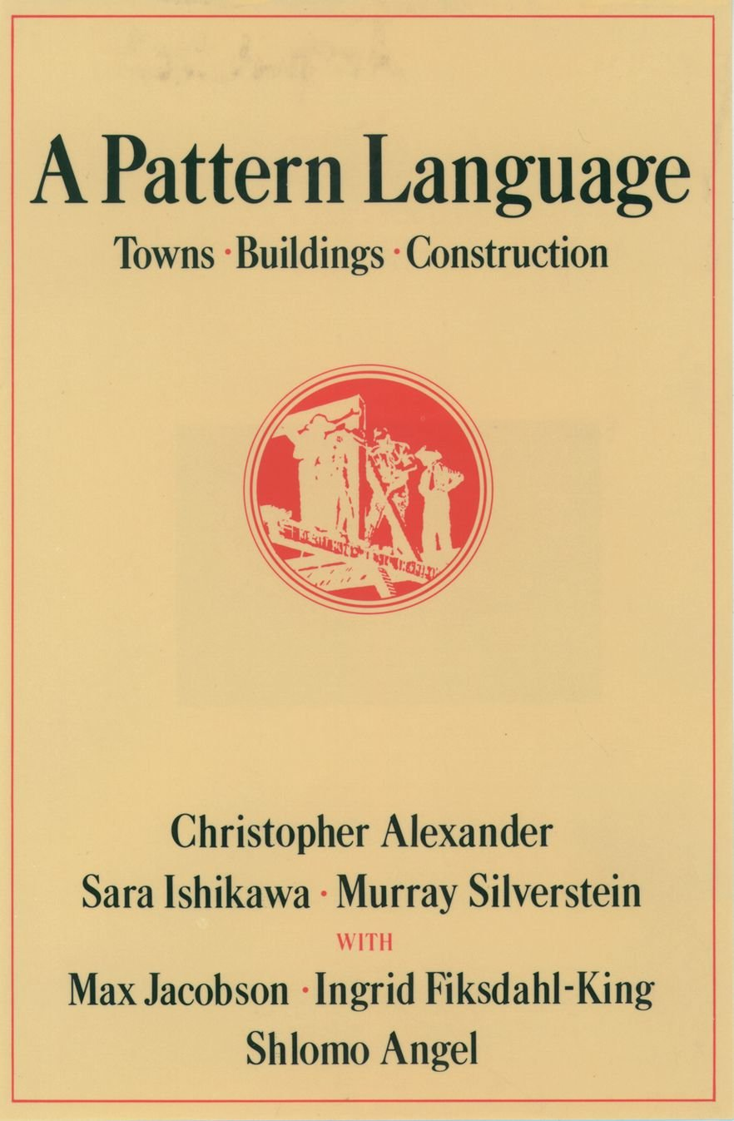
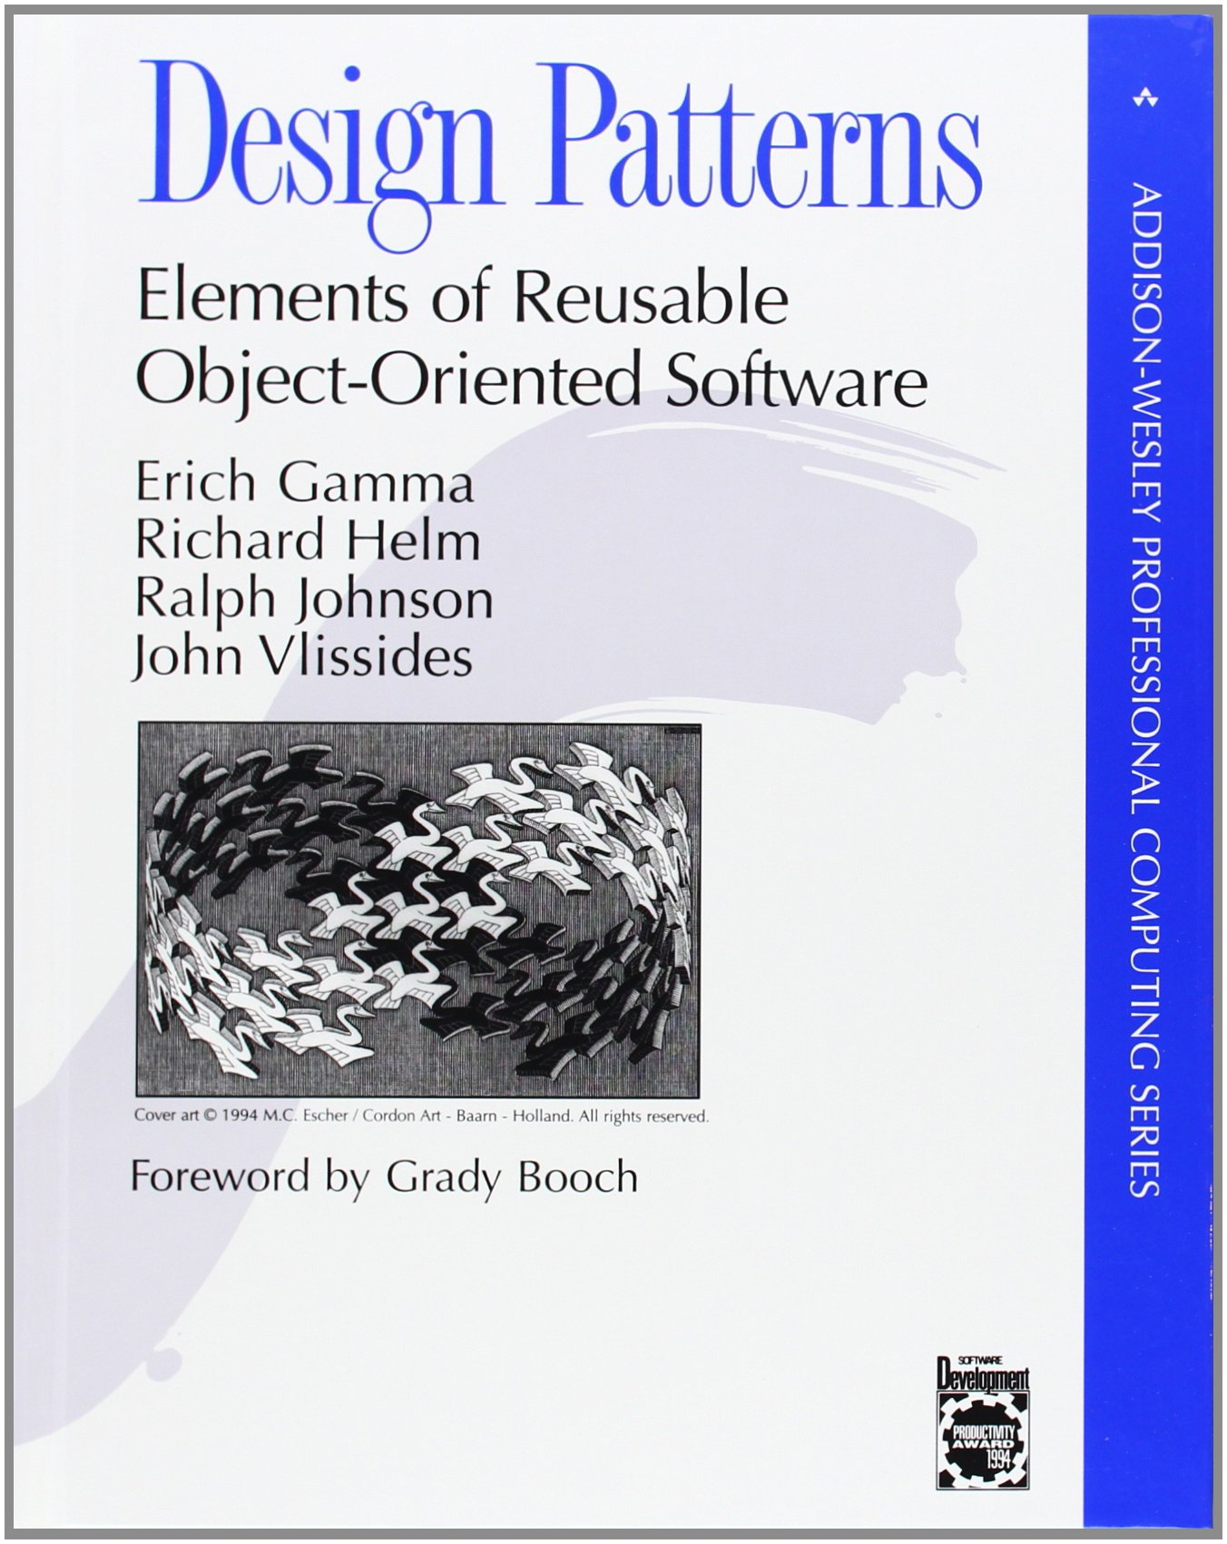
Design Patterns
Patterns are general, reusable solution to commonly occurring problems
Concept originated with Christopher Alexander’s work on architecture
Popularised in software engineering by the “gang of four”
Subject of study by the knowledge engineering community

Slide 46
Design Patterns for the Semantic Web
N-ary relations
How can we say more about a relation instance?
How do we represent an ordered sequence of relations?
Value partitions and value sets
How do we represent a fixed list of values?
Part-whole hierarchies
How do we represent hierarchies other than the subclass hierarchy?

Slide 47
N-ary Relations

Slide 48
Binary Relations
In RDF and OWL, binary relations link two individuals, or an individual and a value
The properties birthYear and fatherOf are binary relations
birthYear
Holbein the Elder
1460
fatherOf
Holbein the Younger

Slide 49
Relations with Additional Information
In some cases, we need to associate additional info with a binary relation
e.g. certainty, strength, dates
For example, Holbein the Elder’s date of birth is unconfirmed
He was born in either 1460 or 1465
How can we represent this uncertainty?
0.6
certainty
birthYear
1460
Holbein the Elder
0.4
certainty
1465
birthYear

Slide 50
N-ary Relations
N-ary relations link an individual to more than a one value
Possible use cases:
A relation needs additional info e.g. a relation with a rating value
Two binary relations are related to each other e.g. body_temp (high, normal, low), and trend (rising, falling)
A relation between several individuals e.g. someone buys a book from a bookstore
Linking from, or to, an ordered list of individuals e.g. an airline flight visiting a sequence of airports

Slide 51
N-ary Relation Patterns
Pattern 1: Reified relation
Use for cases 1, 2, and 3 above
Pattern 2: Sequence of arguments
For case 4

Slide 52
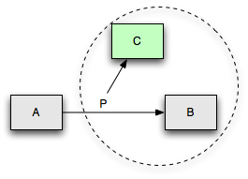
Pattern 1: Reified Relation
To represent additional information about a relation:
Create a new class to represent the relation
Individuals of this class are instances of the relation
Relation class can have additional properties to describe more information about the relation

Slide 53
Use case 1: additional information
Jack has given the film ‘I Am Legend’ a four-star rating
We need to represent a quantitative value to describe the rating relation
Film
Person
I am Legend
film
Jack
Rating
film_rating
8/10

Slide 54
Solution for use case 1
I am Legend
rated_object
Jack
issued_rating
_:Rating_1
rating
8
bNode
Film
rated_object
(someValuesFrom, functional)
Person
issued_rating
(allValuesFrom)
Rating_Relation
rating_value
(allValuesFrom, functional)
Rating

Slide 55
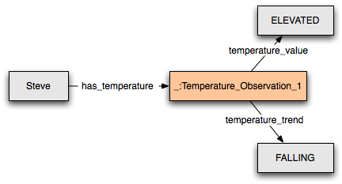
Use case 2: different aspects of a relation
Steve has a temperature which is high, but falling
We need to represent different aspects of the temperature that Steve has
Source: W3C

Slide 56
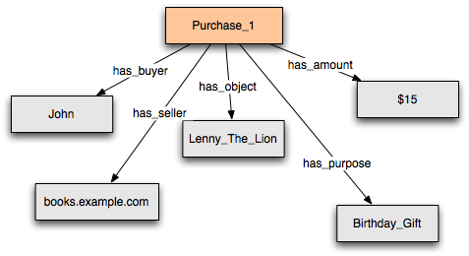
Use case 3: no distinguished participant
John buys a “Lenny the Lion” book from books.example.com for $15 as a birthday gift
No distinguished subject for the relation
i.e. no primary relation to convert into a Relation Class as in cases 1 and 2
Source: W3C

Slide 57
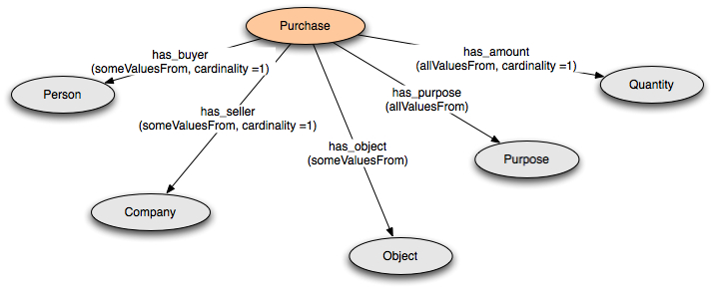
Solution for use case 3

Slide 58
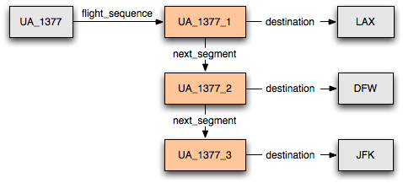
Pattern 2: Sequence of arguments
United Airlines, flight 1377 visits the following airports: LAX, DFW, and JFK
For such an example, we need to represent a sequence of arguments

Slide 59
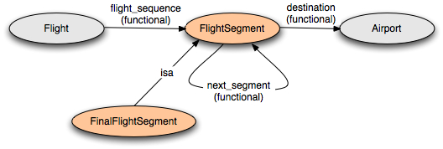
Pattern 2: Sequence of arguments
:FinalFlightSegment a owl:Class ; rdfs:comment "The last flight segment has no next_segment"; rdfs:subClassOf :FlightSegment ; rdfs:subClassOf [ a owl:Restriction ; owl:maxCardinality "0"; owl:onProperty :next_segment] .
Notes:
OWL Lite

Slide 60
Value Partitions and Value Sets

Slide 61
Descriptive Features
Descriptive features are quite common in ontologies:
Size = {small, medium, large}
Risk = {dangerous, risky, safe}
Health status = {good health, medium health, poor health}
Also called “qualities”, “modifiers” and “attributes”
A property can have only one value for each feature to ensure consistency
Three main approaches:
Enumerated individuals (a value set)
Disjoint classes (a value partition)
Datatype values (not considered in this lecture)

Slide 62
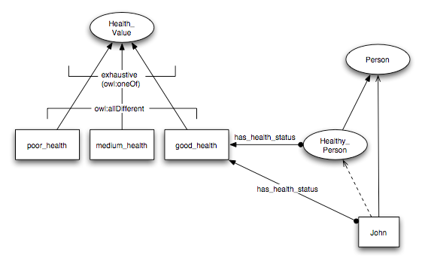
Value Sets
Values of descriptive feature are individuals

Slide 63
Value Sets
A health value can be either poor, medium or good:
$$HealthValue≡\{ poorHealth, mediumHealth, goodHealth \}$$
Poor, medium and good are all different from each other:
$$poorHealth≠mediumHealth$$
$$poorHealth≠goodHealth$$
$$mediumHealth≠goodHealth$$
A healthy person is a person who has some health status which is the value good:
$$HealthyPerson≡Person⊓∃hasHealthStatus.\{ goodHealth \}$$

Slide 64
Notes on Value Sets
Need axioms to set the three health values to be different from each other
This way, a person cannot have more than one health value at a time
Values cannot be further partitioned
e.g. cannot have fairly_good_health as a subtype of good_health
Only one set of values is allowed for a feature
The class HealthValue cannot be equivalent to more than one set of distinct values
Doing so will cause inconsistencies
Notes:
Owl:differentFrom can be set from the individual editor. Click on the individual purple icon and select this property and a value from the ontology

Slide 65
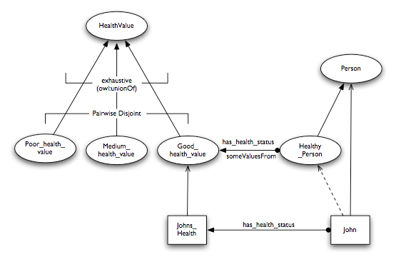
Value Partitions
Values of descriptive features are disjoint subclasses:

Slide 66
Value Partitions
Poor, medium and good are types of health value:
$$PoorHealth⊑HealthValue$$
$$MediumHealth⊑HealthValue$$
$$GoodHealth⊑HealthValue$$
Covering axiom (the only types of health value are poor, medium and good):
$$HealthValue≡PoorHealth⊓MediumHealth⊓GoodHealth$$
Poor, medium and good are pairwise disjoint:
$$PoorHealth⊓MediumHealth≡ ⊥$$
$$PoorHealth⊓GoodHealth≡ ⊥$$
$$MediumHealth⊓GoodHealth≡ ⊥$$
A healthy person is a person who has some health status which is an instance of good
$$HealthyPerson≡Person⊓∃hasHealthStatus.GoodHealth$$

Slide 67
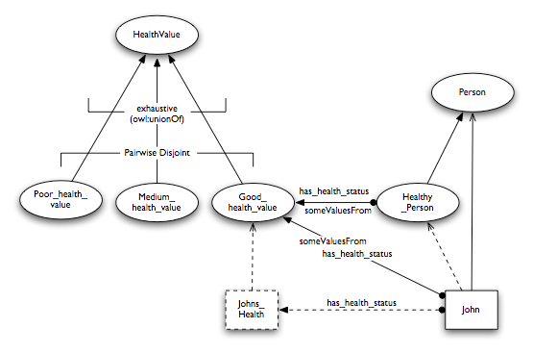
Value Partitions
The instance JohnsHealth can be made anonymous

Slide 68
Notes on Value Partitions
Values can be further partitioned
Simply add subclasses to the value classes
Can have alternative partitions of the same feature
OWL 2 contains specific support for defining disjoint unions
$$C≡C_{1}⊔C_{2}⊔…⊔C_{n}$$
$$C_{1}⊓C_{2}≡ ⊥$$
$$C_{1}⊓C_{3}≡ ⊥$$
$$…$$
$$C_{n−1}⊓C_{n}≡ ⊥$$

Slide 69
Part-Whole Hierarchies

Slide 70
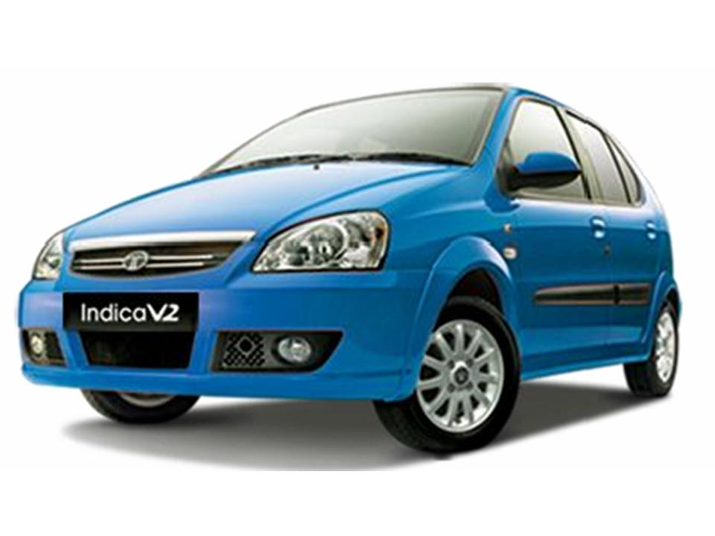
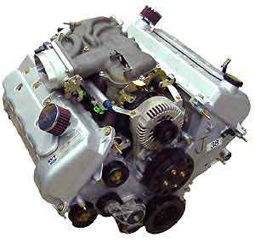
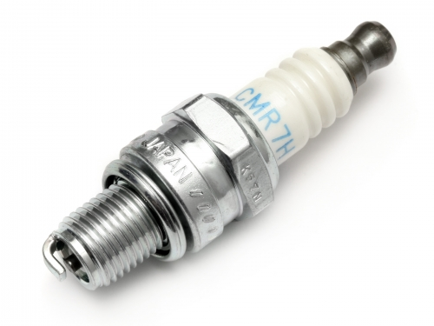
Meronymies (part-whole relations)
Taxonomies are not the only hierarchical relation that we wish to model
A spark plug isn’t a kind of engine (class-instance)
A spark plug is a part of an engine

Slide 71
Simple Part-Whole Representation
We need two properties:
$partOf$ (a transitive property)
$directPartOf$ (a subproperty of $partOf$)
$$part of∘partOf⊑partOf$$
$$directPartOf⊑partOf$$

Slide 72
Part-Whole Hierarchies
Represent part-whole relationships between classes using existential restrictions:
Every spark plug is a direct part of some engine: $SparkPlug⊑∃directPartOf.Engine$
Every engine is a direct part of some car: $Engine⊑∃directPartOf.Car$
Every wheel is a direct part of some car: $Wheel⊑∃directPartOf.Car$

Slide 73
Defining Classes of Parts
Extend the ontology with classes of parts for each level, so that the reasoner can automatically derive a class hierarchy:
A car part is a part of some car: $CarPart≡∃partOf.Car$
A direct car part is a direct part of some car: $DirectCarPart≡∃directPartOf.Car$
An engine part is a part of some engine: $EnginePart≡∃partOf.Engine$
A reasoner will infer that $EnginePart⊑CarPart$ (but not $EnginePart⊑DirectCarPart$)

Slide 74
Fault Location
Once we have a meronymy, we can use it to inherit features within that hierarchy
For example, a reasoner could infer that a fault in a part is a fault in a whole
Need a new property for the location of a fault: $hasLocus$
Need a new class for faults: $Fault$
We can then define general types of located faults:
$$FaultInCar≡Fault⊓∃hasLocus.CarPart$$
$$FaultInEngine≡Fault⊓∃hasLocus.EnginePart$$

Slide 75
Fault Location
Now we can define specific types of located fault:
$$DirtySparkPlug⊑Fault⊓∃hasLocus.SparkPlug$$
$$FlatTyre⊑Fault⊓∃hasLocus.Wheel$$
The definition of the hierarchy allows a reasoner to infer that:
$$DirtySparkPlug⊑FaultInCar$$
$$DirtySparkPlug⊑FaultInEngine$$
$$FlatTyre⊑FaultInCar$$
But not:
$$FlatTyre⊑FaultInEngine$$

Slide 76
Further Reading

Slide 77
SWBP Notes
Defining N-ary Relations on the Semantic Web http://www.w3.org/TR/swbp-n-aryRelations
Representing Specified Values in OWL http://www.w3.org/TR/swbp-specified-values
Simple part-whole relations in OWL Ontologies http://www.w3.org/2001/sw/BestPractices/OEP/SimplePartWhole/

