Slide 2
Web Ontology Language (OWL)
COMP6215 Semantic Web Technologies
Dr Nicholas Gibbins – nmg@ecs.soton.ac.uk
Notes:
In the future:
Skip OWL1.0
Skim over intricacies of computational complexities – way over their head
Consider questioning of a knowledge base as a task in itself – This was not clear to the students

Slide 3
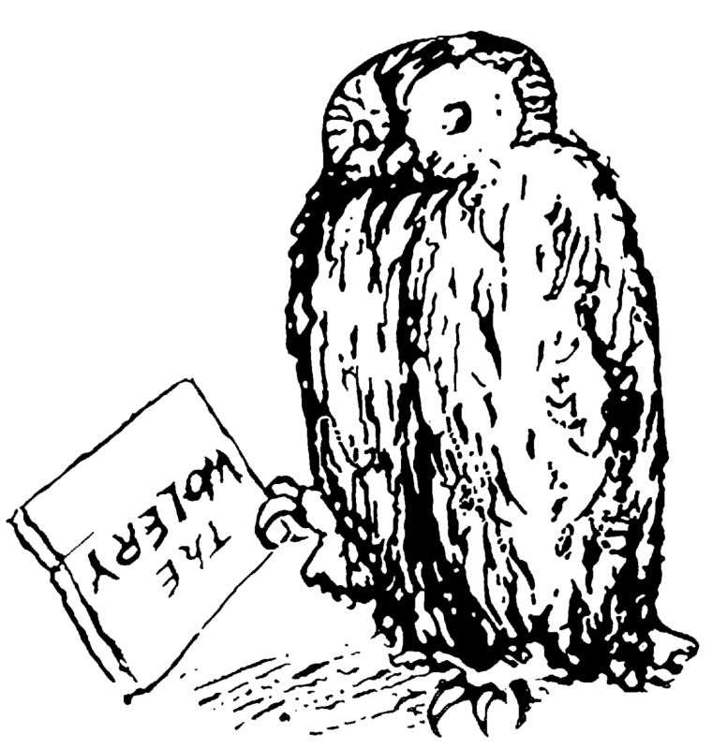
Introducing OWL
For many, RDF Schema is a sufficiently expressive ontology language
However, there are use cases which require a more expressive formalism:
Instance classification
Consistency checking
Subsumption reasoning
OWL is a way of encoding DL axioms as RDF triples whose semantics are broadly compatible with RDF(S)

Slide 4
OWL Feature Summary
Necessary and sufficient conditions for class membership
Property restrictions
Local range, cardinality, value constraints
Equivalence and identity relations
Property characteristics
Transitive, symmetric, functional
Complex classes
Set operators, enumerated classes, disjoint classes
Notes:
How do you express “necessary” and ”sufficient” in DL?

Slide 5
OWL Versions
Two versions of OWL:
OWL 1.0 (became Recommendation on 10 Feb 2004)
OWL 2 (became Recommendation on 29 Oct 2009)
OWL 2 is more expressive than OWL 1.0, and takes advantage of developments in DL reasoning techniques in the intervening time
We will initially concentrate on OWL 1.0

Slide 6
OWL 1.0 Species
Different subsets of OWL features give rise to the following sublanguages (colloquially known as species):
OWL Lite
OWL DL
OWL Full
“There is a tradeoff between the expressiveness of a representation language and the difficulty of reasoning over the representations built using that language.”
Brachman, R. J., and H. J. Levesque. (1984). The tractability of subsumption in frame-based description languages. In Proceedings of the 4th National Conference of the American Association for Artificial Intelligence (AAAI-84). Austin, TX, pp. 34-37.

Slide 7
OWL 1.0 Species
OWL Full
Increasing
expressivity
OWL DL
Increasing
complexity
OWL Lite
RDF(S)

Slide 8
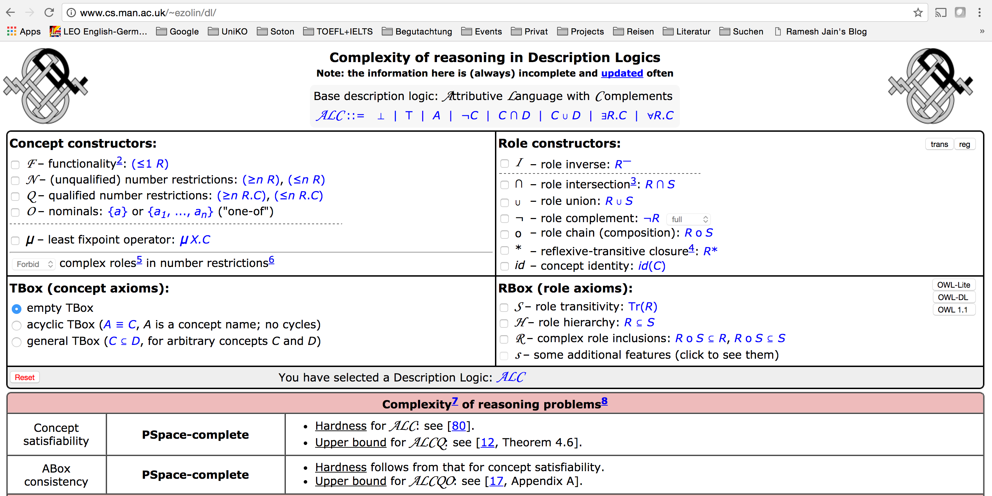
http://www.cs.man.ac.uk/~ezolin/dl/

Slide 9
OWL Lite
Description Logic-based
SHIF(D)
Satisfiability is ExpTime-complete
Less complex reasoning at the expense of less expressive language
No enumerated classes, set operators, or disjoint classes
Restricted cardinality restrictions (values of 0 or 1 – required, permitted and excluded)
No value restrictions
equivalentClass/subClassOf cannot be applied to class expressions

Slide 10
OWL DL
Description Logic-based
SHOIN(D)
Complete and decidable
Higher worst-case complexity than OWL Lite – NExpTime-complete
Supports all OWL constructs, with some restrictions
Properties that take datatype values cannot be marked as inverse functional
Classes, properties, individuals and datatype values are disjoint

Slide 11
OWL Full
No restrictions on use of language constructs
All OWL DL and RDFS constructs
Potentially undecidable

Slide 12
OWL 1.0 Features and Syntax

Slide 13
Ontology header
Ontology header for metadata
<> rdf:type owl:Ontology ; owl:versionInfo “1.4” ; rdfs:comment “An example ontology” ; owl:imports <http://example.org/base/> .

Slide 14
Versioning support
Version properties used in the ontology header
owl:versionInfo
Version number, etc
owl:priorVersion
Indicates that an ontology is a previous version of this
owl:backwardCompatibleWith
Indicates that the specified ontology is a previous version of this one, and that this is compatible with it
owl:incompatibleWith
Indicates that the specified ontology is a previous version of this one, but that this is incompatible with it

Slide 15
Versioning support
Classes and properties may be marked as deprecated
owl:DeprecatedClass
owl:DeprecatedProperty

Slide 16
OWL class types
owl:Class
Distinct from rdfs:Class – needed for OWL Lite/DL
owl:Thing ($⊤$)
The class that includes everything
owl:Nothing (⊥)
The empty class

Slide 17
OWL property types
owl:ObjectProperty
The class of resource-valued properties
owl:DatatypeProperty
The class of literal-valued properties
owl:AnnotationProperty
Used to type properties which annotate classes and properties (needed for OWL Lite/DL)
Any triples whose predicates are typed as annotation properties are ignored by OWL reasoners

Slide 18
OWL versus RDF Schema
Recall that the semantics of a description logic is specified by interpretation functions which map:
Instances to members of the domain of discourse
Classes to subsets of the domain of discourse
Properties to sets of pairs drawn from the domain of discourse
Reflexive definitions of RDF Schema means that some resources are treated as both classes and instances, or instances and properties
Ambiguous semantics for these resources
Can’t tell from context whether they’re instances or classes
Can’t select the appropriate interpretation function
The introduction of owl:Class, owl:ObjectProperty and owl:DatatypeProperty eliminates this ambiguity

Slide 19
OWL restrictions
Class expressions formed by constraints on properties:
Local cardinality constraints $≤n R$, $≥n R$, $=n R$
Local range constraints $∃R.C$, $∀R.C$
Local value constraints $∃R.\{x\}$
Common triple format for restrictions
_:a123 rdf:type owl:Restriction ; owl:onProperty <property URI> ; constraint expression .

Slide 20
Local cardinality constraints
Defines a class based on the number of values taken by a property
owl:minCardinality ($≥ n R$)
“property R has at least n values”
owl:maxCardinality ($≤ n R$)
“property R has at most n values”
owl:cardinality ($= n R$)
“property R has exactly n values”
OWL Lite has restricted cardinalities – $n∈\{0,1\}$

Slide 21
Example: Local cardinality constraint
Single malt whiskies are whiskies which are distilled by one and only one thing
$$SingleMaltWhisky ≡Whisky ⊓ =1.distilledBy$$
ont:SingleMaltWhisky rdf:type owl:Class ; owl:equivalentClass [ rdf:type owl:Class ; owl:intersectionOf ( ont:Whisky [ rdf:type owl:Restriction ; owl:onProperty ont:distilledBy ; owl:cardinality 1 ] ) ] .
Notes:
Write down equivalent DL notation

Slide 22
Local range constraints
Defines a class based on the type of property values
Distinct from global range constraint (rdfs:range) in RDF Schema
owl:someValuesFrom ($∃R.C$)
“there exists a value for property R of type C”
owl:allValuesFrom ($∀R.C$)
“property R has only values of type C”
Can only be used with named classes or datatypes in OWL Lite

Slide 23
Example: Existential restriction
Carnivores are things which eat some things which are animals
$$\text{Carnivore} ≡∃\text{eats}.\text{Animal}$$
ont:Carnivore rdf:type owl:Class ; owl:equivalentClass [ rdf:type owl:Restriction ; owl:onProperty ont:eats ; owl:someValuesFrom ont:Animal ] .

Slide 24
Example: Universal restriction
Vegetarians are things which eat only things which are plants
$$\text{Vegetarian}≡∀\text{eats}.\text{Plant}$$
ont:Vegetarian rdf:type owl:Class ; owl:equivalentClass [ rdf:type owl:Restriction ; owl:onProperty ont:eats ; owl:allValuesFrom ont:Plant ] .

Slide 25
Local value constraints
Defines a class based on the existence of a particular property value
owl:hasValue ($∃R.\{x\}$)
“property R has a value which is X”
Cannot be used in OWL Lite

Slide 26
Example: Local value constraint
Green things are things which are coloured green
$$\text{GreenThing}≡∃\text{hasColour}.\{\text{green}\}$$
ont:GreenThing rdf:type owl:Class ; owl:equivalentClass [ rdf:type owl:Restriction ; owl:onProperty ont:hasColour ; owl:hasValue ont:green ] .

Slide 27
Set constructors
owl:intersectionOf ($C⊓D$)
owl:unionOf ($C⊔D$)
owl:complementOf ($¬C$)
Restrictions on use with OWL Lite
owl:unionOf and owl:complementOf cannot be used
owl:intersectionOf can be used with named classes (not bNodes) and OWL restrictions only

Slide 28
Example: Set constructors
$$GreenApple≡Apple⊓∃hasColour.\{green\}$$
ont:GreenApple rdf:type owl:Class ; owl:equivalentClass [ rdf:type owl:Class ; owl:intersectionOf ( ont:Apple [ rdf:type owl:Restriction ; owl:onProperty ont:hasColour ; owl:hasValue ont:green ] ) ] .

Slide 29
Equivalence and identity relations
Useful for ontology mapping
owl:sameAs ($MorningStar=EveningStar$)
owl:equivalentClass ($C≡D$)
owl:equivalentProperty ($R≡S$)
ont:morningStar rdf:type owl:Thing ; owl:sameAs ont:eveningStar

Slide 30
Non-equivalence relations
owl:differentFrom
Can be used to specify a limited unique name assumption
Ont:HarryCorbett rdf:type owl:Thing ; owl:differentFrom ont:HarryHCorbett
OWL (and DLs in general) make the Open World Assumption
Knowledge of world is incomplete
If something cannot be proven true, then it isn’t assumed to be false

Slide 31
Non-equivalence relations
owl:AllDifferent and owl:distinctMembers
Used to specify a group of mutually distinct individuals
[ rdf:type owl:AllDifferent ; owl:distinctMembers ( ont:John ont:Paul ont:George ont:Ringo ) ] .
Notes:
Why “alldifferent” “distinctmembers” ? Two keywords? Triple representation!

Slide 32
Necessary Class Definitions
Primitive / partial classes ($⊑$)
“If we know that something is a X, then it must fulfill the conditions...”
Defined using rdfs:subClassOf:
$$Person⊑∃hasBirthdate.⊤$$
ont:Person rdf:type owl:Class ; rdfs:subClassOf [ rdf:type owl:Restriction ; owl:onProperty ont:hasBirthdate ; owl:SomeValuesFrom owl:Thing ] .

Slide 33
Sufficient Class Definitions
Describes a subset of the class ($⊒$)
“If we know that something has this property, then it belongs to this class...”
Defined using rdfs:subClassOf – in the other direction
$$Person⊒∃hasNationalInsuranceNumber.⊤$$

Slide 34
Necessary and Sufficient Class Definitions
Defined / complete classes (≡)
“If something fulfills the conditions..., then it is an X."
Defined using owl:equivalentClass:
$$Student≡Person⊓∃isEnrolledAt.University$$
Note: It will be rather difficult, if not impossible, to give conditions that are both sufficient and necessary for a class that is as complex as $Person$

Slide 35
Property types - Inverse
Defines a property as the inverse of another property
($R≡S−$)
ont:hasAuthor rdf:type owl:ObjectProperty ; owl:inverseOf ont:wrote .

Slide 36
Property types - Symmetric
A property R is symmetric if the following condition holds:
$$∀x∀y \left\langle x,y\right\rangle ∈R^{I}⟺\left\langle y,x\right\rangle ∈R^{I}$$
ont:hasSibling rdf:type owl:SymmetricProperty .
In DL notation: $R≡R^{−}$ (symmetric properties are their own inverses)

Slide 37
Property types – Transitive
A property R is transitive if the following condition holds:
$$∀x∀y∀z \left\langle x,y\right\rangle ∈R^{I}∧\left\langle y,z\right\rangle ∈R^{I}⇒\left\langle x,z\right\rangle ∈R^{I}$$
ont:hasAncestor rdf:type owl:TransitiveProperty .
In DL notation: $R⊑R^{+}$

Slide 38
Property types – Functional
A property R is functional if the following condition holds:
$$∀x∀y∀z \left\langle x,y\right\rangle ∈R^{I}∧\left\langle x,z\right\rangle ∈R^{I}⇒y=z$$
ont:hasNINumber rdf:type owl:FunctionalProperty .
(everyone has only one NI number)
(everyone has only one birthdate)
(but: people may have several means of identification)

Slide 39
Property types – Inverse Functional
A property R is inverse functional if the following condition holds:
$$∀x∀y∀z \left\langle y,x\right\rangle ∈R^{I}∧\left\langle z,x\right\rangle ∈R^{I}⇒y=z$$
ont:hasNINumber rdf:type owl:InverseFunctionalProperty .
(people with the same NI number are the same person)
(each identification points to only one person)
(but: many people have the same birthdate)
Cannot be used with owl:DatatypeProperty in OWL Lite/DL
Notes:
National Insurance Number

Slide 40
Disjoint classes
owl:disjointWith
members of one class cannot also be members of some specified other class
ont:Duck rdf:type owl:Class ; owl:disjointWith ont:Goose .
In DL notation: $Duck⊓Goose≡ ⊥$
Cannot be used in OWL Lite

Slide 41
Enumerated classes
Defines a class as a direct enumeration of its members
owl:oneOf ($C ≡ \{a,b,c\}$)
ont:Beatles rdf:type owl:Class ; owl:oneOf ( ont:John ont:Paul ont:George ont:Ringo ) .
Cannot be used in OWL Lite

Slide 42
Ontology modularisation
owl:imports mechanism for including other ontologies
Also possible to use terms from other ontologies without explicitly importing them
Importing requires certain entailments, whereas simple use does not require (but also does not prevent) those entailments

Slide 43
Ontology modularisation example
Ontology 1 (ont1) contains: BBB rdfs:subClassOf AAA .
Ontology-2 (ont2) contains: ont2 owl:imports ont1 . CCC rdfs:subClassOf BBB .
Ontology-2 must entail:
CCC rdfs:subClassOf AAA

Slide 44
Ontology modularisation example
Ontology 1 (ont1) contains: BBB rdfs:subClassOf AAA .
Ontology-3 (ont3) contains: CCC rdfs:subClassOf ont1:BBB .
Ontology-3 does not necessarily entail CCC rdfs:subClassOf ont1:AAA .

Slide 45
OWL status
WebOnt working group formed Nov 2001
OWL Recommendations published in Feb 2004

Slide 46
OWL references
Web Ontology Working Group homepage http://www.w3.org/2001/sw/WebOnt/

Slide 47
OWL 2

Slide 48
From OWL 1 to OWL 2
OWL 1 design based on contemporary understanding of techniques for decidable, sound and complete reasoning in description logics
Our understanding has improved since 2004
Some things that looked intractable have been shown to be possible

Slide 49
From OWL 1 to OWL 2
Changes between 1 and 2 fall into the following categories:
Syntactic sugar (making it easier to say things we could already say)
Constructs for increased expressivity
Datatype support
Metamodelling
Annotation

Slide 50
Syntactic Sugar: Disjoint Classes
OWL 1 lets us state that two classes are disjoint (owl:disjointWith)
OWL 2 lets us state that a set of classes are pairwise disjoint
[ rdf:type owl:AllDisjointClasses ; owl:members ( ont:Duck ont:Goose ont:Swan ) ] .
In DL notation: $$Duck⊓Goose≡ ⊥ \\ Duck⊓Swan≡ ⊥ \\ Goose⊓Swan≡ ⊥$$

Slide 51
Syntactic Sugar: Disjoint Union
Allows us to define a class as the union of a number of other classes, all of which are pairwise disjoint
$$C≡C_{1}⊔C_{2}⊔…⊔C_{n}$$
$$C_{1}⊓C_{2}≡ ⊥$$
$$C_{1}⊓C_{3}≡ ⊥$$
$$…$$
$$C_{n−1}⊓C_{n}≡ ⊥$$
We’ll look at this modelling pattern more in later lectures

Slide 52
Example: Disjoint Union
$$Monotreme≡Platypus⊔Echidna$$
$$Platypus⊓Echidna≡ ⊥$$
ont:Monotreme owl:disjointUnionOf ( ont:Platypus ont:Echidna ) .

Slide 53
Syntactic Sugar: Negative Property Assertions
OWL 1 lets us assert property values for an individual
OWL 2 lets us assert that an individual does not have a particular property value
[ rdf:type owl:NegativePropertyAssertion ; owl:sourceIndividual ont:John ; owl:assertionProperty ont:hasChild ; owl:targetIndividual ont:Susan ] .

Slide 54
New Constructs: Self Restriction
Defines a class of individuals which are related to themselves by a given property
[ rdf:type owl:Restriction ; owl:onProperty property ; owl:hasSelf “true”^^xsd:boolean ] .
In DL notation: $∃R.Self$

Slide 55
Example: Self Restriction
A narcissist is a person who loves themselves
$$Narcissist≡Person⊓∃loves.Self$$
ont:Narcissist rdf:type owl:Class ; owl:equivalentClass [ rdf:type owl:Class ; owl:intersectionOf ( ont:Person [ rdf:type owl:Restriction ; owl:onProperty ont:loves ; owl:hasSelf “true”^^xsd:boolean ] ) ] .

Slide 56
New Constructs: Qualified Cardinality
OWL 1 lets us either specify either the local range of a property, or the number of values taken by the property
OWL 2 lets us specify both together:
[ rdf:type owl:Restriction ; owl:onProperty ont:hasPart ; owl:onClass ont:Wheel ; owl:cardinality 4 ] .
In DL notation: ${∃_{=4}}_{ }hasPart.Wheel$ or $=4 hasPart.Wheel$
Similar construct for datatype properties

Slide 57
New Constructs: Reflexive Properties
Allows us to assert that a property relates every object to itself
A property R is reflexive if the following condition holds:
$$∀x \left\langle x,x\right\rangle ∈R^{I}$$
ont:sameAgeAs rdf:type owl:ReflexiveProperty .

Slide 58
New Constructs: Irreflexive Properties
Allows us to assert that a property relates no object to itself
A property R is irreflexive if the following condition holds:
$$∀x \left\langle x,x\right\rangle ∉R^{I}$$
ont:strictlyTallerThan rdf:type owl:IrreflexiveProperty .
ont:marriedTo rdf:type owl:IrreflexiveProperty .

Slide 59
New Constructs: Asymmetric Properties
A property R is asymmetric if the following condition holds:
$$∀x∀y \left\langle x,y\right\rangle ∈R^{I}⇒⟨y,x⟩∉R^{I}$$
ont:strictlyTallerThan rdf:type owl:AsymmetricProperty .
but:
ont:marriedTo rdf:type owl:SymmetricProperty .

Slide 60
New Constructs: Disjoint Properties
We can state that two individuals cannot be related to each other by two different properties that have been declared disjoint
Two properties R and S are disjoint if the following condition holds:
$$R^{I}∩ S^{I}=∅$$
ont:separatedFrom rdf:type owl:ObjectProperty ; owl:propertyDisjointWith ont:contiguousWith .
Typical examples include antonymic relationships: closeTo – farFrom
Notes:
Love – hates

Slide 61
New Constructs: Property Chain Inclusion
OWL 1 does not let us define a property as a composition of other properties
Example: $hasUncle ≡ hasParent∘hasBrother$
OWL 2 lets us define such property compositions:
ont:hasUncle rdf:type owl:ObjectProperty ; owl:propertyChainAxiom ( ont:hasParent ont:hasBrother ) .
Notes:
locatedIn ≡ part of o locatedIn

Slide 62
New Constructs: Keys
OWL 1 lets us define a property to be functional, so that individuals can be uniquely identified by values of that property
OWL 2 lets us define uniquely identifying keys that comprise several properties:
ont:Person rdf:type owl:Class ; owl:hasKey ( ont:hasSSN ont:hasBirthDate ) .

Slide 63
New Constructs: Datatype Restrictions
Allows us to define subsets of datatypes that constrain the range of values allowed by a datatype
For example, the datatype of integers greater than or equal to 5:
ont:IntGEFive rdf:type owl:Datatype ; owl:withRestrictions ( [ rdf:type xsd:minInclusive “5”^^xsd:integer ] ) .

Slide 64
Metamodelling: Punning
OWL 1 required the names used to identify classes, properties, individuals and datatypes to be disjoint
OWL 2 relaxes this
The same name (URI) can be used for both a class and an individual
However:
A name cannot be used for both a class and a datatype
A name cannot be used for more than one type of property (DataProperty vs ObjectProperty)

Slide 65
Example: Punning
ont:Eagle rdf:type owl:Class . ont:Harry rdf:type ont:Eagle . ont:Eagle rdf:type ont:EndangeredSpecies .
ont:EndangeredSpecies rdfs:subclassOf ont:Species
T-Box
a:Raptor rdfs:subclassOf a:Bird
a:Eagle rdfs:subclassOf a:Raptor
ont:Eagle rdf:type ont:EndangeredSpecies
T-Box
A-Box
ont:Harry rdf:type ont:Eagle
A-Box

Slide 66
Language Profiles
OWL 1 has three dialects: OWL Lite, OWL DL and OWL Full
OWL 2 introduces three profiles with useful computational properties (reasoning, conjunctive queries):
OWL 2 EL (PTIME-complete, PSPACE-complete)
OWL 2 QL (NLOGSPACE-complete, NP-complete)
OWL 2 RL (PTIME-complete, NP-complete)
OWL 1 DL (NEXPTIME-complete, decidability open)

Slide 67
OWL 2 references
OWL 2 New Features and Rationale http://www.w3.org/TR/owl2-new-features/
OWL 2 Primer http://www.w3.org/TR/owl2-primer/

Slide 68
Next Lecture: Protégé

