Slide 2
Linked Data
COMP6215 Semantic Web Technologies
Dr Nicholas Gibbins – nmg@ecs.soton.ac.uk

Slide 3
Linked Data
Semantic Web is the Web for machines
Take existing data and republish it to the Web
Rely on hypertextual nature of the Web to facilitate linking between data
How do we publish this data?
How does the Semantic Web interoperate with the World Wide Web?
What identifiers do we use?

Slide 4
Resources and Identifiers

Slide 5
Architecture of the World Wide Web
The Web architecture has four main components:
Resources (webpages, etc)
Identifiers for resources (URIs)
Protocols for interacting with resources (HTTP)
Data formats for representing the state of resources (HTML, XML, etc)
The Semantic Web builds on this foundation

Slide 6
Architecture of the World Wide Web
URI
identifies
http://example.org/
Resource
yields on dereference
home page for Example, Inc.
Representation
represents
Metadata:
Content-Type: text/html
Data:
<html>
<head>
<title>Welcome to Example, Inc.</title>
...
</html>
http://www.w3.org/TR/webarch/

Slide 7
Uniform Resource Identifiers
What does a URI on the Semantic Web refer to?
A real world object?
A web page?
Both?
What does a URI identify in general?
What is a resource?
What are the implicit semantics in a URI?

Slide 8
What is a resource?
From RFC2616 (HTTP/1.1):
“A network data object or service that can be identified by a URI […] Resources may be available in multiple representations (e.g. multiple languages, data formats, size, and resolutions) or vary in other ways.”
http://www.ietf.org/rfc/rfc2616

Slide 9
What is a resource?
From RFC2396 (URIs):
“A resource can be anything that has identity. Familiar examples include an electronic document, an image, a service (e.g., "today's weather report for Los Angeles"), and a collection of other resources. Not all resources are network "retrievable"; e.g., human beings, corporations, and bound books in a library can also be considered resources.
The resource is the conceptual mapping to an entity or set of entities, not necessarily the entity which corresponds to that mapping at any particular instance in time. Thus, a resource can remain constant even when its content - the entities to which it currently corresponds - changes over time, provided that the conceptual mapping is not changed in the process.”
http://www.ietf.org/rfc/rfc2396.txt

Slide 10
httpRange-14
W3C Technical Architecture Group issue
“What is the range of the HTTP range dereference operation?”
Raised in March 2002
Closed in June 2005
TBL’s original stance: HTTP URIs (without "#") should be understood as referring to documents, not physical things
http://www.w3.org/2001/tag/group/track/issues/14

Slide 11
All resources are equal…
…but some are more equal than others
The things identified by URIs are resources
Some resources can be retrieved by dereferencing their URIs
Or rather, representations of some resources can be retrieved
Some resources cannot be retrieved
People, cats, cars

Slide 12
Information Resources
“Information resources are resources, identified by URIs and whose essential characteristics can be conveyed in a message”
An (abstract) document (with a URI) can be dereferenced to get an ‘obvious’ representation of that document
The majority of current Web resources are information resources

Slide 13
What makes an information resource?
Consider the case of resources identified by HTTP URIs:
If dereferencing the URI results in a 200 OK response code, the resource is an information resource
From the HTTP RFC: “an entity corresponding to the requested resource is sent in the response”
If it results in a 303 See Other response, the resource could be any resource
“the response to the request can be found under a different URI and SHOULD be retrieved using a GET method on that resource”
If it results in a 4xx (client error) or 5xx (server error) response, we can’t say either way

Slide 14
The Linked Data Principles

Slide 15
Linked Data Principles
Set of publishing practices for SW data:
Use URIs as names for things
Use HTTP URIs so that people can look up those names
When someone looks up a URI, provide useful information
Include links to other URIs. so that they can discover more things
Effectively, putting the hypertext back into the Semantic Web
Simplifies integration between datasets while maintaining loose coupling

Slide 16
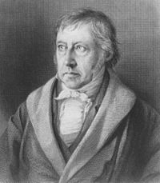
1. Use URIs as names for things
Use a unique identifier to denote things:
Hegel, Georg Wilhelm Friedrich
http://dbpedia.org/resource/Georg_Wilhelm_Friedrich_Hegel
http://viaf.org/viaf/89774942
…
Hegel, Georg Wilhelm Friedrich: Gesammelte Werke / Vorlesungen über die Logik
urn:isbn:978-3-7873-1964-0

Slide 17
2. Use HTTP URIs
Enables “lookup” of URIs via Hypertext Transfer Protocol
Piggy-backs on hierarchical Domain Name System to guarantee uniqueness of identifiers
Uses established infrastructure
Connects logical level (thing) with physical level (source)
Important distinction between name/“thing URI” and location/“source URI”
Also called “other resource“/“non-information resource“ vs. “information resource“
See also httpRange-14

Slide 18
3. Provide useful information
When somebody looks up a URI, return data using the standards (RDF*, SPARQL)

Slide 19
4. Link to other URIs
Enable people (and machines) to jump from server to server
External links vs. internal links (for any predicate)
Using external vocabularies enables linking
Vocabularies might be interlinked, too
Special owl:sameAs links to denote equivalence of identifiers (useful for data merging)
Other types of links are possible as well

Slide 20
Example
graph describing ‘sw’
graph describing ‘tbl’
2001-05
The Semantic Web
tbl
Tim Berners-Lee
date
tbl
name
title
creator
sw
jh
graph describing ‘jh’
publishedIn
creator
jh
James Hendler
sci am
ora
name
creator
graph describing ‘sciam’
graph describing ‘ora’
ora
Ora Lassila
sci am
Scientific American
name
title

Slide 21
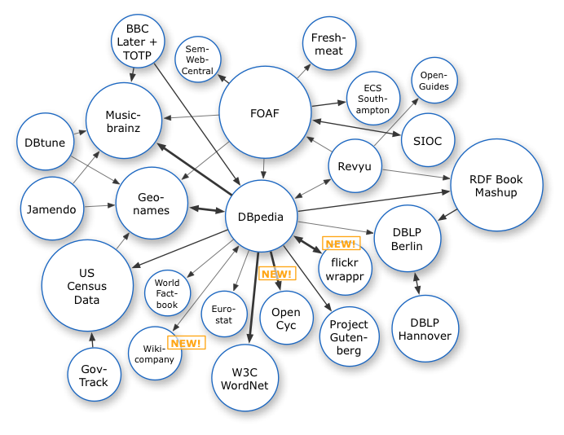
Linked Data on the Web: 2007

Slide 22
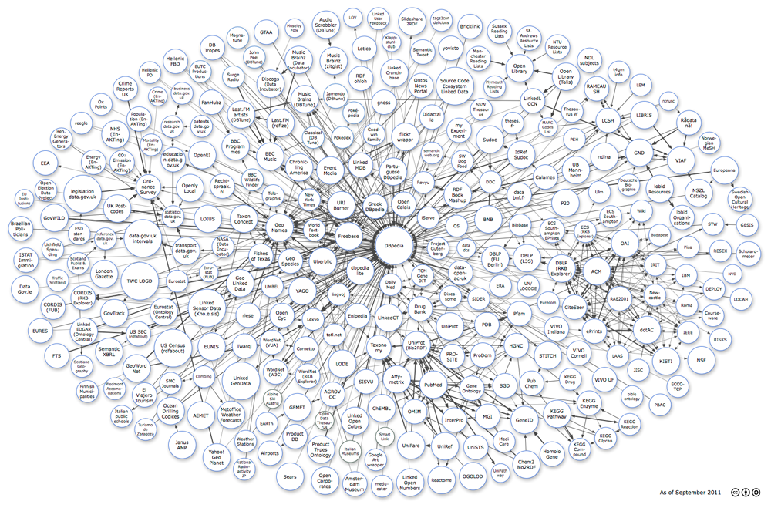
2011

Slide 23
2014
http://lod-cloud.net/state/state_2014/

Slide 24
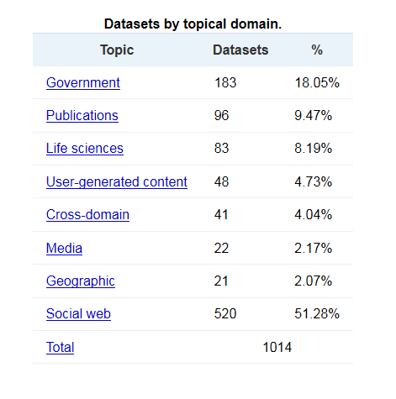
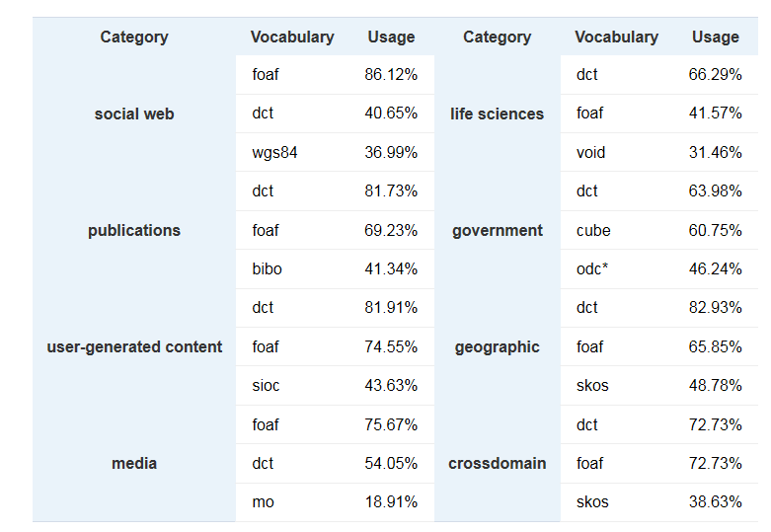
Analysis of the LOD Cloud: 2014
http://linkeddatacatalog.dws.informatik.uni-mannheim.de/state/

Slide 25
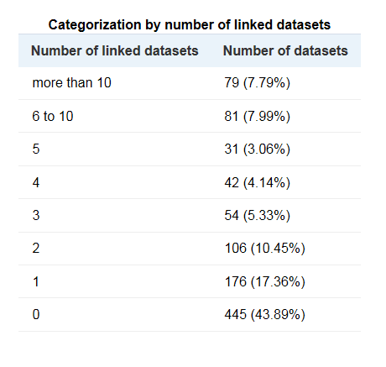
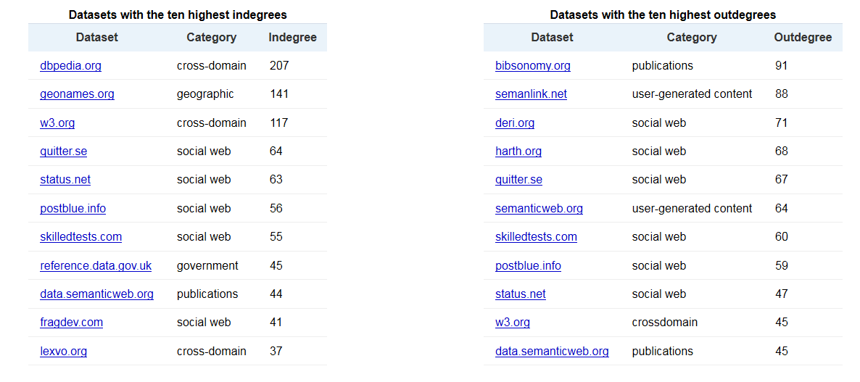
Interlinking in the LOD Cloud 2014
http://linkeddatacatalog.dws.informatik.uni-mannheim.de/state/

Slide 26
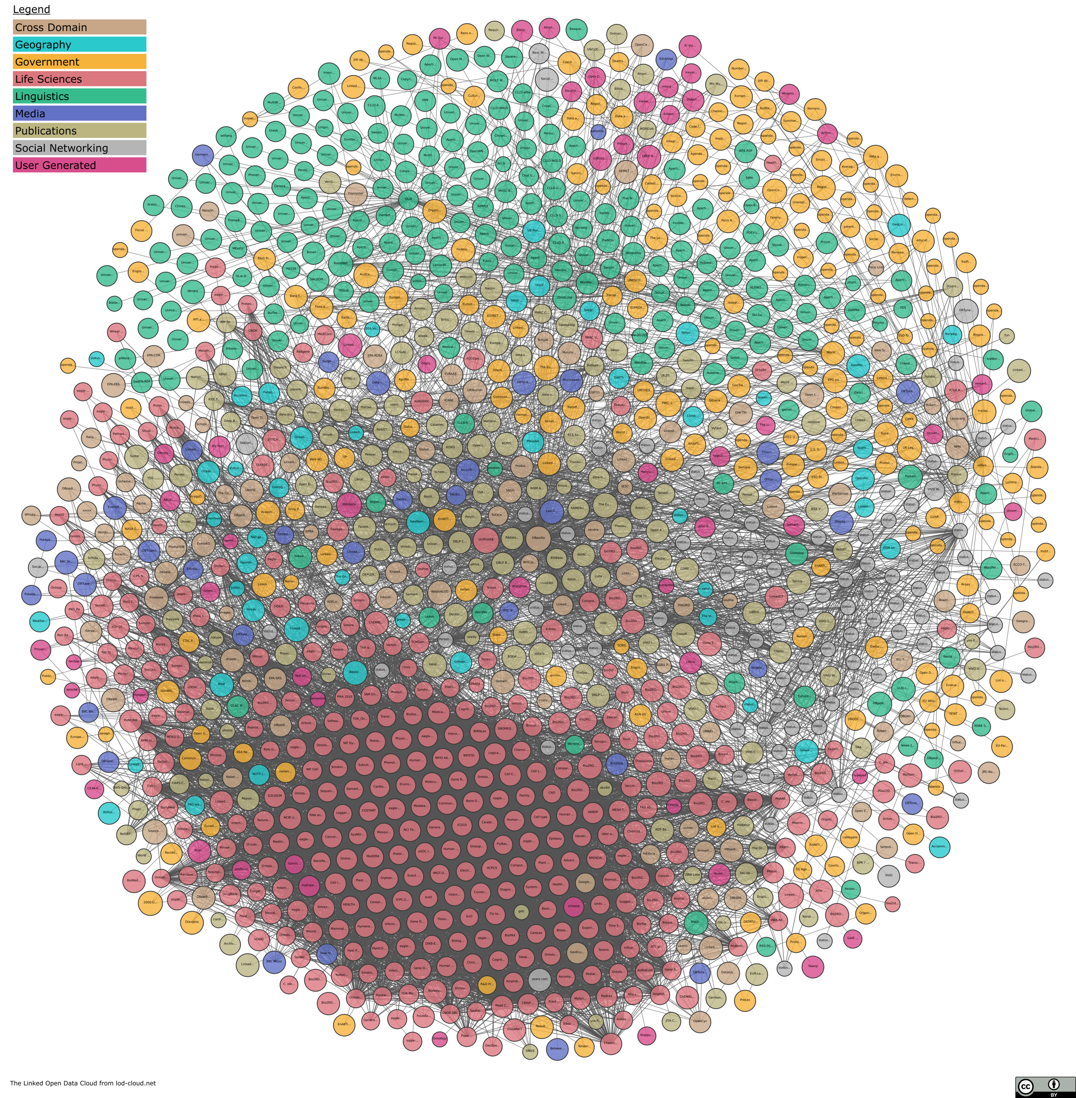
2020
http://lod-cloud.net/

Slide 27
Publishing Semantic Web Data
http://www.flickr.com/photos/cibergaita/97220057/lightbox/

Slide 28
Creating Semantic Web resources
In http://example.org/data.rdf : @prefix foaf: <http://xmlns.com/foaf/0.1/> <#fred> <foaf:name> “Fred Smith”.
We have a new resource: http://example.org/data.rdf#fred

Slide 29
Publishing RDF Vocabularies
SW Best Practice Recipes for Publishing RDF Vocabularies
Distinguishes between ‘hash’ and ‘slash’ namespaces
http://example.org/ontology#foo
http://example.org/ontology/foo
Uses content negotiation (HTTP Accept: header) to serve different representations of resources
Machine-readable RDF vs human-readable HTML
https://www.w3.org/TR/swbp-vocab-pub/

Slide 30
Cool URIs for the Semantic Web
resource identifier
id
for SW applications
for web browsers
rdf
html
RDF document
HTML document

Slide 31
Cool URIs – 303 Redirects
id
GET id Accept: application/rdf 303 See Other Location: rdf
GET id Accept: text/html 303 See Other Location: html
rdf
html

Slide 32
Cool URIs
303 redirect
id
303 redirect
contains
mentions
“homepage”
rdf
html
in metadata

Slide 34
It’s not quite that simple...

Slide 35
rdfURIMeaning-39
W3C Technical Architecture Group issue
Raised in July 2003
Currently open
Is a given inference engine expected to take into account a given document under given circumstances?
How does one avoid having to commit to things one does not trust?
http://www.w3.org/2001/tag/group/track/issues/39

Slide 36
HttpRedirections-57
W3C Technical Architecture Group issue
“Mechanisms for obtaining information about the meaning of a given URI”
Raised in July 2007
Currently open
Further consideration of the use of:
303 HTTP status codes (and interaction with caching)
Other possible mechanisms for obtaining a description of a (non-information) resource (HTTP Link: header – see RFC2068)
http://www.w3.org/2001/tag/group/track/issues/57

Slide 37
UniformAccessToMetadata-62
W3C Technical Architecture Group issue
“Given the URI of an HTTP-accessible information resource R, how can an agent learn the URIs of metadata documents about R authorized by the owner of the original URI”
Raised in March 2009
Currently open
http://www.w3.org/2001/tag/group/track/issues/62

Slide 38
Further Reading
Architecture of the World Wide Web http://www.w3.org/TR/webarch/
R.T. Fielding and R.N. Taylor, Principled Design of the Modern Web Architecture, ACM Transactions on Internet Technology 2 (2): 115–150 http://www.ics.uci.edu/~taylor/documents/2002-REST-TOIT.pdf
Uniform Resource Identifiers (URI): Generic Syntax IETF RFC2396 http://www.ietf.org/rfc/rfc2396.txt
Hypertext Transfer Protocol - HTTP/1.1 IETF RFC2616 http://www.ietf.org/rfc/rfc2616

Slide 39
Further Reading
What do HTTP URIs identify? http://www.w3.org/DesignIssues/HTTP-URI
W3C TAG issue httpRange-14 http://www.w3.org/2001/tag/group/track/issues/14
W3C TAG Issue rdfUriMeaning-39 http://www.w3.org/2001/tag/group/track/issues/39
W3C TAG issue httpRedirections-57 http://www.w3.org/2001/tag/group/track/issues/57
W3C TAG issue UniformAccessToMetadata-62 http://www.w3.org/2001/tag/group/track/issues/62
Dereferencing HTTP URIs http://www.w3.org/2001/tag/doc/httpRange-14/2007-05-31/HttpRange-14

Slide 40
Further Reading
Cool URIs for the Semantic Web https://www.w3.org/TR/cooluris/
Best Practice Recipes for Publishing RDF Vocabularies http://www.w3.org/TR/swbp-vocab-pub/

Slide 41
Next Lecture: SPARQL

