Slide 1
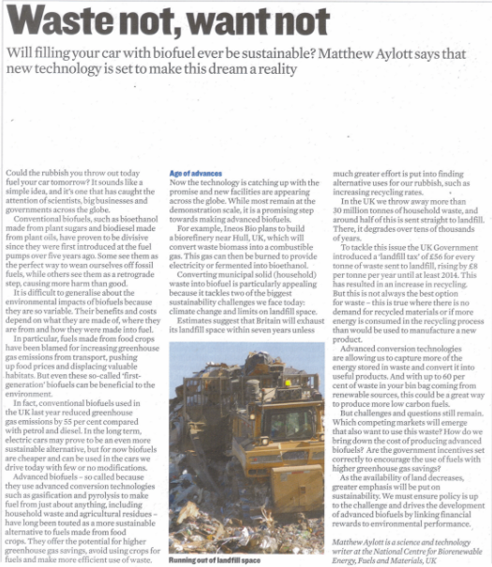
Your next task
Go back into your breakout groups. You should each individually read the article you have been given. Try to identify the key information in the article.
Once you’ve identified the key information, discuss your thoughts with the rest of your group. What things did you have that were the same, and what things were different.
Next, you should write 1 or 2 questions which you can pose to the rest of the class. You should add your question to the PowerPoint slide.
When we return to the main session, David will poll your questions in Vevox. Make sure you add your group letter to the slide.

Slide 2
Enter your question here
Enter your question group letter here:
Enter Text and Press Send
Data Captured
Vote Trigger

