Slide 2
Digital Intellectual Property Rights
COMP6218 Web Architecture
Dr Heather Packer – hp3@ecs.soton.ac.uk

Slide 3
Copyright & Digital Technology
Ease of Reproduction
Once a work is rendered in digital form, it can be reproduced
Rapidly
At little cost
Without any loss of quality
Each copy, in turn, can be further reproduced without any loss of quality
Ease of Storage
Gb media files vs Tb hard disks
Ease of Dissemination
Gb media files vs fibre optic and 4G networks

Slide 4
Digital Intellectual Property Solutions

Slide 5
Licensing
A license allows someone (the licensee) to use a work for some or all purposes, but the owner retains ownership
The license may be for a fixed period or it may be in perpetuity
In an assignment, the copyright owner transfers some or all of the rights of ownership to someone else (the assignee)
Explicit licenses are rarely provided
They are frequently unhelpful
https://www.flickr.com/photos/detroitderek/

Slide 6
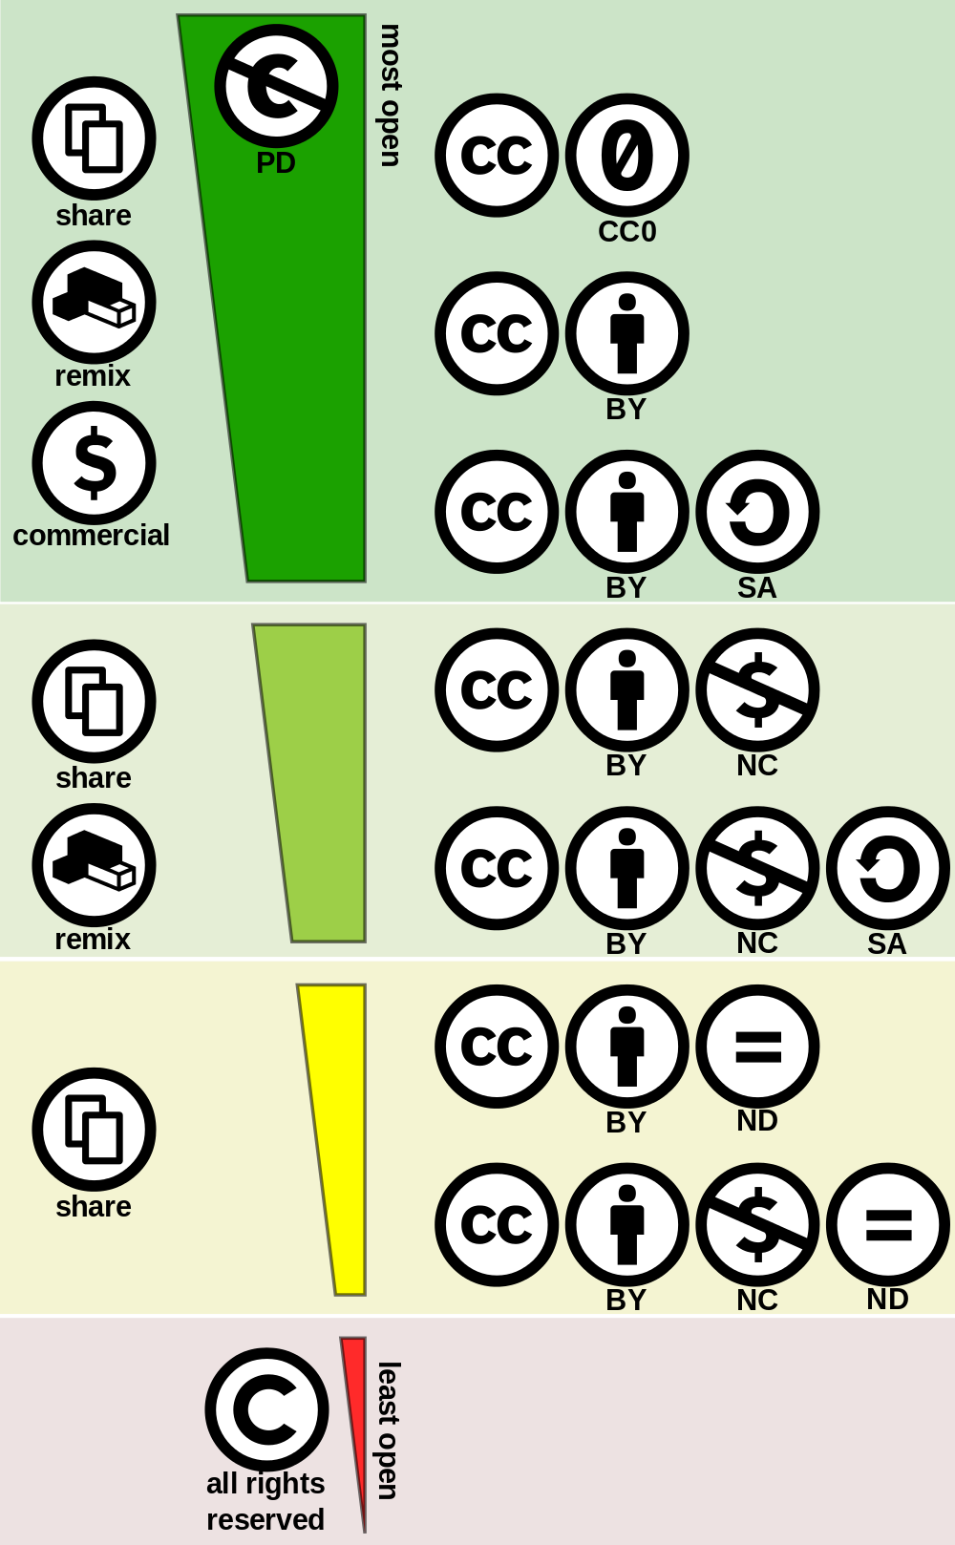
Creative Commons Licensing
Creative commons addresses legal problems in the area of global copyright law
Offers viable middle ground between
Stringent copyright controls
Completely unfettered use of content
Provides a set of user friendly online licenses
Authors, musicians and other creators of content can use these licenses to protect some of their ownership rights, while giving others away
A new global standard or layer of copyright law promoting the dissemination of digital content and the free exchange of ideas
Set up your own creative commons license at creativecommons.org
Once registering something, Code is embedded into an html page to display the license

Slide 7
*https://www.connectsafely.org/copyright/

Slide 8
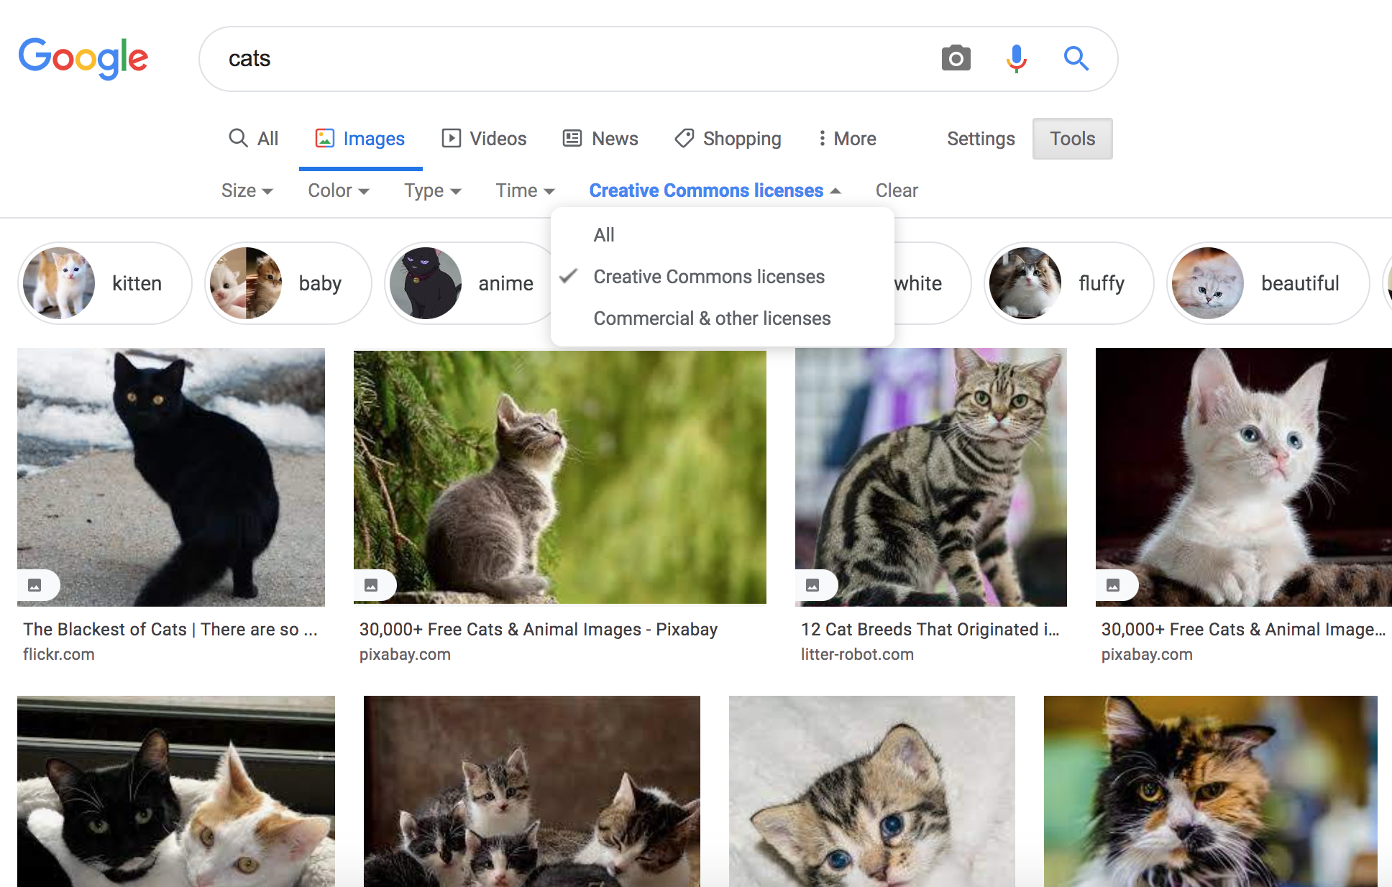

Slide 9
YouTube
YouTube allows users to upload video
Standard YouTube License: Uploader holds copyright, Creative Commons can be selected
YouTube has been criticised for copyrighted content
Provides ability to embed videos to maintain control over IP
A large proportion of YouTube’s revenue goes to the copyright holders of the videos
In early 2007, Viacom served 100,000 take down notices, and sued YouTube for $1 billion

Slide 10
YouTube’s Content ID
Content ID is a system for automatic detection of uploaded videos that infringe copyright
Allows Copyright holders to manage their content
Only for large content owners
Substantial body of original material
Frequently uploaded by YouTube Creators
Copyright holders upload their content to Content ID system which generates fingerprints

Slide 11
YouTube’s Content ID cont.
Every submission by a “YouTube Creator” is matched against fingerprint database
Content is flagged and Rights holder can
Track
Claim
Block
Strike (Full takedown)
YouTube Creator can dispute claims and blocks
After claim resolution revenue generated is passed to Rights holder or YouTube Creator

Slide 12
Problems with Content ID
Only as good as the Matching Algorithm and Content ID database of fingerprints
99.7% accurate but 500 hours per minute being uploaded
A lot of false negatives/positives
Rights holders can take down negative videos but leave positive
Creators can loose channel if the receive too many strikes

Slide 13
Web Standards and Digital Rights Management (DRM)
Encrypted Media Extensions standard
DRM systems to hook directly into browser
Video streams eg Netflix in the browser
Avoids needing plugins like Flash or Silverlight
Controversial for W3C
No View Source

Slide 15
Google News and Legal Action
Google was sued by:
Agence France-Presse for using photos, stories and news headlines 2005
Beligum news sources for using lead paragraphs 2007
Laws passed by German and Spain allowing publishers to charge a fee for other providers publishing short snippets of news
German 2013 law
Google refused to pay and delisted publishers
Publishers saw 40% drop in traffic
Google then successfully challenged the law; ruled invalid due to procedural issues
Spain introduced a similar law in 2014
Google shut its Google News service for Spain
Dubbed “Google tax” because it targeted Google display news results in search results

Slide 16
Learning Outcomes
You should be able to implement a creative commons license
Describe why the Content ID system used by YouTube supports copyright owners
EME DRM standard supports sharing copyrighted material on media sharing platforms
Highlight key copyright aspects in the court case between Google news and news outlets

