Slide 2
Intellectual Property on the Web
COMP1202 Web Infrastructure
Dr Heather Packer – hp3@ecs.soton.ac.uk

Slide 3
“On one hand information wants to be expensive, because it's so valuable. The right information in the right place just changes your life, on the other hand information wants to be free because the cost of getting it out is getting lower and lower all the time. So you have these two fighting against each other"
Steward Brand, 1984

Slide 4
Intellectual Property
“Nonphysical property that stems from, is identified as, and who value is based on an idea or some ideas”
"Only the concrete, tangible, or physical embodiments of the idea are protected by intellectual property law"

Slide 5
Types of IP Rights
Type | Description
Copyright | Protects the skill and labour expanded by someone creating something new
Patents | Protect inventions by giving invention a monopoly on exploiting their inventions for a certain period
Trademarks | Exclusively identify the product of a particular manufacturer or supplier
Database (EU only) | Protects the skill and labour expended by someone creating collections of data or other materials
Performance rights | Protects against unauthorised making of copies of “public performances”, which includes musical, theatrical, dance performance, and also lectures
Design rights | Protects the shape and configuration (how different parts of a design are arranged together of objects)
Moral rights (EU only) | Right of a creator to insist that his/her name is associated with his/her creation. Right of the creator to object to derogatory his/her work which damages his/her reputation

Slide 6
Types of IP Rights
Type | Description
Copyright | Protects the skill and labour expanded by someone creating something new
Patents | Protect inventions by giving invention a monopoly on exploiting their inventions for a certain period
Trademarks | Exclusively identify the product of a particular manufacturer or supplier
Database (EU only) | Protects the skill and labour expended by someone creating collections of data or other materials
Performance rights | Protects against unauthorised making of copies of “public performances”, which includes musical, theatrical, dance performance, and also lectures
Design rights | Protects the shape and configuration (how different parts of a design are arranged together of objects)
Moral rights (EU only) | Right of a creator to insist that his/her name is associated with his/her creation. Right of the creator to object to derogatory his/her work which damages his/her reputation

Slide 7
Copyright
Protects:
Original literary, dramatic, musical, and artistic works
Sound recordings, films, broadcasts and cable transmissions
The typographical arrangement of published editions

Slide 8
Copyright
Copyright gives five exclusive rights to the owner of the copyright. The right to:
Copy the work
Issue copies to the public
Perform, play or show the work to the public
Broadcast the work or transmit on a cable service
Make an adaptation of the work

Slide 9
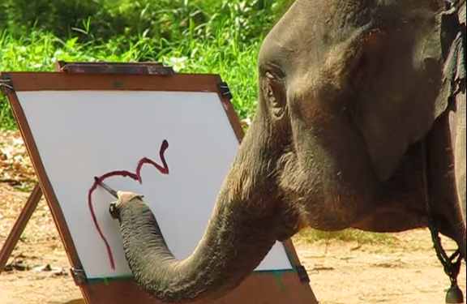
Who owns the Copyright?
Copyright is owned by the author(s) of the work
An employer owns the copyright if the author created the work in the course of employment
Independent contractors own the copyright unless agreed otherwise
Copyright can only be transferred in writing
Copyright does not need to be registered

Slide 10
Infringement
Primary infringement is anyone who, without consent, does any of the five things that are the exclusive right of the owner of the copyright
Primary infringement is purely a civil matter
Secondary infringement occurs when an infringement is performed knowingly and in the course of business
Secondary infringement can be a criminal offense

Slide 11
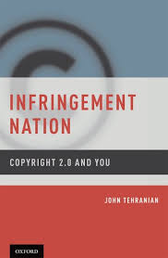
Infringement Nation
He describes a day in the life of an a law-abiding American who infringes on the copyrights of:
20 emails
3 legal articles published online
an architectural rendering
a poem
five photographs
an animated character which is tattooed on his arm,
a musical composition
a painting
fifty notes and drawings
Assuming that full enforcement of rights by copyright holders he would be liable for $12.45 million

Slide 12
Exceptions and Limitation
the reproduction of works for blind and disabled persons
the libraries and archives can preserve copy and distribution protected works
“first rule of sale”
once a copyright owner sells you a legal copy of a book then they no longer have control over the distribution right of that particular copy
© Copyright Mike Faherty and licensed for reuse under this Creative Commons Licence.

Slide 13
Copyright and Fair Use
US has Fair Use exception
Determined by the courts
Difficult to prove fair use

Slide 14
Database Rights
Database rights only arise where the maker of the database has invested substantially in obtaining or verifying data from independent sources
Investment in actually creating data which forms part of a database will not automatically result in a database right
Databases can be subject to copyright if a database is the author’s “own original intellectual creations”
Database rights are independent of copyright
A new set of rights are created each time a database is substantially modified
“substantial investment in obtaining, verifying or presenting the contents of the database”
Owners can object to the copying of substantial parts of their database, even if data is extracted and reconstructed
Database rights under the EU are created automatically
Rights last for 15 years

Slide 15
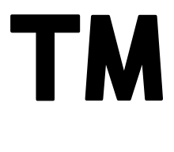
Trademark Rights
Trademark Rights is a type of IP
Recognisable logo, sign or expression which makes products or services identifiable
The trademark owner can be an individual, business organization, or any legal entity
Trademarks may be located on packages, labels, and or products
Or on websites, downloads, or files
Registered Trademark
Non Registered Trademark

Slide 16
Trademark Rights
Web domains can be trademarked
Cyber squatting is registering a domain name with no legitimate reason other than to benefit from another's good reputation
Cyber squatters profit from the trademark by either:
Making money from the trademark, trafficking users to unrelated material
Selling the trademarked domain at an inflated price
In the US through arbitration, if you can show that:
Someone registered a web address with your trademark in it
Registered the web address with the sole purpose of making money
No legitimate reason for the site to be using the trademark

Slide 17
Trademark Rights
Twitter
Forbids selling usernames
Forbids the impersonation of a person that is non-parody
Prevents identify confusion with verified accounts with insignia
Facebook
Reserves the right to claim usernames on the website if they infringe on trademark
Owners are responsible for reporting
Requires mobile phone verification

Slide 18
Learning Outcomes
Identify the most relevant rights to the web:
Copyright
Database Right
Trademark
Evaluate and identify what elements on the Web can be protected by IP
Argue why copyright isn’t suited to modern lifestyle

