Slide 2
Open Access: The Web and Scientific Knowledge
COMP3220 Web Infrastructure
Dr Heather Packer – hp3@ecs.soton.ac.uk

Slide 3
Open Access (OA)
Open Access to Scientific and Scholarly Research Literature
OA is movement for organising and disseminating the worlds research knowledge through Web technology
Free of cost
Other access barriers
Focuses on Peer Reviewed Literature
Open access logo, designed by Public Library of Science

Slide 4
The Budapest Open Access Initiative (BOAI)
The BOAI publishes a set of principles for open access and research literature
Released in February 14th, 2002
It arose from a conference hosted in Budapest by the Open Society Institute in 2001
This small gathering of individuals is recognised as one of the major defining events of the open access movement.
Old tradition of scholarly publishing + New technology of the Internet =
Public good: free and unrestrictive access to peer-reviewed journal literature

Slide 5
Open Access Definition
“By "open access" to this literature, we mean its free availability on the public internet, permitting any users to read, download, copy, distribute, print, search, or link to the full texts of these articles, crawl them for indexing, pass them as data to software, or use them for any other lawful purpose, without financial, legal, or technical barriers other than those inseparable from gaining access to the internet itself. The only constraint on reproduction and distribution, and the only role for copyright in this domain, should be to give authors control over the integrity of their work and the right to be properly acknowledged and cited.”
- The Budapest Open Access Initiative

Slide 6
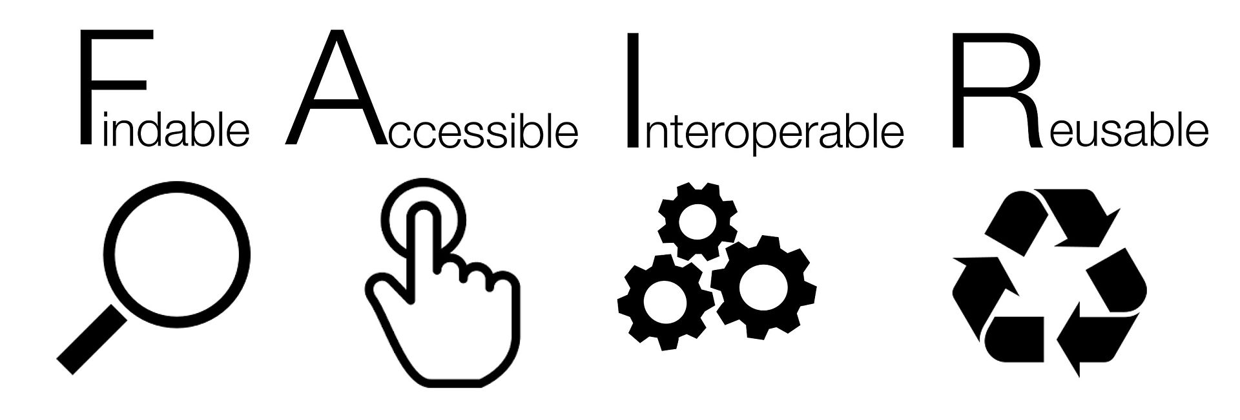
FAIR
FAIR data linked to Open Access
Introduced in 2016
Endorsed by the European commission and the G20

Slide 7
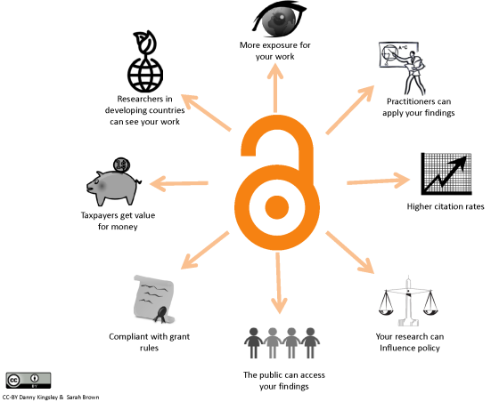
Full Open Access Ideal
The entire full-text refereed corpus online
On every researcher’s desktop, everywhere
24 hours a day
All papers citation-interlinked
Fully searchable, navigable, retrievable

Slide 8
Traditional Subscription Publishing
Limited Dissemination, economic efficiency & social impact
Paywall
Libraries purchase subscriptions
Very limited permissions
Slow process

Slide 9
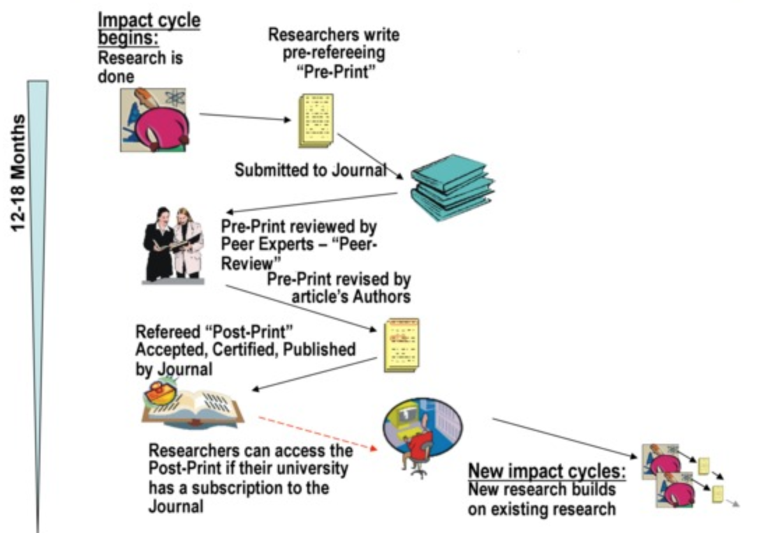
Limited Access: Limited Research Impact
Research is a process
Can take more than a year and a half for a journal

Slide 10
Gold Open Access
Maximised Dissemination, economic efficiency & social impact
Articles freely, permanently and immediately accessible by everyone
Copyright retained by authors
Very few restrictions on use

Slide 11
Green Open Access
Increased Dissemination, economic efficiency & social impact
Self Archiving
A version is freely available
Publish pre or post publication

Slide 12
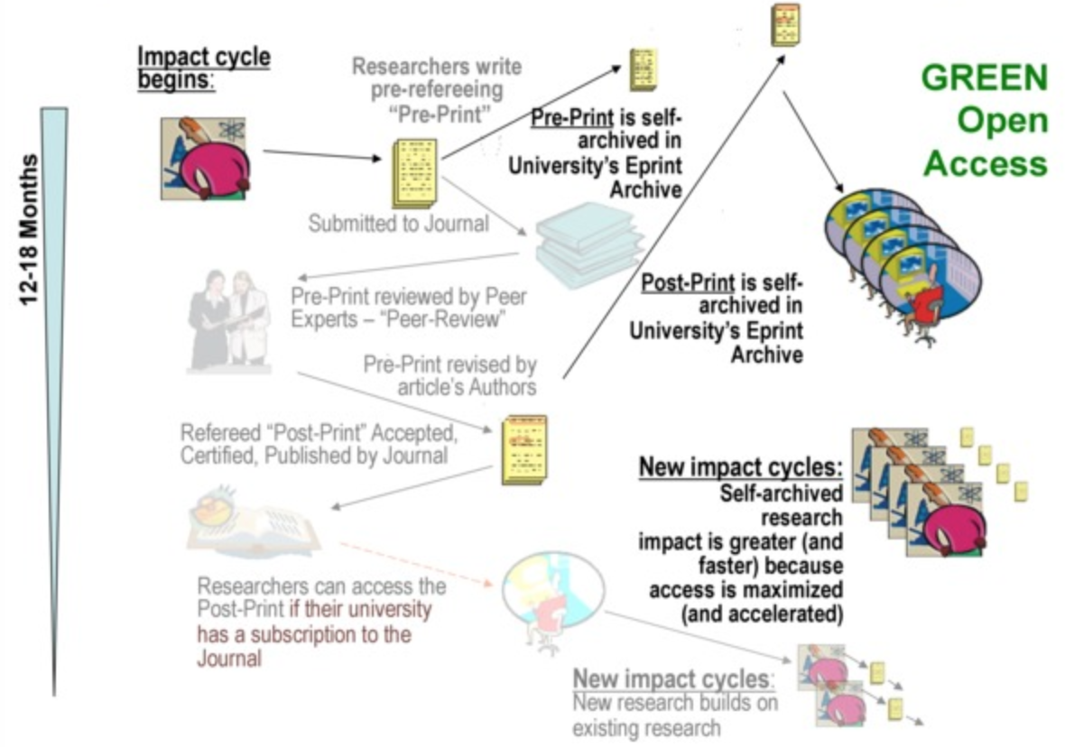
Green Open Access Pre-Prints
Preprints allow people to view work immediately
However, impact is greater after peer reviewed publications

Slide 13
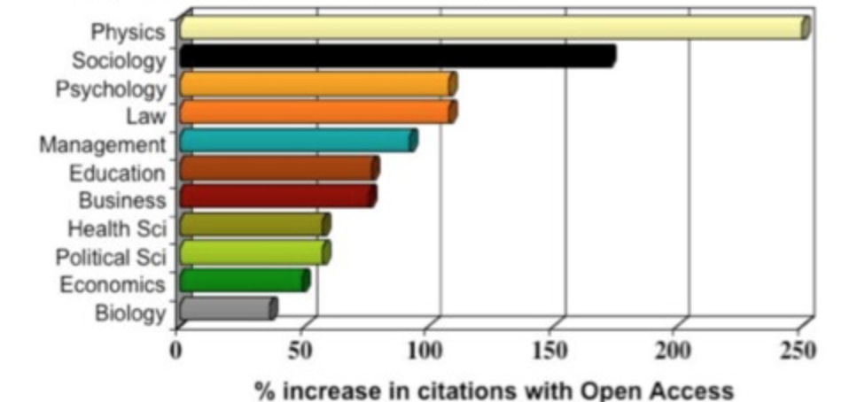
Green OA Advantages
Early Advantage: Self archiving preprints before publications hastens and increases usage and citations
Quality Advantage: Self-archiving postprints immediately upon publication hastens and increases usage and citation
Higher quality articles benefit more
Usage Advantage: Self-archiving both pre/post prints increases downloads
Higher quality articles benefits more!
Full bibilograhy, see
http://opcit.eprints.org/oacitation-biblio.html

Slide 14
Open Access Strategies
Green: Self Archiving | Gold: Publishing
Journal processes continue as normal | Journal changes business model
Authors deposit a copy of their papers into an ‘open access repository’ | Readers no longer pay to read
Public copy is a supplement to the publishers official article for those who can’t afford a subscription | Instead, authors pay to publish or their funders

Slide 15
Problems with OA
20% of new papers are Open Access 2019
50% of new papers, all versions, are behind a paywall
Green OA relies on publishers polices
Romeo service tracks publisher policies
http://www.sherpa.ac.uk/romeo
Gold OA relies on publishers changing their model
Scientific publications is lucrative (18% profits)
Academia highly values the peer review process

Slide 16
Open Access Repositories
Open-access repository or open archive
Free, immediate and permanent access for anyone to use, download and distribute
Institutional or disciplinary
They provide free access to research for users outside the institutional community
Open Archives Initiative Protocol for Metadata Harvesting (OAI-PMH)
A protocol developed for harvesting metadata descriptions of records in an archive so that services can be built using metadata from many archives
Repositories must be interoperable according to OAI-PMH
Search engines harvest the content of open access repositories, constructing a database of worldwide, free of charge available research

Slide 17
Role of the Repository
Who takes responsibility for curating the research knowledge of the world?
Privately owned, profit making, publishing industry
University, research institution, knowledge creator

Slide 18
Learning Outcomes
How OA relates to the publishing industry
Advantages of Green and Gold publishing

