Slide 2
Open Access: The Web and Scientific Knowledge
COMP3220 Web Infrastructure
Dr Heather Packer – hp3@ecs.soton.ac.uk
Notes:
On this course so far we’ve looked at the languages and libraries used to create web pages, the services that can be created, the infrastructure of the web, how we can analyze the web, how the web can be searched and navigated, and how it is funded.
What we haven’t talked about what was the intended purpose of web technologies.

Slide 3
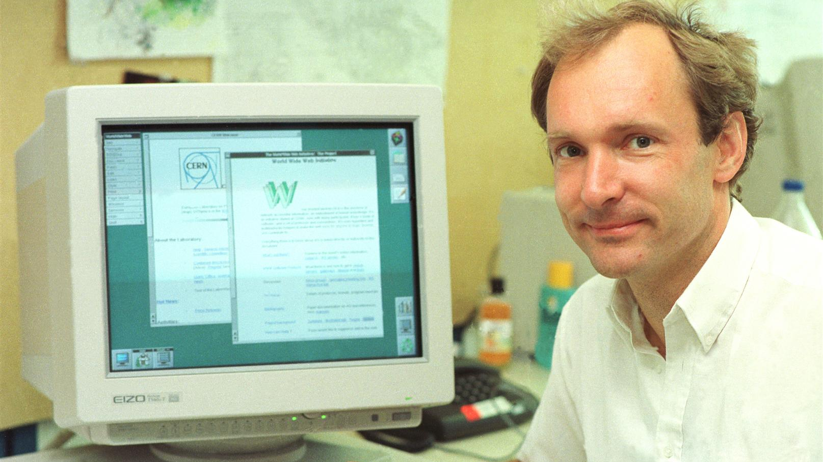
The Original Web Challenge? “In those days, there was different information on different computers, but you had to log on to different computers to get at it. Also, sometimes you had to learn a different program on each computer. Often it was just easier to go and ask people when they were having coffee…” Sir Tim Burners-Lee
Notes:
The original challenge that Tim Burners-Lee was trying by combining hypertext with TCP and DNS to solve, in his word, was
“In those days, there was different information on different computers, but you had to log on to different computers to get at it. Also, sometimes you had to learn a different program on each computer. Often it was just easier to go and ask people when they were having coffee…”

Slide 4
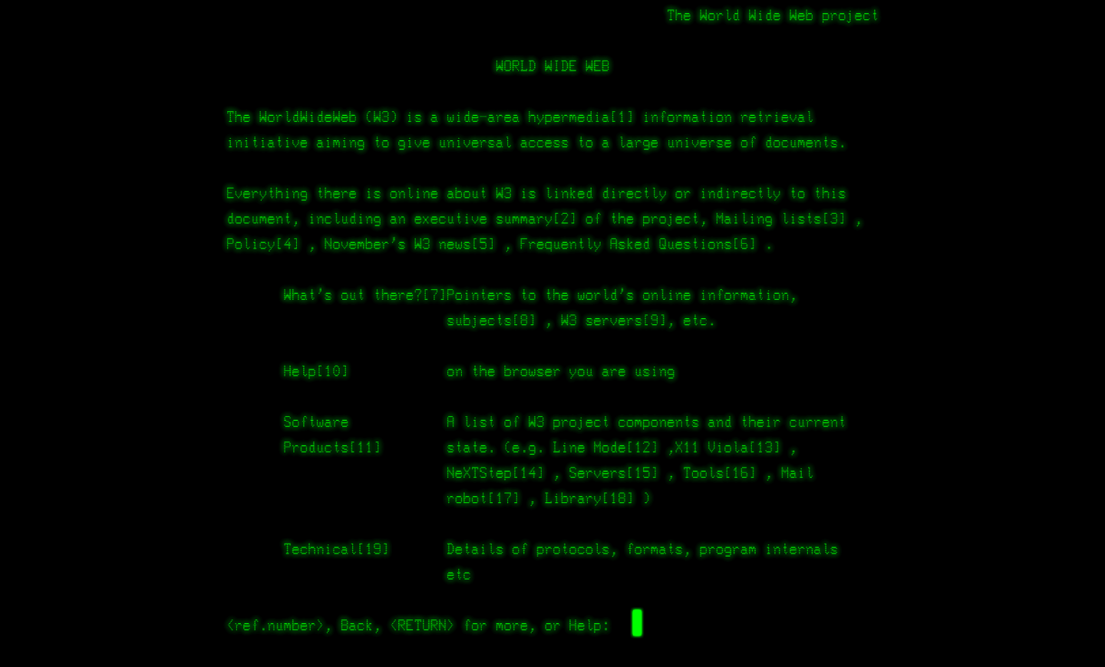
Notes:
The web was originally conceived and developed to meet the demand for automated information-sharing between scientists in universities and institutes around the world.
And this was still it’s purpose in 1991, here is a screenshot of the World Wide Web project which lauched in 1991, the first paragraph says,
The world wide web is the wide area hypermedia information retrieval initiative aiming to universal access to large universe of documents.

Slide 5
Open Access: Tim’s Problem
Universities created a whole new industry and students read and write paid for by external company
Universities and researchers are knowledge producers and knowledge consumers
Publishers owned the academic publications
Authors writes article
Author signs over copyright to publishing company
Publishing company publishes article
Publishing company receives revenue from university libraries
Author receives academic credit
Publication glory
Citations
researchers
publishers
read
write
Notes:
At the time the world wide web project was created, it was not possible to share many academic publications online, because in order to publish a paper the author has to give the copyright of the paper to the publishing company. Publishing companies owned the rights to these papers, so that they could distribute and sell them to university libraries around the world. The author would receive all of the recognition, and the paper would hopefully be built upon by other researchers who would then cite it in their publication.
This need to distribute research created a whole new industry for publishing companies to support, and it was driven by the universities because they needed to disseminate papers and consume papers in order to create more papers. The whole process is circular.

Slide 6
Scholarly Publishing 1665-1960
Scientific and scholarly societies publish their own journals
First scientific journal March 1665
The Royal Society publishes “Philosophical Transactions”
University Presses not for profit but were for prestige
For the benefit of their members, for the benefit of science
Notes:
Historically, university presses published their work for prestige, and were not for profit. They enabled institutions to share their work with others, so that they could use it and build upon it. It was expensive for university presses to publish journals especially because none of the process was digitised, costs were involved with printing detailed colour figures, getting the typesetting right, calculating the number of copies needed and distributing them. Therefore, it beneficial for the university to outsource this to publishing companies who could centralise and manage the process.
In the 17th and 18th centuries publishers started the practice of reviewing papers before publishing them. In those times the editor-in-chief or the editorial board would read a paper and decide whether it was suitable for their publication. The first record of a pre publication review was in 1665 was published by the royal society in "Philosophical Transactions”. In the 20th century, publishers started to get experts to review papers who were familiar with the field. Famously, Alert Einstein was a critic of this external review process, and he did not want his papers to be read by his peers before publication. He took the decision to publish in journals that did not use this process, after this he withdraw a paper. And it has been debated that if that publication had of used an external review process that this paper would not have been published. The review process gave quality to assurance and thus prestige to authors. The review process has become an integral part of the scientific progress.
Peer reviews helps the publisher to decide whether the work should be accepted, considered acceptable with revisions, or rejected. This process is complicated and involves identifying the right reviewers, communications, and managing the revision process.
Before the web, this process worked well, research was distributed and was more accessible by institutions.

Slide 7
Private Sector
After the war 1948 Robert Maxwell decided to publish scientific journals and set up Pergamon Press which was quickly and hugely profitable
Bringing “aggressive publishing in science”
In 1960’s Universities were expanding
UK Robbins Report/expansion of higher education & science budget
In 1968/9 STM Association founded for publishers
The new demand made for a very profitable system – with an increasing number of commercial publishers moving into STM
STM - The International Association of Scientific, Technical and Medical Publishers
Notes:
After the second world war, the number of universities started to increase. And Robert Maxwell decided to publish scientific journals and set up Pergamon Press which was quickly and very profitable. The number of universities continued to increase through the 50s and 60s. The Robbins Report was commissioned by the British government and published in 1963. The report recommended immediate expansion of universities because of the demand in communities, and that all colleges of advanced technology should be given the status of universities.
As the number of universities increased, so did the amount of research output. This growth lead to the commercial publishers in the 60s and 70s selectively acquiring "top-quality" journals that were previously published by nonprofit academic societies. There was a large profit to be made by distributing work that they did not create or review internally. They of course did add value by handling the review process and distribution. In order to make money they charged institutions a subscription fee. When the commercial publishers raised the subscription prices significantly, they lost little of the market, due to the demand for these journals.
In 1969, the International Association of Scientific, Technical and Medical Publishers, known for short as STM was formed. It is an international trade association organised to regulate publishing. Today it has over 120 members in 21 countries who each year collectively publish nearly 66% of all journal articles and tens of thousands of monographs and reference works.

Slide 8
The Serial Crisis
Subscription prices continued to rise
Some research fields were more affected than others
In 2002 the Modern Language Association hoped that electronic publishing would solve the crisis
Notes:
The industry encountered problems when publishing companies continued to increase their subscription prices of serial publications, as in publications that were published periodically, and institutions were struggling to find the money to pay for them, this became known as the serial crisis. The prices of subscriptions have been rising much faster than the Consumer Price Index for several decades, and the funds available to the libraries have remained the same or declined. As a result, academic and research libraries have regularly canceled serial subscriptions to accommodate price increases of the remaining current subscriptions.
The humanities have been particularly affected by the pressure on university publishers, this research field is driven by monographs a single-volume books providing in-depth research into a specialized area of knowledge and the inherent costs of their production prohibits libraries from being able to buy them. This reduces the number of journal published because of demand, this has a knock on effect on the humanities where publishing in monographs is increasingly expected to gain permeant jobs in academia. The Association of Research Libraries found that in "1986, libraries spent 44% of their budgets on books compared with 56% on journals; twelve years later, the ratio had skewed to 28% and 72%."
In 2002 the Modern Language Association expressed hope that electronic publishing would solve the issue.
In 2009 and 2010, surveys and reports found that libraries faced continuing budget cuts, with one survey in 2009 finding that one-third of libraries had their budgets cut by 5% or more. In the 2010s, libraries began more aggressive cost cutting with the leverage of open access and open data. Data analysis with open source tools like Unpaywall Journals empowered library systems in reducing their subscription costs by 70 % these cancellation greatly affected publishers like Elsevier.

Slide 9
The Problem with Paywalls
Restricts access to research papers
Prevents research being used
Prevents research from being built upon
Notes:
The problem of access is something that students and lecturers often come across, I remember being a student and finding interesting abstracts on a topic but not having access to it because our library didn't have a subscription. Even while I was a PhD student, I had read enough papers to know that just because an abstract sounded extremely relevant to my interested, it doesn't mean that that the content of the paper would actually relevant to my particular niche interest. Therefore I often decided to move on and didn't pay to read the read the paper because there was no guarantee that the paper was useful and it was tractable to buy every seemingly interesting paper. This is also the case for lecturers we can't afford to buy every seemingly interesting paper, but the problem is that they can only teach what they have access to. And Southampton University and it's students are comparatively rich, compared with students and research in low and middle income countries who really struggle with accessing research behind these paywalls. It prevents them from contributing fully to world class research, it prevents them from benefiting from research and this is very important for health care professionals and other institutions. It is worth noting that there are various initiatives that support developing nations, but these restrictions still significantly disadvantage these countries.

Slide 10
The Twin Peaks Problem
≈24,000 journals with 2,500,000 article/yr
Pay wall for access
Limited access based on universities budgets
Well funded universities can only afford a fraction of subscriptions
Less well funded universities can afford even fewer subscriptions
≈£10,000 per year for access to some journals, and prices increasing
Universities are measured by their impact
Fewer readers means less impact (fewer citations)
Notes:
There is approximately 24 thousand journals with around 2.5 millions articles published a year, no university has a subscription to all of the journals because of financial limitations. Each journal or publishing house has a subscription fees, and even the well funded universities of the world subscribe to a fraction of them, and less less well funded universities can afford even fewer subscriptions. Subscription fees can be really high, in excess of £10,000 a year and those prices are increasing.
Universities are measured by their impact and the impact determines the quality of researchers and students they attract, having access to these journals plays a big role in the success of the university. As subscriptions become out of reach for universities to afford, the impact of the journals decreases, as institutions decide not to subscribe to them they are not as widely available and therefore get fewer citations.

Slide 11
The Literature: As We Imagine
Integrated
Citations
Readily available
Standing on the shoulders of giants
“we see more and farther than our predecessors, not because we have keener vision or greater height, but because we are lifted up and borne aloft on their gigantic stature”
Notes:
In an ideal world research is well organized, it all links together through citations and builds upon what has come before it. This is where the metaphor of standing on the shoulder of giants comes from, it’s meaning has been described as that, we see more and farther than our predecessors, not because we have keener vision or greater height, but because we are lifted up and borne a lot on their gigantic stature. This allows us to not duplicate effort, to keep us progressing forward. It also allows us to evaluate what has come before and critic it, and because it’s connected we can find where a particular idea steams from, and if something is proven to be incorrect we can find it’s linage and reassess all work that builds upon it.

Slide 12
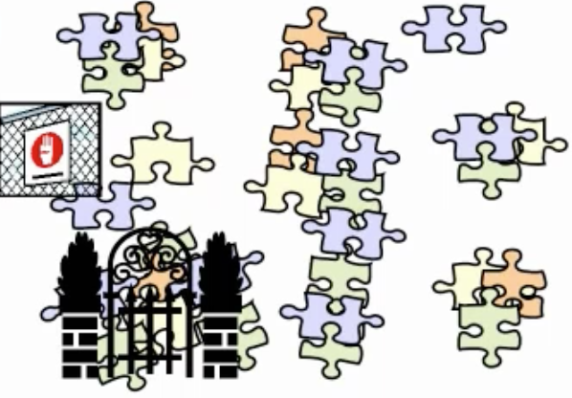
The Literature: As It Is
Inaccessible
Hidden behind pay walls
Not subscribed too
Disjoint
Books
Online journals
Scientific magazines
Notes:
However this is not what literature looks like, and it’s not easy to follow a chain of citations because there are paywalls preventing you from finding the content. And that content is often spread across different journals, magazines and books. So it can be hard to understand the context of the research and question assumptions that are based on others’ research.

Slide 13
Conclusion
A whole publishing industry was created to support research
Subscriptions are continually increasing, thus reducing their reach and impact
Research universities success is based on their impact
Notes:
In summary, a whole publishing industry was created to support peer review the backbone of scientific rigor, and the distribution of papers so that university can create impact with their research.
As the subscription to journals increases, this decreases the impact factor of publishing in journals.
It’s this accessibility issue that has caused the serial crisis, in the next lecture we’re going to talk about what this has done to the industry and the solutions that technology allows us to support.

