Slide 2
Graph Dynamics and the Web
COMP3220 Web Infrastructure
Dr Heather Packer – hp3@ecs.soton.ac.uk

Slide 3
Graph Theory and Graph Dynamics
Graph theory mostly focuses on static graphs
Almost all real world networks are dynamic
Evolution over time creates a new level of complexity

Slide 4
Growing a Network
Simulate growth
  Number of nodes
  Number of links

Slide 5
Growing a Random Network

Slide 6
Thresholds
When average degree goes above 1

Slide 7
Threshold 1

Slide 8
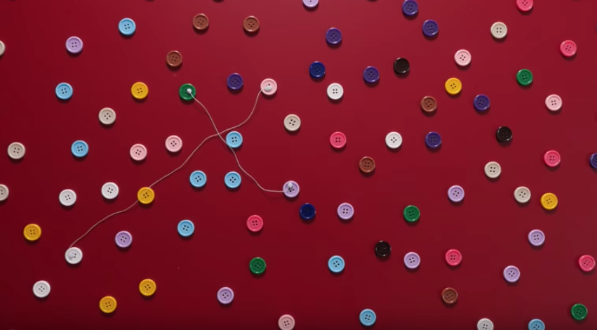
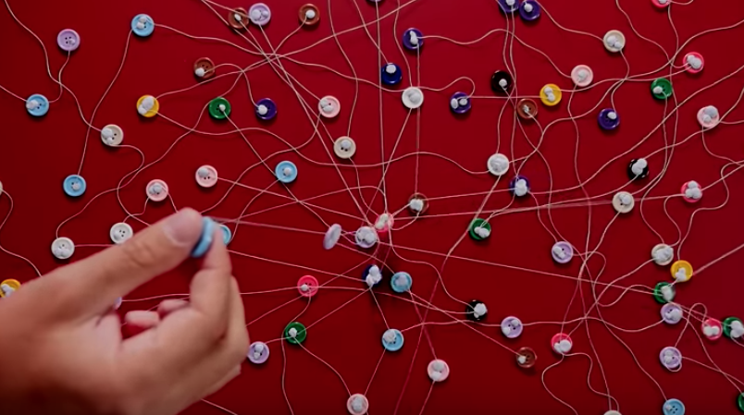
Small World Network – Erdos 1950s
Threshold identified by Paul Erdos
When the number of connections is lower than 1, the network is fragmented
When it’s above 1 it’s connected

Slide 9
Small World Network
Six Degrees of separation is a theory that everyone is 6 or fewer steps away from any other person in the world
Experiment by Stanley Milgram in the 1960s
  200 letters
  Sent to intermediary person on a first name basis
  64 letters arrived
  Average of 5.2 intermediaries
Small World Network is a graph where most nodes are not neighbours but most nodes can be reached by a small number of connections
  Website links
  Social networks
  Wikipedia
Many hubs – pages with in links
Hubs significance can be modeled with degree centrality
Robust for random node deletions

Slide 10
Thresholds
When average degree goes above 1
Nodes have an average degree of log(n)

Slide 11
Threshold 2

Slide 12
Real World Graphs
Real world graphs aren’t built randomly
There are lots of social phenomena that effects the links between real world graphs
  Reciprocity
  Social Influence
  Social Capital
  Homophily
  Preferential attachment
Experimental Observations [Barabasi, Albert (1999)]
  Sparse Graph
  Power Law

Slide 13
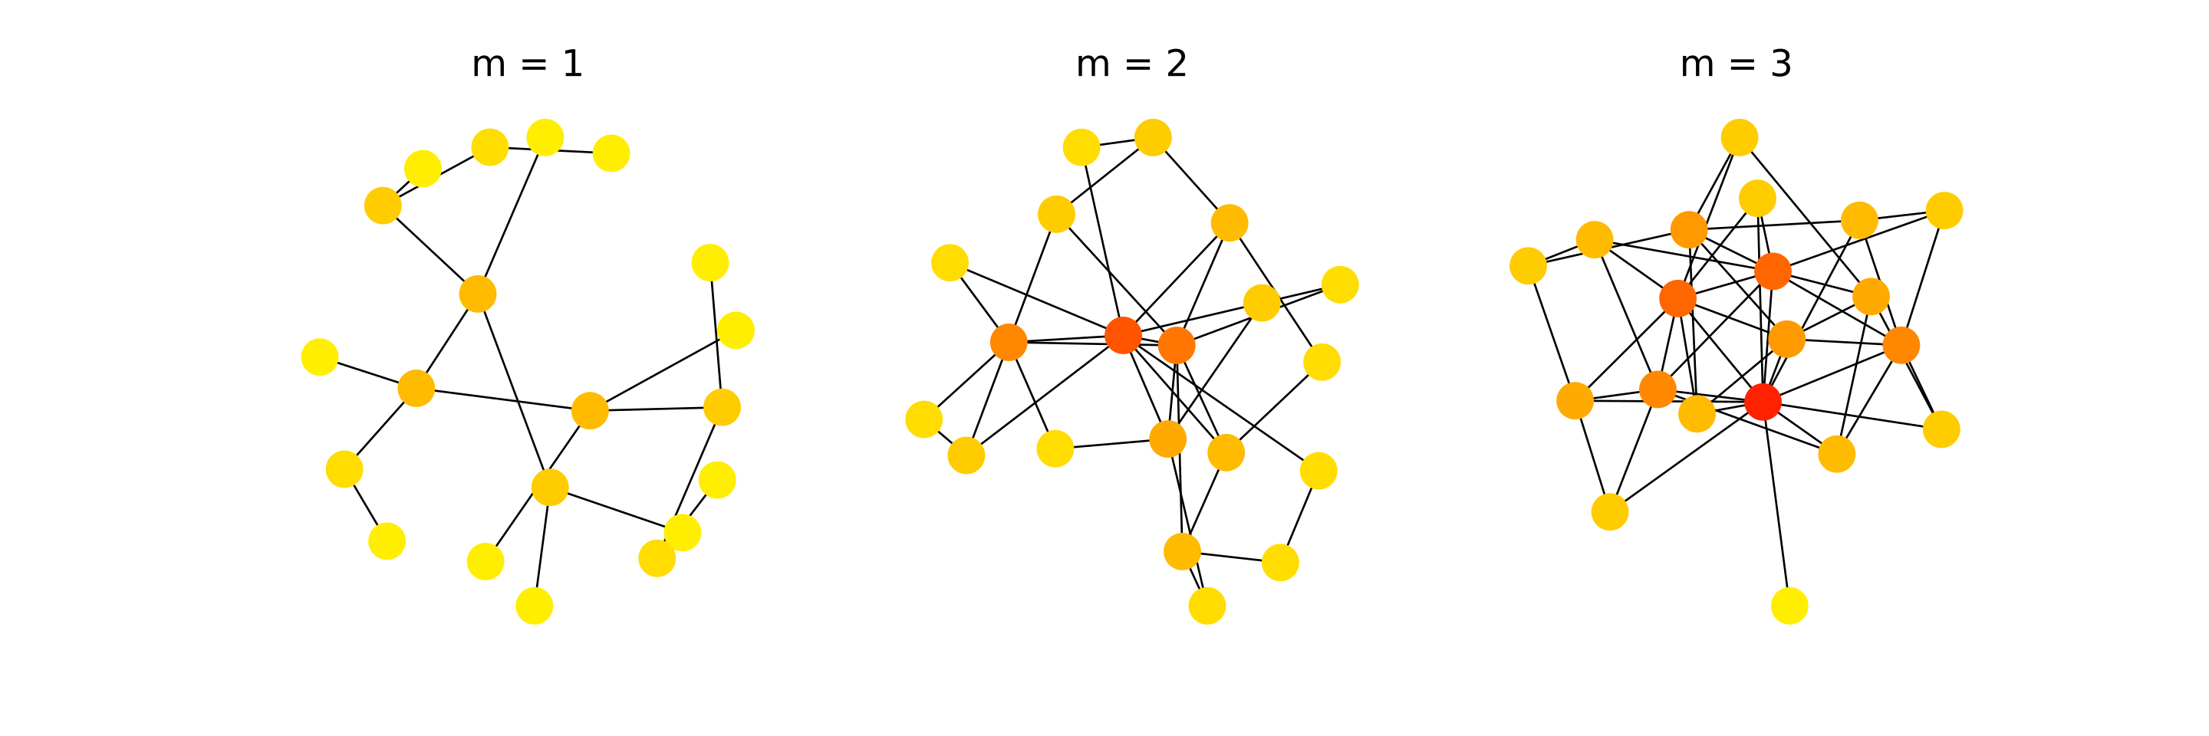
Barabasi and Albert Experimental Methodology
Intuition: Network grows by iterative process
Simulate growing a network and then examine it’s properties
Experiment with different models
Graphs created with the Barabasi-Albert model

Slide 14
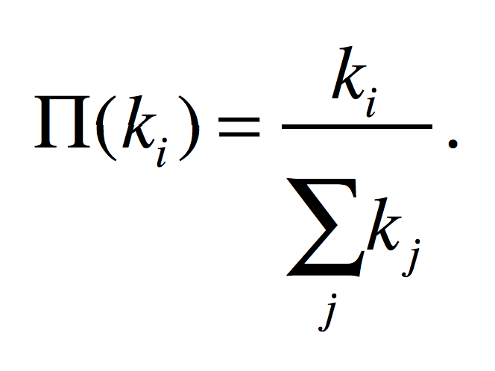
Preferential Attachment
The probability of a new node linking to an existing node is proportional to the degree of that node. The probability Π(k_{i}) that a link of the new node connects to node i depends on the degree k_{i} as:
A new node is free to connect to any node in the network
For example, if a new node has a choice between a degree-two and a degree-four node, it is twice as likely that it connects to the degree-four node

Slide 15
Why Does Preferential Attachment reflect links on the Web?

Slide 16
Why Does Preferential Attachment reflect links on the Web?
Quality resources are likely to be popular
Findability – the more obscure something is the less findable it is, and thus is less likely to be linked to
Human nature – the more popular a website is, the more likely it is to be shares and thus linked to, similar to PageRank’s assumption

Slide 17
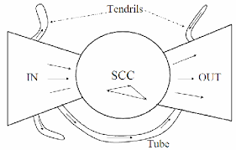
The Shape of the Web – The Bowtie
The Shape of the Web [Broder et al. (2000)]
Bowtie
  Strongly Connected Core
  In links
  Out links
  Tendrils and Tubes
The diameter of the central core is at least 28, and the diameter of the graph as a whole is over 500
The probability of a path between randomly chosen pairs is only 24%
  Average directed path length is about 16
  Average undirected path length is about 6

Slide 18
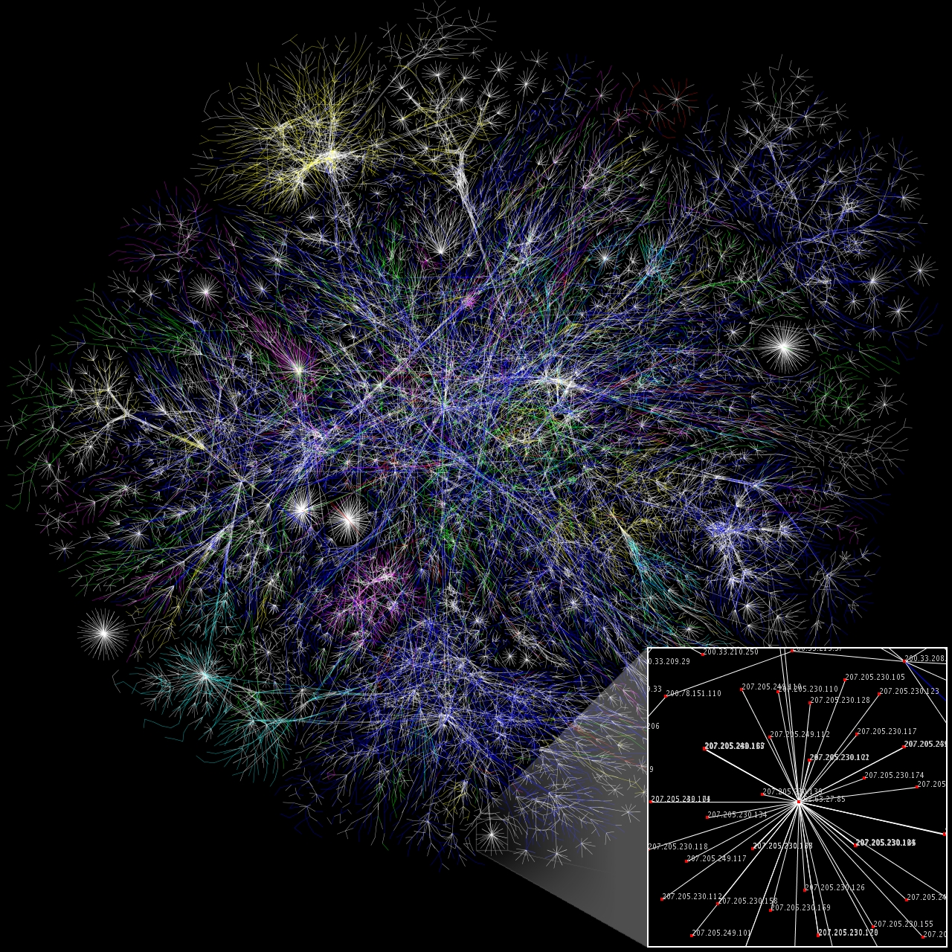
The Opte-Project 2003
Aimed to map the Internet
200 million nodes
1 billion edges
Partial map in Jan 2005
Nodes are IP address
Length of the lines denote delay

Slide 19
Modern Web Research
Temporal aspects – how is the Web Graph evolving over time?
Information aspects – how does new information propergate throughout the web (or blogsphere, or twitter..)
Finer-grained structure – how to define and computer “communities” in information and social networks

Slide 20
Outcomes
Describe the properties of the web
Identify scientific methodologies used to investigate how the web evolved
Describe the social factors that play a role in the clustering of websites
  Preferential attachment

