Slide 1
The Web and Graph Theory
COMP3220 Web Infrastructure
Dr Heather Packer – hp3@ecs.soton.ac.uk

Slide 2
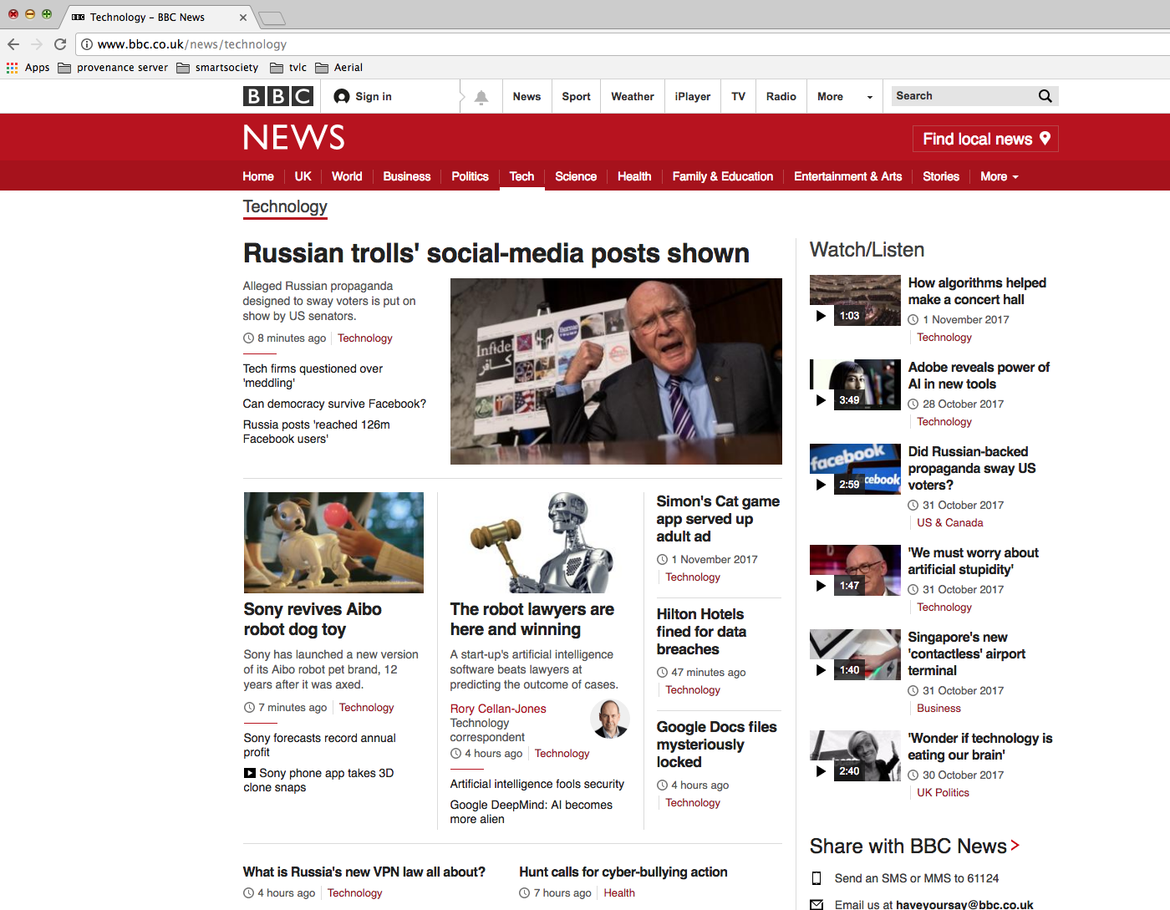
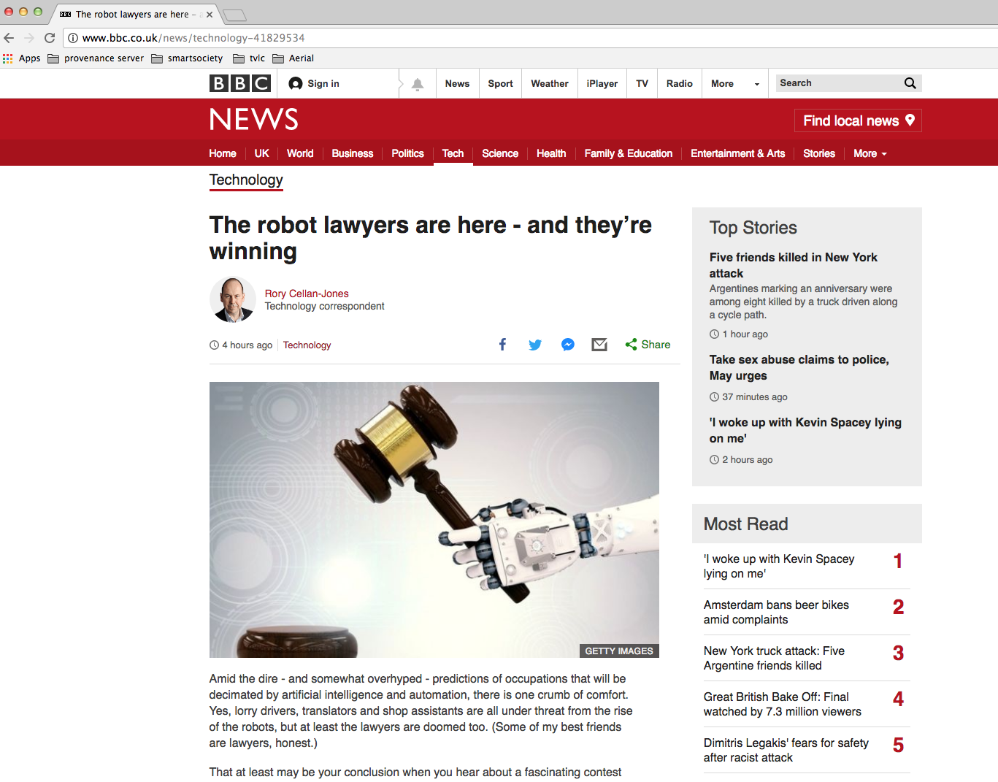
How is the Web Structured?
Graph Theory: Pages are nodes & links are directed edges

Slide 3
Graphs can Model
The Web
Facebook users
Tweets
Publications
Bitcoin/Block chain transactions

Slide 4
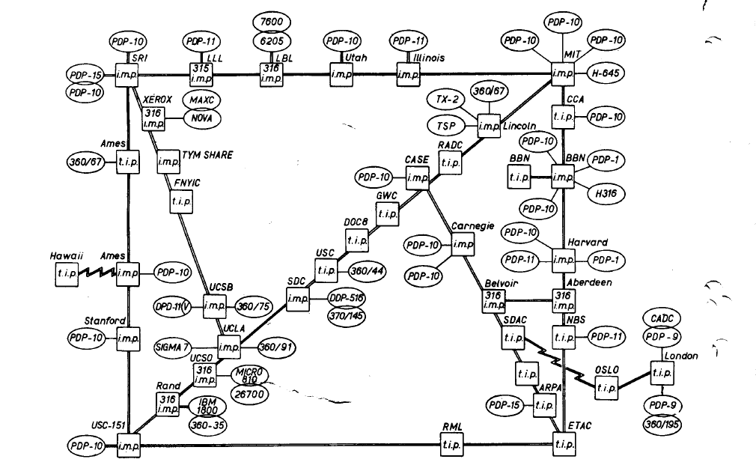
ARPNET 1973

Slide 5
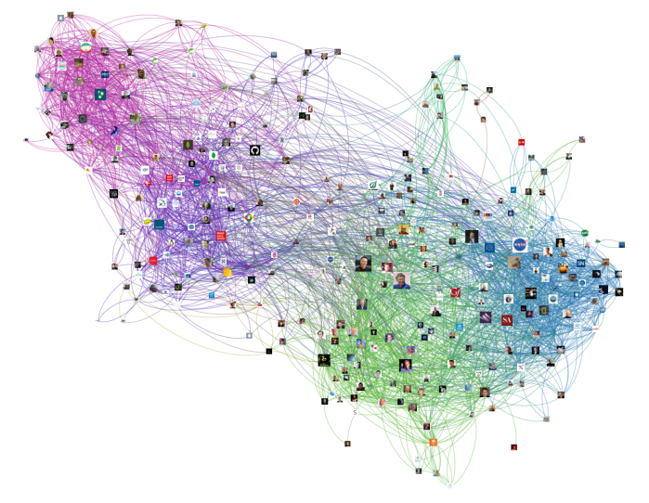
Twitter Graph

Slide 6
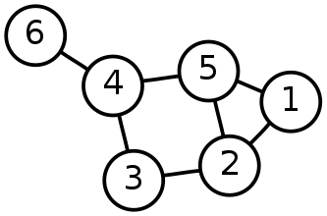
Graph Theory – Useful Measures
Distance between two vertices (v and v’)
Diameter of a graph, longest distance between any two vertices
Average-case diameter, average distance between any pair of nodes (v and v’)
Degree of a vertex, number of edges connected to it
Density of network, ratio of edges to vertices
A graph is made from Nodes or Vertices (V) and Edges (E)
G = (V, E)
Network size, total number of vertices (N)

Slide 7
Graph Theory – Is this Node Important?
Importance measures using centrality:
Degree centrality
Betweenness centrality
Nearness/Closeness centrality
Eigenvector centrality
*Central as in important, vital or `at the heart of’, not near the centre

Slide 8
Degree Centrality
F
Degree centrality focuses on individual nodes – it simply counts the number of edges that a node has
Hub nodes with high degree usually play an important role in a network
B
G
C
A
E
deg(A)=4
H
D
I
J

Slide 9
Degree Centrality
F
Degree centrality focuses on individual nodes – it simply counts the number of edges that a node has
Hub nodes with high degree usually play an important role in a network
B
deg(E)=5
G
C
A
E
deg(A)=4
H
D
I
J

Slide 10
Degree Centrality – In Degree
F
In degree – links to a vertex
Often used as a proxy for popularity
A web page is important if lots of things link to it
A twitter user is important if lots of other users follow it
A journal article is important if lots of other articles cite it
B
inDeg(E)=4
G
C
A
E
H
D
I
J

Slide 11
Degree Centrality – Out Degree
F
Out degree – links from this vertex
Authorities on a topic
B
inDeg(E)=4
G
C
A
E
outDeg(E)=1
H
D
I
J

Slide 12
Degree Distributions
Degree distributions p(k)
A plot showing the degree of nodes in a graph
F
1
B
1
G
1
C
1
A
E
Number of Nodes
4
5
H
D
1
1
I
Number of links
2
J
1

Slide 13
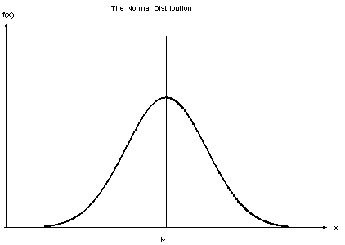
Degree Distribution Examples
Normal distribution
The average degree is most likely
Very high and very low degrees are highly unlikely

Slide 14
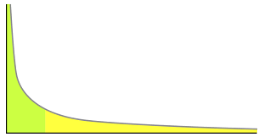
Degree Distribution Examples
Normal distribution
The average degree is most likely
Very high and very low degrees are highly unlikely
Power law distribution
No meaningful average degree
Very low degrees are likely, but very high degrees are unlikely

Slide 15
Power Law Networks
Some nodes have a tremendous number of connections to other nodes (hubs)
Most nodes have just a handful of links
Robust against accidental failures, but vulnerable to coordinated attacks
Nodes can have millions of links: The network appears to have no scale (no limit)
Power Law is a property of a
scale free network
hubs

Slide 16
Betweenness Centrality
Number of shortest paths going through a node
A node that has high betweenness is vital to the communication of the network
Many/most messages between two nodes must travel through it.
E
B
A
D
F
C

Slide 17
Betweenness Centrality
Betweeness Centrality for A
B to D
B to E
B to F
C to D
C to E
C to F
BC(A) = 6
E
B
A
D
F
C

Slide 18
Closeness Centrality
Closeness is the average of the shortest distances to all other nodes in the graph
It can describes how far and close vertexes are
E
B
1 ms
1 ms
1 ms
3 ms
A
D
2 ms
1 ms
F
C

Slide 19
Closeness Centrality
Closeness centrality of A
A to B = 1 ms
A to C = 1 ms
A to D = 1 ms
A to E = 2 ms
A to F = 3 ms
CC(A) = (1+1+1+2+3)/8 = 1.6 ms
E
B
1 ms
1 ms
1 ms
3 ms
A
D
2 ms
1 ms
F
C

Slide 20
Eigenvector Centrality
Eigenvector measures the popularity by looking at the quality of links
Identifies whether a node is connected to influential nodes
A
B
D
C

Slide 21
Surfer Model
A random surfer model can start on any webpage.
Follows links and makes occasional haphazard jumps

Slide 22
Websites and Links
1 links
2 backlinks
A
B
2 links
2 backlinks
D
C
2 links
1 backlinks
2 links
2 backlinks

Slide 23
Probability of Page Traversal
A
1
B
D
C

Slide 24
Probability of Page Traversal
A
1
A
B
0.5
0.5
D
C

Slide 25
Probability of Page Traversal
A
1
B
0.5
0.5
0.5
D
C
0.5

Slide 26
Probability of Page Traversal
A
1
B
0.5
0.5
0.5
0.5
0.5
D
C
0.5

Slide 27
Building a Matrix
A B C D
0 0 .5 .5
1 0 0 .5
0 .5 0 0
0 .5 .5 0
A
1
B
0.5
0.5
0.5
0.5
0.5
D
C
0.5

Slide 28
Surfer Model
A random surfer model can start on any webpage.
Follows links and makes occasional haphazard jumps

Slide 29
Random Surfer
25%
25%
A B C D
0 0 .5 .5
1 0 0 .5
0 .5 0 0
0 .5 .5 0
A
B
D
C
R0
A .25
B .25
C .25
D .25
25%
25%

Slide 30
Random Surfer
A
B
A B C D
0 0 .5 .5
1 0 0 .5
0 .5 0 0
0 .5 .5 0
R0
.25
.25
.25
.25
x
D
C

Slide 31
Random Surfer
R0
.25
.25
.25
.25
R1
.25
.375
.125
.25
A B C D
0 0 .5 .5
1 0 0 .5
0 .5 0 0
0 .5 .5 0
0x.25 + 0x.25 + .5x.25 + .5x.25
1x.25 + 0x.25 + 0x.25 + .5x.25
0x.25 + .5x.25 + 0x.25 + 0x.25
0x.25 + .5x.25 + .5x.25 + 0x.25
x
=
=

Slide 32
Random Surfer
A B C D
0 0 .5 .5
1 0 0 .5
0 .5 0 0
0 .5 .5 0
R1
.25
.375
.125
.25
R2
.1875
.375
.1875
.25
x
=

Slide 33
Random Surfer
A B C D
0 0 .5 .5
1 0 0 .5
0 .5 0 0
0 .5 .5 0
R2
.1875
.375
.1875
.25
R3
.219
.313
.188
.281
x
=

Slide 34
Random Surfer
A B C D
0 0 .5 .5
1 0 0 .5
0 .5 0 0
0 .5 .5 0
Rn
.1875
.375
.1875
.25
Rn+1
.217
.348
.174
.261
x
=

Slide 35
Random Surfer
A B C D
0 0 .5 .5
1 0 0 .5
0 .5 0 0
0 .5 .5 0
Rn
.1875
.375
.1875
.25
Rn+1
.217
.348
.174
.261
x
=

Slide 36
Random Surfer
A
B
Rank
A .217 3
B .348 1
C .174 4
D .261 2
D
C

Slide 37
Eigenvector Centrality
Build a matrix representing the graph
Transform the matrix with an Eigenvector
The resulting transformation can be used to rank the nodes
A B C
A 0 1/2 1
B 1 0 0
C 0 1/2 0
B
A B C
A 0 1/2 1
B 1 0 0
C 0 1/2 0
1/3
1/3
1/3
3/6
2/6 1/6
C
A
x
=

Slide 38
Eigenvector Centrality
Build a matrix representing the graph
Iteratively transform the matrix with an Eigenvector
The resulting transformation can be used to rank the nodes
A B C
A 0 1/2 1
B 1 0 0
C 0 1/2 0
B
A B C
A 0 1/2 1
B 1 0 0
C 0 1/2 0
1/3
1/3
1/3
3/6
2/6 1/6
C
A
x
=

Slide 39
What do the Measures Tell Me?
Degree: exposure to the network, opportunity to directly influence
Betweenness: informal power, gate keeping, brokering, controls flow of browsing
Closeness: estimates time to receive information, indirect influence, point of rapid diffusion
Eigenvector: connected to influential nodes of high degree, “not what you know but who you know”

