Slide 2
Richer Links
COMP3220 Web Infrastructure
Dr Nicholas Gibbins - nmg@ecs.soton.ac.uk

Slide 3
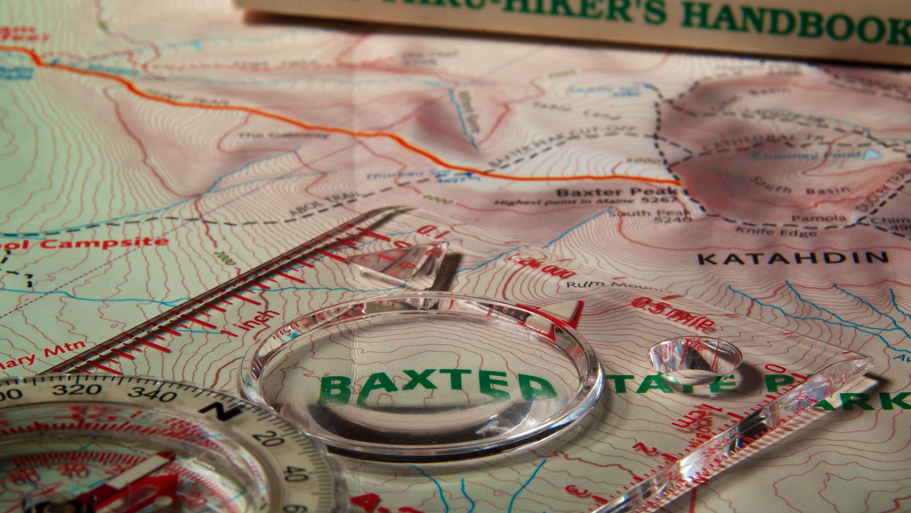
Beyond Navigation
http://www.flickr.com/photos/djwtwo/7891312188/
Notes:
So far, we’ve concentrated on hypermedia systems where the dominant paradigm is one of navigation
Links are to be followed
In this lecture, we’ll consider hypermedia systems where linking structures are not primarily used for navigation

Slide 4
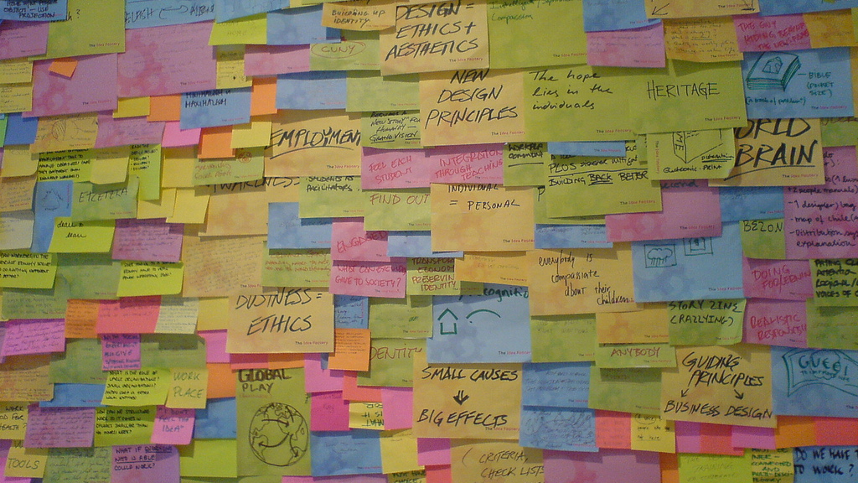
Spatial Hypermedia
http://www.flickr.com/photos/jakecaptive/49915119/

Slide 5
What is Spatial Hypermedia?
Tools for supporting emergent structure (implicit structure -> explicit relationships)
Visual/spatial metaphor allows people to express ambiguous or partial structures
  Focus on creation of structure
  Focus on visual and spatial properties: position, colour, border, shape, font
Distinctive line of spatial hypermedia systems in the literature:
  Notecards, gIBIS, VNS, Aquanet, VIKI, VKB
Marshall, C.C. and Shipman, F. (1993) Searching for the missing link: discovering implicit structure in spatial hypertext. Proceedings of the 5th ACM Conference on Hypertext, pp. 217-230.
Notes:
These tools support common understanding
Less confusing than networks

Slide 6
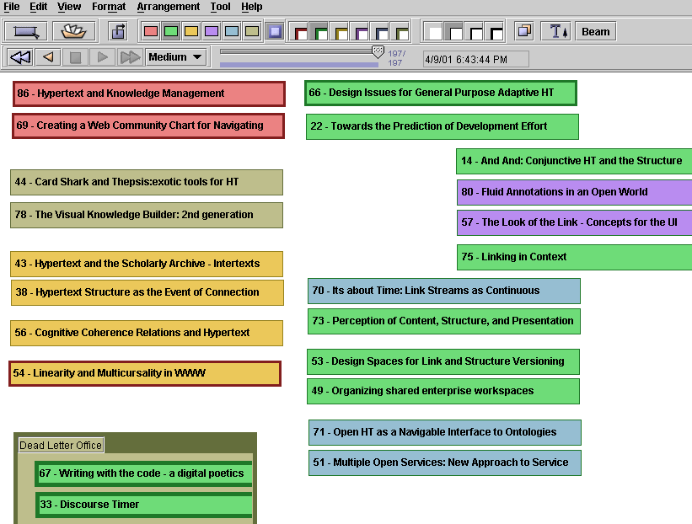
Visual Knowledge Builder
Shipman, F. et al (2001) The Visual Knowledge Builder: A Second Generation Spatial Hypertext, Proceedings of the 12th ACM Conference on Hypertext and Hypermedia, pp. 113-122.
Notes:
Example 2nd Gen spatial hypertext system (2000-)
Based on experiences with VIKI (Shipman and Marshall)
Frank Shipman, Texas A&M

Slide 7
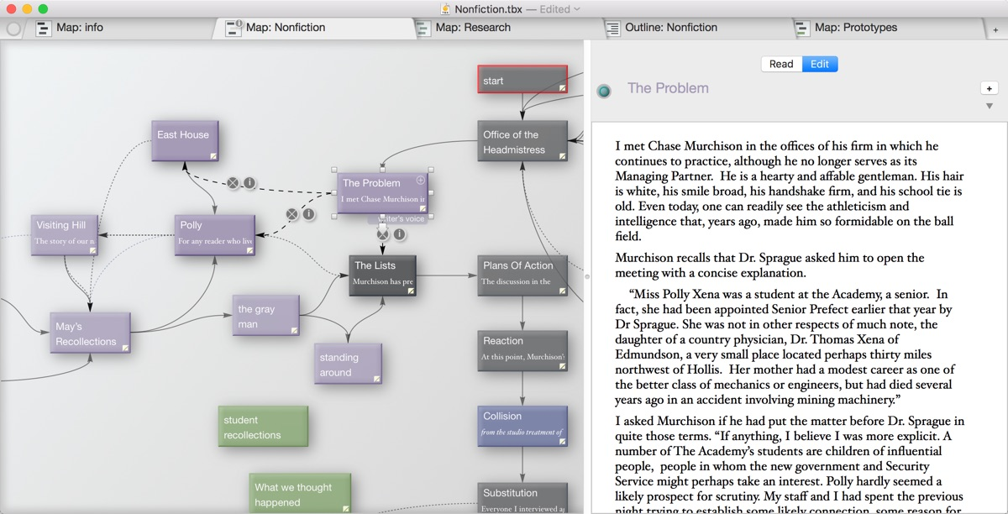
Storyspace (www.eastgate.com)
http://www.eastgate.com/storyspace/
Notes:
Tool for writing hypertexts
Provides a variety of maps and views to help writers create, organize, and revise dynamically.

Slide 8
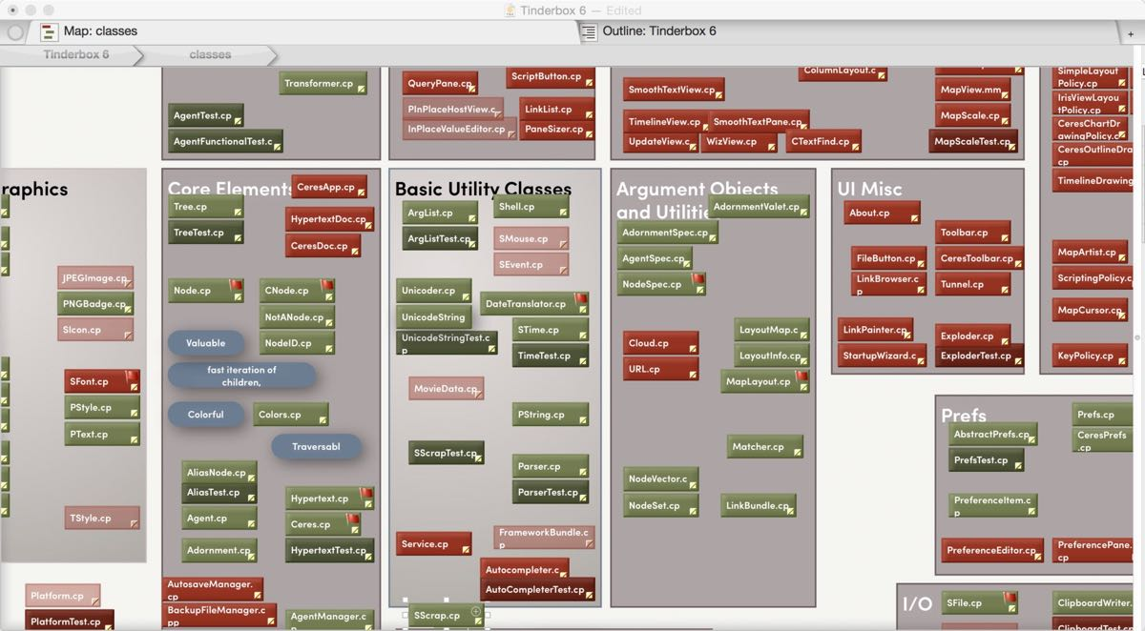
Tinderbox
http://www.eastgate.com/Tinderbox/
Notes:
A personal content management assistant

Slide 9

Sculptural Hypertext and Hypertext Patterns
https://www.flickr.com/photos/swolfe/5800097543/

Slide 10
Sculptural Hypertext
Considerations for the writing of hypertext:
Conventional (calligraphic) hypertext adds links between nodes until the desired structure is achieved
Sculptural hypertext assumes that all nodes are linked to each other, and removes links until the desired structure is achieved

Slide 11
Card Shark
A Card Shark node (or card) contains:
  A brief, focused passage of text
  Optional constraints on the context in which the card may be read
Reading is like playing a solitaire card game
  Reader dealt a hand of seven random cards
  Chooses a card to play (i.e. node to read) based on card constraints
  Deals a replacement card, repeats
Social Shark: collaborative, competitive reading
  Readers take it in turns to play cards
  Points awarded to readers for the playing of particular cards
Bernstein, M. (2001) Card Shark and Thespis: exotic tools for hypertext narrative. Proceedings of the 12th ACM Conference on Hypertext and Hypermedia, pp 41-50.

Slide 12

Temporal Hypermedia
http://www.flickr.com/photos/rachelpasch/2405915548/

Slide 13
Time-Based Hypertext
Linking into temporal and continuous media (sound, animations, video)
  Providing hypertext jumps to other contexts
  Annotation of the current item playing
  Synchronization of multiple media
Issue: embed the links or point from outside?
  If embedded, what media format does this?
  If linking by reference, how to describe the place the link is?
Issue: quality of Service
  Will things happen when they should?

Slide 14
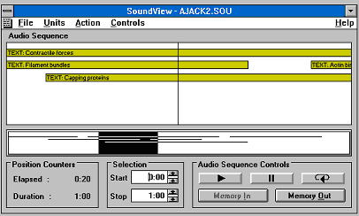
Microcosm Sound Viewer (1993)
Early innovative work on putting jump links into sound files
  Top window shows clickable links and bar is the “now point”
  Bottom window shows top window in context of whole file
  Links can be user activated or automatically invoked (decided by author)
  Link anchors described as start and finish times in seconds through file

Slide 15
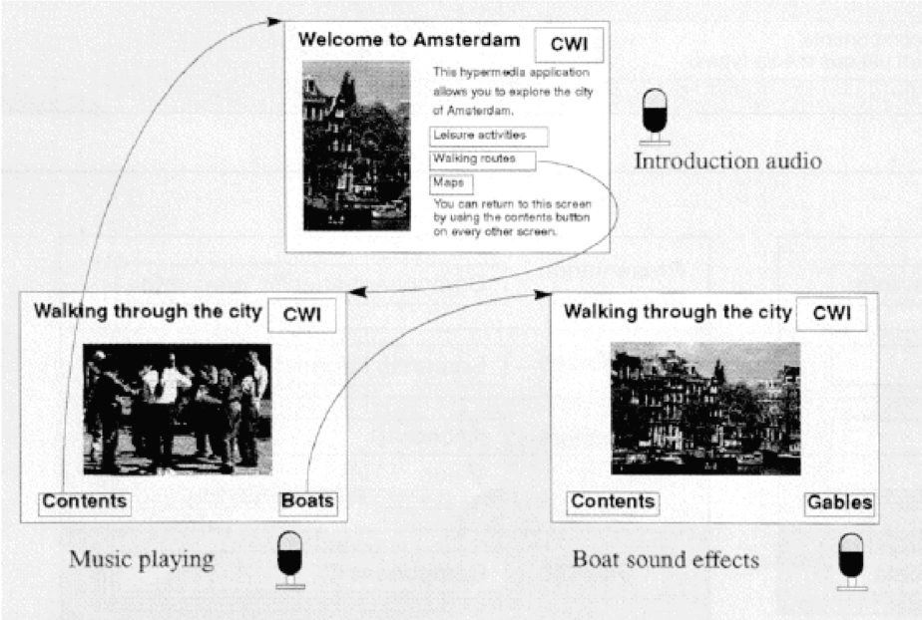
The Amsterdam Hypermedia Model (1994)
Concerned with provision of systems to author multimedia presentations and synchronise multiple data streams
  Parallel “channels”
  Offset links into temporal media
  Stationary hotspots in media
  Inspired SMIL
Hardman, L. et al (1994) The Amsterdam Hypermedia Model: Adding time and context to the Dexter model. Communications of the ACM, 37(2), pp. 50-62.
Notes:
Parallel channels: video, narration in different languages, captions in different languages

Slide 16
HyTime
Hypermedia/Time-based Structuring Language ISO/IEC 10744:1992 (and v2 in 1997)
  Added cross document links to SGML
  Contextual links (c.f. HTML a element) and independent links (c.f. XLink extended links)
Multiple ways of addressing locations:
  Named elements (c.f. name/id attribute in HTML)
  Using document structure – treeloc and dataloc
  (c.f. XPath/XPointer expressions)
  Using queries (HyQ query language, later supplanted by DSSSL – c.f. Xquery/XPath)
  Indirectly via a series of steps – nameloc
HyTime link mechanism inspired that of XLink/XPointer
Goldfarb, C.F. (1991) HyTime: A Standard for Structured Hypermedia Interchange. IEEE Computer, 24(8), pp. 81-84.

Slide 17
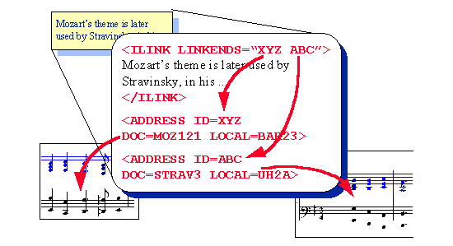
HyTime ilink example

Slide 18
Synchronized Multimedia Integration Language (SMIL)
XML format for multimedia on the Web
  Timing, screen layout, interaction of media elements
  Nested parallel and sequence elements
  Switch element for alternative media (e.g. for different users or different displays)
  Uses CSS, XPointer and XLink
Now largely supplanted by HTML5 (but does things that HTML5 cannot)
Still used for animating SVG
Bulterman, D. et al (2008) Synchronized Multimedia Integration Language (SMIL 3.0). W3C Recommendation.
Available at: https://www.w3.org/TR/SMIL3/

Slide 19

SMIL example
media to
be played
in parallel
alternative audio
based on language
<?xml version="1.0"?>
<smil xmlns="http://www.w3.org/ns/SMIL">
<body>
<par endsync="first">
<switch>
<audio src="greeting-en.mp3" type="audio/mpeg" systemLanguage="en"/>
<audio src="greeting-de.mp3" type="audio/mpeg" systemLanguage="de"/>
</switch>
<seq>
<switch>
<text src="greeting-en.txt" dur="2s" systemLanguage="en"/>
<text src="greeting-de.txt" dur="2s" systemLanguage="de"/>
</switch>
<video src="titles.mp4" type="video/mp4"/>
</seq>
</par>
</body>
</smil>
media to
be played
sequentially

Slide 20
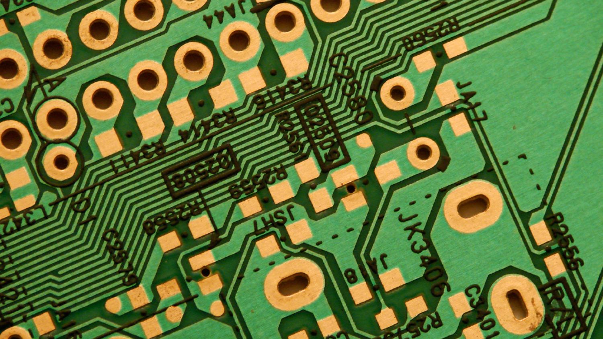
Computational Hypermedia
http://www.flickr.com/photos/jamie_hladky/2126628775/

Slide 21
Seven Issues
Issue 4: Computation in (over) hypermedia networks
  The idea is to provide APIs to allow cards to be orchestrated and scripts to be executed when certain events occur
Interactivity
Adaptivity
Generated nodes and links
Halasz, F. (1989) Reflections on Notecards: seven issues for the next generation of hypermedia systems, Communications of the ACM, 31(7), pp. 836-852.

Slide 22
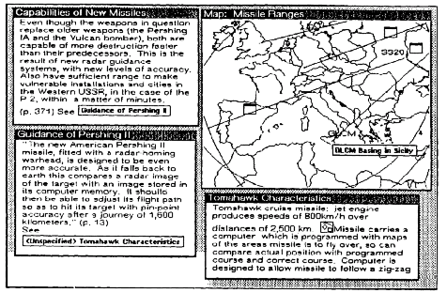
NoteCards
Script cards that orchestrate the display of other cards
  Used to determine what material to show next
  Scripting engine separate from hypertext system
Halasz, F.G. et al (1986) NoteCards in a Nutshell. SIGCHI Bulletin, 18(4), pp.45-52.

Slide 23
Trellis
Petri Net-based hypertext
  Variant finite state automata
  Vertex types: places/transitions
  Places labelled with tokens
  Directed edges are either
  place->transition or transition->place
  Tokens follow edges from place to place through transitions
  Transition can only be activated if all predecessor places have tokens
Petri Nets as hypertext
  Places correspond to nodes
  Nodes with tokens are visible to reader
  Transitions correspond to (n-ary) links
Stotts, P.D. and Furuta, R. (1989) Petri-net-based hypertext: Document structure with browsing semantics. ACM Transactions on Information Systems, 7(1), pp. 3-29.

Slide 26
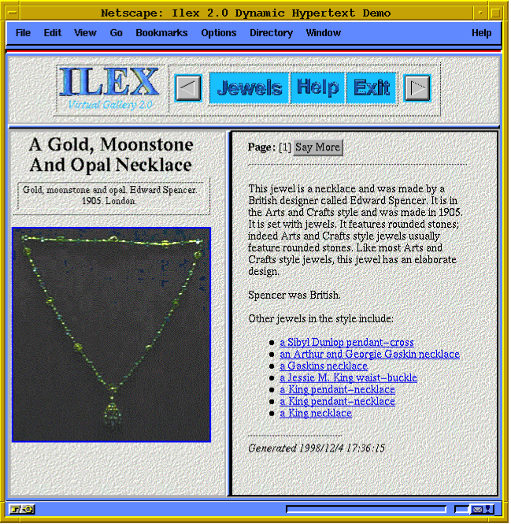
ILEX
Dynamic hypertext system that generates both nodes and links at run-time
  Text generation from structured knowledge
  Hypertext is history-aware
O’Donnell, M. et al (2001) ILEX: An Architecture for a dynamic hypertext generation system. Journal of Natural Language Engineering, 7(3), pp.225-250.

Slide 27
PageRank
Algorithm used by Google to rank search results
  Calculation performed over hypertext structure
  Pages ‘vote’ for each other by linking to each other
  Votes by highly-ranked pages are valued more highly than those by low-ranked pages
100
53
50
3
9
50
50
3
3
Brin, S. and Page, L. (1998). The anatomy of a large-scale hypertextual Web search engine. Computer Networks and ISDN Systems, 30,
pp. 107–117.

Slide 28
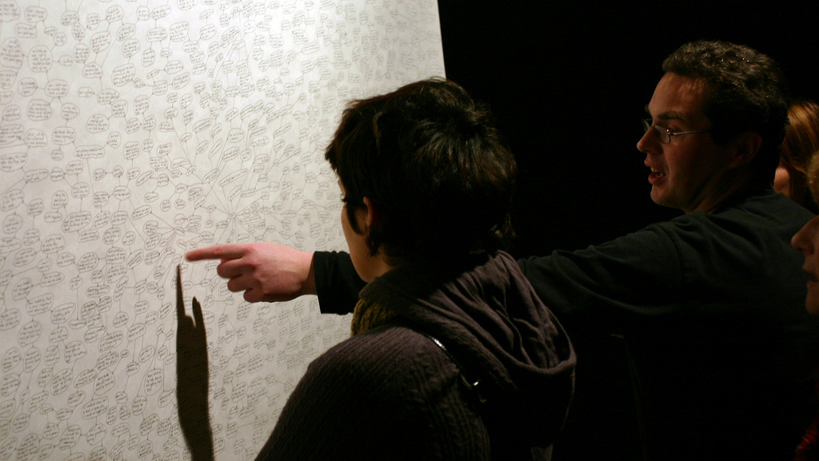
Conceptual Hypermedia
http://www.flickr.com/photos/binary_koala/2069692015/

Slide 29
Origins: typed links
Early hypertext systems allowed links to be “typed”
  Links have meaning (semantics)
  We understand what we get by following a link
We may be able to infer further information
  If the semantics are well defined, then maybe a machine can infer information too
Conklin, J. and Begeman, M.L. (1988) gIBIS: A Hypertext Tool for Exploratory Policy Discussion. Proceedings of the 1988 ACM Conference on Computer-Supported Cooperative Work, pp. 140-152.
Notes:
Randy Trigg’s PhD
Rhetorical moves from IBIS

Slide 30
What is Conceptual Hypermedia?
Conceptual Hypermedia = Hypermedia + Ontologies
“An ontology is a specification of a conceptualisation”
  Specification: A formal description
  Conceptualisation: The objects, concepts, and other entities that are assumed to exist in some area of interest and the relationships that hold among them
Ontologies as engineered artifacts:
  A specific vocabulary used to describe a certain reality, plus
  A set of explicit assumptions regarding the intended meaning of the vocabulary
Gruber, T.R. (1993) A translation approach to portable ontologies. Knowledge Acquisition, 5(2), pp. 199-220.

Slide 31
What is Conceptual Hypermedia?
Hypertext is the study of what can be said using computer media, databases and links
  Computer-mediated extensions to familiar textual communication
Things that exist have complex relationships with each other
  Complex structures are required for expressing and exploring these relationships
  Ontologies formalise these complex structures
Conceptual Hypermedia is the kind of hypertext whose structure and links are derived from the relationships between objects in the real world
  Hypertext with an underlying ontological model

Slide 32
Conceptual Open Hypermedia
Hypermedia links can be viewed as navigable ontology relationships
Ontology used to improve linking
  Concepts used to disambiguate word sense of candidate link endpoints
  Links derived from ontology relations
Carr, L. et al (2001) Conceptual Linking: Ontology-based Open Hypermedia. Proceedings of the 10th International Conference on World Wide Web, pp. 334-342.

Slide 33
ontology
creator
101 Widgets
graduated from
title
name
employee of
name
John Smith
name
Acme, Inc.
homepage
Medfield College
homepage
uri
homepage
Links for John Smith
Homepage
ACME, Inc.
Medfield College
Publications
101 Widgets
hypertext

Slide 34
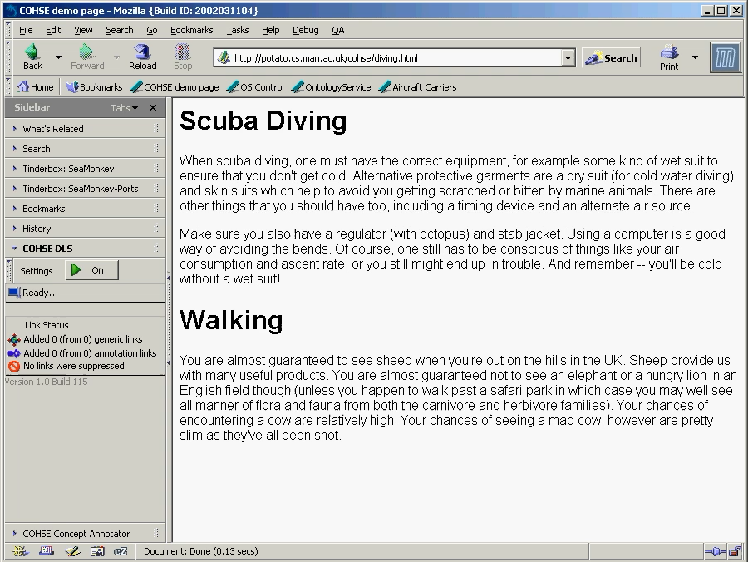

Slide 35
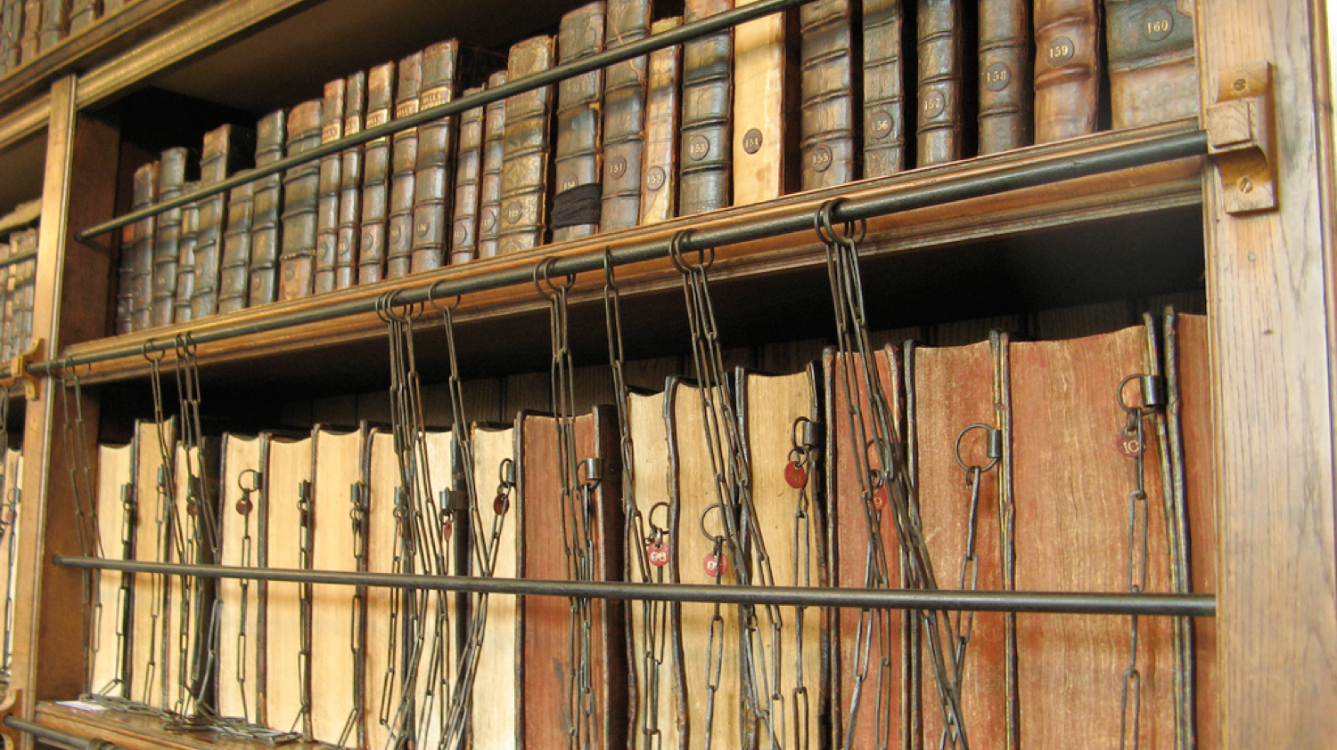
Pervasive Hypermedia
http://www.flickr.com/photos/traceyp3031/2892438542/
Notes:
Physical hypermedia

Slide 36
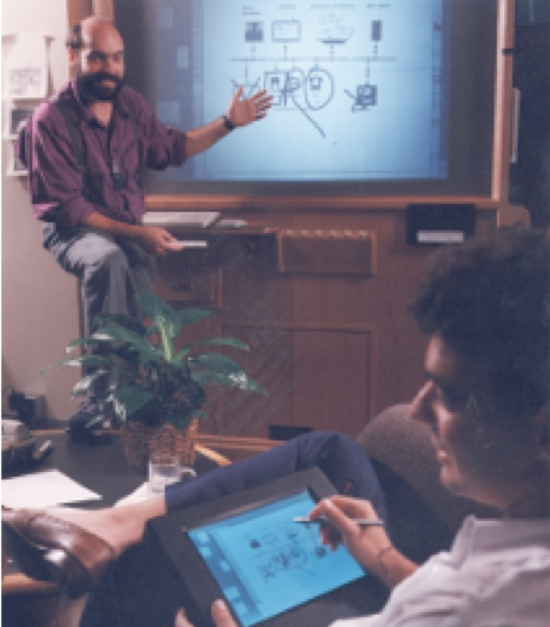
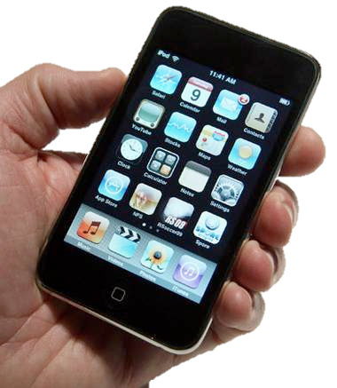
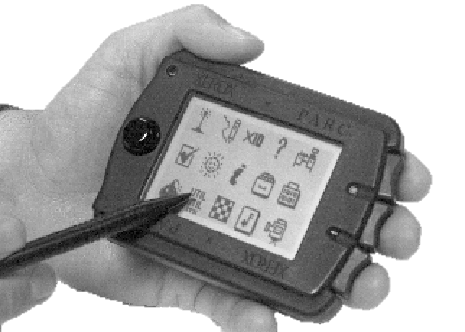
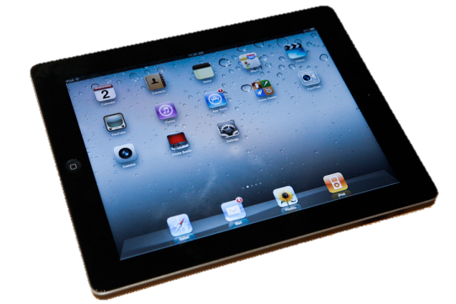
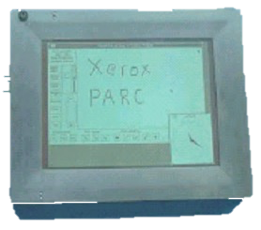
Pervasive Computing
HCI vision in which computers are integrated into everyday activities
  “Machines that fit the human environment”
  Computers in everything
What about links in everything?
Weiser, M. (1991) The Computer for the 21st Century. Scientific American, September pp. 94-104

Slide 37
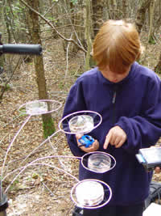
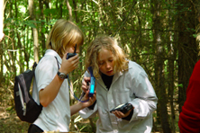
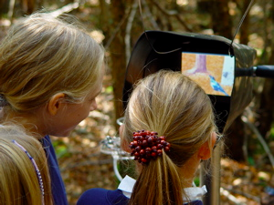
Interactive Spaces
Embedding interactive media in physical environments
Halloran, J. et al (2006) The Literacy Fieldtrip: Using Ubicomp to Support Children’s Creative Writing. Proceedings of the 5th International Conference for Interaction Design and Children, pp. 17-24.
Notes:
Chawton House project

Slide 38
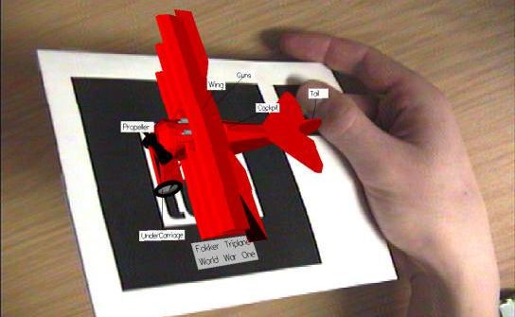
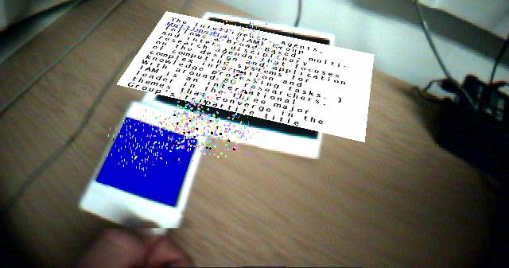
Augmented Reality
Overlaying computer-generated imagery on the real world
  Annotate live video with links
Fifteen years ago, a research curiosity…
Sinclair, P. et al (2003) Augmented reality as an interface to adaptive hypermedia systems. New Review of Hypermedia and Multimedia, 9(1), pp. 117-136.
Notes:
Salt ‘n’ Pepper – Patrick Sinclair

Slide 39
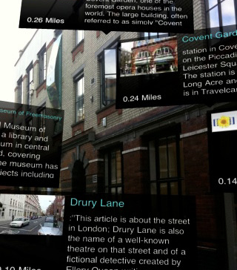

Augmented Reality
…today, a commonplace reality
  Smartphones with cameras and location/position sensors
  Conventions for embedding links in/on physical objects
Notes:
QR-codes

Slide 40
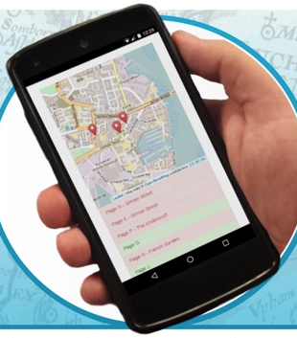
StoryPlaces
Sculptural hypertext system for location-based narratives
Card constraints based on:
  Location
  Environmental factors
  (time, weather, etc)
Try it out - http://storyplaces.soton.ac.uk
Hargood, C., Hunt, V., Weal, M. and Millard, D. (2016) Patterns of sculptural hypertext in location based narratives. Proceedings of the 27th ACM Conference on Hypertext and Social Media.

Slide 41

Adaptive Hypermedia
http://www.flickr.com/photos/worldofoddy/102313059/

Slide 42
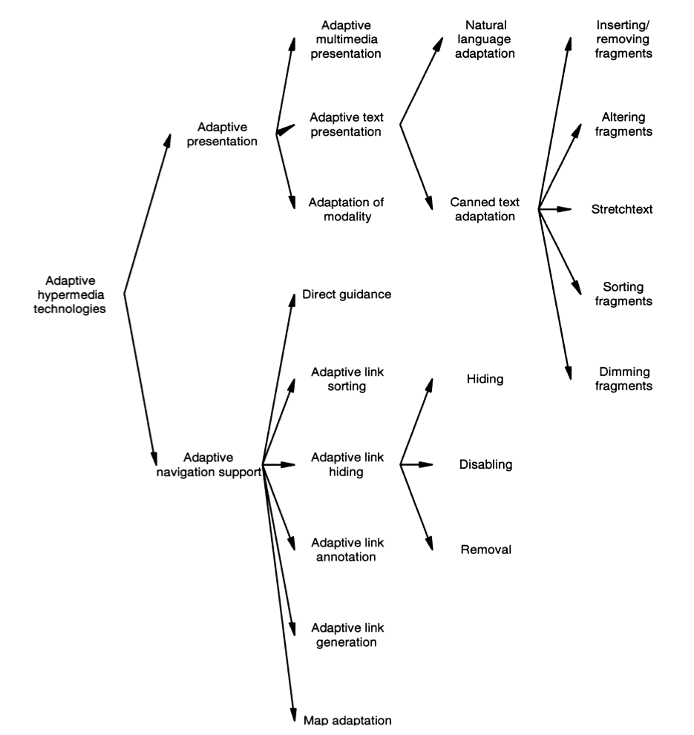
Adaptive Hypermedia
Hypertext systems which adapt:
  Links
  Nodes (content)
  Presentation of links or nodes
Adaptation based on some user model (static or dynamic)
Brusilovsky, P. (2001) Adaptive Hypermedia. User Modeling and User-Adapted Interaction, 11, pp.87-100.
Notes:
Again, back to programmed learning

Slide 43
Intelligent Tutoring Systems
Adaptive hypermedia often based on ideas of “intelligent tutoring systems”
(see also: programmed instruction)
Limited uptake due to difficulty/cost of authoring (for both AH and ITS)
Notes:
Tutor

Slide 44
Adaptive Navigation
Direct guidance (where should the reader go next?)
Link sorting (in order of value to the reader)
Link hiding (don’t show links that aren’t relevant to the reader)
Link annotation (tell the reader about the links)
Link generation (make new links for the reader)

Slide 45
Adaptive Presentation
Stretchtext (text can be expanded or summarised using predetermined fragments)
Natural language adaptation (generated text)
Adaptive modality (video to audio, audio to text, etc)

Slide 46
Summary
Hypertext links aren’t necessarily explicit, static and textual
  They may be derived from underlying relationships: spatial, conceptual, temporal
  They may be computed on the fly
  They may change depending on who is looking at them, or what they’re trying to do
  They may point to physical objects, or be embedded in physical contexts

Slide 47
Next Lecture: Telling Tales

