Slide 2
Documenting REST
COMP3220 Web Infrastructure
Dr Nicholas Gibbins – nmg@ecs.soton.ac.uk

Slide 3
Documentation
What are the key aspects of a RESTful interface?
How should we document each of these?
What does a developer need to know to use our service?

Slide 4
Identification

Slide 5
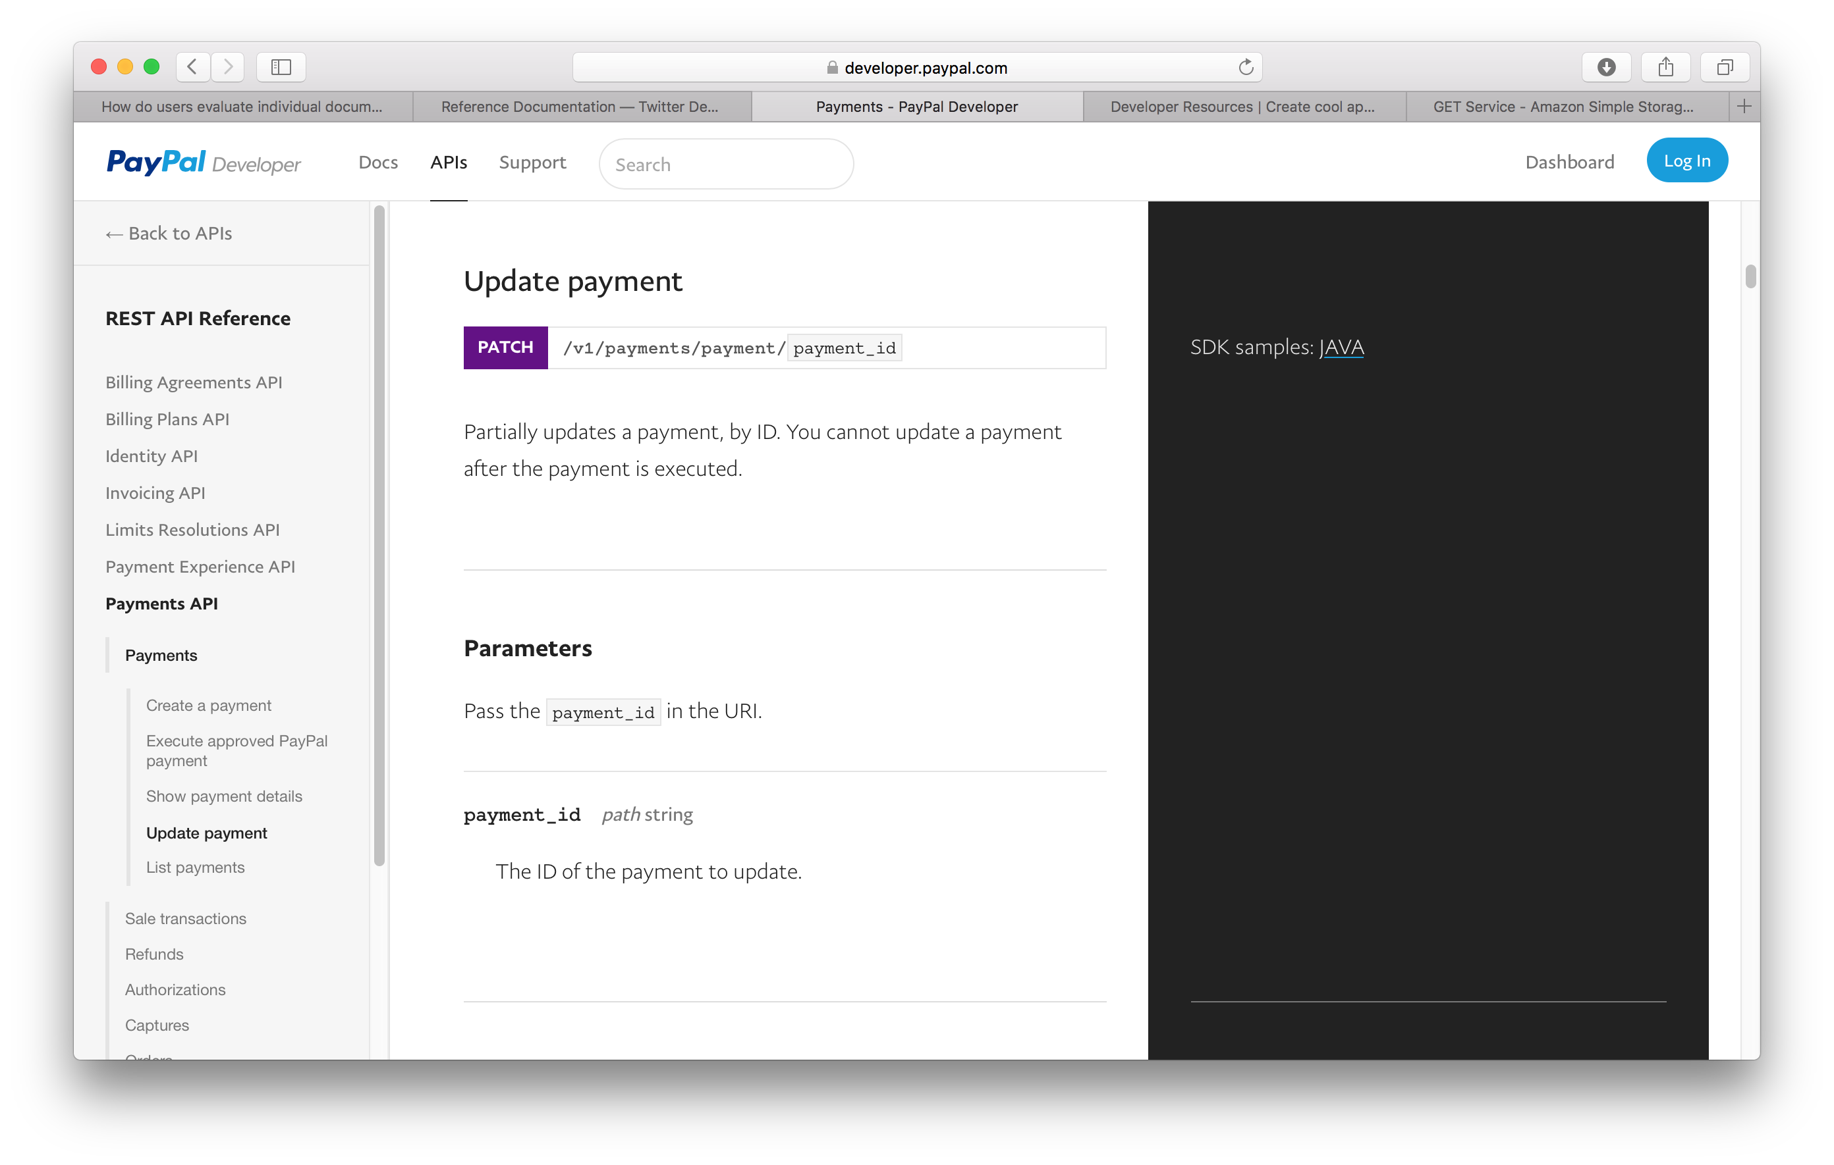
URIs

Slide 6
URI Parameters

Slide 7
Interaction

Slide 8
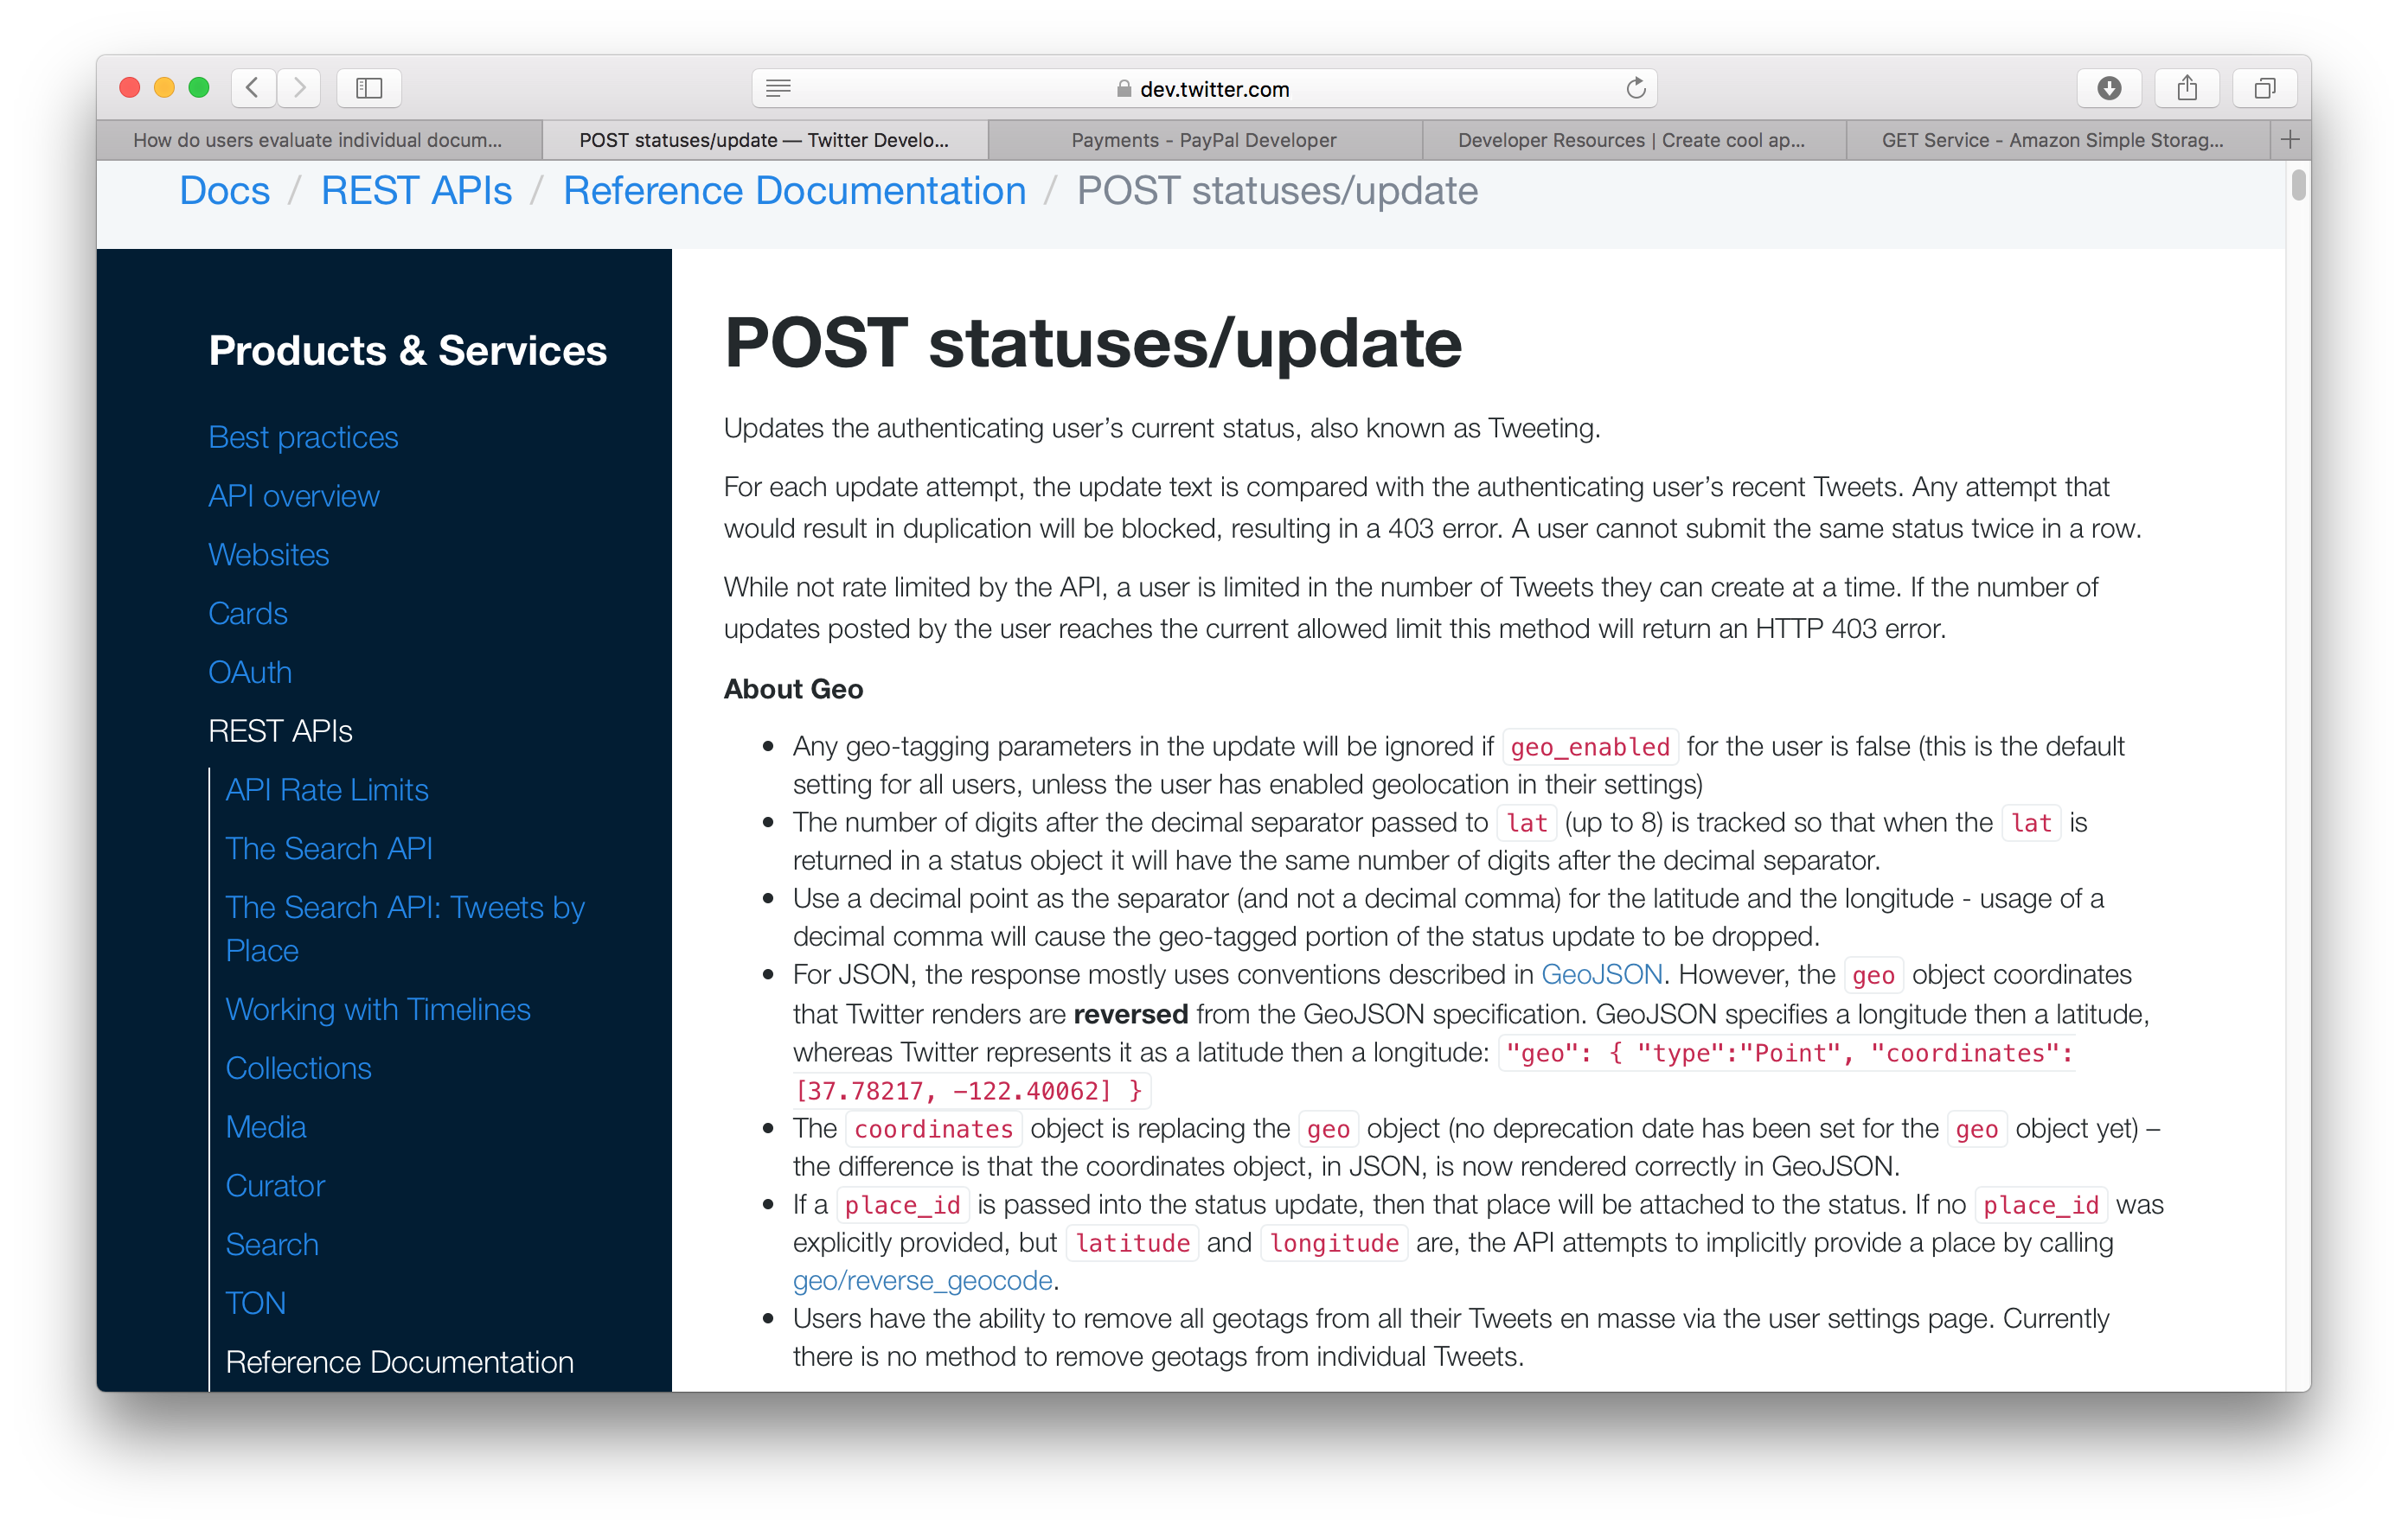
Methods

Slide 9
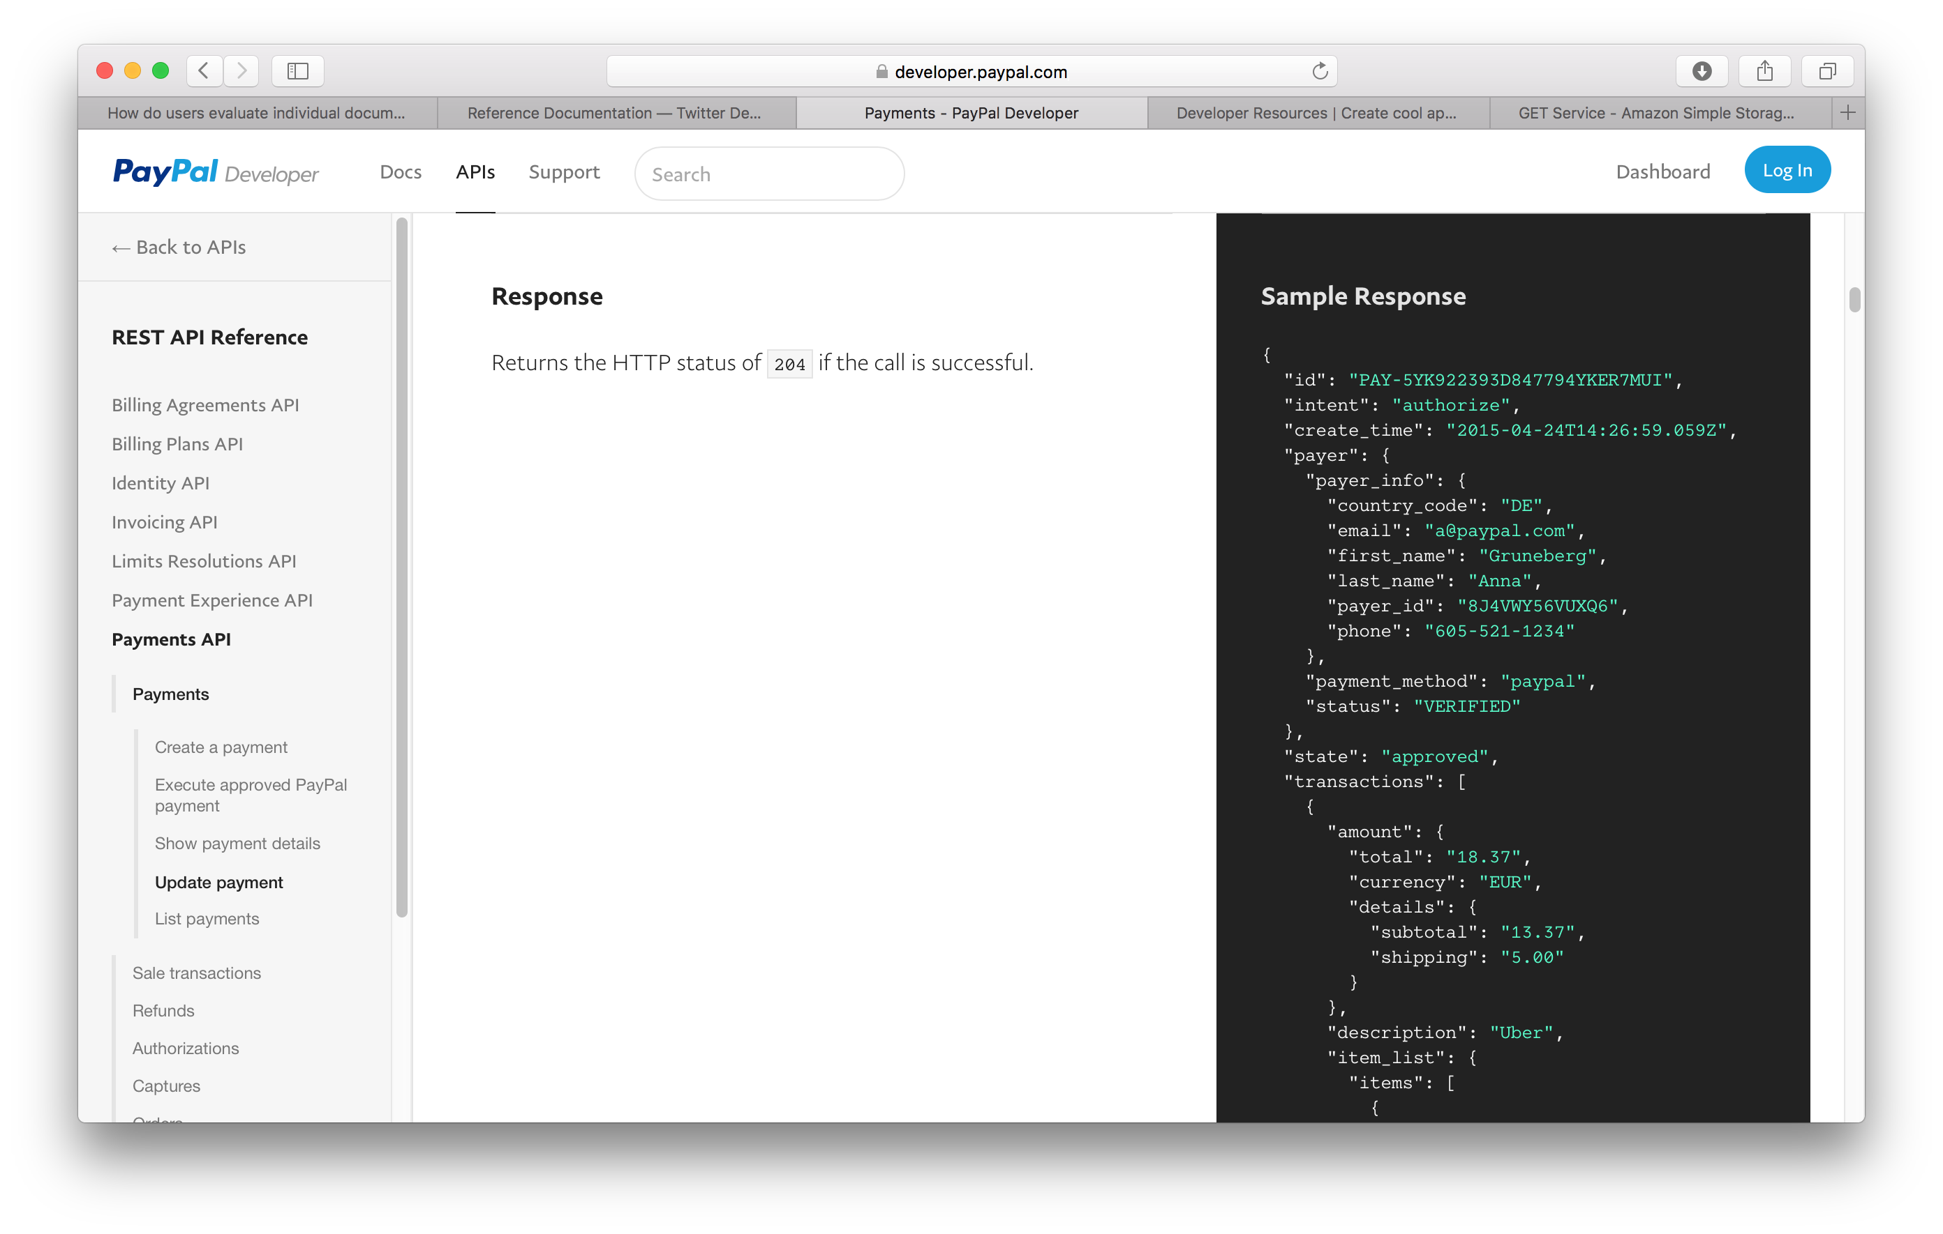
Status Codes

Slide 10
Headers
Mostly for Authorisation
OAuth 2.0, etc
Consider how the various Accept-*: headers might be used.

Slide 11
Representation

Slide 12
Representation

Slide 13
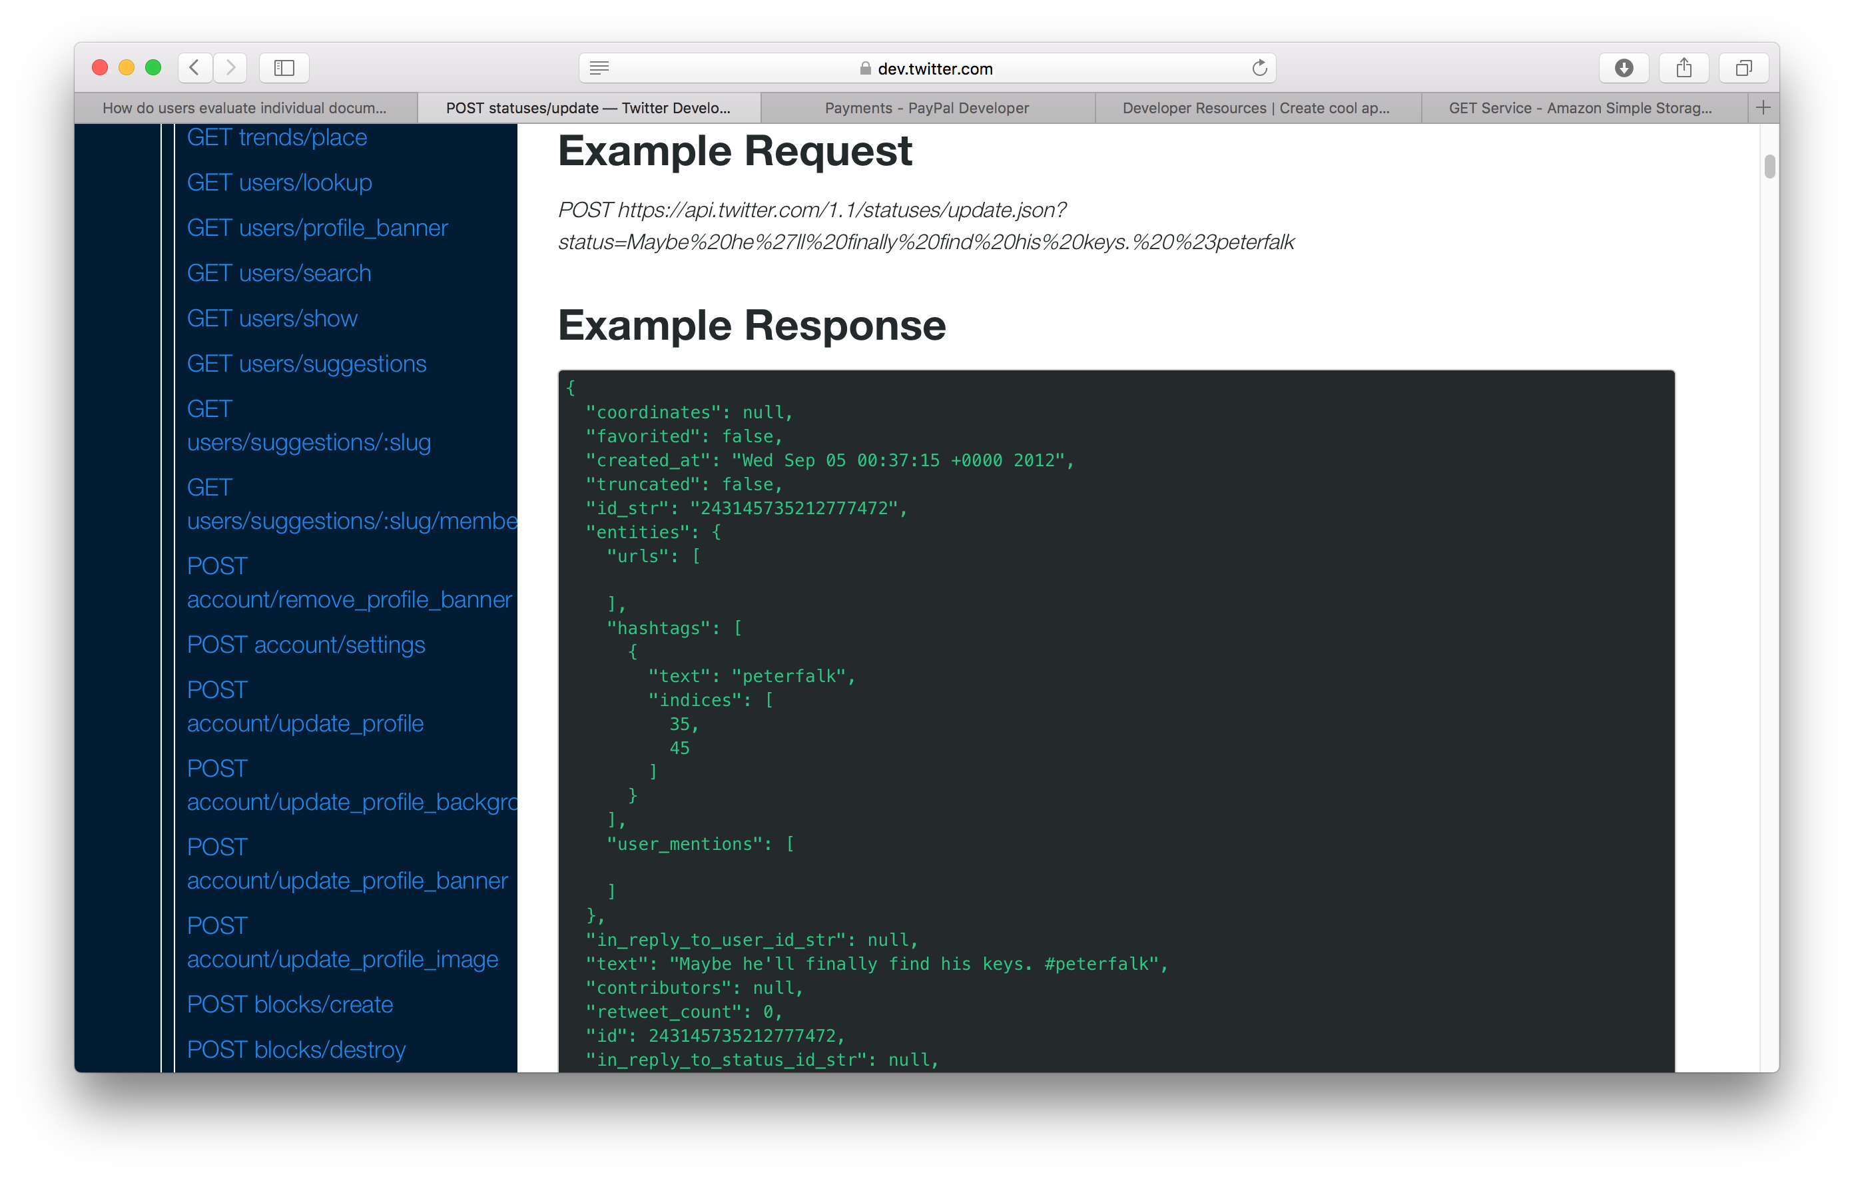
Examples

Slide 14
HATEOAS

Slide 15
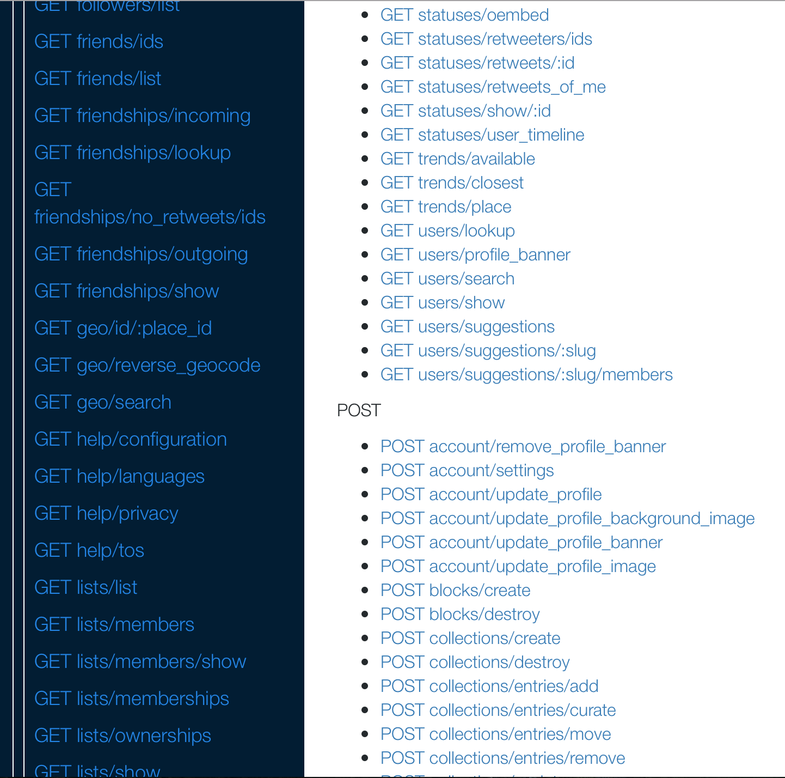
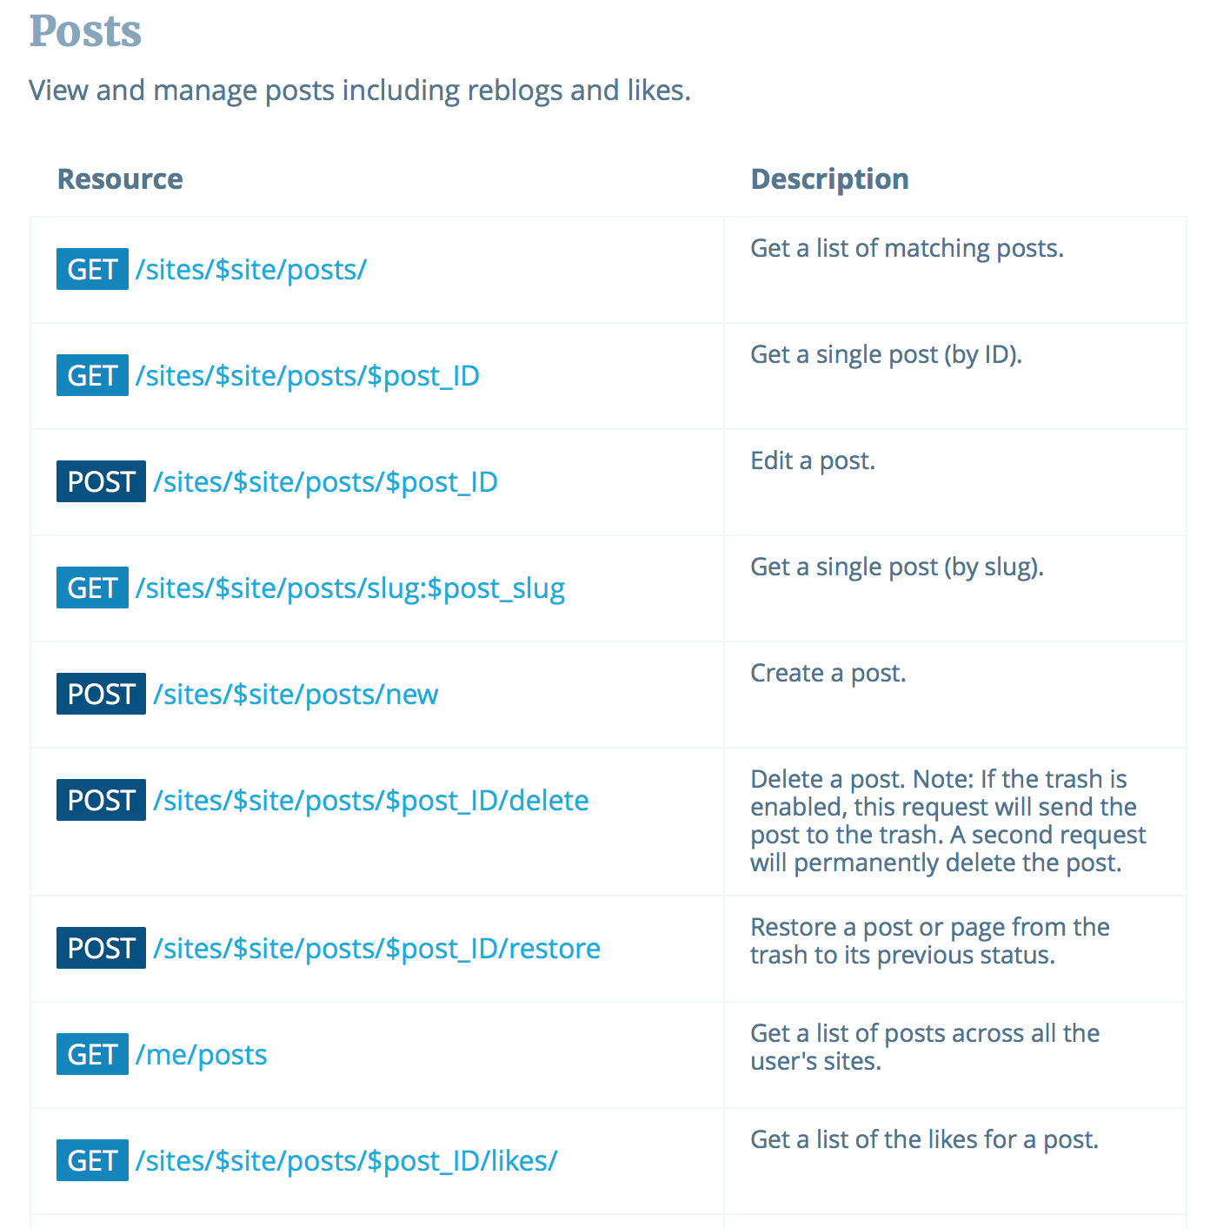
Listings

Slide 16
OpenAPI

Slide 17
OpenAPI
Originated with Swagger tool for designing RESTful APIs
Represents API descriptions in JSON or YAML (Yet Another Markup Language)
We’ll concentrate on the YAML serialization

Slide 18
OpenAPI metadata
OpenAPI description starts with:
Version number of OpenAPI in use
Simple metadata about the service in the info: block
openapi: 3.0.0 info: version: 1.0.0 title: Orinoco API description: The API for the Orinoco online bookseller

Slide 19
Servers
API endpoints are defined relative to a base URI
Defined in OpenAPI using the servers: block
servers: - url: https://orinoco.com description: Live server _ url: https://test.orinoco.com description: Test server (uses dummy data)

Slide 20
Components
components: block used to define repeatedly-used information
Most often used to define format of message bodies
components: schemas: order: type: object properties: items: type: array item: type: string status: type: string

Slide 21
Paths
Lists available paths on the server
e.g. https://orinoco.com/order/1234
For each path, lists:
The methods which can be used on that path
The content of any request body which should accompany the method (for PUT, POST)
The responses which may be received from the method (including response bodies)

Slide 22
Path Example
paths: /order{order_id}: get: description: Obtain information about an order parameters: - name: order_id in: path required: true schema: type: string

Slide 23
Path Example
paths: /order{order_id}: get: ... responses: ‘200’: description: Successfully returned an order content: application/xml: schema: $ref: ‘#/components/schemas/order’

Slide 24
Summary
Documentation should cover all the bases of the web architecture
Identification – parameterised URIs
Interaction – HTTP methods, status codes and headers
Representation – formats for request and response, with examples
Listings of all of the above

Slide 25
RESTful API Examples
Twitter
https://developer.twitter.com/en/docs/api-reference-index
Paypal
https://developer.paypal.com/docs/api/payments/
Imgur
https://apidocs.imgur.com
Wordpress
https://developer.wordpress.org/rest-api/

Slide 26
Tools and Further Reading
Swagger API development tool
https://swagger.io/
Overview of OpenAPI
https://swagger.io/docs/specification/about/
OpenAPI Specification
https://github.com/OAI/OpenAPI-Specification

Slide 27
Next Lecture: Trailblazers

