Slide 2
Content Security Policy
COMP3220 Web Infrastructure
Dr Nicholas Gibbins – nmg@ecs.soton.ac.uk

Slide 3
Cross-Site Scripting (XSS)
The Same-Origin Policy doesn't protect against all cross-site exploits
XSS attacks are a form of code injection
User input used to insert XSS vector (malicious client code) into a web page
via a GET method form that encodes user input into a URI (non-persistent)
via a form that changes the state of a resource (persistent)
Browser trusts malicious code and executes it with user credentials

Slide 4
Content Security Policy
Server sends a header that says:
what a resource is allowed to access
what should be done if the policy is violated
Content-Security-Policy: contains:
Fetch directives, that control the places from which resources can be loaded
Document directives, that control the properties of a document or worker environment
Navigation directives, that control where a user can navigate to
Reporting directives, that controls where violations are reported to

Slide 5
Fetch directives
font-src
Valid sources for fonts loaded with @font-face
frame-src
Valid sources for frames and iframes
img-src
Valid sources for images
media-src
Valid sources for media loaded with <audio>, <video> and <track>
object-src
Valid sources for resources loaded with <object>, <embed> and <applet>
script-src
Valid sources for scripts loaded with <script>
style-src
Valid sources for stylesheets
worker-src
Valid sources for Worker, ServiceWorker
default-src
Fallback rule – default for fetch directive

Slide 6
Document directives
base-uri
Valid URIs for <base> elements
plugin-types
Valid plugins which can be embedded into a document i.e. plugin-types application/x-shockwave-flash application/x-java-applet
block-all-mixed-content
Prevent loading any resources using HTTP when the page is loaded with HTTPS
(defined in West, M. (2016))

Slide 7
Navigation directives
form-action
URIs which can be used as the target of form submissions
frame-ancestors
Valid parents which may embed a page using <frame> or <iframe>
navigate-to
Valid URIs to which a document can initiate navigation i.e. <a> , window.location, etc

Slide 8
Reporting directives
report-uri (from CSP Level 2)
Instructs the user to report violation attempts Sent as a JSON document via a POST request
report-to (from CSP Level 3)
Raises a SecurityPolicyViolationEvent within the page
report-uri has been deprecated in favour of report-to
report-to is experimental (relies on Reporting API)
Web standards are unnecessarily hard!

Slide 10
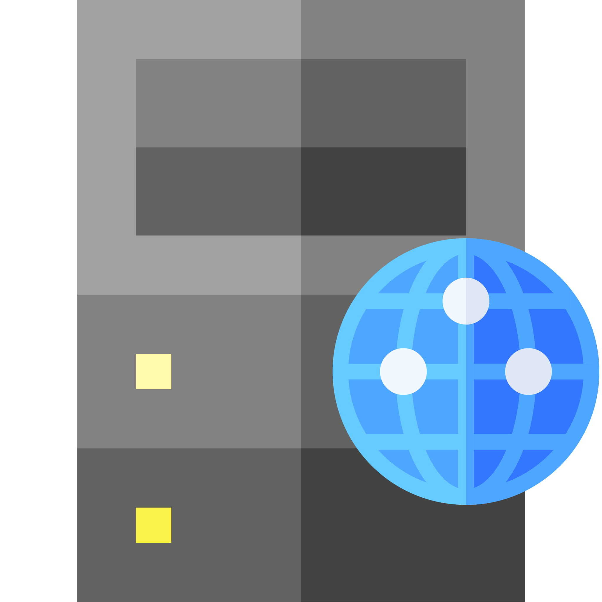
CSP example
GET /page.html HTTP/1.1
Host: example.org
Referer: http://example.org/
HTTP/1.1 200 OK
Content-Type: text/html Content-Security-Policy: default-src 'self'; img-src image.example.org; media-src video.example.org audio.example.org; script-src js.example.org; report-uri http://example.org/csp-report/

Slide 11
CSP violation report
{ "csp-report": { "document-uri": "http://example.org/page.html", "referrer": "http://example.org/", "original-policy": "default-src 'self'; img-src image.example.org; media-src video.example.org audio.example.org; script-src js.example.org; report-uri http://example.org/csp-report/" "violated-directive": "script-src js.example.org", "blocked-uri": "http://malware4u.com/nasty.js", } }

Slide 12
Further reading
West, M. et al (2015) Content Security Policy Level 2. W3C Recommendation.
https://www.w3.org/TR/CSP2
West, M. et al (2018) Content Security Policy Level 3. W3C Working Draft.
https://www.w3.org/TR/CSP3/
West, M. (2016) Mixed Content. W3C Candidate Recommendation.
https://www.w3.org/TR/mixed-content/
Creager, D. et al (2018) Reporting API. W3C Working Draft.
https://www.w3.org/TR/reporting-1/
Creager, D. et al (2020) Reporting API. Editor's Draft.
https://w3c.github.io/reporting/

Slide 13
Next Lecture: Memento

