Slide 2
Cross-Origin Resource Sharing
COMP3220 Web Infrastructure
Dr Nicholas Gibbins – nmg@ecs.soton.ac.uk

Slide 3
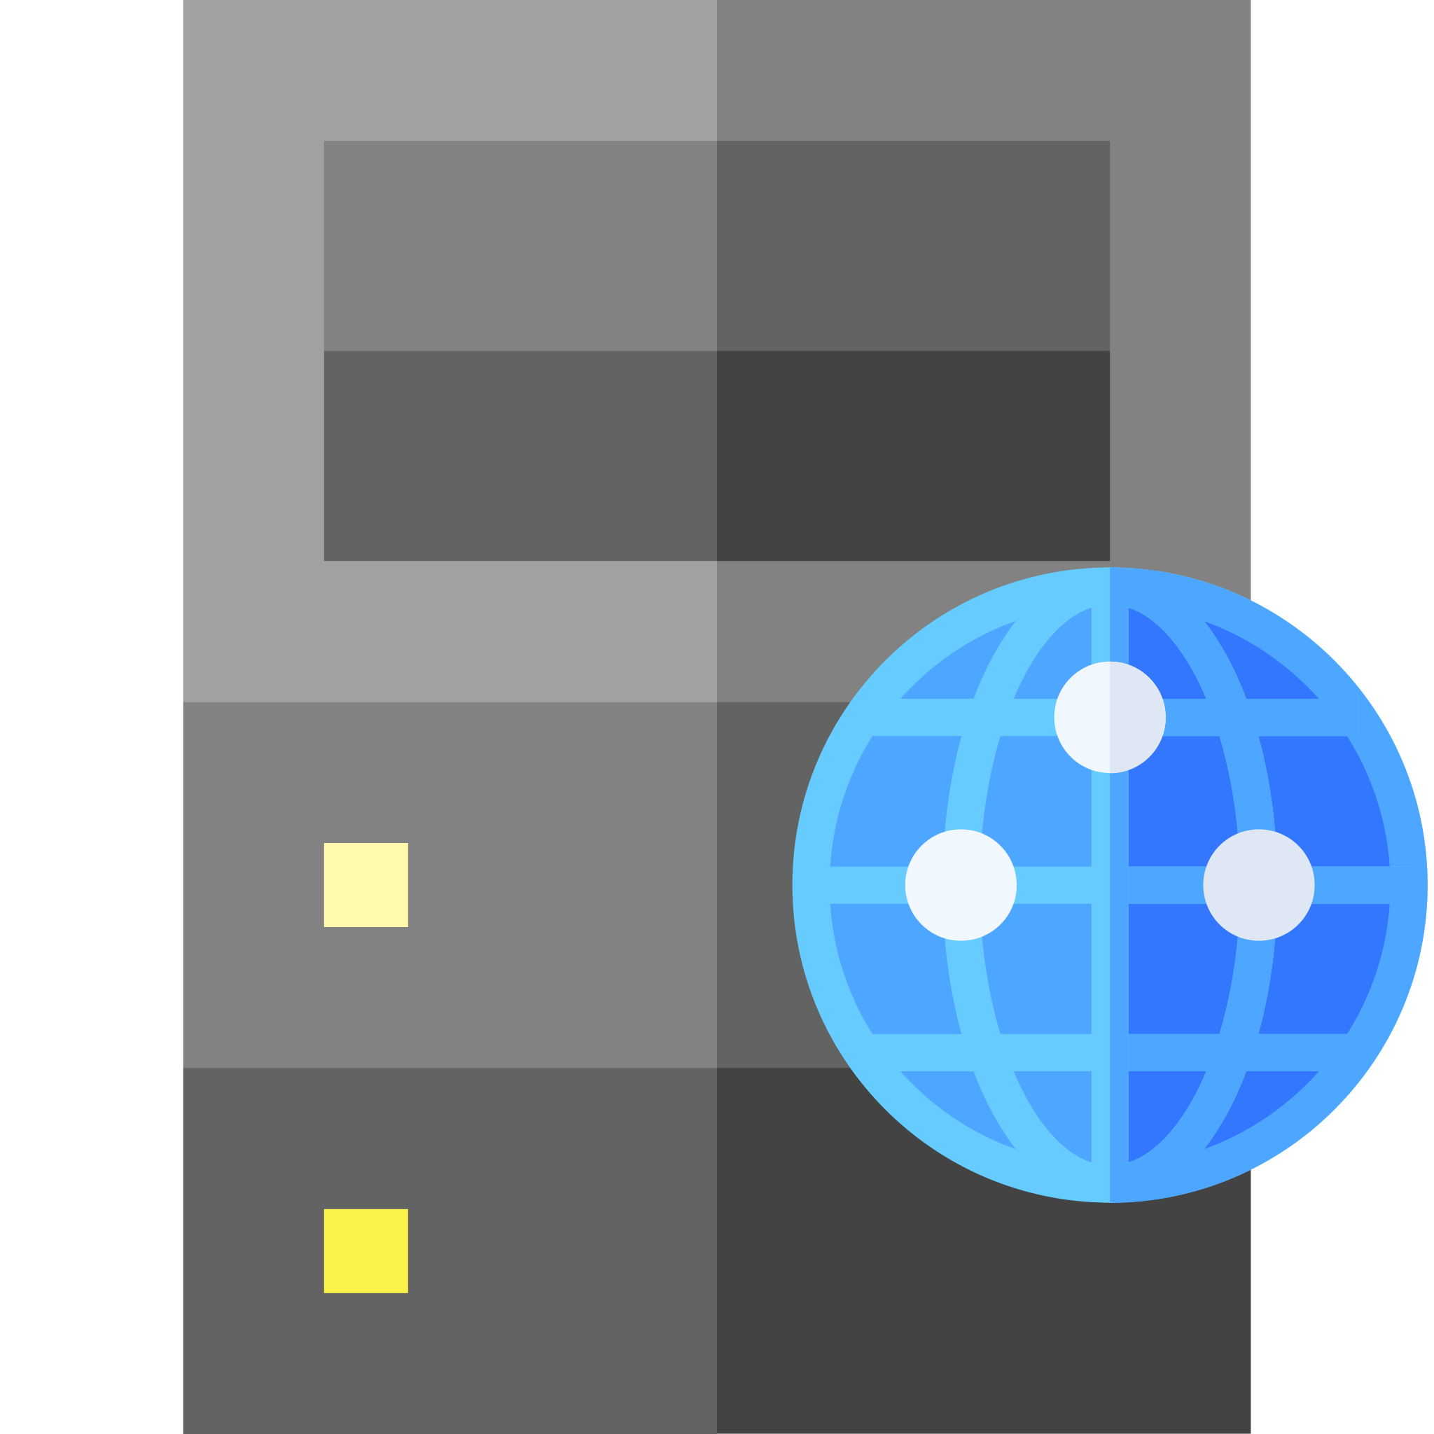
Cross-Site Request Forgery
If user agents allow one origin to talk to a different origin, there may be security issues
User agent will send cookies if available and applicable
Privilege escalation attack – confused deputy
GET
.js
dodgysite.org
XMLHttpRequest
trustedsite.com

Slide 4
Same-Origin Policy
By default, browsers restrict how a resource from one origin interacts with resources from other origins
GET
.js
dodgysite.org
Fetch/XMLHttpRequest
trustedsite.com
Barth, A. (2011) The Web Origin Concept. RFC6454. Available online at: https://tools.ietf.org/html/rfc6454

Slide 5
Same-Origin Policy
Two resources have the same origin if:
Their URIs use the same protocol (i.e. no mixing of http and https)
Their URIs have the same host
Their URIs have the same port
(path is ignored for the purposes of determining origin)

Slide 6
Same-Origin Policy
All the same origin
All different origins
http://example.org/
http://example.org:80/
http://example.org/foo
http://example.org/
https://example.org/
http://example.org:8080/
http://www.example.org/
http://example.com/
https://example.org:80/

Slide 7
Same-Origin Policy
By default, the SOP blocks cross-origin reads by the browser
Exception: embedded resources:
Media (img/audio/video)
external stylesheets (<link rel="stylesheet" href="..."/>)
scripts (<script src="..."></script>)
@font-face (some variability between browsers)
iframe
Cross-origin POSTS that result from form submission are allowed

Slide 8
Cross-Origin Resource Sharing
Mechanism for selectively relaxing the Same-Origin Policy
At a protocol level:
Adds new headers that let servers indicate which origins may make requests
Restricts the headers which may be sent in requests (i.e. avoiding taint)
Restricts the headers which may be received in responses
At an API level:
CORS requests sent via fetch() API
Client-side enforcement
Disallowed request may still result in a message being sent by the browser
Result of a disallowed request is not sent to the script by the browser
Reason for CORS error written to browser console, but not available to script

Slide 9
CORS requests
Simple requests satisfy all of the following
GET, HEAD or POST only
Accept:, Accept-Language:, Content-Type: or Content-Language: are the only headers set manually
Content-Type: is one of text/plain, application/x-www-form-urlencode or multipart/formdata only
All other requests trigger a CORS preflight

Slide 10
CORS flow
call fetch()
GET/HEAD?
yes
no
POST?
yes
standard Content-Type?
yes
custom headers?
no
execute fetch()
no
no
yes
send OPTIONS
access granted?
yes
no
error
preflight

Slide 11
CORS headers
Client header
Origin: - like Referer:, but excludes path (automatically added by browser)
Access-Control-Request-Method: – used in preflight (see later)
Access-Control-Request-Headers: – used in preflight (see later)
Server headers
Access-Control-Allow-Origin: – which origins are accepted? (* for any)
Access-Control-Allow-Methods: – which methods are accepted?
Access-Control-Allow-Headers: – which headers are accepted?
Access-Control-Max-Age: – for how long is a preflight check valid?
Access-Control-Allow-Credentials: – include cookies (etc) in request

Slide 12
Simple request example
GET /page.html
.js
site-a.org
fetch("http://site-b.com/bar.json")
site-b.org

Slide 13
Simple request example
// in a script in https://site-a.org/page.html fetch("https://site-b.org/bar.json", {mode: "cors", method: "GET"}) .then(response => { if (!response.ok) { throw new Error("HTTP status " + response.status); } return response.json(); }) .then(data => console.log(data)) .catch(error => { console.error("Error: " + error); });

Slide 14
Simple request example
fetch()
GET /bar.json HTTP/1.1
Host: site-b.org
Origin: https://site-a.org
HTTP/1.1 200 OK
Access-Control-Allow-Origin: https://site-a.org
Vary: origin
...
response

Slide 15
Simple request example
fetch()
GET /bar.json HTTP/1.1
Host: site-b.org
Origin: https://site-a.org
HTTP/1.1 200 OK
Access-Control-Allow-Origin: *
Vary: origin
...
response

Slide 16
Simple request example
fetch()
GET /bar.json HTTP/1.1
Host: site-b.org
Origin: https://site-c.org
HTTP/1.1 403 Forbidden
Access-Control-Allow-Origin: https://site-a.org/
Vary: origin
...
error
Reason: CORS header 'Access-Control-Allow-Origin' does not match 'https://site-c.org/'

Slide 17
Preflight requests
Unsafe requests (POST, PUT, DELETE ) require a preflight check
Client sends an OPTIONS message to determine if the intended request may be sent
Access-Control-Request-*: headers used to express intended request
Server responds with Access-Control-Allow-*: headers to express permissions

Slide 18
Preflight request example
// in a script in https://site-a.org/page.html fetch("https://site-b.org/qux.json", {mode: "cors", method: "PUT", body: <...>}) .then(response => { if (!response.ok) { throw new Error("HTTP status " + response.status); } return response.json(); }) .then(data => console.log(data)) .catch(error => { console.error("Error: " + error); });

Slide 19
OPTIONS /qux.json HTTP/1.1
Host: site-b.org
Origin: https://site-a.org
Access-Control-Request-Method: PUT
fetch()
HTTP/1.1 204 No Content Access-Control-Allow-Origin: https://site-a.org
Access-Control-Allow-Methods: GET, PUT, OPTIONS
PUT /qux.json HTTP/1.1
Host: site-b.org
Origin: https://site-a.org
response
HTTP/1.1 200 OK Access-Control-Allow-Origin: https://site-a.org Access-Control-Allow-Methods: GET, PUT, OPTIONS

Slide 20
OPTIONS /qux.json HTTP/1.1
Host: site-b.org
Origin: https://site-a.org
Access-Control-Request-Method: PUT
fetch()
HTTP/1.1 204 No Content Access-Control-Allow-Origin: https://site-a.org
Access-Control-Allow-Methods: GET, OPTIONS
error
Reason: Did not find method in CORS header 'Access-Control-Allow-Methods'

Slide 21
Further reading
Barth, A. (2011) The Web Origin Concept. RFC6454
https://tools.ietf.org/html/rfc6454
CORS for developers
https://w3c.github.io/webappsec-cors-for-developers/
HTML5 Fetch API
https://fetch.spec.whatwg.org/
Cross-Origin Resource Sharing at MDN
https://developer.mozilla.org/en-US/docs/Web/HTTP/CORS

Slide 22
Next Lecture: Content Security Policy

