Slide 2
Conditional Requests
COMP3220 Web Infrastructure
Dr Nicholas Gibbins – nmg@ecs.soton.ac.uk

Slide 3
The Lost Update problem
If two or more clients are modifying a resource at the same time, how do we avoid lost updates?
Client 1 GETs representation of resource X
Client 2 GETs representation of resource X
Client 1 PUTs new representation
Client 2 PUTs new representation
time
client 1
client 2

Slide 4
Conditional requests
Some HTTP methods are unsafe; they alter the state of resources
Lost updates occur only when carrying out unsafe methods
Avoid by checking to see whether the state of a resource (i.e. its representation) has changed between the GET and the PUT
Can also be used to avoid unnecessary safe methods
Comparison of representations in terms of validators that describe resource versions
Strong validation: checks whether representations are byte-for-byte identical
Weak validation: checks whether representations contain “the same content”

Slide 5
Entity tags
Entity tags are identifiers for resource versions (can be weak or strong)
Supplied by the server using the ETag: header:
ETag: "38be-5af769c088685" - a strong entity tag
ETag: W/"0023" - a weak entity tag (denoted by the “W/”)
ETag: * - an entity tag matching any resource
If-Match: <etag>, <etag>, ...
Only carry out the operation if the resource entity tag matches one of those listed
If no matches, return 412 Precondition Failed
If-None-Match: <etag>, <etag>, ...
Only carry out the operation if the resource entity tag does not match any of those listed
If matches, return 304 Not Modified for safe methods, or 412 Precondition Failed for unsafe methods

Slide 6
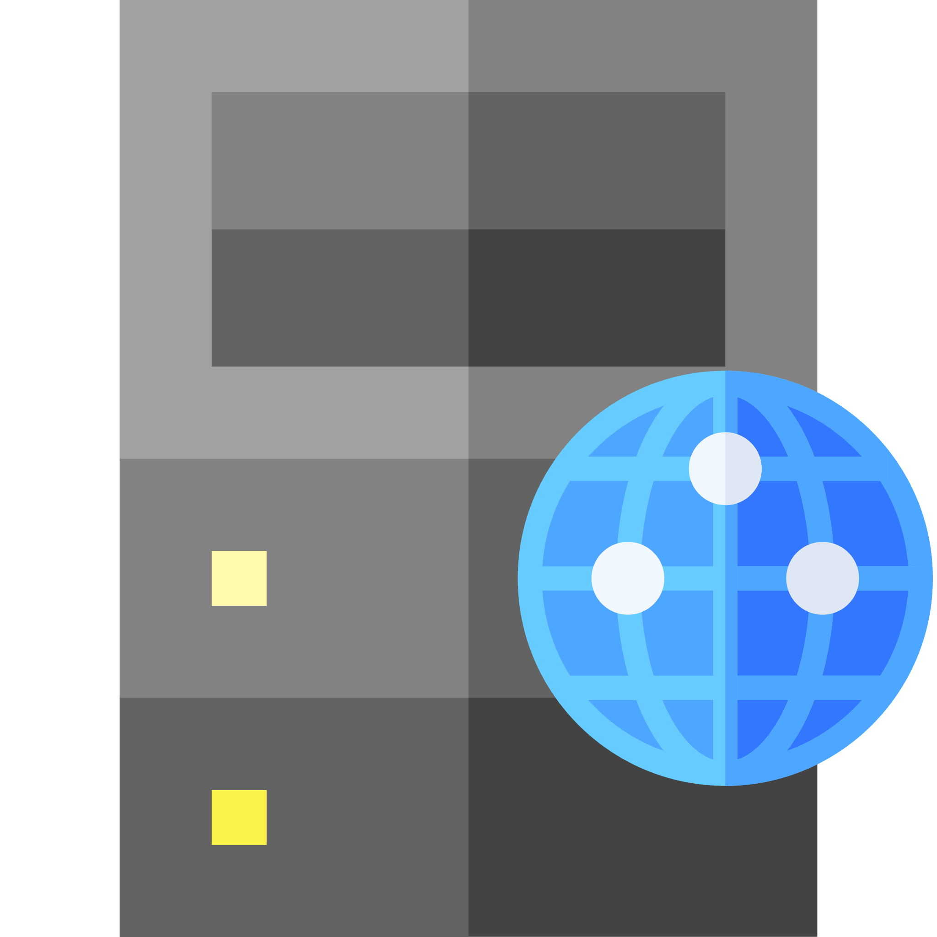
GET / HTTP/1.1
Host: www.example.com
HTTP/1.1 200 OK
Content-Type: text/html
ETag: "39d5-5943f8fdc2607" <representation>
PUT / HTTP/1.1
Host: www.example.com
If-Match: "39d5-5943f8fdc2607" <new representation>
HTTP/1.1 200 OK
Content-Type: text/html
ETag: "47cf-b922e4f191138"

Slide 7
GET / HTTP/1.1
Host: www.example.com
HTTP/1.1 200 OK
Content-Type: text/html
ETag: "39d5-5943f8fdc2607" <representation>
http://www.example.com/ is modified – new ETag is 4b4f-77a6c3ab117a2
PUT / HTTP/1.1
Host: www.example.com
If-Match: "39d5-5943f8fdc2607" <new representation>
HTTP/1.1 412 Precondition Failed
Content-Type: text/html
ETag: "4b4f-77a6c3ab117a2"

Slide 8
GET / HTTP/1.1
Host: www.example.com
If-None-Match: "4b4f-77a6c3ab117a2"
HTTP/1.1 304 Not Modified

Slide 9
Timestamps
Supplied by the server using the Last-Modified: header:
Last-Modified: Fri, 18 Sep 2020 17:25:23 GMT
If-Modified-Since: <dayname>, <day> <month> <year> <hour>:<min>:<sec> GMT
Only carry out the operation if the resource timestamp is after the given date
Return 304 Not Modified if before the given date
If-Unmodified-Since: <dayname>, <day> <month> <year> <hour>:<min>:<sec> GMT
Only carry out the operation if the resource timestamp is not after the given date
Return 412 Precondition Failed if after the given date

Slide 10
GET / HTTP/1.1
Host: www.example.com
HTTP/1.1 200 OK
Content-Type: text/html
Last-Modified: Mon, 14 Sep 2020 12:23:01 GMT <representation>
http://www.example.com/ is modified on Tue, 15 Sep 2020 14:34:07 GMT
PUT / HTTP/1.1
Host: www.example.com
If-Unmodified-Since: Mon, 14 Sep 2020 12:23:01 GMT <new representation>
HTTP/1.1 412 Precondition Failed
Content-Type: text/html
Last-Modified: Tue, 15 Sep 2020 14:34:07 GMT

Slide 11
GET / HTTP/1.1
Host: www.example.com
If-Modified-Since: Tue, 15 Sep 2020 14:34:07 GMT
HTTP/1.1 304 Not Modified

Slide 12
Further reading
Fielding, R. and Reschke, J. (2014) Hypertext Transfer Protocol (HTTP/1.1): Conditional Requests. RFC7232.
https://tools.ietf.org/html/rfc7232

Slide 13
Next Lecture: Cookies

