Slide 1
CV Tutorial
http://edshare.soton.ac.uk/20651/
Lecture 2.1
Dr Su White
Professional development (COMP1205)
https://secure.ecs.soton.ac.uk/module/2021/COMP1205/

Slide 2
This class and this slide set?
We will go through the early slides live
We will break for a class exercise
You will then be ready to work through self study slides

Slide 3
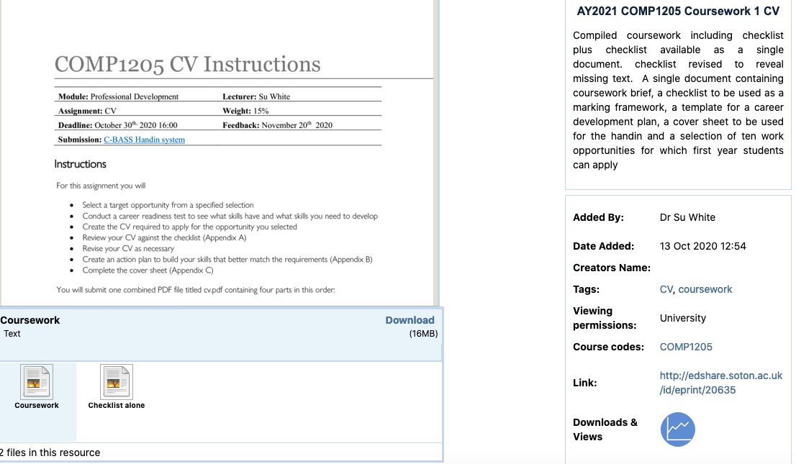
Remind yourself- NOW!
http://edshare.soton.ac.uk/20635/

Slide 4
Why are CVs important?
Activities to develop skills for your CV…
….Will also benefit your achievement as a student
We live in a competitive world
You have to stand out to land the job of your dreams and achieve career success
  In Person (Interviews, Presentations)
  On Paper (CV, Cover Letter, Personal Statement)
  Online (Web site, Blog, Social Media, Professional Networks, etc.)

Slide 5



Who and What is involved in getting a job
Who
What
HR
  Individual or Team
  Given a job requirements, screen CVs to give small set to group
  At end, set bounds for salary
Project Team
  Initial phone interview – yes/no to bring in candidate
  On interview day – part of spread of interviews, lunch, assessment tasks
Project Lead
  Final interview
  Final yes/no with input from team
CV
CV
  2 page recap of you
Interview(s)
  Phone conversations, in-person conversations, skill assessments
Online Presence
  Everything associated with you online
Network
  Who you know/who knows and values your skills
You
Friends
Co-workers
Associates

Slide 6
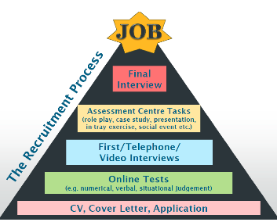
The Process and People
Views (artefacts) of YOU Used
People Involved
CV
CV
CV
CV

Slide 7
CV Fundamentals
CV

Slide 8
How is the CV used at each step?
People Involved
How CV is Used
What final job-grade / financial offer should we make this person?
Conversational assessments:
Can this person talk about
details, success, problems
in a clear, engaging way?
Is our first evaluation correct?
Does this person really know
what they claim they know?
Does this person
meet the minimum criteria?

Slide 9
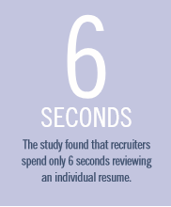
A CV needs to convey*
Our CV exercise
helps you practice achieving these targets
You have the SKILLS for the job
You OUT PERFORM than the other candidates
You are an VALUABLE to the organisation
You will ENHANCE the current team
The person to whom you are conveying this information will look at your CV briefly
Source: Eye Tracking Online Metacognition: Cognitive Complexity and Recruiter Decision Making. Will Evans, Head of User Experience Design, TheLadders. 2012.

Slide 10
Reminder: assessment criteria - NOW!
http://edshare.soton.ac.uk/20635/

Slide 11
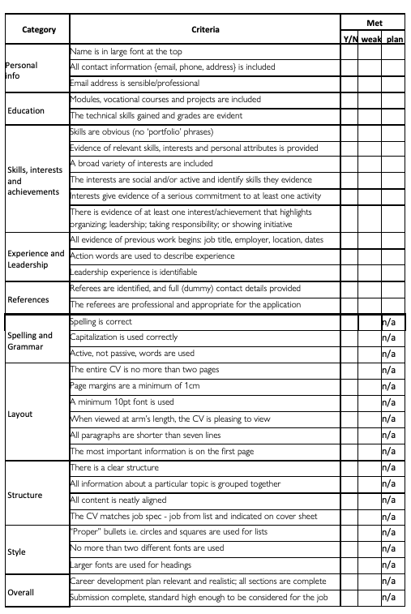
Look at the assessment criteria: content
http://edshare.soton.ac.uk/20635/

Slide 12
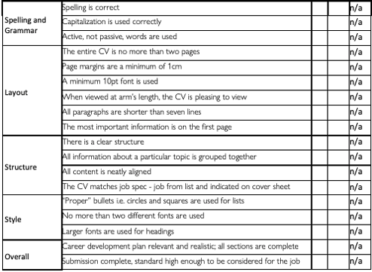
Look at the assessment criteria: impression

Slide 13
So can employer easily see your strengths?*
Make it EASY to find the information they need
Show them CLEARLY how you MEET or EXCEED their requirements
ENGAGE them
* In 30seconds
NEVER give them a REASON TO REJECT you

Slide 14

Reasons to Reject
Employers receive lots of CVs
e.g. Google ~ 50,000 CVs/week
Typos (58% of all CVs)
Length
  Not more than two pages (1 page/10 years of experience)
Presentation/formatting
Confidential information
  Reject anyone who might disclose internal information
  You must assess how to convey evidence
  without violating confidentiality
Lies
  It’s easy to check!
  Lies follow you forever
Source: https://bit.ly/36RGrUK

Slide 15
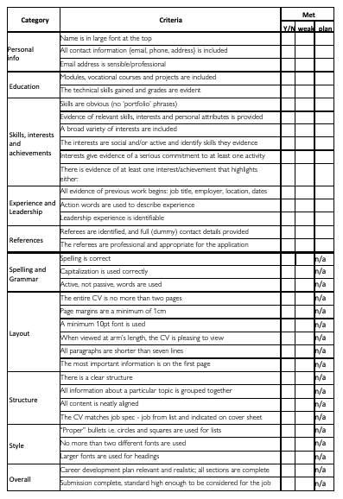
We mark to train you to achieve more
Category
Personal info
Education
Skills, interests and achievements
Experience and Leadership
References
Spelling and Grammar
Layout
Structure
Style
Overall
content
process

Slide 16
One pass??
It would be unrealistic
to get all
THIS
Right first time!!
content
process

Slide 17
Make the content easy to read in order to get over the first hurdle!
Use a template
Tailor it specifically to the job advertisement
  Make sure you highlight the keywords, skills, experience asked for
No more than 2 pages!
Make presentation
  Clear
  Easy to read
  Understandably informative
  Active (not passive)

Slide 18
Step 1: The Job Description
Read the job description from start to finish
Take notes
  Specific skills or experience asked for
Highlight what you have, and what you are missing
Tailor CV to the specific job and audience
Make sure all skills and experience asked for are addressed in some way
  If you have the skill/experience, make sure it’s stated
  If you are missing the skill/experience, adapt the skills you do have

Slide 19
Step 2: Basic Template
Personal Info and Contact
Education and Qualifications
Work History / Experience
Relevant Skills to the job
Achievements, Interests, Hobbies
References
Within each section, put in Chronological Order
Alternative: Put Skills before Education
In no more than 2 pages!

Slide 20
Step 3: A CV for YOU and the JOB - Education
Most recent degree first
Include specialist, vocational, technical training, etc.
Don’t assume people know what your studies have involved
  What international degrees mean
  What grades/scales mean
Tips on the CV
Be Precise
  Don’t say “Studying ECS”
  Say “Studying Electrical Engineering”
Provide evidence
  Include name and grade achieved
  Mention relevant coursework

Slide 21
Step 4: A CV for YOU and the JOB - Experience
Most recent first
In first line of every experience: job title, employer, time span, location
Relate skills acquired in previous position to the one you are seeking
  Worked in a team of …
  Communication with customers…
  Position involved planning…
  I had to manage my own time and prioritize…
Tips on the CV
Assertive and Positive Language
  Don’t say “Helped,” “Was”
  Say “Developed,” “Organized,” “Achieved”
Be Specific
  Don’t say “Strong Leader”
  Say “Responsible for a team of 4 people”
Every position counts!
  I once landed a software engineering job because I taught water polo
At this stage in your career, you may use unpaid/volunteering positions as Work Experience, otherwise it goes in “Interests”

Slide 22
Let’s Practice!
There was a survey …. It’s been replaced with a PDF doc…
Step through a number of questions
Describe one of your skills
  In a way which is likely to satisfy a prospective employer
  This can be done
    alone
    in a small group
    or in your tutorial groups

Slide 23
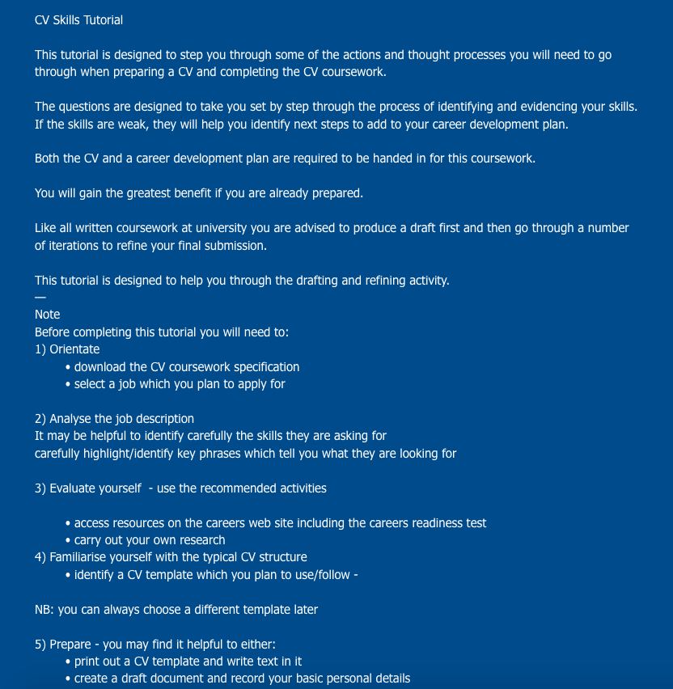
Preview
Briefing
Set of questions
Designed to help
Draft your CG
Work on your career
development plan

Slide 24
As you work through the next few slides
Refer to your preferred role and …
But when thinking about the future
look at the requirements of more advanced posts
We provide an example, but why not go and find a few for yourself?
You are planning for your future as well as your next coursework

Slide 25
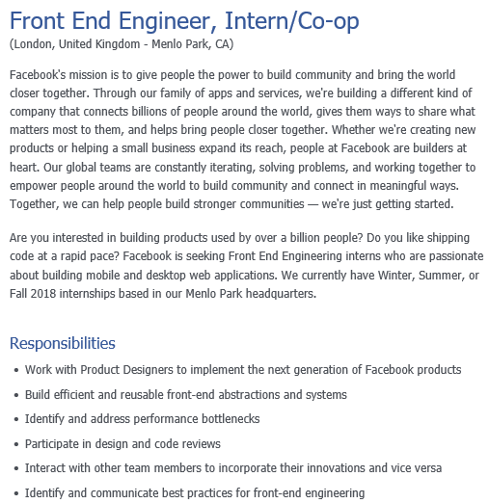
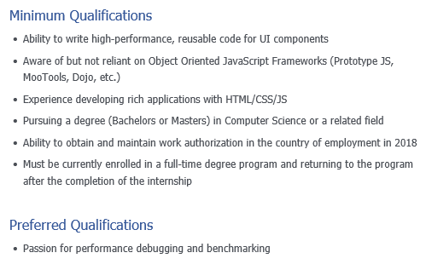
What experience highlights for this job

Slide 26
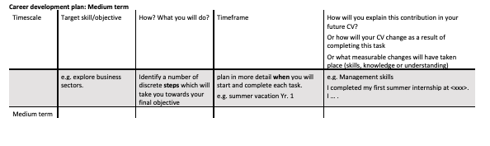
These more advanced examples can help you work on your career development plan

Slide 27
A CV for YOU and the JOB - Skills
SKILLS
  Computer Skills (e.g. IT Literacy, Programming Languages)
  Languages {Basic, Conversant, Proficient, Fluent, Bilingual, Native language}
  Driving License, First Aid, Health and Safety, Scuba Diving, etc.
“Soft” Skills are just as important
  Communication, Team work
  Leadership, Autonomy
  Problem Solving, Decision making
  Adaptability
Tips on the CV
Be Precise
  Don’t say “Good with languages”
  Say “Fluent in Arabic; Proficient in German”
Provide evidence
  Don’t say “Strong Leader”
  Say “Strong Leader, as shown in <insert previous experience here>”
Match what job requires
  If job says “code in C++ and Java”
  Don’t say “Code in all Object Oriented Languages”
  Do say “Code in C++; Java”

Slide 28
Find the required skills for this job

Slide 29
A CV for YOU and the JOB - Interests
Anything to shows how Diverse, Interesting, and Skilled you are
Highlight positions of responsibility,
  Working in a team
  Personal initiative
Examples:
  Advertisement manager for a student newspaper
  Being on a sports team
  Self-employed as a Birthday Clown
Tips on the CV
Active Interests
  Don’t say
  “Enjoy watching Netflix, keen gamer”
  Can you use it to describe a skill?
  E.g blog on xxx series, YouTube videos teaching gameplay
  Rather than
  “Active member of my Youth Group”
Be Specific
  Don’t say “Amersham Youth Club”
  Say “Treasurer for Amersham Youth Club”

Slide 30
Step 3: A CV for YOU and the JOB - References
Who
  Someone who can vouch for your skills and experience
Ask them
  Before you put them on your CV
Provide a brief overview of
  who you are
  what you are applying for
  how they know you, achievements related to them
Tips on the CV
Professional Knowledge of You
  Teachers, Tutors, Former Employers
  NOT Parents or Friends
Complete and Correct
  Put the Job Title of your reference
  Provide three ways to contact your referee:
  Email, Phone, Address
Dear Professor Jones,
I am applying for positions as a software engineer. I was your student in COMP1205, in which I received high marks. I also completed my 3rd year project under your supervision.
My report on using deep learning to identify student behaviours in MOOCs earned a first.
Could I please put your name down as a reference?
Sincerely,
Jane Smith, ECS 3rd year student

Slide 31
Step 4: Evidenced, Truthful
Be honest, but sell yourself
  Some skills are easy to check, and employers do!
Provide official certificates, diplomas, where possible
Explain (briefly) why you have the skills if formal proof isn’t possible
NEVER lie!

Slide 32
Step 5: Presentation and revision
Clear, professional layout
Separate sections
Use tabs, bullet points, spacing
Keep fonts and formatting modest
  Minimum 10pt font,
  black text on white paper
No essays. Bullet points.
  Dynamic words
Proofread!
PDF
  not Word or other proprietary formats
Make it easy to find information
Exercise
Review a few CVs for their whole-page visual impact?
What looks best to you
Why?
Tip
It’s often easier to produce a messy first draft and then improve it
  The reader spends the most time on the upper middle of the 1st page. Put key information there.
Source: Monster.com

Slide 33
Summary

Slide 34
Why?
We live in a competitive world
You have to stand out to land the job of your dreams and achieve career success
  In Person (Interviews, Presentations)
  On Paper (CV, Cover Letter, Personal Statement)
  Online (Web site, Blog, Social Media, Professional Networks, etc.)
Who
What
CV
You
Friends
Co-workers
Associates

Slide 35
Coursework 1 reminder:CV

Slide 36
Where to find information – ecs.handin.soton.ac.uk
Pick a job description from those provided
Write a CV for that job
Self-Assess
Complete your career development plan
Complete the Cover sheet
Submit: the four parts as a single PDF
https://secure.ecs.soton.ac.uk/module/2021/COMP1205/

Slide 37
Next steps?
Schedule a time to review your slides
Plan your timescale to complete the CV
Get on and enjoy the whole of your degree

