Slide 1
Careers and Employability
COMP1205 Professional Development
Careers and Employability Service www.southampton.ac.uk/careers
careers@southampton.ac.uk
UoSCareersandEmployability
UoS_Careers
Notes:
Welcome

Slide 2
Before this lecture you will have
Participated in and reviewed lecture 1
Completed the online survey
Completed the career readiness test
Reviewed the slides following the first lecture which recapped on the content and presented the summary of the findings

Slide 3
Lecture part 2
In the first week of teaching

Slide 4
Next
What is employability?
The Careers and Employability Service
Work and development opportunities
Introduction to writing your CV

Slide 5
let’s begin with some data

Slide 6
Employability
What does it mean?
Graduate Destinations and earnings (FT, UK, UG)?
2009 ECS – CS/SE/ITO
FT Employed 67% FT study = 7% Unemployed 7%
2016 ECS – All ECS
FT Employment 70.7% FT Study = 11.9% Unemployed 5.8% Pay £30,637 average - more earn over £30k than below) .
364/601 responded, 99.3% in positive employment

Slide 7
The most recently available figures
Via annual DLHE survey
16/17 is the most recently available from the careers and employability service in October 2020
The reason for this is that the method of collecting and analysing data changed
There is a PDF you can download (edshare)
I have put it into the resources collection for this lecture – link from module page
all links are accessible from the module page

Slide 8
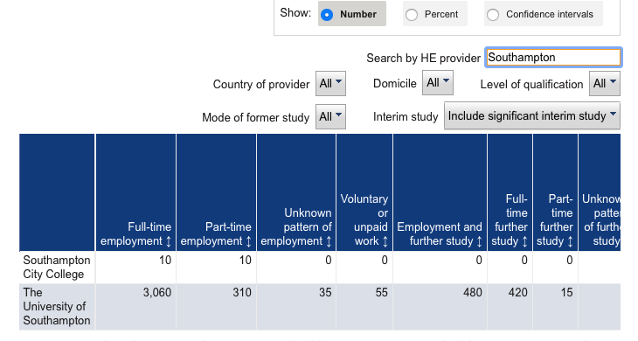
This is the official data replacement

Slide 9
Alternative sources
Your best alternative source of information is to look at some of the job search websites
This slide shows and image from the Prospect web site
all links are accessible from the module page

Slide 10
What are Employers looking for?
FIT
Knowledge
Work experience
Passion
Professionalism
Skills, attributes
Achievement
Evidence
Capability
Now
Graduation
Work

Slide 11
Looking at work experience survey
Wide range of different experience
Large number of people don’t have formal work experience
You possibly have experience doing some work voluntarily
School/college
Via religious practice/community
Local community
Responses may prompt you to think of possible jobs
Lots of opportunity via university
Volunteering schemes
Class reps
Roles in clubs and societies
You could do things which will appear on your career development plan

Slide 12
Careers and Employability Service
https://youtu.be/lug4X96bESg
Open
Term time
Mon – Friday
Go online to check out the latest times
Online surgeries available
Location:
Student
Services
Building
37
Room
2001
http://www.southampton.ac.uk/careers/contact-us.page?

Slide 13
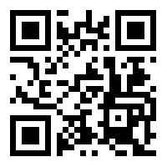
MyCareer for events and jobs
mycareer.soton.ac.uk
Set your preferences
Sign up for job alerts
See which employers are on campus
Sign up to workshops
Check your appointments

Slide 14
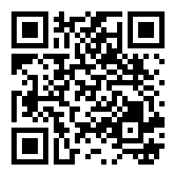
Jobs and work experience
MyCareer portal https://mycareer.soton.ac.uk/student/home.html
Excel Southampton Internships and Business Innovation Programme
Agencies/web/Temp Bank (Bldg 37)
ECS and ‘Networking’ – emails!
Joyce Lewis
Tutors, Labs, Research Groups, Societies, On-line
Speculative applications
FPSE Careers Hub and affiliated companies https://secure.ecs.soton.ac.uk/careers/

Slide 15
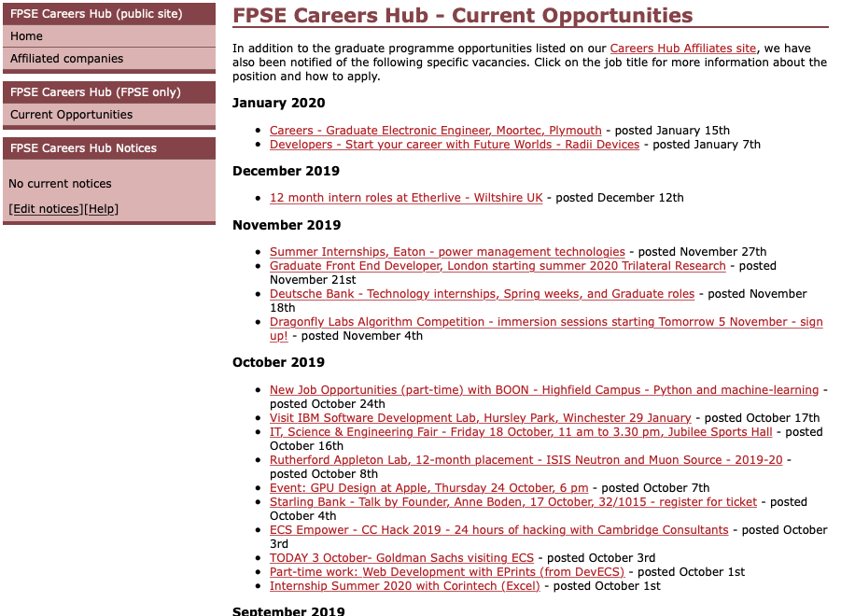
use as a reference!! https://goo.gl/vLH1SC

Slide 16
Specialist job agencies
www.gradcracker.com
www.targetjobs.co.uk
www.prospects.ac.uk

Slide 17
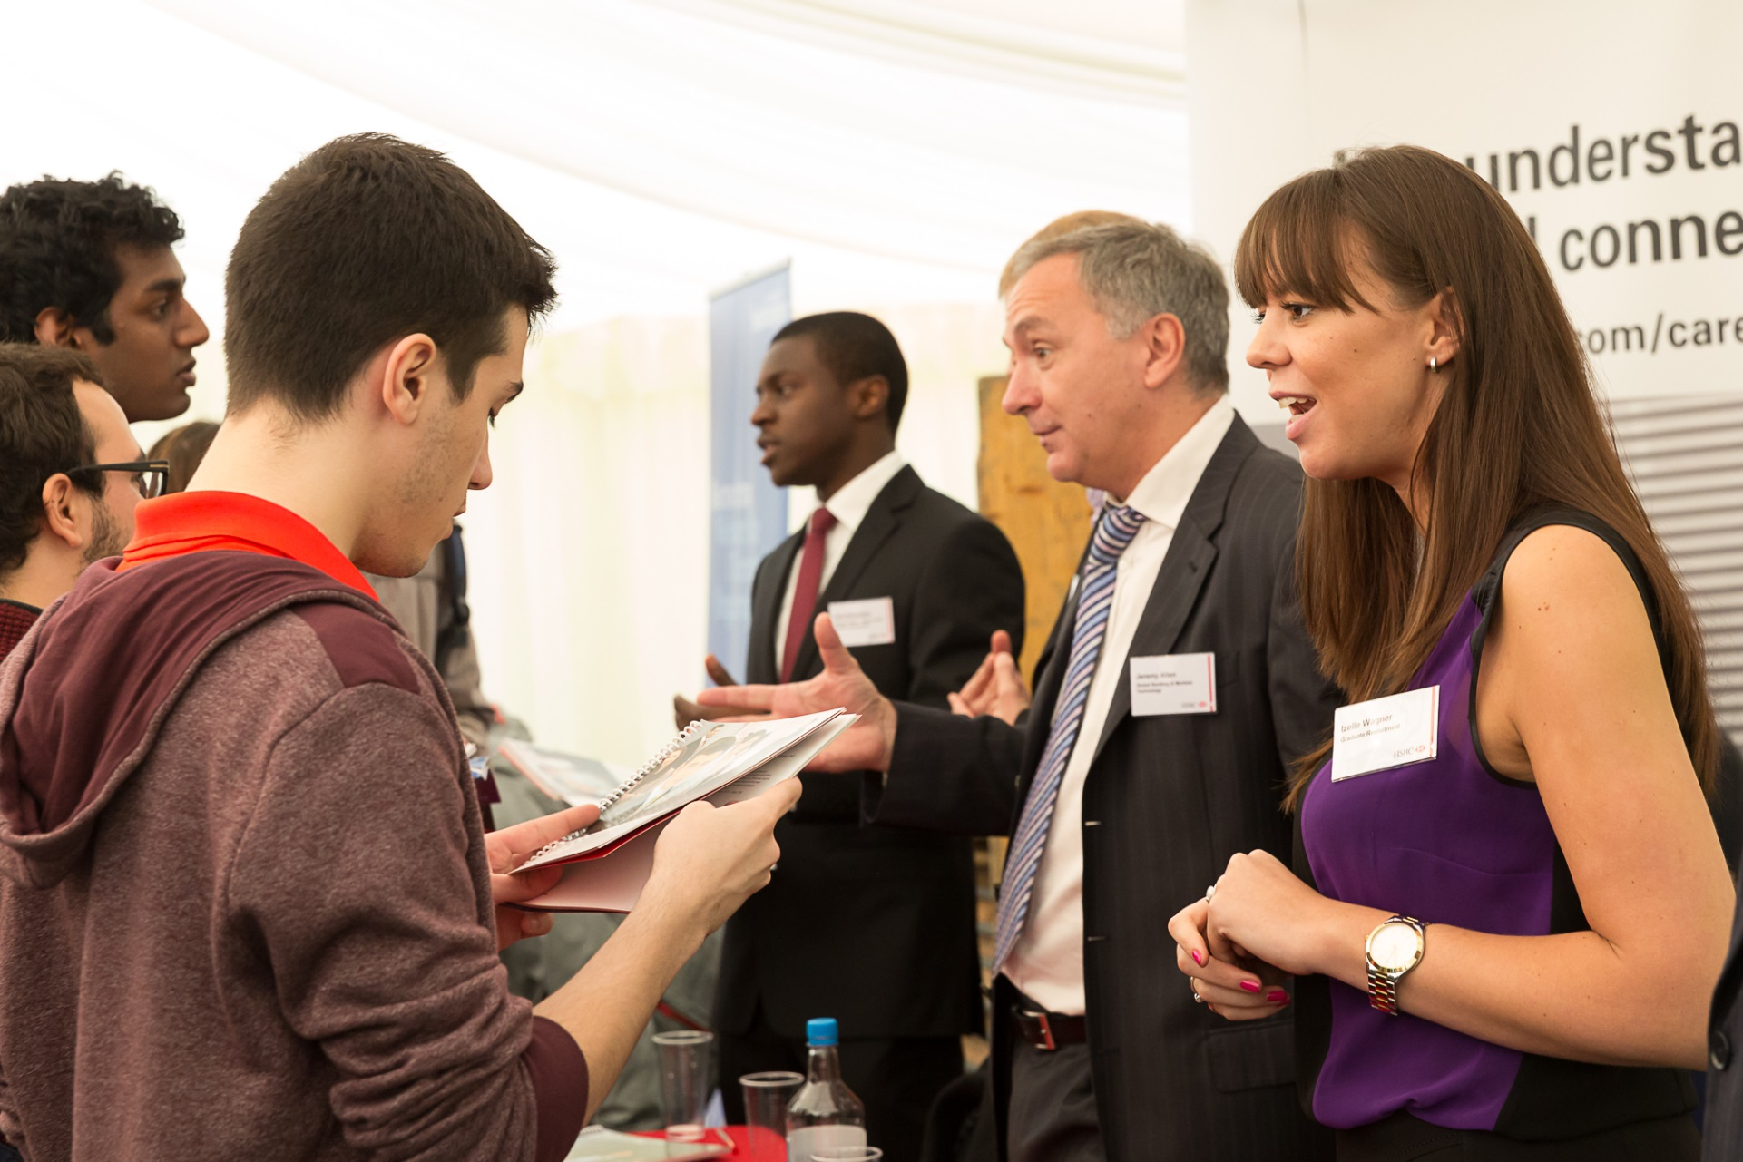
Careers Fairs
October Fairs:
currently virtual – check out the careers site
https://www.southampton.ac.uk/careers/students/events-workshops-fairs/index.page?

Slide 18
Careers and Employability Service
Building 37, Highfield Campus
careers@southampton.ac.uk
+44 (0)23 8059 3501
www.southampton.ac.uk/careers
UoS_CareersandEmployability
UoS_Careers
UoS_Careers

Slide 19
let’s think about a concrete example

Slide 20
Use the module web page
We have a little coursework for you

Slide 21
ECS Module Page

Slide 22
No I expect you to have:
Downloaded and read the assignment spec
Completed the career readiness test
Be planning your next steps
This will help you
understand the purpose of the content we are presenting
Give you out of class activities to help in the preparation

Slide 23
Use the ’30-day challenge’ as a guide
We don’t expect you to cover the whole 30 days
Certainly not before the handin

Slide 24
Read and prepare
I don’t expect to cover these slides in the first class
It would be helpful if you read them before we meet again

Slide 25
Professional impact
You never get a second chance to make a first impression
In person, on-line
Your CV
Your email
Research, preparation, practice, learn, time
On email etiquette https://goo.gl/5gLzPt (warning requires flash!)

Slide 26
JOB
Final Interview
The Recruitment Process
Assessment Centre Tasks
(role play, case study, presentation, in-tray exercise, social event etc.)
Reasonable adjustments?
First/Telephone/
Video Interviews
Online Tests
(e.g. numerical, verbal, situational judgement)
CV, Cover Letter, Application

Slide 27
Fit for purpose
Targeted to the job, the employer, to your objective
Demonstrating your skillset

Slide 28
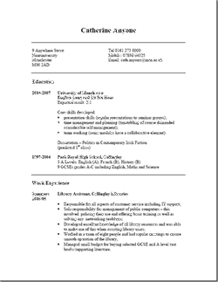
CV - reality check
Volume of applicants per vacancy
Time you have to impress
Rejection is easier than short listing
Visual impact
Lack of relevant information
Pertinent skills do not stand out
Too much information
Typing errors and grammar
Lacks interest and achievement
Notes:
Volume of applications can be really high, don’t let it put you off, just make sure you put in the effort.
Relevant information: tasks – can you make a cappuccino, is it relevant?
This summer every Excel placement had something like 10 applicants per place, SKY TV stats:
So even though there is a shortage of IT skills, there is always competition .

Slide 29
Technical Skills (and achievement)
Key modules
Projects (and project life-cycle)
Core technical skills (eg programming, platforms, object orientated, relational design, clean room,) and proficiency
Specific (JavaScript, Agile SD, C#, etc)
Report writing, presentations
General IT, Excel, data handling
Grades
Predicted degree classification
Position in class/group, eg Best Group Project.
Prizes, awards, strengths
Self taught skills/projects
Be specific, quantify where possible, be truthful.
If you don’t tell them, who will?
www.prospects.ac.uk > Options with your subject
http://www.itjobswatch.co.uk/jobs/uk/developer.do

Slide 30
Finding Clues
http://www.ecs.soton.ac.uk

Slide 31
CV Challenge
Equality Act 2010
One/Two sides of A4
Reverse chronological order
No Gaps
Relevant headings
Balance your information
Web links/profiles (Linked-in?)
Use action words: negotiated, organised
Match your skills to the employer/role needs

Slide 34
CV Style
Uncluttered
too small, fancy fonts, BOLD
Short sentences, bullet points
Check spelling/grammar
Tables and open source software?
Focus on skills, knowledge and
achievements.
STAR = Situation, Task, Action, Result

Slide 35
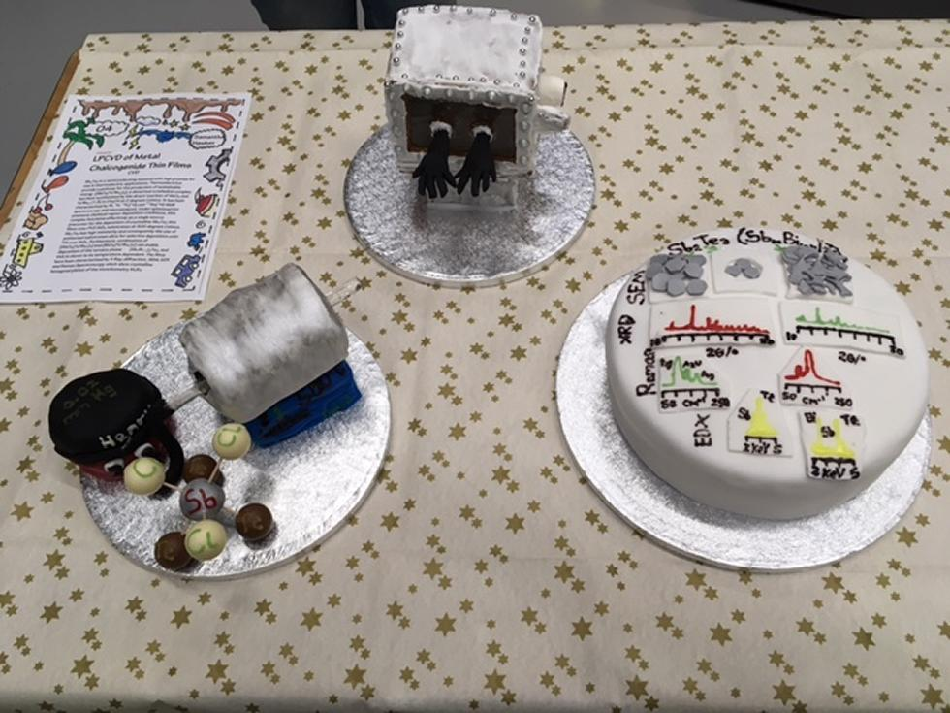
Extra curricular activities ->evidence
What?
Why?
Where?
Use to build and demonstrate relevant skills

Slide 36
Further Help
CV advice
Examples
Sample structure
https://goo.gl/ieBqBe

Slide 37
Career Planning
Explore the pages
Follow the links
https://www.southampton.ac.uk/careers/students/career-planning/index.page

Slide 38
Careers readiness
following the career readiness link …
…will take you to some pages in eFolio
just bear with the demands …
(if necessary) to login yet again and you will ultimately reach the career readiness evaluation
https://www.southampton.ac.uk/careers/students/career-planning/index.page

Slide 39
why is IS this relevant?

Slide 40
COMP1205 Learning objectives
B3. Audit, evaluate and critically reflect upon strengths and weaknesses in knowledge, skills and abilities
B4. Evaluate and critically reflect upon self-presentation, particularly those aspects that relate to career development
D1. Communicate ideas in written and oral forms in appropriate styles for different audiences
D2. In written communications, make appropriate and effective use of layout and referencing conventions

Slide 41
Careers and Employability Service
Building 37, Highfield Campus
careers@southampton.ac.uk
+44 (0)23 8059 3501
www.southampton.ac.uk/careers
UoS_CareersandEmployability
UoS_Careers
UoS_Careers

Slide 42
REMINDER
Use the ’30-day challenge’ as a guide
We don’t expect you to cover the whole 30 days
Certainly not before the handin

Slide 43
Before the next lecture
Watch the videos – read your emails!!
Complete the next survey
you will be invited
You will be reminded to make sure you complete it!!
Help each other
Tell us if you face specific difficulties

Slide 44
Three ways to one link!
https://goo.gl/grvpYA
BUT
check out the University career pages for ECS students
Make notes on points which you think will be relevant to the draft of your CV
https://www.southampton.ac.uk/careers/students/subject-info/ecs.page

Slide 45
Web references in this slide set

