Slide 2
Securing HTTP
COMP3220 Web Infrastructure
Dr Nicholas Gibbins – nmg@ecs.soton.ac.uk

Slide 3
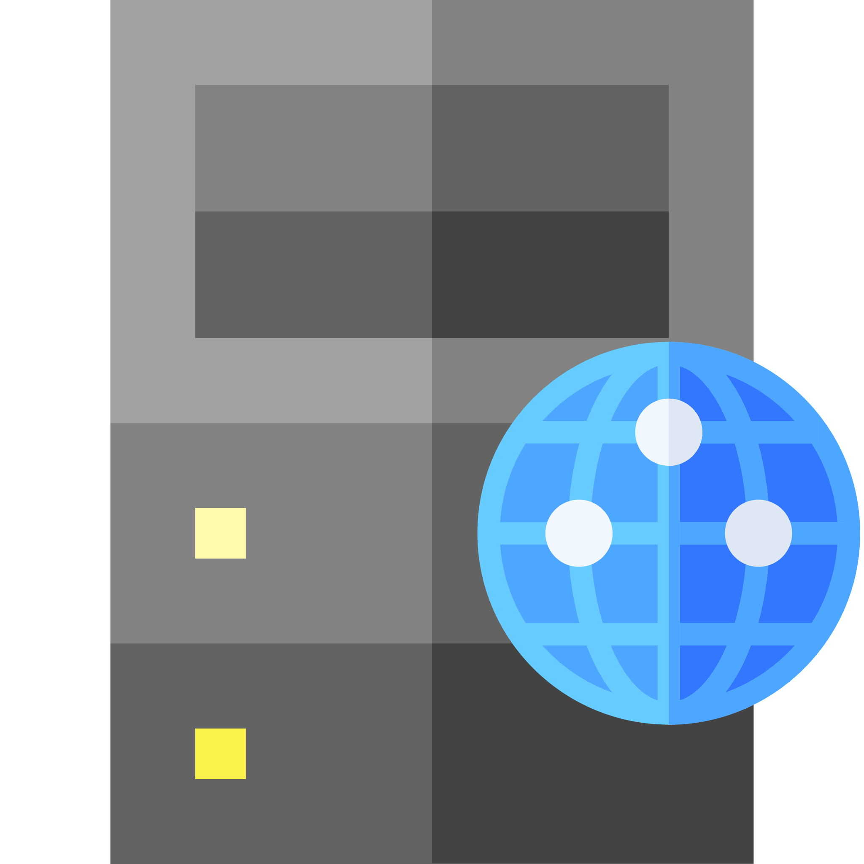
Securing HTTP
As originally designed, HTTP sends all data in the clear
Vulnerable to interception by third parties
GET X
200 OK
X

Slide 4
Transport Layer Security
The foundation for Secure HTTP (HTTPS)
Formerly known as Secure Sockets Layer (SSL) – dates back to 1995
Protocol for establishing secure communications channels between internet hosts
Also used for protocols other than HTTP: IMAP, POP3, FTP, SMTP
Despite the name, considered an application layer protocol (in the OSI 7-layer model, a session layer protocol)

Slide 5
Cryptography 101
Confidentiality – data cannot be read by unauthorised parties
Integrity – data cannot be modified by unauthorised parties without being detected
Authentication – authorised parties can prove who they are
Non-Repudiation – the author of data cannot deny that authorship
Alice
Bob
Eve

Slide 6
Symmetric-key Encryption
Uses a single key for both encryption and decryption
Generally fast
Examples: AES, IDEA, 3DES
Key exchange is an issue
encrypt
decrypt
plain
text
cypher
text
plain
text

Slide 7
Asymmetric-key Encryption
Keys are generated in pairs
Each key can decrypt what the other has encrypted
Given one key from a pair, cannot work out the other key
Generally slower than symmetric encryption
Examples: RSA, ElGamal, Elliptic-Curve Cryptography

Slide 8
Public Key Cryptography
Commonly-used term for asymmetric-key encryption
Refers to the different roles of the keys in a pair
Public key
Shared with all by the owner
Used to encrypt messages sent to the owner
Private key
Kept a secret by the owner
Used by the owner to decrypt messages sent to them

Slide 9
Cryptographic hash algorithms
Algorithm that turns an arbitrary-sized message into a fixed size bit string (the digest or hash, typically 256 or 512 bits long)
Lossy transformation
Given a digest cannot easily calculate the corresponding message
Brute force attacks, rainbow table attacks
Used to ensure integrity
Modern hash algorithms: SHA-2, SHA-3
Older insecure hash algorithms: MD5, SHA-1
hash
#

Slide 10
Digital signatures
Authentication, non-repudiation, integrity of messages
Generate a cryptographic hash of the message
Encrypt the hash with your private key
Attach the encrypted hash to the message
hash
#
#
Notes:
Authentication – you can demonstrate that you signed it
Non-repudiation – you can’t deny that you signed it
Integrity – it can be demonstrated that the message hasn’t been tampered with

Slide 11
Signature verification
Decrypt the encrypted hash with the public key
Generate a cryptographic hash of the message
Compare the hashes
hash
#
compare
#
#

Slide 12
Certificates
A public key that has been digitally signed by a trusted third party (a Certificate Authority or CA)
Used to make guarantees about ownership of a public key
CA public keys typically incorporated into browsers or operating systems

Slide 13
Key exchange
Symmetric cryptography needs a shared key
How can two parties agree a shared key over an insecure channel?
?
Alice
Bob
Eve

Slide 14
Diffie-Hellman key exchange
By Ralph Merkle, based on earlier work by Whitfield Diffie and Martin Hellman
Relies on each participant being able to apply an operation that is secret, commutative, and difficult to reverse
Difficult to reverse = trapdoor function
In its original implementation, uses multiplicative groups of a finite field
${\left(g^{a} mod p\right)}^{b} mod p=g^{ab} mod p ={\left(g^{b} mod p\right)}^{a} mod p$
Far easier to calculate exponents than logarithms in a finite field
Can be generalised to other finite cyclic groups
For example, elliptic curve groups
Diffie, W. and Hellman, M. (1976) New Directions in Cryptography. IEEE Transactions on Information Theory. 22(6). pp. 644-654.
Merkle, R.C. (1978) Secure communications over insecure channels. Communications of the ACM. 21(4). pp.294-299.

Slide 15
Diffie-Hellman key exchange
$p$ is a large prime number
$g$ is a primitive root modulo $p$ (i.e. for every integer $a$ coprime to $p$, there is an integer $k$ such that $g^{k}=a mod p$
Pick random large integer $a$
Pick random
large integer $b$
$$A=g^{a} mod p$$
$$B=g^{b} mod p$$
$$A$$
$$B$$
$$Z=B^{a} mod p$$
$$Z=A^{b} mod p$$

Slide 16
Transport Layer Security
Symmetric-key encryption is much faster than asymmetric-key encryption
TLS is a hybrid cryptosystem
Uses asymmetric-key encryption to agree on a shared symmetric key
Uses symmetric-key encryption for subsequent application data, using the shared key
TLS 1.2 defined in Aug 2008, TLS 1.3 defined in Aug 2018
TLS 1.3 offers significant security and efficiency improvements over TLS 1.2
TLS 1.3 is widely supported by most modern browsers (notable exception: Microsoft)
Adoption by websites is much lower (<40% as of September 2020)
Dierks, T. and Rescorla, E. (2008) The Transport Layer Security Protocol Version 1.2. RFC5246. Available at: https://tools.ietf.org/html/rfc5246
Rescorla, E. (2018) The Transport Layer Security (TLS) Protocol Version 1.3. RFC8446. Available at: https://tools.ietf.org/html/rfc8446

Slide 17
Transport Layer Security handshake
TLS handshake is the protocol used to agree on the shared symmetric key
Several key exchange algorithms in use – these are the most common cases:
RSA (TLS 1.2 and earlier only)
Ephemeral Diffie-Hellman (TLS 1.3 onwards)
Because TLS 1.2 is still in wide use, we’ll look at both TLS 1.2 and TLS 1.3

Slide 18
RSA (TLS 1.2)
CA public key
server private key
server public key (signed by CA)
generate random number
n
ClientHello
n
m
ServerHello
m
generate random number
Certificate
CertificateVerify
generate transcript hash
#
#
#
generate transcript hash
ServerHelloDone
verify server public key
generate premaster secret
ClientKeyExchange
construct master secret
construct master secret
+
m
+
n
→
←
m
+
n
+
ChangeCipherSpec
Finished
ChangeCipherSpec
Finished
begin secure communication
begin secure communication

Slide 19
Perfect forward secrecy
As shown, protocol ensures the confidentiality of the subsequent communications
What happens if the server’s private key is leaked at some point in the future?
With a copy of the messages from ClientHello to ClientKeyExchange, we can reconstruct the session key (master secret) and decrypt the rest of the session
We need to protect past communications against the loss of a long-term secret
Ephemeral Diffie-Hellman is used by TLS 1.3+ to ensure perfect forward secrecy
TLS 1.3 lets the client identify their preferred $p$ and $g$ from a small registry of “good” values
Gillmor, D. (2016) Negotiated Finite Field Diffie-Hellman Ephemeral Parameters for Transport Layer Security. RFC7919. Available at: https://tools.ietf.org/html/rfc7919

Slide 20
Latency
The handshake from TLS 1.2 and earlier requires two round trips before secure communications can begin
Minimum of 4 * 0.067 = 0.27s
This is on top of the 3-way TCP handshake (minimum 0.2s) and before any additional overheads from HTTP
TLS 1.3 reduces the handshake to a single round trip
0.067s
Image: NASA

Slide 21
DHE (TLS 1.3)
CA public key
server private key
server public key (signed by CA)
generate random number
n
ClientHello
n
generate public DH key
key_share
m
ServerHello
m
generate random number
key_share
generate public DH key
generate transcript hash
#
#
generate transcript hash
construct shared DH key
construct shared DH key
construct handshake secret
EncryptedExtensions
construct handshake secret
+
#
→
←
#
+
Certificate
authenticate server
CertificateVerify
Finished
generate transcript hash
#’
#’
generate transcript hash
construct master secret
construct master secret
+
#’
→
←
#’
+
begin secure communication
begin secure communication

Slide 22
HTTPS
HTTP over a TLS connection
Standard port is 443 (as opposed to port 80 for HTTP)
Now common for HTTP URIs to redirect to an equivalent HTTPS URI
301 Moved Permanently or 308 Permanent Redirect
GET / HTTP/1.1
Host: example.org
HTTP/1.1 301 Moved Permanently Location: https://example.org/

Slide 23
HTTP Strict Transport Security
301 Moved Permanently requires a redirect for every URI on a website
Strict-Transport-Security: header allows a website to declare that it is only accessible via HTTPS
Avoids future redirections for all URIs on that website (and possibly also sub-domains)
GET / HTTP/1.1
Host: example.org
HTTP/1.1 301 Moved Permanently Location: https://example.org/
Strict-Transport-Security: max-age=31536000; includeSubDomains
Hodges, J. et al (2012) HTTP Strict Transport Security. RFC6797. Available at: https://tools.ietf.org/html/rfc6797

Slide 24
Further Reading
The Transport Layer Security (TLS) Protocol Version 1.2
https://tools.ietf.org/html/rfc5246
The Transport Layer Security (TLS) Protocol Version 1.3
https://tools.ietf.org/html/rfc8446

Slide 25
Next Lecture: Representational State Transfer

