Slide 2
Optimising HTTP
COMP3220 Web Infrastructure
Dr Nicholas Gibbins – nmg@ecs.soton.ac.uk

Slide 3
Physical Limits
Upper limit on speed of communication is the speed of light: c = 300,000,000 m/s
A message sent halfway round the world on a great circle route will take a minimum of 0.067 s to reach its destination
~20,000 km
Image: NASA

Slide 4
Network Latency
The time between a source sending a packet and the destination receiving it
Actual speed of communication will be less than the speed of light:
Optical fibre is typically ~70% of c
Coaxial cable may be >80% of c
Routers, switches, etc introduce delays
0.067s
Image: NASA

Slide 5
The Internet Protocol Suite
HTTP SMTP FTP DNS SSH IMAP POP TLS ...
Application Layer process-to-process
Transmission Control Protocol (TCP)
User Datagram Protocol (UDP)
Transport Layer
host-to-host
Internet Protocol (IP)
Internet Layer
addressing and routing
Ethernet
802.11 (WiFi)
Link Layer
physical transmission

Slide 6
HTTP over TCP
HTTP runs on top of TCP (Transmission Control Protocol)
TCP provides a reliable connection
Guarantees that packets will eventually reach their destination
Lost packets are resent
Opening an HTTP connection requires that a TCP connection be opened first

Slide 7
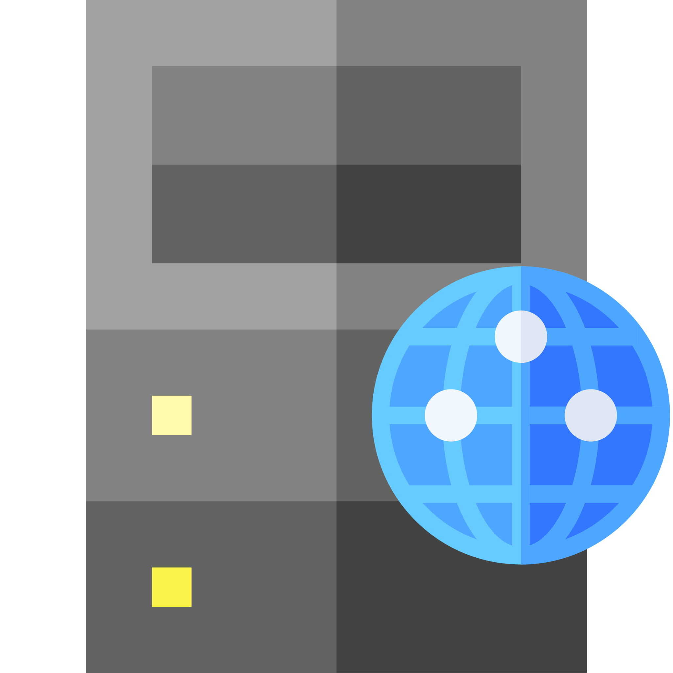
TCP Set-up and Teardown
TCP establishes reliable connection using a three-way handshake
SYN, SYN/ACK, ACK
Lower limit for the duration of this exchange to a host at the antipodes: 0.2 s
for just the TCP connection (no HTTP)
at the speed of light
without additional delays
before any additional overhead from the TLS handshake
0.067 s
SYN
0.067 s
SYN/ACK
0.2 s
0.067 s
ACK

Slide 8
HTTP/1.0 and earlier
Before HTTP/1.1, each HTTP request used a separate TCP connection
Expensive and time-consuming!
3-way handshake for each TCP open
4-way handshake for each TCP close
Latency issues
Some clients open multiple connections at same time
Increased server load to handle many simultaneous connections
GET
TCP open
TCP close
200 OK
GET
TCP open
TCP close
200 OK
GET
TCP open
TCP close
200 OK

Slide 9
HTTP keep-alive
HTTP/1.1 introduced keep-alive
TCP connections reused for multiple HTTP requests
one TCP open and TCP close handshake
Still latency issues, but now in the application layer rather than the transport layer
GET
TCP open
200 OK
GET
200 OK
GET
TCP close
200 OK

Slide 10
HTTP pipelining
Also available from HTTP/1.1
Pipelining allows multiple requests to be made without waiting for responses
Server must send responses in same order as received requests
Reduces application layer latency
GET
TCP open
GET
GET
200 OK
200 OK
200 OK
TCP close

Slide 11
Network bandwidth
Latency isn’t the only consideration
There are also limits to the data transfer capacity of the network
How long will it take to transmit a message?
Content encoding (covered in content negotiation lecture) can be used to compress message bodies
Smaller message body – less time taken to transmit

Slide 12
HTTP/2
First major HTTP revision since 1997
Based in part on earlier SPDY proposal from Google
Preserves existing HTTP semantics (methods, response codes, headers, etc)
RFC7540 published 14 May 2015
Offers four improvements over HTTP/1.1:
Multiplexed requests
Prioritised requests
Compressed headers
Server push

Slide 13
HTTP/2 prioritised requests
A connection may contain multiple streams - multiplexing
Each stream consists of a sequence of frames
Each stream has an associated priority
Frames from higher priority streams sent before those from lower priority streams
Allows asynchronous stream processing (unlike HTTP/1.1 Pipelining)

Slide 14
HTTP/2 compressed headers
HTTP/1.1 can compress message bodies (using LZW/LZ77/deflate/Brotli)
Content-Encoding: header (see content negotiation lecture)
Sends headers in plain text
HTTP/2 also provides the ability to compress message headers

Slide 15
HTTP/2 server push
HTTP/1.1 servers only send messages in response to requests
HTTP/2 enables a server to pre-emptively send (or push) multiple associated resources to a client in response to a single request.
Send images, stylesheets, etc before they’re requested by the client

Slide 16
HTTP/3
Named as future planned development of HTTP in 2018
Replaces TCP with QUIC over User Datagram Protocol (UDP)
Addresses shortcoming of HTTP/2; multiplexes are not visible to TCP's loss recovery mechanism, so a lost or reordered packet stalls all active requests
UDP is an unreliable protocol
No guarantee of delivery or ordering
Lightweight, however
QUIC
Eliminates some issues with TCP (blocking if packets are delayed or lost)
Supports multiplexed connections over UDP
Designed to reduce TLS overhead (see next lecture)

Slide 17
Further Reading
Hypertext Transfer Protocol (HTTP/1.1): Message Syntax and Routing (see §6)
https://tools.ietf.org/html/rfc7230 (see §6)
Hypertext Transfer Protocol Version 2 (HTTP/2)
https://tools.ietf.org/html/rfc7540
Hypertext Transport Protocol Version 3 (HTTP/3)
https://quicwg.org/base-drafts/draft-ietf-quic-http.html

Slide 18
Next Lecture: Securing HTTP

