Slide 2
Hypertext Markup Language
COMP3220 Web Infrastructure
COMP6218 Web Architecture
Dr Nicholas Gibbins – nmg@ecs.soton.ac.uk

Slide 3
Representation
URI
identifies
http://www.bbc.co.uk/weather/2637487
Resource
accesses
today’s BBC weather forecast for Southampton
Representation
represents
Metadata:
Content-Type: text/html
Data:
<html>
<head>
<title>BBC Weather – Southampton</title>
...
</html>

Slide 4
What is HTML?
The data format for Web pages
A markup language for structured documents
A platform for Web application development
All of the above
Notes:
In this lecture, we’ll concentrate on #2

Slide 5
Which HTML?
HTML Tags
HTML+
HTML 2.0
HTML 3.0
HTML 3.2
HTML 4
HTML 4.01
XHTML
XHTML 2
HTML 5
HTML 5.1
HTML 5.1 2nd ed.
HTML 5.2
HTML 5.3
...
Notes:
Evolution of features – overview of HTML 5 in next lecture

Slide 6
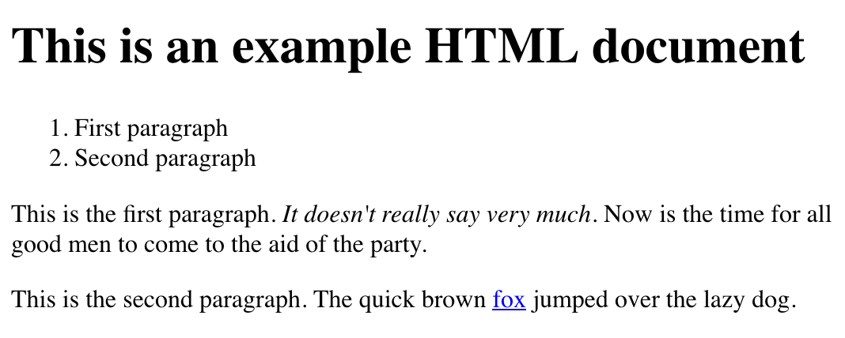

Slide 7
HTML source
<!DOCTYPE html>
<html>
<head>
<title>My Document</title>
</head>
<body>
<h1>This is an example HTML document</h1>
<ol>
<li>First paragraph</li>
<li>Second paragraph</li>
</ol>
<p>This is the first paragraph. <em>It doesn't really say
very much.</em> Now is the time for all good men to come
to the aid of the party.</p>
<p>This is the second paragraph. The quick brown
<a href="http://example.org/">fox</a> jumped over the
lazy dog.</p>
</body>
</html>

Slide 8
HTML markup basics
Tags that structure a document as a hierarchy of elements
  <p> ... </p>
Attributes that modify elements
  <a href=“...”>...</a>
Entity references that represent character sequences
  R&amp;D

Slide 9
Element structure
html
head
title
body
ol
li
li
p
i
p
h1
a

Slide 10
Evolution of HTML
Initially a language for encoding simple document semantics
<h1>Things to See in London</h1>
<p>The <i>Millennium Dome</i> is great.</p>

Slide 11
Evolution of HTML
Subsequently extended to allow more design precision and visual effects
<h1><center>Things to See in London</center></h1>
<p><font size=“3” text=“#FF0000”>The <i>Millennium Dome</i> is <blink>great</blink>.</font></p>

Slide 12
Evolution of HTML
Separation of semantics from presentation using stylesheets
Large font, bold, red
<h1>Things to See in London</h1>
<p>The <em>Millennium Dome</em> is great.</p>
Normal font, 1cm indent
Italic font

Slide 13
Next Lecture: HTML5

