Slide 2
Cookies
COMP3200 Web Infrastructure
Dr Nicholas Gibbins – nmg@ecs.soton.ac.uk

Slide 3
The infamous cookie
Intended as a way for web servers to persist state across HTTP requests
(but isn't HTTP supposed to be stateless?)
Invented in 1994 by Lou Montulli of Netscape
(also the inventor of the <blink> tag)
Patented in 1995
(Netscape Communications Corp. vs ValueClick Inc.)
Ostensibly deprecated in favour of HTML5 local storage ... and yet it still lives!
Barth, A. (2011) HTTP State Management Mechanism. RFC6265. Available online at: https://tools.ietf.org/html/rfc6265

Slide 4
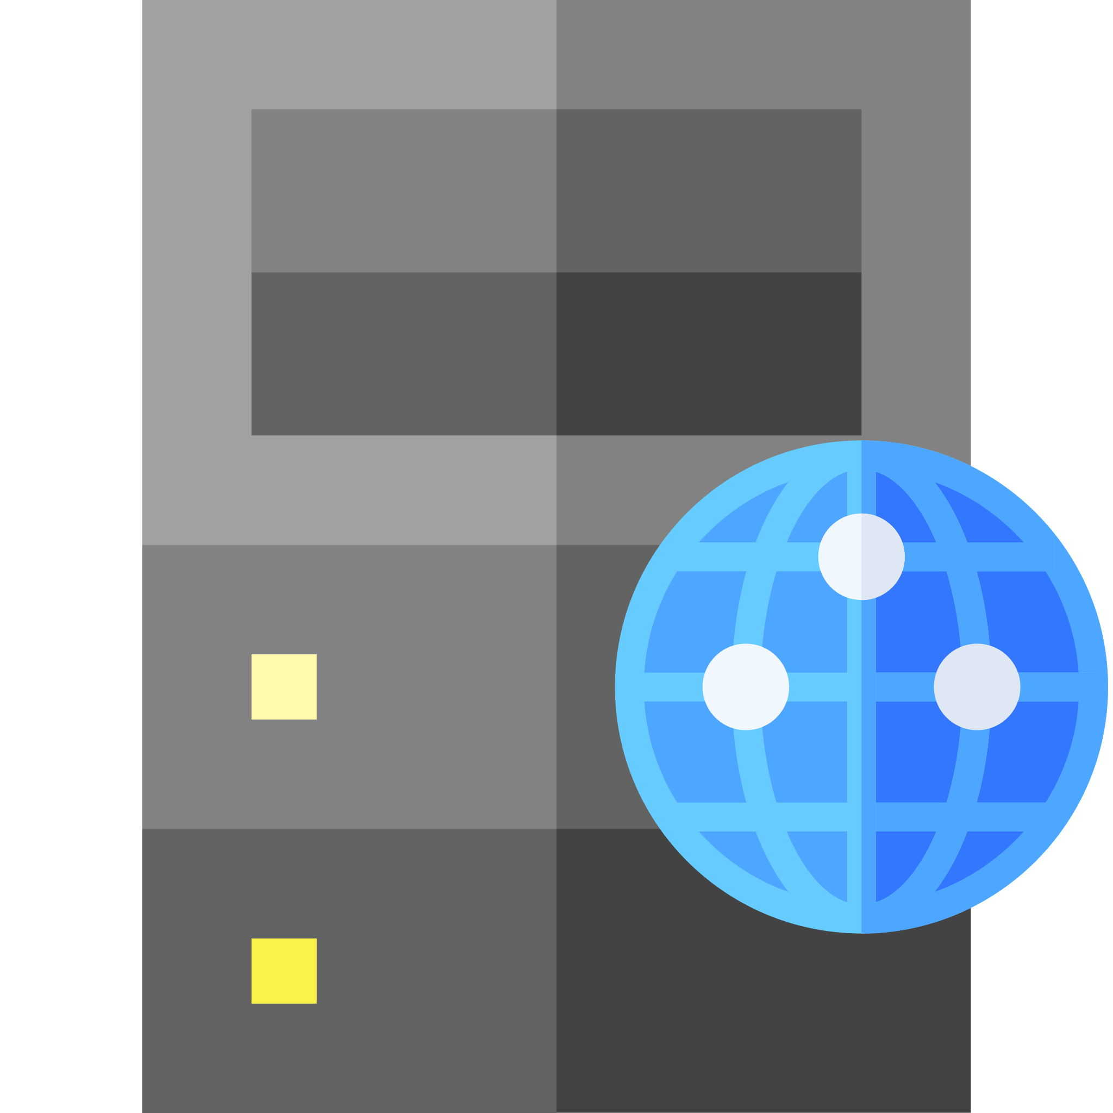
Cookies
GET / HTTP/1.1
Host: www.example.org
HTTP/1.1 200 OK
Content-Type: text/html
Set-Cookie: foo=23 Set-Cookie: bar=qux
...
GET / HTTP/1.1
Host: www.example.org
Cookie: foo=23; bar=qux

Slide 5
Lifetime
Cookies can either be session cookies or permanent cookies
Session cookies expire "when the current session ends" (when the browser is closed?)
Permanent cookies have a specified expiry time
Set-Cookie: foo=23; Expires=Fri, 23 Oct 2020 10:05:34 GMT
Indicates that the cookie should expire after the given date
Set-Cookie: foo=23; Max-Age=21600
Indicates that the cookie should expire after Max-Age seconds

Slide 6
Access restriction
Set-Cookie: foo=23; Secure
Indicates that the cookie should only ever be sent over HTTPS
Set-Cookie: foo=23; HttpOnly
Indicates that the cookie should not be visible from within the Document.cookie interface

Slide 7
Scope
Set-Cookie: foo=23; Domain=example.org
Cookie should only be sent to example.org or its subdomains (i.e. foo.example.org)
Defaults to the origin server that set the cookie (excluding subdomains)
Set-Cookie: foo=23; Path=/bar
Cookie should only be sent if value of Path is in the requested URI
Set-Cookie: foo=23; SameSite=Strict
Strict: only send cookie to the same site that originated it
Lax: cookie is withheld for cross-site subrequests (i.e. images) but sent when user follows a link (typical browser default setting)
None: no restrictions on cross-site requests

Slide 8
Privacy considerations
Cookies can be used to track users across websites
Relies on websites embedding resources (typically images) from third parties
When a user fetches the third party resource, it sets a cookie
Cookie may be read when the user fetches a resource from the third party in future
Relies on default browser cookie scope of SameSite=None

Slide 9
page.html
GET /page.html
site1.org
foo.gif
200 OK
GET /foo.gif
bigbrother.com
foo.gif
200 OK
Set-Cookie: id=12345
GET /doc.html
doc.html
site2.org
bar.gif
200 OK
GET /bar.gif
Cookie: id=12345
bigbrother.com
bar.gif
200 OK

Slide 10
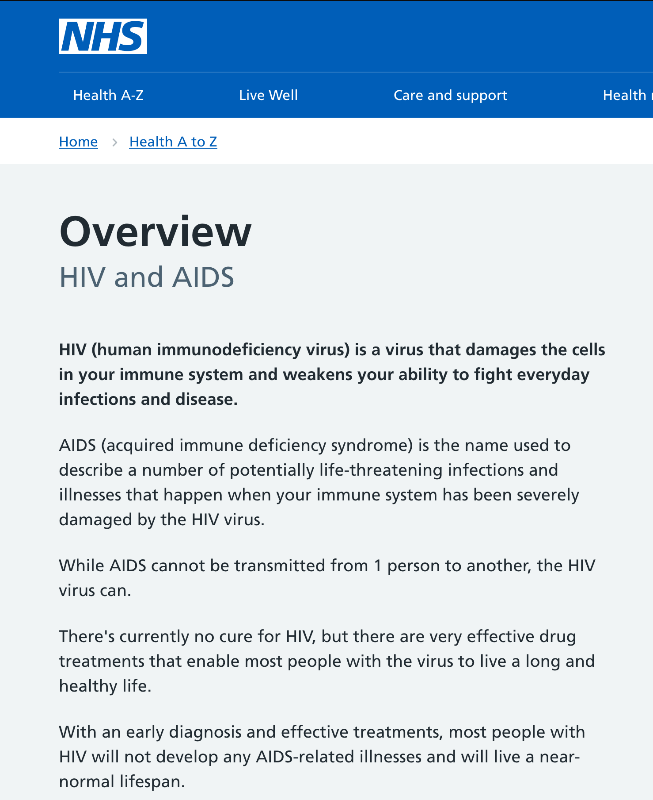
Privacy considerations
High profile UK case in 2010 (discovered by a Southampton graduate!)
NHS put Facebook "like" buttons on their webpages (loaded from Facebook's CDN)
When a user visited an NHS webpage, Facebook set a cookie
If the user visited a different page with a like button, Facebook could read the cookie and correlate those visits
If they were logged into Facebook, Facebook now knew what their users are searching the NHS for
https://mmt.me.uk/blog/2010/11/21/nhs-and-tracking/

Slide 11
Next Lecture: HTML

