Slide 1
Careers and Employability
COMP1205 Professional Development
Careers and Employability Service www.southampton.ac.uk/careers
careers@southampton.ac.uk
UoSCareersandEmployability
UoS_Careers

Slide 2
Careers, Employability and…your first coursework
We need some introductions and context setting

Slide 3
A preview

Slide 4
A roadmap from our careers service
You will need to work independently
We can use their roadmap to help us prepare

Slide 5
What progress you might make
We don’t expect you to cover the whole 30 days
Certainly not before the handin

Slide 6
But these are different times
I want to get to know you a little
You probably want to get to know your fellow students
We have to use different ways…
I don’t know how long this is all going to take!
I have a short survey
I will try to share the results dynamically
Please forgive me if there are some hiccups!
Some slides from this set are likely to spill over to the next lecture

Slide 7
Password protected survey
https://www.isurvey.soton.ac.uk/38410
Password COMP1205w
The password is CASE sensitive

Slide 8
Please complete
We will resume the lecture
after approx. 10 minutes
We will then go on to discuss some of the issues raised
I will need you to use the chat channel to help sustain discussion and allow us to shape future online lectures and activities

Slide 9
Questions
Would you like to have distanced safe meetings with your fellow students from ECS?
Would you prefer small group meetings online?
Can you imagine that your tutor groups will help?
What can we do to make remote teaching better?
How many of you might like small group tutorials from me as part of this course?

Slide 10
Next
What is employability?
The Careers and Employability Service
Work and development opportunities
Introduction to writing your CV

Slide 11
let’s begin with some data

Slide 12
Employability
What does it mean?
Graduate Destinations and earnings (FT, UK, UG)?
2009 ECS – CS/SE/ITO
FT Employed 67% FT study = 7% Unemployed 7%
2016 ECS – All ECS
FT Employment 70.7% FT Study = 11.9% Unemployed 5.8% Pay £30,637 average - more earn over £30k than below) .
364/601 responded, 99.3% in positive employment

Slide 13
The most recently available figures
Via annual DLHE survey
16/17 is the most recently available from the careers and employability service in October 2020
The reason for this is that the method of collecting and analysing data changed
There is a PDF you can download (edshare)
I have put it into the resources collection for this lecture – link from module page
all links are accessible from the module page

Slide 14
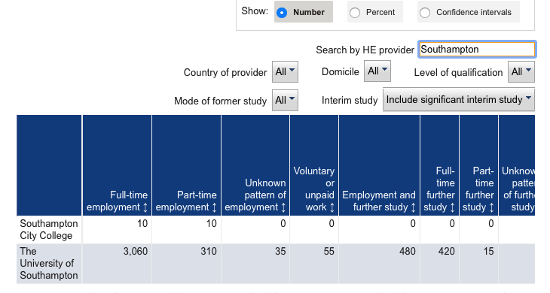
This is the official data replacement

Slide 15
Alternative sources
Your best alternative source of information is to look at some of the job search websites
This slide shows and image from the Prospect web site
all links are accessible from the module page

Slide 16
What are Employers looking for?
FIT
Knowledge
Work experience
Passion
Professionalism
Skills, attributes
Achievement
Evidence
Capability
Now
Graduation
Work

Slide 17
Careers and Employability Service
https://youtu.be/lug4X96bESg
Open
Term time
Mon – Friday
Go online to check out the latest times
Online surgeries available
Location:
Student
Services
Building
37
Room
2001
http://www.southampton.ac.uk/careers/contact-us.page?

Slide 18
MyCareer for events and jobs
mycareer.soton.ac.uk
Set your preferences
Sign up for job alerts
See which employers are on campus
Sign up to workshops
Check your appointments

Slide 19
Jobs and work experience
MyCareer portal https://mycareer.soton.ac.uk/student/home.html
Excel Southampton Internships and Business Innovation Programme
Agencies/web/Temp Bank (Bldg 37)
ECS and ‘Networking’ – emails!
Joyce Lewis
Tutors, Labs, Research Groups, Societies, On-line
Speculative applications
FPSE Careers Hub and affiliated companies https://secure.ecs.soton.ac.uk/careers/

Slide 20
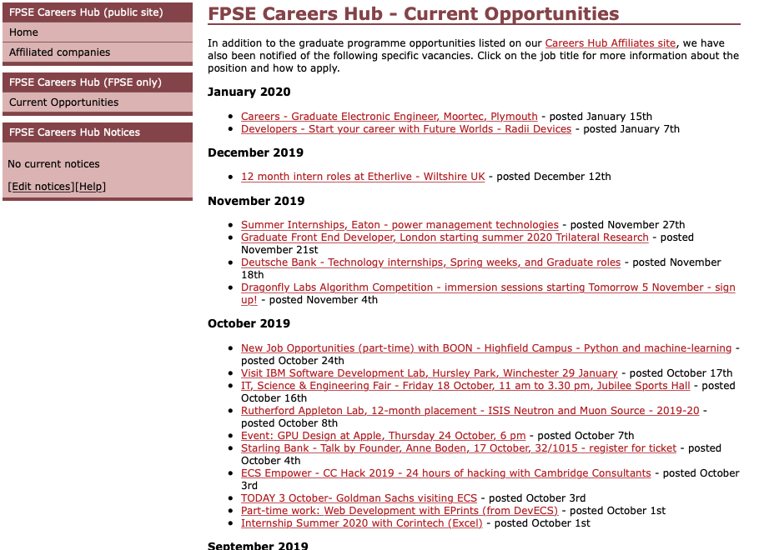
use as a reference!! https://goo.gl/vLH1SC

Slide 21
Directories
www.gradcracker.com
www.targetjobs.co.uk
www.prospects.ac.uk

Slide 22
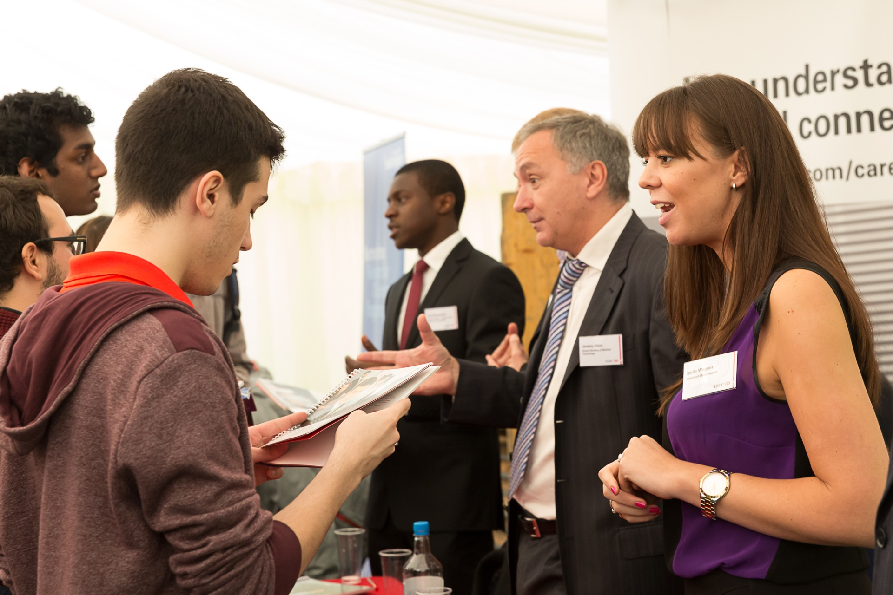
Careers Fairs
October Fairs:
currently virtual – check out the careers site
https://www.southampton.ac.uk/careers/students/events-workshops-fairs/index.page?

Slide 23
Careers and Employability Service
Building 37, Highfield Campus
careers@southampton.ac.uk
+44 (0)23 8059 3501
www.southampton.ac.uk/careers
UoS_CareersandEmployability
UoS_Careers
UoS_Careers

Slide 24
let’s think about a concrete example

Slide 25
Time to EXPLORE the Module web page
We have a little coursework for you

Slide 26
ECS Module Page

Slide 27
What to do next?
You need to download and read the assignment spec
This will help you understand the purpose of the content we are presenting

Slide 28
Use the ’30-day challenge’ as a guide
We don’t expect you to cover the whole 30 days
Certainly not before the handin

Slide 29
Read and prepare
I don’t expect to cover these slides in the first class
It would be helpful if you read them before we meet again

Slide 30
Professional impact
You never get a second chance to make a first impression
In person, on-line
Your CV
Your email
Research, preparation, practice, learn, time
On email etiquette https://goo.gl/5gLzPt (warning requires flash!)

Slide 31
JOB
Final Interview
The Recruitment Process
Assessment Centre Tasks
(role play, case study, presentation, in-tray exercise, social event etc.)
Reasonable adjustments?
First/Telephone/
Video Interviews
Online Tests
(e.g. numerical, verbal, situational judgement)
CV, Cover Letter, Application

Slide 32
Fit for purpose
Targeted to the job, the employer, to your objective
Demonstrating your skillset

Slide 33
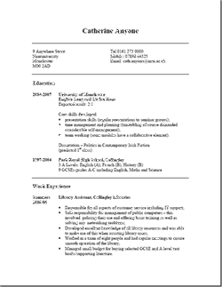
CV - reality check
Volume of applicants per vacancy
Time you have to impress
Rejection is easier than short listing
Visual impact
Lack of relevant information
Pertinent skills do not stand out
Too much information
Typing errors and grammar
Lacks interest and achievement
Notes:
Volume of applications can be really high, don’t let it put you off, just make sure you put in the effort.
Relevant information: tasks – can you make a cappuccino, is it relevant?
This summer every Excel placement had something like 10 applicants per place, SKY TV stats:
So even though there is a shortage of IT skills, there is always competition .

Slide 34
Technical Skills (and achievement)
Key modules
Projects (and project life-cycle)
Core technical skills (eg programming, platforms, object orientated, relational design, clean room,) and proficiency
Specific (JavaScript, Agile SD, C#, etc)
Report writing, presentations
General IT, Excel, data handling
Grades
Predicted degree classification
Position in class/group, eg Best Group Project.
Prizes, awards, strengths
Self taught skills/projects
Be specific, quantify where possible, be truthful.
If you don’t tell them, who will?
www.prospects.ac.uk > Options with your subject
http://www.itjobswatch.co.uk/jobs/uk/developer.do

Slide 35
Finding Clues
http://www.ecs.soton.ac.uk

Slide 36
CV Challenge
Equality Act 2010
One/Two sides of A4
Reverse chronological order
No Gaps
Relevant headings
Balance your information
Web links/profiles (Linked-in?)
Use action words: negotiated, organised
Match your skills to the employer/role needs

Slide 37
CV Style
Uncluttered
too small, fancy fonts, BOLD
Short sentences, bullet points
Check spelling/grammar
Tables and open source software?
Focus on skills, knowledge and
achievements.
STAR = Situation, Task, Action, Result

Slide 38
Extra curricular activities?
What?
Why?
Space?
Where?

Slide 39
Further Help
CV advice
Examples
Sample structure
https://goo.gl/ieBqBe

Slide 40
Career Planning
Explore the pages
Follow the links
https://www.southampton.ac.uk/careers/students/career-planning/index.page

Slide 41
Careers readiness
following the career readiness link will take you to some pages in eFolio
just bear with the demands to login yet again and you will ultimately reach the career readiness evaluation
https://www.southampton.ac.uk/careers/students/career-planning/index.page

Slide 42
why all this is relevant

Slide 43
COMP1205 Learning objectives
B3. Audit, evaluate and critically reflect upon strengths and weaknesses in knowledge, skills and abilities
B4. Evaluate and critically reflect upon self-presentation, particularly those aspects that relate to career development
D1. Communicate ideas in written and oral forms in appropriate styles for different audiences
D2. In written communications, make appropriate and effective use of layout and referencing conventions

Slide 44
before next week
https://goo.gl/grvpYA
check out the University career pages for ECS students
Watch the various videos
Make notes on points which you think will be relevant to the draft of your CV
https://www.southampton.ac.uk/careers/students/subject-info/ecs.page

Slide 45
Careers and Employability Service
Building 37, Highfield Campus
careers@southampton.ac.uk
+44 (0)23 8059 3501
www.southampton.ac.uk/careers
UoS_CareersandEmployability
UoS_Careers
UoS_Careers

Slide 46
Web references in this slide set

