Slide 2
The World Wide Web
COMP3220 Web Infrastructure
Dr Nicholas Gibbins – nmg@ecs.soton.ac.uk

Slide 3
What is the World Wide Web?

Slide 4
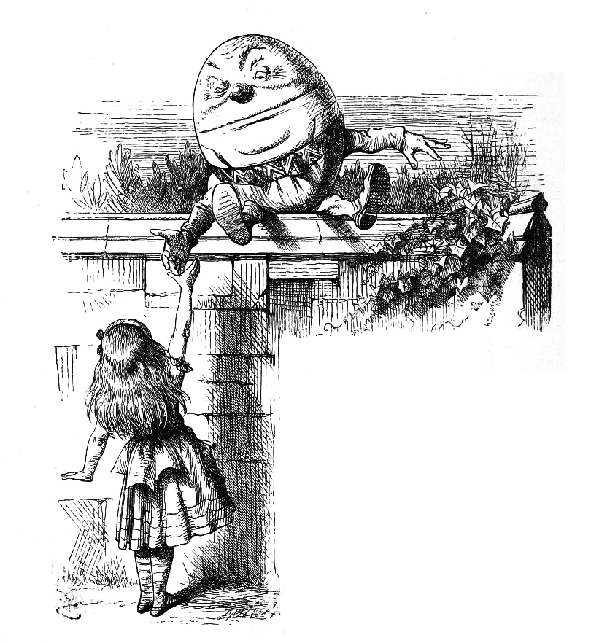
“When I use a word,” Humpty Dumpty said, in rather a scornful tone, “it means just what I choose it to mean—neither more nor less.”

Slide 5
Before the Web
A user typed a host address into a client program
The client communicated with a file server using the File Transfer Protocol (FTP)
The user typed commands into the client:
To navigate to the right directory
To specify whether the file being transferred was binary or ASCII
To get the right file
The server sent a file back
The client stored the file on the hard disk
The user printed the file, or used a separate viewer
Notes:
Interaction characterised as downloading

Slide 6
The Web experience
A user clicks on a link in a browser
(the browser talks to a web server)
(the server sends a document back)
The browser displays the document
The user clicks on another link (etc)
Notes:
Interaction characterised as browsing

Slide 7
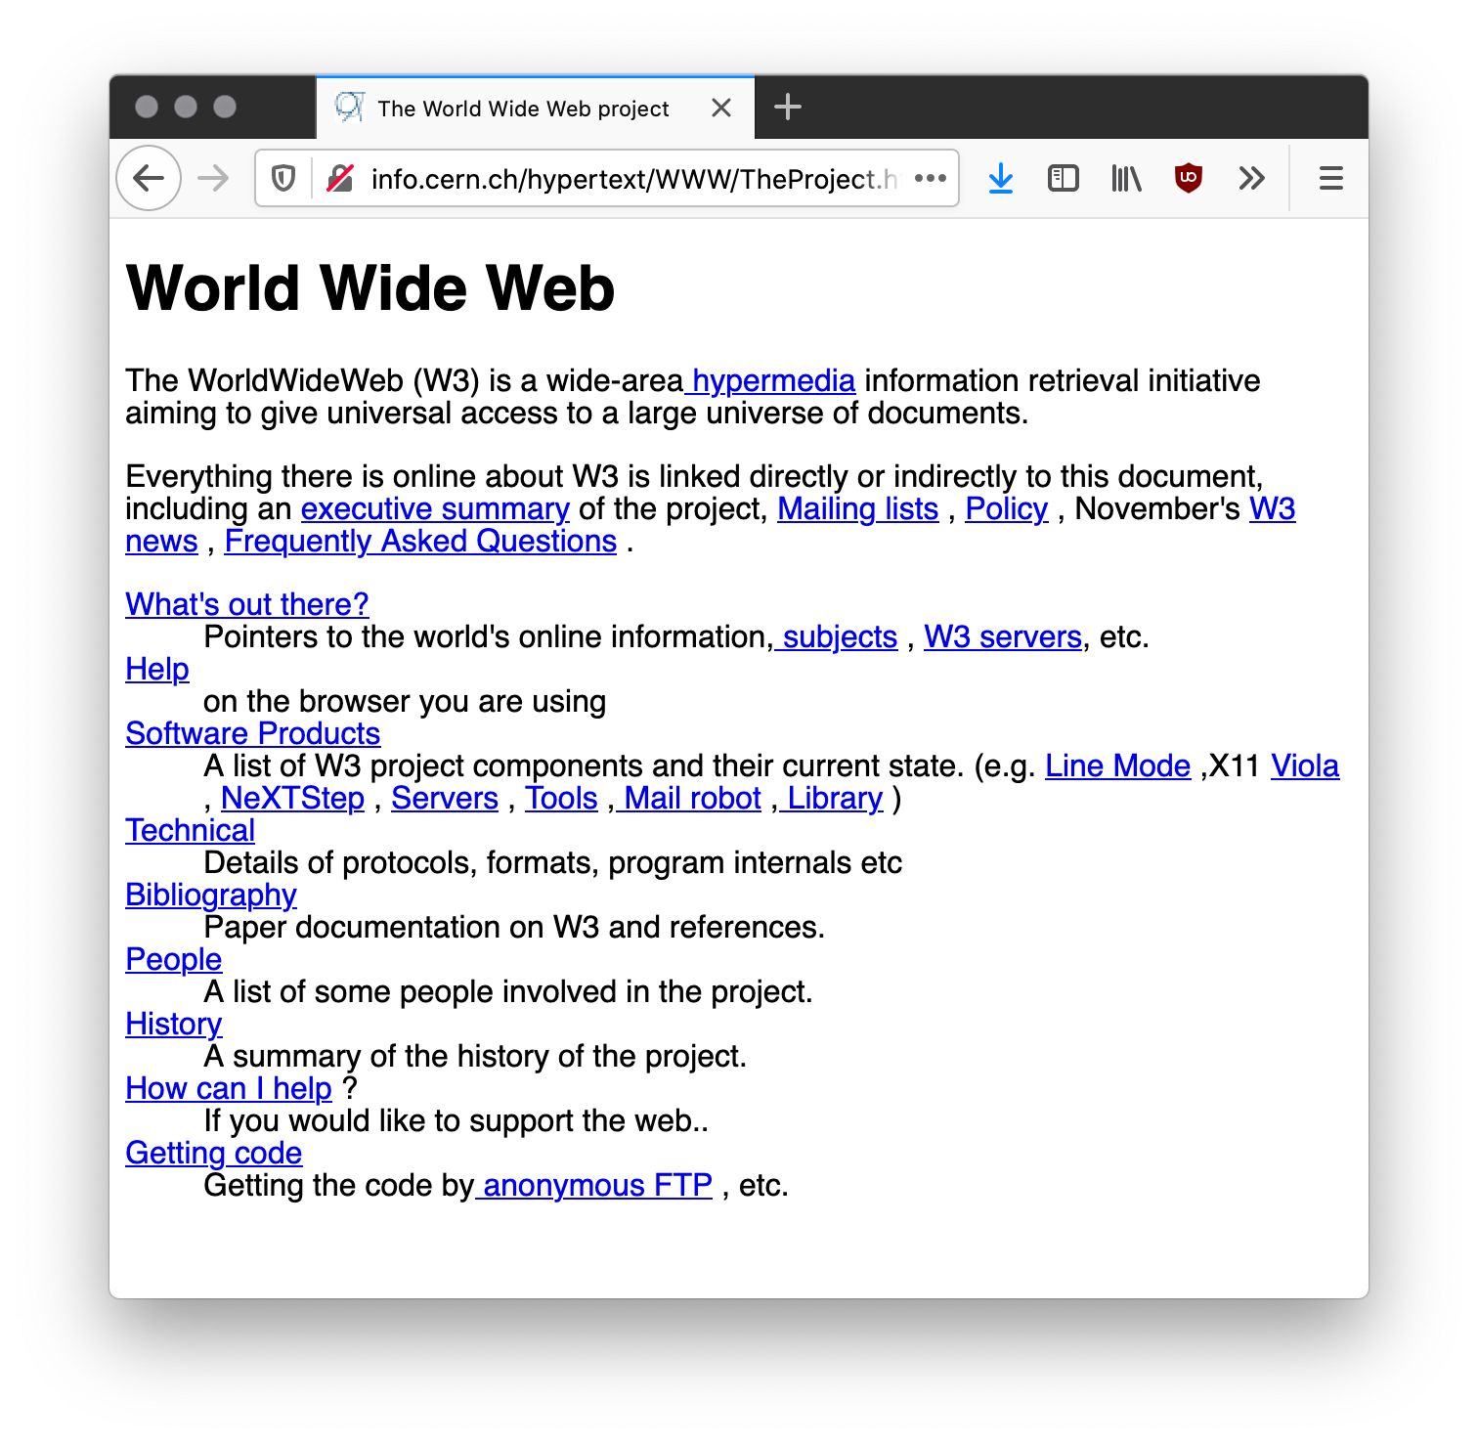
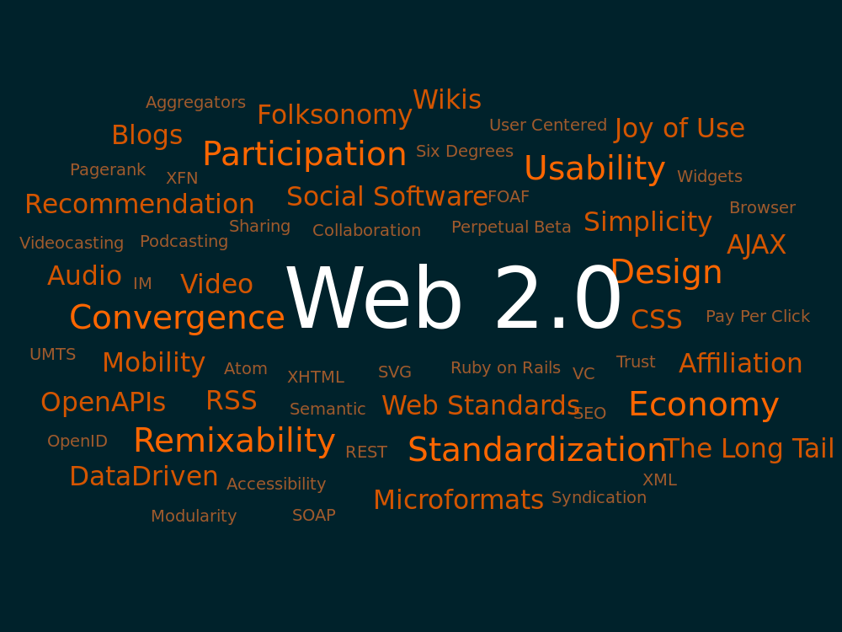
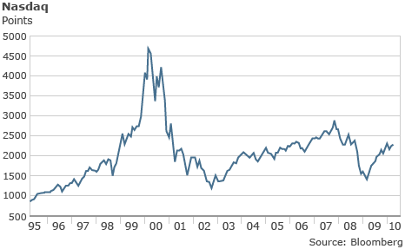
Web evolution
The Web is for scientists (1991-1995)
Document-centric
Limited interactivity
The Web is for commerce (1996-2000)
Invention of Secure Sockets
The dot-com bubble
The Web is for users (2000-2005)
Web 2.0 (just a marketing slogan?)
Emphasis on user-generated content
Web browser as rich client
The Web as application platform (2005-)

Slide 8
What is the World Wide Web?

Slide 9
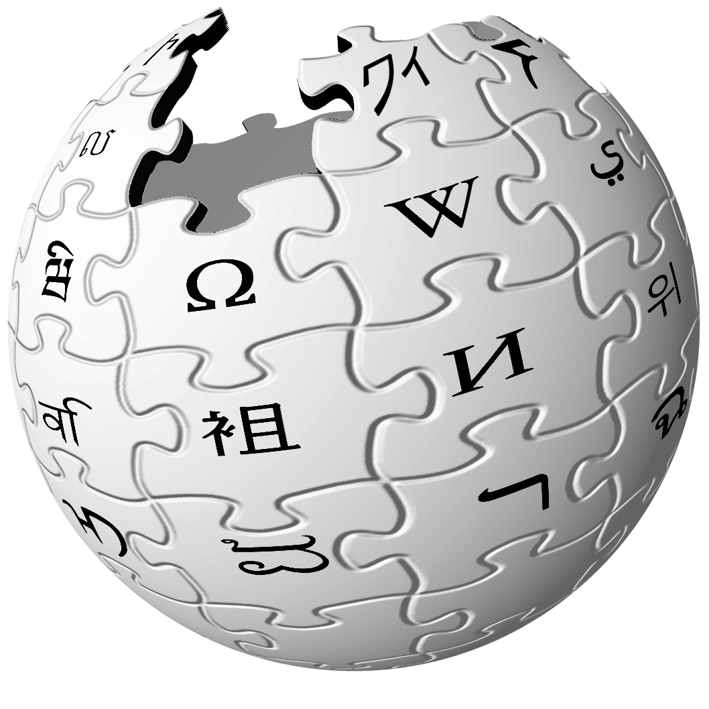
A distributed information system that provides access to hypertext documents and other objects of interest
We have a general name for these objects of interest:
resources

Slide 10
What is a resource?
“Familiar examples [of resources] include an electronic document, an image, a source of information with a consistent purpose (e.g., ‘today's weather report for Los Angeles’), a service (e.g., an HTTP-to-SMS gateway), and a collection of other resources. A resource is not necessarily accessible via the Internet; e.g., human beings, corporations, and bound books in a library can also be resources. Likewise, abstract concepts can be resources, such as the operators and operands of a mathematical equation, the types of a relationship (e.g., ‘parent’ or ‘employee’), or numeric values (e.g., zero, one, and infinity).”
Berners-Lee, T. et al (2005) Uniform Resource Identifier (URI): Generic Syntax. RFC3986.

Slide 11
Web Architecture
Resources are identified by URIs (Uniform Resource Identifiers)
Resources have representations in different formats (HTML, text, PDF)
Resources can be interacted with using network protocols (HTTP)
URI
http://www.bbc.co.uk/weather/2637487
identifies
Resource
accesses
today’s BBC weather forecast for Southampton
Representation
Metadata:
Content-Type: text/html
Data:
<html>
<head>
<title>BBC Weather – Southampton</title>
...
</html>
represents

Slide 12
Web principles
All entities of interest should be identified by URIs
All URIs should be resolvable (i.e. you can use them to fetch something)
When you resolve a URI, you get some data about the identified resource
Data should be provided using standard formats
Data should be linked with other data

Slide 13
5 Stars of Linked Data (2010)
★ Available on the Web (in whatever format) under an open licence
★★ As above, but as machine-readable structured data (e.g. Excel instead of an image of a table)
★★★ As above, but in a non-proprietary format (e.g. CSV instead of Excel)
★★★★ As above, but using W3C standards (RDF, SPARQL) to identify things, so that others can point at your data
★★★★★ As above, but linked to other people’s data to provide context

Slide 14
What is the World Wide Web?

Slide 15
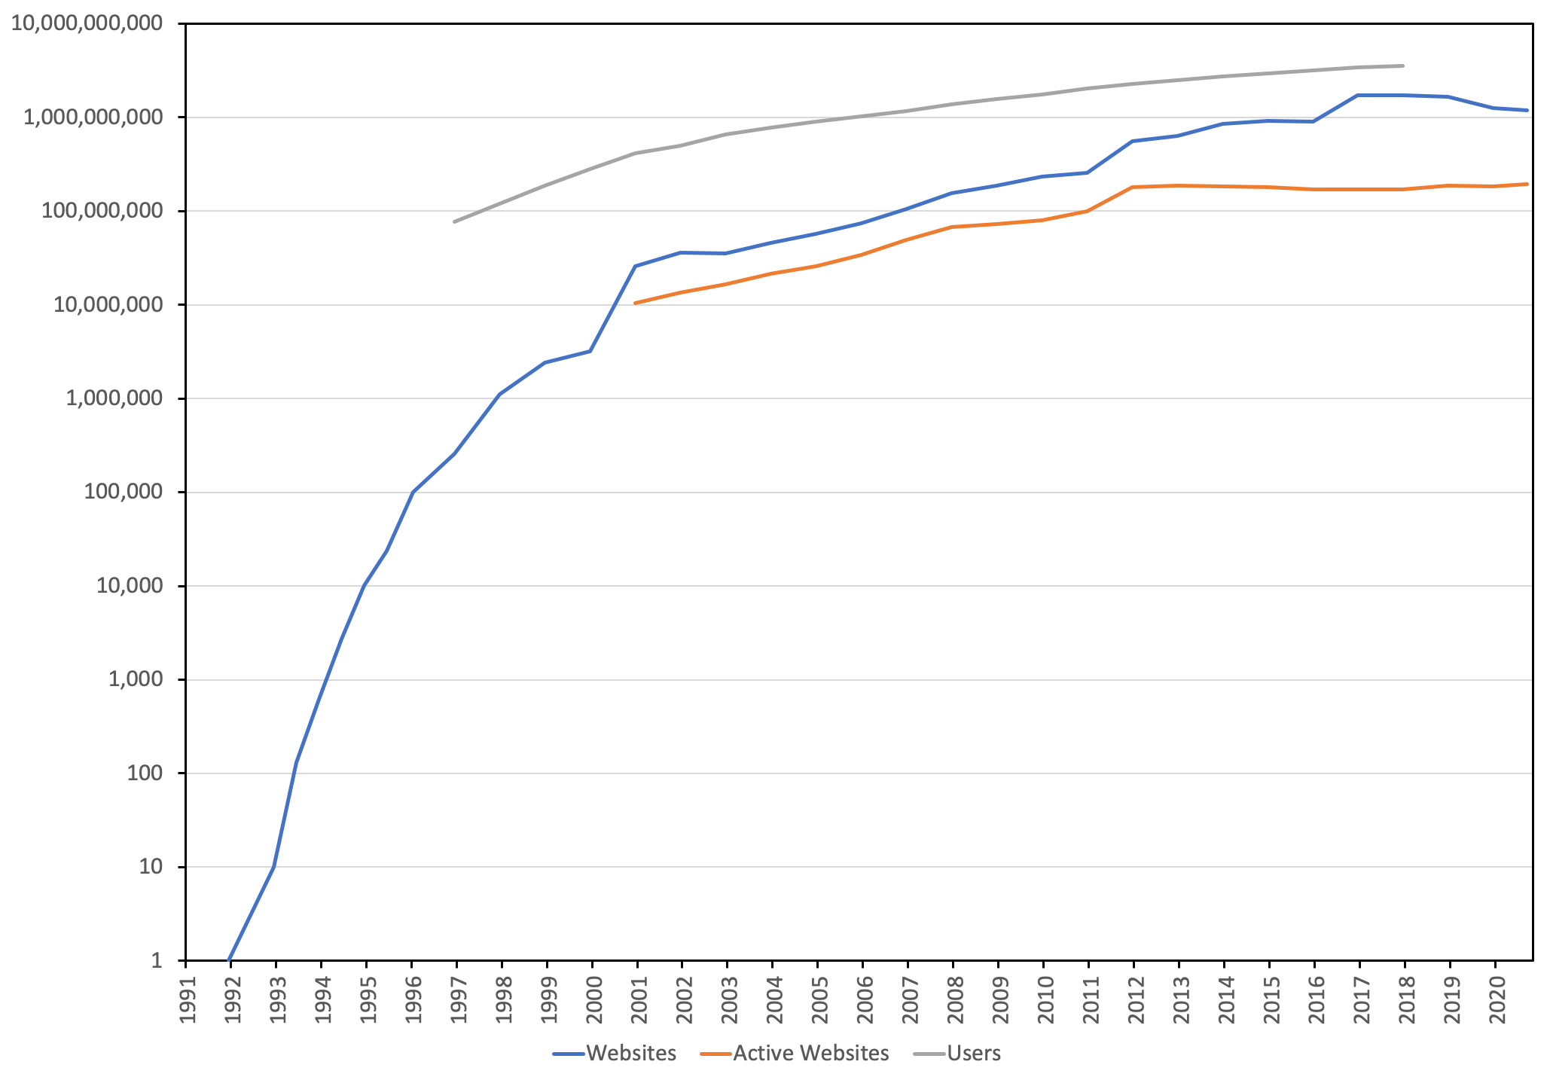
Web growth
Netcraft (2020) Web Server Survey. Available online at: https://news.netcraft.com/archives/category/web-server-survey/
Notes:
Number of web pages on the indexed Web ~=5.5 billion

Slide 16
Measuring the Web
How many webpages are there?
Harder to count than websites (deep Web – not linked)
Estimate size of the indexed Web using search engines
Around 800 million in 1999 (compare with ~3 million websites)
At least 10 billion in 2005 (compare with ~34 million active websites)
At least 1 trillion in 2016 (compare with ~170 billion websites)
What is the diameter of the Web?
How many links do you need to follow to travel between an arbitrary pair of webpages?
Longest shortest finite path
Even harder to measure...
Estimated at 19 in 1999
Lawrence, S. and Giles, C.L. (1999) Accessibility of information on the Web. Nature, 400, pp. 107-109. Albert, R. and Barabási, A-L. (1999) Diameter of the World-Wide Web. Nature, 401, pp.130-133.

Slide 17
The shape of the Web
Broder, A. et al (2000) Graph Structure in the Web. Computer Networks 33, pp. 309-320. Meusel, R. et al (2015) Graph Structure in the Web – Revisited. In Proceedings of the 14th International World Wide Web Conference. pp. 427–432.
Notes:
Number of web pages on the indexed Web ~=5.5 billion

Slide 18
Next Lecture: Hypertext

