Slide 2
Hypertext
COMP3220 Web Infrastructure
Dr Nicholas Gibbins - nmg@ecs.soton.ac.uk

Slide 3
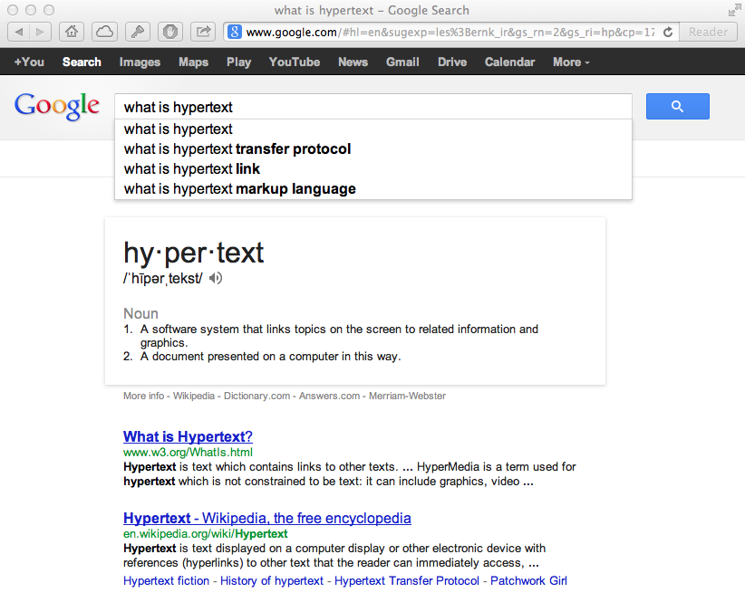

Slide 4
What is Hypertext?
Nelson, T.H. (1965) A file structure for the complex, the changing and the indeterminate.
Proceedings of the 20th ACM National Conference..

Slide 5
What is Hypertext?
[hypertext is] a combination of natural language text with the computer’s capacity for branching, or dynamic display
Nelson, T.H. (1967) "Getting it out of our system": Information Retrieval: A Critical Review, Schechter, G. (ed.). Washington, DC: Thompson Books.

Slide 6
What is Hypertext?
By “hypertext” I mean non-sequential writing
Nelson, T.H. (1974) Computer Lib/Dream Machines. Chicago, IL: Nelson, T.H.

Slide 7
What is Hypertext?
“vague, but exciting”
— Mike Sendall

Slide 8
What is Hypertext?
The reaction of the hypertext research community to the World Wide Web is like finding out that you have a fully grown child.
And it’s a delinquent.
Nelson, T.H. (1997) After-dinner speech at Hypertext ‘97, Southampton, UK.

Slide 9
What is Hypertext?
“An application which uses associative relationships among information contained within multiple media data for the purpose of facilitating access to, and manipulation of, the information encapsulated by the data.”
Lowe, D and Hall, W. (1999) Hypermedia and the Web: An Engineering Approach. Chichester, UK: John Wiley.

Slide 10
What is Hypertext?
Non-linear writing
Interlinked texts
Multiple pathways, multiple reading sequences
Annotation and commentary
Association of ideas
Writing and reading not separated
Interactive
Not limited to text - hypermedia
Notes:
Associative relationships, Non-linearity, networks
Not flat, linear presentation of information, read sequentially but a network of nodes connected by links Author creates connections and (perhaps) the nodes, but reader interactively follows own trail in preferred order and to depth of detail desired, ... and makes new connections? Contrast paper documents - sequential reading. Exceptions Encyclopaedias?

Slide 11
Next Lecture: Hypertext Terminology

