Slide 2
Information Retrieval
COMP3211 Advanced Databases
Dr Nicholas Gibbins – nmg@ecs.soton.ac.uk
2019-2020

Slide 3
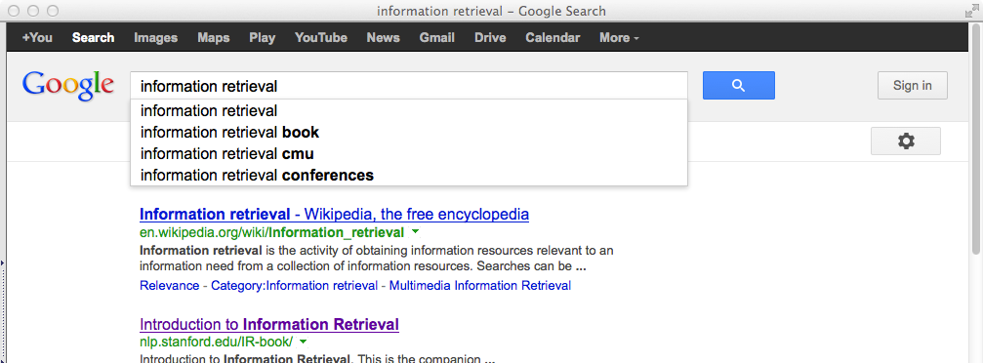
A Definition
Information retrieval (IR) is the task of finding relevant documents in a collection
Best known modern examples of IR are Web search engines

Slide 4
Overview
Information Retrieval System Architecture
Implementing Information Retrieval Systems
Indexing for Information Retrieval
Information Retrieval Models
  Boolean
  Vector
Evaluation

Slide 5
The Information Retrieval Problem
The primary goal of an information retrieval system is to retrieve all the documents that are relevant to a user query while retrieving as few non-relevant documents as possible

Slide 6
Terminology
An information need is a topic about which a user desires to know more
A query is what the user conveys to the computer in an attempt to communicate their information need.
A document is relevant if it is one that the user perceives as containing information of value with respect to their personal information need.

Slide 7
High-Level System Architecture
query
document collection
query
parsing
indexer
index
retrieval and ranking
answerset

Slide 8
Characterising IR Systems
Document collection
  Document granularity: paragraph, page or multi-page text
Query
  Expressed in a query language
  List of words [AI book], a phrase [“AI book”], contain boolean operators [AI AND book] and non-boolean operators [AI NEAR book]
Answer Set
  Set of documents judged to be relevant to the query
  Ranked in decreasing order of relevance

Slide 9
Implementing IR Systems
User expectations of information retrieval systems are exceedingly demanding
  Need to index billion document collections
  Need to return top results from these collections in a fraction of a second
Design of appropriate document representations and data structures is critical

Slide 10
Information Retrieval Models
An information retrieval model consists of
  A set D of representations of the documents in the collection
  A set Q of representations of user information needs (queries)
  A ranking function R(d_{i},q_{i}) that associates a real number with a query representation q_{i} ∈ Q and a document representation d_{i} ∈ D
queries
q_{i}
R(q_{i},d_{i})
d_{i}
documents

Slide 11
Information Retrieval Models
Information retrieval systems are distinguished by how they represent documents, and how they match documents to queries
Several common models:
  Boolean (set-theoretic)
  Algebraic (vector spaces)
  Probabilistic
Notes:
We’ll look at the first two in this lecture in detail

Slide 12
Implementing Information Retrieval

Slide 13
Term Selection
Information retrieval systems either:
  index all words contained in documents (full-text indexing)
  selectively extract index terms from the documents that are to be indexes
term selection
docs
Tokens
Stop word removal
Noun
grouping
Stemming
Manual
indexing
index
terms
full text

Slide 14
Tokenisation
Identify distinct words
  Separate on whitespace, turn each document into list of tokens
  Discard punctuation (but consider tokenisation of O’Neill, and hyphens)
  Fold case, remove diacritics
Tokenisation is language-specific
  Identify language first (using character n-gram model, Markov model)
  Languages with compound words (e.g. German, Finnish) may require special treatment (compound splitting)
  Languages which do not leave spaces between words (e.g. Chinese, Japanese) may require special treatment (word segmentation)
Notes:
Hyphenation – add both hyphenated token and component tokens

Slide 15
Word Significance
P_{n}
Zipf’s law: P_{n} ~= 1/nª
word
frequency
word rank order
n

Slide 16
Word Significance
upper cut-off
P_{n}
lower cut-off
word
frequency
Resolving power of
significant words
significant words
word rank order
n

Slide 17
Stop Word Removal
Extremely common words have little use for discriminating between documents
  e.g. the, of, and, a, or, but, to, also, at, that...
Construct a stop list
  Sort terms by collection frequency
  Identify high frequency stop words (possibly hand-filtering)
  Use stop list to discard terms during indexing

Slide 18
Noun Grouping
Most meaning is carried by nouns
Identify groups of adjacent nouns to index as terms
  e.g. railway station
  Special case of biword indexing

Slide 19
Stemming
Terms in user query might not exactly match document terms
  query contains ‘computer’, document contains ‘computers’
Terms have wide variety of syntactic variations
  Affixes added to word stems, that are common to all inflected forms
  For English, typically suffixes
  e.g. connect is the stem of: connected, connecting, connects
Use stemming algorithm:
  to remove affixes from terms before indexing
  when generating query terms from query
Notes:
Small increase in recall

Slide 20
Stemming Algorithms
Lookup table
  Contains mappings from inflected forms to uninflected stems
Suffix-stripping
  Rules for identifying and removing suffixes
  e.g. ‘-sses’→‘-ss’
  Porter Stemming Algorithm
Lemmatisation
  Identify part of speech (noun, verb, adverb)
  Apply POS-specific normalisation rules to yield lemmas
Notes:
lemma: dictionary form of a word (as opposed to a stem)

Slide 21
Stemming
Yields small (~2%) increase in recall for English
  More important in other languages
Can harm precision
  ‘stock’ versus ‘stocking’
Difficult in agglomerative languages (German, Finnish)
Difficult in languages with many exceptions (Spanish)
  Use a dictionary

Slide 22
Manual Indexing
Identification of indexing terms by a (subject) expert
Indexing terms typically taken from a controlled vocabulary
  may be a flat list of terms, or a hierarchical thesaurus
  may be structured terms
  (e.g. names or structures of chemical compounds)

Slide 23
Result Presentation
Probability ranking principle
  List ordered by probability of relevance
  Good for speed
  Doesn’t consider utility
  If two copies of most relevant document, second has equal relevance but zero utility once you’ve seen the first.
Many IR systems eliminate results that are too similar

Slide 24
Result Presentation
Results classified into pre-existing taxonomy of topics
  e.g. News as world news, local news, business news, sports news
  Good for a small number of topics in collection
Document clustering creates categories from scratch for each result set
  Good for broader collections (such as WWW)

Slide 25
Indexing

Slide 26
Lexicon
Data structure listing all the terms that appear in the document collection
  Lexicon construction carried out after term selection
  Usually hash table for fast lookup
aardvark
antelope
antique
...

Slide 27
Inverted Index
Data structure that relates a word in the lexicon to a document in which it appears (a posting)
May also include:
  occurrence count within document
  pointer to location of word within document
aardvark
d₁₇
d₂₃
antelope
d₁₃
d₁₉
d₂₉
antique
d₁₇
d₂₀
d₃₁
d₃₂
...
lexicon
postings

Slide 28
Searching for single words, attempt 1
If postings consist only of document identifiers, no ranking of results is possible
Lookup query term in lexicon
Use inverted index to get address of posting list
Return full posting list

Slide 29
Searching for single words, attempt 2
If postings also contain term count, we can do some primitive ranking of results:
Lookup query term in lexicon
Use inverted index to get address of posting list
Create empty priority queue with maximum length R
For each document/count pair in posting list
  If priority queue has fewer than R elements,
  add (doc, count) pair to queue
  If count is larger than lowest entry in queue,
  delete lowest entry and add the new pair

Slide 30
Boolean Model

Slide 31
Boolean Model
Lookup each query term in lexicon and inverted index
Apply boolean set operators to posting lists for query terms to identify set of relevant documents
  AND - set intersection
  OR - set union
  NOT - set complement

Slide 32
Example
Document collection:
  d1 = “Three quarks for Master Mark”
  d2 = “The strange history of quark cheese”
  d3 = “Strange quark plasmas”
  d4 = “Strange Quark XPress problem”

Slide 33
Example
Lexicon and inverted index:
  three → {d₁}
  quark → {d₁, d₂, d₃, d₄}
  master → {d₁}
  mark → {d₁}
  strange → {d₂, d₃, d₄}
  history → {d₂}
  cheese → {d₂}
  plasma → {d₃}
  xpress → {d₄}
  problem → {d₄}

Slide 34
Example
Query:
  “strange” AND “quark” AND NOT “cheese”
Result set:
  {d₂, d₃, d4} ∩ {d₁, d₂, d₃, d₄} ∩ {d₁, d₃, d₄} = {d₃, d₄}

Slide 35
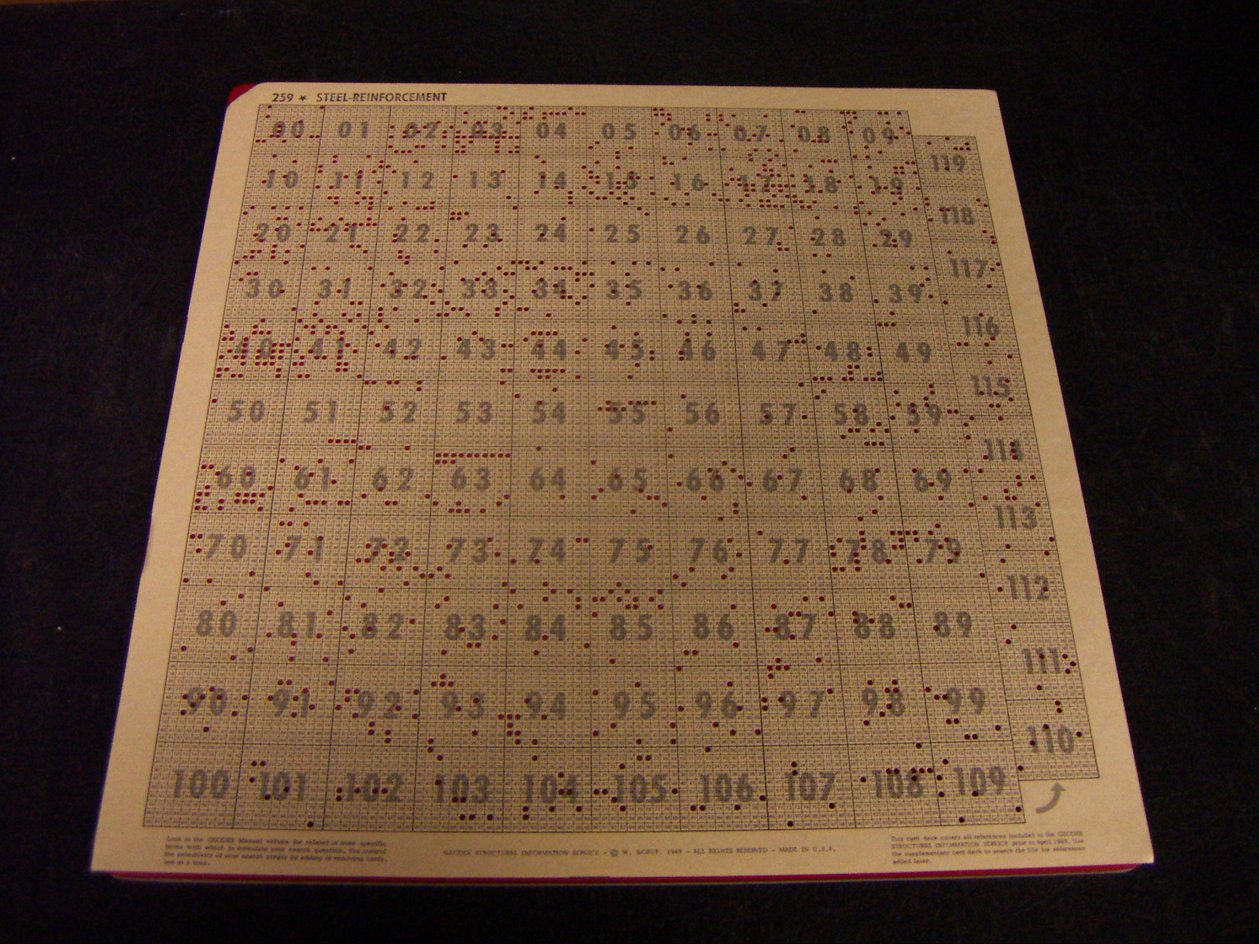
Image courtesy of Deborah Fitchett

Slide 36
Document Length Normalisation
In a large collection, document sizes vary widely
  Large documents are more likely to be considered relevant
Adjust answer set ranking – divide rank by document length
  Size in bytes
  Number of words
  Vector norm

Slide 37
Positional Indexes
If postings include term locations, we can also support a term proximity operator
  term1 /k term2
  effectively an extended AND operator
  term1 occurs in a document within k words of term2
When calculating intersection of posting lists, examine term locations
Notes:
Also a more general NEAR operator

Slide 38
Biword Indexes
Can extend boolean model to handle phrase queries by indexing biwords (pairs of consecutive terms)
Consider a document containing the phrase “electronics and computer science”
  After removing stop words and normalising, index the biwords “electronic computer” and “computer science”
  When querying on phrases longer than two terms, use AND to join constituent biwords

Slide 39
Vector Model

Slide 40
Beyond Boolean
In the basic boolean model, a document either matches a query or not
  Need better criteria for ranking hits (similarity is not binary)
  Partial matches
  Term weighting

Slide 41
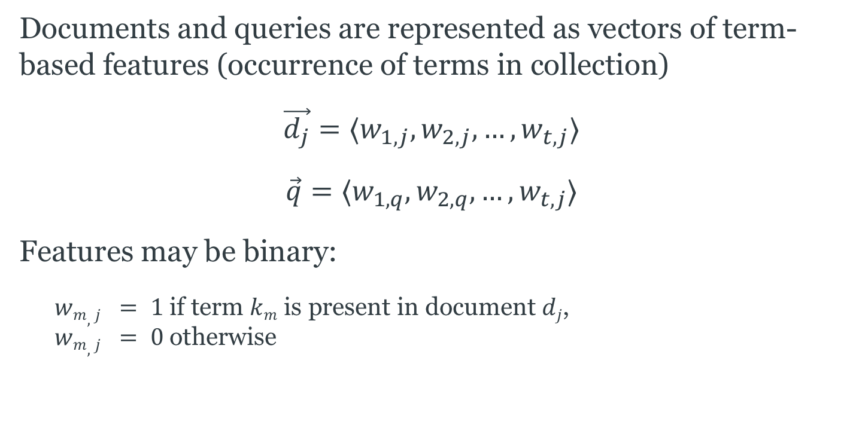
Binary Vector Model
Documents and queries are represented as vectors of term-based features (occurrence of terms in collection)
$$\vec{d_{j}}=⟨w_{1,j},w_{2,j},…,w_{t,j}⟩$$
$$\vec{q}=⟨w_{1,q}, w_{2,q}, …, w_{t,j}⟩$$
Features may be binary:
  $wm,j = 1$if term $km$ is present in document $dj$,
  $wm,j = 0$otherwise

Slide 42
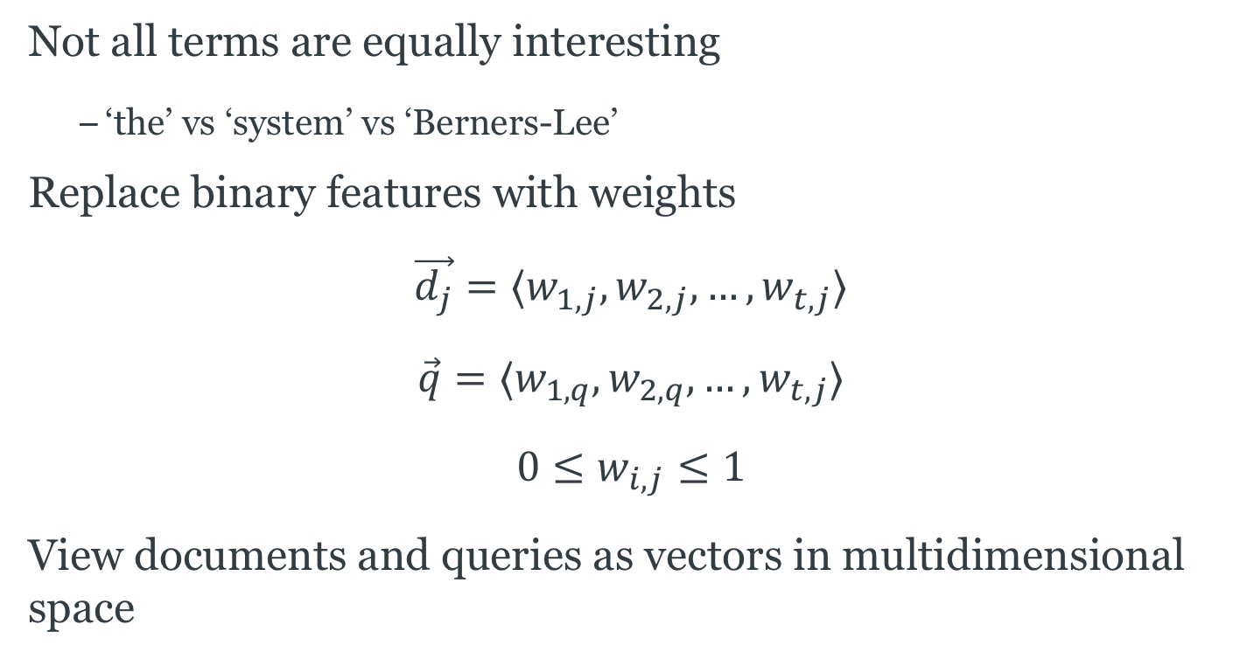
Weighted Vector Model
Not all terms are equally interesting
  ‘the’ vs ‘system’ vs ‘Berners-Lee’
Replace binary features with weights
$$\vec{d_{j}}=⟨w_{1,j},w_{2,j},…,w_{t,j}⟩$$
$$\vec{q}=⟨w_{1,q}, w_{2,q}, …, w_{t,j}⟩$$
$$0≤w_{i,j}≤1$$
View documents and queries as vectors in multidimensional space

Slide 43

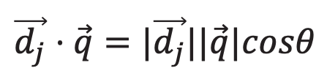


Vector Model Similarity
$$\vec{d_{j}}$$
$$\vec{d_{j}}⋅\vec{q}=|\vec{d_{j}}||\vec{q}|cosθ$$
$$\vec{q}$$
$$θ$$

Slide 44

Vector Model Similarity
Similarity can still be determined using the dot product
  Angle between vectors in multidimensional space
$sim\left(\vec{q},\vec{d_{j}}\right)=\frac{\vec{q}⋅\vec{d_{j}}}{| \vec{q}|| \vec{d_{j}}|}$
$$sim\left(\vec{q},\vec{d_{j}}\right)=\frac{\sum_{i=1}^{t}{w_{i,j}w_{i,q}}}{\sqrt{\sum_{i=1}^{t}{w_{i,j}^{2}\sum_{i=1}^{t}{w_{i,q}^{2}}}}}$$

Slide 45
Term Weighting
Need a basis for assigning weights to terms in documents
How common is the term in the document?
  Within document measure
  Term frequency
How common is the term in the document collection?
  Collection frequency
  Inverse document frequency

Slide 46

TF-IDF
Term Frequency
$$tf_{i,j}=\frac{\#(t_{i} in{ d}_{j})}{\sum_{k}{\#(t_{k} in d_{j})}}$$
Inverse Document Frequency
$$idf_{i}=\log_{2}{\frac{|D|}{|\{d∈D:t_{i} in d\}|}}$$
Term Weighting
$$w_{i,j}=tf_{i,j}idf_{i}$$

Slide 47
TF-IDF Example
Consider the following document collection:
  d₁ = “Introduction to Expert Systems”
  d₂ = “Expert System Software: Engineering and Applications”
  d₃ = “Expert Systems: Principles and Programming”
  d₄ = “The Essence of Expert Systems”
  d₅ = “Knowledge Representation and Reasoning”
  d₆ = “Reasoning About Uncertainty”
  d₇ = “Handbook of Knowledge Representation”
  d₈ = “Expert Python Programming”

Slide 48
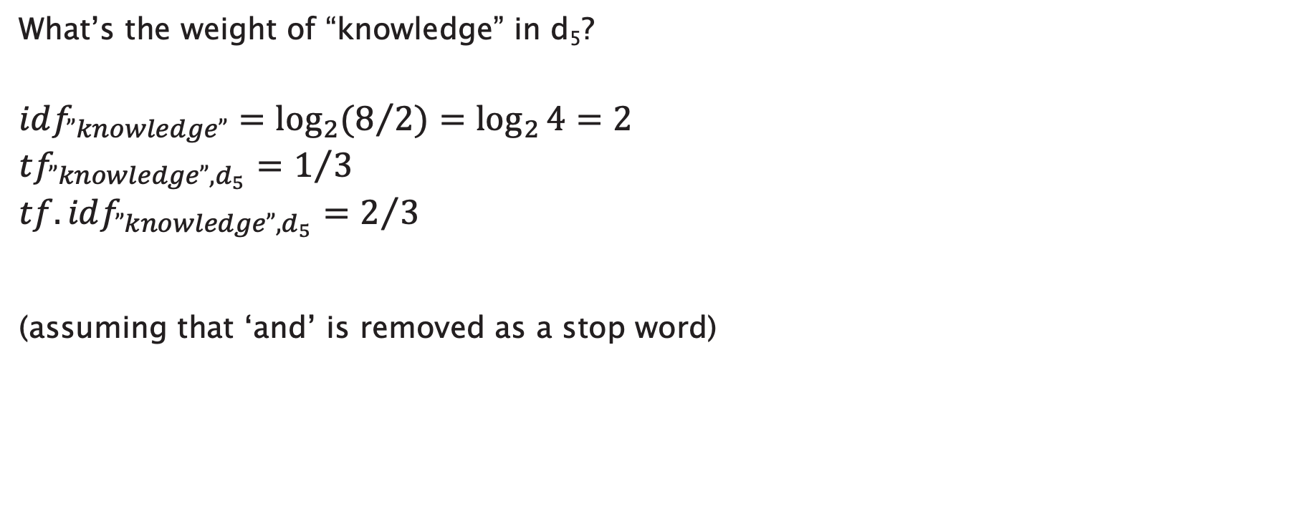
TF-IDF Example
What’s the weight of “knowledge” in d₅?
$$idf_{”knowledge”}=\log_{2}{(8/2)}=\log_{2}{4}=2$$
$$tf_{”knowledge”,d_{5}}=1/3$$
$$tf.idf_{”knowledge”,d_{5}}=2/3$$
(assuming that ‘and’ is removed as a stop word)
Notes:
Assuming that ‘and’

Slide 49
Query Refinement

Slide 50
Query Refinement
Typical queries very short, ambiguous
  Add more terms to disambiguate, improve
Often difficult for users to express their information needs as a query
  Easier to say which results are/aren’t relevant than to write a better query

Slide 51
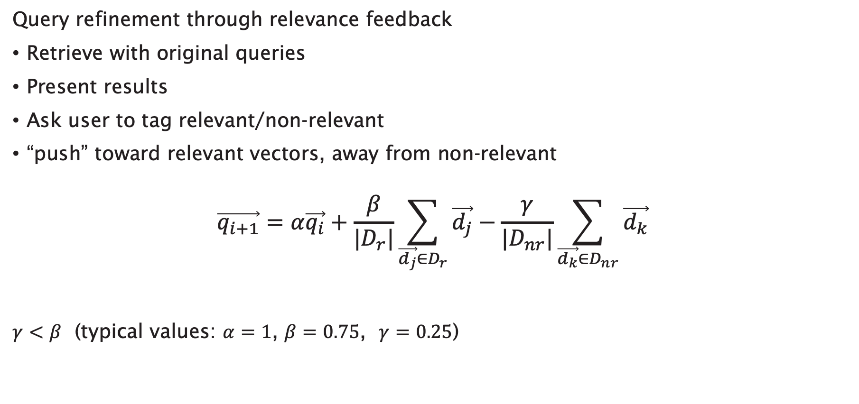
Rocchio Method
Query refinement through relevance feedback
Retrieve with original queries
Present results
Ask user to tag relevant/non-relevant
“push” toward relevant vectors, away from non-relevant
$$\vec{q_{i+1}}=α\vec{q_{i}}+\frac{β}{|D_{r}|}\sum_{\vec{d_{j}}∈D_{r}}{\vec{d_{j}}}−\frac{γ}{|D_{nr}|}\sum_{\vec{d_{k}}∈D_{nr}}{\vec{d_{k}}}$$
$γ<β$ (typical values: $α=1$, $β=0.75$, $γ=0.25$)

Slide 52




Rocchio Method
$$Dr$$
$$q_{n+1}$$
$$qn$$
$$Dnr$$

Slide 53
Evaluation

Slide 54
Relevance
Relevance is the key to determining the effectiveness of an IR system
  Relevance (generally) a subjective notion
  Relevance is defined in terms of a user’s information need
  Users may differ in their assessment of relevance of a document to a particular query

Slide 55
Relevance versus Retrieved
The set of all documents
The set of relevant
documents
The set of retrieved
documents
R
A
Notes:
Maximise the intersection between these two sets

Slide 56
Precision and Recall
Two common statistics used to determine effectiveness:
Precision: What fraction of the returned results are relevant to the information need?
Recall: What fraction of the relevant documents in the collection were returned by the system?

Slide 57
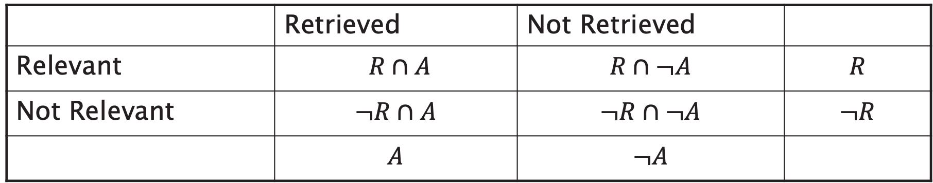
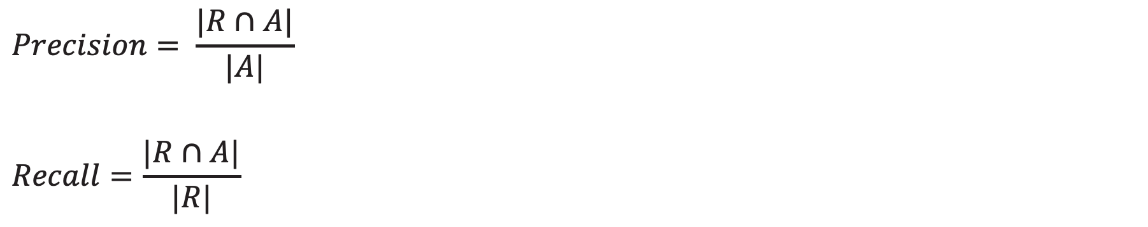
Precision and Recall
 | Retrieved | Not Retrieved
Relevant | $R∩A$ | $$R∩¬A$$ | $$R$$
Not Relevant | $$¬R∩A$$ | $$¬R∩¬A$$ | $$¬R$$
 | $$A$$ | $$¬A$$
$$Precision= \frac{|R∩A|}{|A|}$$
$$Recall=\frac{|R∩A|}{|R|}$$
Notes:
Contingency table
Very difficult to compute recall in WWW because no easy way to examine every page of the web
Estimate recall by sampling or ignore completely

Slide 58
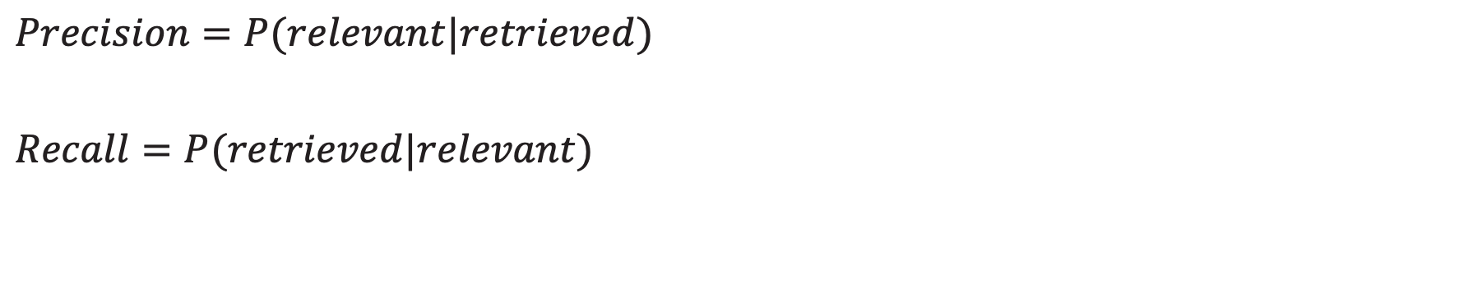
Precision and Recall, an alternative view
 | Retrieved | Not Retrieved
Relevant | $R∩A$ | $$R∩¬A$$ | $$R$$
Not Relevant | $$¬R∩A$$ | $$¬R∩¬A$$ | $$¬R$$
 | $$A$$ | $$¬A$$
$$Precision=P(relevant|retrieved)$$
$$Recall=P(retrieved|relevant)$$

Slide 59
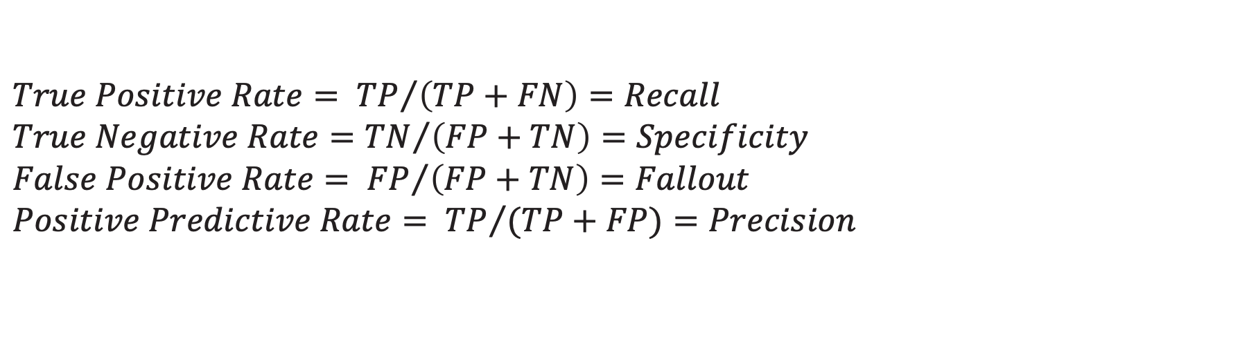
Positive and Negative Rates
 | Retrieved | Not Retrieved
Relevant | True Positive | False Negative
Not Relevant | False Positive | True Negative
$$True Positive Rate= {TP}/{\left(TP+FN\right)=Recall}$$
$$True Negative Rate={TN}/{\left(FP+TN\right)=Specificity}$$
$$False Positive Rate= {FP}/{\left(FP+TN\right)}=Fallout$$
$$Positive Predictive Rate= {TP}/{(TP+FP)}=Precision$$
Notes:
Specificity measures how well the system rejects irrelevant documents

Slide 60
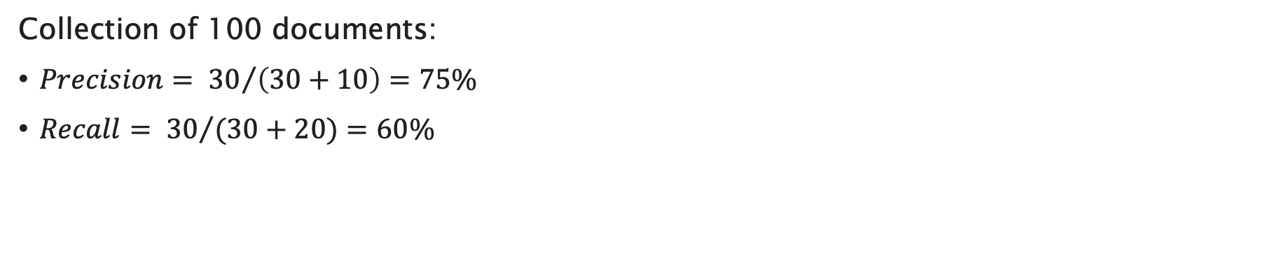
Example
 | Retrieved | Not Retrieved
Relevant | 30 | 20
Not Relevant | 10 | 40
Collection of 100 documents:
$Precision= {30}/{\left(30+10\right)}=75\%$
$Recall= {30}/{(30+20)}=60\%$

Slide 61
Precision versus Recall
Can trade off precision against recall
  A system that returns every document in the collection as its result set guarantees recall of 100% but has low precision
  Returning a single document could give low recall but 100% precision

Slide 62
Precision versus Recall
precision
varying control parameter
line of iso-effectiveness
recall

Slide 63
Precision versus Recall
precision
Increasing effectiveness
recall
Notes:
Note: comparison using AVERAGED precision/recall

Slide 64
Precision versus Recall - Example
An information retrieval system contains the following ten documents that are relevant to a query q:
d1, d2, d3, d4, d5,
d6, d7, d8, d9, d10
In response to q, the system returns the following ranked answer set containing fifteen documents (bold are relevant):
d3, d11, d1, d23, d34,
d4, d27, d29, d82, d5,
d12, d77, d56, d79, d9

Slide 65

Precision versus Recall - Example
Calculate curve at eleven standard recall levels:
0%, 10%, 20%, ... 100%
Interpolate precision values as follows:
$$P\left(r_{j}\right)=\max_{∀r>r_{j}}{P(r)}$$
where $r_{j}$ is the j-th standard recall level

Slide 66
Precision versus Recall - Example
Calculate curve at eleven standard recall levels:
0%, 10%, 20%, ... 100%
If only d3 is returned
  Precision = 1 / 1 = 100%
  Recall = 1 / 10 = 10%

Slide 67
Precision versus Recall - Example
Calculate curve at eleven standard recall levels:
0%, 10%, 20%, ... 100%
If d3, d11, d1 are returned
  Precision = 2 / 3 = 67%
  Recall = 2 / 10 = 20%

Slide 68
Precision versus Recall - Example
Calculate curve at eleven standard recall levels:
0%, 10%, 20%, ... 100%
If d3, d11, d1, d23, d34, d4 are returned
  Precision = 3 / 6 = 50%
  Recall = 3 / 10 = 30%

Slide 69
Precision versus Recall - Example
Calculate curve at eleven standard recall levels:
0%, 10%, 20%, ... 100%
If d3, d11, d1, d23, d34, d4, d27, d29, d82, d5 are returned
  Precision = 4 / 10 = 40%
  Recall = 4 / 10 = 40%

Slide 70
Precision versus Recall - Example
Calculate curve at eleven standard recall levels:
0%, 10%, 20%, ... 100%
If full answer set is returned
  Precision = 5 / 15 = 33%
  Recall = 5 / 10 = 50%

Slide 71
Precision versus Recall

Slide 72
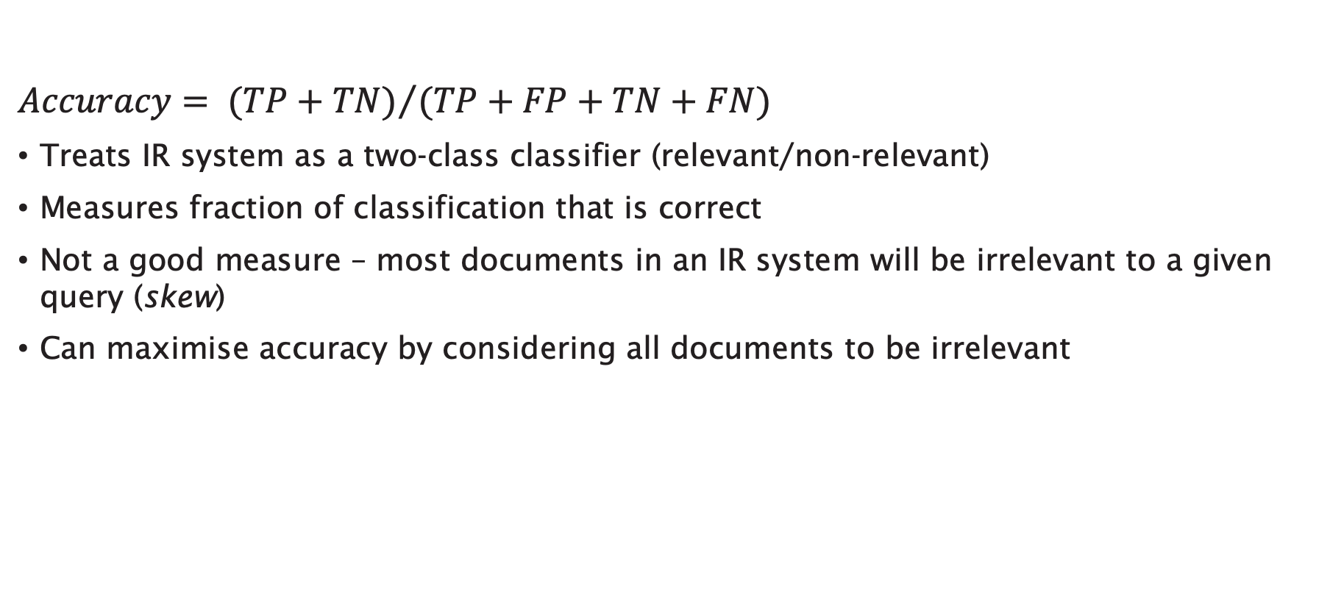
Accuracy
$$Accuracy= {(TP+TN)}/{(TP+FP+TN+FN)}$$
Treats IR system as a two-class classifier (relevant/non-relevant)
Measures fraction of classification that is correct
Not a good measure – most documents in an IR system will be irrelevant to a given query (skew)
Can maximise accuracy by considering all documents to be irrelevant

Slide 73
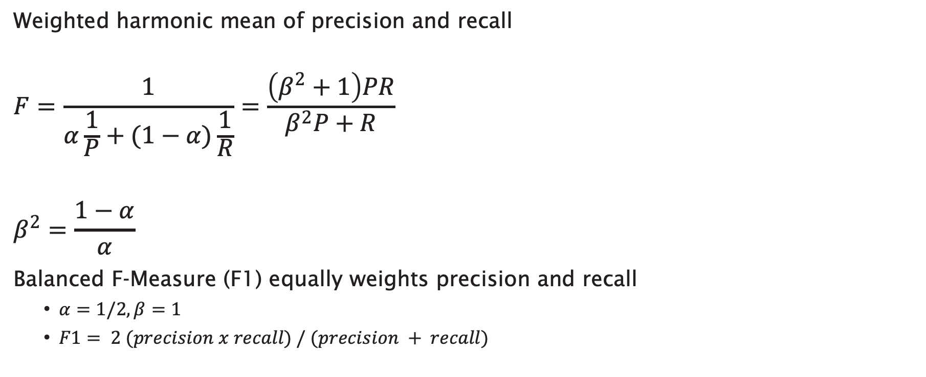
F-Measure
Weighted harmonic mean of precision and recall
$$F=\frac{1}{α\frac{1}{P}+(1−α)\frac{1}{R}}=\frac{\left(β^{2}+1\right)PR}{β^{2}P+R}$$
$$β^{2}=\frac{1−α}{α}$$
Balanced F-Measure (F1) equally weights precision and recall
  $α=1/2, β=1$
  $F1= 2 (precision x recall) / (precision + recall)$

Slide 74
Average Precision at N (P@N)
For most users, recall is less important than precision
  How often do you look past the first page of results?
Calculate precision for the first N results
  Typical values for N: 5, 10, 20
  Average over a sample of queries (typically 100+)
Notes:
How often do you look past the first page of results?

Slide 75
Receiver Operating Characteristic
Plot curve with:
  True Positive Rate on y axis (Recall or Sensitivity)
  False Positive Rate on x axis (1 – Specificity)

Slide 76
Receiver Operating Characteristic Curve
1.0
perfect
better
TPR
line of discrimination
worse
0.0
0.0
FPR
1.0

Slide 77
Other Effectiveness Measures
Reciprocal rank of first relevant result:
  if the first result is relevant it gets a score of 1
  if the first two are not relevant but the third is, it gets a score of 1/3
Time to answer measures how long it takes a user to find the desired answer to a problem
  Requires human subjects

Slide 78
Moving to Web Scale

Slide 79
Scale
Typical document collection:
  1E6 documents; 2-3 GB of text
  Lexicon of 500,000 words after stemming and case folding; can be stored in ~10 MB
  Inverted index is ~300 MB (but can be reduced to >100 MB with compression)

Slide 80
Web Scale
Web search engines have to work at scales over four orders of magnitude larger (1.1E10+ documents in 2005)
  Index divided into k segments on different computers
  Query sent to computers in parallel
  k result sets are merged into single set shown to user
  Thousands of queries per second requires n copies of k computers
Web search engines don’t have complete coverage (Google was best at ~8E9 documents in 2005)

Slide 81
Extended Ranking
So far, we’ve considered the role that document content plays in ranking
  Term weighting using TF-IDF
Can also use document context – hypertext connectivity
  HITS
  Google PageRank

