Slide 1
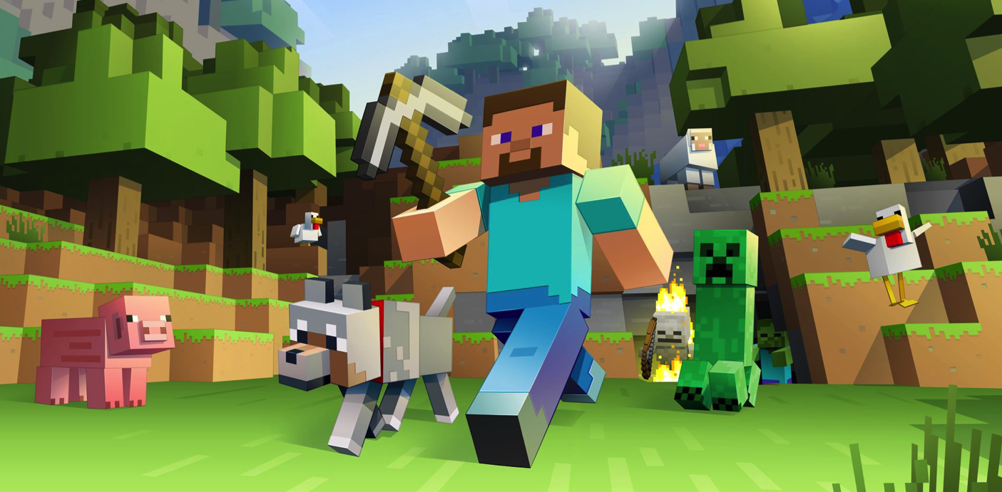
Games Design and Development
Welcome to COMP3218

Slide 2
Games Matter
“Life is more fun if you play games.”
Roald Dahl, My Uncle Oswald
“Games lubricate the body and the mind.”
Benjamin Franklin
“Reality is broken. Game designers can fix it.”
Jane McGonigal
Computer Games are our medium, our culture, our means of expression. They matter because they reflect us.

Slide 3
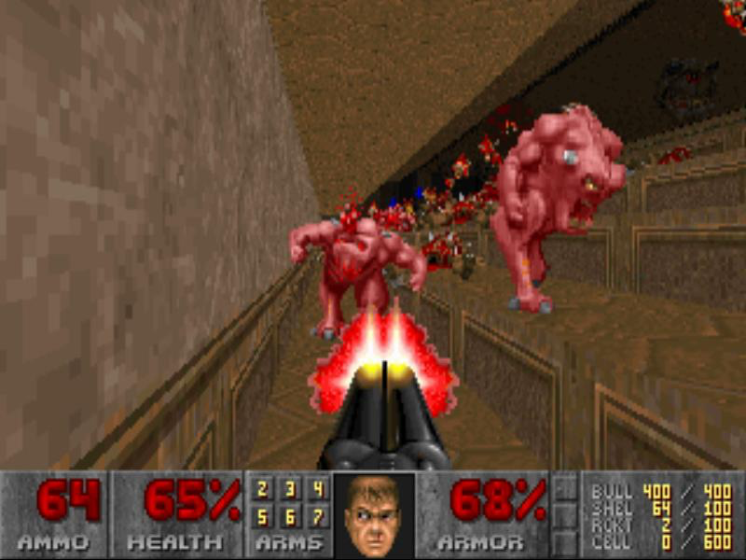
Games Matter
“Over the centuries, mankind has tried many ways of combating the forces of evil... prayer, fasting, good works and so on
Terry Pratchett
Doom

Slide 4
Games Matter
“Over the centuries, mankind has tried many ways of combating the forces of evil... prayer, fasting, good works and so on. Up until Doom, no one seemed to have thought about the double-barrel shotgun. Eat leaden death, demon...”
Terry Pratchett
Doom

Slide 5
For Everyone
We believe that everyone, no matter what gender, sexual orientation, ethnicity, religion or disability has the right to play games, criticize games and make games without getting harassed or threatened. It is the diversity of our community that allows games to flourish.
If you see threats of violence or harm in comments on Steam, YouTube, Twitch, Twitter, Facebook or reddit, please take a minute to report them on the respective sites.
If you see hateful, harassing speech, take a public stand against it and make the gaming community a more enjoyable space to be in.
Because Games Matter!
Horizon Zero Dawn

Slide 6
Who Are We?

Slide 7
Who Are We?
David Millard
@hoosfoos | davidmillard.org | dem@soton.ac.uk
Team Fortress 2

Slide 8
Who Are We?
age chapman
Adriane.Chapman@soton.ac.uk
Team Fortress 2

Slide 9
Who Are We?
Tom Blount
@Tom_Blount | tb12g09@ecs.soton.ac.uk
Team Fortress 2

Slide 10
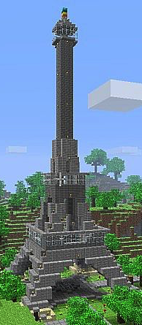
Structure
We have two objectives:
1) To make you think more deeply about games
2) To give you direct experience of making games
So the course is based around two Unity game development activities done in pairs
Each lasts five weeks
Different pair for each activity
Each finishes with an Expo where you show your games to each other and other students
Minecraft

Slide 11
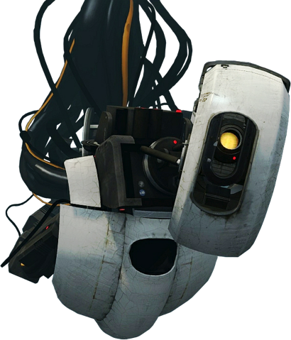
How Will You Be Assessed?
For each Expo:
You submit a 1 page document answering key questions about your game
Related to the ideas and theories from the course
Explaining how you responded to feedback from labs
You submit the game itself – as a runnable game (a windows .exe), and as a project (.zip)
We mark the submission as one, you will get
public feedback in the form of a Let’s Play video
We will compare your game to the marks criteria
But will not discuss marks (you get a private email instead)
Search for COMP3218 on YouTube for previous years’
There is no exam. 100% of marks come from the 2 games. Marks are shared equally between your pair.
Portal

Slide 12
Marks Breakdown
Quality
40%
Brief
30%
Design
20%
Feed-
Back
10%
Expo1
50%
Game 1
Expo2
50%
Game 2
Portal

Slide 13
Structure
Week | Lectures (Tue 9-11am ) | Lab (Thu 3-5pm) | Person
1 | Intro to the Course and Unity | No lab | all
2 | Game Structures and Elements | Unity Workshop | age
3 | Mechanics, Dynamics, and Interactions | Sprint Workshop | age
4 | Level Design and Tutorials | Sprint Workshop | tb
5 | Balance and Difficulty | Feedback Workshop | dem
6 | Adaptivity and Procedural Generation | Sprint Workshop | age
7 | Interactivity, Agency and Non-linear Narratives | Expo 1 | dem
8 | Writing for Games: Form and Technique | Sprint Workshop | tb
9 | Game Narrative Design and Poetics | Sprint Workshop | dem
10 | Innovation in Games | Feedback Workshop | dem
11 | The Games Industry Guest Lecture | Sprint Workshop | all
12 | No lecture | Expo 2
Sprint 1
Game Design Basics
EASTER
Sprint 2
Narrative

Slide 14
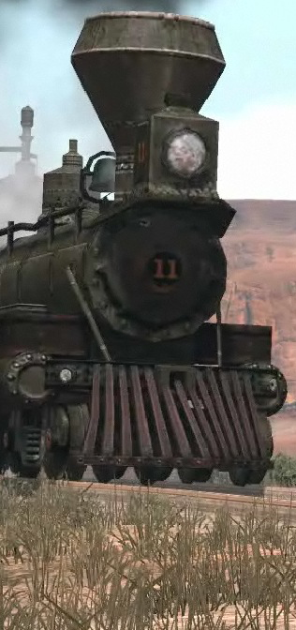
In this course we will use Unity
Cross-platform Game Engine
2d and 3d support
Scripts written in C# and JavaScript
Download Unity from www.unity.com
Free Personal Edition is sufficient
Great Tutorials at www.unity.com/learn
Red Dead Redemption

Slide 15
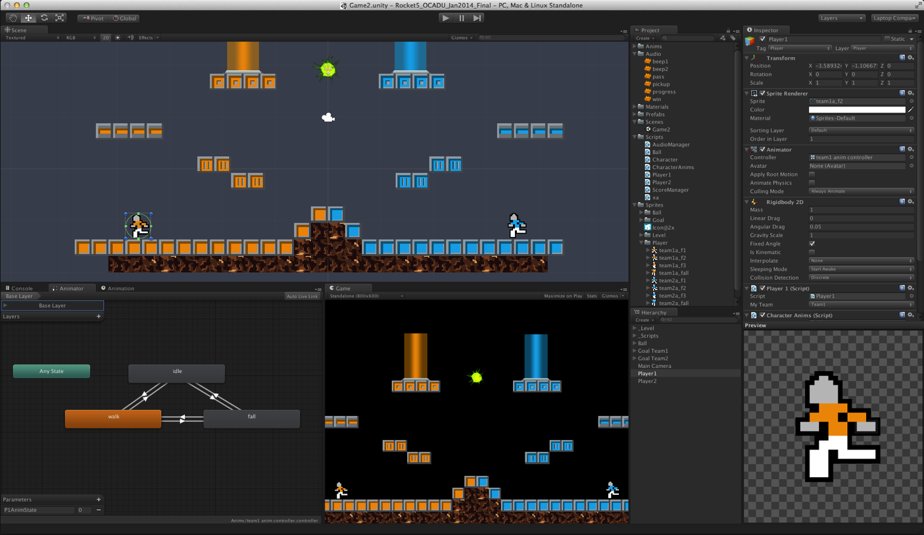
Example Screen
Rocket5studios, Unity tutorials - www.rocket5studios.com/tag/unity3d/

Slide 16
Alternatives to Unity
General Platforms
Unreal Engine (suite of game dev tools)
Gamemaker (drag + drop with simple scripts)
Genre Specific
Twine (web-based tool for creating IF)
Inform 7 (natural language tool for IF)
AGS (tools to create graphic adventure games)
RPGmaker (tools to create 2d (J)RPGs
For this course please use Unity – it’s a powerful, flexible and popular engine – knowing it will only do you good!

Slide 17
Labs
Lab (Thu 3-5pm)
No lab
Unity Workshop
Sprint Workshop
Sprint Workshop
Feedback Workshop
Sprint Workshop
Expo 1
Sprint Workshop
Sprint Workshop
Feedback Workshop
Sprint Workshop
Expo 2
Tuesday 1500-1700, building 25/1009
Plenty of Machines with Unity (2 per pair)
Welcome to bring your own machine
Unity personal license is free
There are four types of lab event:
Unity Workshop – work through a Unity Tutorial
Sprint Workshop – work with partner on your game
Feedback Workshop – get feedback on your game idea
Expo – show off your games to each other
Relatively unstructured but demonstrators will be there to answer questions and help where possible

Slide 18
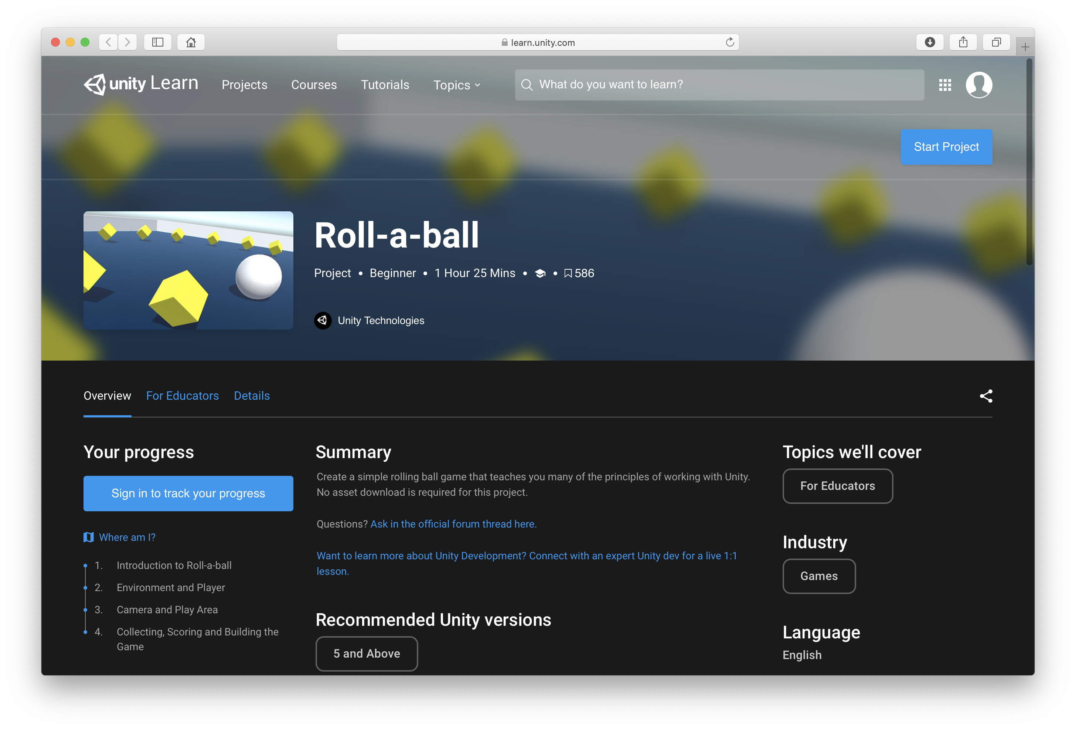
Roll-a-ball tutorial

Slide 19
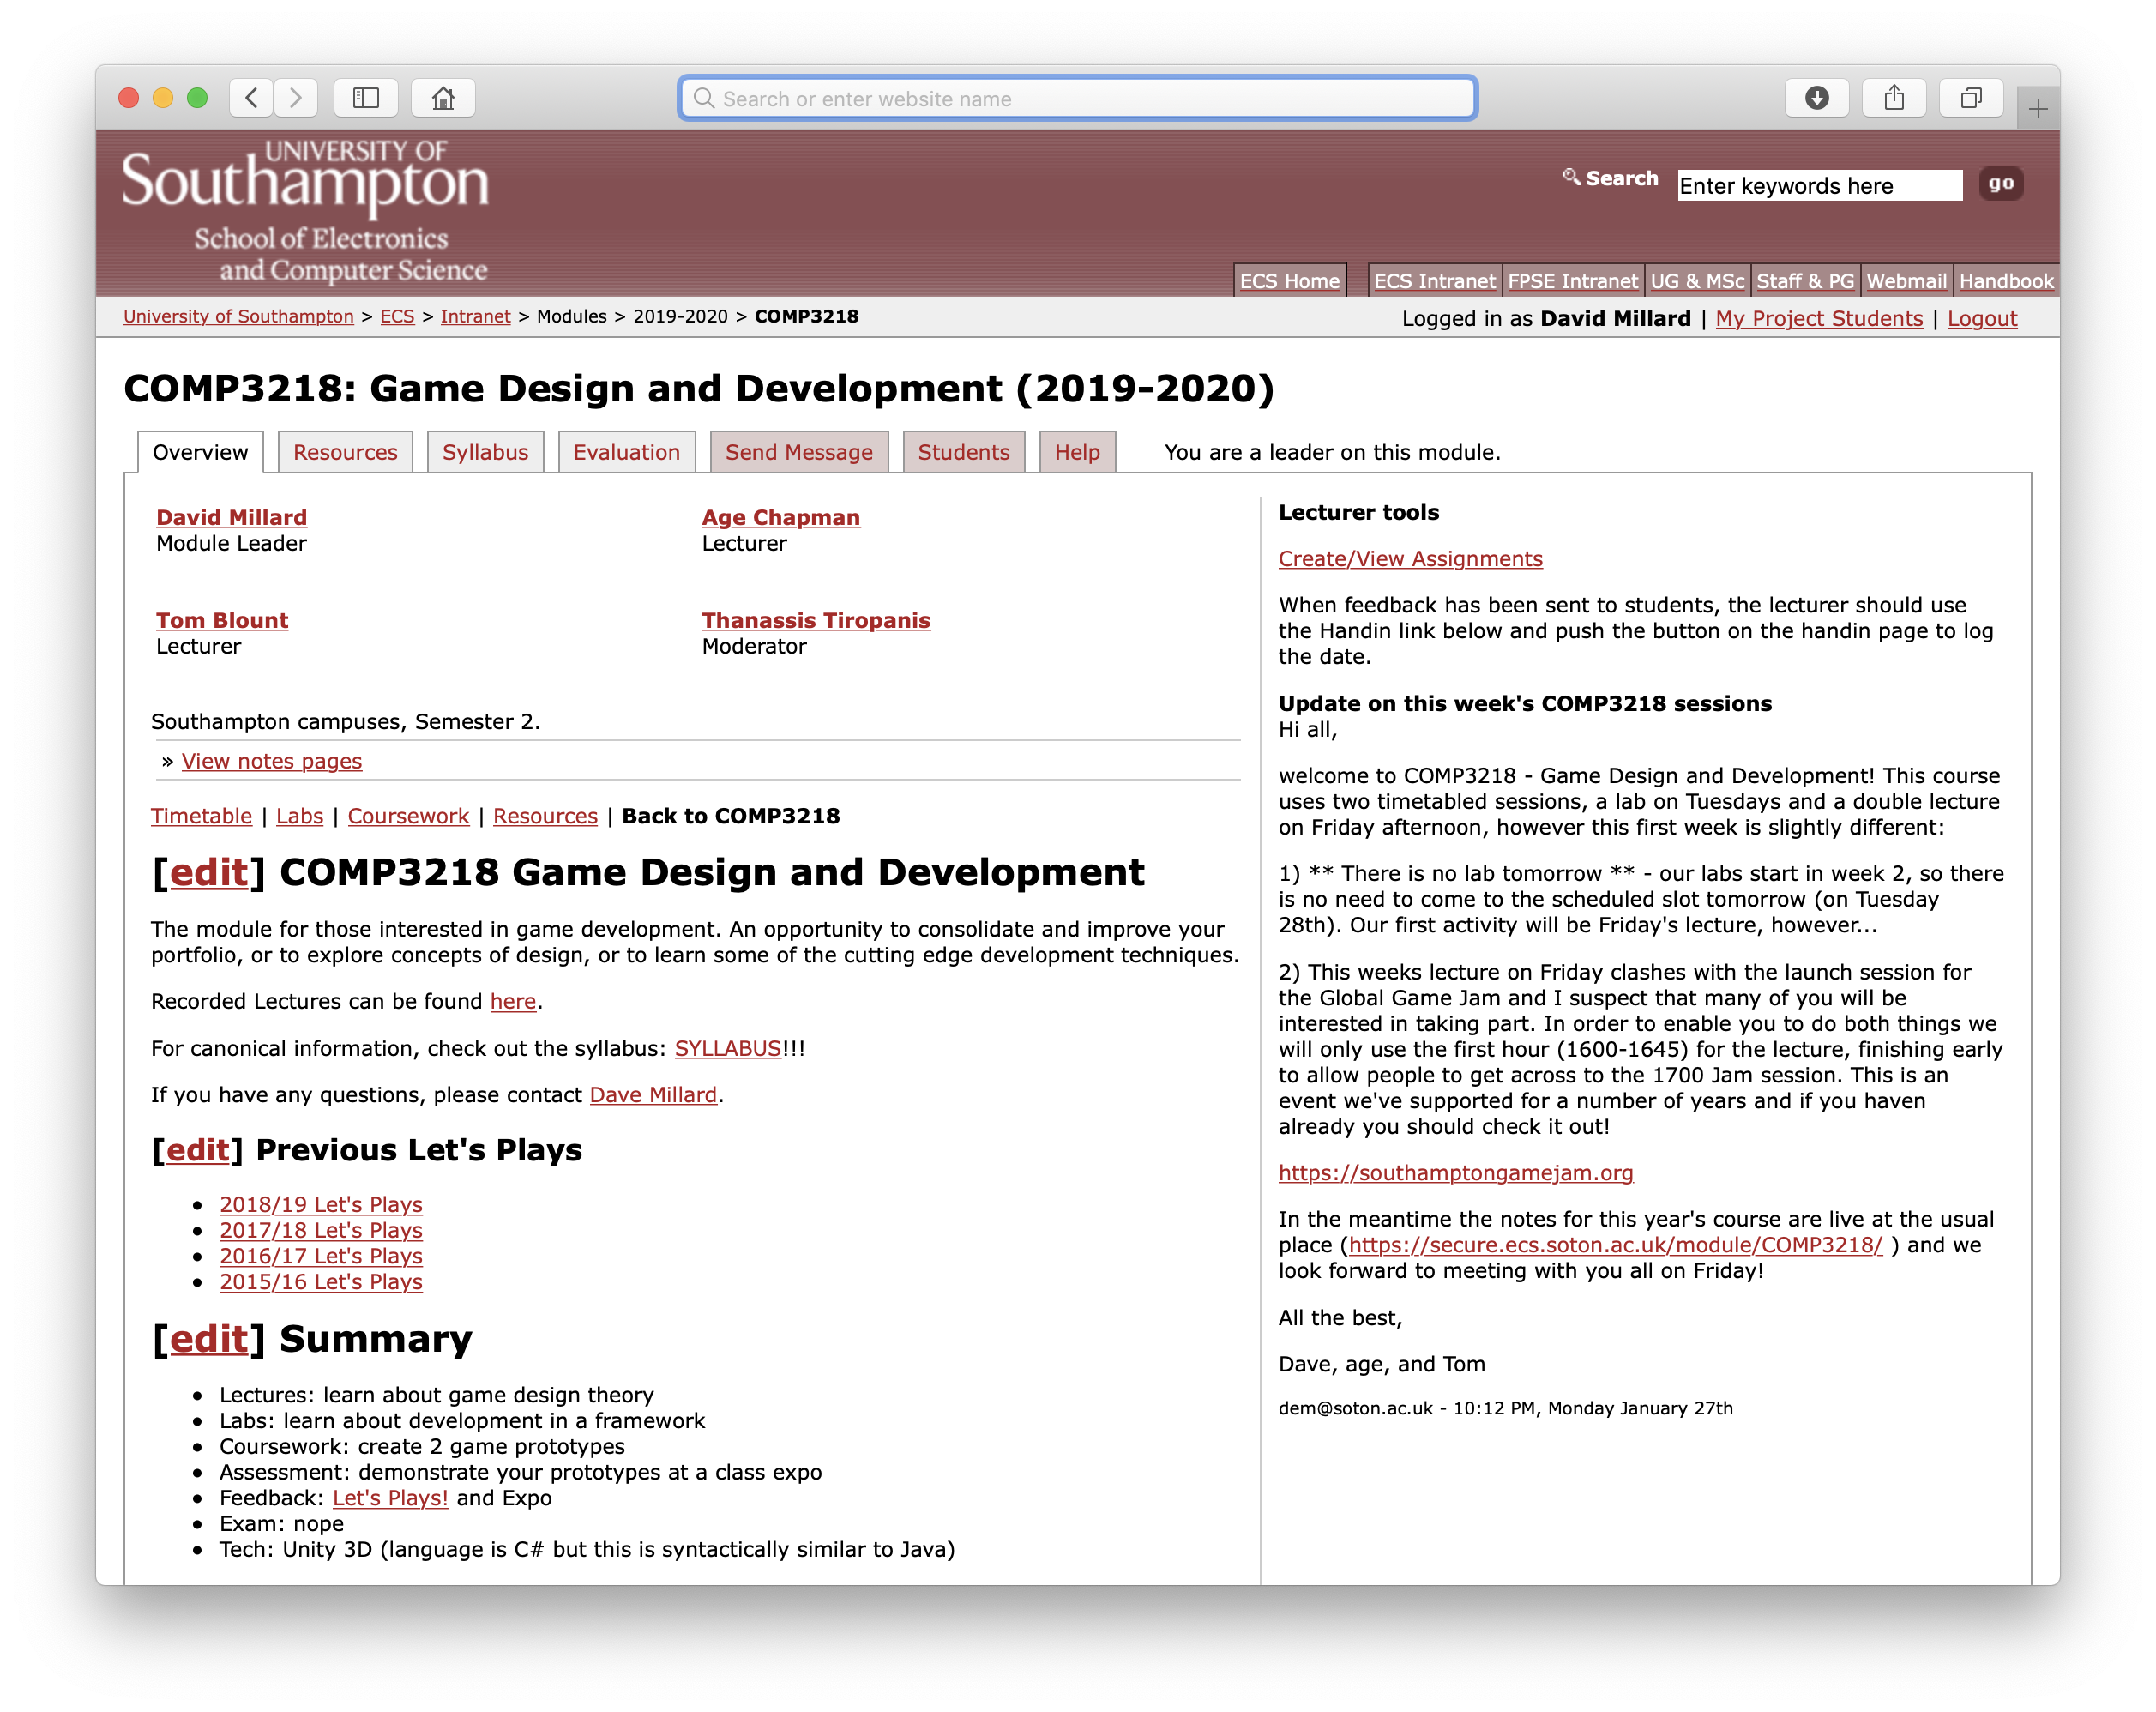
Website
Timetable
Presentations
Tutorial Links
Expo Info
Resources
https://secure.ecs.soton.ac.uk/module/COMP3218/

Slide 20
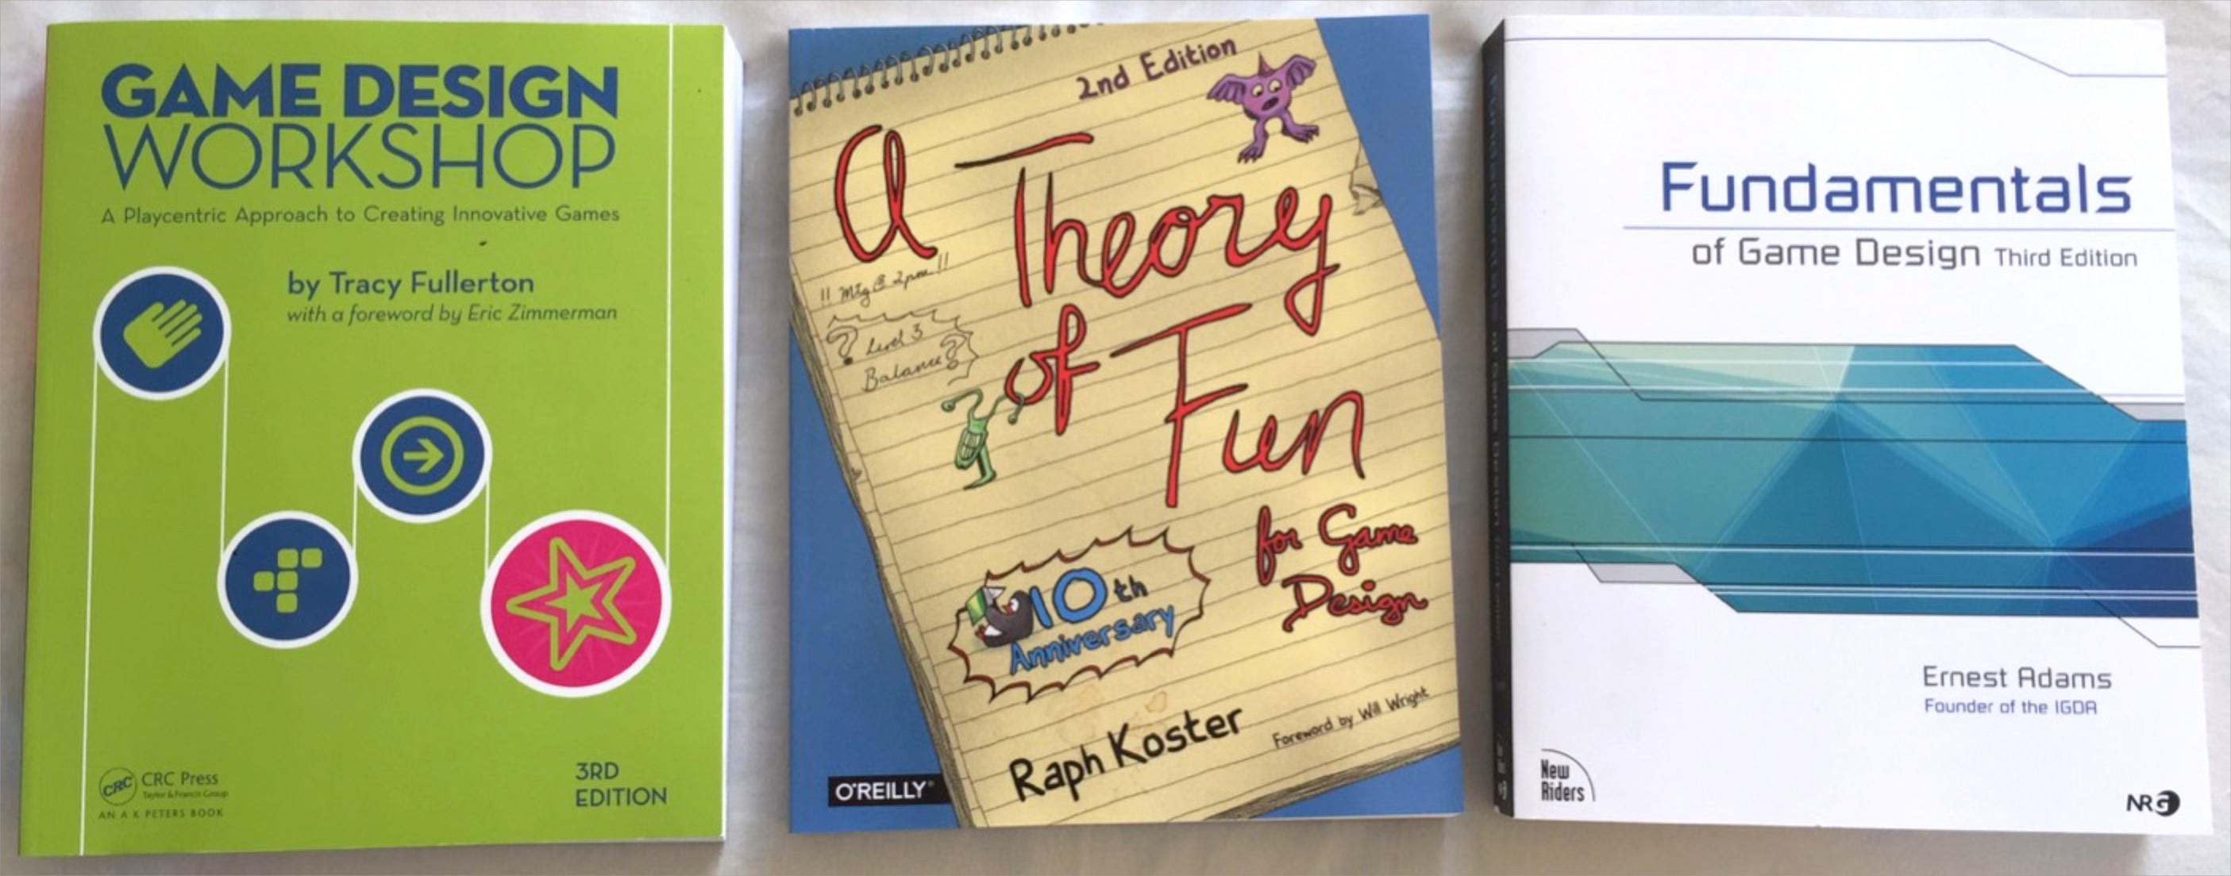
Books + Resources
Course Text: Game Design Workshop
Available online as a PDF* or through the library
* Google is your friend

Slide 21
Online Resources
YouTube channel on all aspects of game design
Started by James Portnow and Daniel Floyd
Links to relevant episodes on our website
www.extra-credits.net
www.youtube.com/user/ExtraCreditz
Free online version of Game Developer Magazine
Lots of info on the games industry
Case studies of real problems tackled in real games
www.gamasutra.com

Slide 22
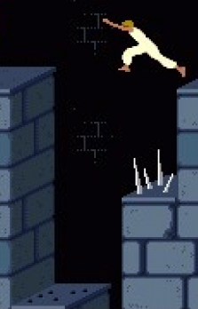
Pitfalls
Creating Games is fun and absorbing
DON’T SPEND TOO MUCH TIME ON IT!
Expectation is 8 hours a week (inc lectures!) ≈ 25 hours of dev time each per Expo
The goal of each Expo is not a complete game – there are no marks for scale!
Work on creating a small playable prototype that fulfills the brief
Prince of Persia

Slide 23
Pitfalls 2
Creating Games is fun and absorbing
DON’T FORGET THE GOAL!
This is not about creating random games
For each Expo you will be expected to demonstrate a specific thing
60% of the mark is for this!
A good game will get a bad mark if it does not fulfil the brief!
Prince of Persia: The Sands of Time

Slide 24
Marks Breakdown
Quality
40%
Brief
30%
Design
20%
Feed-
Back
10%
Expo1
50%
Game 1
Expo2
50%
Game 2
Portal

Slide 25
Marks Breakdown
Quality
40%
Brief
30%
Design
20%
Feed-
Back
10%
Expo1
50%
Game 1
Expo2
50%
Don’t attend the labs
Game 2
Portal

Slide 26
Marks Breakdown
Quality
40%
Brief
30%
Design
20%
Expo1
50%
Game 1
Expo2
50%
Don’t attend the labs
Game 2
Portal

Slide 27
Marks Breakdown
Quality
40%
Brief
30%
Design
20%
Expo1
50%
Game 1
Expo2
50%
Don’t apply what you’ve learned
Game 2
Portal

Slide 28
Marks Breakdown
Quality
40%
Brief
30%
Expo1
50%
Game 1
Expo2
50%
Don’t apply what you’ve learned
Game 2
Portal

Slide 29
Marks Breakdown
Quality
40%
Brief
30%
Expo1
50%
Game 1
Expo2
50%
Don’t do what was asked
Game 2
Portal

Slide 30
Marks Breakdown
Quality
40%
Expo1
50%
Game 1
Expo2
50%
Don’t do what was asked
Game 2
Portal

Slide 31
Extra Credits – Ludus Florentis
https://www.youtube.com/watch?v=dGJCTOsbqNI

Slide 32
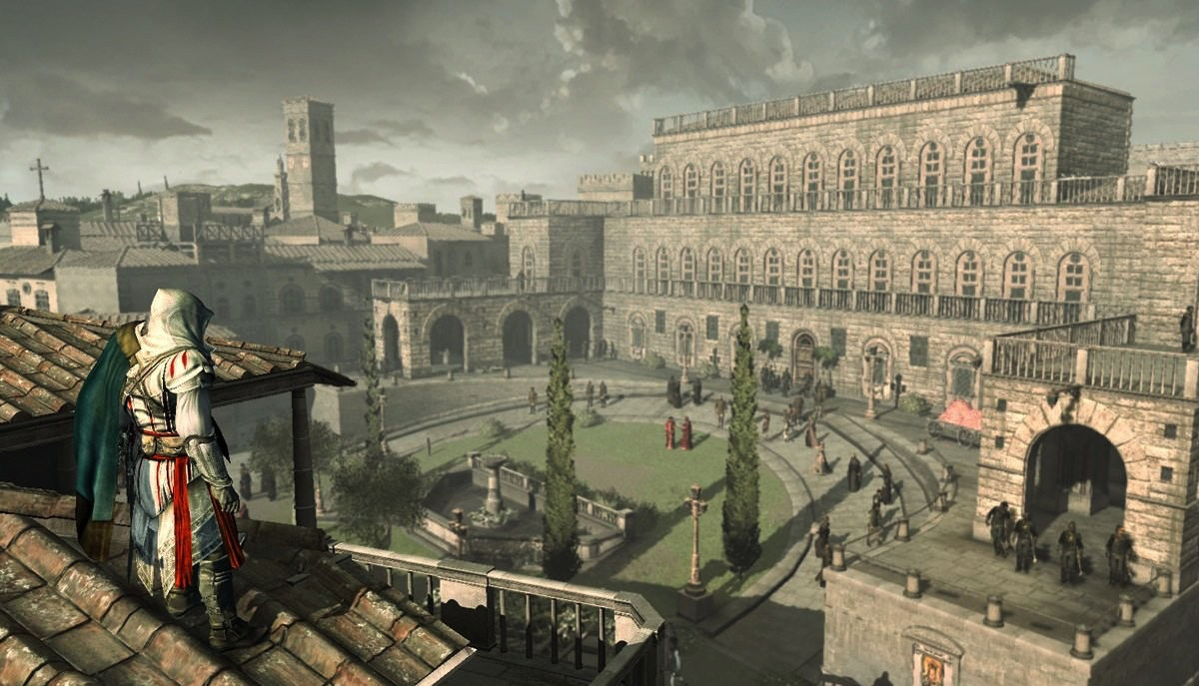
Discussion: Are Games Art?
Assassin’s Creed II
Notes:
Is this is a useful or divisive question?
Do you agree with the definition that ‘Art gives something back’?
What is fun?

Slide 33
Paper Prototyping Exercises
In Pairs and on Paper
Consider Tic-Tac-Toe (Noughts and Crosses)
The Brief, either:
Extend the game to 3 players
OR add element of chance to the game
Spend:
20 min design
5 min playtesting another pair’s game
20 min discussion

Slide 34
Discussion
What is your new mechanic?
What is the impact of the new mechanic(s)
Time to play?
Complexity?
New strategies?
More fun?

Slide 35
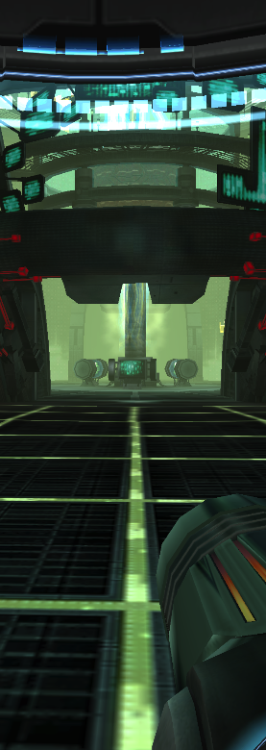
What is Tic-Tac-Toe Anyway?
What are the existing Core Dynamics
MDA Framework
Mechanics produce…
Dynamics invoke…
Aesthetics
Metroid Prime 2

Slide 36
Thank You
COMP3218 Website: https://secure.ecs.soton.ac.uk/module/COMP3218/
David Millard
@hoosfoos | davidmillard.org | dem@soton.ac.uk
age chapman
Adriane.Chapman@soton.ac.uk
Tom Blount
@Tom_Blount | tb12g09@ecs.soton.ac.uk

