Slide 2
The Future of the Web
COMP3220 Web Infrastructure COMP6218 Web Architecture
Dr Nicholas Gibbins and Dr Heather Packer

Slide 6
The future ain’t what it used to be

Slide 7
The Mobile Web

Slide 8
The changing environment of the Web
1989
2019

Slide 9
Bringing the Web to mobile devices
W3C Mobile Web Initiative
Combining the power of the Web with the strengths of mobile devices
Key technologies:
HTML5 – audio and video elements – no need for Adobe Flash
CSS3 – responsive web design – adaptation for small screens
SVG Tiny/SVG Basic – scalable vector graphics for mobile devices

Slide 11
Which apps do you use on your mobile phone? Vevox ID: 138-085-843

Slide 12
Mobile applications
Platform-specific native app development environments
Android (Android Studio)
iOS (Apple Xcode)
Typical to find a 3-layer architecture:
Presentation
Business logic
Data storage

Slide 13
3-Layer Architecture
Presentation
client
Business Logic
thin vs. thick clients
server
Data Storage

Slide 14
Native apps versus Web apps
Native apps
Web apps
Don’t require a browser
Written for specific platforms/devices using specific APIs and languages
Run (mostly) on the device
Do require a browser
Written for all platforms/devices using HTML5/CSS/SVG/ECMAScript
Run (mostly) not on the device

Slide 15
Cross-Platform Mobile Development
Developing multiple different native mobile apps is expensive
Potentially very little shared code in the presentation and business logic layers
The goal: increase the amount of code in common between platforms
Could use a cross-platform library that abstracts differences between platforms
Could use a Web-based framework (since the mobile platforms already understand the Web)

Slide 16
Web-based mobile app frameworks
Presentation
(HTML5 + SVG + CSS)
mobile device
Business Logic
(ECMAScript + HTML5 APIs)
HTTP
server
Data Storage

Slide 17
Which apps do you use on your mobile phone? Vevox ID: 138-085-843

Slide 18
Web Protocols
Communication Whatsapp (XMPP), Gmail (IMAP, Rest API)
Media Netflix (MPEG-Dash), YouTube (MPEG-Dash, Rest API)
Social media Instagram, Facebook, Twitter (Rest API)
Ride sharing Uber (Rest API, VoIP)
File sharing Dropbox (Rest API)
Music Spotify (HTTP, Rest API)
Shopping Amazon (HTTP)

Slide 19
An open question:
If a mobile application uses Web technologies behind the scenes, does that make it part of the Web?

Slide 20
The Architecture of the World Wide Web
URI
identifies
http://www.bbc.co.uk/weather/2637487
Resource
yields on dereference (via http)
today’s BBC weather forecast for Southampton
Representation
represents
Metadata:
Content-Type: text/html
Data:
<html>
<head>
<title>BBC Weather – Southampton</title>
...
</html>

Slide 21
Apps and Openness
One key reason for the success of the Web has been its openness
Navigation between websites is as easy as navigation within a website
Visible (and human-readable) resource identifiers
Apps (frequently) break this ideal
Resource identifiers are almost always not visible
Walled gardens to keep users in the app
User analytics -> targeted advertising -> money
”You can check out any time you like / But you can never leave”

Slide 22
Internet of Things

Slide 26
Internet of Things
The reality falls short of the hype
Interoperability is a significant issue
Many competing protocols and services
As with apps, (lack of) openness is a concern
Ongoing standardisation work within W3C – Web of Things
Builds on web architecture – WoT things are resources
Thing Description
Data schemas (i.e. common representations)
Hypermedia controls (i.e. REST)
Semantic annotations (i.e. Semantic Web/Linked Data)

Slide 27
Virtual and Augmented Reality

Slide 28
Web3D was initially the idea to fully display and navigate Web sites using 3D.
http://revitaddons.blogspot.com/2019/05/free-express-family-web3d-share-and.html

Slide 29
Interactive 3D content is now embedded into web pages
https://www.awwwards.com/websites/3d/

Slide 30
3D Web - Tools, Languages and Formats
3DMLW (dead 2016)
A-Frame (VR)
Additive Manufacturing File Format
Adobe Shockwave (discontinued)
Blend4Web
Java 3D
JOGL
LWJGL
O3D
Oak3D
PlayCanvas
ShiVa
Three.js
Unity
Verge3D
Virtools (discontinued)
VRML
Web3D Consortium
WebGL
WebVR
WireFusion
X3D (extension of VRML)
X3DOM

Slide 31
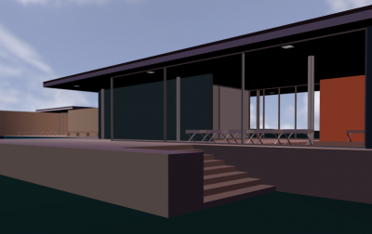
VR/AR
VRML is a standard file format for representing 3D interactive vector graphics for the Web, superseded by X3D
X3D, VRML extension
Web3d - royalty-free ISO standards for web-based 3D graphics
WebVR open specification that makes it possible to experience VR in your browser
https://www.x3dom.org

Slide 32
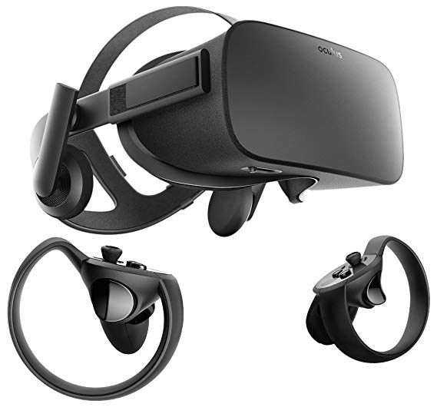
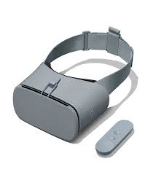
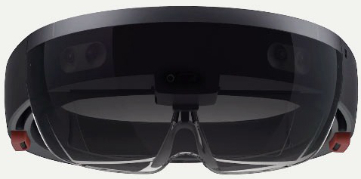
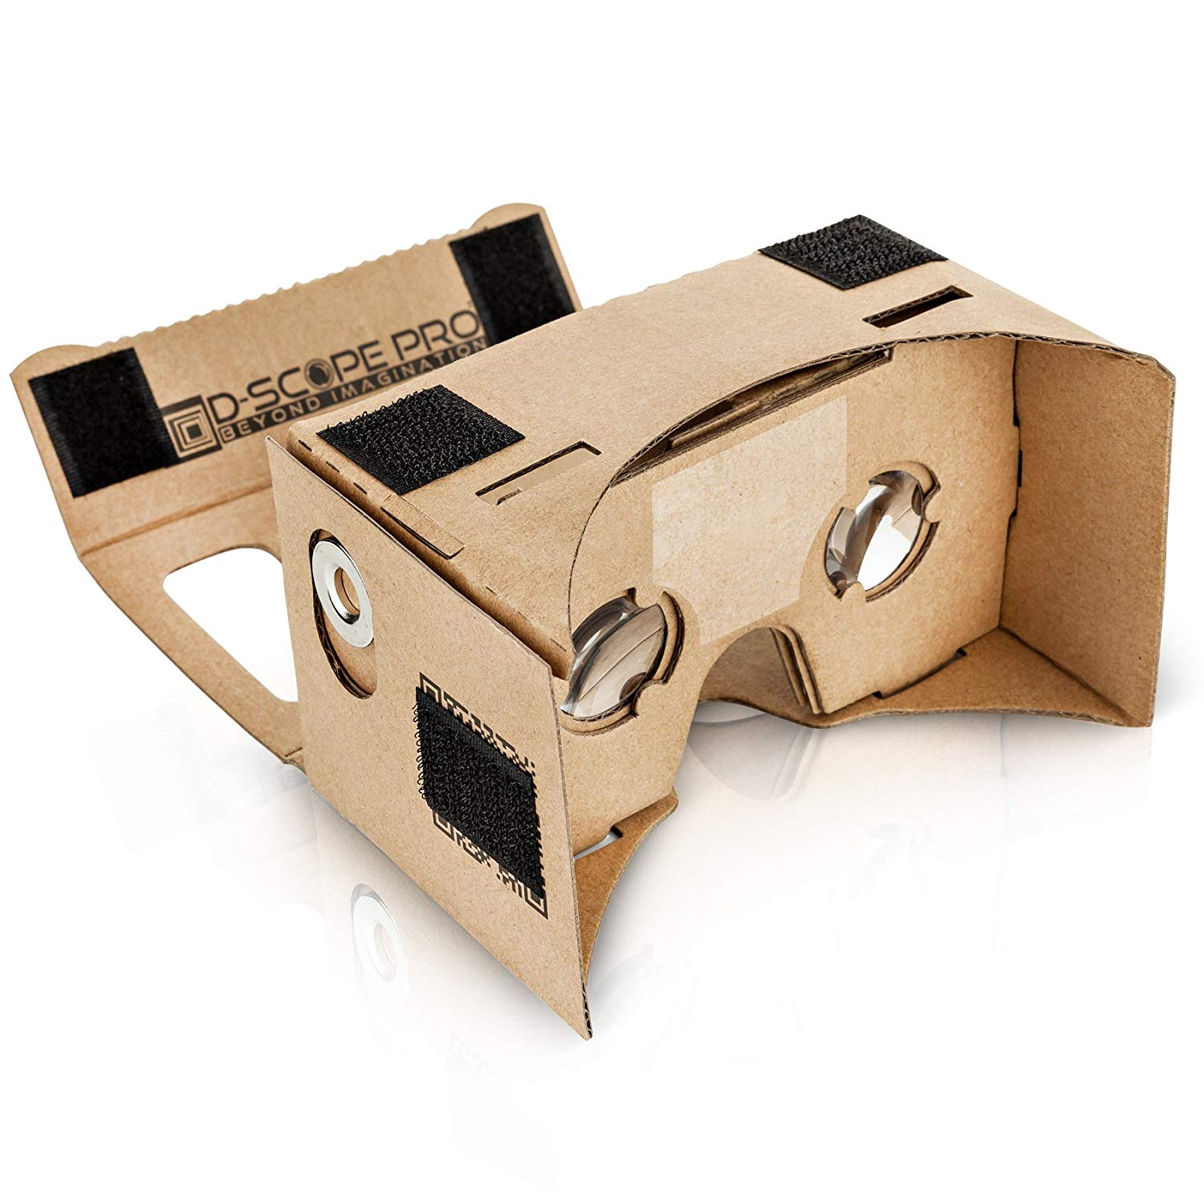
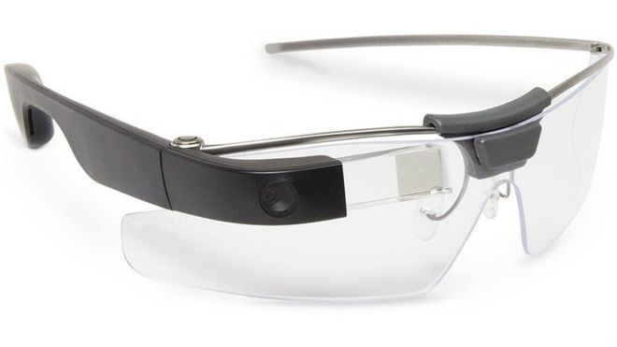
Devices
Today used in
Hospitals and surgeries
Manufacture
Military
Gaming
General population did not widely accept these devices in public spaces
Privacy concerns

Slide 33
Smart wearables

