Slide 2
Caching and Content Delivery Networks
COMP3220 Web Infrastructure COMP6218 Web Architecture
Dr Heather Packer – hp3@ecs.soton.ac.uk

Slide 3
Caching
Caching stores the result of an operation so that future operations return faster
Computation is slow
Computation will run multiple times
When the output is the same for a particular input

Slide 4
Slashdot effect
Popular website links to a smaller website
Causes a massive increase of traffic
The website is virtually unreachable
Slashdot early 2000s
Twitter
Digg
Reddit

Slide 5
Web Caching
The temporary storage (caching) of frequently accessed data for rapid access
Typically caches store "static assets”
Web documents
HTML pages
Images
Caches can be located at various points in a network
Reduces access time/latency for clients
Reduces bandwidth usage across slower links
Reduces load on a server

Slide 6
What can be Cached?
Cache friendly
Logos and brand images
Style sheets
Javascript files, site and library
Downloadable content
Media files
Be careful caching:
Data
HTML pages
Rotating images
Frequently modified Javascript and CSS
Content requested with authentication cookies
Never cache
Sensitive data
User-specific data that frequently changes

Slide 7
Terminology
Origin server – original location of content
Hit – response in cache
Miss – response is not in the cache
Stale content – Expired response
Cache hit ratio – hits:total requests
Validation – Check that cached response is most recent version
Invalidation – Removal of response before it expires, due to update on origin server

Slide 8
Different Web Caching Solutions
Caches can be located at various points in a network
Browser Cache
Proxy Cache
Reverse Proxy Cache

Slide 9
Browser Cache
Browsers maintain a small cache
Stored locally
Cache for a single user or application
Browser sets a caching policy, deciding what data to cache
User specific content
Expensive content
Local Machine
Origin Server
resource
Browser Cache

Slide 10
Browser Cache vs Cookies
Cache | Cookies
Stores files | Stores session info or tracking
Faster viewing | Preferences and targeting advertising
Stored locally | Stored locally

Slide 11
Tracking and Caches
Browser caches can also be used to track users
It is possible to track you cross-site and across browser restarts, even if you disable or clear cookies
Browsers cache content based on the expiration headers provided by the server
A web application can include unique content in a page, and then use JavaScript to check if the content is cached or not in order to identify a user.
It is difficult to defend against unless you routinely (e.g. on closing the browser) delete all content.

Slide 12
Proxy Cache
Cache located close to the clients (hosted by University or Internet Service Provider)
Decrease bandwidth usage
Decreases network latency
Scale provides the main advantage: many users within the ISP may all be asking for the same web pages
ISPs use this approach to decrease bandwidth across their networks
Server
Local Machine
resource
Proxy Cache

Slide 13
Reverse Proxy Cache
Cache proxy located closer to the origin web server
Usually deployed by a Web host
Decreases load on the Web service (e.g. database)
Several reverse proxy caches implemented together can for a Content Delivery Network
Server
Local Machine
Reverse Proxy Cache
resource

Slide 14
Controlling Caches with HTTP: Last-Modified Header
GET Conditional GET
GET /HTTP/1
Host: comp3220.ecs.soton.ac.uk
Accept: */*
HTTP/1 200 OK
Date: Wed 15 Nov 2017 07:43:20 GMT
Connection: keep-alive
Content-Type: text/html; charset=UTF-8
Content-Length: 4003
Last-Modified: Tue 14 Nov 2019 08:00:20 GMT
GET /HTTP/1
Host: comp3220.ecs.soton.ac.uk
Accept: */*
If-Modified-Since: Tue 14 Nov 2019 08:00:20 GMT
HTTP/1 304 Not Modified
Date: Wed 15 Nov 2017 07:55:10 GMT
Connection: keep-alive
Last-Modified: Tue 14 Nov 2019 08:00:20 GMT

Slide 15
Caching Headers
Last-Modified
Cache-Control flags
no-store - no-cache
max-age - must-revalidate
proxy-revalidate - no-transform
Etag – used in validation
Content-Length – can be used in caching policies

Slide 16
HTTP with Cache-Control Header
GET GET
GET /HTTP/1.1
Host: comp3220.ecs.soton.ac.uk
Accept: */*
HTTP/1.1 200 OK
Date: Wed 15 Nov 2017 07:43:20 GMT
Connection: keep-alive
Content-Type: text/html; charset=UTF-8
Content-Length: 4003
Last-Modified: Thurs 7 Dec 2019 08:00:20 GMT
Cache-Control: max-age=86400
* No request sent *

Slide 17
Content Delivery Networks

Slide 18
Motivation Scenario
Stream video content to 100,000+ simultaneous users
You could use a single large “mega-server”

Slide 19
Motivation Scenario
Stream video content to 100,000+ simultaneous users
You could use a single large “mega-server”
Single point of failure
Point of network congestion
Long path to distant clients
Multiple copies of video sent over outgoing link
This solution doesn’t work in practice

Slide 20
Content Delivery Network
CDN a geographically distributed network of proxy servers (edge nodes)
Hosts static content (such as images, CSS and JS)
Data travels to user via the shortest path (reduced latency)

Slide 21
CDN
Origin Server
CDN Connection
User
Connection
User
Edge Server

Slide 22
Commercial CDNs
Limelight Networks
Level 3 Communications
Akamai Technologies
Amazon CloudFront (cloudping.info)
CloudFlare

Slide 23
Motivational Scenario
Streaming video to 100,000+ simultaneous users
Working Web solution: store/serve many copies of video at multiple geographically distributed sites (CDN)
Two strategies:
Push CDN servers deep into many access networks
Close to users
Placed near ISP
Used by Akamai, 1700 locations
Place larger clusters at key points in the network near internet exchanges
Internet exchanges where network providers connect their networks to each other
Dedicated high speed private networks are used to connect the clusters together
Used by Limelight

Slide 24
Motivational Scenario
Streaming video to 100,000+ simultaneous users
Working Web solution: store/serve many copies of video at multiple geographically distributed sites (CDN)
Two strategies:
Push CDN servers deep into many access networks
Close to users
Placed near ISP
Used by Akamai, 1700 locations
Place larger clusters at key points in the network near internet exchanges
Internet exchanges where network providers connect their networks to each other
Dedicated high speed private networks are used to connect the clusters together
Used by Limelight
Better latency and better network performance.
Harder to maintain because there are many more servers in the CDN.
Higher latency and lower performance for the end user
Easier to manage but with higher latency and lower performance for the end user.

Slide 25
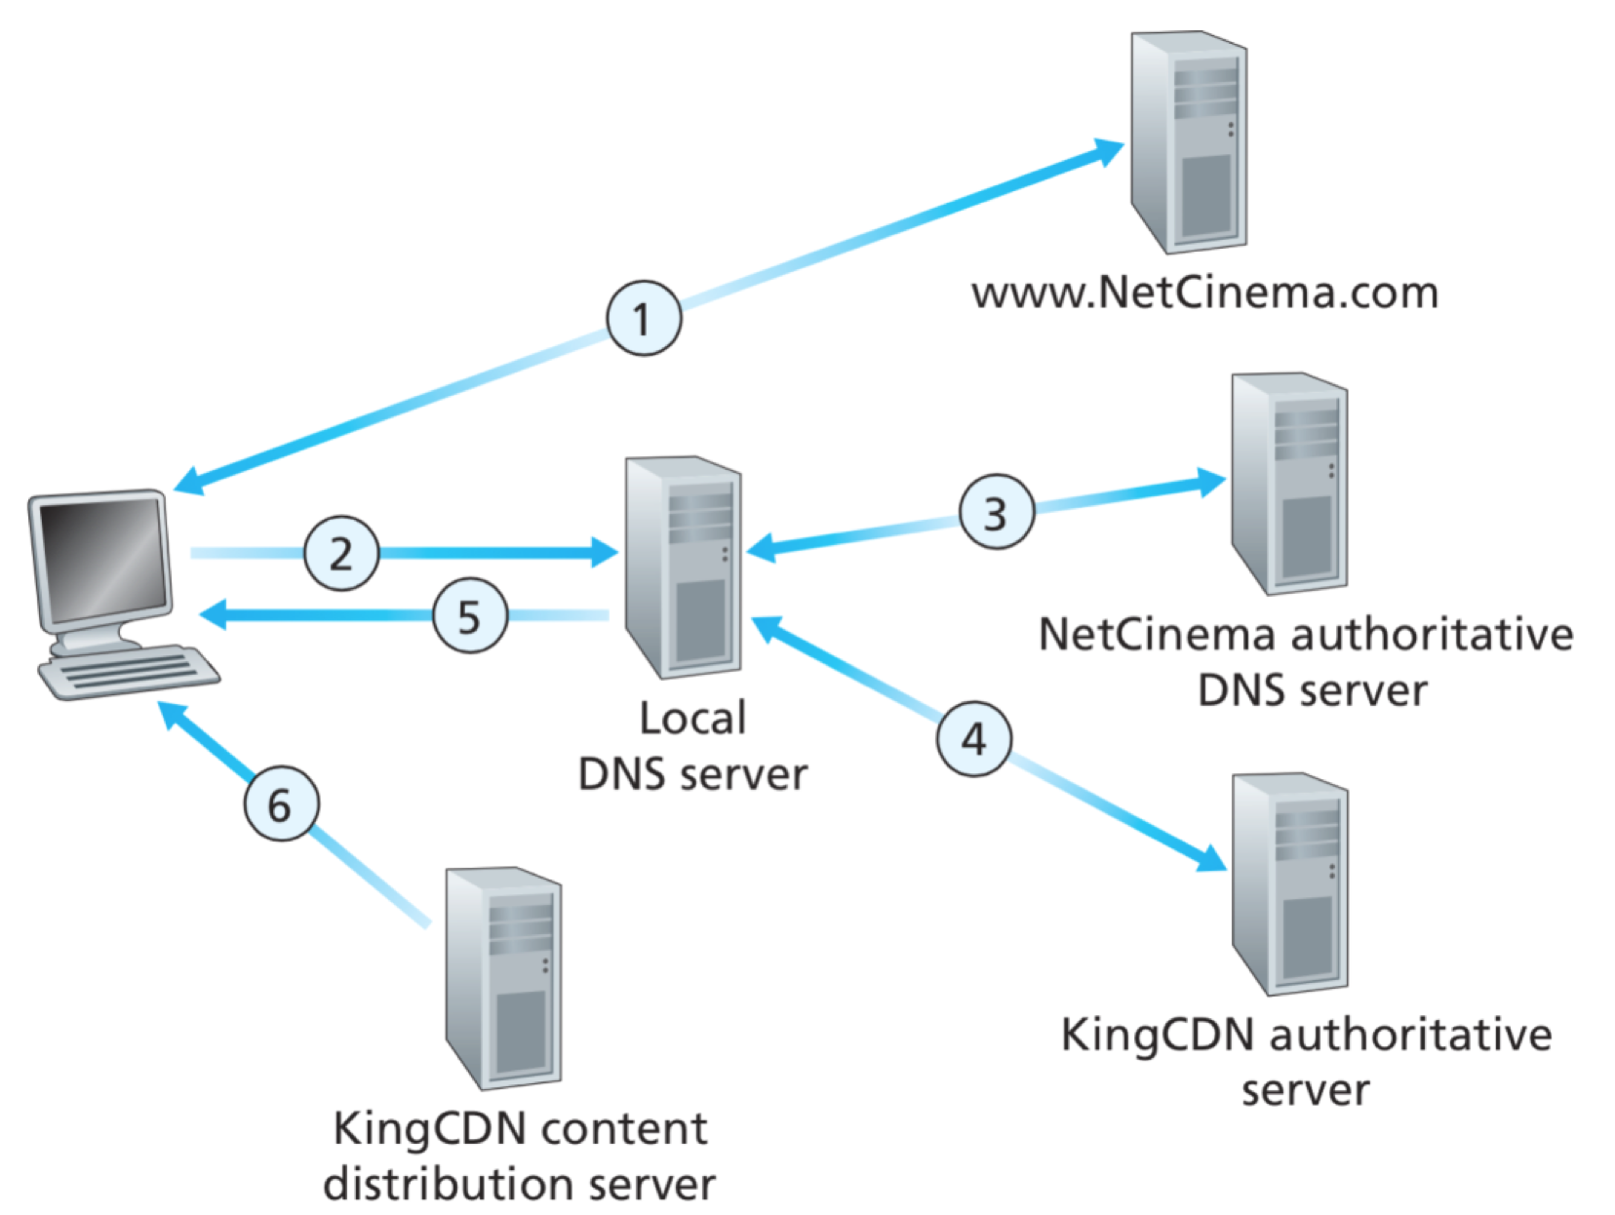
CDN: Simple content access scenario
A CDN has to be able to tell clients where to find resources
A client will request a file, with one URL but retrieve it from another
http://video.netcinema.com/6Y7B23V
http://KingCDN.com/NetC6Y7B23V

Slide 26
Requests URL for videohttp://video.netcinema.com/6Y7B23V

Slide 27
2. Resolves Domain name via local DNS video.netcinema.com

Slide 28
4. Resolves Domain name KingCDN.com
5. Returns IP of KingCDN

Slide 29
6. Requests URL http://KingCDN.com/NetC6Y7B23V

Slide 30
CDN Cluster Selection Strategy
The CDN’s DNS decides which edge server to use
Pick CDN node geographically closest to client
Pick CDN node with shortest delay (min hops) to client (CDN nodes periodically ping access ISPs, report results to CDN DNS)
Or let the Client decide – give client a list of several CDN servers

Slide 31
Case Study: Netflix’s first Approach
Owned very little infrastructure, uses 3rd party services
Own registration, payment servers
Amazon (3rd party) cloud services
Netflix uploads studio master to Amazon cloud
Create multiple version of movie (different encodings) in cloud
Upload versions from cloud to CDNs
Three 3rd party CDNs host/stream Netflix content: Akamai, Limelight, Level-3

Slide 32
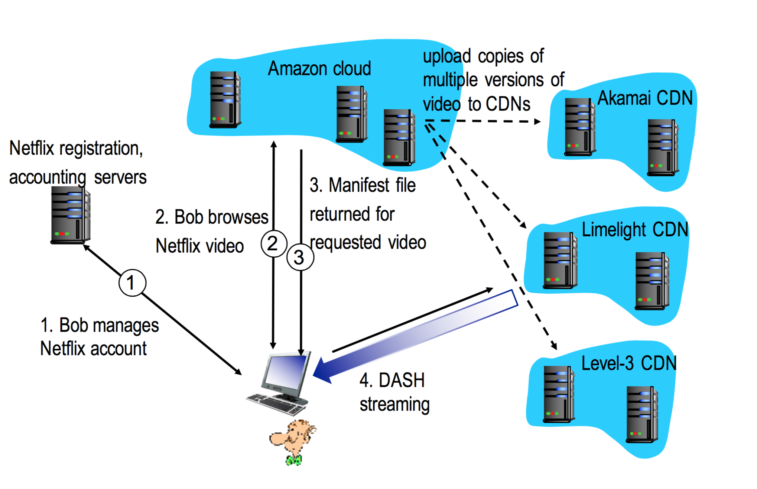
Case Study: Netflix

Slide 33
DASH - Dynamic Adaptive Streaming over HTTP
Server
Divides video files into multiple chucks
Each chunk stored encoded at different bit rates
Manifest file: provides URLs for different chunks
Client
Periodically measures server-to-client bandwidth
Consulting manifest, requests one chunk at a time
Chooses maximum coding rate sustainable given current bandwidth
Can choose different coding rates at different points in time (depending on available bandwidth at time)
The Intelligence happens at the client level so it can makes sure that there is no buffer starvation or overflow

Slide 34
MPEG-DASH Adoption
MPEG DASH is independent, open and international standard, which has broad support from the industry
HTML5 Media Source Extensions and HbbTV are MPEG-DASH enabled
Heavy plugins like Silverlight and Flash perform poorly and cause security issues
Chrome dropped the Silverlight support,
It was a problem for the majority of premium video providers,
They delivered their streams via Smoothstreaming and Playready DRM, which enforced Silverlight
These providers switch to using HTML5 with MPEG-DASH and MPEG-CENC based DRM

Slide 35
Neflix OpenConnect
Netflix wanted the absolute best streaming they could get, while lowering cost
They developed OpenConnect
High optimised for delivery large files, still use Akamai for small assets.
Data centers around the world
There may be a data center with a couple of racks that contain the entire Netflix library
Others might only have 80% of the most popular content.
Unpopular material will have to travel further
Client Intelligence
Calculates best edge server to use
Selects which edge server based on the required bit rate and latency
Continually probes the best way of receiving content
However the intelligence happens client side, it’s the client that calculates the best edge server to use (based on bit rate and closeness)

Slide 36
Summary

Slide 37
Learning Outcomes
Caches
Browser
Proxy
Reverse Proxy
Cache Control Headers
Content Delivery Networks
CDNs in practice

