Slide 2
Open Access: The Web and Scientific Knowledge
COMP3220 Web Infrastructure COMP6218 Web Architecture
Dr Heather Packer – hp3@ecs.soton.ac.uk

Slide 3
So Far..
How to create web pages
Hypertexts
Web services
Big structure network
How to analyse the Web with graph theory
Search engines and advertising

Slide 4
The Original Web Challenge? “In those days, there was different information on different computers, but you had to log on to different computers to get at it. Also, sometimes you had to learn a different program on each computer. Often it was just easier to go and ask people when they were having coffee…” Tim Burners-Lee

Slide 5
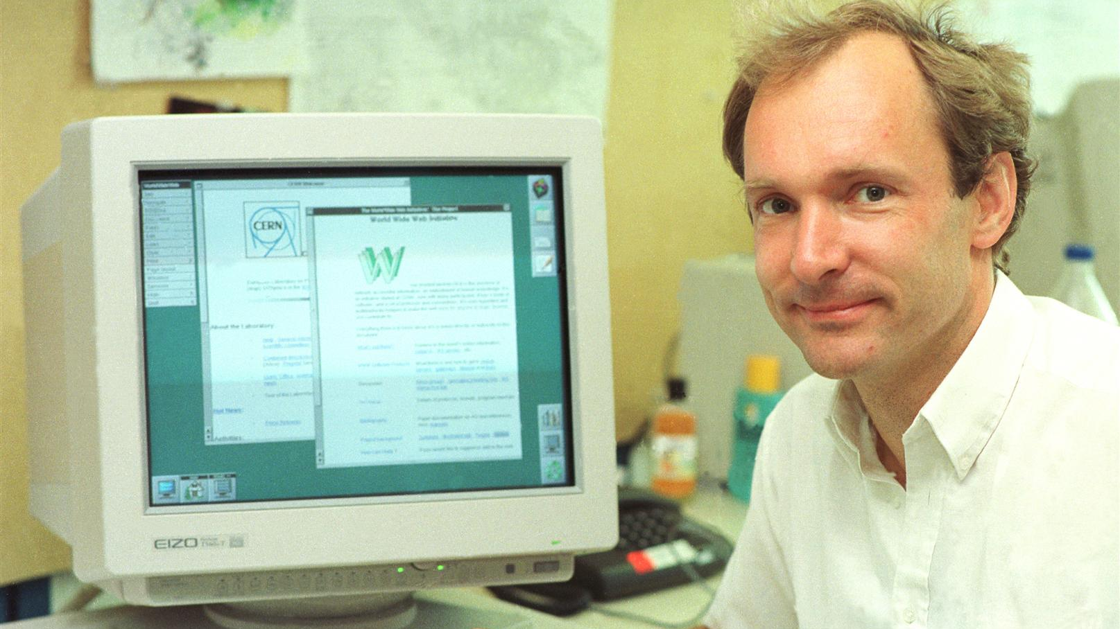
The Web
Help with dissemination of knowledge at their research lab
Automated information-sharing between scientists in universities and institutes around the world
He designed:
The first web server
Browser
Networking protocols

Slide 6
Open Access: Tim’s Problem
Problem that Tim faced that publishers had all of the academic publications
Universities created a whole new industry and students read and write paid for by external company
Universities and researchers are knowledge producers and knowledge consumers
Scholarly communications have been outsourced
researchers
publishers
read
write

Slide 7
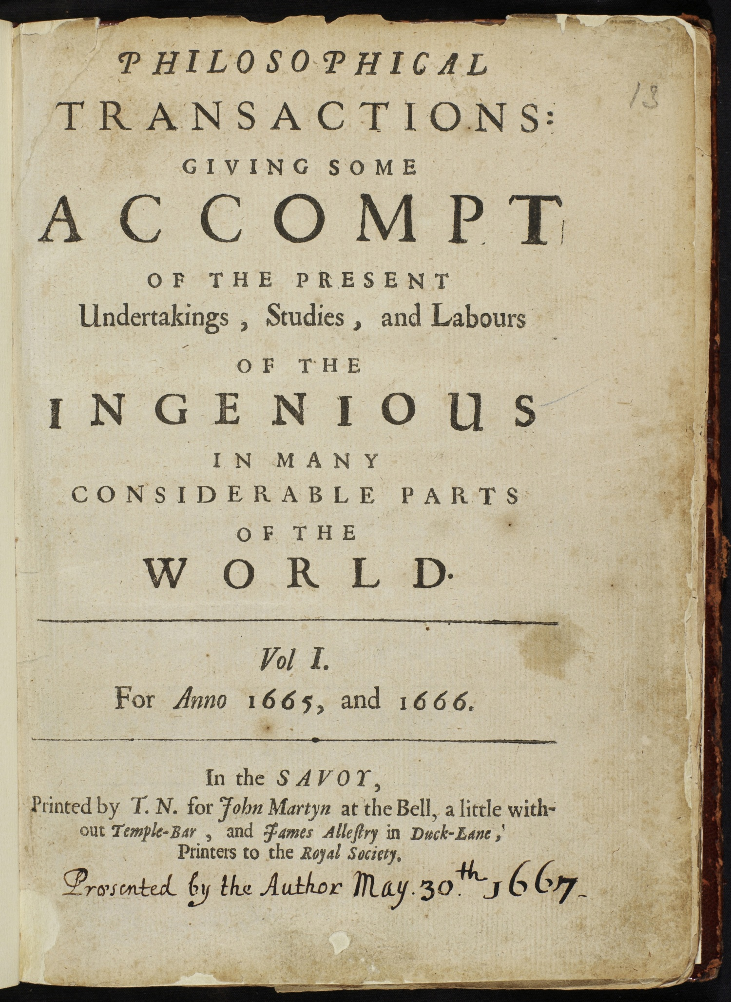
Scholarly Publishing 1665-1960
Scientific and scholarly societies publish their own journals
First scientific journal March 1665
The Royal Society publishes “Philosophical Transactions”
University Presses not for profit but were for prestige
For the benefit of their members, for the benefit of science

Slide 8
Private Sector
After the war 1948 Robert Maxwell decided to publish scientific journals and set up Pergamon Press which was quickly and hugely profitable
Bringing “aggressive publishing in science”
In 1960’s Universities were expanding
UK Robbins Report/expansion of higher education & science budget
In 1968/9 STM Association founded for publishers
The new demand made for a very profitable system – with an increasing number of commercial publishers moving into STM
STM - The International Association of Scientific, Technical and Medical Publishers

Slide 9
Publishing Conditions
Authors writes article
Author gives article to publishing company
Author signs over copyright to publishing company
Publishing company publishes article
Publishing company receives revenue repeat to sell to university libraries around the world
Author receives academic credit
Publication glory
Citations

Slide 10
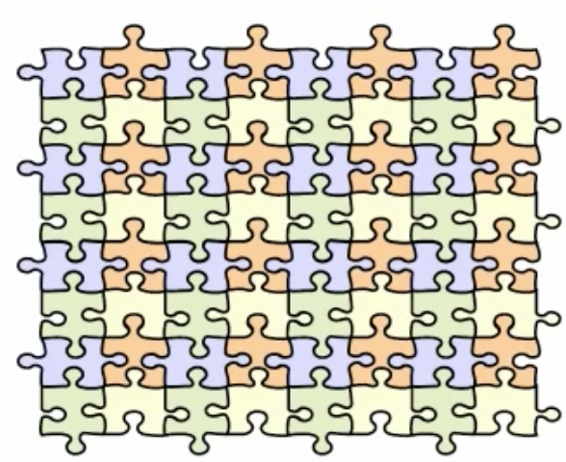
The Literature: As We Imagine
Integrated
Citations
Readily available
Standing on the shoulders of giants
“we see more and farther than our predecessors, not because we have keener vision or greater height, but because we are lifted up and borne aloft on their gigantic stature”

Slide 11
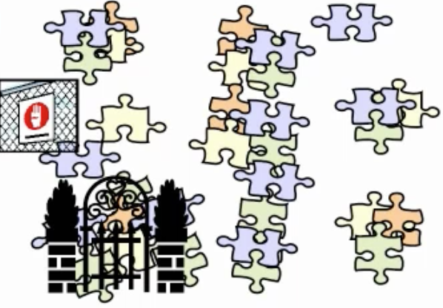
The Literature: As It Is
Inaccessible
Hidden behind pay walls
Not subscribed too
Disjoint
Books
Online journals
Scientific magazines

Slide 12
The Twin Peaks Problem
≈24,000 journals with 2,500,000 article/yr
Pay wall for access
Limited access based on universities budgets
Well funded universities can only afford a fraction of subscriptions
Less well funded universities can afford even fewer subscriptions
≈£10,000 per year for access to some journals, and prices increasing
Universities are measured by their impact
Fewer readers means less impact (fewer citations)

Slide 13
Open Access Definitions

Slide 14
Open Access (OA)
Open Access to Scientific and Scholarly Research Literature
OA is movement for organising and disseminating the worlds research knowledge through Web technology
Free of cost
Other access barriers
Focuses on Peer Reviewed Literature
Open access logo, designed by Public Library of Science

Slide 15
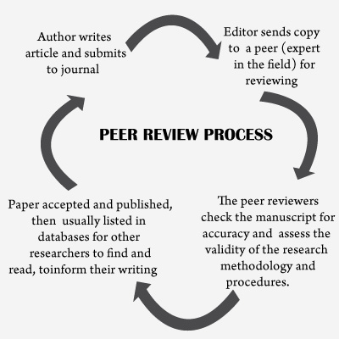
Peer Reviewed Literature
Evaluation of work by one or more people with similar competences to the creator/authors of the work
A process
Provides a means to self-regulate
Maintain quality standards, improve performance, and provide credibility

Slide 16
The Budapest Open Access Initiative (BOAI)
The BOAI publishes a set of principles for open access and research literature
Released in February 14th, 2002
It arose from a conference hosted in Budapest by the Open Society Institute in 2001
This small gathering of individuals is recognised as one of the major defining events of the open access movement.
Old tradition of scholarly publishing + New technology of the Internet =
Public good: free and unrestrictive access to peer-reviewed journal literature

Slide 17
Open Access Definition
“By "open access" to this literature, we mean its free availability on the public internet, permitting any users to read, download, copy, distribute, print, search, or link to the full texts of these articles, crawl them for indexing, pass them as data to software, or use them for any other lawful purpose, without financial, legal, or technical barriers other than those inseparable from gaining access to the internet itself. The only constraint on reproduction and distribution, and the only role for copyright in this domain, should be to give authors control over the integrity of their work and the right to be properly acknowledged and cited.”
- The Budapest Open Access Initiative

Slide 18
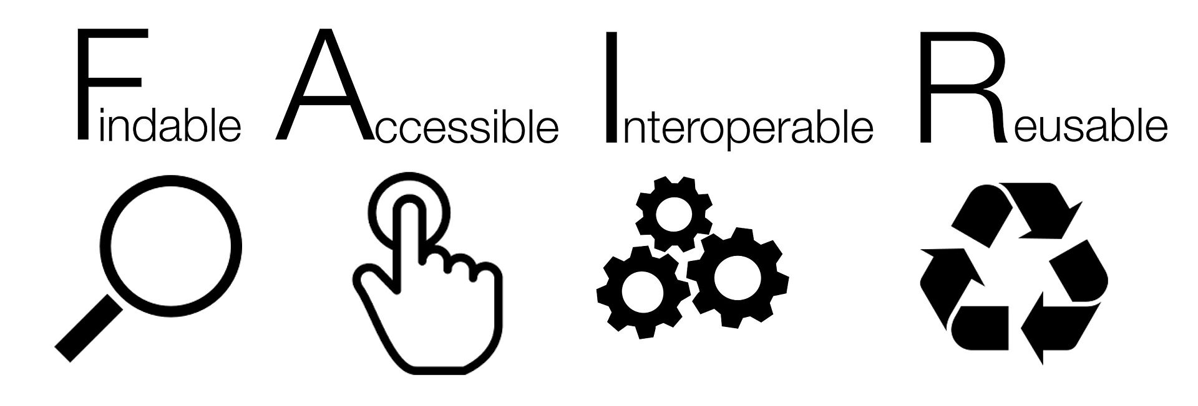
FAIR
FAIR data linked to Open Access
Introduced in 2016
Endorsed by the European commission and the G20

Slide 19
Open Access Initiatives and Models

Slide 20
Full Open Access Ideal
The entire full-text refereed corpus online
On every researcher’s desktop, everywhere
24 hours a day
All papers citation-interlinked
Fully searchable, navigable, retrievable

Slide 21
Open Access Strategies
Green: Self Archiving | Gold: Publishing
Journal processes continue as normal | Journal changes business model
Authors deposit a copy of their papers into an ‘open access repository’ | Readers no longer pay to read
Public copy is a supplement to the publishers official article for those who can’t afford a subscription | Instead, authors pay to publish or their funders
Also an institutional record of its work for sharing, reuse, marketing etc

Slide 22
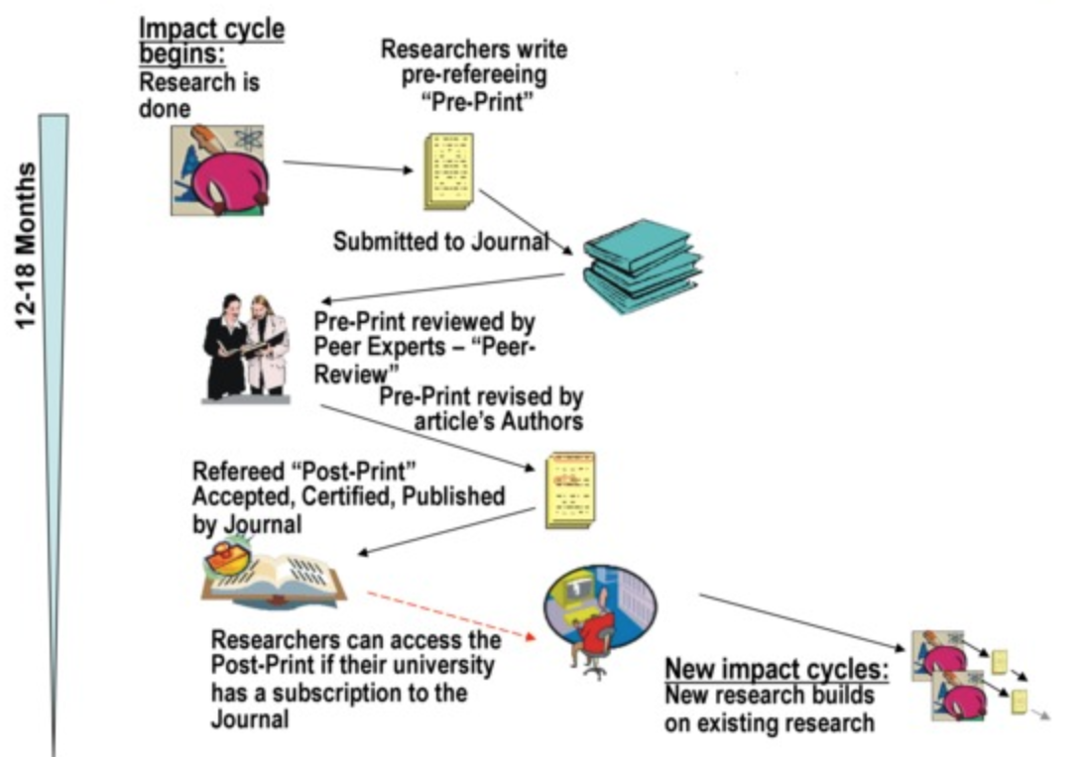
Limited Access: Limited Research Impact
Research is a process
Can take more than a year and a half for a journal

Slide 23
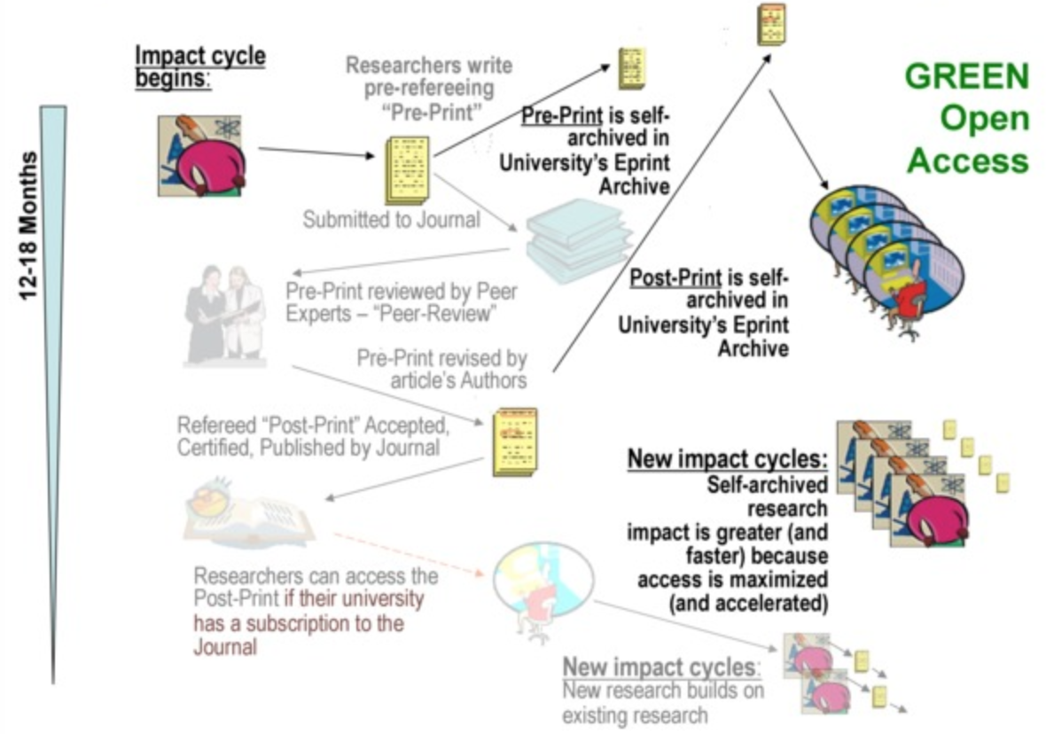
Maximised Research: Access and Impact through Self-Archiving
Preprints allow people to view work immediately
However, impact is greater after peer reviewed publications

Slide 24
Problems with Green OA
ECS repository, 11,000 records, 4,000 full text, 80-100% open access to our research output
Average repository, 300 items, 200 full text, negligible research output
Recent NIH request for OA achieved 4% compliance
Copyright assignment to publishing company means the author no longer has the right to control the paper
Relies on “publisher usage policy”
May not allow submission to a repository
Many not allow copies to be made for teaching, research assessment or career advancement processes
Romeo service tracks publisher policies
http://www.sherpa.ac.uk/romeo

Slide 25
Problems with Gold OA
Relies on publishers changing their business model
Scientific publishing is very lucrative (18% profits)
Gold publishers making slow advances

Slide 26
OA Advantages
Early Advantage: Self archiving preprints before publications hastens and increases usage and citations
Higher quality articles benefit more: top 20% of articles receive 80% of citations
Quality Advantage: Self-archiving postprints immediately upon publication hastens and increases usage and citation
Higher quality articles benefit more
Usage Advantage: Self-archiving both pre/post prints increases downloads
Higher quality articles benefits more!

Slide 27
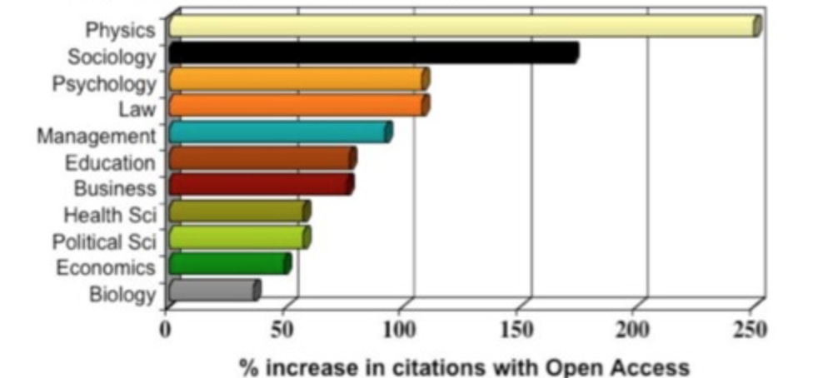
Open Access Advantage
OA increases citations
Full bibilograhy, see
http://opcit.eprints.org/oacitation-biblio.html

Slide 28
Open Access Repositories

Slide 29
Open Access Repositories
Open-access repository or open archive
Digital platform that holds research output and provides free, immediate and permanent access to research results for anyone to use, download and distribute
Open-access repositories can be institutional or disciplinary
They provide free access to research for users outside the institutional community
This is referred to as the self-archiving or "green”
Repositories must be interoperable according to the Open Archives Initiative Protocol for Metadata Harvesting (OAI-PMH)
Search engines harvest the content of open access repositories, constructing a database of worldwide, free of charge available research

Slide 30
Open Archives Initiative - Protocol for Metadata Harvesting (OAI-PMH)
A protocol developed for harvesting metadata descriptions of records in an archive so that services can be built using metadata from many archives
An implementation of OAI-PMH must support representing metadata in Dublin Core
Usually just referred to as the OAI Protocol
OAI-PMH uses XML over HTTP
Version 1.0 was introduced to the public in January 2001
Version 1.1 modifications to the XML standard by the W3C required making minor modifications version 1.0
Version 2.0 of the protocol was released in 2002
Was last updated in 2015
Not backwards compatible
It has a Creative Commons license

Slide 31
Repositories
Commonly used OA repositories:
Digital Commons
DSpace
EPrints
EPrints
Proposed as a ‘build your own repository’ solution
Enable institutions and groups to participate in OAI metadata sharing initiative
EPrints Example
http://eprints.soton.ac.uk/
A repository for the University of Southampton
It achieves 80-100% full text self-deposit
ECS eprints Merged with University of Southampton repository in 2011

Slide 32
Role of the Repository
Who takes responsibility for curating the research knowledge of the world?
Privately owned, profit making, publishing industry
University, research institution, knowledge creator
The Institutional repository is a place where the member of an institution can curate their intellectual outputs/knowledge capital
Share
Use
Reuse

Slide 33
Summary

Slide 34
Learning Outcomes
How OA relates to the publishing industry
Advantages of Green and Gold publishing
Why the Web was a vital technology for OA

