Slide 1
Web Advertising and Cookies
COMP3220/6218
Web Infrastructure/Web Architecture
Heather Packer – hp3@ecs.soton.ac.uk
Mark Dix – med1n18@soton.ac.uk
26/11/19

Slide 2
Today’s Lecture
Key concepts
Types of web advertising:
  Display advertising
  Search advertising (Adwords)
  Contextual advertising (Adsense)
Cost models for web advertising
Display advertising platforms
Cookies

Slide 3
Advertisers and Audiences
Advertisers are people who want to sell a product
They want to tell a target audience about their product
An audience template or persona describes their ideal audience:
  Socio-economic grouping
  Income and personal finances
  Family status
  Home ownership
  Past purchasing behavior
  Location
Notes:
Because the web is data rich, it is possible for advertisers to collect this information about you to engage in micro-targeting.

Slide 4
Web Advertising
Provides ways for advertisers to reach their target audience
Improves efficiency with profiling customers vs broadcast advertising methods
Notes:
It also funds the many of the platforms and much of the content we consume online.

Slide 5
Digital Consumer Funnel
Awareness
(Lead Generation)
Interest
(Prospect)
++Intent
++Data
Decision
(Opportunity)
Repurchase
Action
(Conversion)
Source: Adapted from Lewis (1898; in Strong, 1925)
Notes:
See: E. K. Strong, Jr. The Psychology of Selling and Advertising. New York 1925, p. 349 and p. 9.
Maybe slightly outdated; in fact, the online consumer journey is probably much more complicated, fragmented and less linear now;
But still a useful representation of the basic steps that users follow online.

Slide 6
Web Advertising Delivery Methods
Display
Advertising
Search
Advertising
Contextual
Advertising
e.g. banners
e.g. Adwords
e.g. Adsense
Notes:
There are many types of web advertising but these can essentially be boiled down to three key categories.
We can also see how these map to the consumer funnel.

Slide 7
Display Advertising

Slide 8
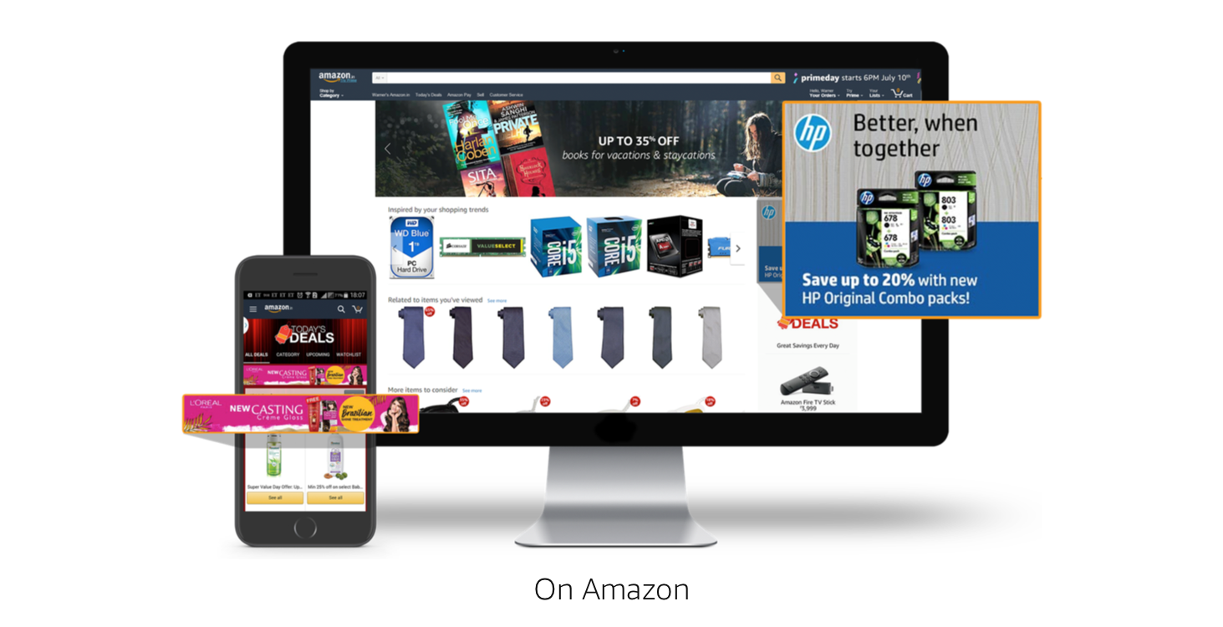
Source: Amazon Advertising (2019)
Notes:
See: https://advertising.amazon.co.uk/products/display-ads

Slide 9
Terminology
Placement: the available space to place banner adverts on a web page
Impression: one ad served to a page once
Click-through: when a person clicks on the ad
Click-through-rate (CTR): the ratio of (clicks/impressions)*100
Notes:
CTR e.g.: (10 clicks / 20,000 impressions) = 0.05%

Slide 10
Factors that Affect the Rates Charged
Ad size and type
Location of an ad on the page
The nature of the site
Contract length
Cost Model

Slide 11
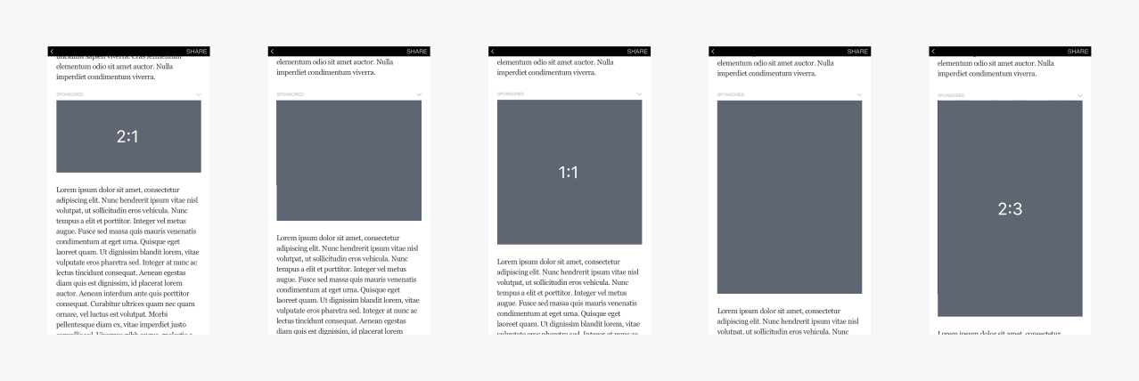
Advertisement’s Size and Type - Mobile

Slide 12
Factors that Affect the Rates Charged
Ad size and type
Location of an ad on the page
The nature of the site
Contract length
Cost Model

Slide 13
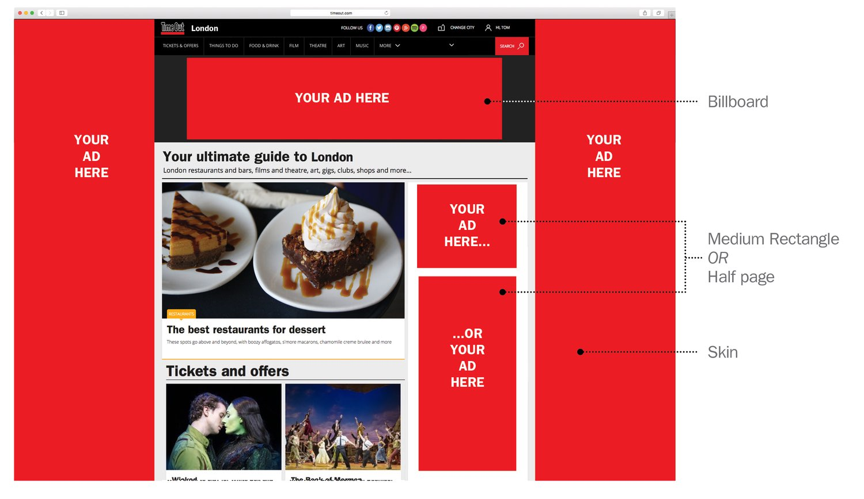
Location of Advertisements
Each page may have multiple banners so more than one impression can be sold per page view
Ads do not have a standardised placement, but larger ones and ones in better positions typically cost more
Notes:
Location is a big issue in the industry and is linked to a concept called ‘viewability’, which is concerned with the extent to which an ad that is served to a web page is visible on the page.
Third-party viewability software is now used to measure the pixel viewability of ads, with some advertisers dictating that they pay only for ads that are actually viewed by users.

Slide 14
Facebook Ad Placement
Facebook Desktop Newsfeed
Facebook Mobile Newsfeed
The Right-hand Column
Facebook Instant Articles
Facebook In-Stream Articles
Facebook Suggested Videos
Instagram Feed
Instagram Stories
Facebook Audience Network

Slide 15
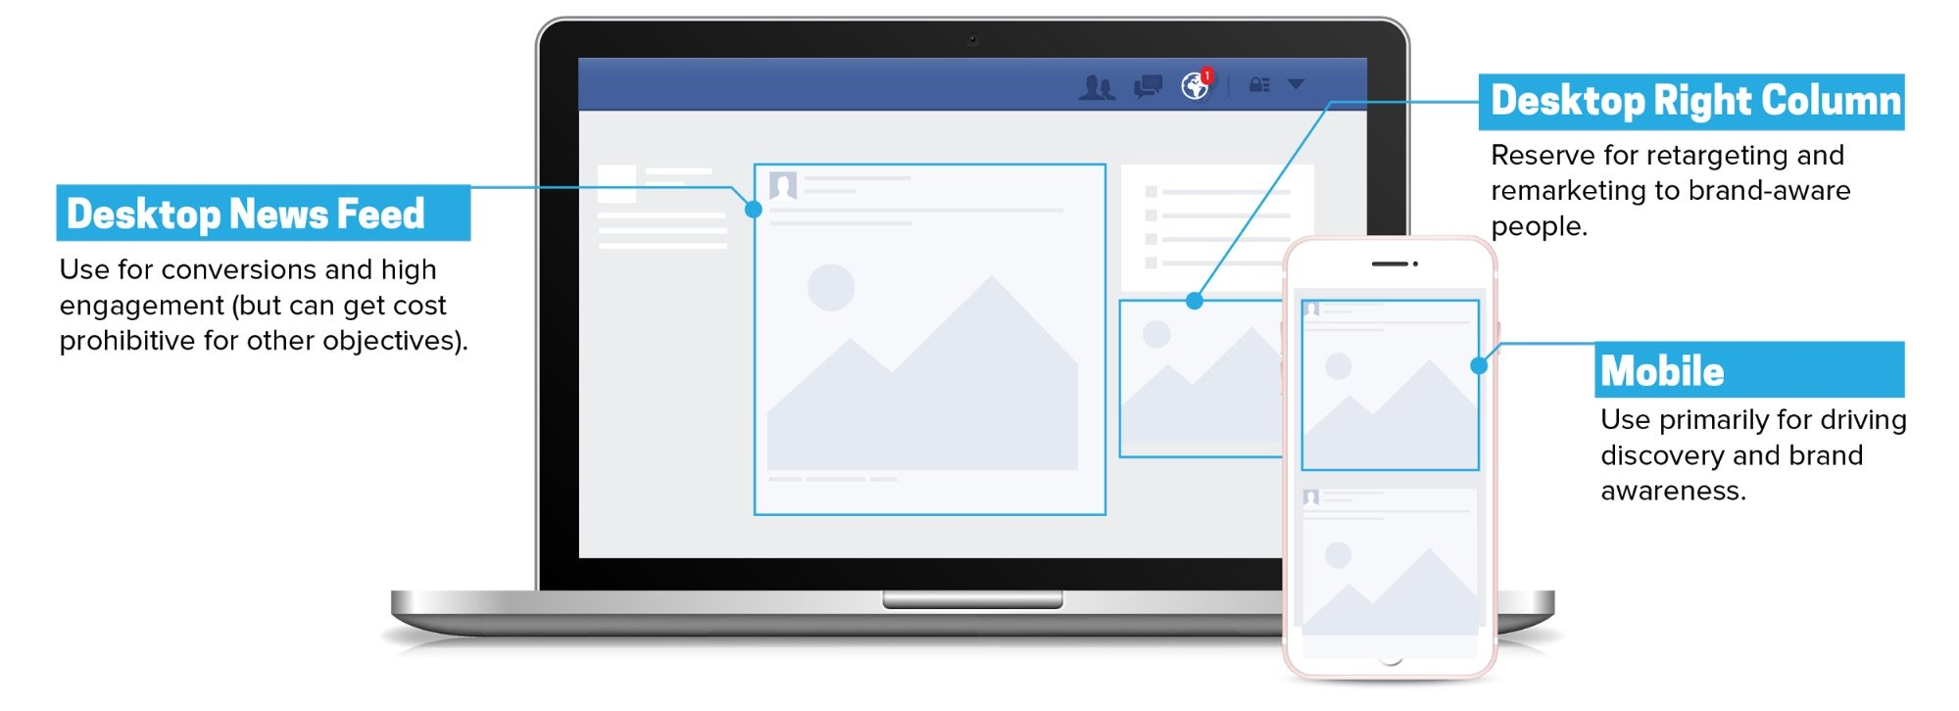
Source: Facebook Advertising (2019)
Notes:
See: https://www.facebook.com/business/ads

Slide 16
Factors that Affect the Rates Charged
Ad size and type
Location of an ad on the page
The nature of the site
  Content sites vs portals
  Google, Facebook
Contract length
Cost Model
Notes:
As we’ll come onto discuss, an additional factor is now dynamic demand. Ad prices are determined programmatically via auction based platforms and demand-led pricing.

Slide 17
Search Advertising

Slide 18
Search Ads
Search Engines (SE) have huge audiences
Advertisers can place ads against keyword searches
SE can leverage their massive platform capabilities to action many such mappings at once
Highly effective since it reaches people when they are interested in a topic
Relevant, yet not obtrusive
October 2016: Google: 89.3%, Bing 4.36%
Notes:
Google handles 77,500 queries per second.

Slide 19
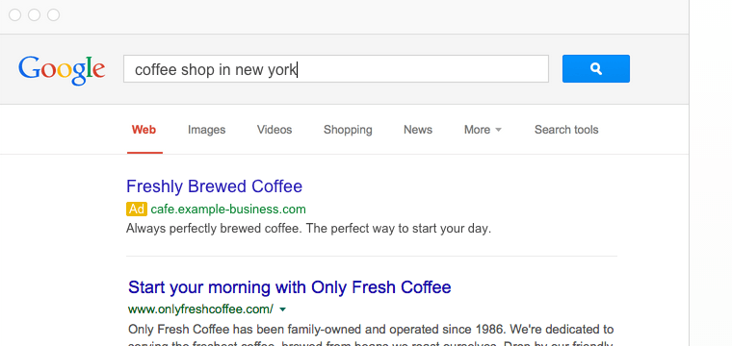
Search Ads - Google Adwords

Slide 20
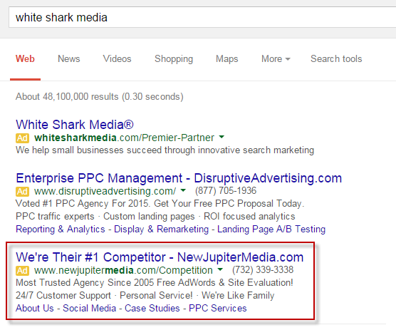
Search Ads - Google Adwords
Notes:
It is also possible to bid on the brand names / keywords targeted by your competitors.

Slide 21
Auctions for AdWords
Find all ads whose keywords match the search terms
Ignore ads that are not eligible e.g. different country
Calculate Ad Rank
Only show ads with a sufficient Ad Rank; position also determined
Notes:
Ad Rank components:
Bid amount
Ad quality: CTR, relevance, landing page experience i.e. your quality score
Context of search: Device, time of day, terms
Ad extensions

Slide 22
Contextual Advertising

Slide 23
Contextual Ads – Google AdSense
Ads are related to the page they are displayed on
They use a keyword matching engine to match ads
Matching algorithm have been tweaked to deal with multiple topics on a page
Auctions mechanisms cater for ad position on page
Notes:
Contextual advertising doesn’t so much relate to the ad formats – these are just the same kind of display and search ads that you see elsewhere – but instead how the ads are targeted.

Slide 24
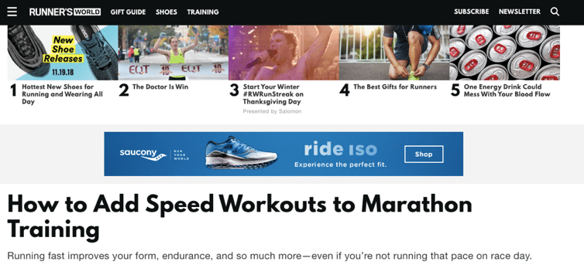
Contextual Ads – Google AdSense

Slide 25
Google AdWords vs Google AdSense
AdWords | AdSense
Ad keywords match search | Ad keywords match page topic/s
AdWords is on Google Search Engine Result Page (SERP) | AdSense is shown on web pages
Higher click through | Lower click through
Both use Auctions to select Ads to place on SERP or individual web page

Slide 26
Fitting it all together (1)

Slide 27
Digital Consumer Funnel
Awareness
(Lead Generation)
Display
Advertising
Interest
(Prospect)
Contextual
Advertising
++Intent
++Data
Decision
(Opportunity)
Repurchase
Search
Advertising
Action
(Conversion)
Notes:
Maybe slightly outdated; in fact, the online consumer journey is probably much more complicated, fragmented and less linear now;
Logic:
Display:
Display advertising is visual
Display advertising is ‘pushed’ and doesn’t rely on pre-existing behaviour
Contextual advertising:
Once users are ‘aware’ and ‘interested’ they may visit contextually relevant information to research their purchase or action
Search advertising:
Users then actively search on relevant terms prior to action

Slide 28
Cost Models for Web Ads

Slide 29
Cost Model: CPM
CPM –Cost Per Mille (1,000 ad impressions)
Cost model for display advertising (and some AdSense).
Whether the ad is clicked is not taken into account.
Each time an ad is fetched, it is counted as one impression.
CPM = (Total spending/Number of impressions)*1,000

Slide 30
Cost Model: CPM examples
Advertiser: How many impressions can my budget afford?
($100,000 budget / $2 CPM) *1,000 = 50,000,000 impressions
Publisher: Where should I set CPM to hit my revenue target?
($100,000 target / 50,000,000 impressions) *1,000 = $2CPM

Slide 31
Cost Model: CPC
CPC/PPC – Cost per Click/Pay per Click
Cost model for search advertising (and some AdSense).
An advertiser pays a publisher when the ad is clicked.
CPC = (Total spending/Number of clicks)

Slide 32
Other Cost Models and Formulae
CPA – Cost Per Action
Advertiser is charged for ads upon fulfilment of some pre-agreed action e.g.
  Mailing list subscription
  Item purchase
  Quote request
  CPA = (Total spending/Number of conversions)
CTR – Click-Through-Rate
  CTR = (Total clicks / Impressions)*100
Notes:
CPA models typically represent a higher risk for the publisher, as it could require a huge number of ad impressions before an action is completed.

Slide 33
Fitting it all together (2)

Slide 34
Digital Consumer Funnel
Display
Advertising
(CPM)
Awareness
(Lead Generation)
Interest
(Prospect)
Contextual
Advertising
(CPM/CPC)
Decision
(Opportunity)
++Intent
++Data
Repurchase
Search
Advertising
(CPC)
Action
(Conversion)
Notes:
Maybe slightly outdated; in fact, the online consumer journey is probably much more complicated, fragmented and less linear now;
Logic:
Display:
Display advertising is visual
Display advertising is ‘pushed’ and doesn’t rely on pre-existing behaviour
There is no guarantee of a ‘click’ so it makes sense to monetise on an impression basis
Contextual advertising:
Once users are ‘aware’ and ‘interested’ they may visit contextually relevant information to research their purchase or action
Depending on the format, contextual advertising could be monetised on a CPM or CPC basis
Search advertising:
Users then actively search on relevant terms prior to action
As the aim of search advertising is to have users click on the ads, it makes sense to monetise on a CPC basis

Slide 35
Display Advertising Platforms

Slide 36
Display Advertising Platforms
Previously display ads were targeted contextually and costs were pre-negotiated between publishers and advertisers.
The ecosystem was relatively simple.

Slide 37
Requesting and Serving an Ad
User
1
2
3
Publisher website
5
7
4
8
6
Publisher Web Server
Publisher Ad Server
Marketer Ad Server
HTTP calls / redirects
Final Ad Creative
Source: AdOps Insider (2010)
Notes:
See: http://www.adopsinsider.com/ad-serving/how-does-ad-serving-work/
When a browser navigates to a publisher website;
The publisher’s web server sends back HTML code;
That tells the browser where to get the content and how to format it;
Part of the HTML code returned to the browser includes a coded link known as an ad tag;
The ad tag points the browser to the publisher’s ad server, a system designed exclusively for delivering and tracking advertising;
The ad server points the browser at the marketer’s ad server, which stores the ad creative;
The browser requests the creative;
The creative is delivered to the browser.
So…relatively simple.

Slide 38
Real Time Bidding (RTB)
“Instead of bulking buying…RTB mimics stock exchanges and utilises computer algorithms to automatically buy and sell ads in real-time;
It uses per impression context and targets the ads to specific people based on data about them, and hence dramatically increases the effectiveness of display advertising.”
(Yuan, Wang and Zhao, 2013)
Notes:
See: https://arxiv.org/pdf/1306.6542.pdf

Slide 39
Real Time Bidding (RTB)
We talk about RTB in a display context but had been pioneered by Google in search as early as 1999/2000.
Several developments in the late 2000s allowed web publishers (other than Google) to automate and scale this process:
  Data
  Cloud processing power
  AI / ML
Notes:
The major change that has affected the advertising industry over the last 10 years.
Deliver general advertisements and brand messages to website visitors.
Standardized Ad shapes with images / video
Normally not related to content
Retargeting
Ad served to people who have already visited the advertiser’s website or are on a list of their customers

Slide 40
Real Time Bidding (RTB)
Algorithmic Implementation
  Millions of impressions per second
Dynamic pricing
  Stock markets, Uber etc.
Increased ecosystem complexity

Slide 41
RTB Terminology
Ad Exchange: “a digital marketplace that enables advertisers and publishers to buy and sell advertising space, often through real-time auctions” (Digiday, 2014)
Supply-Side Platform (SSP): “a piece of software used to sell advertising in an automated fashion” (Digiday, 2014)
Demand-Side Platform (DSP): “a piece of software used to buy advertising in an automated fashion” (Digiday, 2014)
Source: Digiday (2014)
Notes:
See: https://digiday.com/wp-content/uploads/2018/06/digiday-wtf-programmatic-bible.pdf

Slide 42
RTB Terminology
Data Management Platform (DMP): a data warehouse that is used to “manage cookie IDs (and other types of data) and to generate audience segments, which are subsequently used to target specific users with online ads” (Digiday, 2014)
Source: Digiday (2014)
Notes:
See: https://digiday.com/wp-content/uploads/2018/06/digiday-wtf-programmatic-bible.pdf
Because the web is data rich, it is possible for advertisers to collect this information about you to engage in micro-targeting.

Slide 43
Programmatic Trading (Auction)
User
Publisher SSP
1
5
2
3
10
6
Publisher website
12
11
13
14
9
4
7
Publisher Web Server
7
8
Marketer Ad Server
7
Multiple ad
exchanges
HTTP calls / redirects
Cookie ID passed
DSPs
8
Winning Bid / Redirect
Final Ad Creative
Source: AdOps Insider (2010)
8
Notes:
See: http://www.adopsinsider.com/ad-serving/diagramming-the-ssp-dsp-and-rtb-redirect-path/
When a browser navigates to a publisher website;
The publisher’s web server sends back HTML code;
That tells the browser where to get the content and how to format it;
Part of the HTML code returned to the browser includes a coded link known as an ad tag; instead of redirecting to the publisher ad server, the ad passes a dynamic JavaScript tag that passes information on the publisher, site and ad slot;
Browser calls the SSP and passes the cookie ID of the user (dropped by the publisher web server) to the SSP;
Which in turn passes it to the ad exchange;
Multiple advertisers bid on that cookie ID;
The bids are processed by the ad exchange;
And SSP;
The winning bid is passed from the SSP back to the browser;
Which in turn calls the winning DSP;
The DSP sends a request to the browser to call the relevant ad from the marketer ad server (13, 14).

Slide 44
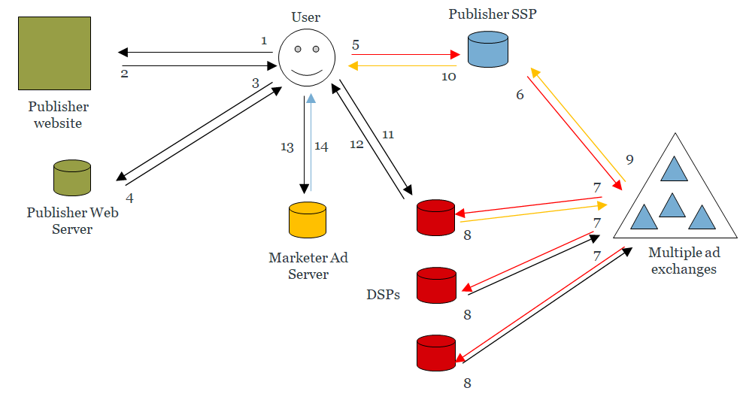
Data Augmentation
Publisher Data Management Platform (DMP)
Advertiser / Agency Data Management Platform (DMP)
Source: AdOps Insider (2010)
Notes:
See: http://www.adopsinsider.com/ad-serving/diagramming-the-ssp-dsp-and-rtb-redirect-path/
When the browser cookie ID is passed to the SSP, it may be enriched with all kinds of data (third-party cookie synching);
The enriched profile is passed to the ad exchange, and DSPs will bid on those enriched profiles;
DSP bidding will also be guided by data from advertiser side DMPs. This may be through:
Prior analysis (i.e. audience segmentation strategies) – prospecting
Cookie syncing with the SSP cookie IDs (the same cookie IDs present in the DSP and SSP) - retargeting

Slide 45
Types of Web Advertising Data
Browser Specific
Website adds
Ad server adds
Advertiser adds
IP Address
User Agent
Cookies
IP Address
User Agent
Cookies
IP Address
User Agent
Cookies
IP Address
User Agent
Cookies
Referrer URL
Location URL
Site specific
information
Referrer URL
Location URL
Site specific
information
Referrer URL
Location URL
Site specific
information
Geo location
Ad interaction
behaviour
Content type
Geo location
Ad interaction
behaviour
Content type
DSP cookie data
Web analytics data
Other PII*
*PII = Personally Identifiable Information
Notes:
This level of granular profiling enables micro-targeting e.g. Facebook.

Slide 46
Cookies

Slide 47
Cookies
Cookies are small text files
Provide web and ad servers with a mechanism to store and retrieve state information on the client application's system
They identify you and remember things about you
Record your browsing activities:
  Pages content you looked at
  When you visited
  What you searched
  You clicked on an ad
Notes:
They break the statelessness of HTTP.

Slide 48
Cookies
1991 - Lou Montulli developed cookies for use on Lynx (web browser)
Magic cookie
  “something that passed between routines or programs that enable the receiver to perform some operation, a capability ticket or opaque identifier”
1994 - Cookies were used in Netscape
  “verify whether users had visited Netscape website before and enabled websites to remember your preferences”

Slide 49
Cookies
1996 - media started to report on the potential threat to privacy
1998 - US Department of Energy Computer Incident Advisory Capability released a bulletin:
  “The vulnerability of systems to damage or snooping by using Web browser cookies is essentially nonexistent. Cookies can only tell a Web server if you have been there before and can pass short bits of information (such as user number) from the Web server back to itself the next time you visit... Information about where you came from and what. Web pages you visit already exists in the Web server’s log files and could also be used to track users browsing habits, cookies just make it easier.”
See also: DoubleClick Privacy Litigation (2001)
Notes:
The public furore became so great that the US Government was forced to make a statement.

Slide 50
Cookies and HTTP
Scope of the cookie (Domain and Path)
Set-Cookie HTTP Response Header (server sets cookies):
  Set-Cookie: name1=value1
  Set-Cookie: name2=value2; Expires=Wed, 09 Jun 2021 10:18:14 GMT
Cookie Request Header (browser requests cookies):
  Cookie: name1=value1; name2=value2
Notes:
Set-cookie response header: Browser makes HTTP request, server sets a cookie with some information expressed in key value pairs.
Browser request cookies: When the browser makes a second request to the server it sends the cookie information; the server can then respond accordingly.

Slide 51
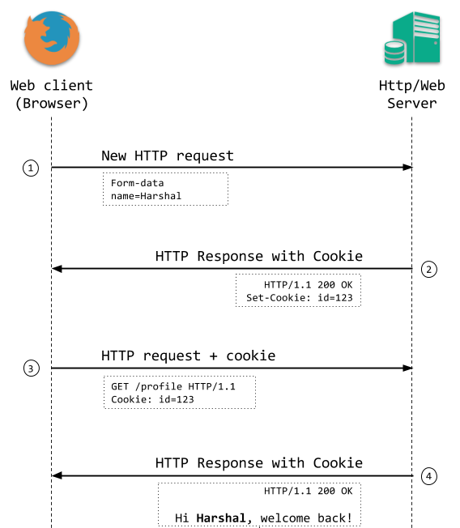
Source: web/F (2018)
Notes:
https://blog.webf.zone/ultimate-guide-to-http-cookies-2aa3e083dbae
User completes form;
Web or ad server responds with a SET-cookie in the HTTP header with cookie id=123;
The next time an HTTP GET request is made, the cookie is sent;
The HTTP request returns the cookie ID, which is associated to the form data.

Slide 52
First Party Cookies
Placed by a site when you visit it
Make your experience on the web more efficient
For example
  Log-in name
  Session
  Preferences
  Game scores
  Items in your shopping cart

Slide 53
Third Party Cookies
Placed by someone other than the site you are on
Include an advertising network or a company that helps track website usage
Usually attached to images and other webpage components
  e.g. invisible 1x1 images

Slide 54
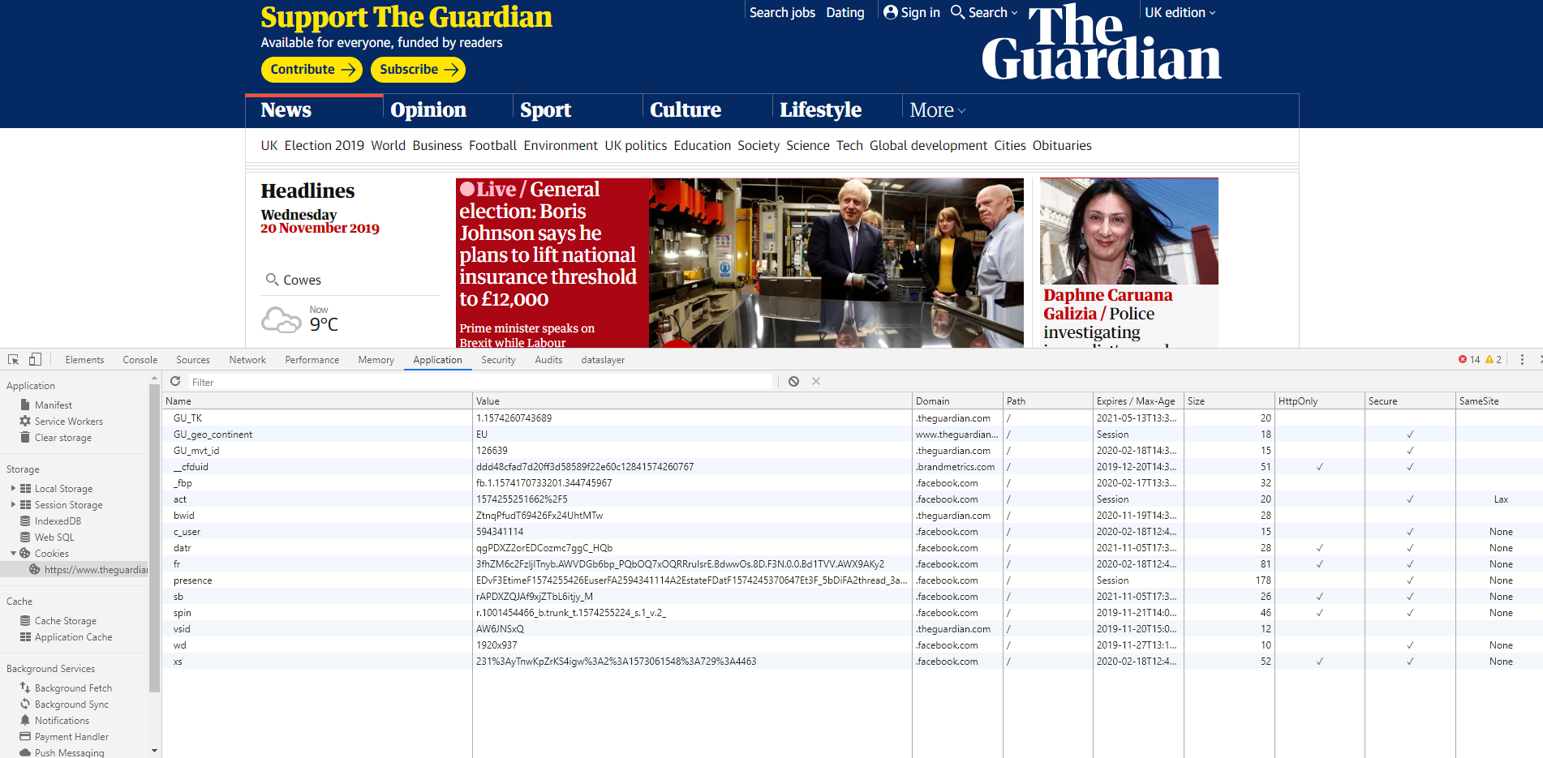
3rd party
1st party
Notes:
ICO 2015 survey:
Average website places 34 cookies your first visit:
70% third-party cookies
30% first-party cookies

Slide 55
Transient and Persistent Cookies
Transient cookies | Persistent cookies
Session cookie | Multi-session cookie
Helps ‘sessionise’ website experience | Helps ‘personalise’ website experience
‘SET’ when visiting the site; deleted when leaving the site | ‘SET’ when site is visited for the first time; remains either until the expiration date or manual deletion
Created simply by not setting a date in the Set-Cookie option | Expiration date in Set-Cookie option
 | Used as a reference ID for information stored about users on web / ad servers
Notes:
ICO 2015 survey:
86% of cookies are persistent cookies
14% of cookies were transient cookies

Slide 56
Cookie Issues
Clearly cookies have an important function
But they are a potential threat to privacy:
  Ad agencies and analytics companies can track you across members of their network
    May reconcile across multiple tracking networks
  Understand your web-browsing activity in order to better profile you
  Evercookies, Device fingerprinting, Cross-device tracking
Shoshana Zuboff: The Age of Surveillance Capitalism (2019)
  See also: Zuboff (2015): https://journals.sagepub.com/doi/pdf/10.1057/jit.2015.5

Slide 57
What makes it easier to blend into the crowd?
Use a system configuration that many others use
  Don’t install other fonts and browser plugins
Clear your cache and cookie each time you close your browser
Disable JavaScript and Flash
  Many websites will not function unless enabled
Control which scripts are allowed to run
  Some website may not function when certain scripts are blocked

Slide 58
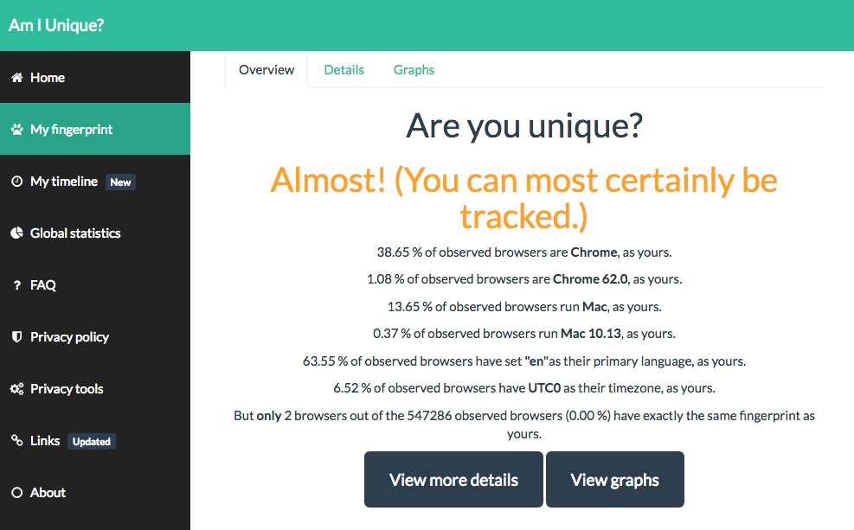
Am I Unique? amiunique.org

Slide 59
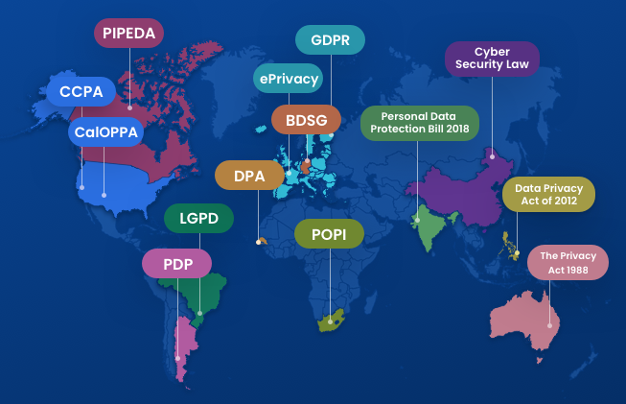
Legislation
A handful of powerful US companies hold vast amount of PII.
Legislation is inconsistent and disjointed.
The need for multi-lateral coordination of legislation?
Source: Termly.io (2019)
Notes:
See: https://termly.io/resources/infographics/privacy-laws-around-the-world/

Slide 60
GDPR Cookie Consent
Cookies are now defined as personal data.
  online identifiers, including pseudonymous, which has the potential for an individual to be identified or singled out is personal data
Implied consent is no longer compliant.
  GDPR requires the user to make an ‘affirmative action’
Advice to adjust browser settings won’t be enough.
  GDPR says it must be as easy to withdraw consent
  Telling people to block cookies isn’t sufficient

Slide 61
GDPR Cookie Consent
‘By using this site, you accept cookies’ statements are not compliant.
  If there is no genuine and free choice, then there is no valid consent.
Sites require an always available opt-out.
Consent must be specific to different cookie purposes.
  Granular levels of control - separate consents for functional, analytics and marketing cookies.

Slide 62
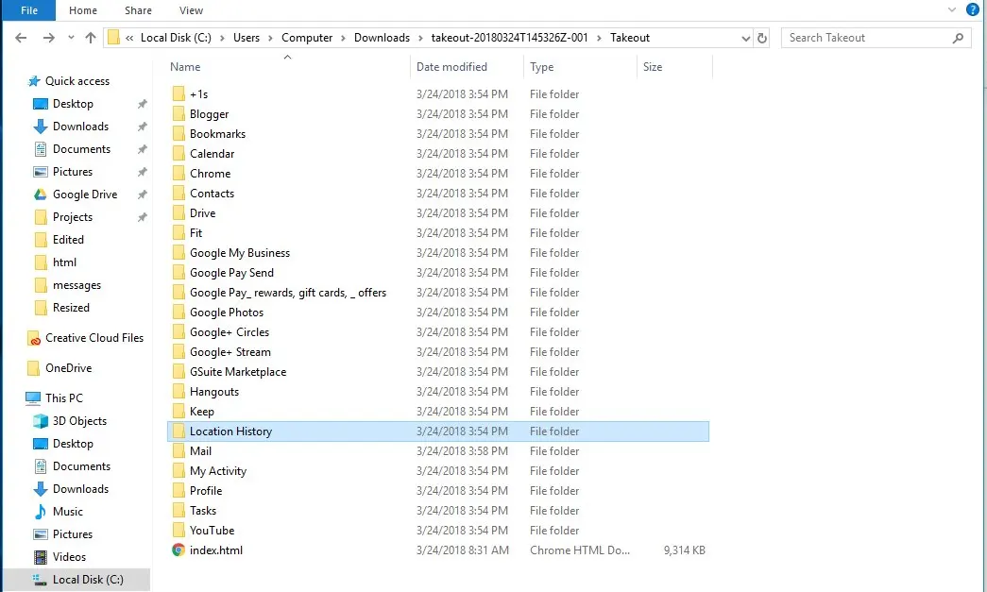
Beyond the Cookie…
Source: theguardian.com (2018); https://www.theguardian.com/commentisfree/2018/mar/28/all-the-data-facebook-google-has-on-you-privacy

Slide 63
Conclusions

Slide 64
Conclusions
Client-server Web is a private two-party communication
But adverts are from a third party, on behalf of a fourth party, mediated by a fifth party!
Google try to occupy the whole service space themselves with integrated data architectures
  Everyone else has to piece it together with different specialist services

Slide 65
Conclusions
Regulating cookies may not improve online privacy
There are similar technologies that most people don’t know about (like HTML5 local storage and non-cookie based storage), which can do the same thing
Cookies by themselves pose no threat to the average Web user; commercial or political misuse are the key issues

