Slide 2
Intellectual Property on the Web
COMP3220 Web Infrastructure COMP6218 Web Architecture
Dr Heather Packer – hp3@ecs.soton.ac.uk

Slide 3
Intellectual Property Rights
Intellectual property (IP) is intangible creations of the human intellect
There are many types of intellectual property, and some countries recognise more than others
Intellectual property law encourages the creation of a wide variety of intellectual goods property
Rights should encourage the creation of intellectual goods but not prevent the goods' wider use
Rights last between 50-100 years

Slide 4
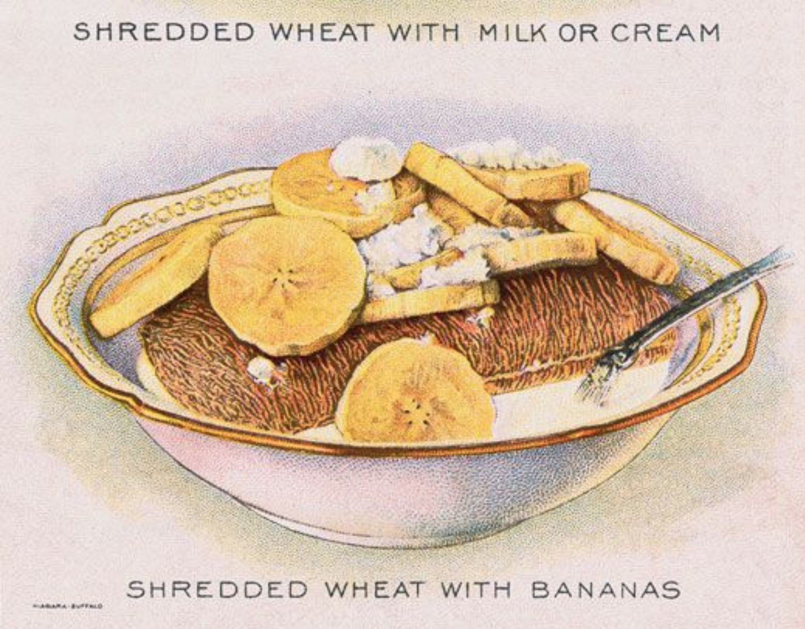
Intellectual Property

Slide 5
Types of IP Rights
Copyright | Protects the skill and labour expanded by someone creating something new
Database (EU only) | Protects the skill and labour expended by someone creating collections of data or other materials
Performance rights | Protects against unauthorised making of copies of “public performances”, which includes musical, theatrical, dance performance, and also lectures
Patents | Protect inventions by giving invention a monopoly on exploiting their inventions for a certain period
Trademarks | Exclusively identify the product of a particular manufacturer or supplier
Design rights | Protects the shape and configuration (how different parts of a design are arranged together of objects)
Moral rights (EU only) | Right of a creator to insist that his/her name is associated with his/her creation. Right of the creator to object to derogatory his/her work which damages his/her reputation

Slide 6
Copyright
Protects:
Original literary, dramatic, musical, and artistic works
Sound recordings, films, broadcasts and cable transmissions
The typographical arrangement of published editions
Copyright gives five exclusive rights to the owner of the copyright. The right to:
Copy the work
Issue copies to the public
Perform, play or show the work to the public
Broadcast the work or transmit on a cable service
Make an adaptation of the work

Slide 7
Who owns the Copyright?
Copyright is owned by the author(s) of the work
An employer owns the copyright if the author created the work in the course of employment
Independent contractors own the copyright unless agreed otherwise
Copyright can only be transferred in writing
Copyright does not need to be registered

Slide 8
Database Rights
Database rights only arise where the maker of the database has invested substantially in obtaining or verifying data from independent sources
Investment in actually creating data which forms part of a database will not automatically result in a database right
Databases can be subject to copyright if a database is the author’s “own original intellectual creations”
Database rights are independent of copyright
A new set of rights are created each time a database is substantially modified
“substantial investment in obtaining, verifying or presenting the contents of the database”
Owners can object to the copying of substantial parts of their database, even if data is extracted and reconstructed
Database rights under the EU are created automatically
Rights last for 15 years

Slide 9
Trademark Rights
Trademark Rights is a type of IP
Recognisable logo, sign or expression which makes products or services identifiable
The trademark owner can be an individual, business organization, or any legal entity
Trademarks may be located on packages, labels, and or products
Or on websites, downloads, or files
Registered Trademark
Non Registered Trademark

Slide 10
Trademark Rights
Web domains can be trademarked
Cyber squatting is registering a domain name with no legitimate reason other than to benefit from another's good reputation
Cyber squatters profit from the trademark by either:
Making money from the trademark, trafficking users to unrelated material
Selling the trademarked domain at an inflated price
In the US through arbitration, if you can show that:
Someone registered a web address with your trademark in it
Registered the web address with the sole purpose of making money
No legitimate reason for the site to be using the trademark

Slide 11
Trademark Rights
Twitter
Forbids selling usernames
Forbids the impersonation of a person that is non-parody
Prevents identify confusion with verified accounts with insignia
Facebook
Reserves the right to claim usernames on the website if they infringe on trademark
Owners are responsible for reporting
Requires Mobile phone verification

Slide 12
Infringement
Primary infringement is anyone who, without consent, does any of the five things that are the exclusive right of the owner of the copyright
Primary infringement is purely a civil matter
Secondary infringement occurs when an infringement is performed knowingly and in the course of business
Secondary infringement can be a criminal offense

Slide 13
Data Rights Ownership
Combining data sources can provide valuable and sometimes unexpected insights
“The whole is greater than the sum of its parts” –Aristotle
The resulting data may be valuable as input for another processes
Its hard to know:
whether particular uses of data are lawful
the degree to which the holder of rights in one set of data can assert rights in data derived from it

Slide 14
Copyright & Digital Technology
Ease of Reproduction
Once a work is rendered in digital form, it can be reproduced
Rapidly
At little cost
Without any loss of quality
Each copy, in turn, can be further reproduced without any loss of quality
Ease of Storage
Gb media files vs Tb hard disks
Ease of Dissemination
Gb media files vs fibre optic and 4G networks

Slide 15
Copyright & Web
The Web violates the principle of copyright

Slide 16
Copyright & Web
The Web violates the principle of copyright
Copyright is created as soon as something is written down

Slide 17
Copyright & Web
The Web violates the principle of copyright
Copyright is created as soon as something is written down
Copies are made from server, through proxies, to hard disk, to screen

Slide 18
Digital Intellectual Property Solutions

Slide 19
Licensing
A license allows someone (the licensee) to use a work for some or all purposes but the owner retains ownership
The license may be for a fixed period or it may be in perpetuity
In an assignment, the copyright owner transfers some or all of the rights of ownership to someone else (the assignee)
Explicit licenses are rarely provided
They are frequently unhelpful
https://www.flickr.com/photos/detroitderek/

Slide 20
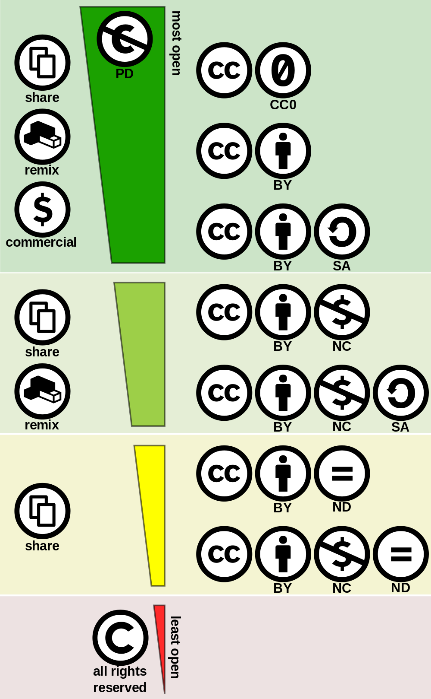
Creative Commons Licensing
Creative commons cc addresses legal problems in the area of global copyright law
Offers viable middle ground between
Stringent copyright controls
Completely unfettered use of content
Provides a set of user friendly online licenses
Authors, musicians and other creators of content can use these licenses to protect some of their ownership rights, while giving others away
A new global standard or layer of copyright law promoting the dissemination of digital content and the free exchange of ideas

Slide 21
*https://www.connectsafely.org/copyright/

Slide 22
YouTube
YouTube allows users to upload video
Standard YouTube License: Uploader holds copyright, Creative Commons can be selected
YouTube has been criticised for copyrighted content
Provides ability to embed videos to maintain control over IP
A large proportion of YouTube’s revenue goes to the copyright holders of the videos

Slide 23
YouTube’s Content ID
Content ID is a system for automatic detection of uploaded videos that infringe copyright
Allows Copyright holders to manage their content
Only for large content owners
Substantial body of original material
Frequently uploaded by YouTube Creators
Copyright holders upload their content to Content ID system which generates fingerprints

Slide 24
YouTube’s Content ID cont.
Every submission by a “YouTube Creator” is matched against fingerprint database
Content is flagged and Rights holder can
Track
Claim
Block
Strike (Full takedown)
YouTube Creator can dispute claims and blocks
After claim resolution revenue generated is passed to Rights holder or YouTube Creator

Slide 25
Problems with Content ID
Only as good as the Matching Algorithm and Content ID database of fingerprints
99.7% accurate but 500 hours per minute being uploaded
A lot of false negatives/positives
Rights holders can take down negative videos but leave positive
Creators can loose channel if the receive too many strikes

Slide 26
Web Standards and Digital Rights Management (DRM)
Encrypted Media Extensions standard
DRM systems to hook directly into browser
Video streams eg Netflix in the browser
Avoids needing plugins like Flash or Silverlight
Controversial for W3C
No View Source

Slide 27
Legal Case: Peer-to-Peer File Sharing

Slide 28
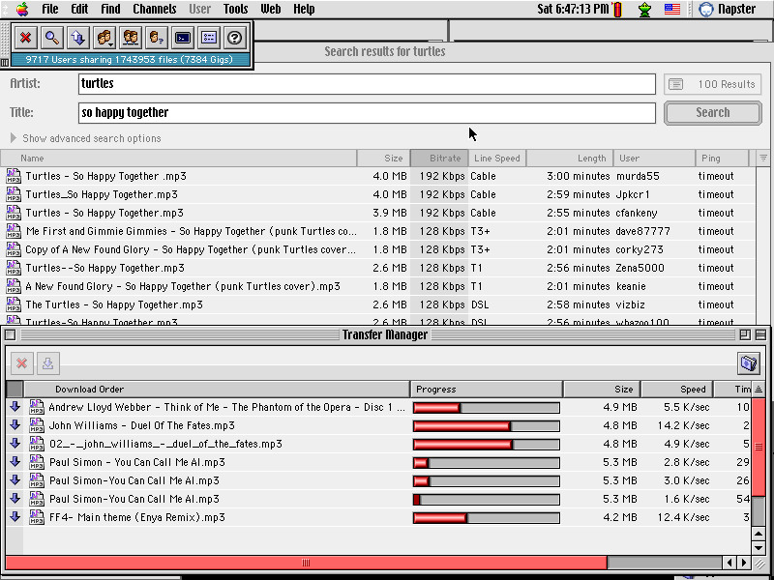
Napster
Napster was a popular peer-to-peer file sharing network 1999-2001
Users shared music files
A central server indexed available users’ files, creating a searchable list of music

Slide 29
A&M Records vs. Napster
In 2001 a landmark intellectual property case
A&M Records claimed that Napster were liable infringement on copyrighted works
This was the first major case to address the application of copyright laws to peer-to-peer file-sharing

Slide 30
Plaintiffs
A&M Records, a subsidiary of Universal Music Group
Geffen Records, a subsidiary of Universal Music Group
Interscope Records, a subsidiary of Universal Music Group
Sony Music Entertainment
MCA Records, a subsidiary of Universal Music Group
Atlantic Records, a subsidiary of Warner Music Group
Island Records, a subsidiary of Universal Music Group
Motown Records, a subsidiary of Universal Music Group
Capitol Records, a subsidiary of EMI
LaFace Records, a subsidiary of Sony Music Entertainment
BMG Music d/b/a The RCA Records Label, subsidiaries of Sony Music Entertainment
Universal Records, a subsidiary of Universal Music Group
Elektra Entertainment Group, a subsidiary of Warner Music Group
Arista Records, a subsidiary of Sony Music Entertainment
Sire Records Group, a subsidiary of Warner Music Group
Polygram Records, a subsidiary of Universal Music Group
Virgin Records America, a subsidiary of EMI
Warner Bros. Records, a subsidiary of Warner Music Group
Universal Music Group, Sony Music Entertainment, EMI, and Warner Music Group are known as the "big four" in the music industry

Slide 31
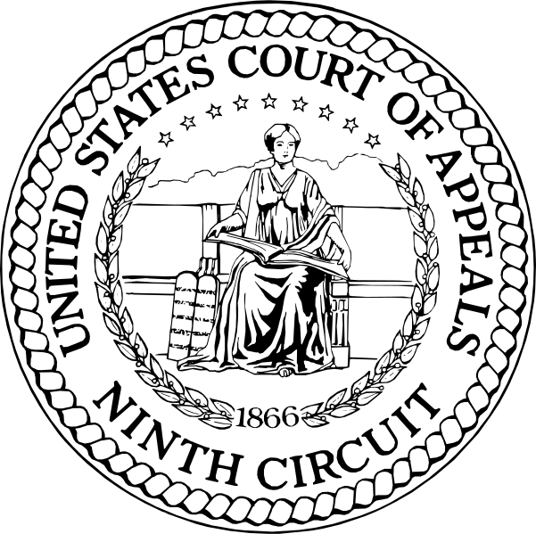
Napster Initial Ruling
Napster was served with an injunction stopped them from engaging in or facilitating others in:
copying
downloading
uploading
transmitting
or distributing
copyrighted music without the permission of the rights owner

Slide 32
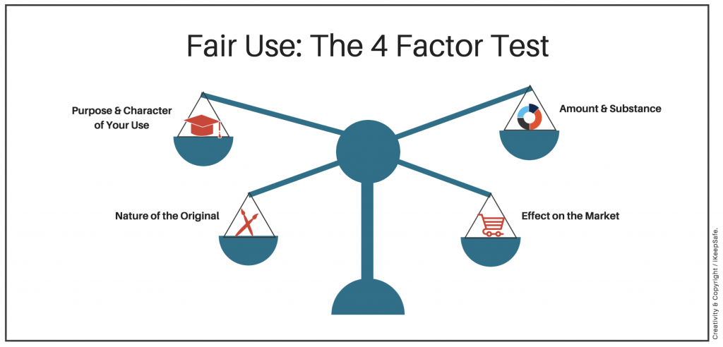
Defense Fair Use
"sampling, where users make temporary copies of a work before purchasing;
space-shifting, where users access a sound recording through the Napster system that they already own in audio CD format;
and permissive distribution of recordings by both new and established artists."

Slide 33
Ruling
The court found that Napster could control the infringing behavior of users
Napster had a duty to control this
The court affirmed that Napster did not have a valid fair use defense

Slide 34
EU and Intellectual Property

Slide 35
Google News
In 2013 Google News was watching more than 50,000 news sources worldwide
They provide Google News stories based on country
The service covers news articles appearing in the past 30 days
News articles shared on Google News contain a:
Title
Source
Snippet

Slide 36
Google News and Legal Action
Google was sued by:
Agence France-Presse for using photos, stories and news headlines 2005
Beligum news sources for using lead paragraphs 2007
Laws passed by German and Spain allowing publishers to charge a fee for other providers publishing short snippets of news
German 2013 law
Google refused to pay and delisted publishers
Publishers saw 40% drop in traffic
Google then successfully challenged the law; ruled invalid due to procedural issues
Spain introduced a similar law in 2014
Google shut its Google News service for Spain
Dubbed “Google tax” because it targeted Google display news results in search results

Slide 37
EU Copyright Directive
Directive on Copyright in the Digital Single Market 2019
Article 15 grants news publishers direct copyright over “online use of their press publications by information society service providers”
Article 17 requires content sharing service providers to police the copyright of content uploaded to their service

Slide 38
Article 15
Ratified June 2019
Member states have 2 years to implement
France first to implement July 2019
Link, headline and thumbnail – no fee
Snippets and more - fee
Google have indicated they will not pay and leave it to the publishers to determine what level they wish to appear in search results

Slide 39
Article 17
Online content sharing platforms must obtain permission from rights holders for uploaded works
Can now be held responsible for unlicensed content
Required to pay fairly for their work

Slide 40
Neil Gaiman on Copyright Piracy and the Web
https://www.youtube.com/watch?v=0Qkyt1wXNlI

Slide 41
Summary

Slide 42
Learning Outcomes
Evaluate and identify what elements on the Web can be protected by IP
Understand which controls and measures undertaken to adhere to IP rights
Laws
Licenses
Systems

