Slide 2
Search Engines
COMP3220 Web Infrastructure COMP6218 Web Architecture
Dr Heather Packer – hp3@ecs.soton.ac.uk

Slide 3
Introduction
Search Engines and their components
History of Search Engines
Search Engine Issues

Slide 4
Specific Board and Vague Queries
 | Specific | Broad | Vague
I know specifically what I’m looking for | ✔ | ✖ | ✖
I know where to look for what I’m looking for | ✔ | ✔ | ✖
Example | Looking for a specific gene in the Gene Database | Looking for the manager of HR, in the company directory | Google

Slide 5
Specific Board and Vague Queries
Search Engines
 | Specific | Broad | Vague
I know specifically what I’m looking for | ✔ | ✖ | ✖
I know where to look for what I’m looking for | ✔ | ✔ | ✖
Example | Looking for a specific gene in the Gene Database | Looking for the manager of HR, in the company directory | Google

Slide 6
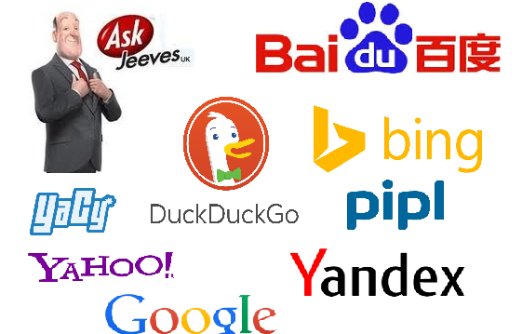
Search Engines

Slide 7
Search Engines
Search engines are a service
They allow users to search for content using keywords
They DO NOT access the web directly
They USE huge databases
A query returns a ranked set of results

Slide 8
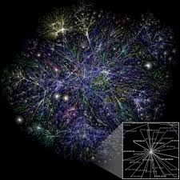
Simple Framework – Altravista’s Framework 1994
Query Engine
Search
index
Interface
Web Crawler

Slide 9
Web Crawler, Spider or bot
An algorithm that systematically browses the web
A basic algorithm
Start at a webpage
Follow the hyperlinks that webpage points to
Then follows the links those webpages point to
Each page it visits it collects metadata about it
Stores a file for each resource, with its metadata in a search index
Crawlers consume resources
Can visit sites without approval

Slide 10
Web Crawler - robots.txt
Block all web crawlers
User-agent: *
Disallow: /
Allow all web crawlers
User-agent: *
Disallow:
Block a specific web crawler from a specific folder
User-agent: Googlebot
Disallow: /example-subfolder/
Disallow: /index.html

Slide 11
Web Crawler Policies
The behaviour of a web crawler is based on:
Selection Policy
Re-visit Policy
Politeness Policy
Parallelisation Policy

Slide 12
Web Crawler Selection Policy
Search engines only index part of the web
It’s important to download the most relevant pages
A selection policy states which pages to index
Strategies:
Breadth first
Back link count
PageRank
Only request pages that have searchable content (HTML, PDF etc)

Slide 13
Web Crawler Re-visit Policy
Its worth revisiting web pages because they change over time
An ideal search engine would have the most up-to-date version of every page in its index
Strategies
Re-visit all pages equally frequent
Prioritise pages that change often (but not too often!)
May take page quality into account

Slide 14
Web Crawler Politeness Policy
Issues of schedule and load when large collections of pages are accessed
Strategies
Do not make parallel calls to the same server
Spread out requests
Abide by Crawler delay in Robots.txt

Slide 15
Web Crawler Parellisation Policy
An efficient crawler needs to access many web servers at once
Run multiple processes in parallel
Could find the same URL on multiple pages
Strategies:
Dynamically assign pages to crawler processes
Static mapping eg based on a hash function

Slide 16
Web Crawler - Crawlability
Broken links
Denied access
Outdated URLs
URL errors
Blocked
No out links
Slow load speed
Duplicated pages
Flash content
JavaScript (Googlebot executed from 2014)
HTML frames (outdated and thus poorly indexed)

Slide 17
Search Index Ranking
Query results can be ranked using many features:
How many times does the page contain the keywords
Do keywords appear in the title or url
Does it contain synonyms for your keywords
Is it from a quality source
What is it’s importance
How often a page is updated
Freshness of information
Page load time

Slide 18
Indexing Data Issues
Distributed data
Changes over time
Large volume
Data
Unstructured data - gifs, pdf, etc
Redundant data - 30% pages are near duplicates
Quality of data - False, poorly written, invalid, misspelt
Heterogeneous data - media, formats, languages, alphabets

Slide 19
User Search Problems
Users do not understand how to provide a sequence of words for searches
Users may get unexpected answers because they are not aware of the input requirement of the search engine.
For example, some search engines are case sensitive.
Users have problems understanding Boolean logic
Around 85% of users only look at the first page of the result, so relevant answers might be skipped.

Slide 20
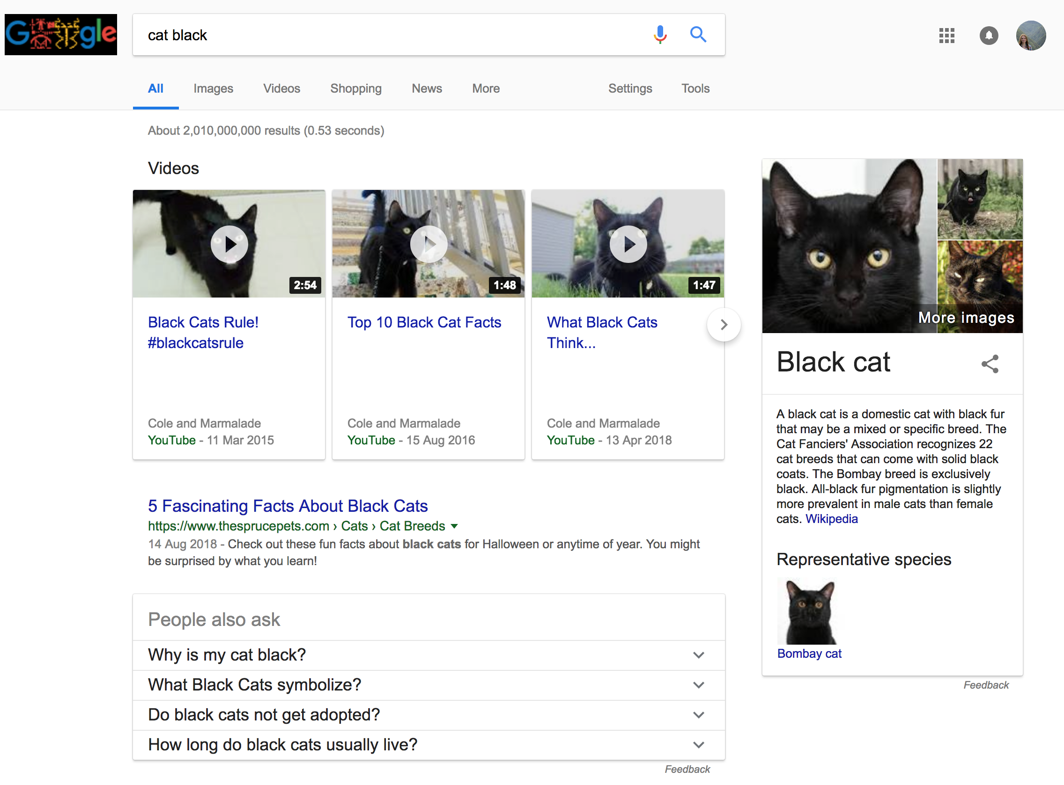
User Search Problems: Ordering of Terms

Slide 21
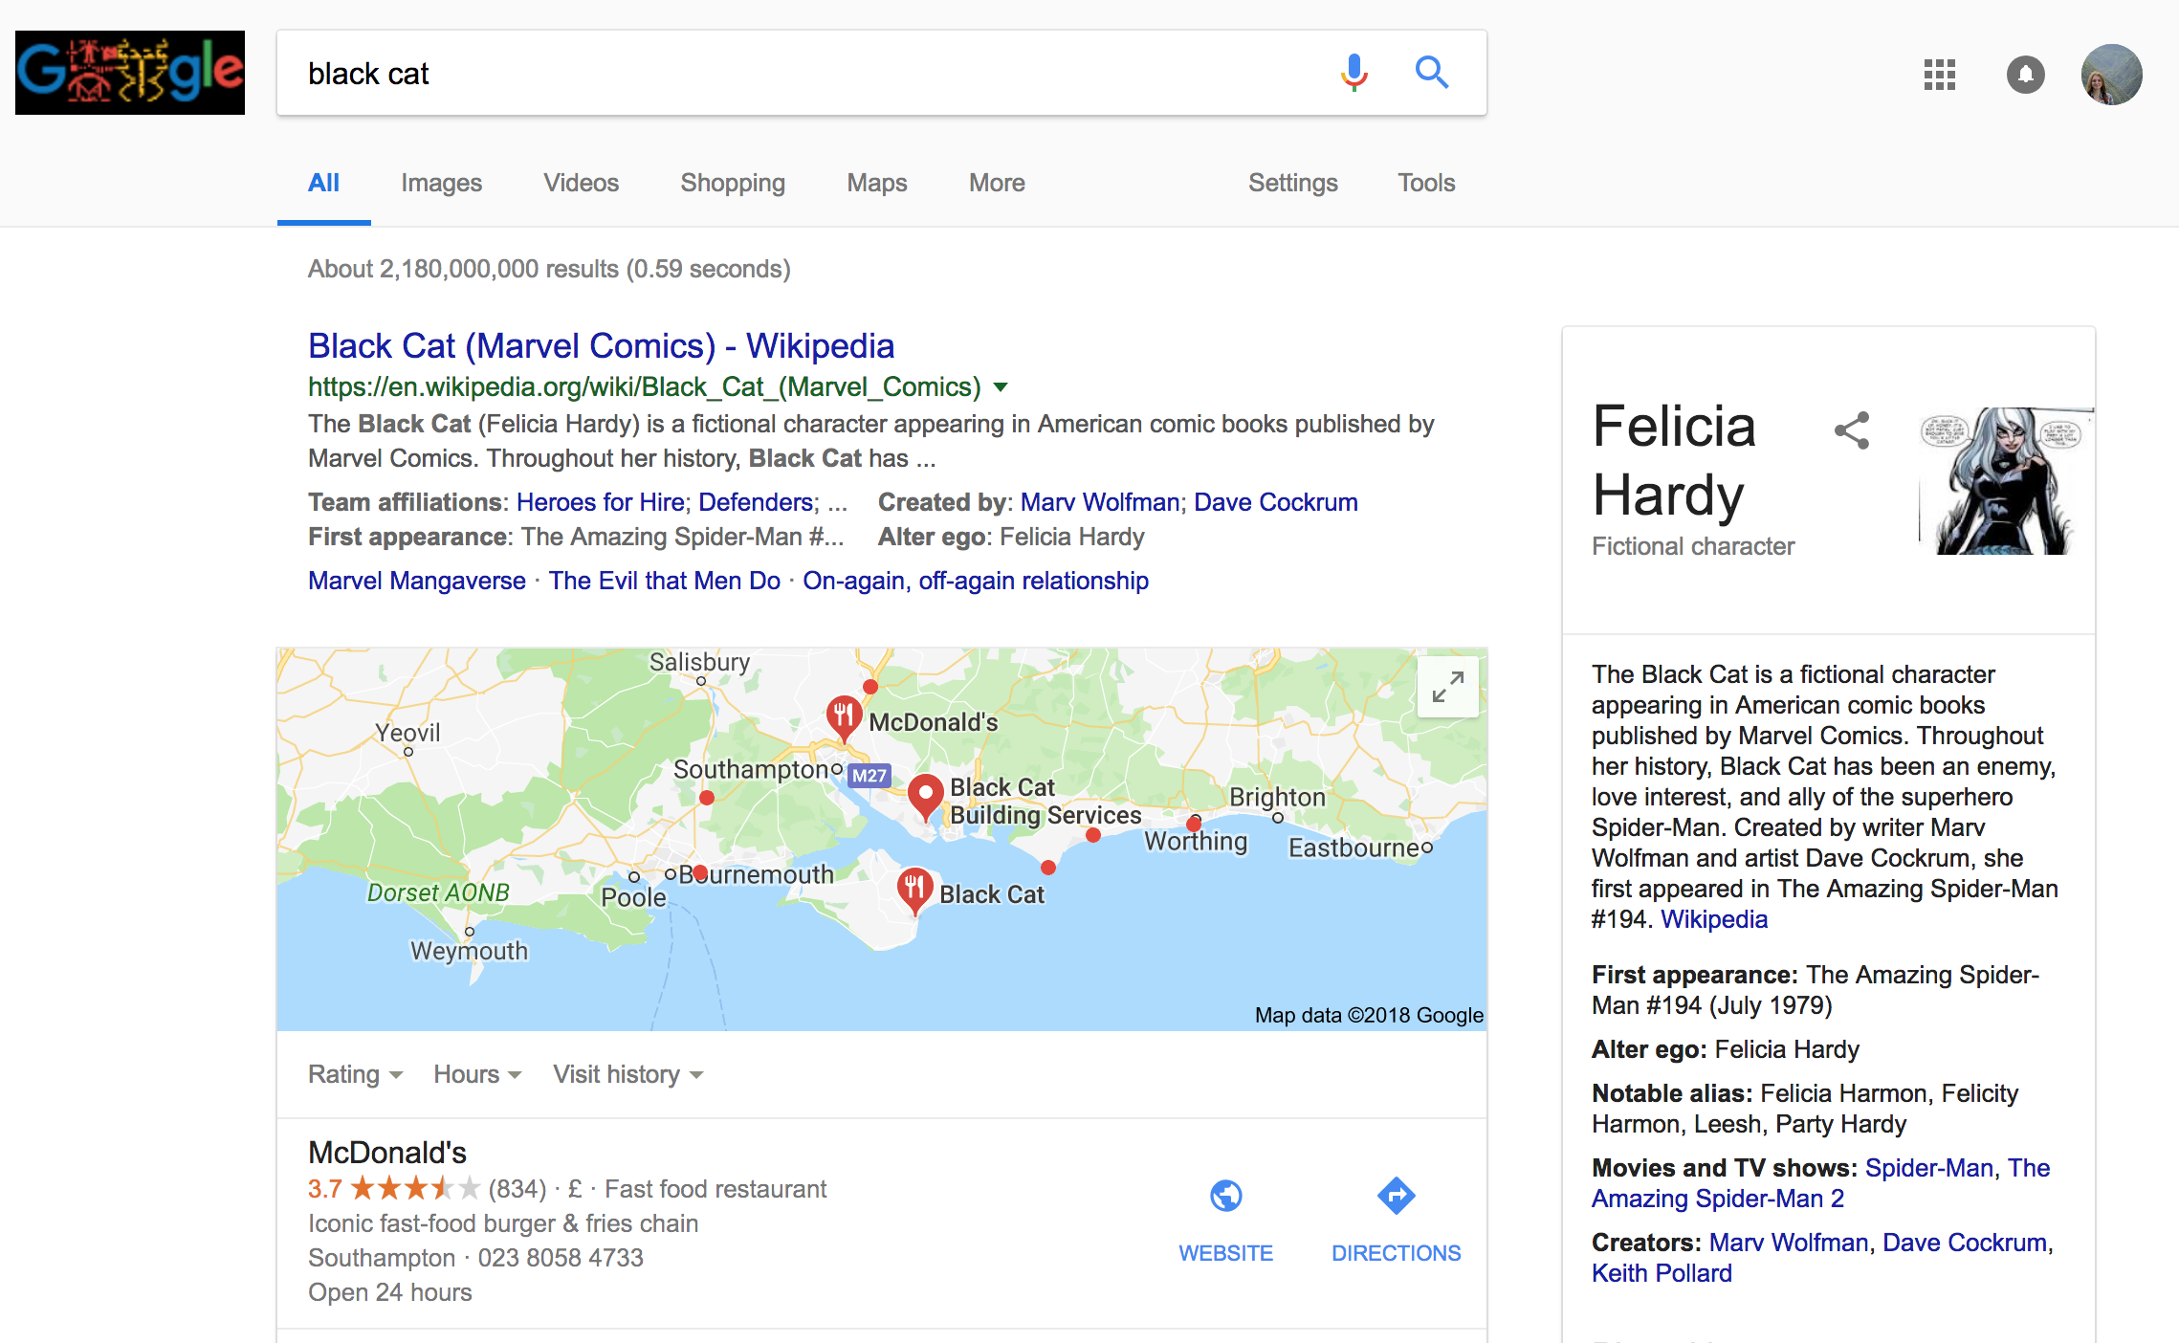
User Search Problems: Ordering of Terms

Slide 22
History of Search Engines

Slide 23
Before Search Engines
Exploit hyperlink structure
Personal homepages with links
Directories
Word of mouth
Email, forums, Usenet

Slide 24
Timeline 90’s – Hand vs Crawler
Services to search the web started in the early 90s
The indexes were either created and edited by hand
Or, by crawlers
June 1993
1st Web Robot
Wandex
Meausres size
Marh 1996
Larry Page
BackRub
SE
1998
Google Search
SE
Jan 1994
Altavista
Crawler
Sept1993
1st Web SE
By Hand
April 1997
Ask Jeeves
SE
Jul/Sept 1998
MSN Search
1995
LookSmart
Web Directory
May 1996
HotBot
SE
April 1994
Yahoo!
Web Directory
By Hand
Oct/Nov 1993
2nd Web SE
By Hand
Dec 1993
3rd Web SE
Crawler
Jul7 1994
Lycos
Crawler
1993 1994 1995 1996 1997 1998

Slide 25
Early 90s Architectures
Query Engine
Search
index
Interface
Web Crawler
Or
Person

Slide 26
Early 90s Architectures
Query Engine
Search
index
Interface
Web Crawler
Or
Person

Slide 27
Early 90s Architectures
Query Engine
Search
index
Interface
Web Crawler
Or
Person

Slide 28
Web Crawlers
Wandex 1993 – size of the web
WebCrawler Dec 1993 - indexer
WebCrawler 1994 - indexed entire web page

Slide 29
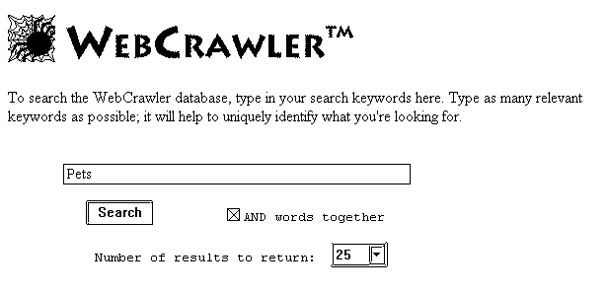

Slide 30
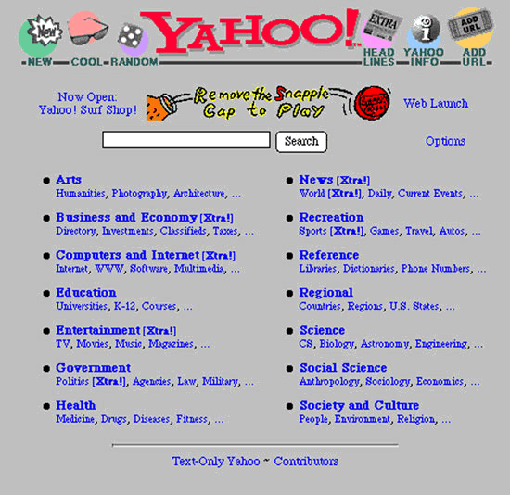
Yahoo!

Slide 31
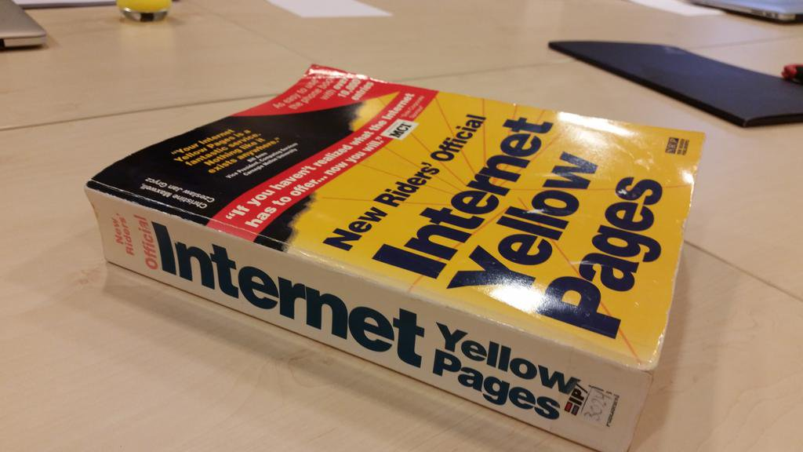
Internet Yellow Pages 1994

Slide 32
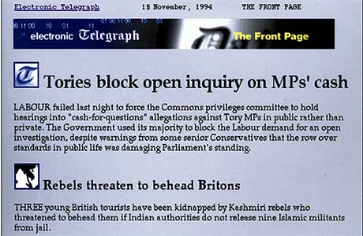
Website - Telegraph 1994

Slide 33
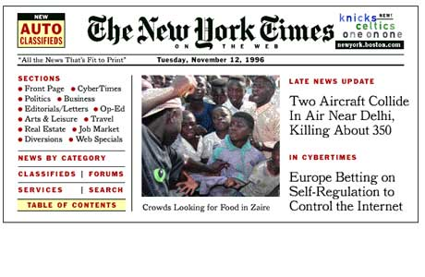
Website – New York Times 1995

Slide 34
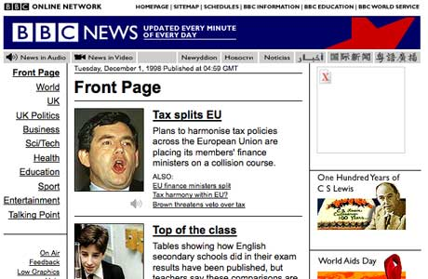
Website – BBC News 1997

Slide 35
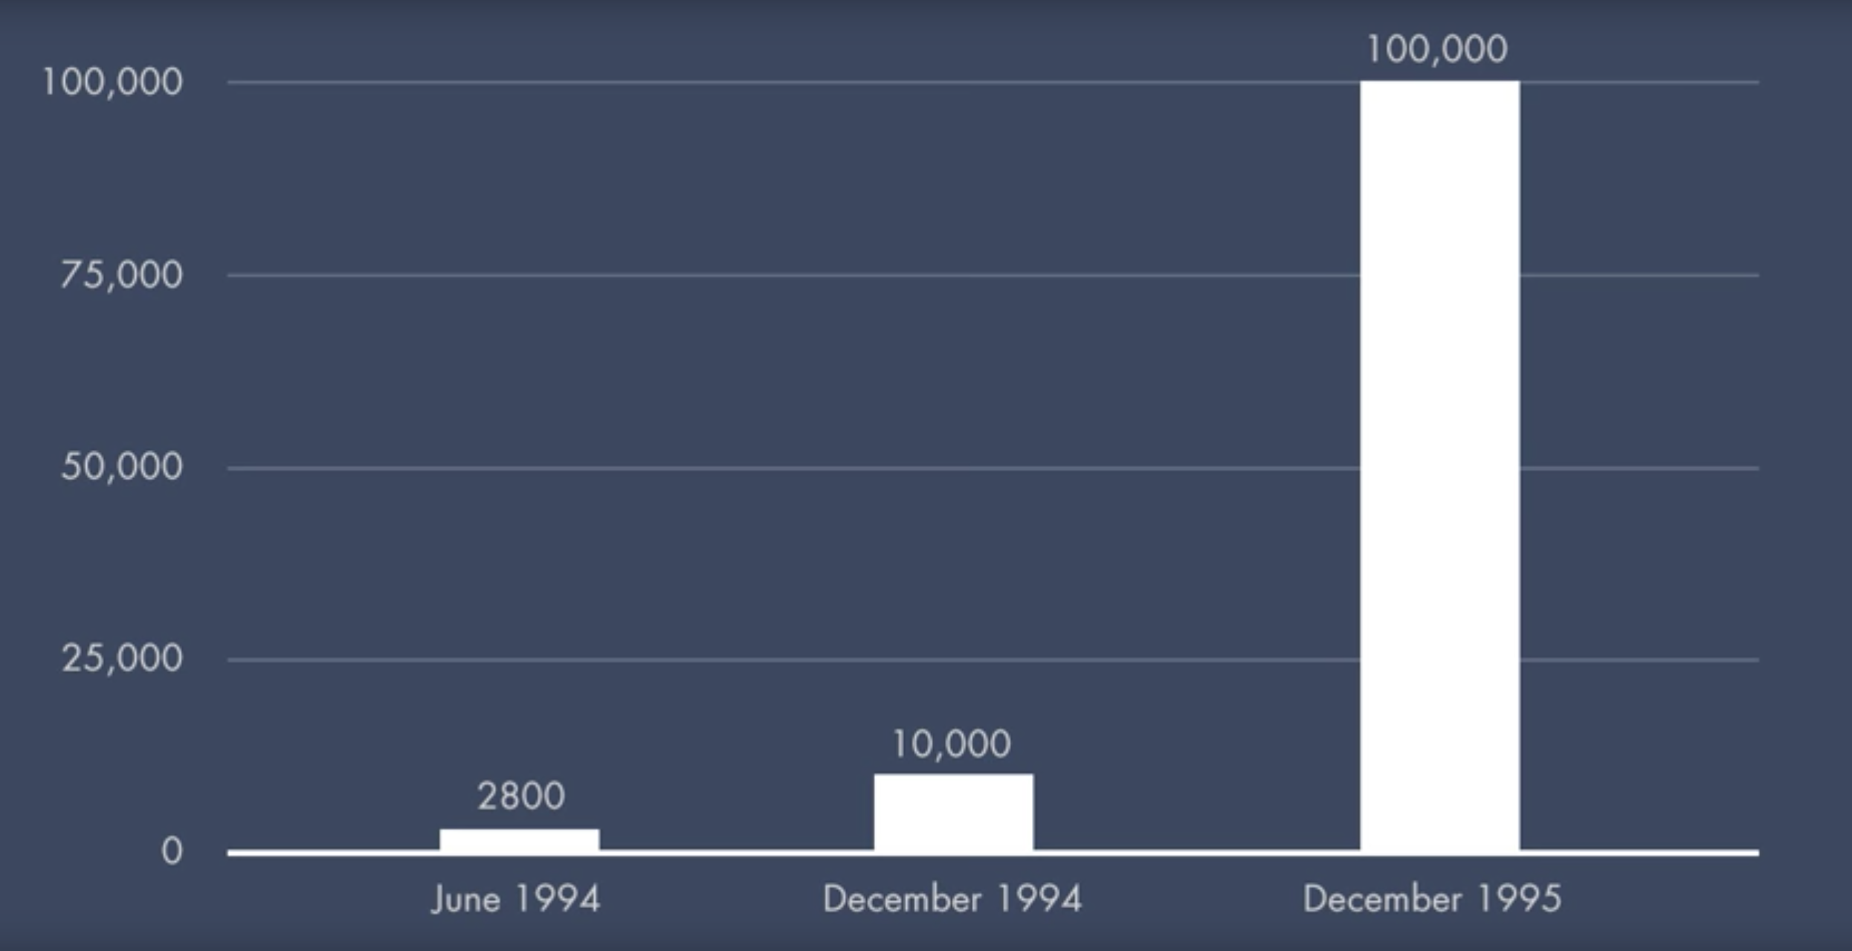
Number of Websites June 1994 - Dec 1995

Slide 36
Search Engines Issues Mid ‘90s
Scale
How to rank pages to give the best results
Spamming
Web searches favoured web pages with high keyword density
Keywords
Spelling mistakes

Slide 37
Timeline 90’s
June 1993
1st Web Robot
Wandex
Meausres size
Marh 1996
Larry Page
BackRub
SE
1998
Google Search
SE
Jan 1994
Altavista
Sept1993
1st Web SE
List
April 1997
Ask Jeeves
SE
Jul/Sept 1998
MSN Search
1995
LookSmart
Web Directory
May 1996
HotBot
SE
April 1994
Yahoo!
Web Directory
Oct/Nov 1993
2nd Web SE
List
Jul7 1994
Lycos
SE
Dec 1993
3rd Web SE
Crawler
Indexer
Seraching
1993 1994 1995 1996 1997 1998

Slide 38
BackRub
Utilised PageRank
More advanced than previous indexing
Used back links

Slide 39
PageRank
Assumes important websites are likely be linked to
Similar to a voting:
where in links are votes
the quality of a vote is determined by the number of votes (in links)
your vote is worth more if you have a higher page rank
Factors Considered:
Number of in links
Quality of in links
Web page’s context
Favoured high keyword density

Slide 40
Keyword Stuffing
Our company provides software development and consultation services. We are the best software development and consultation services. Our company staff provides software development and consultation services. We offer the best software development and consultation services. Our software development and consultation services is the right solution for your business. Satisfaction with our software development and consultation services is guaranteed. We build your business solution with out software development and consultation services. Contact us and you will receive quality software development and consultation services.

Slide 41
Keyword Stuffing
Our company provides software development and consultation services. We are the best software development and consultation services. Our company staff provides software development and consultation services. We offer the best software development and consultation services. Our software development and consultation services is the right solution for your business. Satisfaction with our software development and consultation services is guaranteed. We build your business solution with out software development and consultation services. Contact us and you will receive quality software development and consultation services.

Slide 42
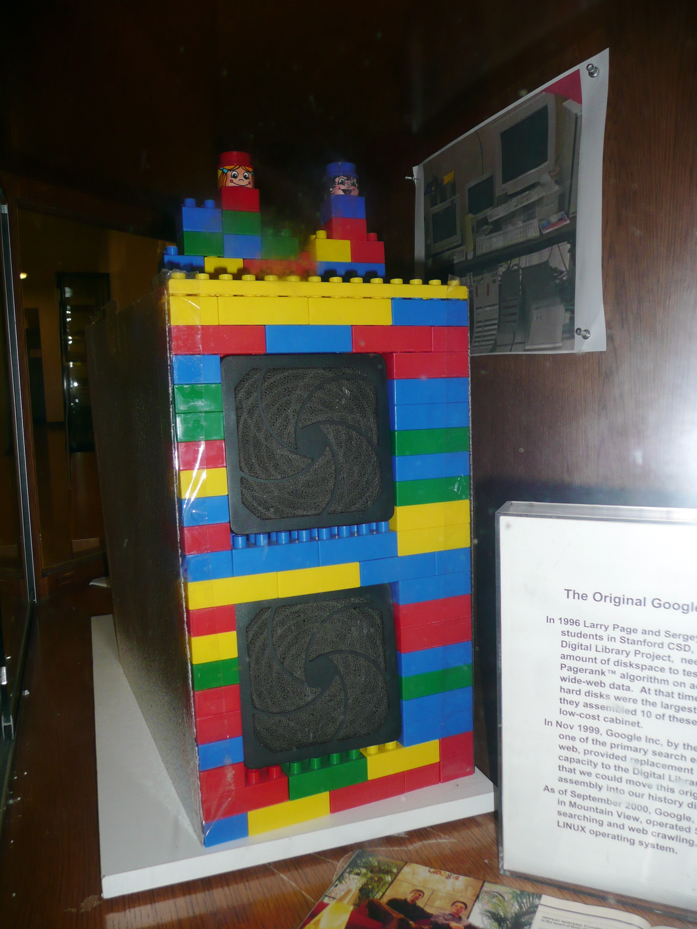
The Original Google Storage
Larry Page needed a large amount of diskspace to test PageRank
10 4GB hard drives

Slide 43
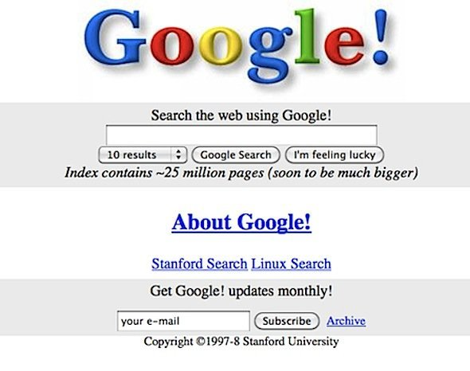
Google 1997-8

Slide 44
The Evolution of Search Engine Features
Search Engine algorithms are constantly changing
They strive to improve their:
Efficiency
How to order the results
Freshness
Relevancy
How to improve user interaction
Additional features

Slide 45
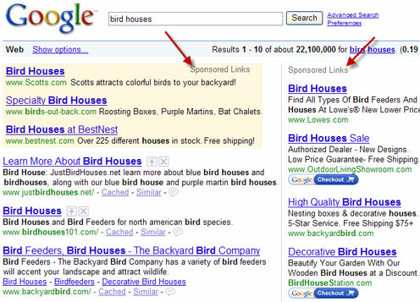
Google Adwords 2000 Funding

Slide 46
Relevancy
During 9/11 it was apparent that search engines did not cater of time-sensitive queries
This lead to Google developing Google News
The freshness of search engine’s index became more important

Slide 47
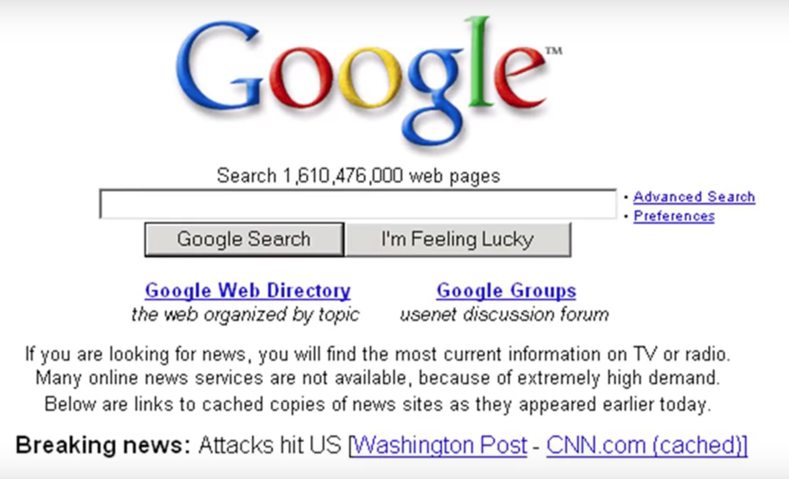

Slide 48
Google 2012
In 1999, it took Google one month to crawl and build an index of about 50 million pages.*
In 2012, the same task was accomplished in less than one minute.*
16% to 20% of queries that get asked every day have never been asked before.*
*Mitchell, Jon. "How Google Search Really Works." Readwrite. February 29, 2012.

Slide 49
Search Verticals
In a bid for content and market share, Search Engines develop other search verticals:
Books
Travel
Finance
Shopping
Scholar

Slide 50
Mobile Search
By 2015 mobile accounted for more than half of all searches
Searches need to be context aware (location)
Limited screen and bandwidth means relevancy is critical
Boost mobile-friendly pages in ranking algorithm

Slide 51
Search Engine Optimisation and Issues

Slide 52
Boosting web traffic
Search engines direct traffic to websites
85% of people don’t look at the second page
People try to optimise their site so that it ranks highly on Search Engines
Could be fundamental to a website’s business model

Slide 53
Search Engine Optimisation
Whole industry exists trying to boost search ranking to ensure pages are indexed by search engines
Legitimate SEO (White Hat)
Good Design
Valid metadata, alt tags on images
Illegitimate SEO (Black Hat)
Often gaming search ranking algorithms
Deception
Leads to arms race between SEO and search engines

Slide 54
Combatting SEO
Most search engines have rules against:
Invisible text
Meta tag abuse
Heavy repetition
“domain spam”
Overtly submission of “mirror” sites in an attempt to dominate the listings for particular terms

Slide 55
Google and other SEs are a Business
Search Engines record tracking information
Google saves every voice search
IP addresses
Location
Saves your searches
Google’s revenue is from adverts
Improve their revenue with targeted advertising
Google has a large research department
Improve their technology

Slide 56
Overview
What types of queries can be answered on the web
Search engines and their basic framework:
Web crawler
Search index
Query engine
Interface
Their history
Issues with Search Engines

