Slide 2
Intellectual Property on the Web
COMP3220 Web Infrastructure COMP6218 Web Architecture
Dr Heather Packer – hp3@ecs.soton.ac.uk

Slide 3
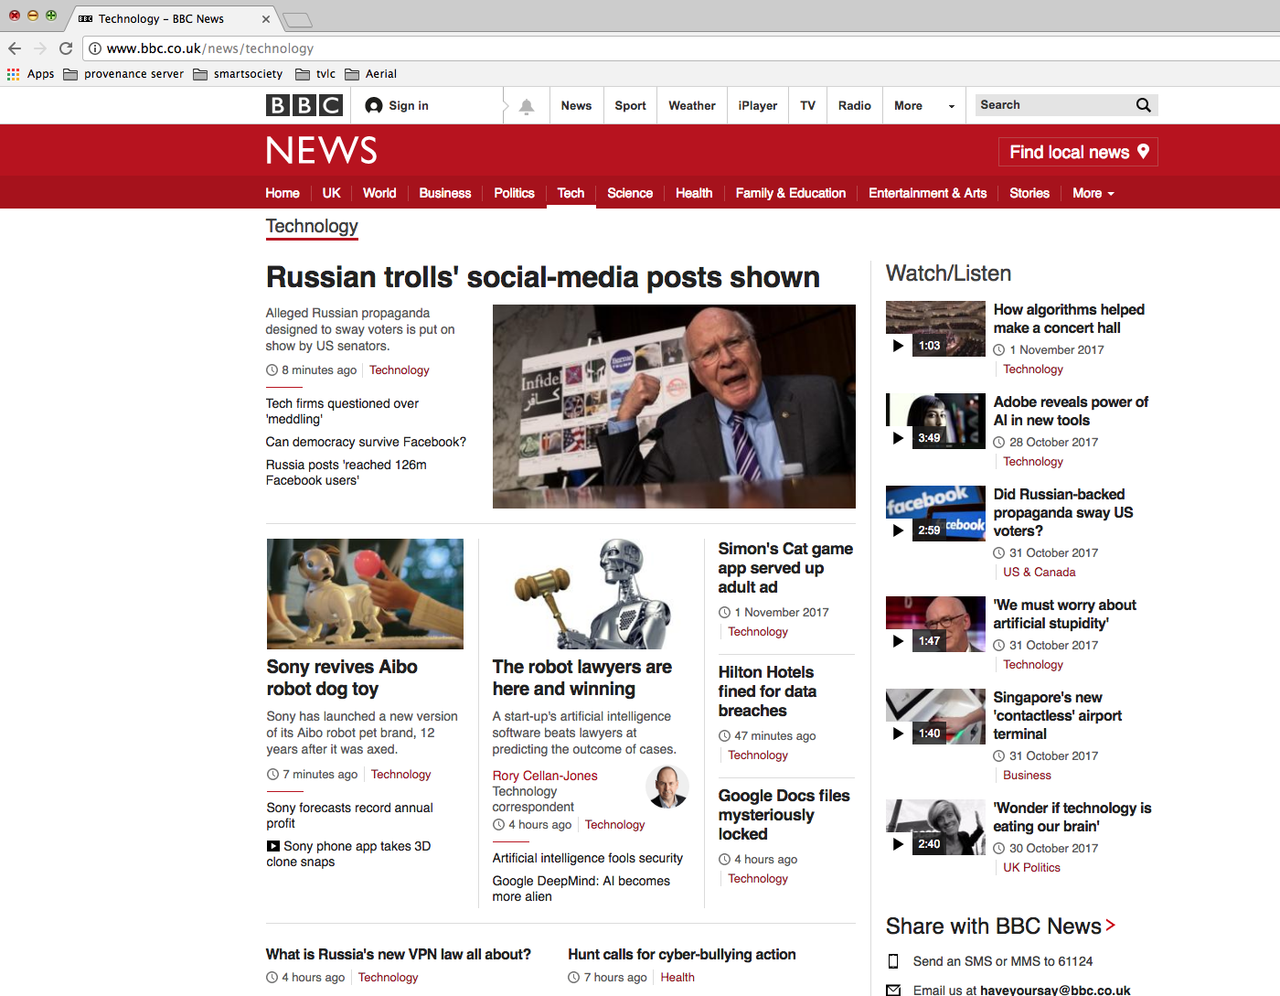
How is the Web Structured?

Slide 4
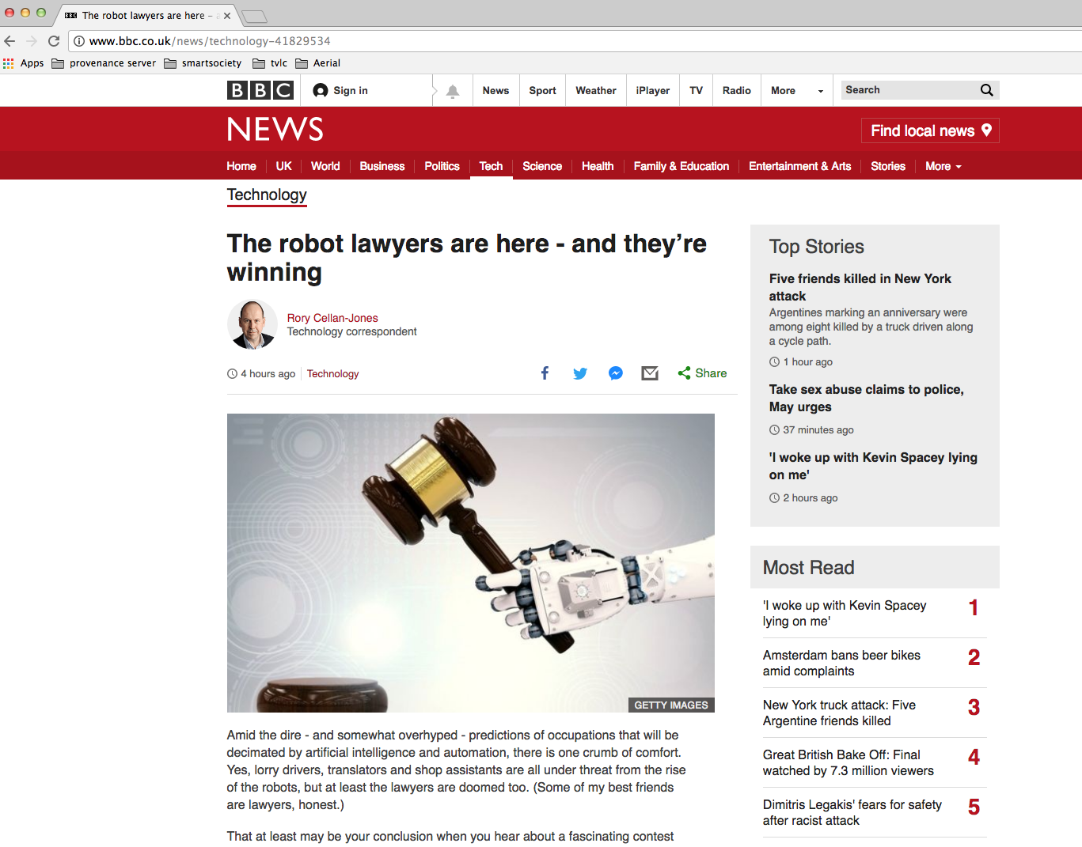
How is the Web Structured?
hyperlink

Slide 5
How is the Web Structured?
hyperlink
Graph Theory: Pages are nodes & links are directed edges

Slide 6
Graphs can Model
The Web
Facebook users
Tweets
Publications
Bitcoin/Block chain transactions

Slide 7
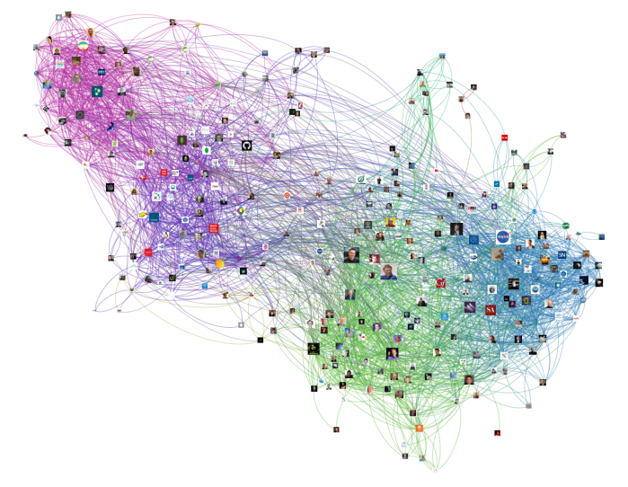
Twitter Graph

Slide 8
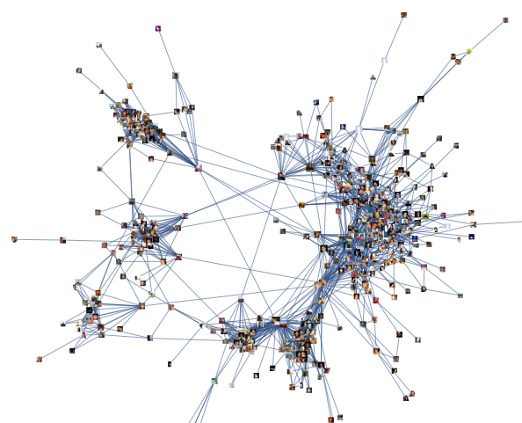
Facebook Graph

Slide 9
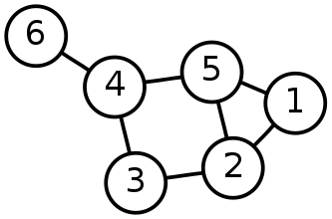
Graph Theory – Useful Measures
Distance between two vertices (v and v’)
Diameter of a graph, longest distance between any two vertices
Average-case diameter, average distance between any pair of nodes (v and v’)
Degree of a vertex, number of edges connected to it
Density of network, ratio of edges to vertices
A graph is made from Nodes or Vertices (V) and Edges (E)
G = (V, E)
Network size, total number of vertices (N)

Slide 10
Which is the Most Important Node?
P
L
Q
M
N
I
O
H
J
K
D
G
A
E
B
F
C

Slide 11
Which is the Most Important Node?
Eigenvector
P
L
Q
M
N
Degree
I
Closeness
O
H
J
K
D
G
Betweenness
A
E
B
F
C

Slide 12
Graph Theory – Is this Node Important?
Importance measures using centrality:
Degree centrality
Betweenness centrality
Nearness centrality
Eigenvector centrality
*Central as in important, vital or `at the heart of’, not near the centre

Slide 13
Degree Centrality
F
Degree centrality focuses on individual nodes – it simply counts the number of edges that a node has
Hub nodes with high degree usually play an important role in a network
B
deg(E)=5
G
C
A
E
deg(A)=4
H
D
I
J

Slide 14
Degree Centrality – In Degree
F
In degree – links to a vertex
Often used as a proxy for popularity
A web page is important if lots of things link to it
A twitter user is important if lots of other users follow it
A journal article is important if lots of other articles cite it
B
inDeg(E)=4
G
C
A
E
H
D
I
J

Slide 15
Degree Centrality – Out Degree
F
Out degree – links from this vertex
Authorities on a topic
B
inDeg(E)=4
G
C
A
E
outDeg(E)=1
H
D
I
J

Slide 16
Degree Distributions
Degree distributions p(k)
A plot showing the degree of nodes in a graph
F
1
B
1
G
1
C
1
A
E
Number of Nodes
4
5
H
D
1
1
I
Number of links
2
J
1

Slide 17
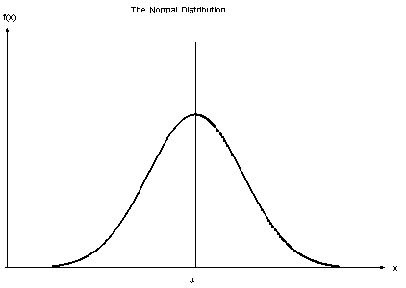
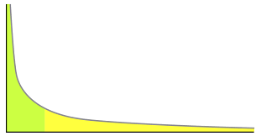
Degree Distribution Examples
Normal distribution
The average degree is most likely
Very high and very low degrees are highly unlikely
Power law distribution
No meaningful average degree
Very low degrees are likely, but very high degrees are unlikely

Slide 18
Power Law Networks
Some nodes have a tremendous number of connections to other nodes (hubs)
Most nodes have just a handful of links
Robust against accidental failures, but vulnerable to coordinated attacks
Nodes can have millions of links: The network appears to have no scale (no limit)
Power Law is a property of a
scale free network
hubs

Slide 19
Betweenness Centrality
Number of shortest paths going through a node
A node that has high betweenness is vital to the communication of the network
Many/most messages between two nodes must travel through it.
E
B
A
D
F
C

Slide 20
Betweenness Centrality
Betweeness Centrality for A
B to D
B to E
B to F
C to D
C to E
C to F
BC(A) = 6
E
B
A
D
F
C

Slide 21
Closeness Centrality
Closeness is the average of the shortest distances to all other nodes in the graph
It can describes how far and close vertexes are
E
B
1 ms
1 ms
1 ms
3 ms
A
D
2 ms
1 ms
F
C

Slide 22
Closeness Centrality
Closeness centrality of A
A to B = 1 ms
A to C = 1 ms
A to D = 1 ms
A to E = 2 ms
A to F = 3 ms
CC(A) = 1.6 ms
E
B
1 ms
1 ms
1 ms
3 ms
A
D
2 ms
1 ms
F
C

Slide 23
Eigenvector Centrality
F
Eigenvector measures the popularity by looking at the quality of links
Identifies whether a node is connected to influential nodes
PageRank is an example
B
G
C
A
E
H
D
I
J

Slide 24
PageRank
Good example using web graph theory of importance to make a big difference in how people used the web
Larry Page developed page rank in 1996
Page rank works on the assumption that more important websites are likely to receive more links from other websites
The actual algorithm used today is not openly known

Slide 25
Google’s PageRank Algorithm
Number of links
Pages with more in-links rank higher, than a page fewer in-links
Link Quality
A link from an important page is worth more than many links from relatively unknown sites
Link Context
The text in and around out links relates to the page they point at.
Ranking boosts on text styles

Slide 26
PageRank: Original Formula
PageRank (PR) of page u is given by the summation of the PR of all pages in the set of all pages linking to page u (v∈B_{u}), divided by the number of L(v) of links from page v
Iterative formula, starting with rank 1/n for all n pages
It can handle the scale of the web

Slide 27
PageRank: Surfer Model
Usage simulation
Based on a model of a Web surfer who follows links and makes occasional haphazard jumps
User randomly navigates
Jumps to random page with probability p
Follows a random hyperlink with probability 1-p
Never goes back to a previously visited page

Slide 28
What do the Measures Tell Me?
Degree: exposure to the network, opportunity to directly influence
Betweenness: informal power, gate keeping, brokering, controls flow of browsing
Closeness: estimates time to receive information, indirect influence, point of rapid diffusion
Eigenvector: connected to influential nodes of high degree, “not what you know but who you know”

Slide 29
What does the web look like?

Slide 30
What Does the Web Look Like?
Experimental Observations [Barabasi, Albert (1999)]
Sparse graph
Power law
Small world network
The Shape of the Web [Broder et al (2000)]
2005 what the web looks like
Notes:
Sites and hyperlinks between them
In mathematics a dense graph is a graph in which the number of edges is close to the maximal number of edges. The opposite, a graph with only a few edges, is a sparse graph.
Property of almost any network is the power law distribution of degrees

Slide 31
Small World Network
Six Degrees of Separation is a theory that everyone is 6 or fewer steps away from any other person in the world
Experiment by Stanley Milgram in the 1960
300 letters
Sent to intermediary person on a first name basis
64 made it
Average hops of 5.2 intermediaries
Notes:
s

Slide 32
Small World Network – Erdos 1950s

Slide 33
Small World Network - Erdos

Slide 34
Small World Network
Small World Network is a graph which most nodes are not neighbours but most nodes can be reached by a small number of connections
Website links
Social networks
Wikipedia
Many hubs – pages with many in links
Hubs significance can be modeled with degree centrality
Robust for random node deletions

Slide 35
Barabasi and Albert Experimental Methodology
Intuition: Networks grow by iterative process
Simulate growing a network and then examine its properties
Experiment with different models
One model they used was Preferential Attachment

Slide 36
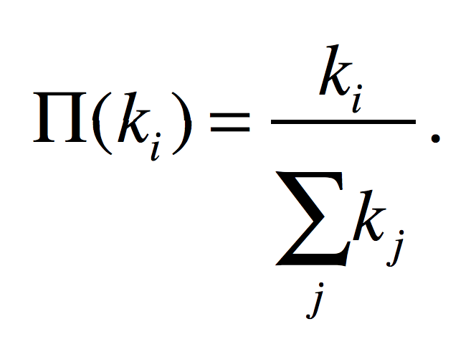
Preferential Attachment
The probability of a new node linking to an existing node is proportional to the degree of that node. The probability Π(k_{i}) that a link of the new node connects to node i depends on the degree k_{i} as:
A new node is free to connect to any node in the network
For example, if a new node has a choice between a degree-two and a degree-four node, it is twice as likely that it connects to the degree-four node

Slide 37
Preferential Attachment and the Web
A new webpage is free to link to any webpage on the network
If a webpage has a choice between a degree-two and a degree-four webpage, it is twice as likely that it connects to the degree-four webpage
Why does this model reflect pages and links on the web?

Slide 38
Preferential Attachment and the Web
Why does this model reflect pages and links on the web?
Good quality resources are likely to be popular
Human nature - the more popular a website is, the more likely it to be shared and thus linked to, similar to Pagerank’s assumption
Findability – the more obscure something is the less findable it is, and thus is less likely to be linked to

Slide 39
What does the Web look like?
Experimental Observations [Barabasi, Albert (1999)]
Sparse graph (n vertices, mn edges)
Small world network
Power law
The Shape of the Web [Broder et al (2000)]
The Opte Project 2003

Slide 40
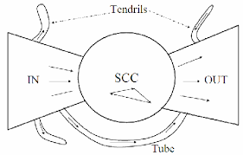
The Bow Tie
Strongly Connected Components
In links
Out links
Tendrils and Tubes

Slide 41
Web Graph Results
The diameter of the central core (SCC) is at least 28, and the diameter of the graph as a whole is over 500
The probablity of a path between randomly chosen pairs is only 24%
Average directed path length is about 16
Average undirected path length is about 6

Slide 42
What does the Web look like?
Experimental Observations [Barabasi, Albert (1999)]
Sparse graph (n vertices, mn edges)
Small world network
Power law
The Shape of the Web [Broder et al (2000)]
The Opte Project 2003

Slide 43
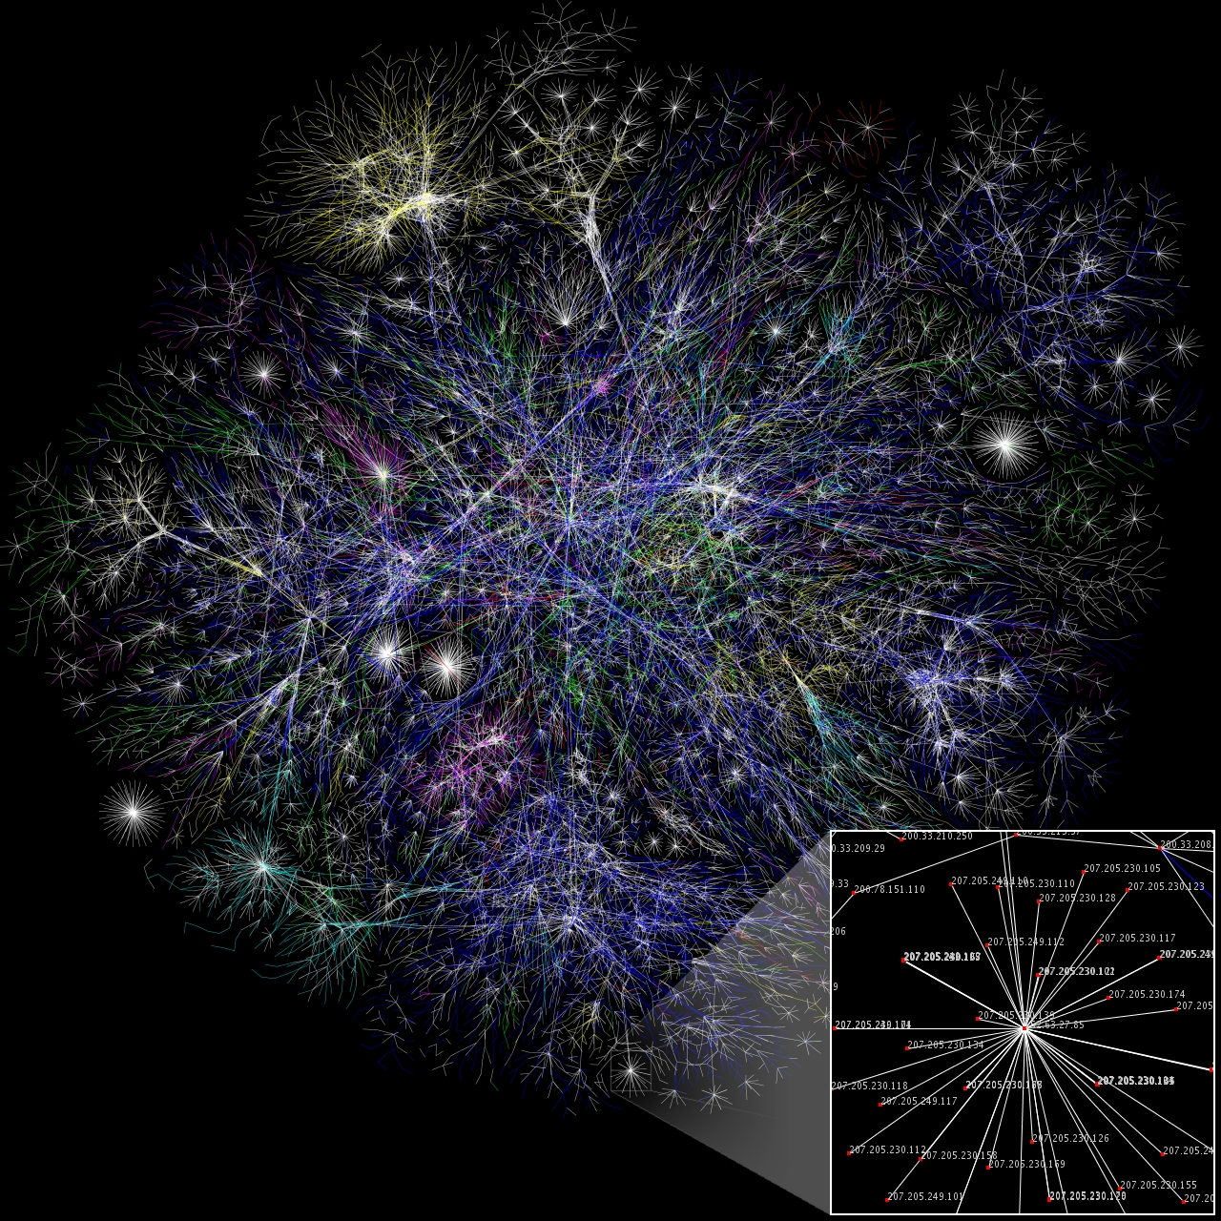
Web Graph

Slide 44
Modern Web Research
Temporal aspects – how is the Web Graph evolving over time?
Information aspects – how does new information propagate throughout the web (or blogosphere, or twitter, ...)
Finer-grained structure – how to define and compute “communities” in information and social networks

Slide 45
Outcomes
Understand that the web can be modeled as a graph
Importance measures played a big role in searching the web
Understand how graph theory can be applied, and apply it to describing the web:
small world property
scale free networks and power laws
Preferential attachment
What the web looks like at scale

