Slide 2
Telling Tales: Hypertext Writing
COMP3220 Web Infrastructure
COMP6218 Web Architecture
Dr Nicholas Gibbins - nmg@ecs.soton.ac.uk

Slide 3
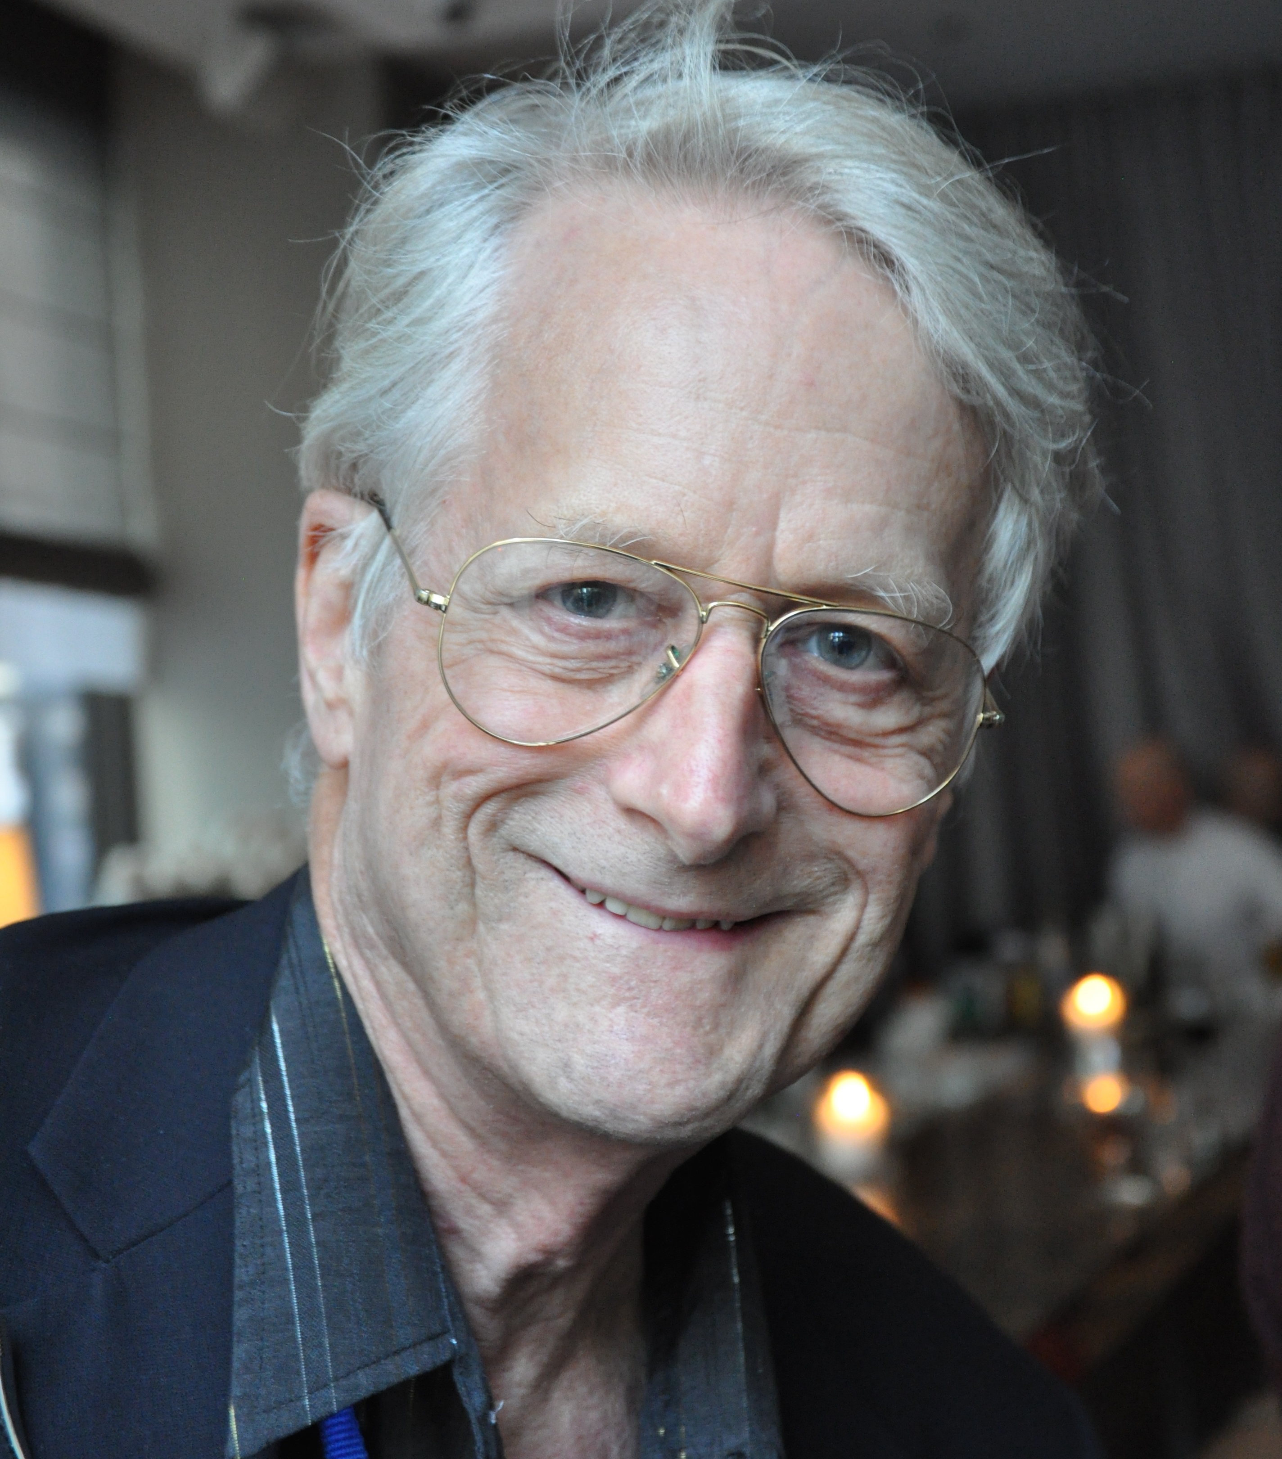
A Working Definition
By ‘hypertext’, I mean non-sequential writing - text that branches and allows choices to the reader, best read at an interactive screen. As popularly conceived, this is a series of text chunks connected by links which offer the reader different pathways.
Nelson, T.H. (1981) Literary Machines, Sausalito, CA: Mindful Press.

Slide 4
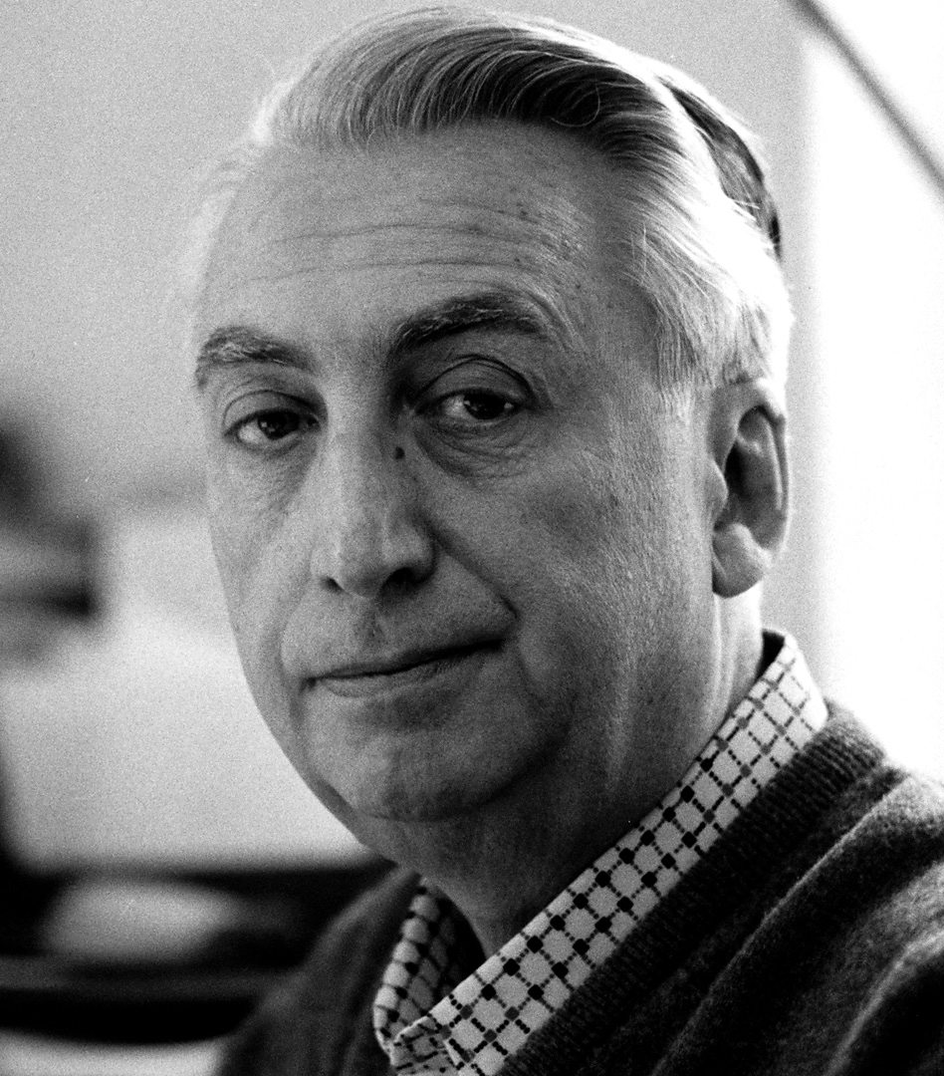
The Death of the Author
We know now that a text is not a line of words releasing a single ‘theological’ meaning (the ‘message’ of the Author-God) but a multi-dimensional space in which a variety of writings, none of them original, blend and clash.
To give a text an Author is to impose a limit on that text, to furnish it with a final signified, to close the writing.
Barthes, R.G. (1967) The Death of the Author. Aspen, no. 5-6.

Slide 5
Hypertext and the Death of the Author
“It is tempting to see hypertext as realizing Barthes' utopian dreams of a writing liberated from the Author. The ability for each reader to add to, alter, or simply edit a hypertext opens possibilities of collective authorship that breaks down the idea of writing as originating from a single fixed source.
Similarly, the ability to plot out unique patterns of reading, to move through a text in an aleatory, non-linear fashion, serves to highlight the importance of the reader in the “writing” of a text - each reading, even if it does not physically change the words - writes the text anew simply by re-arranging it, by placing different emphases that might subtly inflect its meanings.”
Keep, C., McLaughlin, T. and Parmar, R. (1993-2000) The Electronic Labyrinth. http://elab.eserver.org/
Notes:
Aleatory: dependent on the throw of a die

Slide 6
Forking Paths
“In all fictional works, each time a man is confronted with several alternatives, he chooses one and eliminates the others; in the fiction of Ts’ui Pên, he chooses— simultaneously—all of them. He creates, in this way, diverse futures, diverse times which themselves also proliferate and fork. Here, then, is the explanation of the novel’s contradictions.
Fang, let us say, has a secret; a stranger calls at his door; Fang resolves to kill him. Naturally, there are several possible outcomes: Fang can kill the intruder, the intruder can kill Fang, they both can escape, they both can die, and so forth. In the work of Ts’ui Pên, all possible outcomes occur; each one is the point of departure for other forkings.”
Borges, J.L. (1941) The Garden of Forking Paths, Translated from Spanish by Yates, D.A.

Slide 7

Ergodic Literature
http://www.flickr.com/photos/danielygo/5391176827/

Slide 8
Ergodic Literature
“ Ergodic […] derives from the Greek words ergon and hodos, meaning "work" and "path." In ergodic literature, nontrivial effort is required to allow the reader to traverse the text. If ergodic literature is to make sense as a concept, there must also be nonergodic literature, where the effort to traverse the text is trivial, with no extranoematic responsibilities placed on the reader except (for example) eye movement and the periodic or arbitrary turning of pages. ”
Aarseth, E. (1997) Cybertext: Perspectives on Ergodic Literature. Baltimore, MD: The John Hopkins University Press.
Notes:
Typically, the nontrivial effort manifests itself as a choice (possibly random) that is applied to the text.
Extranoematic: A process that occurs outside of the confines of human thought

Slide 9
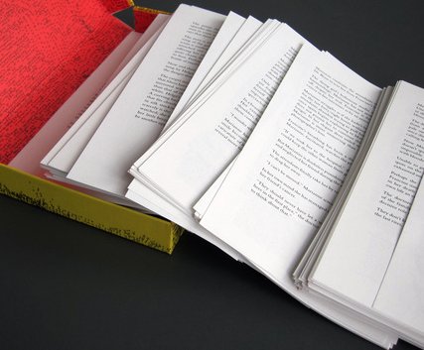
Composition No. 1, Roman (1962)
150 loose leaf pages
  Pages are to be shuffled before reading
  CONTENT WARNING!
Saporta, M. (1963) Composition No. 1, Roman. Translated from French by Howard, R., New York: Simon and Schuster.

Slide 10

Hopscotch (Rayuela) (1963)
Structured as 155 chapters
  Chapters 57-155 designated as ‘expendable’
Two readings of the book:
  Chapters 1-56 in order
  All chapters, following the reading order given in the instructions: 73-1-2-116-3-…
Cortázar, J. (1966) Hopscotch. Translated from Spanish by Rabassa, G. New York: Pantheon Books.
Notes:
Two interwoven narratives:
Horacio Oliveira and La Maga in Paris
Traveler and Horacio in Argentina
Fourth key character, Morelli, an experimental novelist admired by Horacio and his friends who is involved in an accident
p.556 (§154)
“But what if we should make a mistake,” Oliveira said, “and get things all mixed up. There was a terrible complication in the first volume, this guy here and I argued hours on end as to whether there hadn’t been some mistake in the printing of the texts.”
“Who care,” Morelli said, “You can read my book any way you want to. Liber Fulguralis, mantic pages, and that’s how it goes. The most I do is set it up the way I would like to reread it. And in the worst of cases, if they do make a mistake, it might just turn out perfect. [...]”

Slide 11
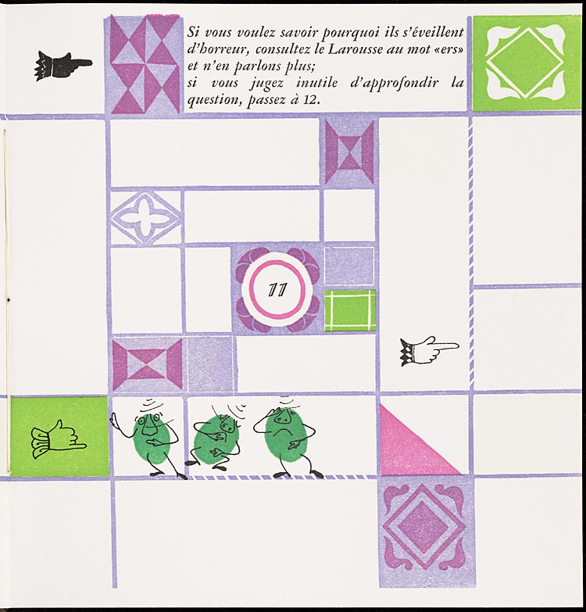
Un conte à votre façon (1967)
Numbered double-page spreads
  Story on verso pages
  Explicit choices on recto pages
Queneau, R. (1982) Un conte à votre façon, Paris: Kickshaws.
Notes:
“A story your way” published in English as “Yours for the Telling”
Do you wish to hear the story of the three alert peas?
11. They dreamed they would get their soup at the soup kitchen, and on opening their bowl they discovered that it was ers soup. In horror, they woke up.
If you want to know why they woke up in horror, look up the word “ers” in Larousse and say no more
If you feel that it is useless to pursue the issue, go to 12
A work by one of the oulipo (Ouvroir de littérature potentielle – workshop of potential literature) group

Slide 12
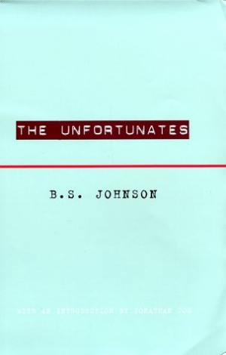
The Unfortunates (1969)
27 chapters, bound as pamphlets
  Designated first chapter
  25 chapters, to be read in any order
  Designated last chapter
Johnson, B.S. (1969) The Unfortunates, London: Secker and Warburg.
Notes:
Semi-autobiographical work
Narrator is a sports reporter (thinly veiled version of Johnson, himself a sports writer for the Observer) who travels to a city in the East Midlands (Nottingham) to cover a football match, and recalls the times that he’d been to the city before when visiting a close friend (a lecturer, who had since died of cancer).

Slide 13
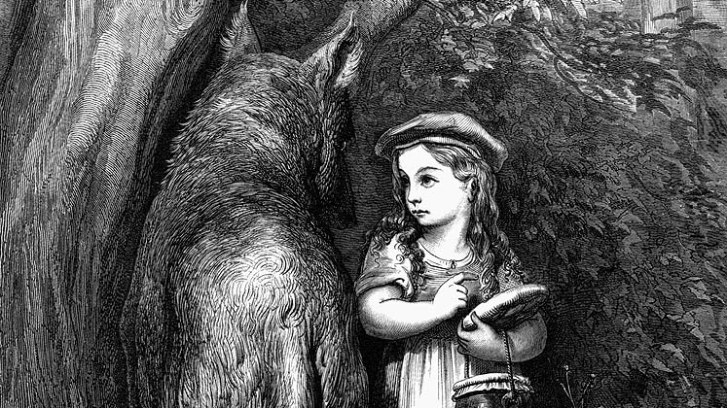
Story, Narrative and Text

Slide 14
Story, Narrative and Text
Narrative theory identifies three levels in fiction:
  Story: the content of a tale; the underlying events related in a tale (also referred to as fabula)
  Narrative: a recounting of a story; the reorganisation of events by time or point-of-view (also referred to as syuzhet or plot)
  Text: the signs (words, images) that are processed by the reader
Non-linearity may be introduced at any or all of these levels
Lowe, N.J. (2009) A Cognitive Model, In Reading Hypertext, Bernstein, M. and Greco, D. (eds), Watertown, MA: Eastgate Systems
Notes:
Story = Fabula
Narrative = Plot

Slide 15
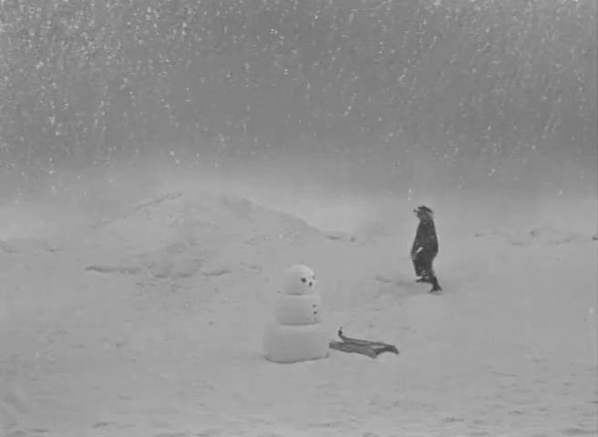
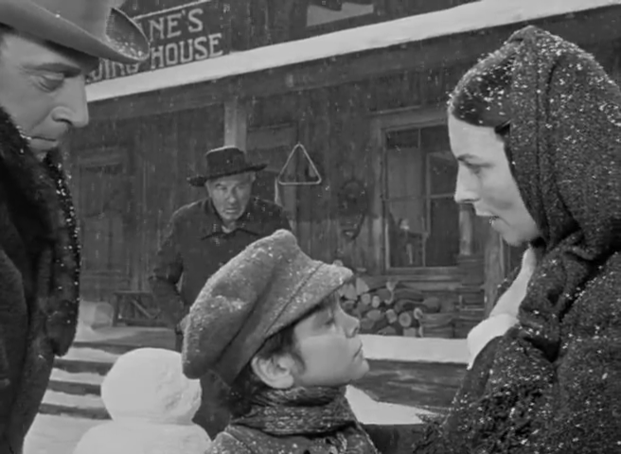
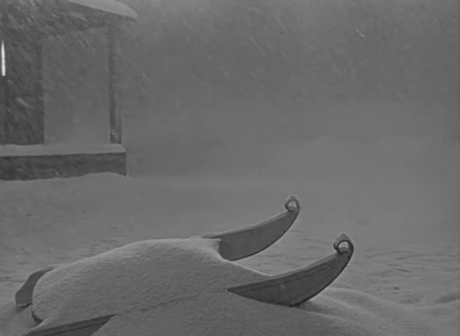
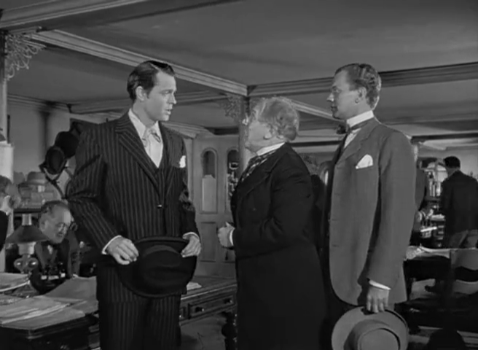
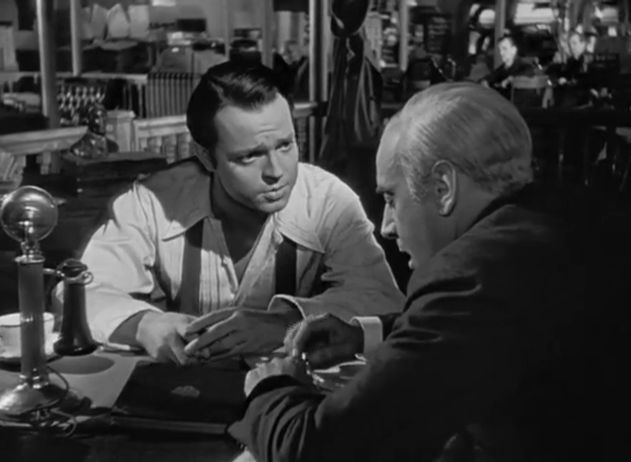
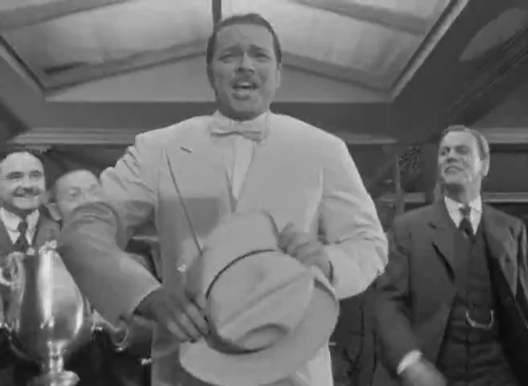
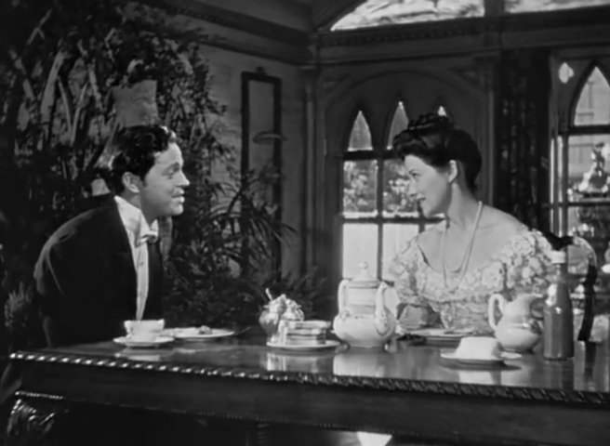
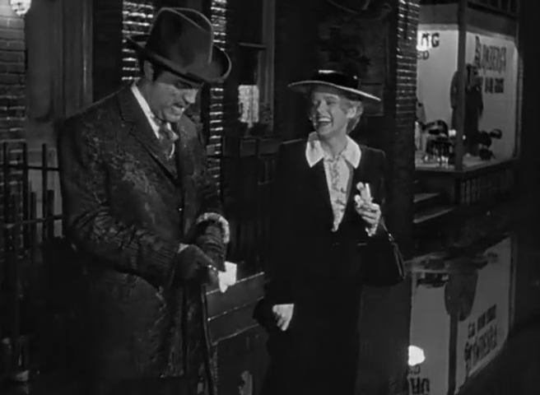
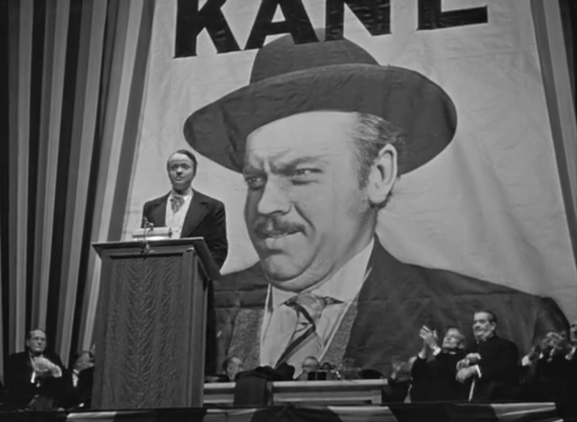
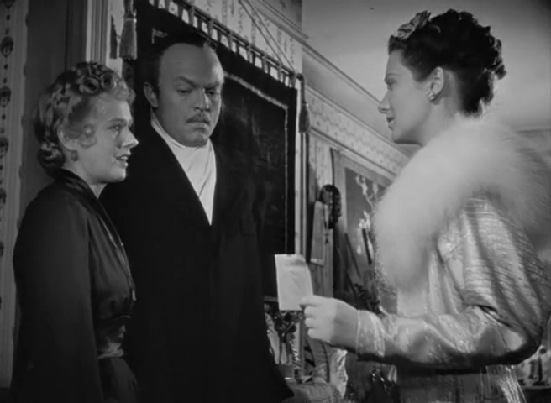
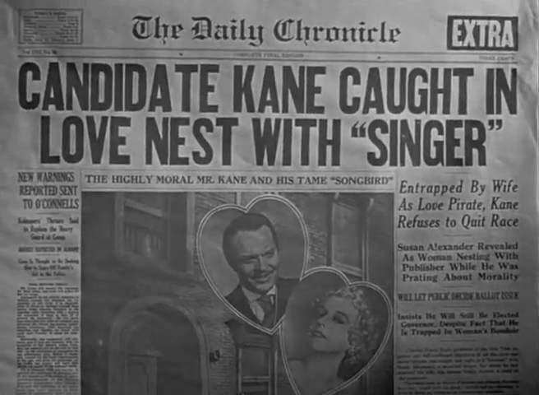
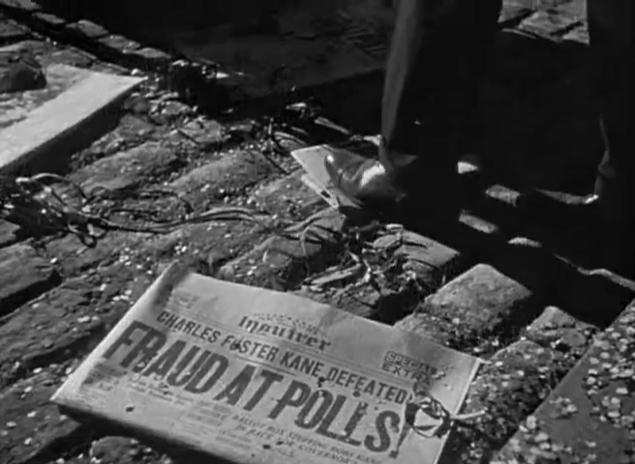
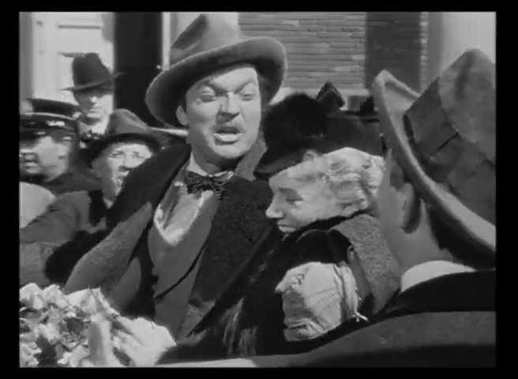

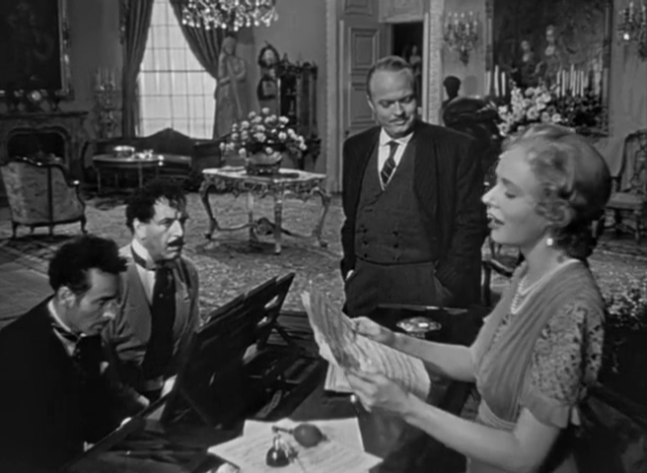
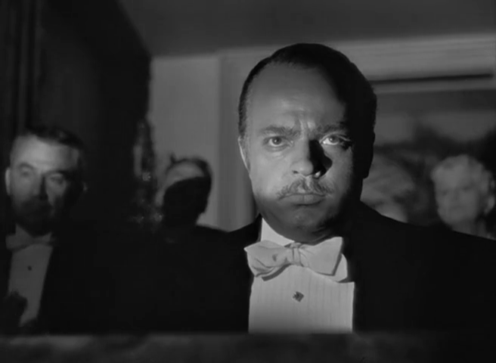
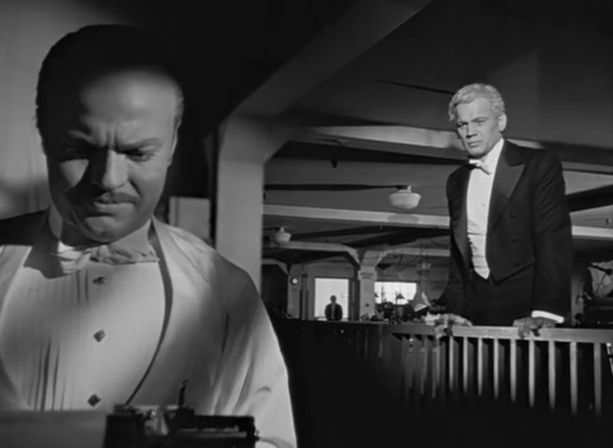
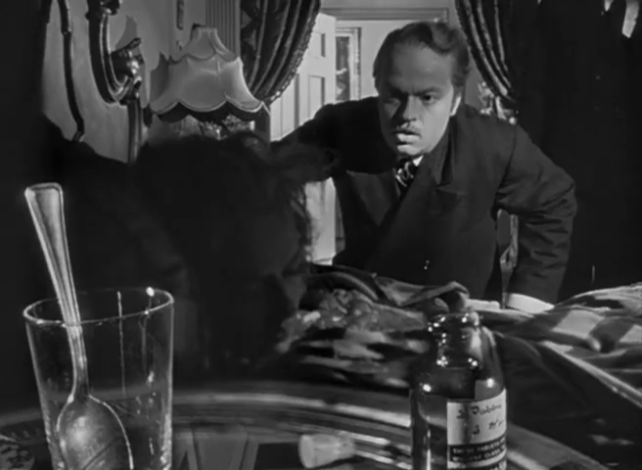
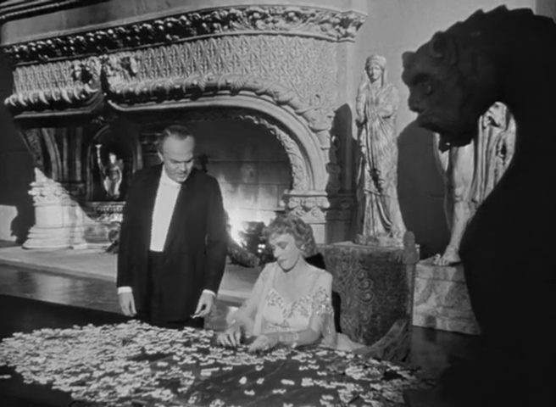
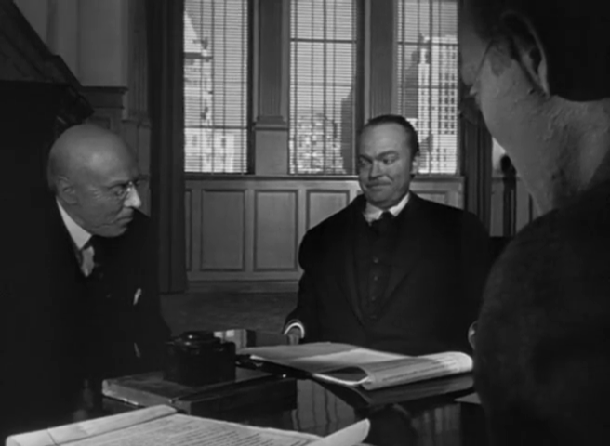
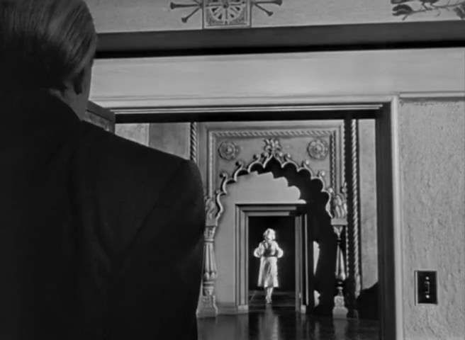
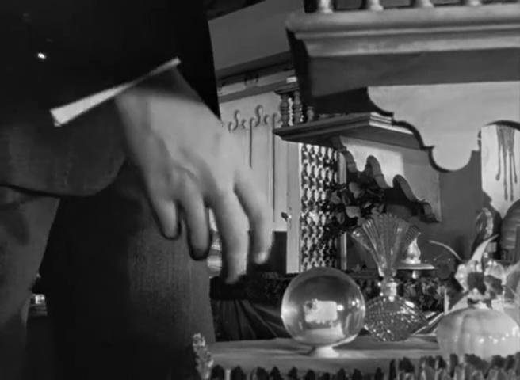
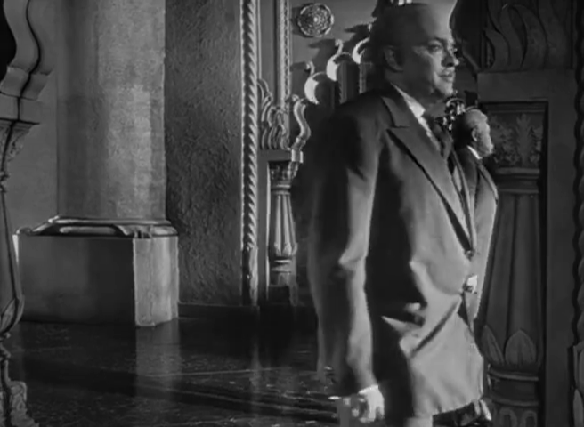
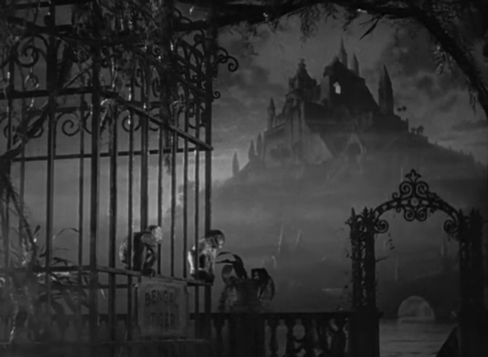
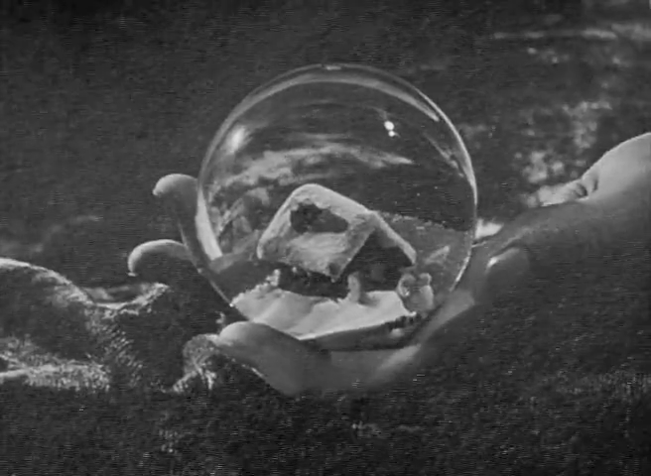
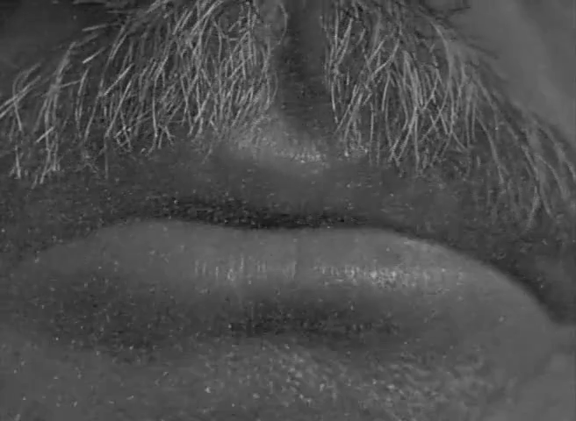
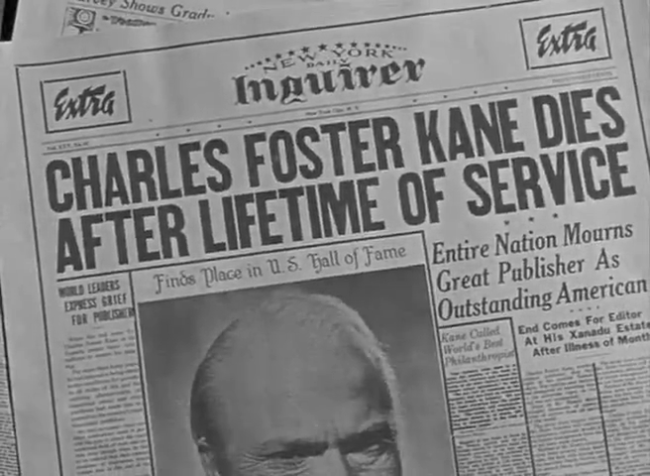
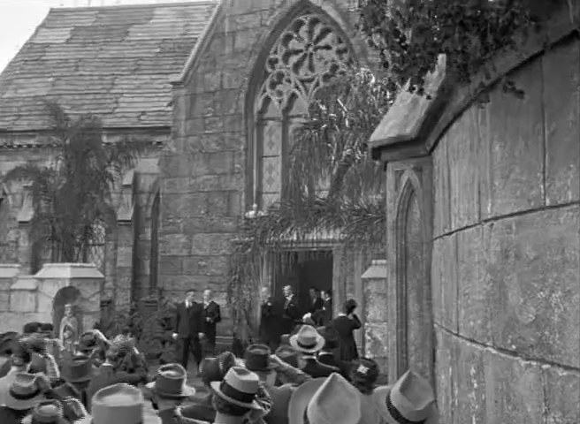
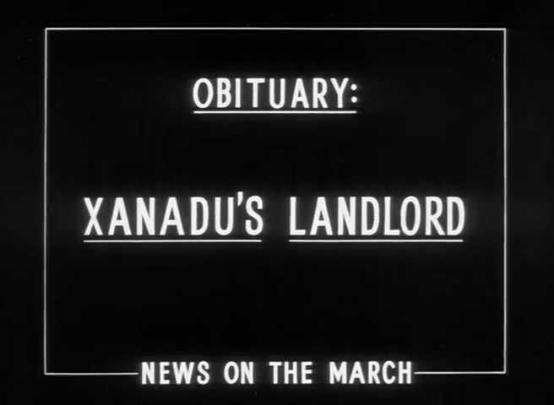
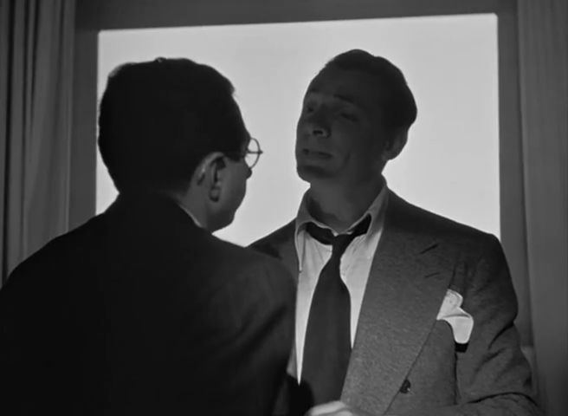
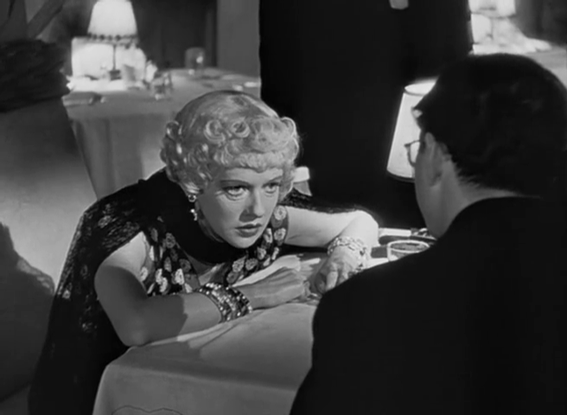
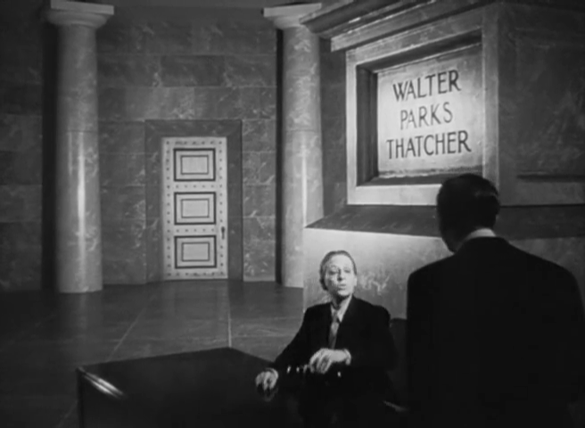
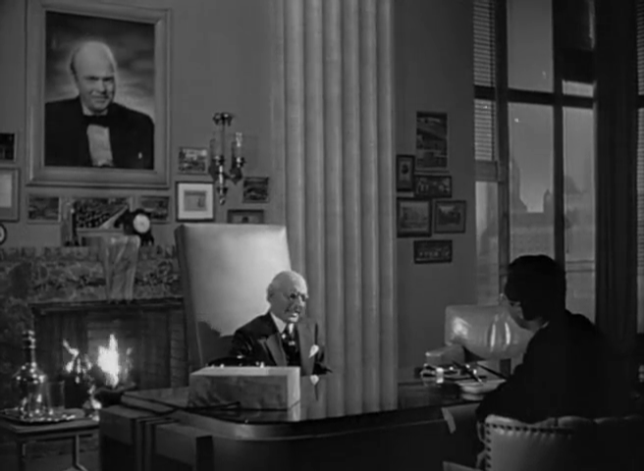
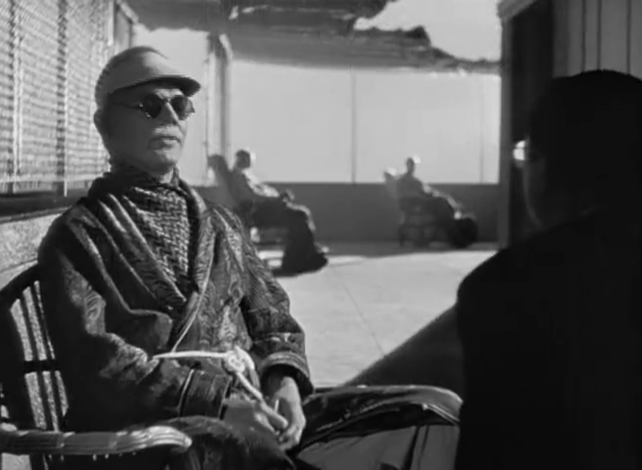
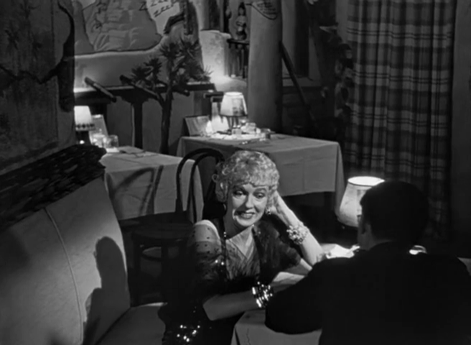
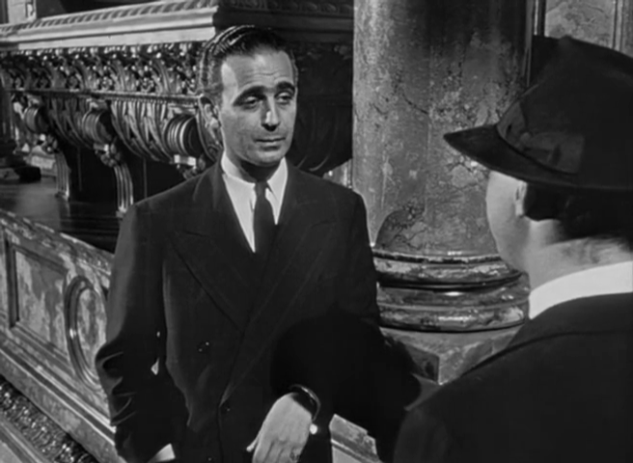
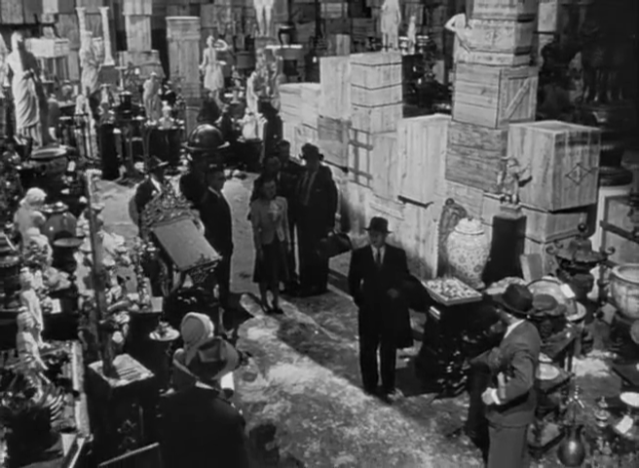
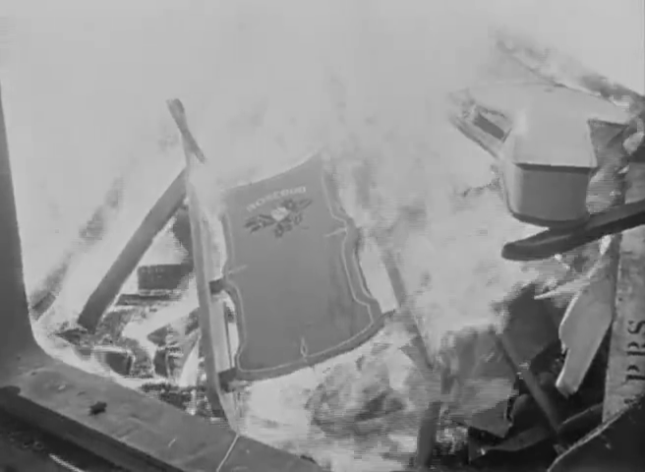
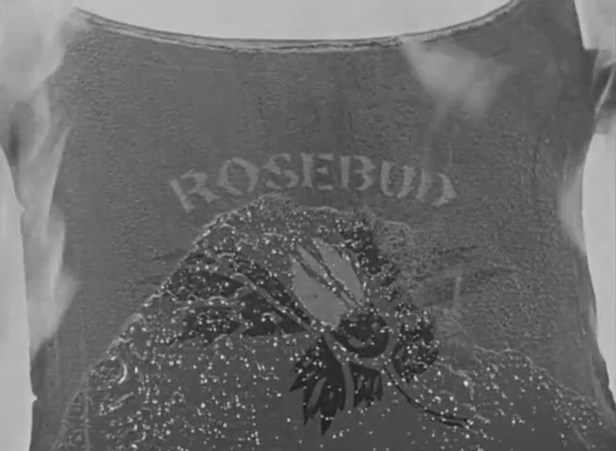
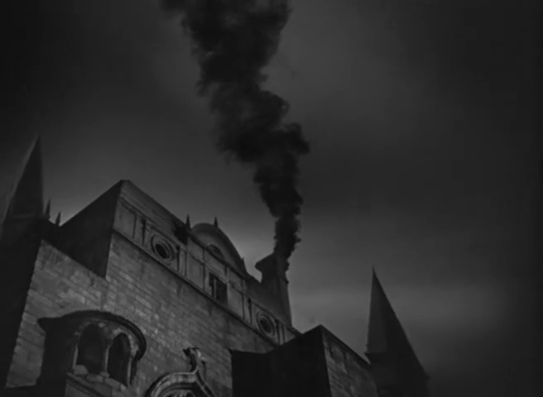
Story versus Narrative: Citizen Kane
Citizen Kane (1941) Directed by Orson Welles [Film]. NYC, USA: RKO Radio Pictures.

Slide 16
Story versus Narrative: Citizen Kane
Citizen Kane (1941) Directed by Orson Welles [Film]. NYC, USA: RKO Radio Pictures.
Notes:
Charles Foster Kane
Jerry Thompson (reporter)
Jedediah Leland (best friend)
Susan Alexander (mistress and second wife)
Mr Bernstein (employee)
Walter Parks Thatcher (guardian)
Emily Monroe Norton Kane (first wife)
Raymond (butler)

Slide 17
Story versus Narrative: Citizen Kane
Citizen Kane (1941) Directed by Orson Welles [Film]. NYC, USA: RKO Radio Pictures.
Notes:
Other notable examples of non-linearity in film:
Citizen Kane (Orson Welles) – told as flashback/recounting
Short Cuts (Robert Altman) – multi-threaded narrative
Pulp Fiction (Quentin Tarantino) – multi-threaded and flashbacks
Timecode (Mike Figgis) – multiple simultaneous viewpoints
Film does not generally expect the audience to choose – non-ergodic.

Slide 18
Story versus Narrative: Citizen Kane
Citizen Kane (1941) Directed by Orson Welles [Film]. NYC, USA: RKO Radio Pictures.
Notes:
Charles Foster Kane
Jerry Thompson (reporter)
Jedediah Leland (best friend)
Susan Alexander (mistress and second wife)
Mr Bernstein (employee)
Walter Parks Thatcher (guardian)
Emily Monroe Norton Kane (first wife)
Raymond (butler)

Slide 19

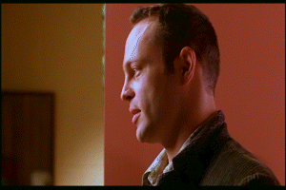
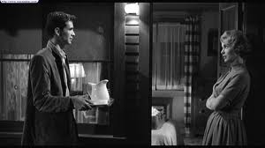
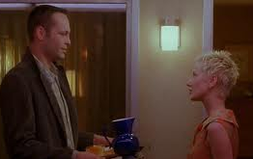

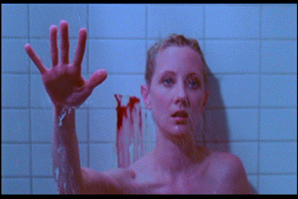
Narrative versus Text: Psycho
Psycho (1960)
Psycho (1998)
Psycho (1960) Directed by Alfred Hitchcock [Film]. Los Angeles, USA: Paramount Pictures.
Psycho (1998) Directed by Gus Van Sant [Film]. Los Angeles, USA: Universal Pictures.
Notes:
Psycho

Slide 20
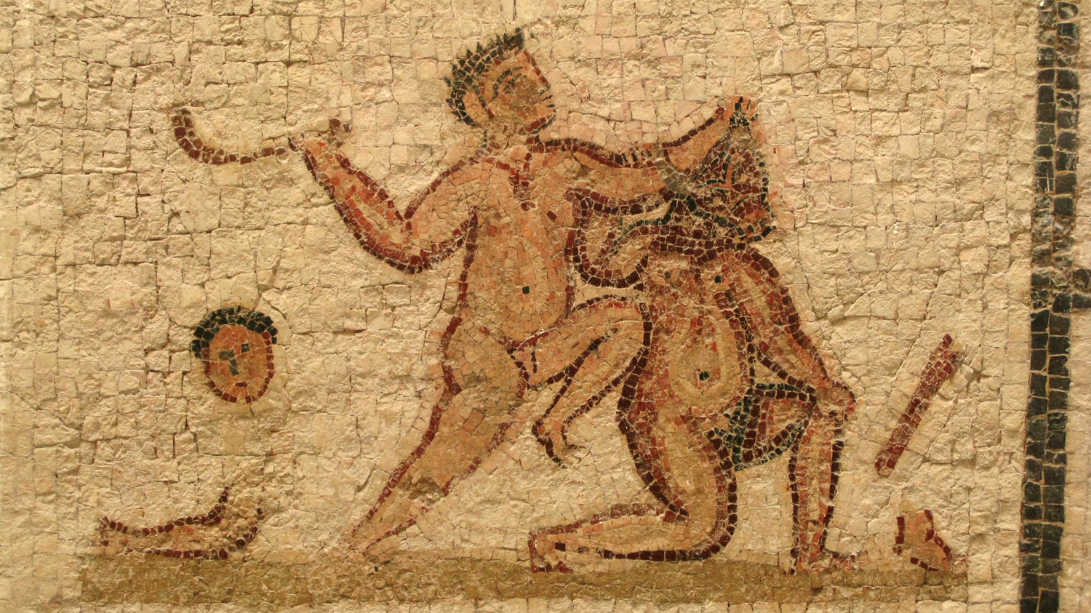
Hypertext Fiction
http://www.flickr.com/photos/nealy-j/4579505879/

Slide 21



Hypertext Fiction
A selection:
  Michael Joyce (1987) - afternoon, a story
  Stuart Moulthrop (1992) - Victory Garden
  Geoff Ryman (1996) - 253

Slide 22

afternoon, a story (1987)
"I want to say I may have seen my son die this morning.”
Non-linear narrative with default path
  Notecard-like lexias
  No explicit anchors; all words are anchors
  Built as demonstration of the hypertext authoring system Storyspace
Joyce, M. (1990) afternoon, a story. Watertown, MA: Eastgate Systems.
Notes:
Follows the story of Peter, who begins his afternoon with the suspicion that the car crash he saw earlier might have involved his ex-wife.

Slide 23

Victory Garden (1992)
Follows a central character (Emily) and the interactions of those connected with her, set during Gulf War I.
  Multiple non-linear narratives with default paths
  Anchors indicate branches to other narratives (initially hidden, but can be made explicit)
  Provides a taxonomic overview map
Moulthrop, S. (1992) Victory Garden. Watertown, MA: Eastgate Systems.

Slide 24

253 (1996)
Descriptions of the 253 occupants (passengers plus driver) of a London Underground train
  Extensive cross-referencing and footnotes support a non-linear narrative
  Each description is 253 words long
  Originally published on the Web
Ryman, G. (1998) 253: the print remix. London: Flamingo.
https://web.archive.org/web/20140530180412/http://www.ryman-novel.com/

Slide 25
Hypertext Fiction
Academic study concentrates on literary hypertext (c.f. literary fiction)
  Typified by non-linear narratives, rather than non-linear stories
What about the hypertext equivalent of genre or popular fiction?

Slide 26

Consider the Consequences (1930)
Earliest known example of a branching novel!
Third person narrative
Relatively fine-grained, non-linear story
  Multi-paragraph lexias
  Three intertwined stories within the book
  (a woman and her two suitors)
  Introductory text suggests that the ”game” may be played by a group
Webster, D. and Hopkins, M.A. (1930) Consider the Consequences. New York: The Century Company

Slide 27

Lucky Les (1967)
Third person narrative
Coarse-grained, non-linear story
  Multi-page lexias corresponding to episodes in Les’ life
  Each episode concludes with an explicit choice for the reader
Hildick, E.W. (1967) Lucky Les: the adventures of a cat of five tales, Leicester: Brockhampton Press.
Notes:
B.F. Skinner – programmed instruction

Slide 28

State of Emergency (1969)
Crossover between hypertext fiction and programmed instruction
  Intent of book is to teach the reader about the challenges of running a newly-independent African state
  Coarse-grained (multipage) lexia
  Non-linear story
Guerrier, D. and Richards, J. (1969) State of Emergency: A Programmed Entertainment. Harmondsworth: Penguin
Notes:
Guerrier produced other related books, including a solo noughts and crosses gamebook.

Slide 29


Choose Your Own Adventure (1979-)
Second person narrative
Again, non-linear story
  Single page lexias
  Numbered pages
  with explicit
  choices
See also interactive fiction
(Colossal Cave/Advent, etc)
Montgomery, R.A. (1979) Journey Under the Sea. New York: Bantam Books.
Notes:
Ludic hypertext

Slide 30


Slide 31

Life’s Lottery (1999)
Increasing sophistication – not a children’s book!
  Lexias vary in size from a paragraph of a few sentences to several pages
  Non-linear story, but with an additional narrative if lexias are read in order, rather than by following the directions in the lexias
Newman, K. (1999) Life’s Lottery, London: Simon and Schuster.

Slide 32

Ludic Hypertext
http://www.flickr.com/photos/jamesrbowe/4001776922/

Slide 33
Ludic Narrative
Game + Story … but what’s in a game?
Different forms of play:
  Competition (agon)
  Chance (alea)
  Simulation (mimicry)
  Disorientation (ilinx)
Different types of play:
  Structured, explicit rules (ludus)
  Unstructured, spontaneous (paidia)
Caillois, R. (1961) Man, Play and Games. New York: Free Press of Glencoe.
Notes:
Les Jeux et les Hommes

Slide 34


Fighting Fantasy (1982-)
Combines CYOA-style second person narrative with Dungeons & Dragons-style rules
  Non-linear story
  Numbered paragraphs
  (more finely-grained narrative)
  Mixture of explicit and random
  choices (aleatory reading)
  External state
  (hit points, inventory, etc)
Jackson, S. & Livingstone, I. (1982) The Warlock of Firetop Mountain. Harmondsworth: Puffin.
Notes:
1980s fantasy boom – hypertext books!
Some self-published solo D&D adventures predate
Largely a paper-based fusion of role-playing games and computer adventure games
Ludic hypertext

Slide 35

Duel Master (1986-7)
Two-player gamebook (agon)
  Non-linear story
  Split across two paired books
  (even/odd numbered lexia)
  Shared state and synchronization
  (keywords, WAIT)
  Mixture of explicit and random choices
  (aleatory reading)
Smith, M. & Thomson, J. (1987) Arena of Death. London: Armada Books.

Slide 36

Being Elizabeth Bennet (2007)
Second person narrative
  Again, non-linear story
  Simple rules
  No aleatory aspects
Mimicry aimed at a different demographic to that of other gamebooks!
Campbell Webster, E. (2007) Being Elizabeth Bennet. London: Atlantic.
Notes:
See also do-over novels: Heather McElhatton’s Pretty Little Mistakes and A Million Little Mistakes
Arguably an alternative narrative in which the eponymous protagonist, having decided that she’s too clever and too confident for Mr. Darcy, sits down to write a comedy of manners beginning “It is a truth universally acknowledged…”

Slide 37
Dark Cults (1983)
Storytelling card game
  Story assembled from random selection of text fragments (alea)
  Aim is to improvise a narrative around the story
Rules ensure well-formed stories
  Card types limit which cards may be played next
Integral competition (agon)
  Play alternates between players (Life and Death)
  Scores assigned to different card types for each player
Rahman, K. (1983) Dark Cults. Theilman, MN: Dark House Publishing.
Notes:
See also: Bernstein’s Card Shark

Slide 38







Dark Cults (1983)
Rahman, K. (1983) Dark Cults. Theilman, MN: Dark House Publishing.

Slide 39
Card Shark
A Card Shark node (or card) contains some text, typically a brief, focused passage
Each card may also specify constraints on the context in which it may appear
Reader receives seven random cards, based on constraints chooses which card to visit next, repeats
Social Shark: collaborative, competitive reading
  Readers take it in turns to play cards
  Points awarded to readers for the playing of particular cards
Bernstein, M. (2001) Card Shark and Thespis: exotic tools for hypertext narrative. Proceedings of the 12th ACM Conference on Hypertext and Hypermedia, pp 41-50..

Slide 40


80 Days
Second person narrative
  Non-linear story
  Fine-grained lexia (short paragraphs)
  No aleatory aspects
Some overlap between interactive fiction and (ludic) hypertext fiction
  In general, interactive fiction presents a less constrained choice to the reader
  (80 Days is an interactive fiction outlier)
80 Days (2014) [Video Game] Cambridge, UK: Inkle.
Montfort, N. (2005) Twisty Little Passages: An approach to interactive fiction. Cambridge, MA: MIT Press
Notes:
Inkle have also created a series of video game adaptations of Steve Jackson’s Sorcery! books (see Fighting Fantasy)

Slide 41

Hypertext Comics
http://www.flickr.com/photos/dolmansaxlil/5606944557/

Slide 42

Hypercomics (1986-)
Early hypertext comics based on gamebooks
  Dice Man 1-5 (1986)
  You are Maggie Thatcher (1987)
Typically second person narrative
  Numbered frames/pages
  Explicit choices in captions
  Ludic elements
Talbot, B. et al, (1986) House of Death. Dice Man, no. 1, London: IPC Magazines.

Slide 43

Carl (2001)
Implicit choices in alternate frames
  Relies on left-to-right, top-to-bottom reading conventions
  Spatial juxtaposition of frames on the printed page permits multiple reading paths
Examined by Scott McCloud in Understanding Comics
McCloud, S. (2001) Choose Your Own Carl. http://www.scottmccloud.com/
McCloud, S. (1993) Understanding Comics. Northampton, MA: Tundra Publishing.
Notes:
Hypertextual narrative – reading order is left/top to right/bottom
Many other examples (albeit less hypertextual) that rely on spatial juxtaposition to indicate parallel action - Dave Sim’s Cerebus, Alan Moore’s Watchmen

Slide 44

Jimmy Corrigan (2001)
Ware, C. (2001) Jimmy Corrigan: The Smartest Kid On Earth, London: Jonathan Cape.
Notes:
Linear story, but with sections of non-linear narrative that are read as a gestalt.

Slide 45

Meanwhile (2010)
Visual grammar for linking:
Tabs for inter-page navigation
Shiga, J. (2010) Meanwhile. New York: Amulet Books.
Notes:
Comment on visual grammar
Non-linear story

Slide 46

Hypertext Poetry
http://www.flickr.com/photos/rossap/4160004956/

Slide 47

Cent Mille Milliards
De Poèmes (1961)
Book of sonnets
  Each of the fourteen lines is printed on a separate strip
  10 alternatives for each line
  Reader chooses which of the ten alternatives to read for each line
  10¹⁴ = 100,000,000,000,000 poems
Queneau, R. (1961) Cent mille milliards de poèmes. Paris: Éditions Gallimard.
Notes:
Another ergodic work from the Oulipo group.

Slide 48

Hypertext Poetry
Rosenberg, J. (2005) Diagrams Series 6, #1.

Slide 49

Hypertext Drama
http://www.flickr.com/photos/slimjim/2169745303/

Slide 50
Drama vs. Hyperdrama
Traditional drama:
  presents the playwright’s (and director’s) preferred account (narrative) of a story
  distinguishes between on-stage and off-stage
Hyperdrama:
  allows the audience to follow different narratives (and to choose when to switch narratives)
  continues action off-stage
Deemer, C. (1999) The New Hyperdrama: How hypertext scripts are changing the parameters of dramatic storytelling. In Theatre in Cyberspace: Issues of Teaching, Acting and Directing (ed. Schrum S.A.) New York: Peter Lang.
Notes:
http://www.ibiblio.org/cdeemer/newhype.htm
See also: interactive drama

Slide 51

Rosencrantz and Guildenstern are Dead (1966)
Additional narrative centred on minor characters in Hamlet
  Non-ergodic, therefore not hyperdrama
Stoppard, T. (1973) Rosencrantz and Guildenstern are Dead. London: Faber and Faber.
Notes:
First staged in 1966
Example of a boundary case – the audience can’t choose to leave Hamlet or R&G and follow the other play, so this isn’t ergodic and therefore not hyperdrama.
(it is however intertextual – in semiotic terms, Hamlet is the hypotext and R&G is the hypertext)
See also Alan Ayckbourn’s Norman Conquests (Table Manners, Living Together, Round and Round the Garden) from 1973, and his later House and Garden (from 1999) in which the two plays are performed simultaneously.

Slide 52

Night of January 16th (1935)
Courtroom drama by Ayn Rand, centred on a murder trial
  Members of the audience are selected to form a jury
  The jury’s verdict determines the ending of the play (ergodic)
Rand, A. (1936) Night of January 16th: a comedy-drama in three acts. New York: Longmans & Co.

Slide 53

Kinoautomat (1967)
Czech experimental interactive film
  First shown at Expo 67 in Montreal
  Film is stopped at intervals and audience is asked how they think the film should be continued
  Audience votes on two options (red/green) with the majority determining the future path of the film (ergodic)
Kinoautomat: Človĕk a jeho dům (1967) Directed by Činčera, R., Roháč, J. and Svitáček, V [Film]. Czechoslovakia.
Notes:
”One Man and his House”
Satire of democracy – audience choice doesn’t actually affect the outcome.
Banned in 1972!

Slide 54

Tamara (1981)
Play takes place in a large house
  Actors perform simultaneously in up to nine different rooms
  Spectators must choose which actor(s) they follow (ergodic)
  Multiple narratives
Krizanc, J. (1989) Tamara: A play. London: Methuen Drama.
Notes:
Based on 1927 diary entries of the housekeeper at Il Vittoriale, the villa of Gabriele D'Annunzio.
Tamara de Lempicka invited to paint D’Annunzio’s portrait.
Play ran for ten years in Los Angeles

Slide 55

Intimate Exchanges (1982)
Group of eight stories originating from an opening scene
  Two actors play all of the roles in the play
  Story repeatedly splits in two
  Sixteen possible endings
  Non-linear story
The actors choose which path to take at each split, not the audience
  Non-linear, but not conventionally ergodic!
Ayckbourn, A. (1982) Intimate Exchanges. New York: Samuel French.

Slide 56

Mr A’s Amazing Maze Plays (1988)
Children’s play in which the main characters (a young girl and her dog) explore a deserted house
  Main characters take directions from the audience (ergodic)
  30 locations in the house, not all of which are visited in a single performance
  Non-linear story
Ayckbourn, A. (1993) Mr A’s Amazing Maze Plays. New York: Samuel French.

Slide 57

Timecode (2000)
Film composed of four overlapping narratives
  Filmed simultaneously as four continuous 90-minute takes
  Screen divided into quarters, all four films projected at same time
  Audience ‘choose’ which sub-film to watch (ergodic)
Timecode (2000) Directed by Figgis, M. [Film]. Culver City, CA: Screen Gems.

Slide 58

Puss in Book (2017)
Interactive children’s film from the Shrek franchise
  Film broken up into a series of episodes
  Binary choice presented at the end of each episode
Puss in Book: Trapped in an Epic Tale (2017) Directed by Burdine, R. and Castuciano, J. [Film] Los Gatos, CA: Netflix.
Notes:
Netflix soon to add an interactive version of Black Mirror

Slide 59

Black Mirror: Bandersnatch (2018)
Interactive film written by Charlie Brooker
  Repeated binary choices throughout film
Black Mirror: Bandersnatch (2018) Directed by Slade, D. [Film] Los Gatos, CA: Netflix.

Slide 60
Summary

Slide 61
Summary
Non-linearity is the essence of hypertext
  Hypertext fiction may be non-linear in story, narrative or text
  Non-linearity may equally apply to poetry, comics, film and drama
Hypertext is also ergodic
  Non-trivial effort typically manifests itself as choice
  May also involve ludic elements

Slide 62
Next Lecture: HTML5 APIs

