Slide 2
Documenting REST
COMP3220 Web Infrastructure
COMP6218 Web Architecture
Dr Nicholas Gibbins – nmg@ecs.soton.ac.uk

Slide 3
Exercise
Five-minute discussion in pairs:
  What are the key aspects of a RESTful interface?
  How could you document each of these?
(remind yourselves of the three parts of the Web architecture)

Slide 4
Identification

Slide 5
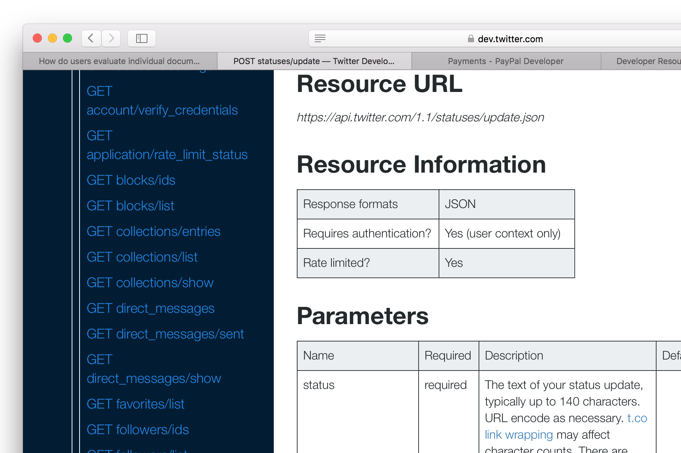
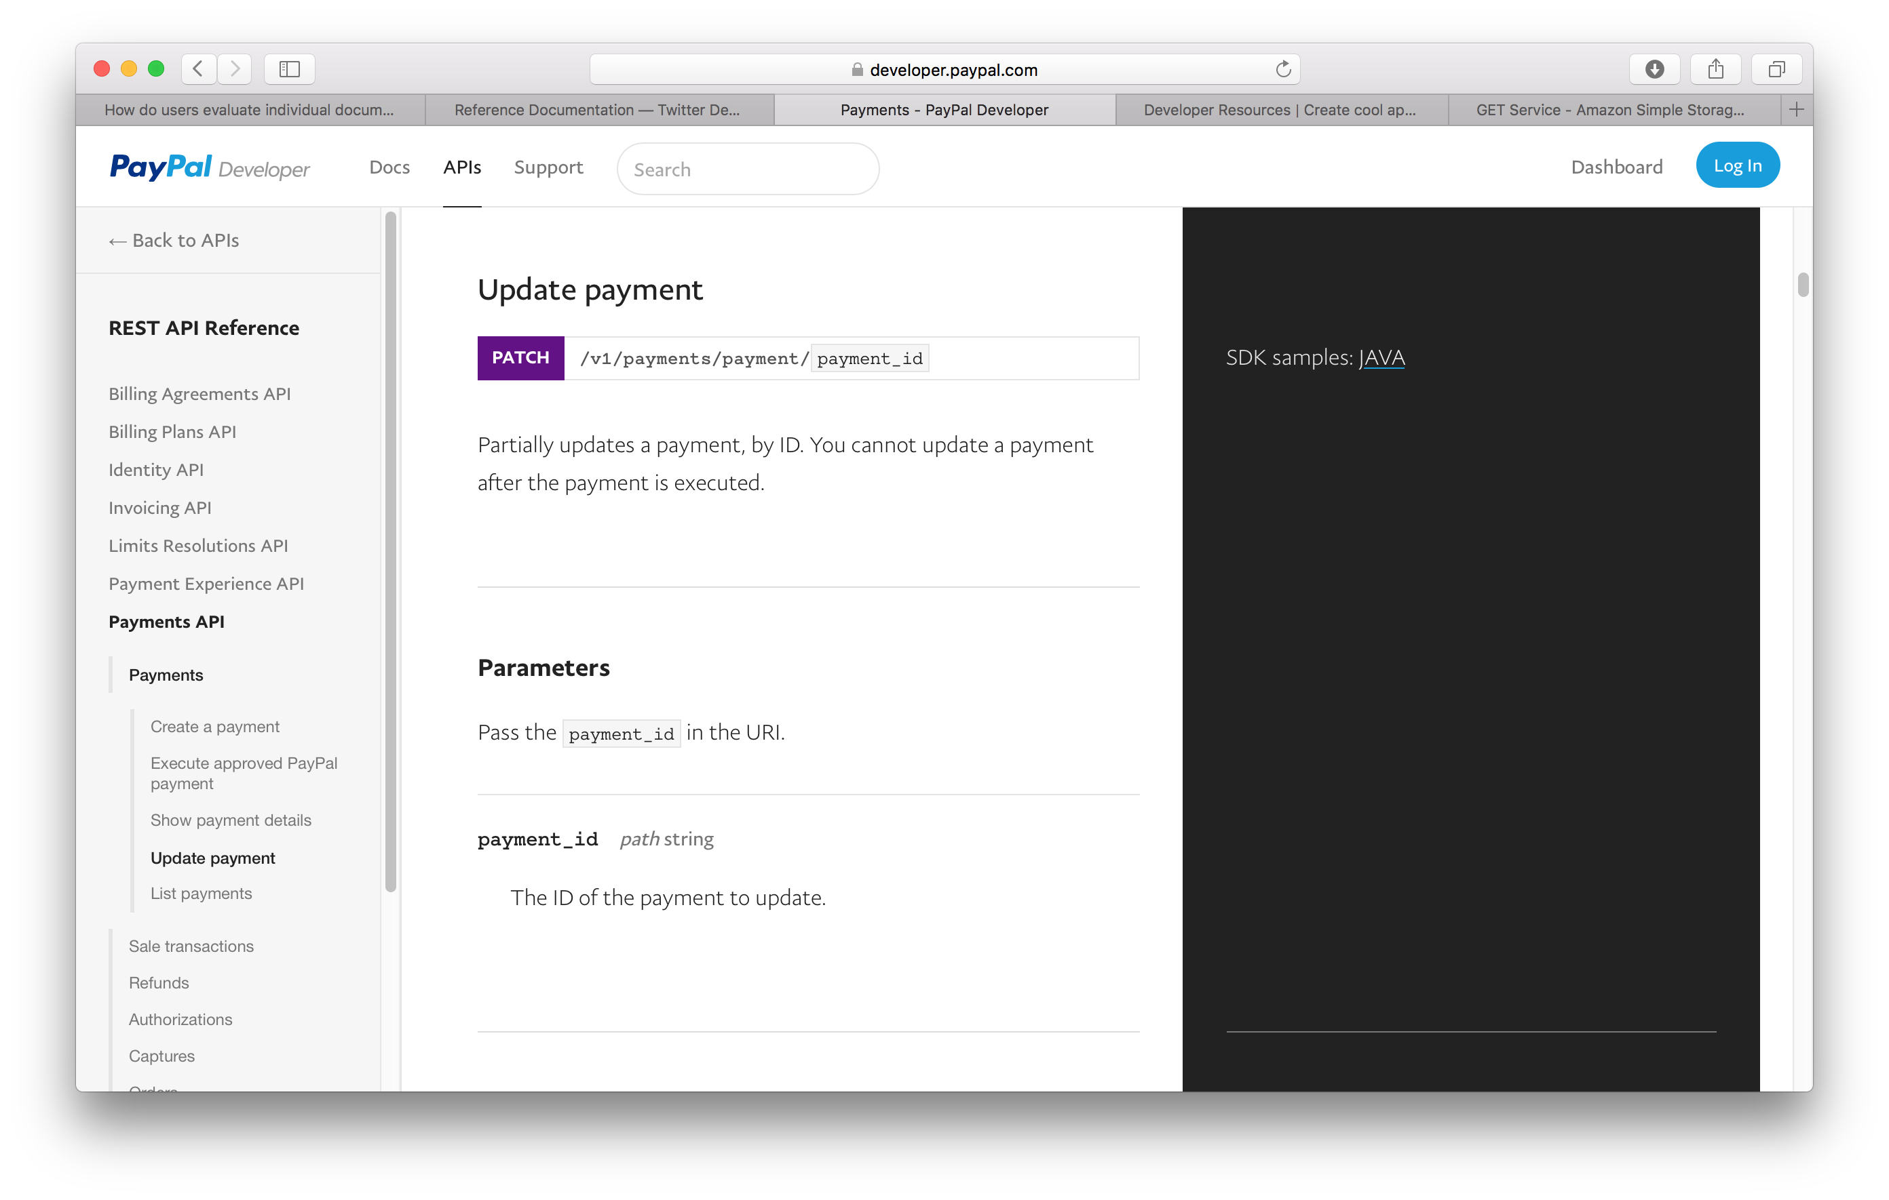
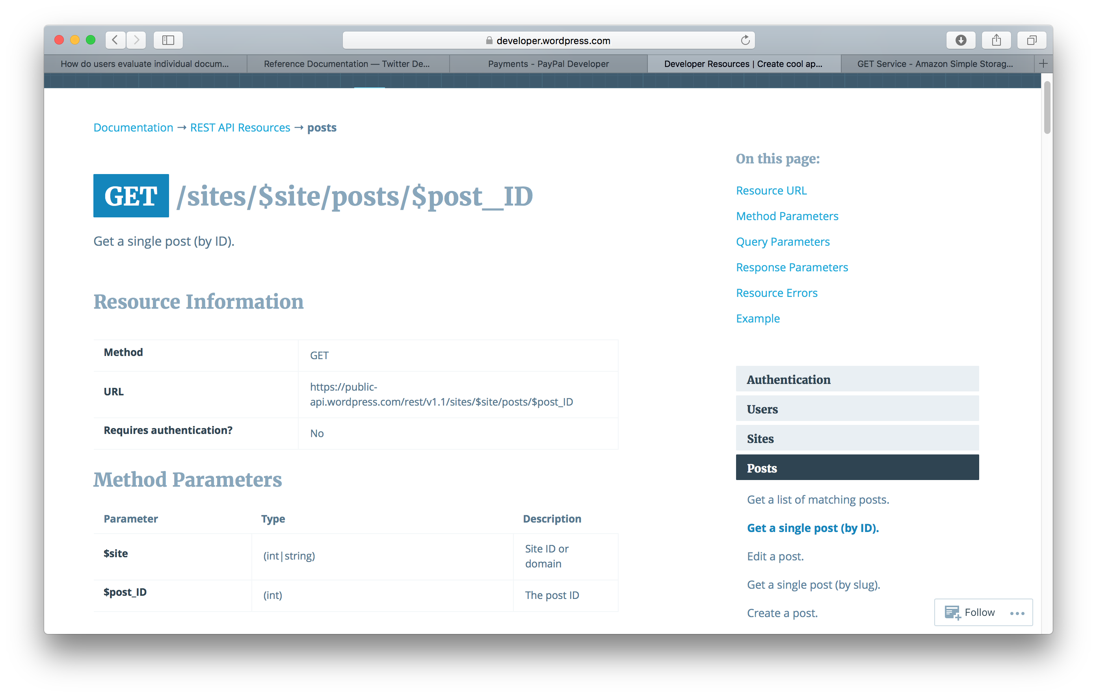
URIs

Slide 6
URI Parameters

Slide 7
Interaction

Slide 8
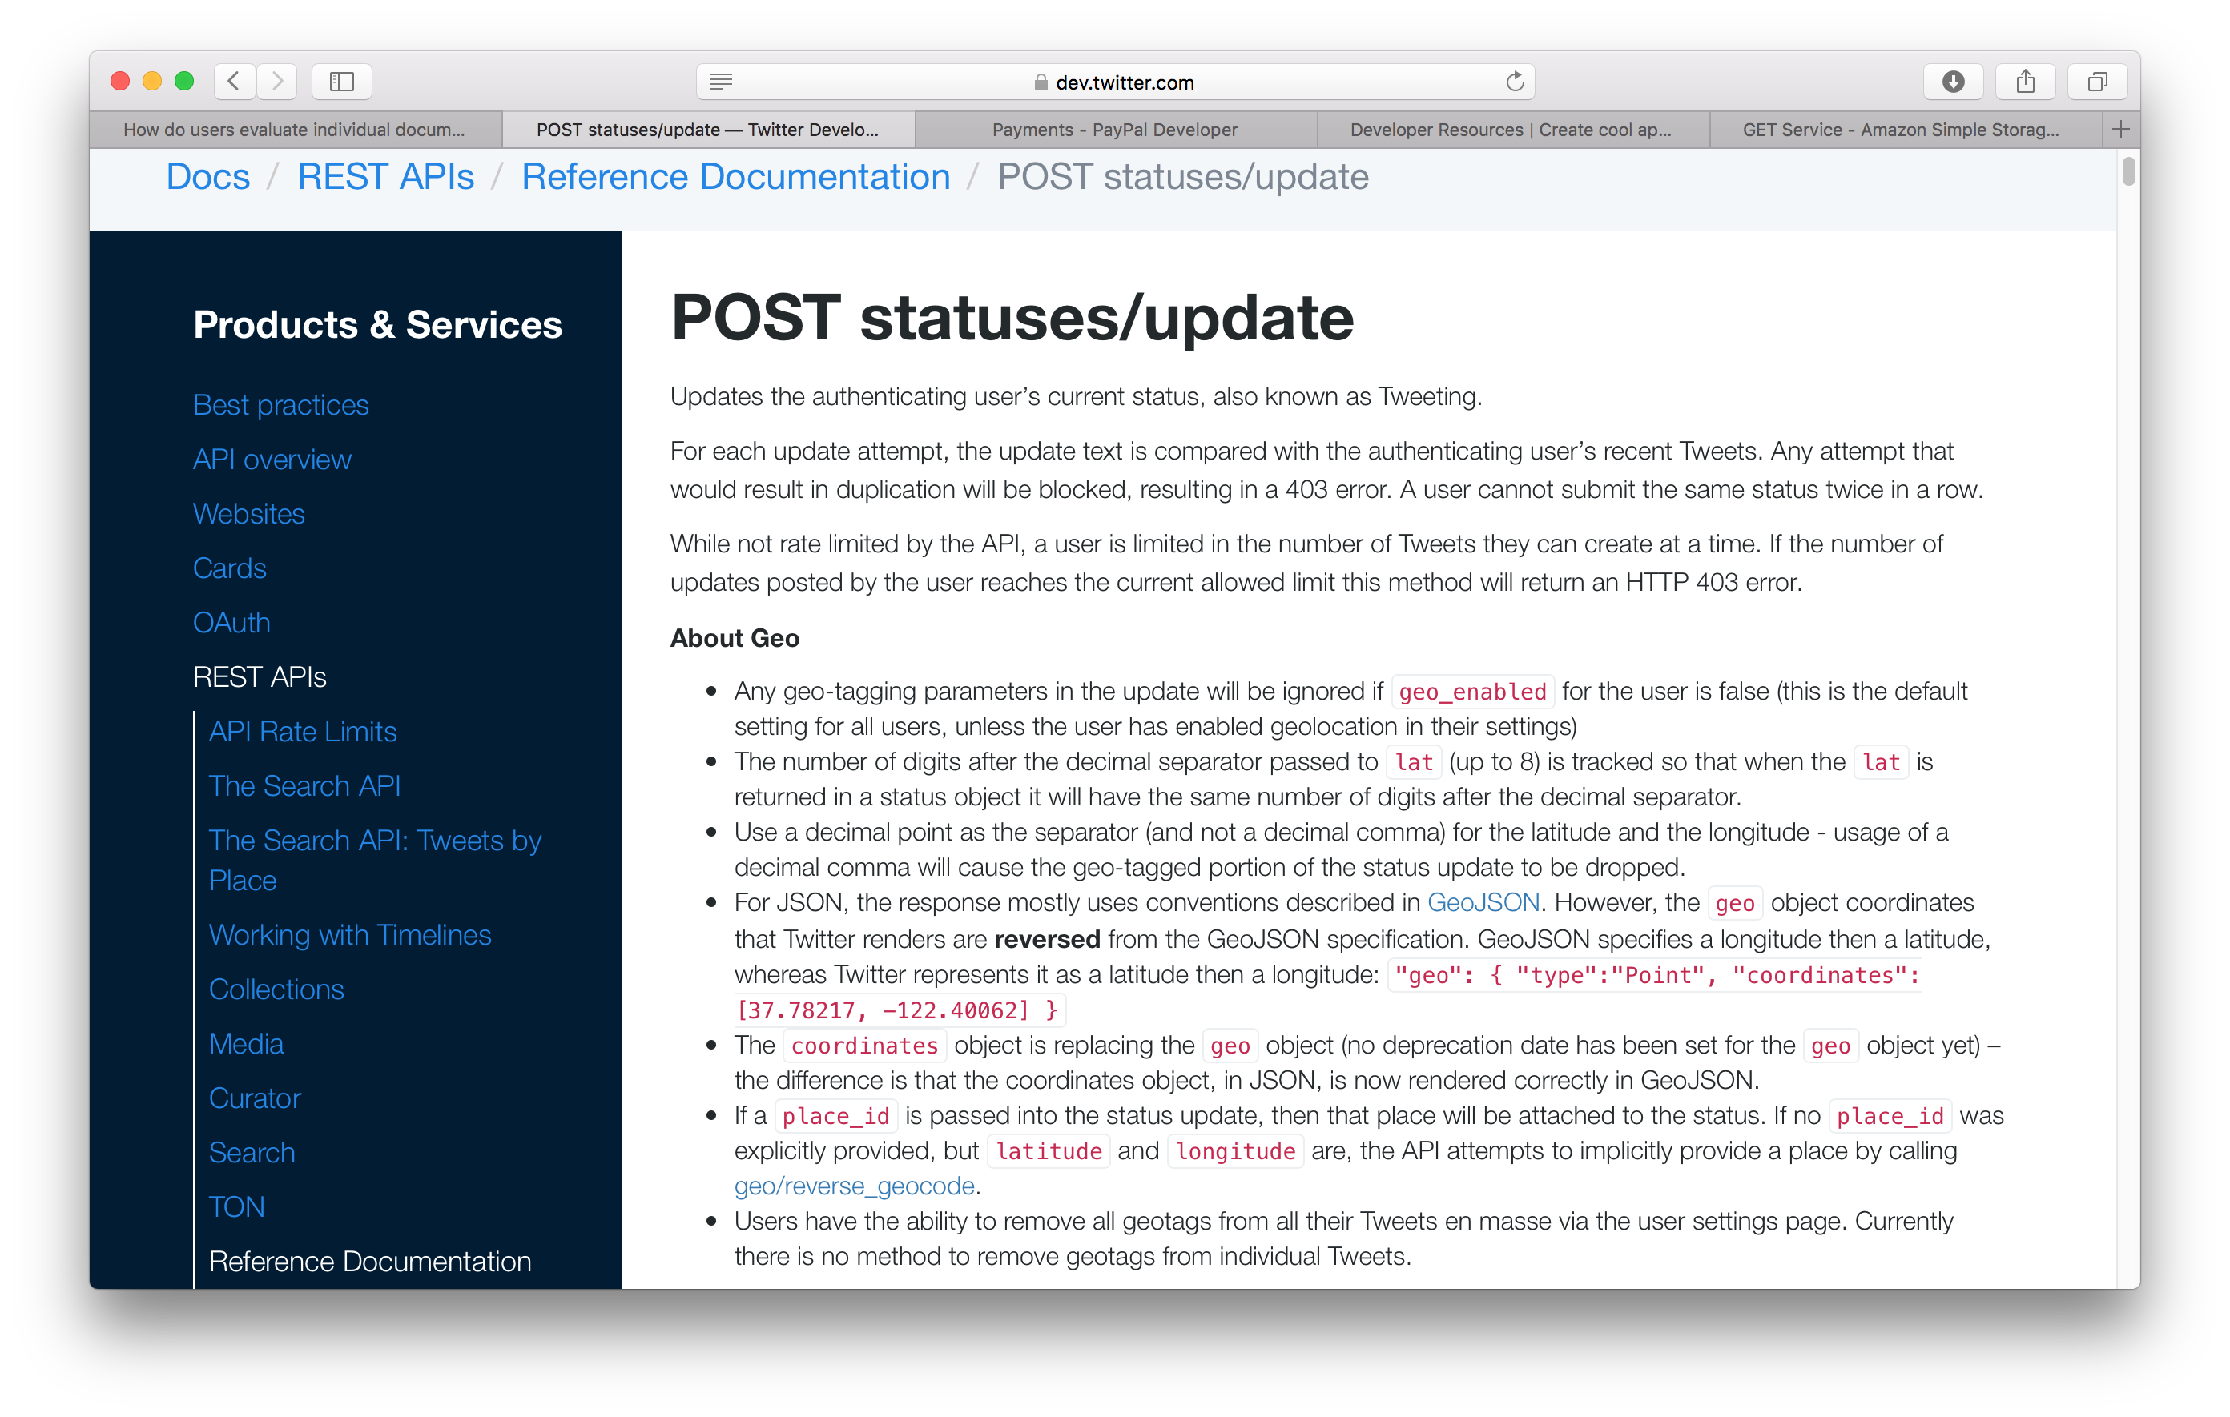
Methods

Slide 9
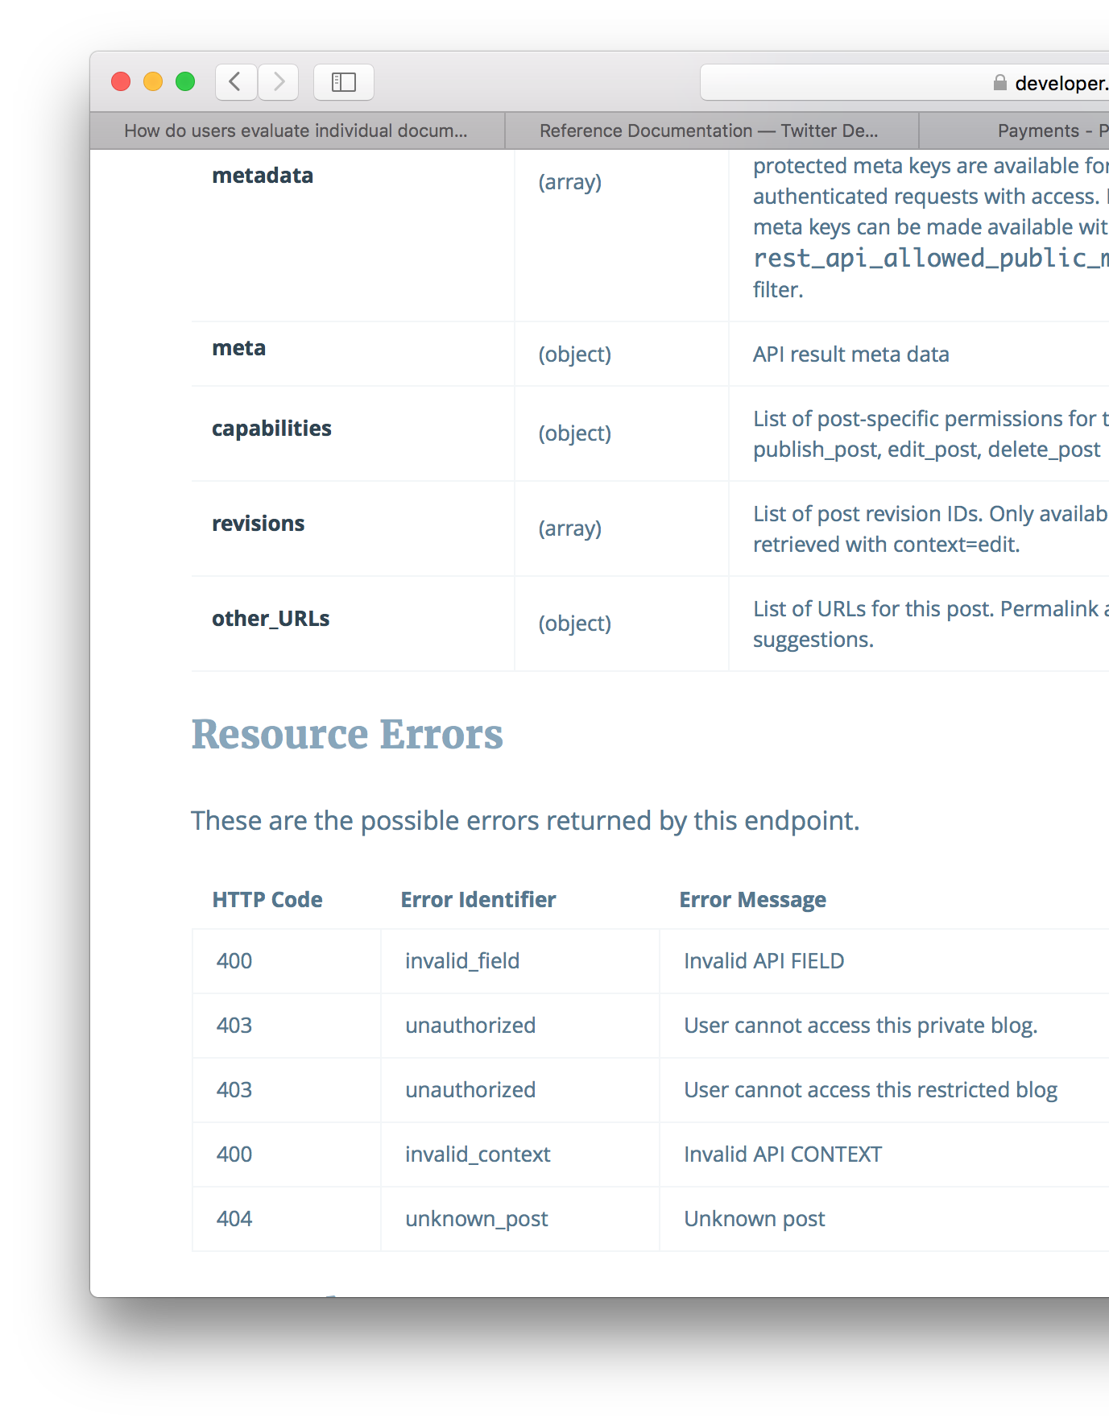
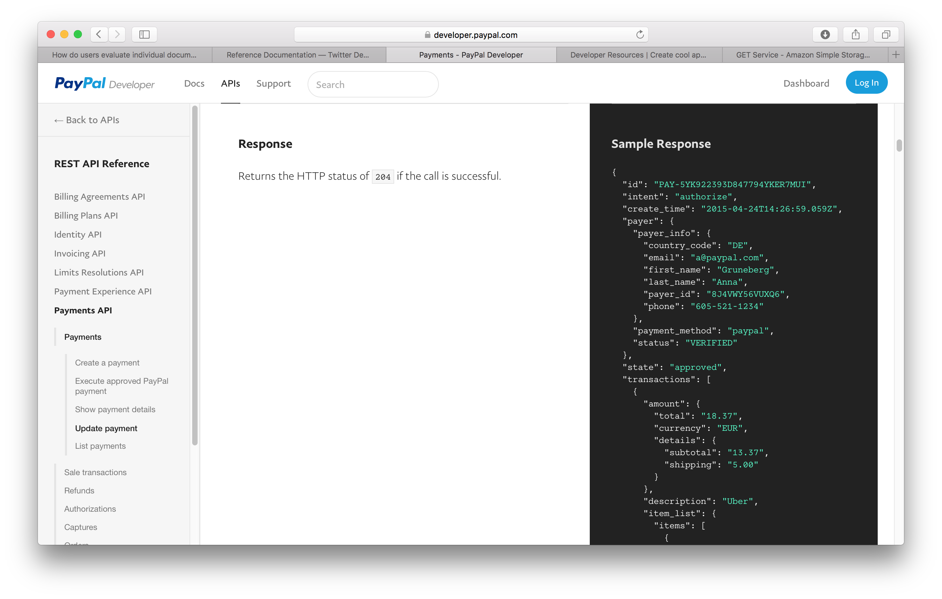
Status Codes

Slide 10
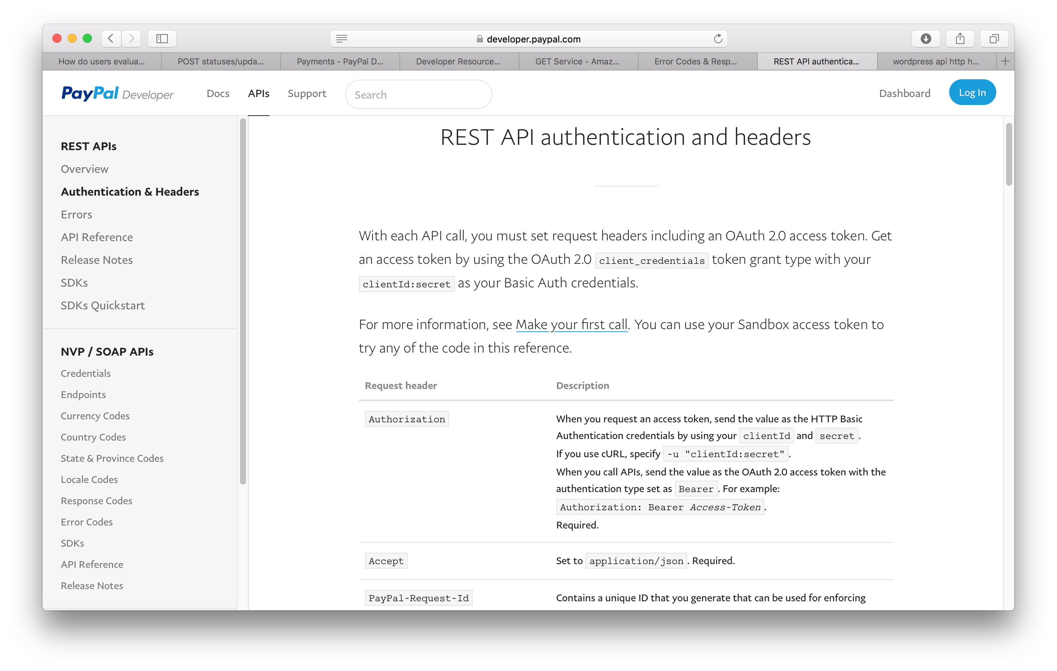
Headers
Mostly for Authorisation
    OAuth 2.0, etc
Consider how the various Accept-* headers might be used.

Slide 11
Representation

Slide 12
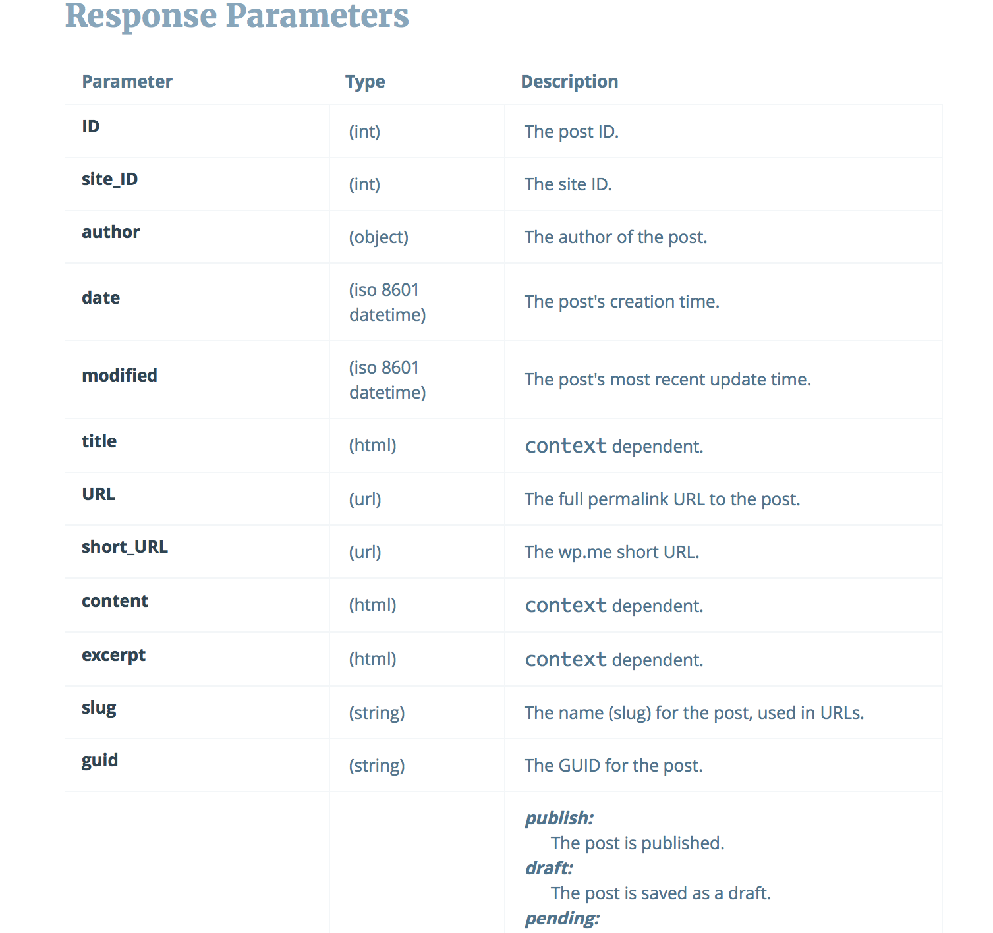
Representation

Slide 13
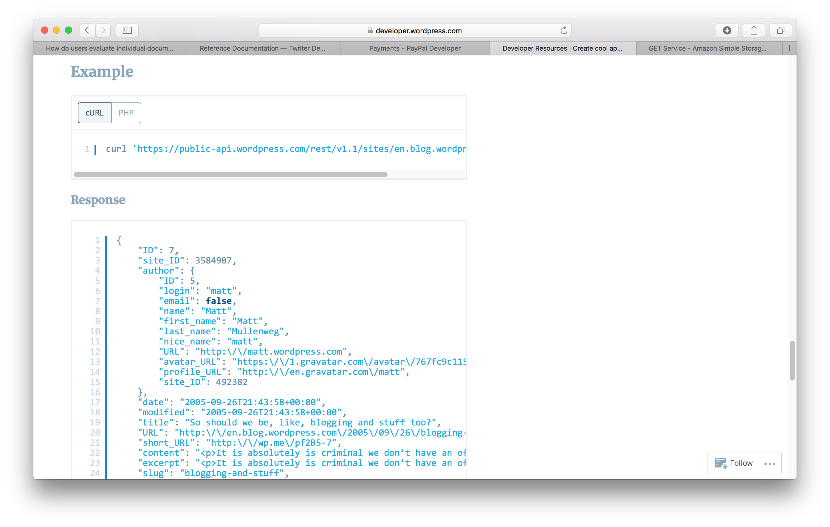
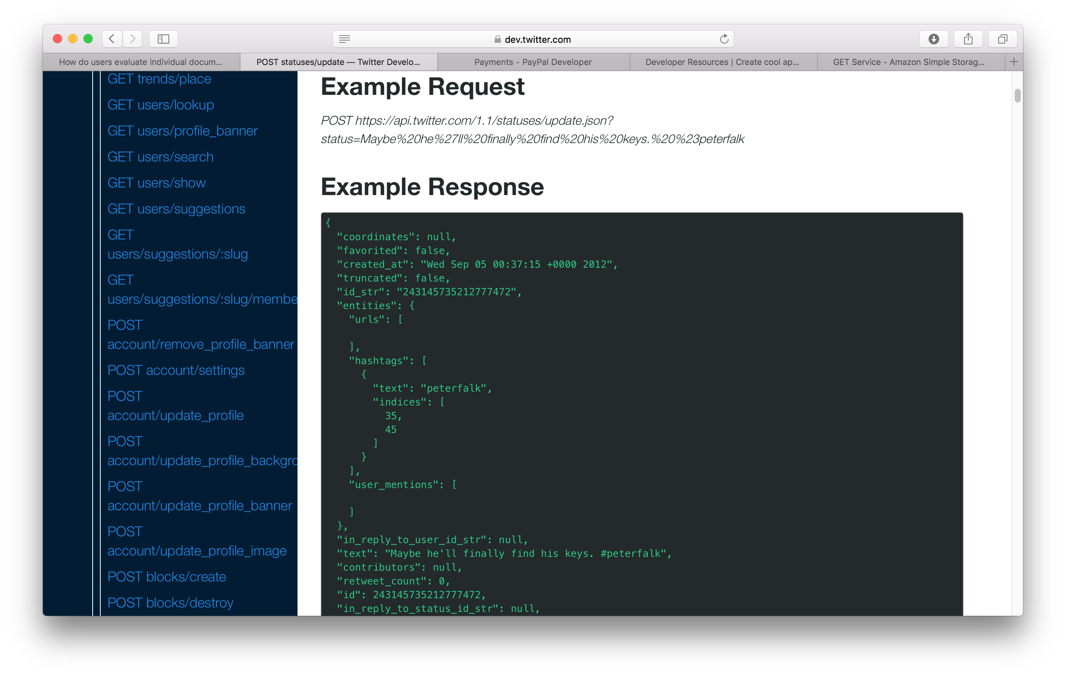
Examples

Slide 14
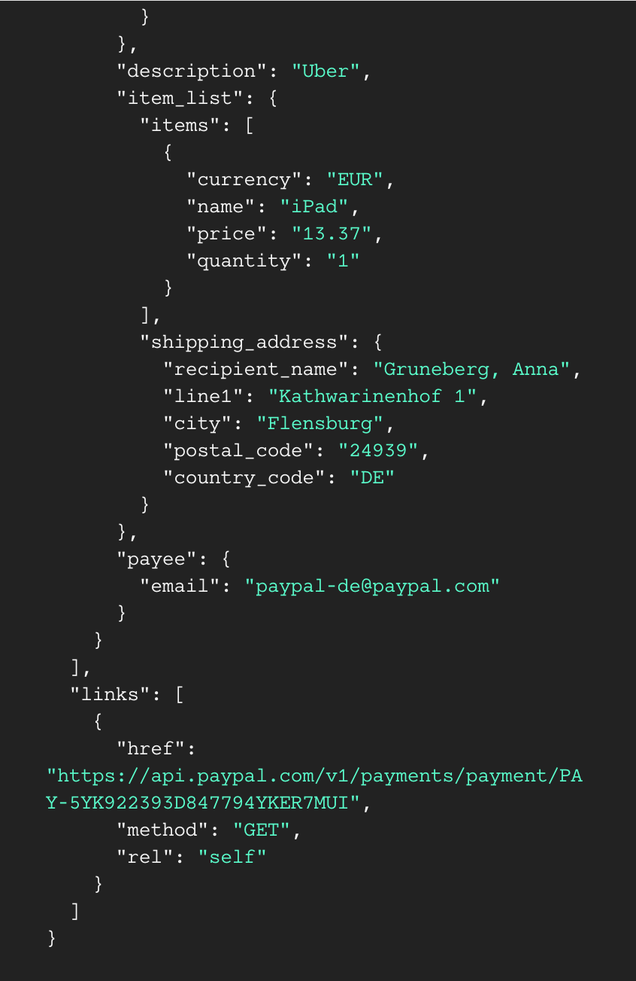
HATEOAS

Slide 15
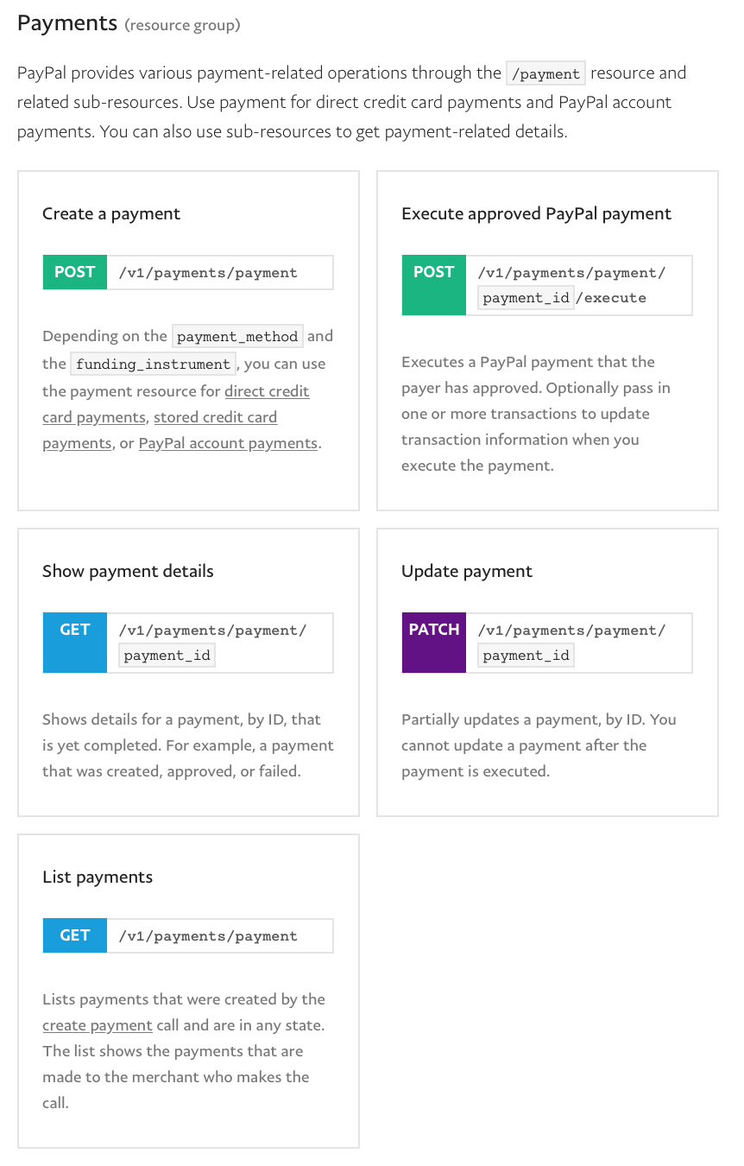
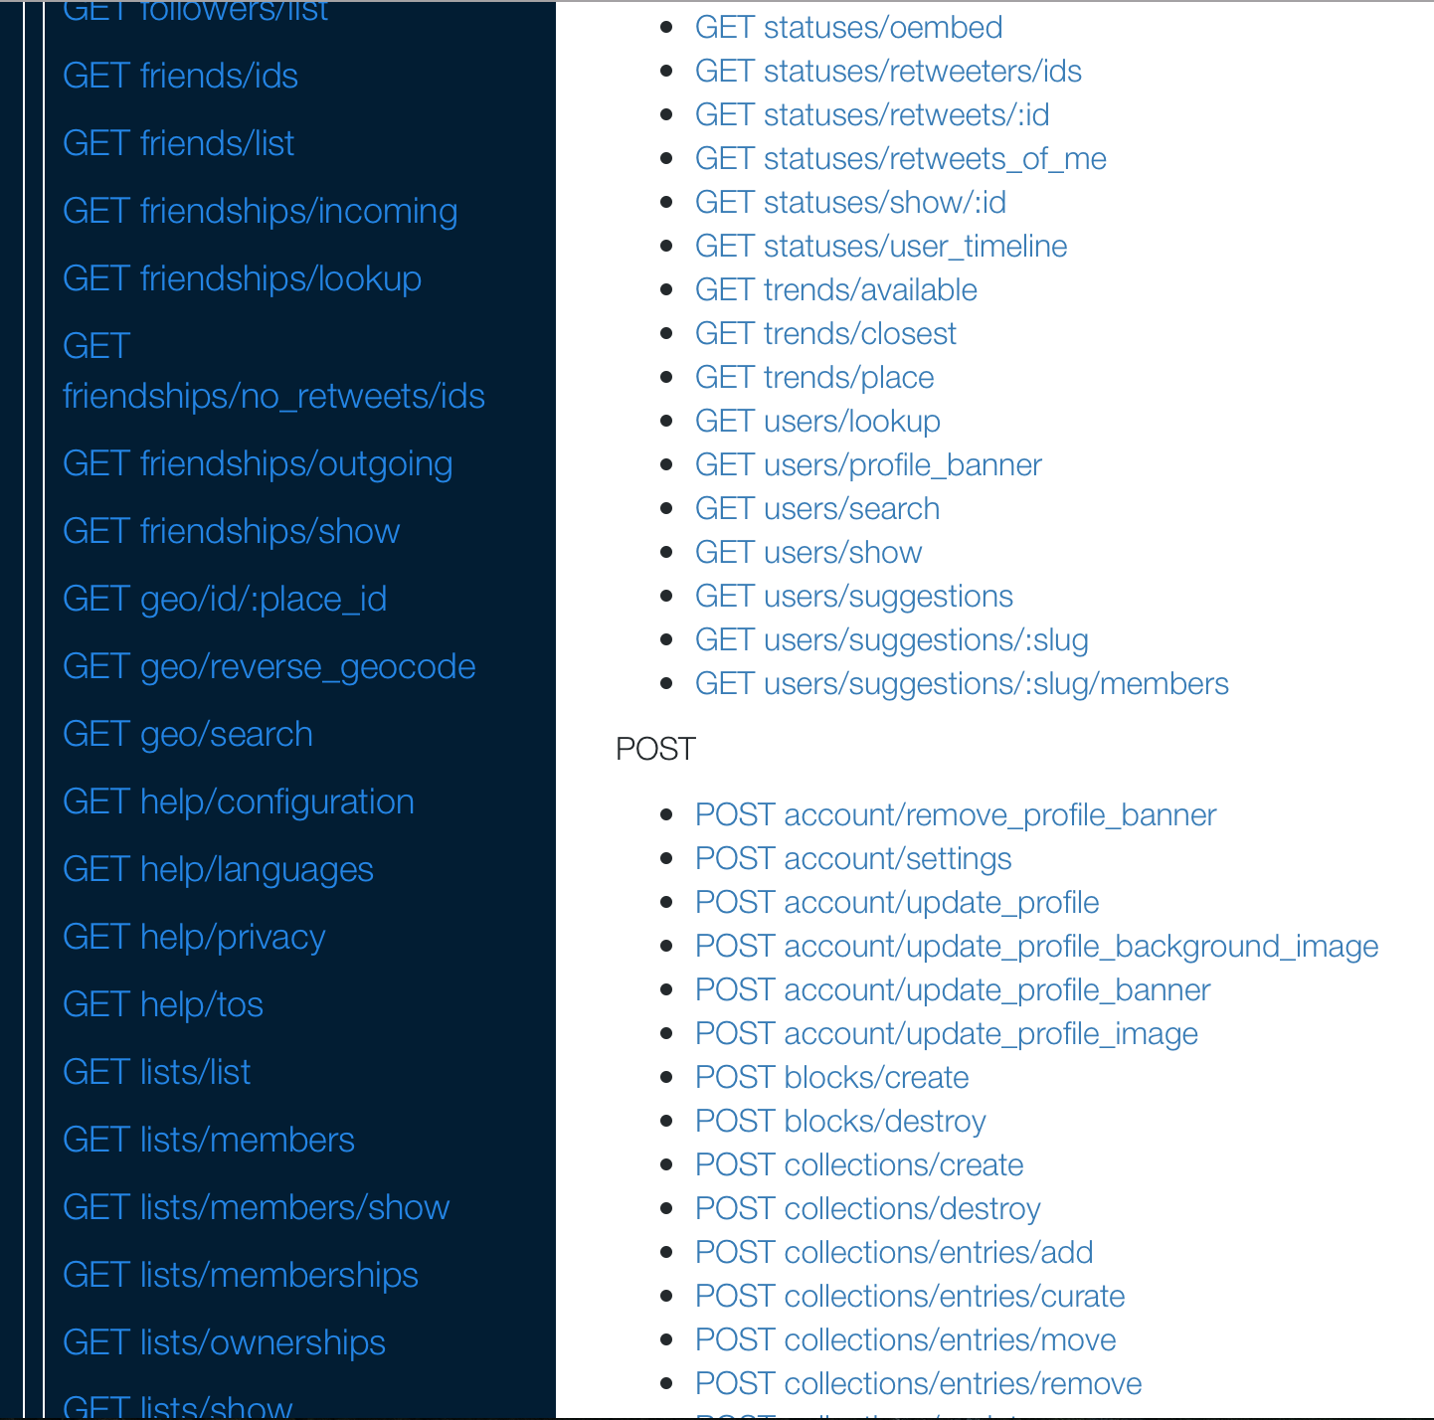
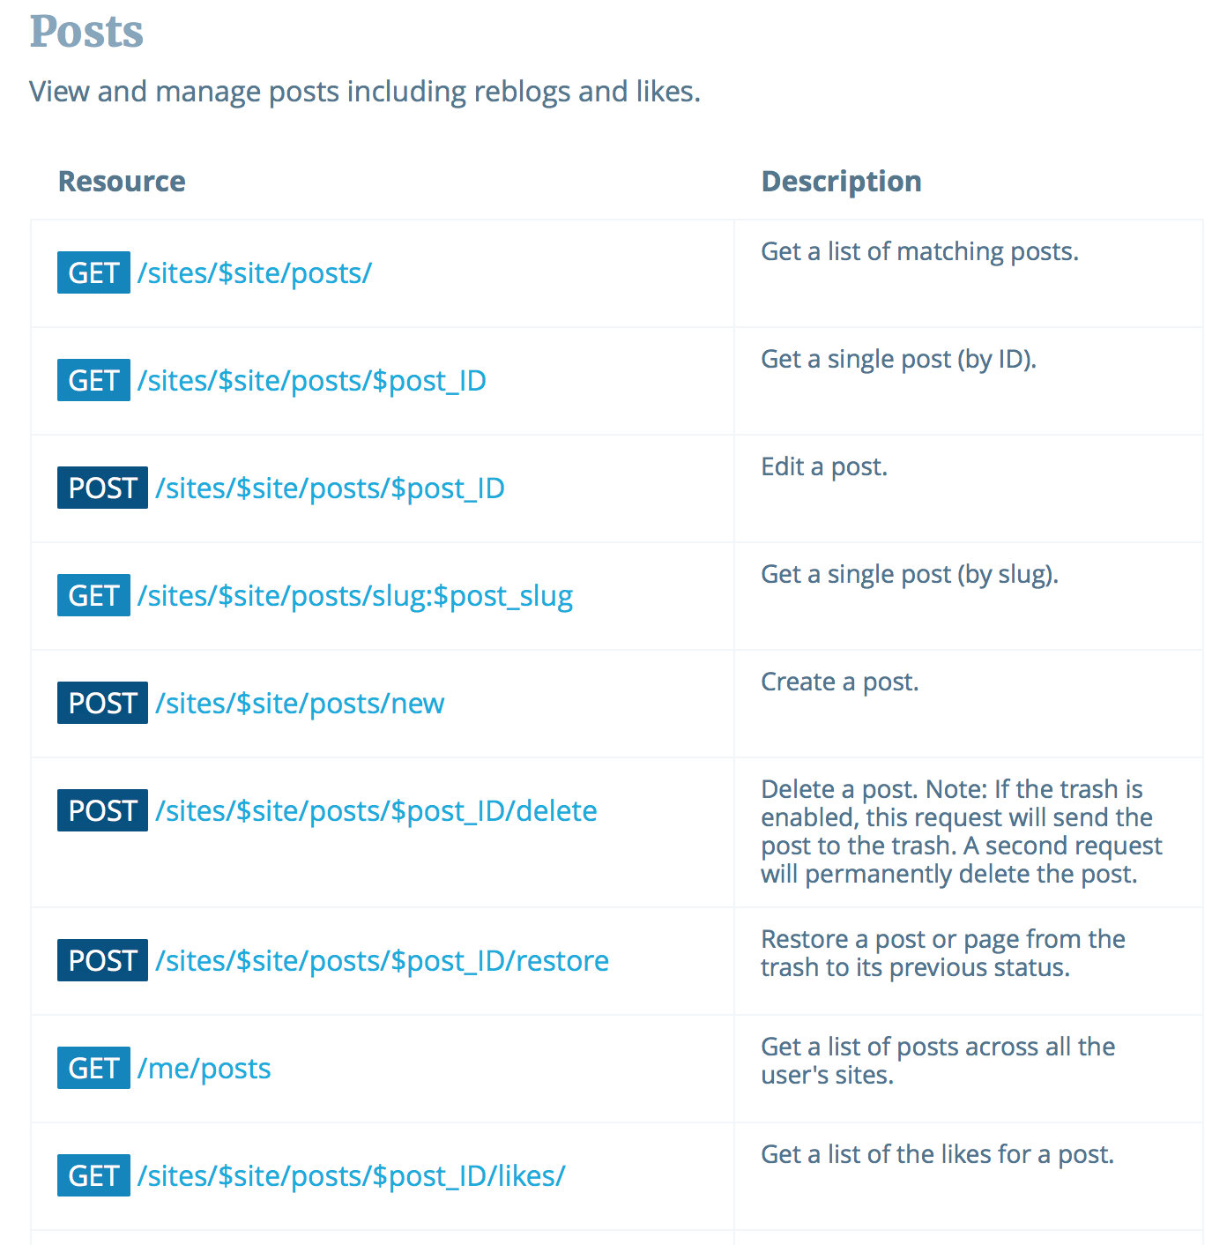
Listings

Slide 16
OpenAPI

Slide 17
OpenAPI
Originated with Swagger tool for designing RESTful APIs
Represents API descriptions in JSON or YAML (Yet Another Markup Language)
  We’ll concentrate on the YAML serialization

Slide 18
OpenAPI metadata
OpenAPI description starts with:
  Version number of OpenAPI in use
  Simple metadata about the service in the info: block
openapi: 3.0.0
info:
version: 1.0.0
title: Orinoco API
description: The API for the Orinoco online bookseller

Slide 19
Servers
API endpoints are defined relative to a base URI
  Defined in OpenAPI using the servers: block
servers:
- url: https://orinoco.com
description: Live server
_ url: https://test.orinoco.com
description: Test server (uses dummy data)

Slide 20
Components
components: block used to define repeatedly-used information
  Most often used to define format of message bodies
components:
schemas:
order:
type: object
properties:
items:
type: array
item:
type: string
status:
type: string

Slide 21
Paths
Lists available paths on the server
  e.g. https://orinoco.com/order/1234
For each path, lists:
  The methods which can be used on that path
  The content of any request body which should accompany the method (for PUT, POST)
  The responses which may be received from the method (including response bodies)

Slide 22
Path Example
paths:
/order{order_id}:
get:
description: Obtain information about an order
parameters:
- name: order_id
in: path
required: true
schema:
type: string

Slide 23
Path Example
paths:
/order{order_id}:
get:
...
responses:
‘200’:
description: Successfully returned an order
content:
application/xml:
schema:
$ref: ‘#/components/schemas/order’

Slide 24
Summary
Documentation should cover all the bases of the web architecture
  Identification – parameterised URIs
  Interaction – HTTP methods, status codes and headers
  Representation – formats for request and response, with examples
Listings of all of the above

Slide 25
RESTful API Examples
Twitter
  https://developer.twitter.com/en/docs/api-reference-index
Paypal
  https://developer.paypal.com/docs/api/payments/
Imgur
  https://apidocs.imgur.com
  Wordpress
  https://developer.wordpress.org/rest-api/

Slide 26
Tools and Further Reading
Swagger API development tool
https://swagger.io/
Overview of OpenAPI
https://swagger.io/docs/specification/about/
OpenAPI Specification
https://github.com/OAI/OpenAPI-Specification

Slide 27
Next Lecture: Telling Tales

