Slide 2
Trailblazers: History of Hypertext
COMP3220 Web Infrastructure
COMP6218 Web Architecture
Dr Nicholas Gibbins – nmg@ecs.soton.ac.uk

Slide 3
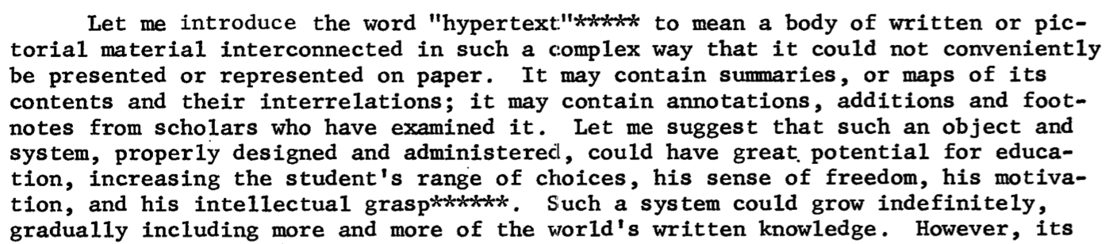
Revisiting Nelson’s definition
The history of hypertext is intrinsically bound up
with the history of knowledge organisation
Nelson, T.H. (1965) A File Structure for the Complex, the Changing and the Indeterminate. Proceedings of the 20th ACM National Conference.

Slide 4
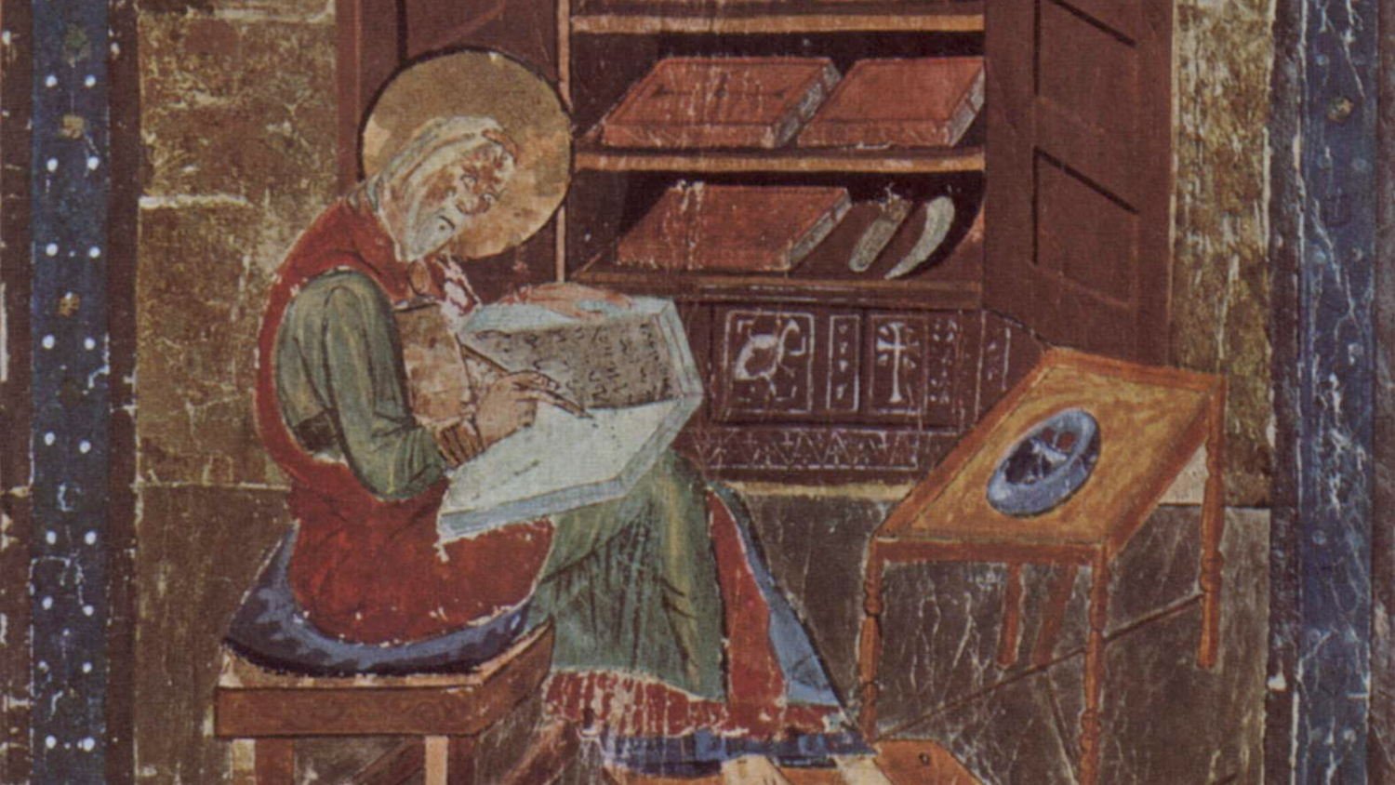
From the Middle Ages to the Age of Enlightenment
St Cuthbert Gospel, 7th century England

Slide 5
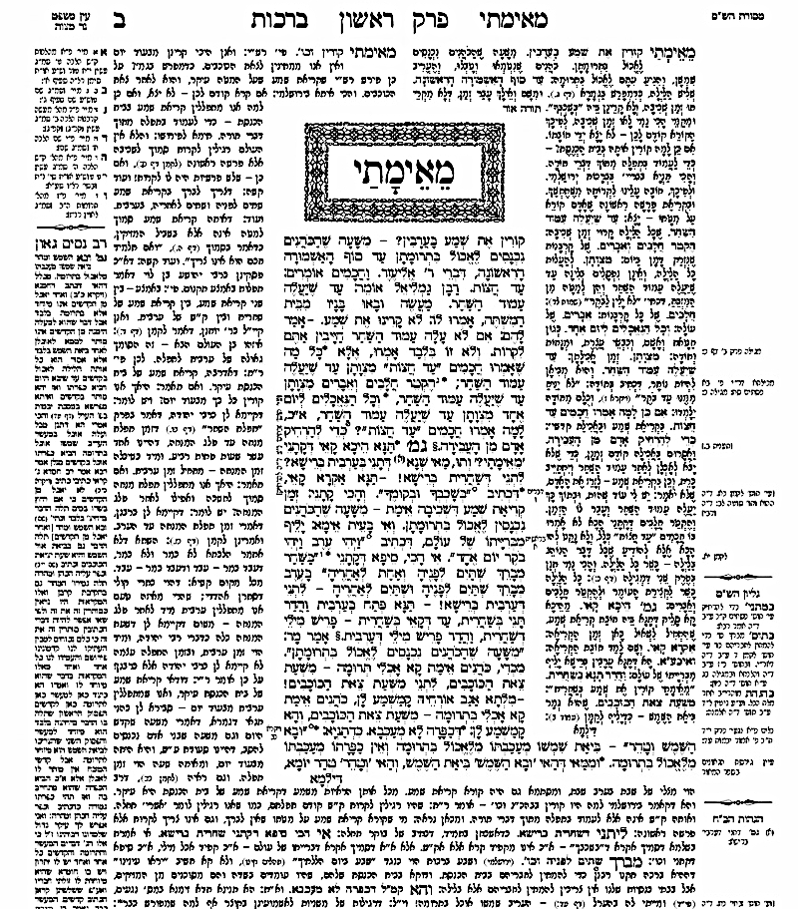
The Talmud
Central text of Rabbinical Judaism after the Jewish-Roman Wars
  Encoding of earlier oral tradition
  Commentaries on original text
  Commentaries on commentaries
Mishnah
C2-3rd
Later commentaries
and cross-references
Rashi
C11th
Gemara
C5-6th
Tosafot
C12-13th
Notes:
Central text upper: Mishnah, earlier oral tradition (c. 220 CE),
Central text lower: Gemara, analysis of the Mishnah (c. 450CE)
RH: Rashi, early medieval commentaries by Rabbi Shlomo ben Yitzhak (France, C11-12)
LH: Tosafot, medieval commentaries by a variety of scholars (France/Germany, C12-13)
Outer columns: modern commentaries, cross references

Slide 6
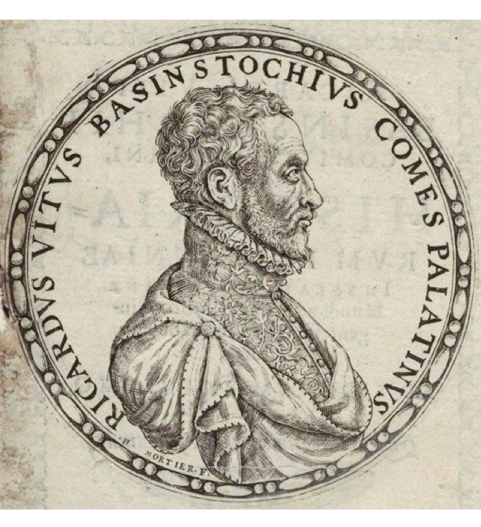
Richard White of Basingstoke
dunce
Author of Historiarum libri cum notis antiquitatum Britannicarum (1597-1607)
One of the earliest scholars to make use of endnotes.
"as bees take honey from different flowers, so we must take materials from all sorts of different authors and, once they have been systematically collected, store them away, as it were, in the proper combs.”
Notes:
“History books with notes of British Antiquities”
Facts mainly taken from Annio di Viterbo’s Antiquitatum Variarum (1498) (thus largely fabricated)

Slide 7
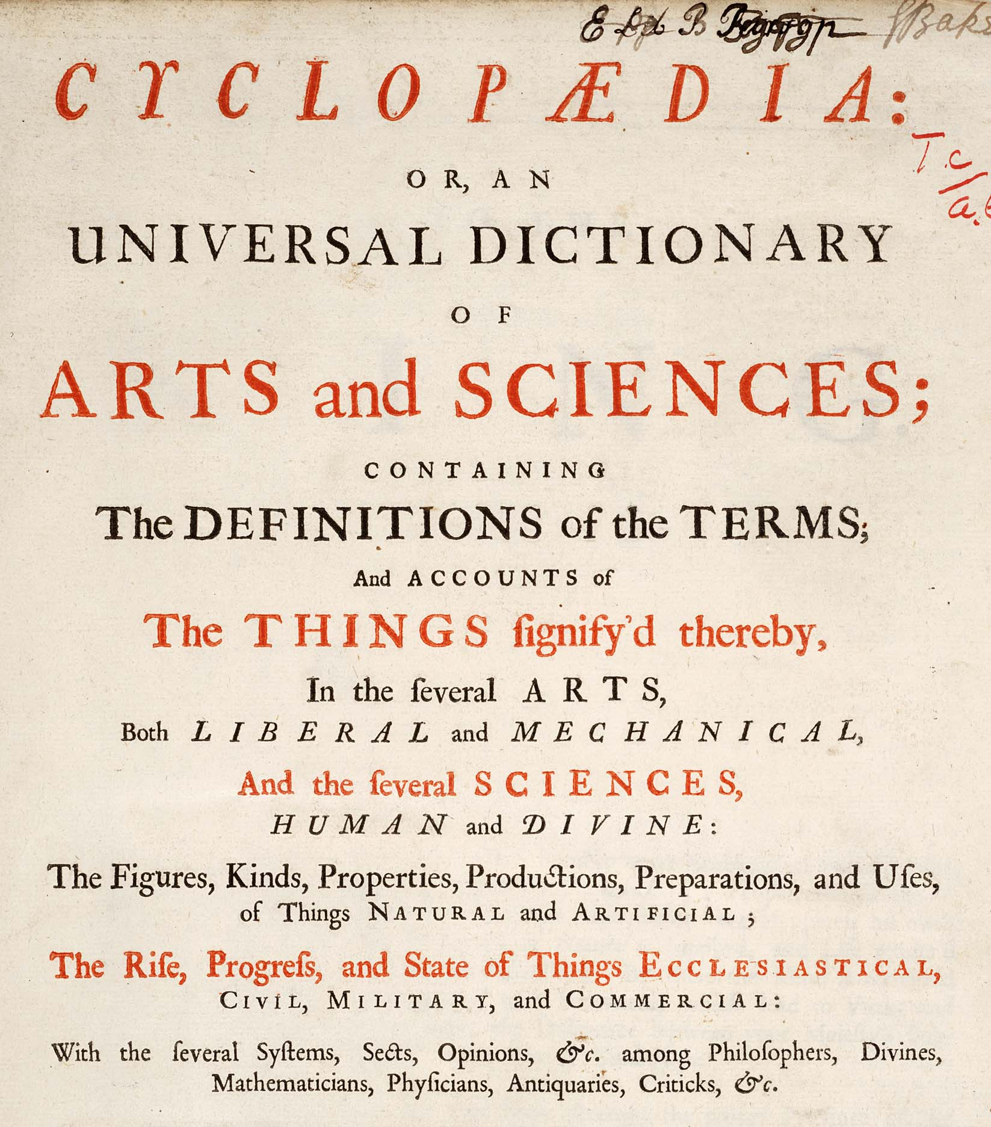
The birth of the encyclopedia
Comprehensive in scope, systematic in organisation
  Ephraim Chambers’ Cyclopædia in 1728
  Denis Diderot’s Encyclopédie in 1751
Common features:
  Subject-based classification of entries
  Cross-references between entries
Notes:
Encyclopaedia, or a Systematic Dictionary of the Sciences, Arts, and Crafts

Slide 8
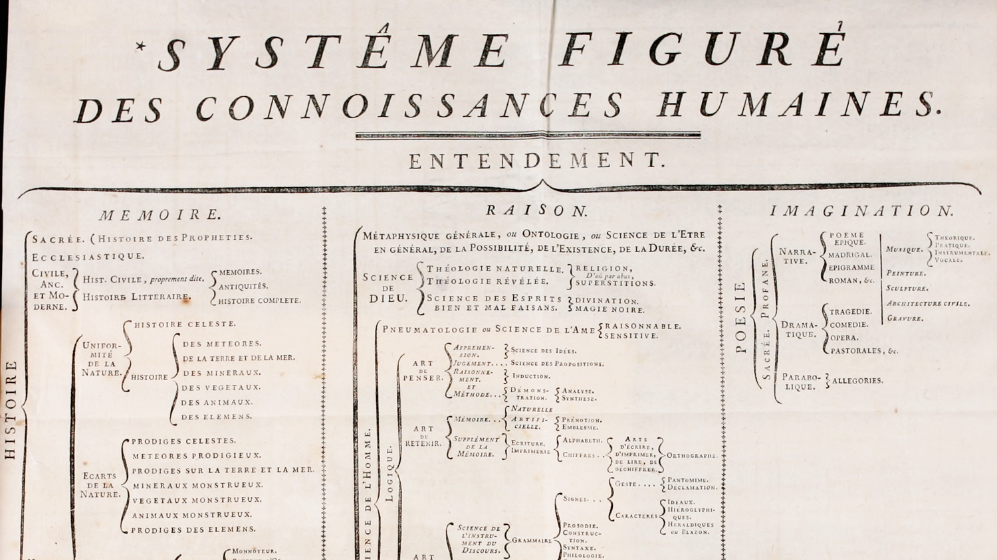

Slide 9
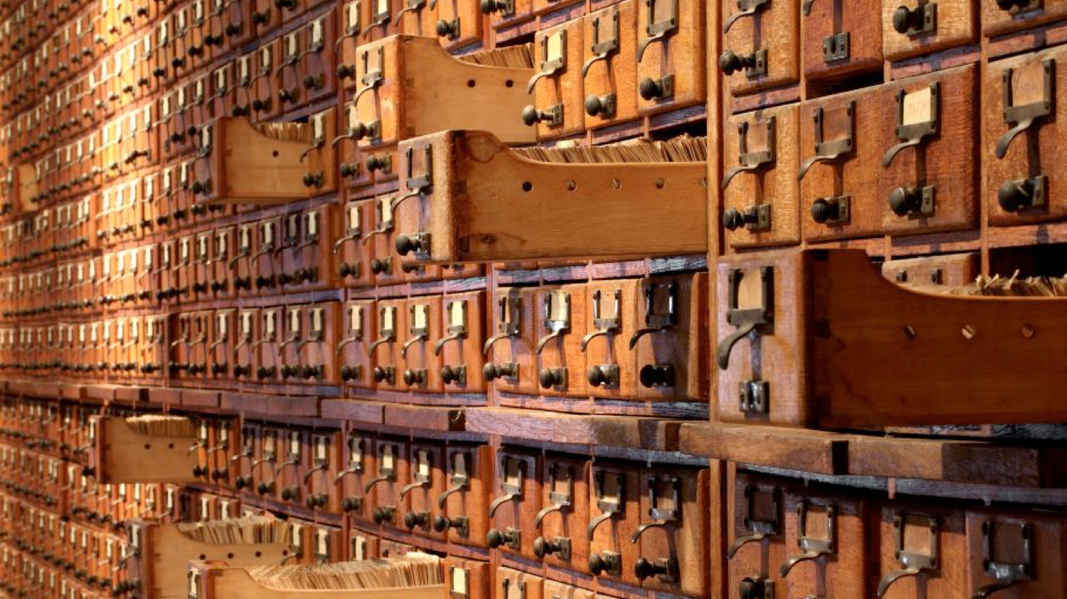
Organising Utopia
Notes:
The history of hypertext is closely related to the history of information science and information management

Slide 10
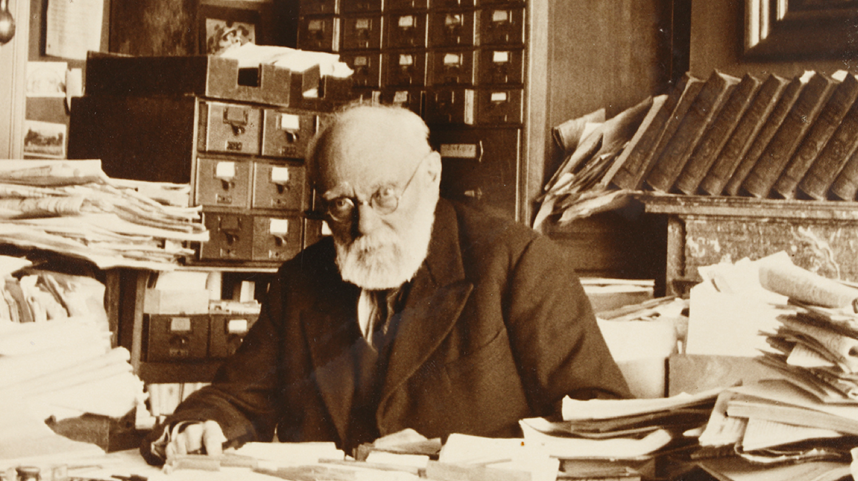

Slide 11
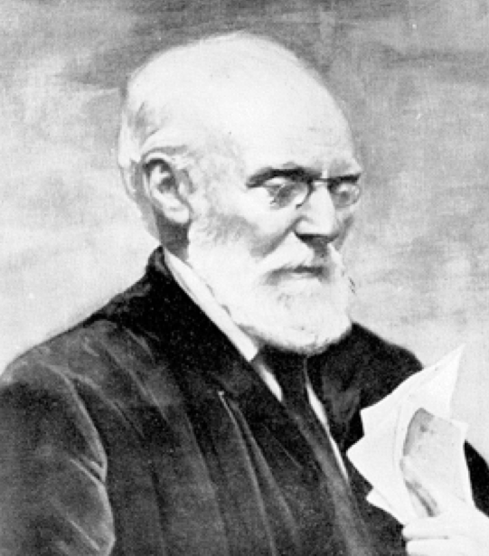
Paul Otlet (1868-1944)
Belgian lawyer, internationalist and ‘father of Information Science’
  Created the Universal Decimal Classification for libraries
  (still in use around the world)
  With Henri La Fontaine, established the Répertoire Bibliographique Universel in 1895
Notes:
La Fontaine received the Nobel Peace Prize in 1913 for his work as the head of the International Peace Bureau, and was the Belgian delegate at the Versailles Peace Conference in 1919

Slide 12
The external make-up of a book, its format and the personality of its author are unimportant provided that its substance, its sources of information and its conclusions are preserved and can be made an integral part of the organisation of knowledge
Otlet, P. (1892) Something About Bibliography. In International Organisation and Dissemination of Knowledge: Selected Essays of Paul Otlet. Edited and translated from French by W.B. Rayward., 1990. Amsterdam: Elsevier.
Notes:
First published work on knowledge organisation

Slide 13
The ideal would be to strip each article or each chapter in a book of whatever is a matter of fine language or repetition or padding and to collect separately on cards whatever is new and adds to knowledge. These cards, minutely subdivided, each one annotated as to the genus and species of the information they contain, because they are separate could then be accurately placed in a general alphabetical catalogue [...]
Otlet, P. (1892) Something About Bibliography. In International Organisation and Dissemination of Knowledge: Selected Essays of Paul Otlet. Edited and translated from French by W.B. Rayward., 1990. Amsterdam: Elsevier.
Notes:
Introduces the monographic principle (see later work of Ostwald), but not referred to as such.

Slide 14
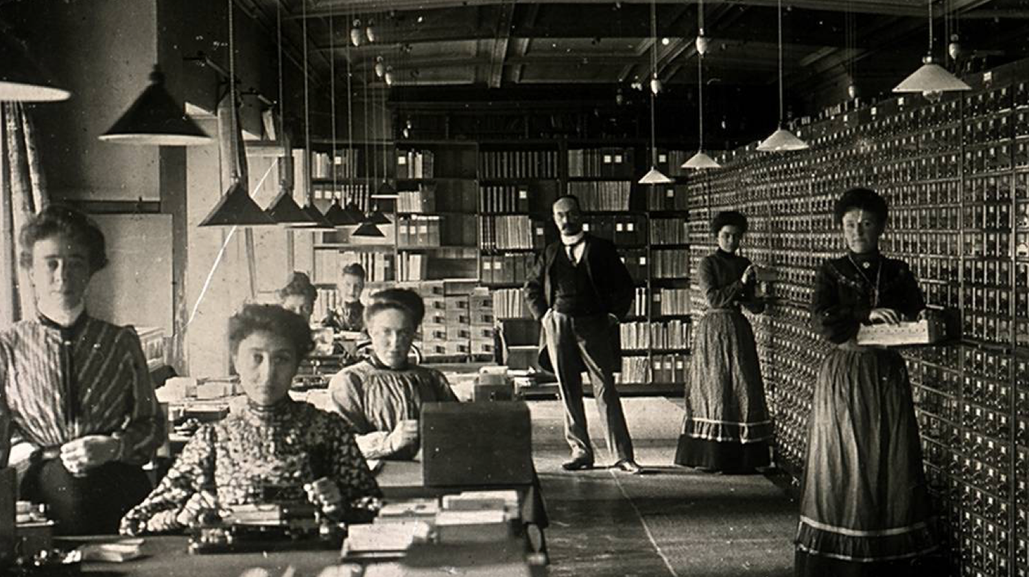
Répertoire Bibliographique Universel
Notes:
RBU – fee-based service (Otlet visible at back)
Human-driven search engine
15 million 3x5 index cards by 1934
“What works have been written by this or that author?” and “What has been written on this or that subject?”

Slide 15
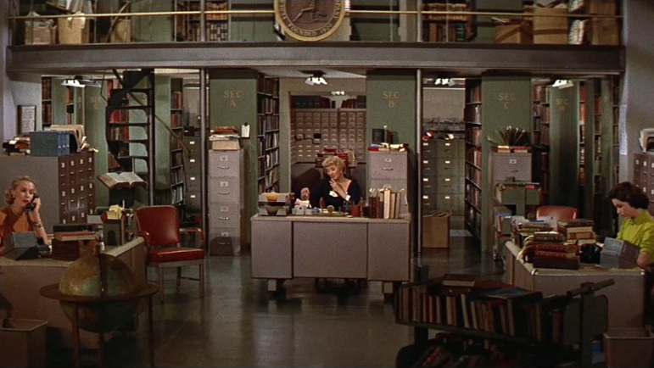
Desk Set (1957) Directed by Walter Lang [Film]. USA: 20th Century Fox.
Notes:
Still a common enough occurrence as late as the 1950s as to be the subject of a romantic comedy starring Katharine Hepburn and Spencer Tracey (Desk Set, 1957)

Slide 16
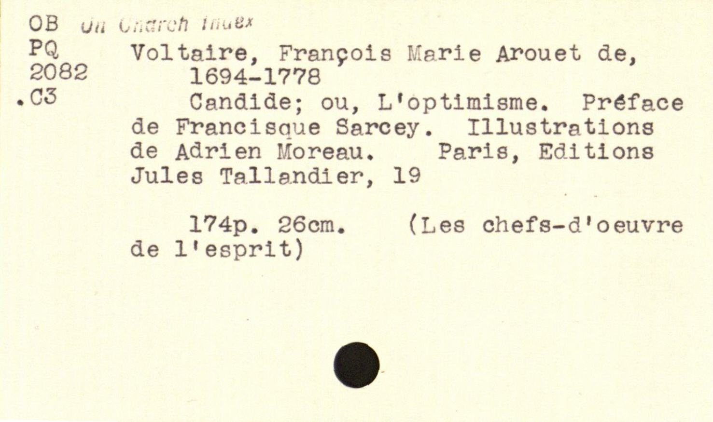
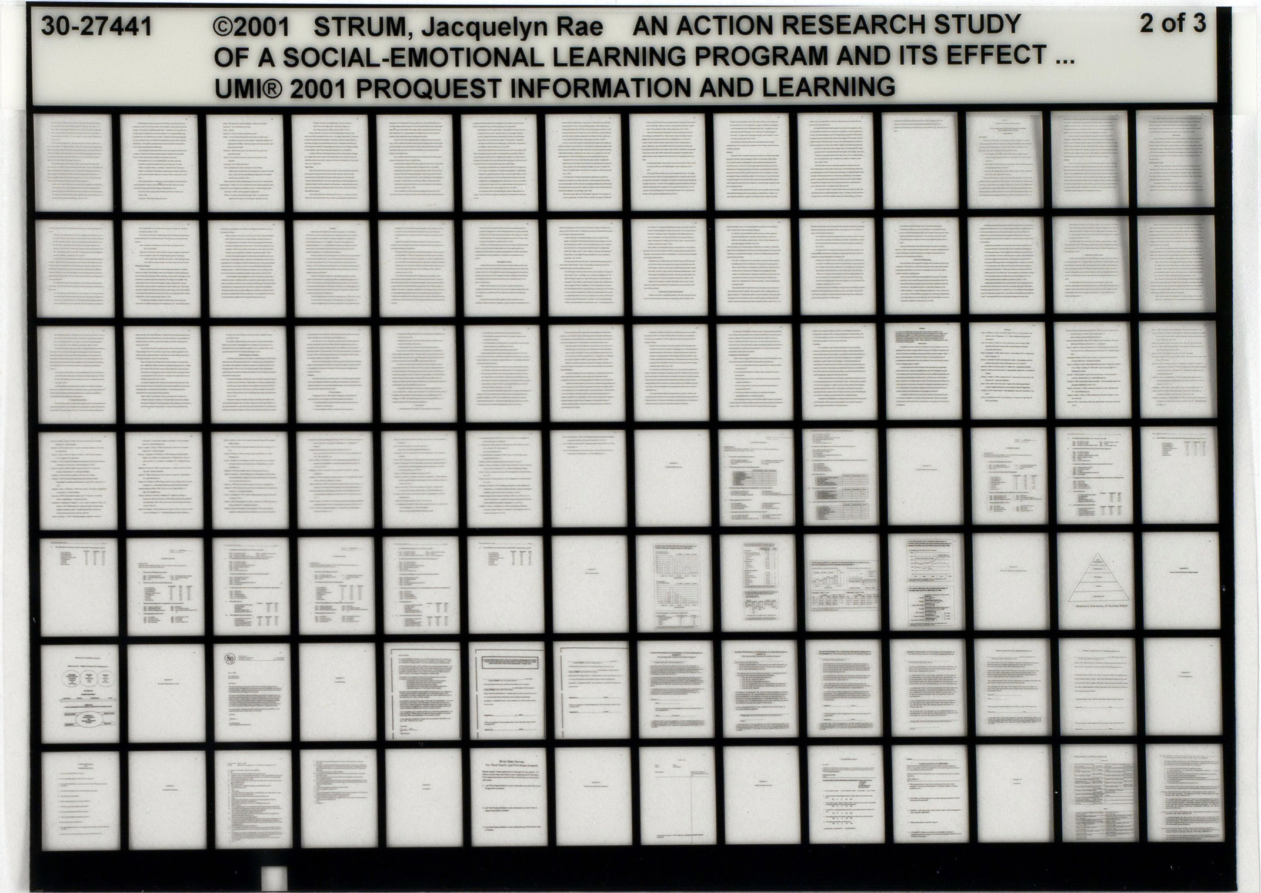
Notes:
Championed the standard 3” x 5” index card
Proposed standard microfiche in 1906

Slide 17
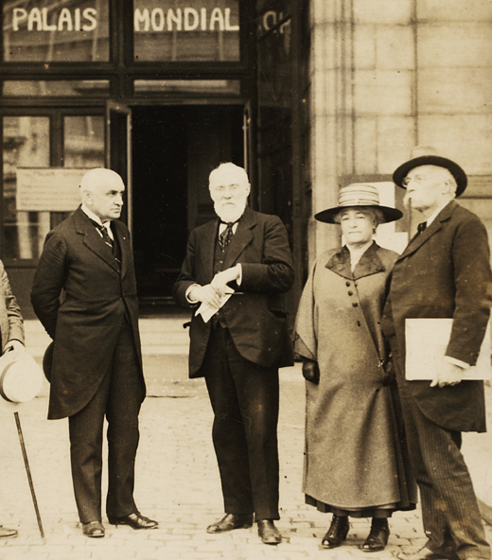
The Mundaneum
A central repository for all the world’s knowledge!
  First envisaged in 1910 by Otlet and
  La Fontaine
  Built on the earlier Repertoire Bibliographique Universel
  With support from the Belgian government, established in Brussels in 1919
Notes:
Image above is the original location of the Mundaneum in the Palais du Cinquantenaire in Brussels – the Palais Mondial was Otlet’s original name for the Mundaneum
Indexed using UDC
100,000s of files, 1,000,000s of images
Cards contain both bibliographic and substantive information
Le Réseau Universel d'lnformation et Documentation

Slide 18
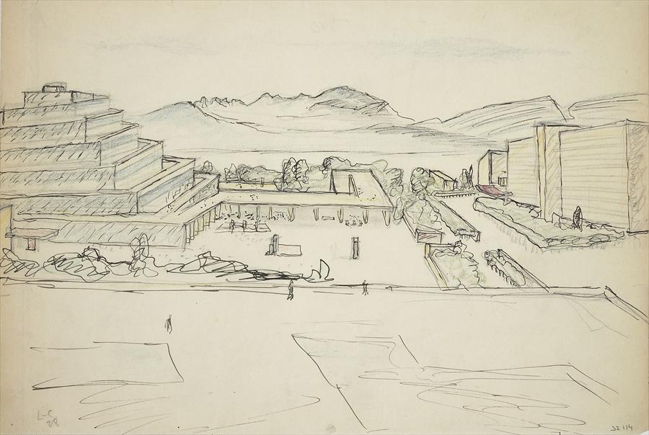
The World City
Otlet’s visionary plan for a city that brought together international institutions, containing the Mundaneum at its heart
  Design by Le Corbusier in 1929, to be built outside Geneva alongside the palace of the League of Nations
Fondation Le Corbusier
Notes:
Criticism by Czech architect Karel Teige in 1929:
The whole ideological scheme for the Mundaneum, as explained by Otlet, is an illusion, a vain wish, a utopia; a music of the future about which the only certainty is that if it does happen, it will happen differently than Otlet and Le Corbusier have imagined. This is not the place to outline in detail the errors in the ideological program for the Mundaneum: […] To ask how Otlet imagines international cooperation to be a solution to questions of political, diplomatic and vested interests of individual governments, military and national rivalry: To ask how a world institute under the supervision of the League of Nations, created from states having different social systems, could elaborate plans for the social transformation of the world. We can only mention that this ideological proposal of Mundaneum does not have a concrete rationale or a realistic chance of realization, as long as the League of Nations is a society of governments, powers, diplomacy and armies, and not a “wider league”; a union of nations, not a government built up on the basis of cultural work; above all, not an international political alliance of modern mankind, that being a conception which is completely unknown and which is probably not even in the program of the League of Nations, as Otlet and Le Corbusier seem to realize.
Brussels Mundaneum site closed after the Belgian government withdrew funding for the Mundaneum in 1934

Slide 19
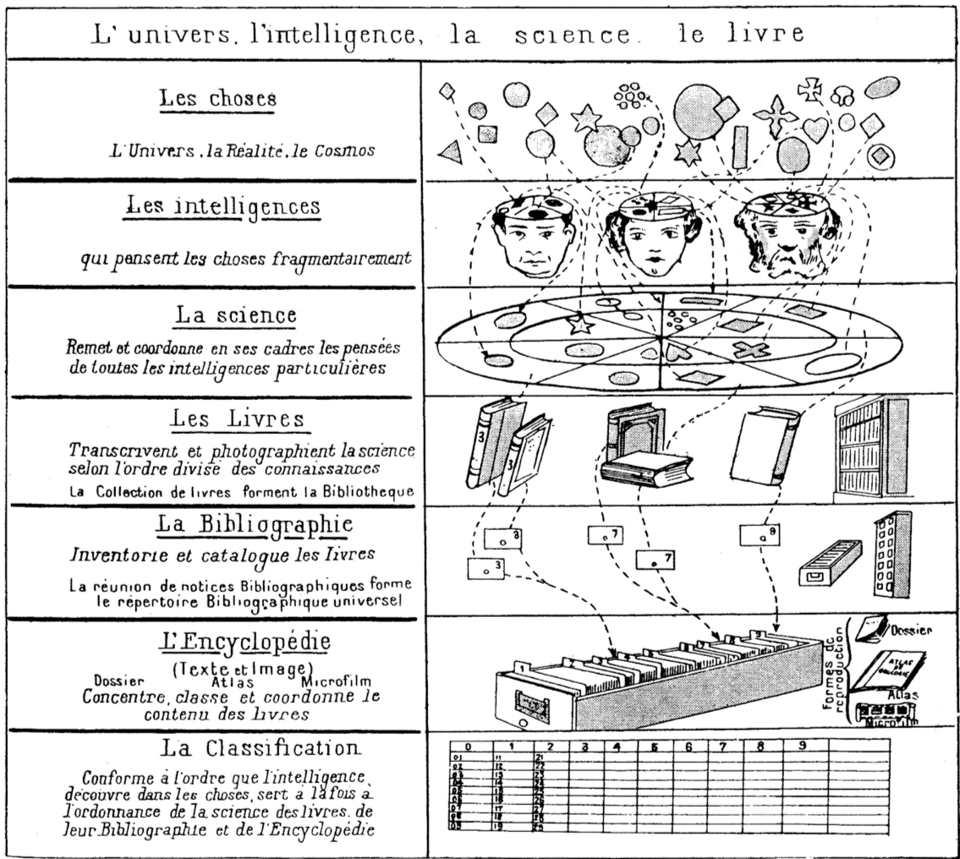
Otlet, P. (1934) Traité de Documentation. Brussels: Editiones Mundaneum, p.41.
Notes:
THINGS: the universe, reality, the cosmos
Our MINDS think about fragments of things
SCIENCE manages and coordinates our thoughts
BOOKS transcribe science by areas of knowledge (a collection of books forms a library)
The BIBLIOGRAPHY inventories and catalogues books (the collection of bibliographic entries forms the Universal Bibliographic Index (RBU))
The ENCYCLOPEDIA concentrates, classifies and coordinates the content of books
CLASSIFICATION serves science, books, the bibliography and the encyclopedia at the same time, following the patterns that minds discover in things,

Slide 20
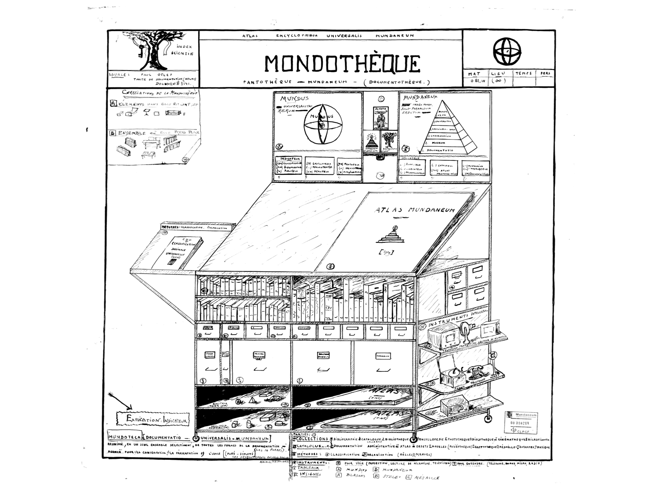
Notes:
1941 drawing of a scholar’s workstation
From Traité:
Here the Working Table is no longer loaded with any book. In their place stands a screen and within range a telephone. There in the distance, in an immense building, are all the books and all the information, with all the space required for their registration and handling, with all the apparatus of its catalogs, bibliographies and indexes, with all the redistribution data on cards, sheets and files, with the choice and combination operated by a well-qualified permanent staff. The place of storage and classification also becomes a place of distribution, remotely with or without wire, television or teletaugraphy. From there, the page to be read is displayed on the screen so that the answer to the questions posed by telephone, wired or wireless can be known. A screen would be double, quadruple or tenfold if it were to multiply the texts and the documents to be compared simultaneously; there would be a loudspeaker if the sight should be helped by a given hearing, if the vision should be supplemented by an audition. Such an assumption, a Wells certainly would like it. Utopia today because it does not exist anywhere yet, but it could become the reality of tomorrow provided that our methods and instrumentation are further perfected. And this improvement could go so far as to make automatic the call of documents on the screen (simple classification numbers, books, pages); automatic also the consecutive projection, provided that all the data has been reduced in their analytical elements and arranged to be implemented by the selection machines.

Slide 21
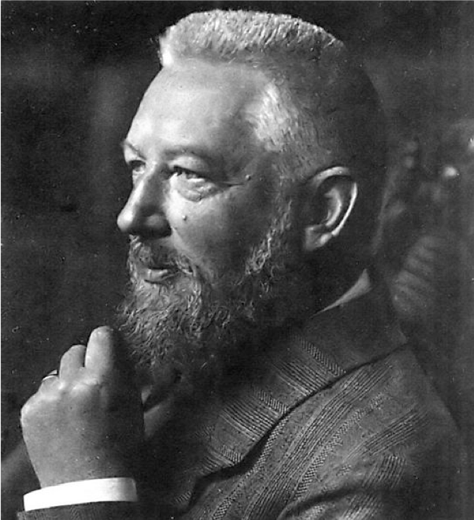
Wilhelm Ostwald
German chemist, Nobel Prize winner and polymath
  Inspired by Otlet’s work, established die Brücke (the Bridge) in 1911 using his prize money
Hapke, T. (1998) Wilhelm Ostwald, the “Brücke” (Bridge), and Connections to Other Bibliographic Activities at the Beginning of the Twentieth Century. Proceedings of the 1998 Conference on the History and Heritage of Science Information Systems. pp.139-147.
Notes:
Ostwald process – manufacture of nitric acid – Nobel in 1909
Coined the term “mole”
Later interest in colour theory
Brücke collaborators: Adolt Saager and Karl Bührer

Slide 22

Die Brücke
International Institute for the Organizing of Knowledge Work
  Short-lived – wound up in 1913
  Reduced literature to small units of recorded knowledge (‘monos’) that could be arranged and linked with other units
  Monos categorised using Dewey Decimal Classification
Notes:
The monograph principle (described by Otlet, possibly as a result of his acquaintance with Ostwald) – one sheet, one topic
Mono – small card/leaflet in a standardised format (Weltformat)
Linked via classification

Slide 23
Die Brücke
Die Brücke is planned as a central station, where any question which may be raised with respect to any field of intellectual work whatever finds either direct answer or else indirect, in the sense that the inquirer is advised as to the place where he can obtain sufficient information
Ostwald, W. (1913) Scientific Management for Scientists.
Scientific American, 108(1), pp. 5-6.
Notes:
Bankrupt in 1913, abolished in 1914

Slide 24
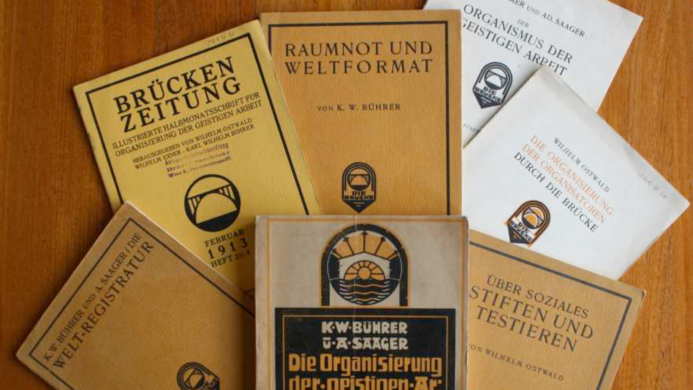
Technical University of Hamburg-Harburg
Notes:
Weltformat – based on work of Karl Bührer (of the Central Swiss Geo-Commercielle society), who founded the “International Mono Society” –
standardised formats – adapted to form basis of ISO A,B,C,D series paper sizes
Weltformat I – 1cm x 1.41cm
Weltformat II – 1.41cm x 2cm
Weltformat X (22.9cm x 32.4cm) corresponds to ISO C4.

Slide 25
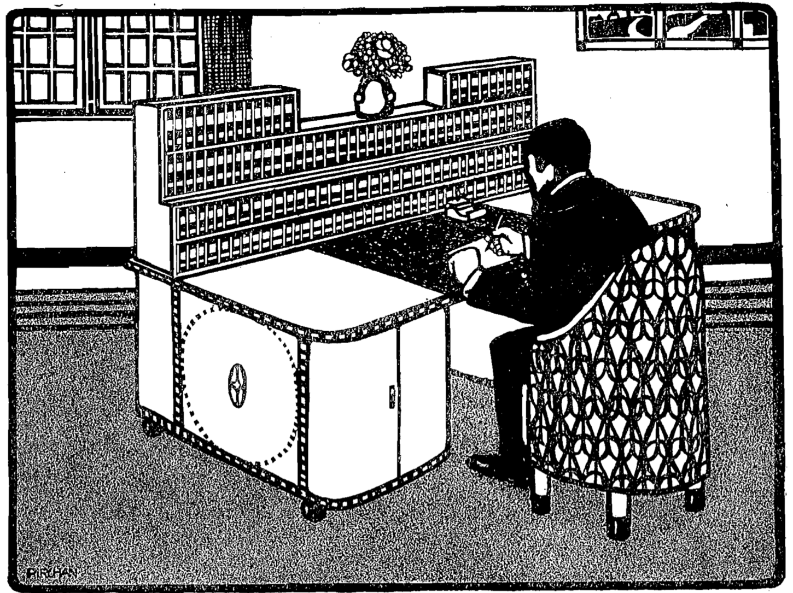
Bührer, K.W. (1912) Raumnot und Weltformat. München: Die Brücke, p.15.
Notes:
Lack of Space and the World Format

Slide 26
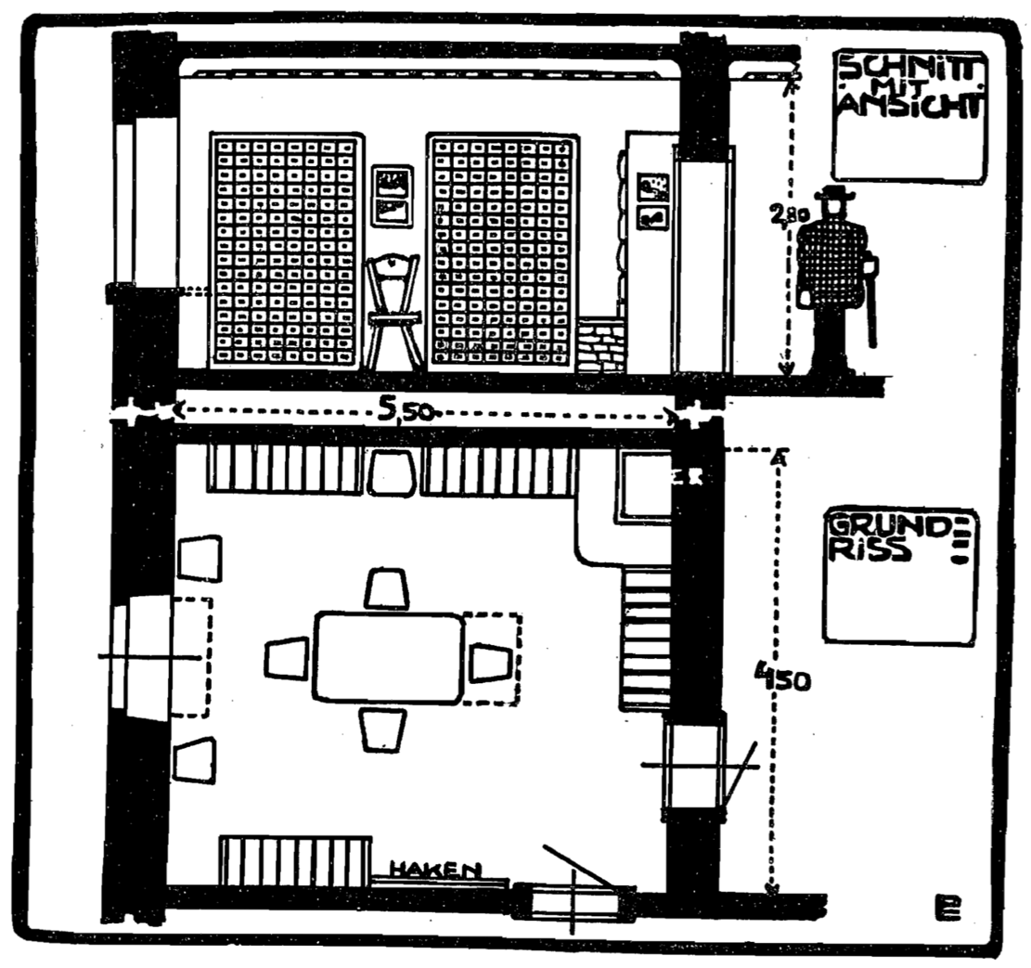
Bührer, K.W. (1912) Raumnot und Weltformat. München: Die Brücke, p.21.

Slide 27
Das Gehirn der Welt
[The] cerebral results of creative minds have already assumed a thoroughly international character. [...] Every member of this small community of intellectual leaders works essentially for himself, and the happiness of the individual depends on whether he can connect with his fellow workers, who perhaps live far from him in another country and in another language.
Ostwald, W. (1912) Das Gehirn der Welt. München: Die Brücke.
Notes:
“das Gehirn der Welt” = “the World Brain”

Slide 28
Das Gehirn der Welt
Thus we conclude that, with the best attitudes and the broadest and most noble mindsets of such organisational idealists, the means to harness such great thought for the intellectual benefit of mankind is a central organ, so to speak a brain of the whole world.
Ostwald, W. (1912) Das Gehirn der Welt. München: Die Brücke.

Slide 29
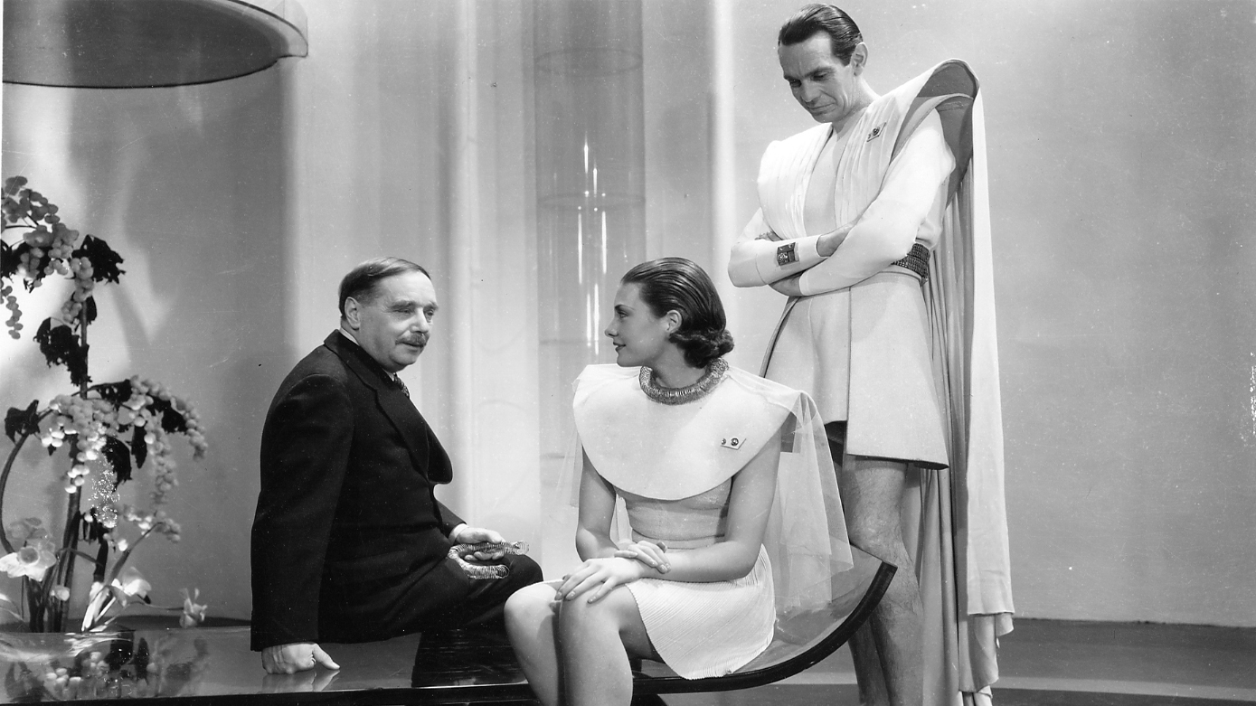
Things to Come (1936) Directed by William Cameron Menzies [Film]. London: London Films
Notes:
H.G. Wells on the set of Things to Come in 1936 (pictured with Raymond Massey and Pearl Argyle

Slide 30
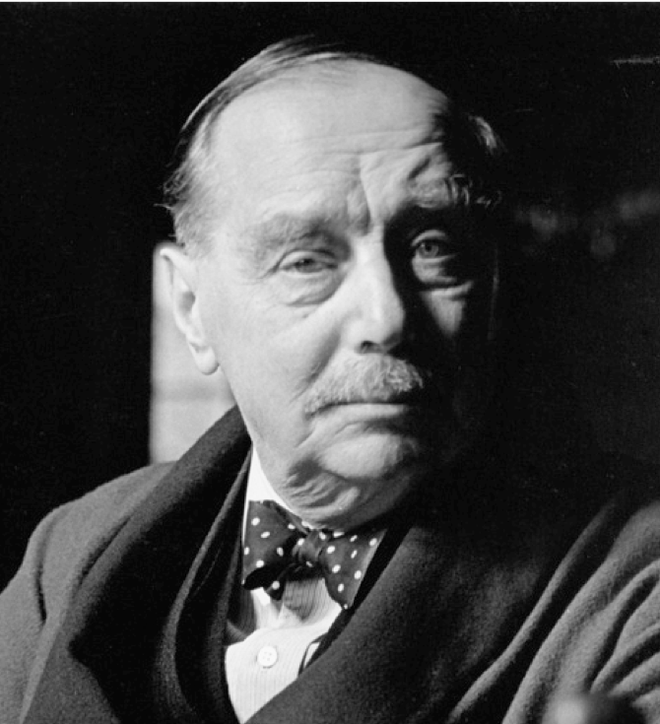
The World Brain
It is probable that the idea of an encyclopaedia may undergo very considerable extension and elaboration in the near future [...] the core would be a world synthesis of bibliography and documentation with the indexed archives of the world. A great number of workers would be engaged perpetually in perfecting this index of human knowledge and keeping it up to date.
Wells, H.G. (1938) World Brain, London: Methuen and Co. Ltd.
Notes:
Met Otlet (and Emmanuel Goldberg) at the First World Congress on Documentation, organised by Otlet in Paris in 1937.
Posits a World Encyclopedia as a continuation of the work of Diderot et al
Explicitly draws the link with internationalist organisations like the League of Nations.
“The time is close at hand when any student, in any part of the world, will be able to sit with his projector in his own study at his or her convenience to examine any book, any document, in an exact replica."

Slide 31

The World Brain
!
Wells, H.G. (1938) World Brain, London: Methuen and Co. Ltd.
Notes:
This description seems awfully familiar...

Slide 32
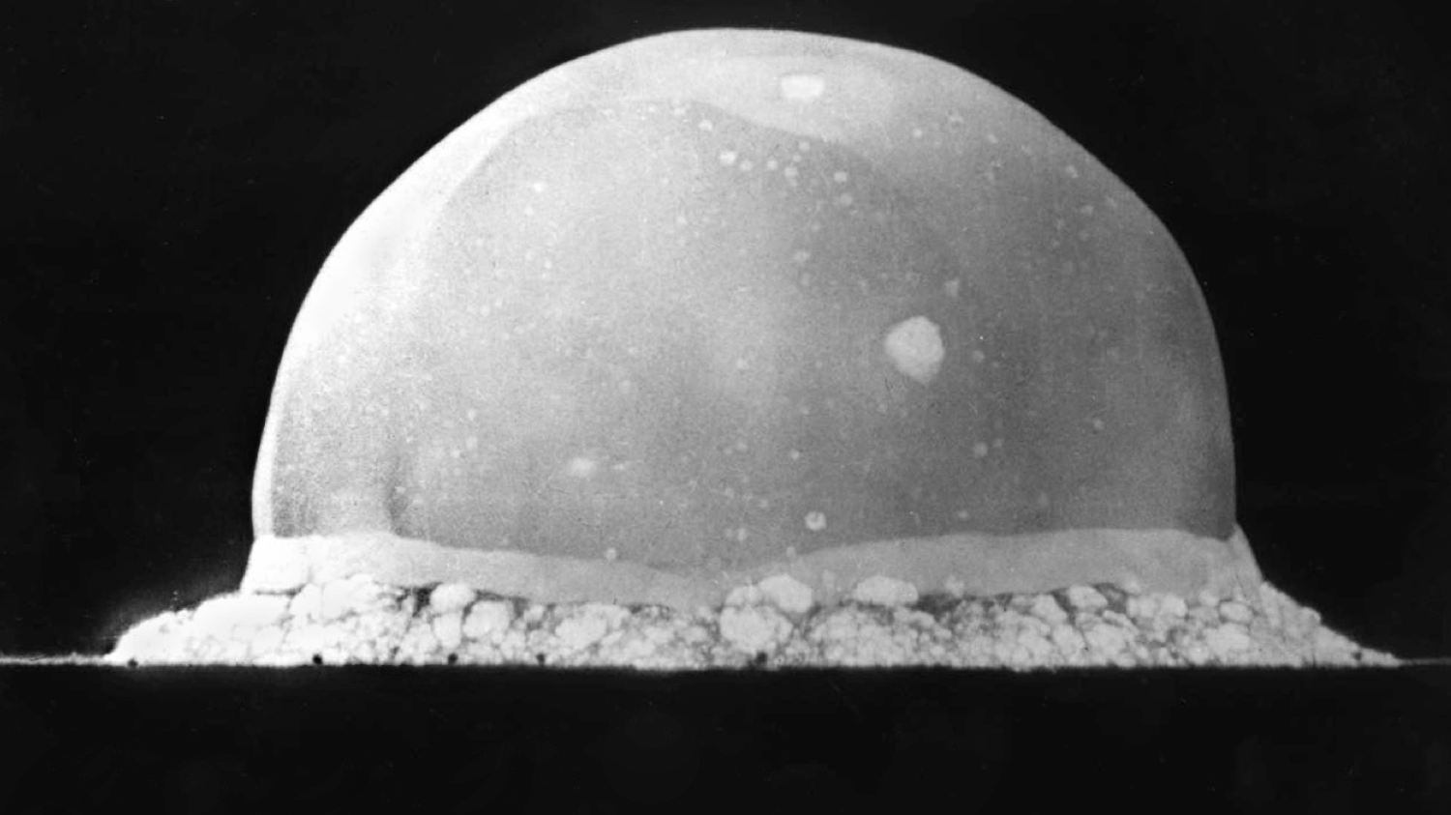
Interlude, 1939-1945
Notes:
Mundaneum damaged in 1940 during German occupation (building was used to exhibit art of the Third Reich)
Ostwald died in 1932
Otlet died in 1944
Wells died in 1946

Slide 33
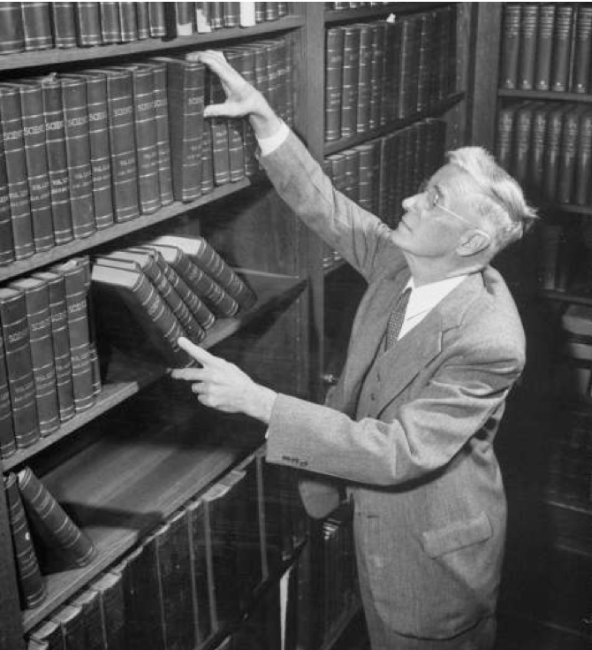
Vannevar Bush
US engineer, inventor and science administrator
Co-founder of Raytheon
Vice-president of MIT
Chair of the National Advisory Committee for Aeronautics
Director of the US Office of Scientific Research and Development during WWII
De facto director of the Manhattan Project until 1943
Notes:
While a professor at MIT, had Claude Shannon as a PhD student (founded the discipline of information theory, coined the term bit)
NACA – predecessor of the National Aeronautics and Space Administration

Slide 34
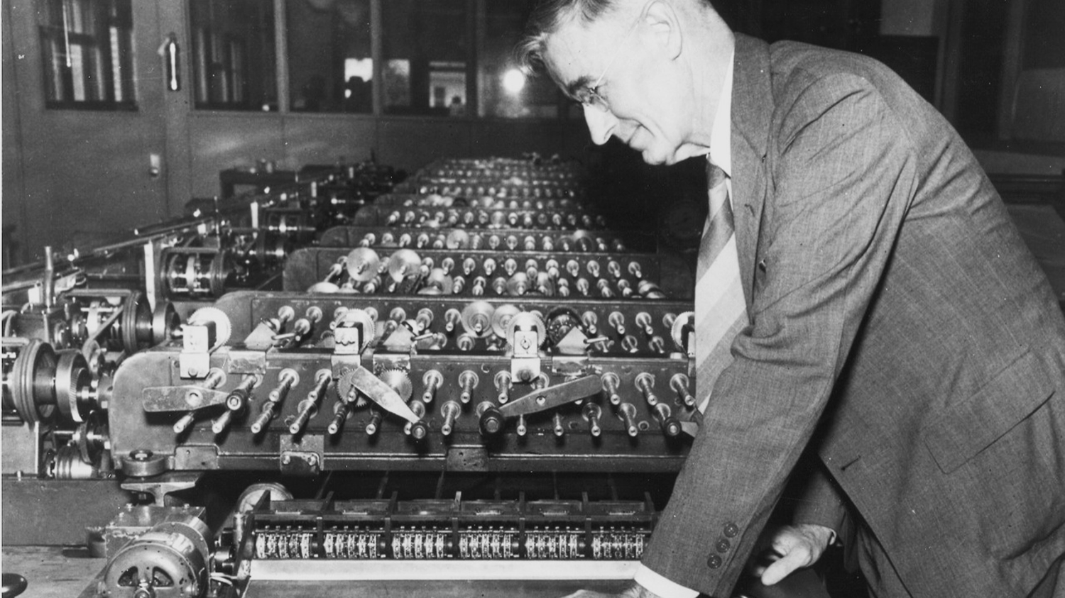
Zachary, G.P. (1995) Vannevar Bush, IEEE Spectrum, 32(7) pp. 65-69.
Notes:
Differential Analyser – analogue computer built in 1931
Work on the Differential Analyser informed US developments in military fire control (everything from the Norden Bombsight to the Mark I Fire Control Computer, both of which were in use as late as the Vietnam War)

Slide 35
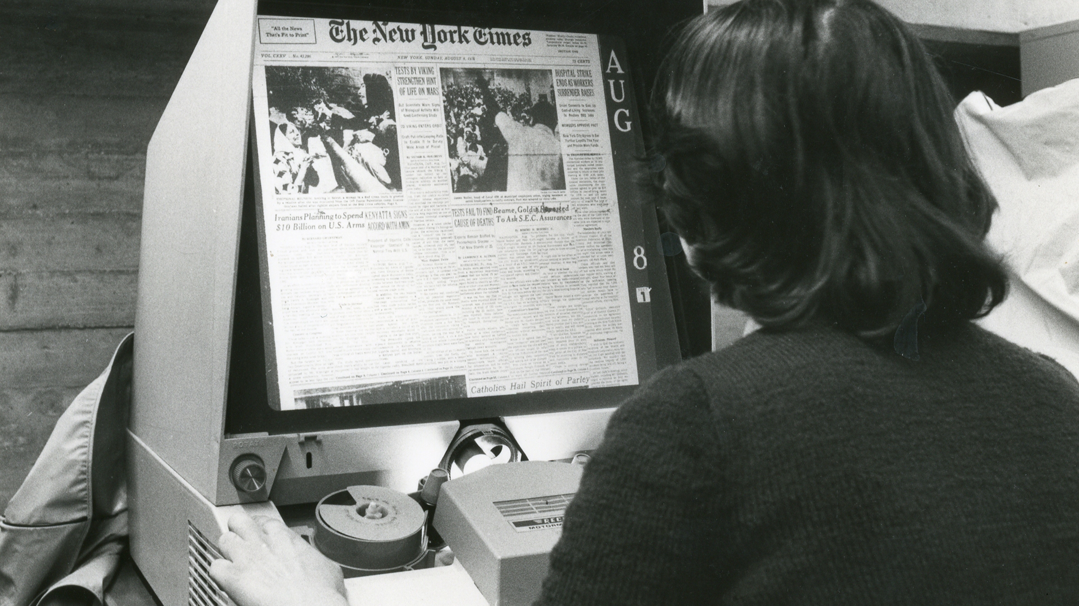

Slide 36
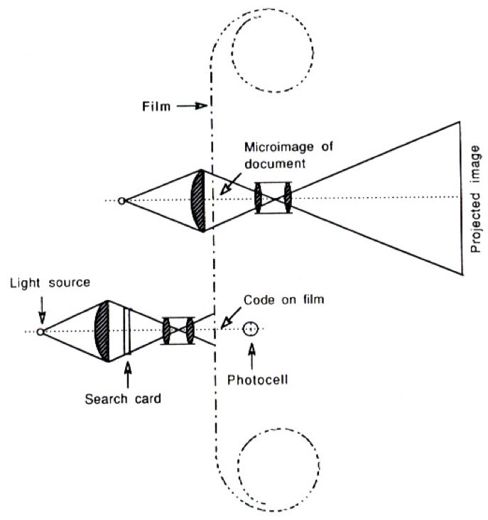
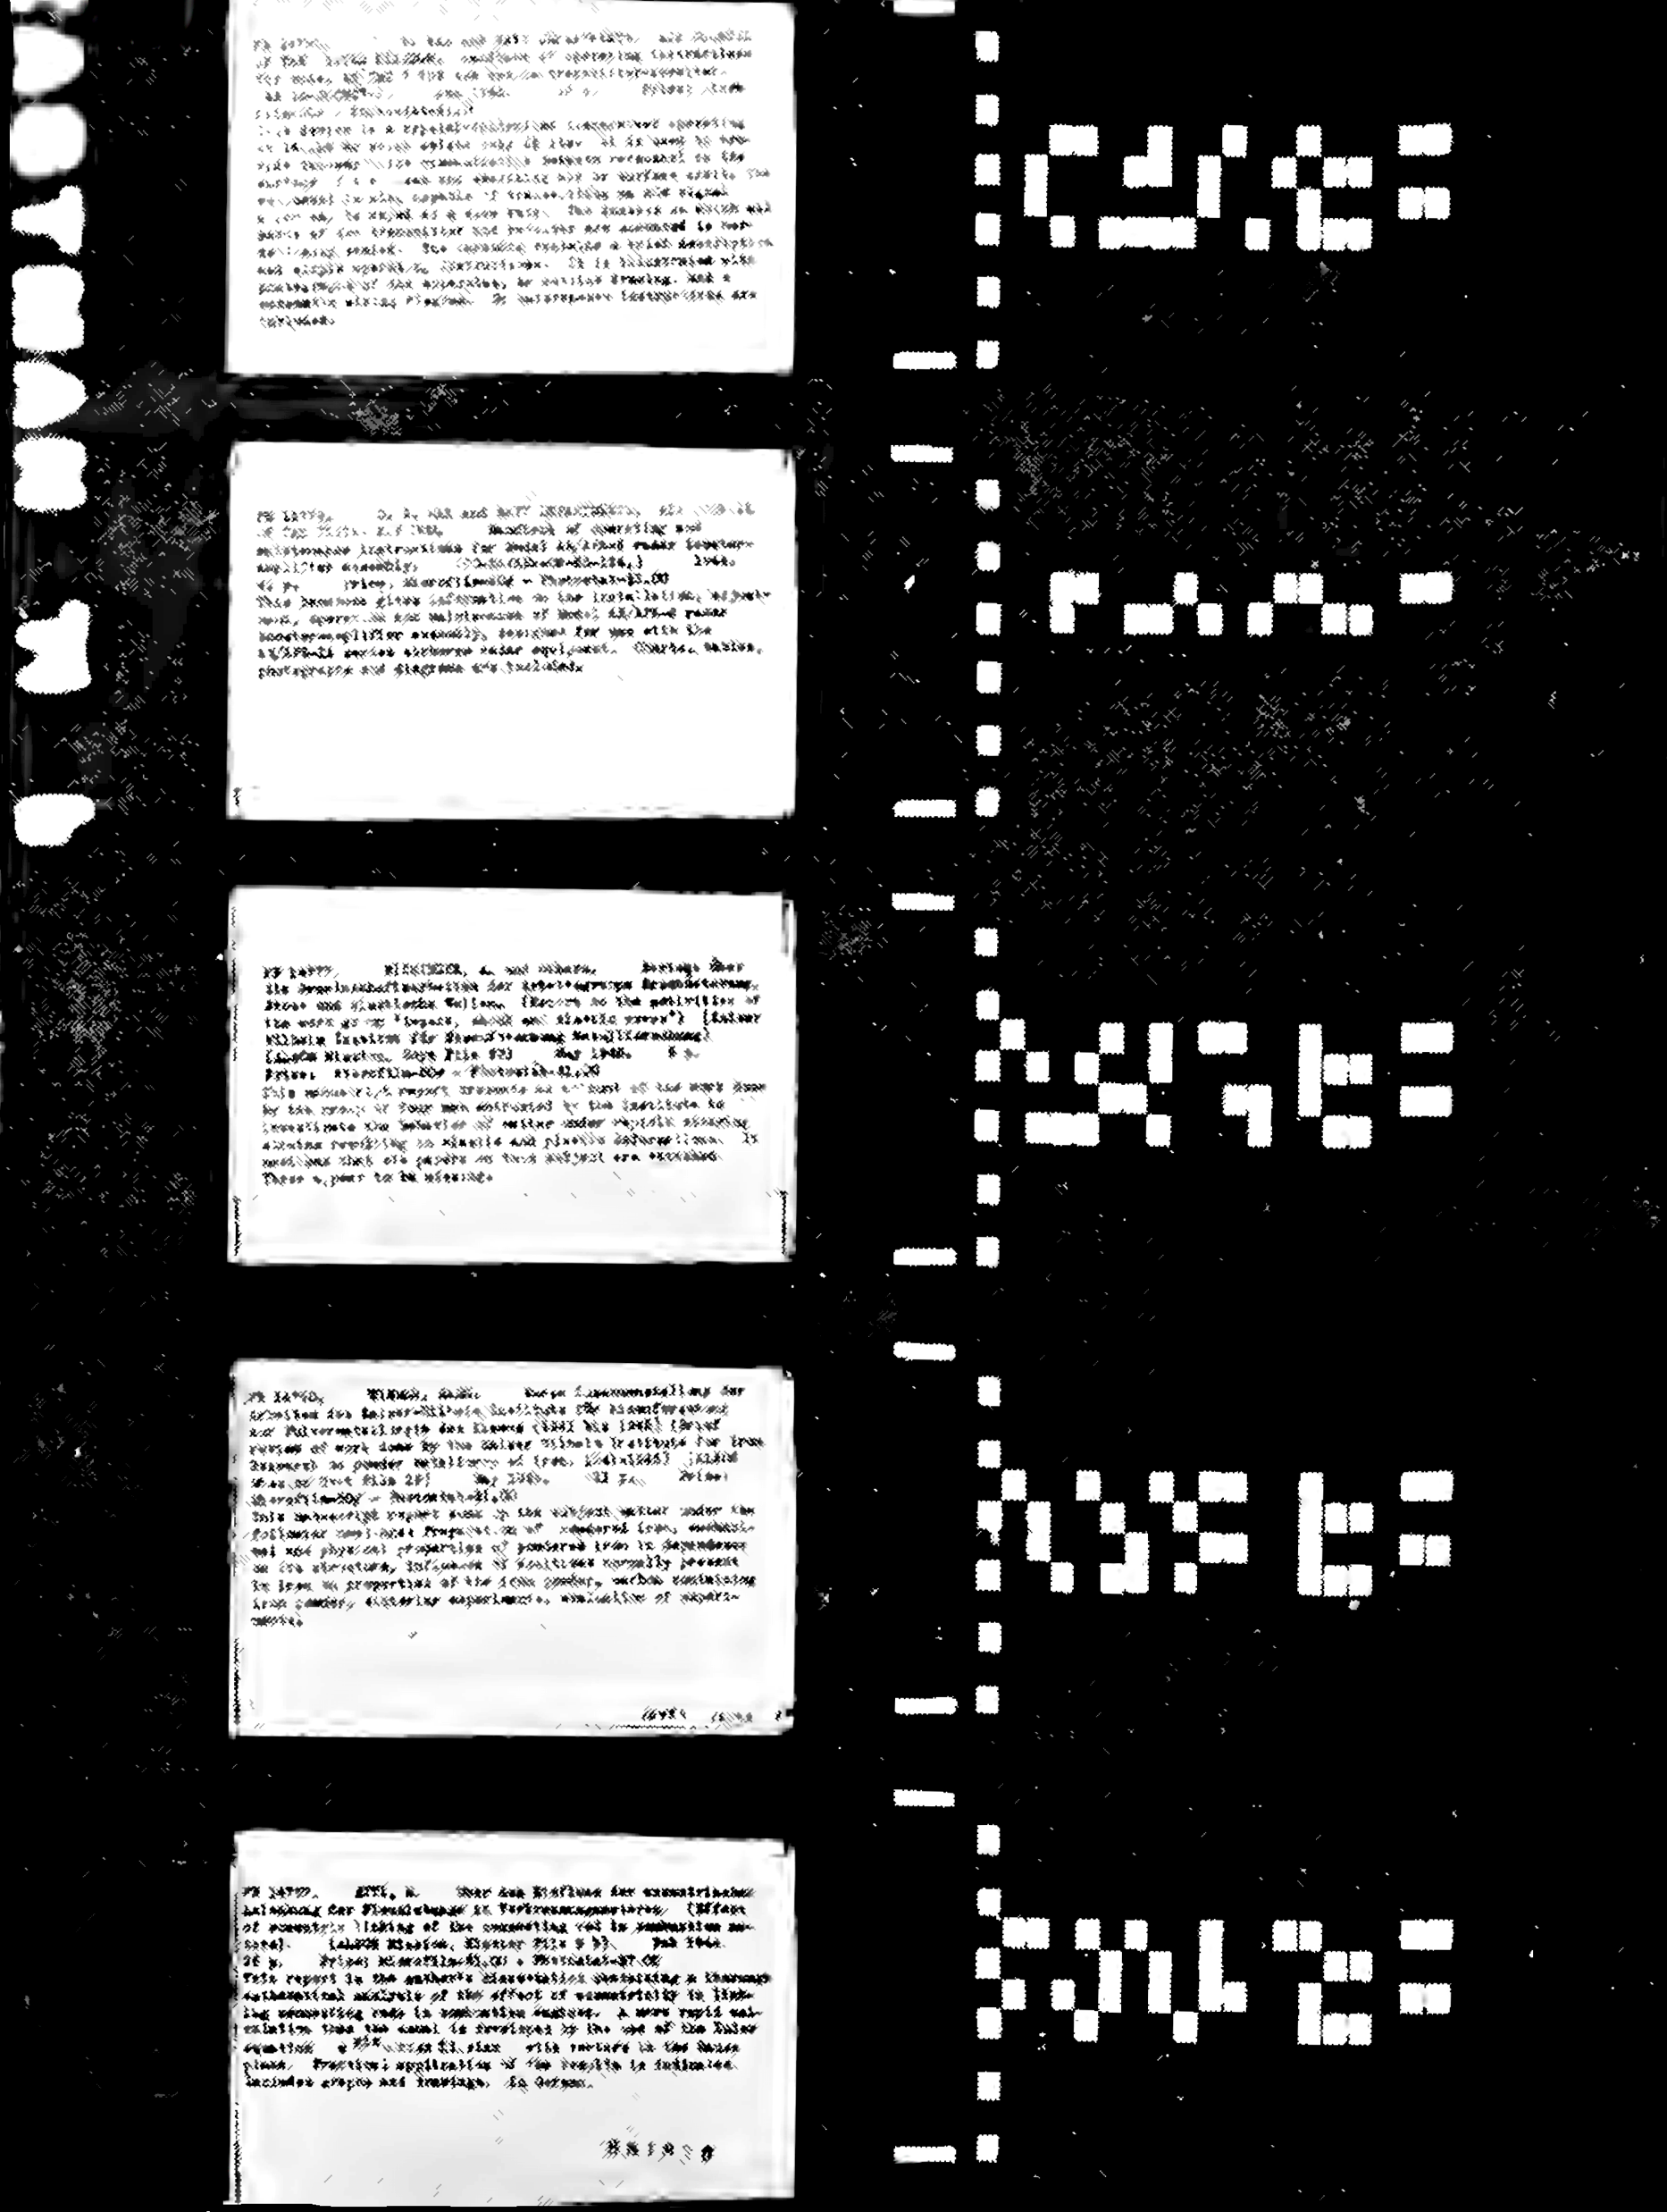
The Rapid Selector
Buckland, M.K. (1992) Emanuel Goldberg, electronic document retrieval, and Vannevar Bush's Memex. Journal of the American Society of Information Science, 43(4), pp. 284-294.
Notes:
Photoelectric microfilm selector developed at MIT in 1938
Based on earlier (patented!) work by Emanuel Goldberg of Zeiss Ikon (US Patent 1838389) from 1931 (the Statistical Machine)

Slide 37
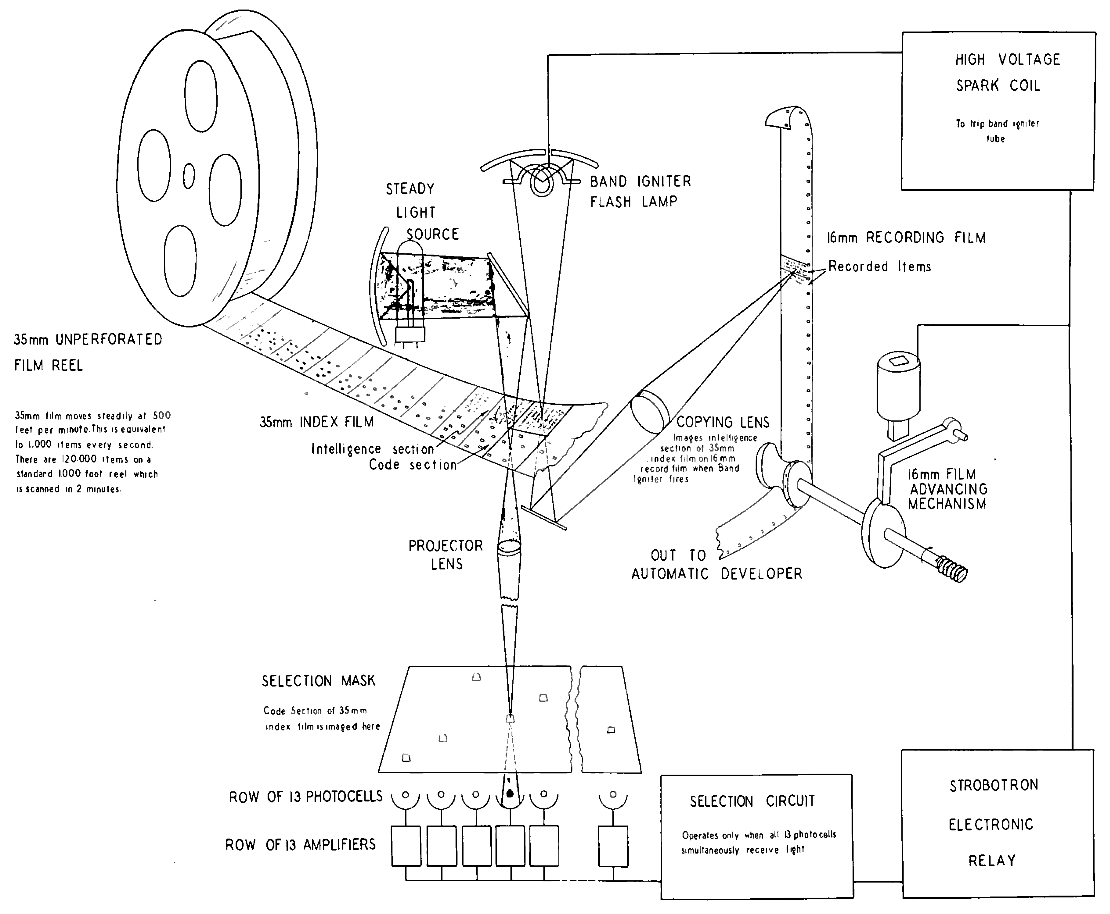

Slide 38
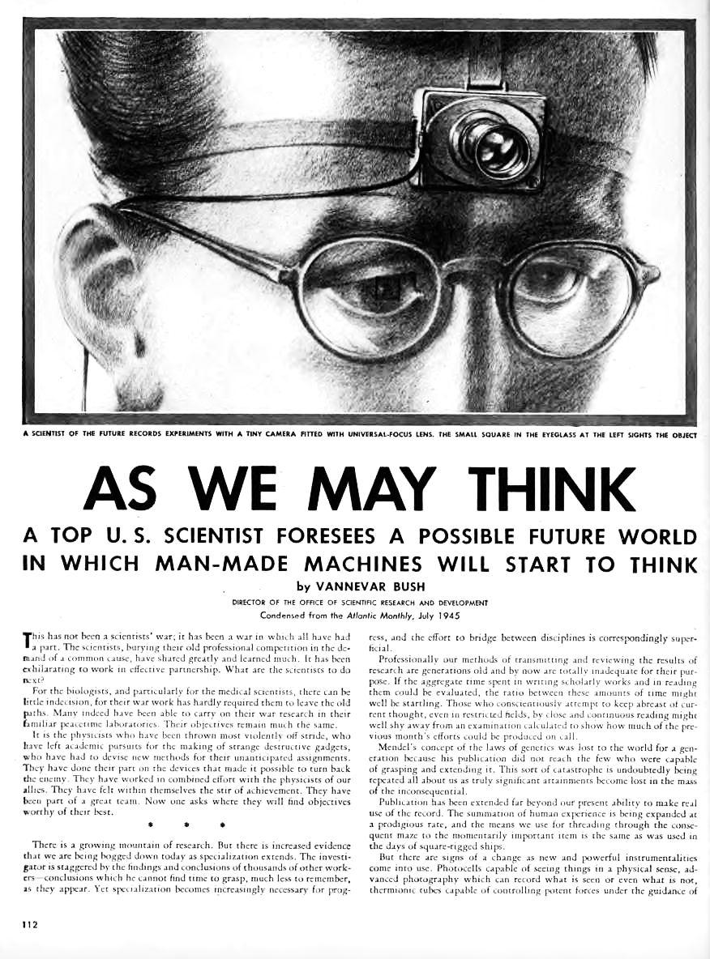
Notes:
July 1945

Slide 39
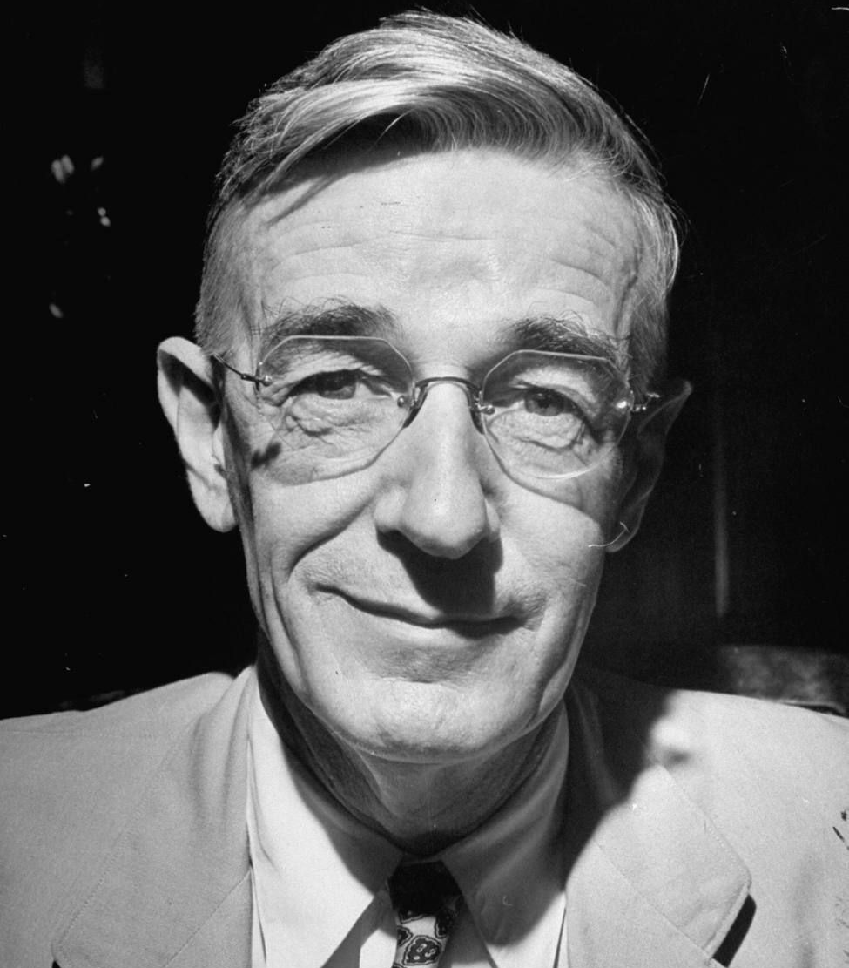
As We May Think
The difficulty seems to be, not so much that we publish unduly in view of the extent and variety of present-day interests, but rather that publication has been extended far beyond our present ability to make real use of the record.
Bush, V. (1945) As We May Think. The Atlantic Monthly, 176, pp.101-108.

Slide 40
As We May Think
Our ineptitude in getting at the record is largely caused by the artificiality of systems of indexing. […] Having found one item, moreover, one has to emerge from the system and re-enter on a new path.
The human mind does not work that way. It operates by association. With one item in its grasp, it snaps instantly to the next that is suggested by the association of thoughts
Bush, V. (1945) As We May Think. The Atlantic Monthly, 176, pp.101-108.

Slide 41
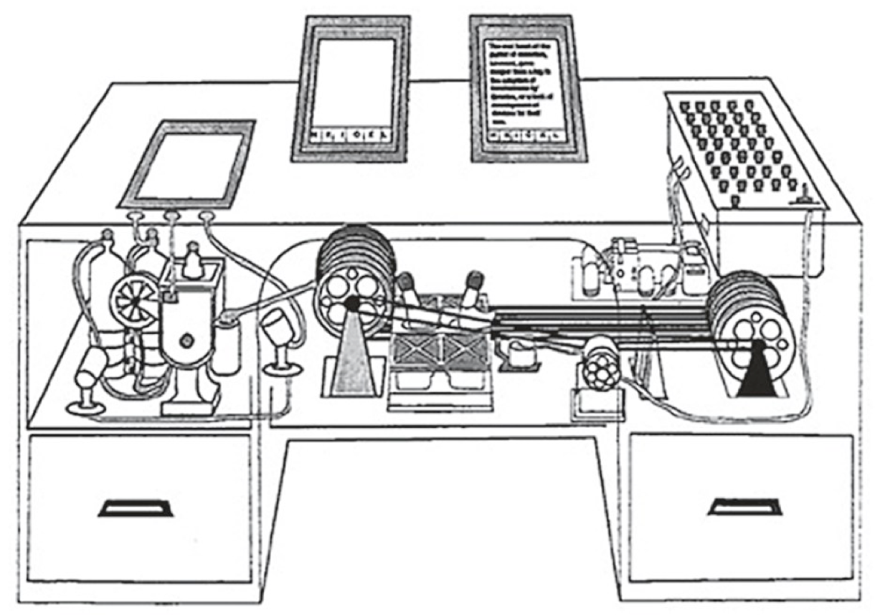

Slide 42
The Memex
An electro-mechanical analogue device for organising knowledge: microfilm, photocells and typewriter.
Allows user to create:
Associative trails – arbitrary sequences of pages
Skip trails – relevant summaries
Commentaries on works
Notes:
Ideas first formulated c. 1932.

Slide 43
As We May Think
Wholly new forms of encyclopedias will appear, ready made with a mesh of associative trails running through them, ready to be dropped into the memex and there amplified.
Bush, V. (1945) As We May Think. The Atlantic Monthly, 176, pp.101-108.

Slide 44
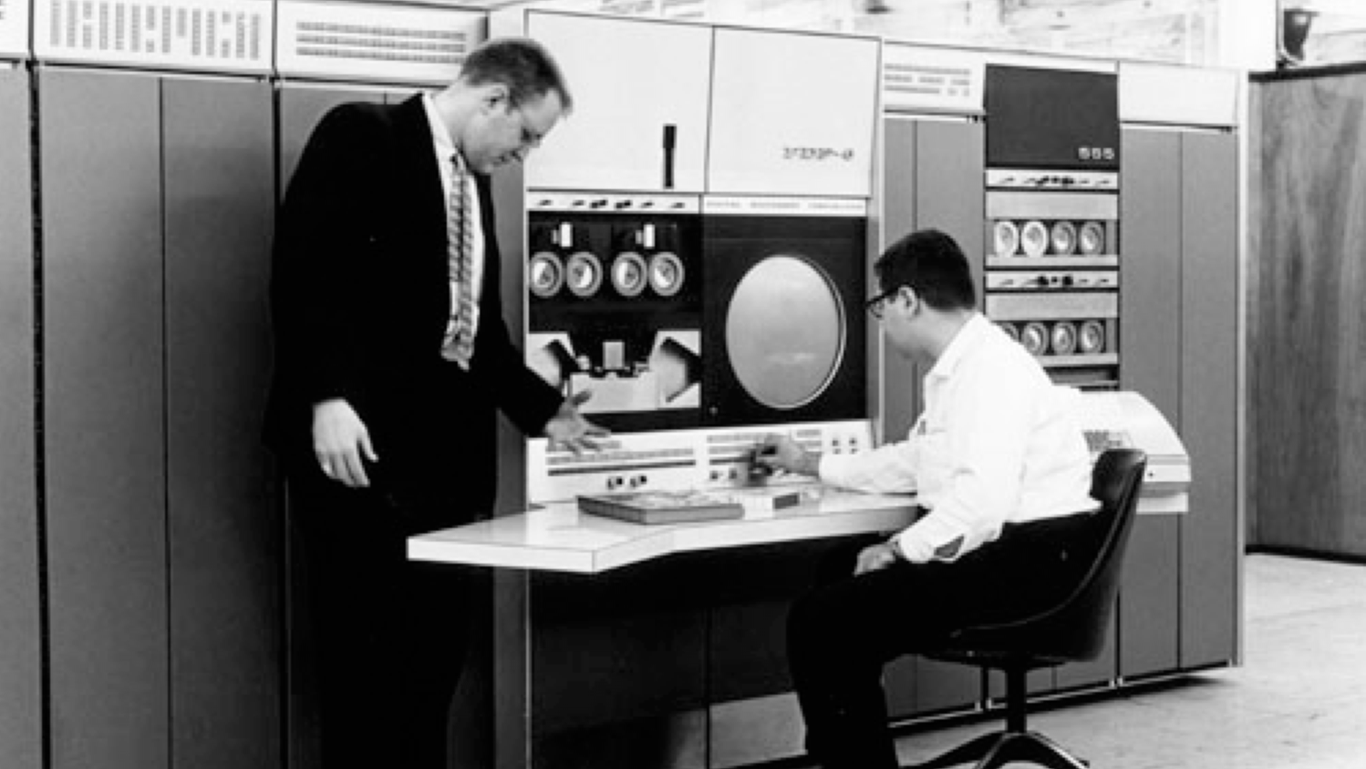
The Information Age
Computer History Museum
Notes:
Standing: Gordon Bell
architect of the PDP-4 and PDP-6, VP in charge of the development of the DEC VAX.
In later years, the experimental subject of the Microsoft MyLifeBits project – lifelogging experiment inspired by Bush’s Memex
Seated: Alan Kotok
As an undergraduate, helped develop the first video game: Spacewar
While at Digital in 1994, encouraged Berners-Lee to start a new organisation at MIT to coordinate Web development
Associate chairman of W3C from 1997

Slide 45
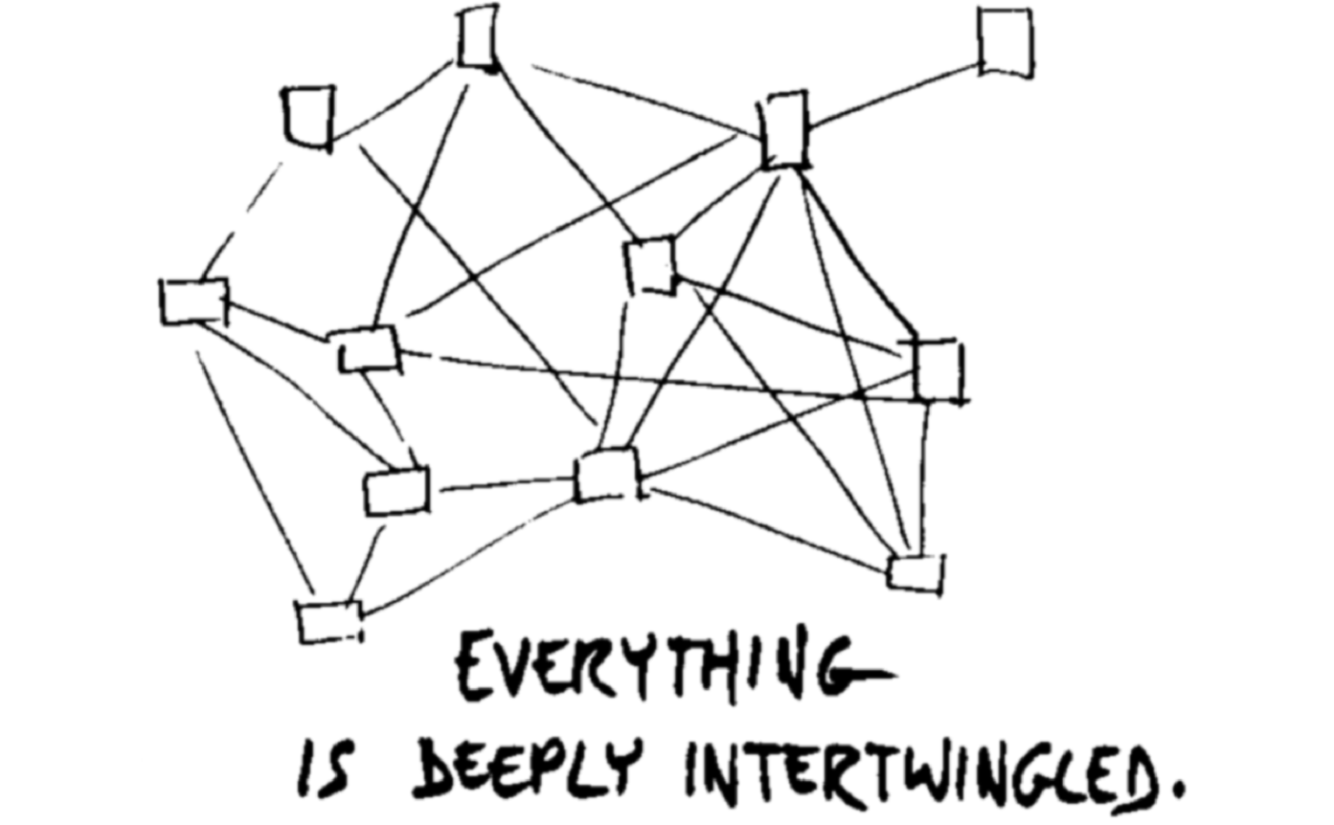
Nelson, T.H. (1974) Computer Lib/Dream Machines. Chicago, IL: Nelson, T.H.
Notes:
“In an important sense, there are no “subjects” at all; there is only all knowledge, since the cross-connections among the myriad topics of this world cannot be divided up neatly.
Hypertext at last offers the possibility of representing and exploring it all without carving it up destructively”

Slide 46
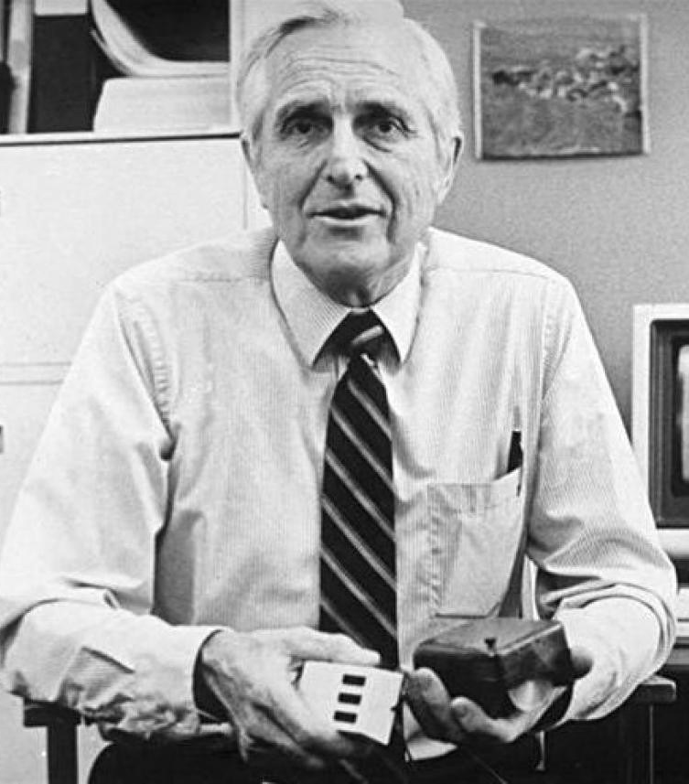
Doug Engelbart
Member of the Stanford Research Institute and founder of the Augmentation Research Center
ARC played key role in early Internet history
Notes:
ARC played key role in early history of the Internet
First message on ARPANET was between ARC computer and UCLA
ARC-run ARPANET reference library service turned into InterNIC (domain name and IP address allocations until 1998 -> ICANN)
When ARC folded in the 70s, many researchers went to Xerox PARC

Slide 47
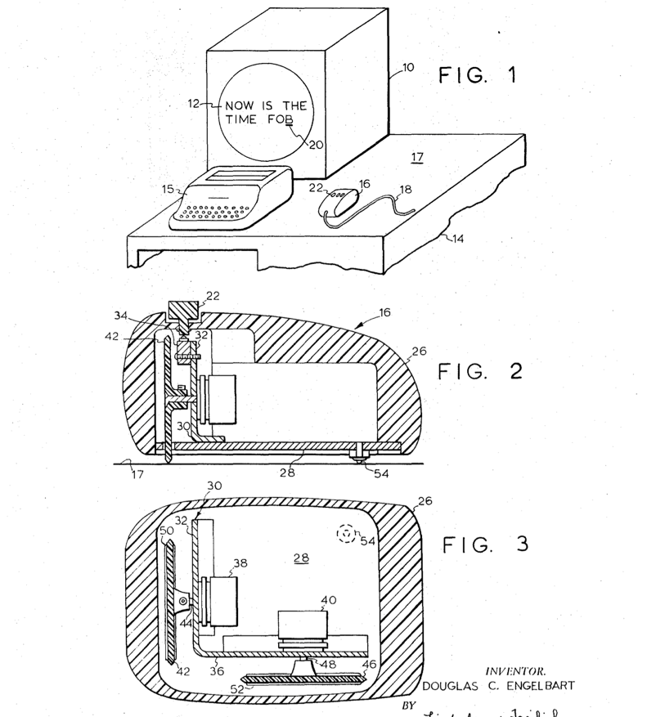
Engelbart, D.C. (1970) X-Y Position Indicator for a Display System. US Patent 3,541,541.

Slide 48
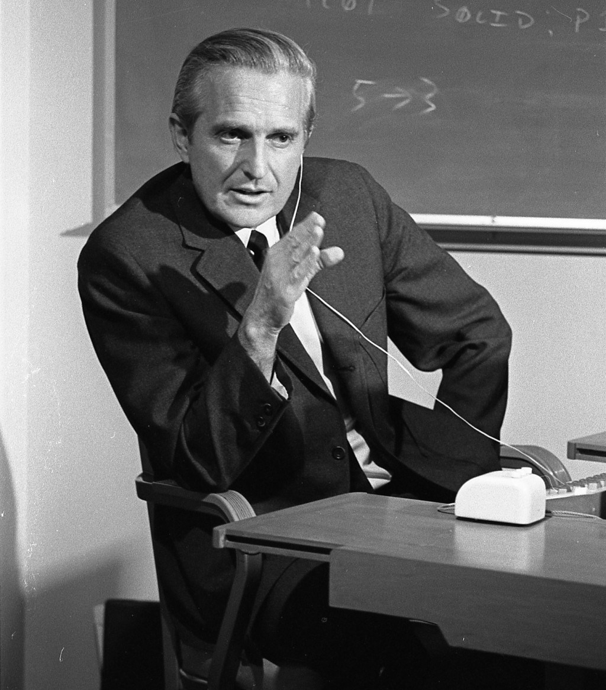
Augmenting Human Intellect
A new stage of human evolution, characterised by "automated external symbol manipulation”
[...] symbols with which the human represents the concepts he is manipulating can be arranged before his eyes, moved, stored, recalled, operated upon according to extremely complex rules—all in very rapid response to a minimum amount of information supplied by the human, by means of special cooperative technological devices.
Engelbart D.C. (1962) Augmenting Human Intellect: A Conceptual Framework. SRI Summary Report AFOSR-3223. USA: Stanford Research Institute.

Slide 49
Augmenting Human Intellect
We are concentrating fully upon reaching the point where we can do all of our work on line — placing in computer store all of our specifications, plans, designs, programs, documentation, reports, memos, bibliography and reference notes, etc., and doing all of our scratch work, planning, designing, debugging, etc., and a good deal of our intercommunication, via the consoles.
Engelbart D.C. and English W.K. (1968) A Research Center for Augmenting Human Intellect. AFIPS Conference Proceedings of the 1968 Fall Joint Computer Conference. Vol.33, pp.395-410.

Slide 50
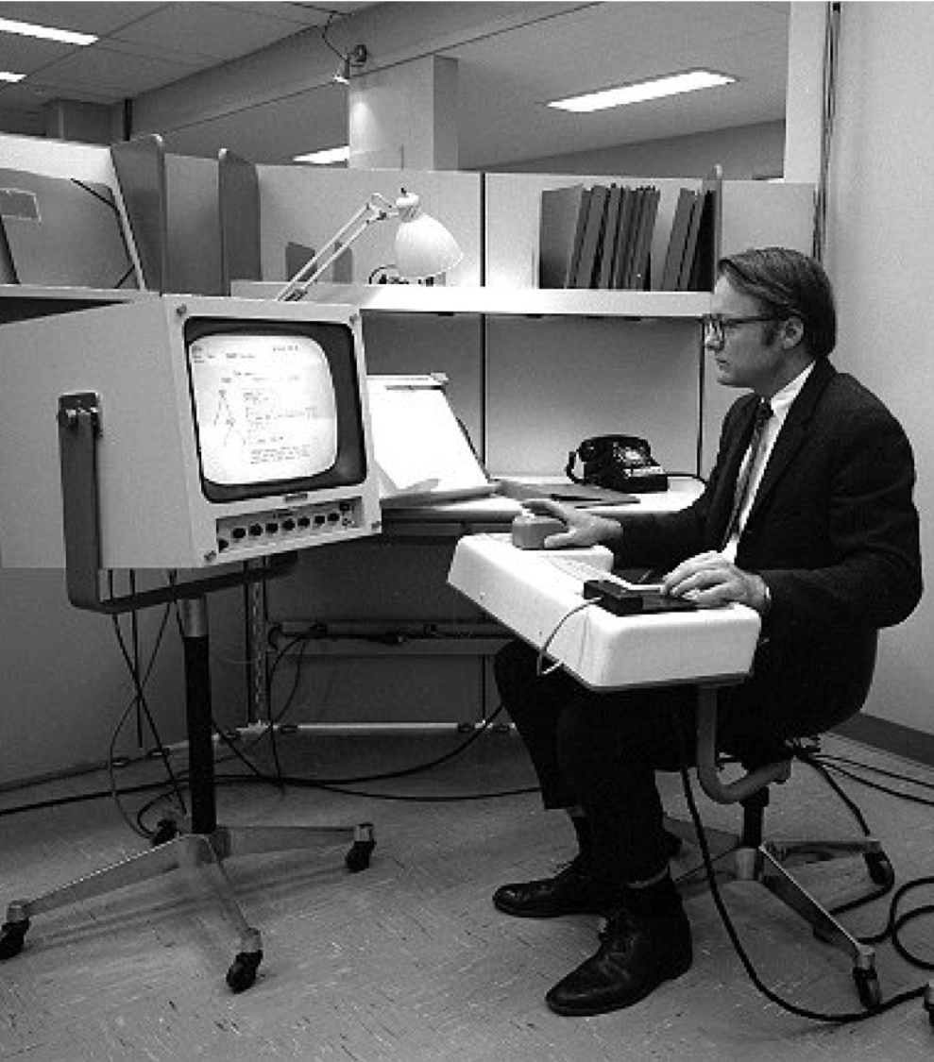
NLS: the oN-Line System
Timesharing computer with multiple consoles
UI features:
  Windowed display
  Mouse
  Chorded keyboard
  Videoconferencing
  Links in content!

Slide 51
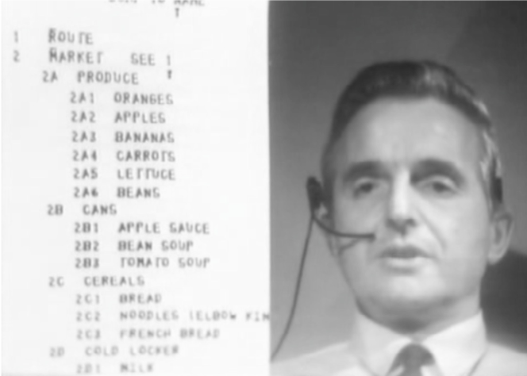
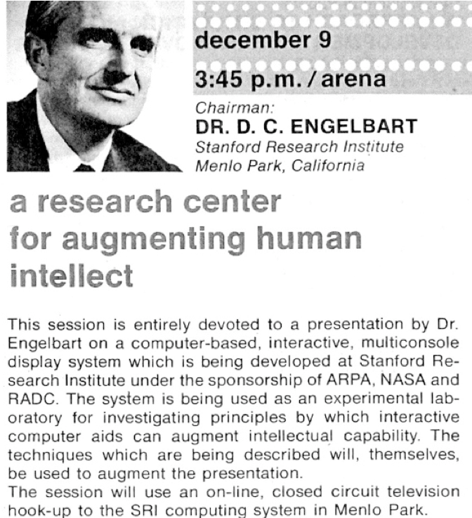
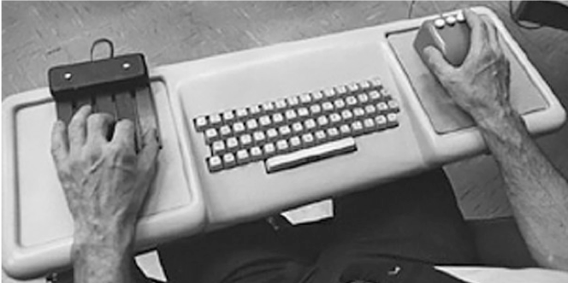
The Mother of all Demos
http://thedemo.org/

Slide 52
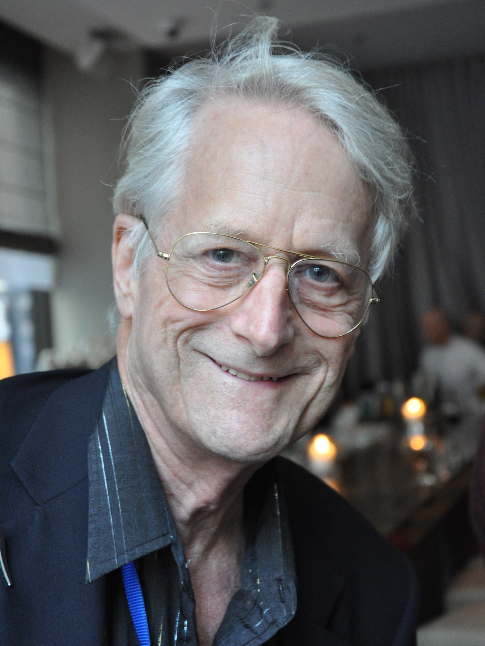
Ted Nelson
Sociologist, philosopher and film maker
Coined the term “hypertext” in 1965
A user interface should be so simple that a beginner in an emergency can understand it within ten seconds.”
Most people are fools, most authority is malignant, God does not exist, and everything is wrong.
Notes:
Son of Ralph Nelson and Celeste Holm

Slide 53
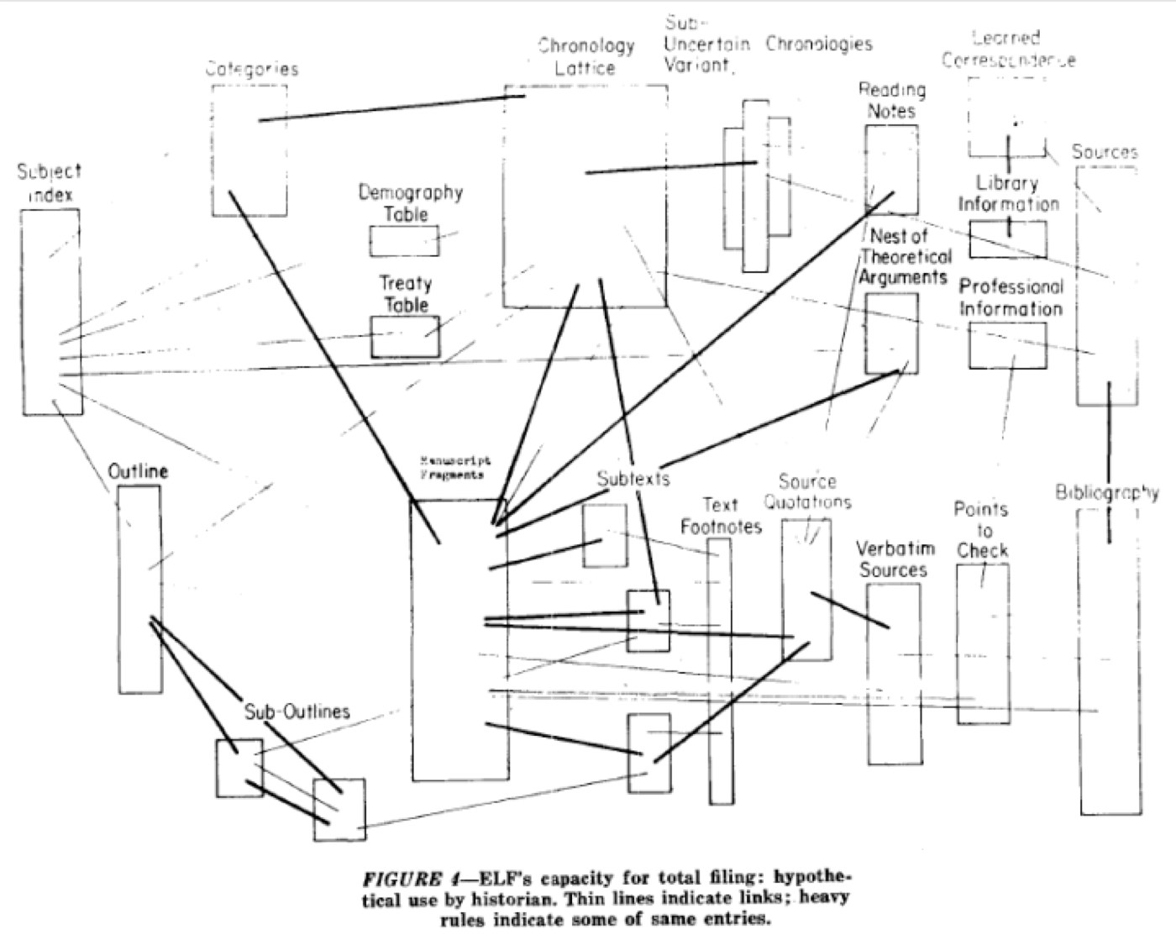
Nelson, T.H. (1965) A File Structure for the Complex, the Changing and the Indeterminate. Proceedings of the ACM 20th National Conference, pp. 84-100
Notes:
First use of the term “hypertext” – this is where we came in.

Slide 54
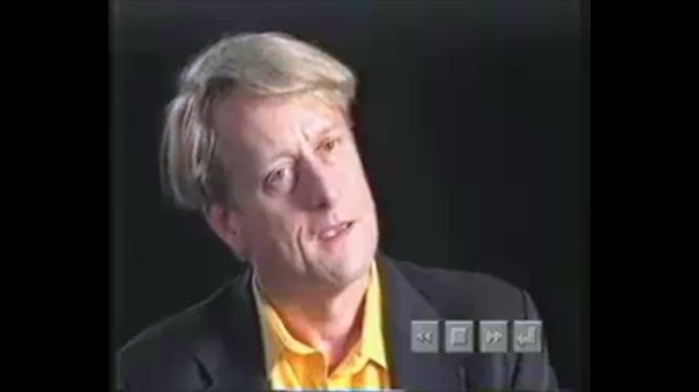
Hyperland (1990) Produced by Max Whitby [Television Programme]. London: British Broadcasting Corporation.

Slide 55
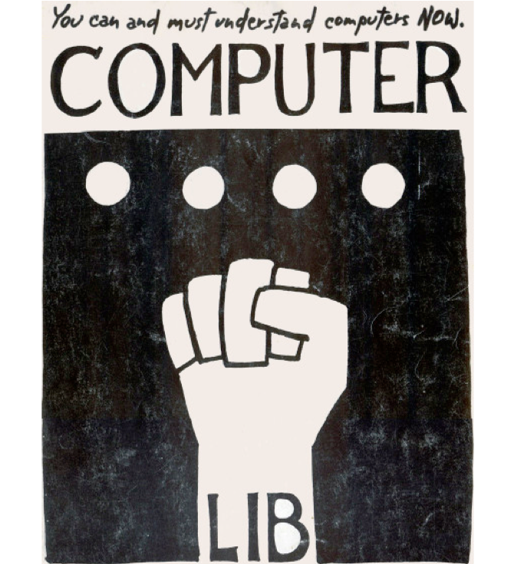
Computer Lib /
Dream Machines
“No one's life has yet been simplified by a computer.”
Two books in a dos-a-dos binding:
Computer Lib is a clarion call for people to understand computers deeply
Dream Machines is a sketch of the flexible media potential of computers
Nelson, T.H. (1974) Computer Lib/Dream Machines. Chicago, IL: Nelson, T.H.
Notes:
"Down with Cybercrud"
anti centralisation
democratisation of computing – computer experts intentionally obscure

Slide 56
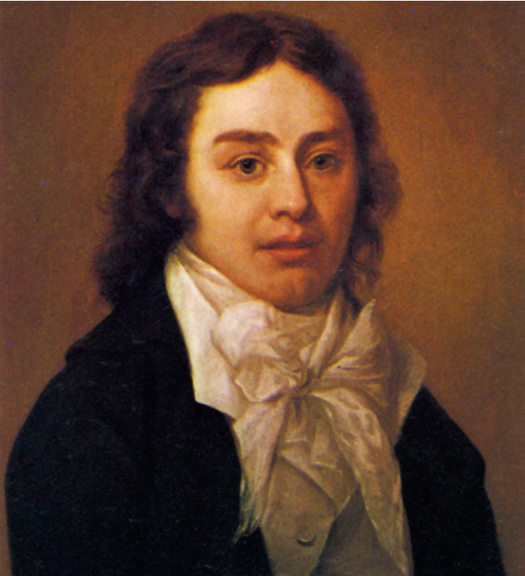
A Vision in a Dream
In 1797, Samuel Taylor Coleridge (supposedly) wrote the poem Kubla Khan after awaking from an opium dream:
In Xanadu did Kubla Khan
A stately pleasure-dome decree:
Where Alph, the sacred river, ran
Through caverns measureless to man
Down to a sunless sea.
He was interrupted by a visitor from Porlock, and never completed the poem…

Slide 57

Project Xanadu (1960-)
Founded in 1960, still ongoing
(famously never completed...)
Hugely influential, nonetheless
Described in Dream Machines, and Nelson’s subsequent book Literary Machines
Nelson, TH. (1993) Literary Machines. Sausalito, CA: Mindful Press.
Notes:
"longest-running vaporware story in the history of the computer industry” – Gary Wolf in WiReD
First demo version in 1972
With Roger Gregory, Mark Miller, Stuart Greene in 1979
1983-1992 – With Autodesk
1992- Xanadu Operating Company
Open-sourced in 1998
2007 - XanaduSpace
Literary machines – first published 1980

Slide 58
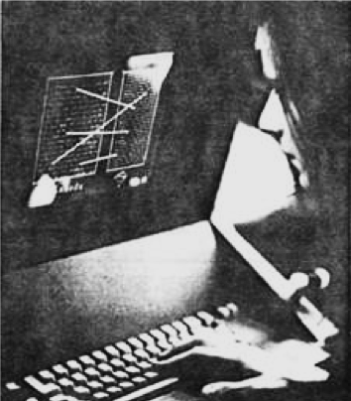
Project Xanadu
Intercomparison of parallel documents
World-wide publishing without barriers
Transclusion
Transcopyright
Versioning
Links that don't break
Nelson, T.H. (1972) As We Will Think. Proceedings of Online 72 Conference, Uxbridge, England.

Slide 59
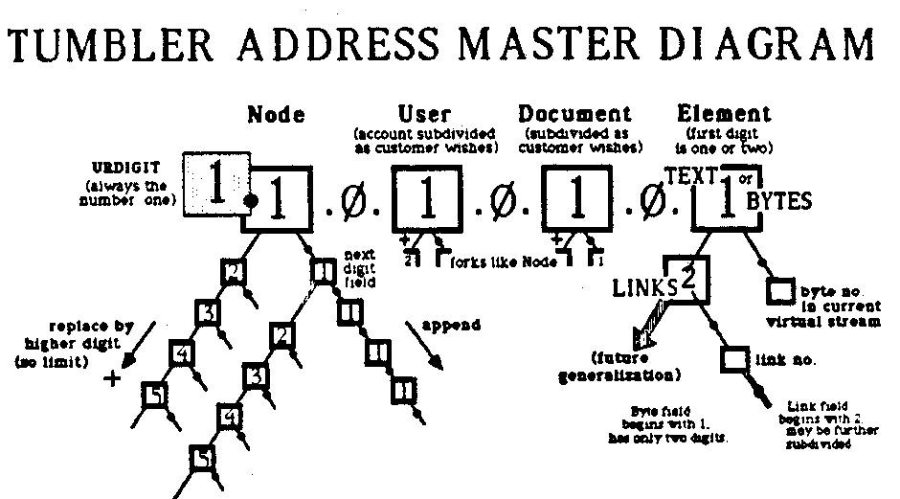
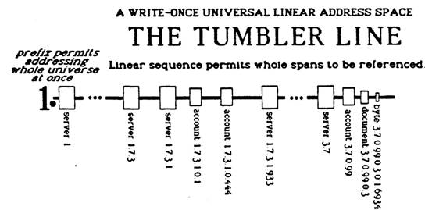
Addressing
Document addressing in Xanadu uses numeric identifiers known as tumblers
Expandable, write-once address space that allows referencing of document fragments
Nelson, TH. (1993) Literary Machines. Sausalito, CA: Mindful Press.

Slide 60

Links
Can be stored separately from documents (i.e. first-class)
Can be stored within a document (in its link-train)
N-ary – multiple addresses in the from-set and to-set
Multiple types associated with the link (via the three-set – more addresses)
Markup considered as link type!
Nelson, T.H. (1997) Embedded markup considered harmful, World Wide Web Journal 2(4).

Slide 61

Transclusion
Documents are composite objects that can contain parts of other documents, via special links: transclusions
Instead of copy and pasting, the address of a fragment of another document is inserted and the referenced content is retrieved and displayed at runtime
(also provides a mechanism for tracking fractional royalties for use of these fragments – transcopyright)
Nelson, TH. (1993) Literary Machines. Sausalito, CA: Mindful Press.

Slide 62

Versioning
Transparent versioning of documents
Editing a document creates a new revision (possibly with transclusion of material from previous version)
Versioning also permits different variants (alternative versions) of a document
Nelson, TH. (1993) Literary Machines. Sausalito, CA: Mindful Press.

Slide 63

Distribution
Xanadu separates the front end clients that display content to users from the back end servers that manage that content
Front End to Back End (FEBE) Protocol
  Used for user interaction
Back End to Back End (BEBE) Protocol
  Used to manage consistency between back end servers
Nelson, TH. (1993) Literary Machines. Sausalito, CA: Mindful Press.
Notes:
FEBE described in some detail in Literary Machines, BEBE didn’t exist...

Slide 64
Nelson on the Web
The Xanadu project did not ‘fail to invent HTML’. HTML is precisely what we were trying to PREVENT - ever-breaking links, links going outward only, quotes you can't follow to their origins, no version management, no rights management.

Slide 65

Hypertext Systems
http://www.flickr.com/photos/mwichary/2355783479/

Slide 66

HES/FRESS (1967)
Hypertext Editing System developed at Brown University
Used by NASA to produce and manage documentation for the Apollo programme
Carmody, S. et al (1969) A Hypertext Editing System for the /360. Pertinent Concepts in Computer Graphics: Proceedings of the Second University of Illinois Conference on Computer Graphics, pp.291-330.
Notes:
Ted Nelson was involved with this project
File Retrieval and Editing System

Slide 67

ZOG (1975)
Developed at Carnegie Mellon University
Features:
Early proponent of the “card” or “frame” model of hypertext
(c.f. index cards)
One-way links, embedded in frames
Robertson, G. et al (1981) The ZOG approach to man-machine communication. Int. J. Man-Machine Studies, 14, pp.461-488.

Slide 68

Akscyn R.M. and McCracken D.L. (1981) ZOG and the USS CARL VINSON. Computer Science Research Review 1980-1981. USA: Carnegie Mellon University.
Notes:
ZOG was installed on the Nimitz-class nuclear carrier USS Carl Vinson to handle a variety of shipboard training and administrative tasks.

Slide 69

KMS (1983)
Akscyn, R.M. et al (1988) KMS: A distributed hypermedia system for managing knowledge in organizations. Communications of the ACM, 31(7), pp. 820-835.
Notes:
Commercialisation of ZOG

Slide 70

Hyperties (1983)
Developed by Ben Schneiderman at the University of Maryland
Features:
Link previews
Links point to whole documents
Shneiderman, B. (1987) User interface design for the Hyperties electronic encyclopedia. Proceedings of Hypertext '87, pp. 199-205.

Slide 71

Intermedia (1985)
Developed at Brown University
Features:
A/UX-based
Bidirectional linking
Graphics
Garrett, L.N. et al (1986) Intermedia: issues, strategies, and tactics in the design of a hypermedia document system. Proceedings of the 1986 ACM Conference on Computer-Supported Cooperative Work, pp.163-174.

Slide 72

NoteCards (1985)
Developed at Xerox PARC (Trigg, Moran and Halasz)
Features:
Hierarchical browser
Programmable API
Graphics
Halasz, F.G. et al (1986) NoteCards in a Nutshell. SIGCHI Bulletin, 18(4), pp.45-52.

Slide 73

HyperCard (1987)
Developed by Apple Computer Inc., and bundled with new Mac SEs.
Features:
OO programming language (HyperTalk)
Graphics
Widely used for application development

Slide 74

Miller, R. and Miller, R. (1993) Myst [Video game]. Mead, WA, USA: Cyan, Inc.

Slide 75
Conklin on Hypertext

Slide 76
Hypertext: An Introduction and Survey
“The concept of hypertext is quite simple: windows on the screen are associated with objects in a data base and links are provided between these objects, both graphically (i.e. as labelled icons) and in the data base (i.e. as pointers).”
Conklin, J. (1987) Hypertext: An introduction and survey. IEEE Computer, 20(9), pp.17-41.
Notes:
Conklin at the time was at Microelectronics and Computer Technology Corporation (MCC), and had written
a hypertext-like system of his own: gIBIS (the graphical issue-based information system)

Slide 77
Disadvantages of hypertext
Disorientation
  The tendency to lose one's sense of location and direction in a non-linear document
  “Lost in Hyperspace”
Cognitive overhead
  The additional effort and concentration necessary to maintain several tasks or trails at one time.

Slide 78
A hypertext typology
Macro Literary Systems
Large on-line libraries in which inter-document links are machine supported; all publishing, reading, collaboration, and criticism takes place within the network
e.g. Memex, NLS/Augment, Nelson's Xanadu

Slide 79
A hypertext typology
Macro Literary Systems
Problem Exploration Tools
Tools to support early unstructured thinking on a problem when many disconnected ideas come to mind
  Early authoring and outlining
  Problem solving
  Programming and design
e.g. gIBIS
Notes:
gIBIS – Conklin’s own work
typed links for recording and structuring discussions

Slide 80
A hypertext typology
Macro Literary Systems
Problem Exploration Tools
Structured Browsing Systems
Smaller-scale systems for teaching, reference, and public information, where speed of access and ease of use is crucial
  Typically designed only for reading, not for authoring
e.g. ZOG/KMS, Hyperties

Slide 81
A hypertext typology
Macro Literary Systems
Problem Exploration Tools
Structured Browsing Systems
General Hypertext Technology
Research platforms to allow experimentation with a range of hypertext applications; most commonly applied to reading, writing, collaboration
e.g. NoteCards, Intermedia, HES/FRESS

Slide 82
Halasz on Hypertext

Slide 83
Reflections on Notecards
In 1989, Halasz identified seven issues for the next generation of hypertext systems:
  Search and query
  Composites
  Virtual Structures
  Computation over networks
  Versioning
  Support for collaboration
  Extensibility
Halasz, F. (1989) Reflections on Notecards: seven issues for the next generation of hypermedia systems, Communications of the ACM, 31(7), pp. 836-852.
Notes:
Member of the Notecards team at Xerox

Slide 84
The seven issues
Issue 1: Search and query in a hypermedia network
  Link navigation is not always the best way to find things
  Better might be content-based or structural search
Issue 2: Composites - augmenting the basic model
  A way of representing and dealing with sets (or sub-networks) of nodes and links as unique entities separate from their components
Issue 3: Virtual structures
  Documents created/defined by queries
  (could be considered equivalent to views in a relational database)

Slide 85
The seven issues
Issue 4: Computation in (over) hypermedia networks
  APIs allow cards to be orchestrated and scripts to be executed when certain events occur
Issue 5: Versioning
  Versioning was a natural feature of early OSs that was discarded by Microsoft for DOS
  (versioning of hypertext is difficult)
Issue 6: Support for collaborative work
Issue 7: Extensibility and tailorability
  The ability to change the system to extend and change behaviours, have different appearances and use different hypertext models
Notes:
Issue 4 – Trellis (more later)

Slide 86
Halasz on Hypertext (part 2)

Slide 87
Seven Issues Revisited
Halasz gave a keynote at Hypertext ‘91 in San Antonio that reconsidered and amended his seven issues:
  Ending the tyranny of the link
  Open Systems
  User interfaces for large information spaces
  Very large hypertexts
http://www2.parc.com/spl/projects/halasz-keynote/

Slide 88
Ending the Tyranny of the Link
Hypermedia that includes non-network structures as well as virtual structures on an equal footing with network structures.
  Wider variety of hypermedia “data models”
  Provides increased opportunity for integration with a variety of complementary systems and technologies
Notes:
Effectively a restatement of his earlier issue #7

Slide 89
Open Systems
“The monolithic hypermedia system of the 1980s is no longer a viable species (!)
Introduction of open hypermedia systems:
  Decompose hypertext system into separate components
  Define communications protocols and formats for coordination

Slide 90
User Interfaces for Large Information Spaces
Interfaces that allow users to manipulate large network structures on a workstation screen is a long-standing problem for many hypermedia systems
  Many previous systems used some form of network browser, but not always successfully

Slide 91
Very Large Hypertexts
Very large: >10s or 100s of thousands of documents (!)
  Large hypertexts uncommon at this time
  One of the main selling points in the hypertext vision has been its proficiency in helping to manage VERY LARGE document collections
Challenge is to build a useable industrial-strength hypertext system capable of handling 10,000 documents (!)

Slide 92

…and then the Web happened

Slide 93
1990
Three new Hypertext systems made their first appearance
  The World Wide Web
  Hyper-G
  Microcosm
The above list is roughly in ascending order of the degree to which they addressed Halasz’s seven issues…
…and in descending order of their uptake

Slide 94
Web Growth 1991-2015
Netcraft (2015) Web Server Survey.

Slide 95
What is (was) the Web?
The idea of a boundless information world in which there is:
  A system of identifiers for resources (URIs)
  A network protocol that can be used to interact with those resources (HTTP)
  A mark-up language used for representing resources (HTML) which every client must understand how to render - and which can contain links to other resources

