Slide 1
Computer Applications
Introduction to Programming in Python 1
Hugh Davis hcd@soton.ac.uk
Jian Shi Jian.Shi@soton.ac.uk
Yvonne Howard rfp@ecs.soton.ac.uk

Slide 2
What is Programming?
Wikipedia (2011)
“the process of writing, testing, debugging and maintaining the source code of computer programs. The purpose of programming is to create a program that exhibits a certain desired behavior.”
Thefreedictionary.com (2011)
“creating a sequence of instructions to enable the computer to do something”
OED (2011)
“The operation or practice of programming a computer; the writing or preparation of computer programs.”

Slide 3
Learning to Program
Why bother?
All of your degrees will involve some programming
A lot of your jobs will involve programming,
or working with programmers
Appreciation of what you can do
Simplify your lives
Repetitive tasks

Slide 4
How are you going to learn to program?
We will explain the Principle of Programming at classes via Coding Dojos
We will also get you to follow Code Academy lessons (Sometimes having it explained twice helps)
There is an on-line book (a third explanation!)
Think Python: How to Think Like a Computer Scientist.
http://www.greenteapress.com/thinkpython/thinkpython.pdf
There is lots of online Help e.g. https://docs.python.org/2/tutorial/
You will put what you learn into by Labs and Homework (~5 hours a week?) PRACTICE!
We will provide extra help sessions on Wednesday Afternoons (starting next week)
Ask your friends – two brains are often better than one! Some already know…
We will provide you with tests every 3 or 4 weeks to make sure that you are making progress.

Slide 5
A Dirty Secret
No matter how we teach you will mainly learn through practice!
Programming is an important skill for a scientist or engineer
Systematic thinking and problem solving
Abstraction and data modeling
Did we mention that you need to practice?

Slide 6
PRACTICE!
“I've often thought that sucking less every year is how humble programmers improve. You should be unhappy with code you wrote a year ago.”
- Jeff Atwood, http://www.codinghorror.com/
“I have no talent. What I do have is a lot of practice. And I am not talking about occasionally dabbling in Ruby on the weekends. I am talking about the kind of practice where I beat code that isn’t working into submission (though often times the code wins).”
- John Nunemaker, http://railstips.org/

Slide 7
Hints - Finding Help
ALWAYS TYPE THE CODE
Will at least help you to get the muscle memory.
Don't let people (even me or demonstrators) touch your keyboard or mouse!
INTERNET
search: "<language> programming tutorial"
search: "how do I <something> in <language>”
BOOKS
Read whole section and understand
OTHER PEOPLE
Don't just copy, get them to explain
Practice, practice, practice!

Slide 8
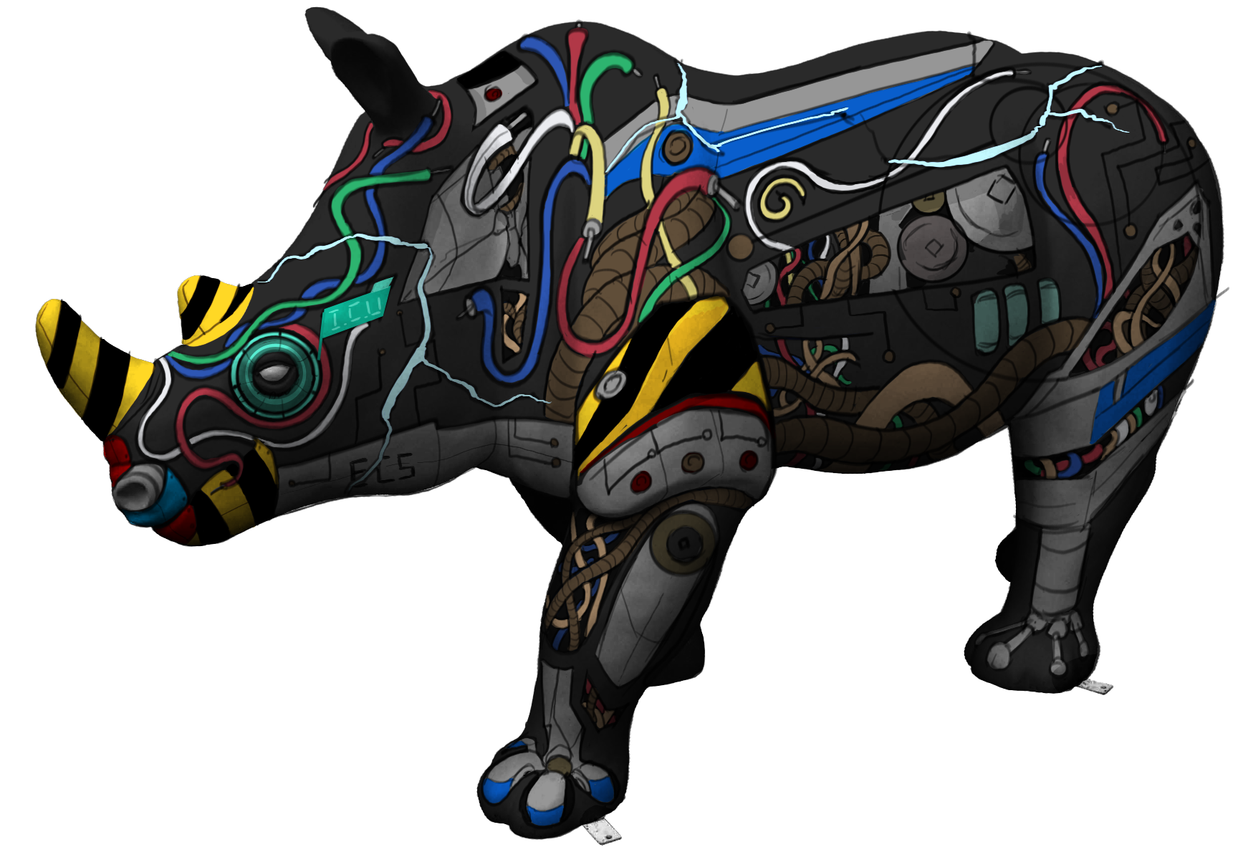
Learning to Program: why Python?
Rapid prototyping,
scientific and engineering specialisations
Meet ERICA the cyber Rhino created by ECS
32 LEDs
19 bespokely built circuit boards
15 Red-Green-Blue (RGB) LEDs
8 sensors
5 raspberry Pis
4 power supplies
2 LCD screens
2 ethernet switches
2 servo motors
2 stepper motors
2 stepper motor controllers
2 cameras
2 Wi-Fi dongles
a bluetooth dongle
a speaker
a real-time clock
a USB hub
and a kill switch.
Developed using Python

Slide 9
Getting Python on your own machine
Go to https://python.org
->Downloads (and select Windows or MacOSX etc)
-> Chose Latest Python Release (at the top!) of ->2<- (currently 2.7.17, in Oct 2019)
Select The appropriate installer for your version of the OS (usually 64 bit) and follow instructions
When you run Python (or Idle) from the command line make sure it gives you the right version. (Others may already exist on your computer)

Slide 10
Coding Dojo: an Intro

Slide 13
Lets Go!
First two volunteers please ☺

Slide 14
The End
Introduction to Programming in Python
Rikki Prince rfp@ecs.soton.ac.uk
Yvonne Howard rfp@ecs.soton.ac.uk
And Aristea, Huw, Jian, Jordi Nawar and Priyanka

