Slide 1

Presentation Briefing
Presentation Briefing
Lecture 3.1
Hugh Davis
Professional development (COMP1205)
https://secure.ecs.soton.ac.uk/module/COMP1205/

Slide 2
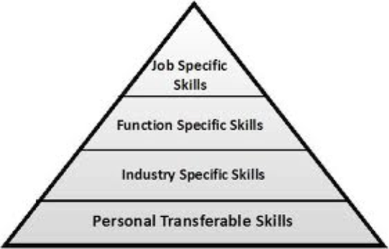
What this course is about
Sales Pitch to potential customer
Conference presentation
Technology upgrade pitch to your team
Project Progress report to management
Specification summary discussion with a customer

Slide 3

Some general interest questions
How often have you made a formal presentation before?
  0-3 times?
  4-10 times?
  More than 10 times?
Remember: We all have different experience
Image: http://www.ventiq.com/
Notes:
After this discussion, print outs of groups are distributed and students re-organise themselves into groups seeing who they will be working with, and identifying the missing folk in their group

Slide 4

Beginning a journey…
Image: http://www.paulsbodine.com/

Slide 5

Objectives
To introduce you to some guidelines for making presentations and to prepare you to learn for yourself how to make an excellent presentation
To prepare you (mentally) for the task of making a short presentation
To understand some aspects of successful teamwork (under a bit of time pressure!)
To help you to refine your learning through applying your critical skills.

Slide 6

Rationale
Learning by doing
Simple approaches first
Practice to perfection
But accept mistakes …
which lead to learning ☺
Realistically
are you likely to be able to do
a perfect job first time?
https://johnrchildress.files.wordpress.com/2011/04/

Slide 7
Flow Chart Here
Week 3/4
Week 4
Team selects preferred topics
Team Select 1 topic in Tool
Week 5
Team Write Summary and Plan
Team Get F2F Feedback
Team
Handin
Team
Handin
Team Make Presentation
Team Produce Final Presentation
Team Peer Review other presentations
Team
Handin

Slide 8

How this course will progress
Week 3
An Introduction to the Library and Scholarly Research (Hugh, with Fiona Nichols from Library)
How to find the Evidence to present in your presentations and Papers
Introduction to Presentations and Coursework 2. (this lecture)
What you have to do and why!
Group Presentation Planning
How to go about doing it
Week 4
Team Work
Writing Abstracts (Presented by Mark Weal)
How to tell people what you are doing/have done
Week 5
Feedback on your Abstracts and Plans
Week 6
Other lectures - + Time to prepare your presentation
Weeks 7 and 8
Presentations and Peer Review
The remaining 4 weeks of the course will mostly be concerned with producing a Technical Report,

Slide 9
details
IMPORTANT

Slide 10
Presentation FAQs
The Coursework Spec and details are all released
Presentations last 15 minutes + Q&A
You will select your topic online as from Monday pm.
Topics are allocated on a first come first serve basis (no more than 3 per topic)
The brief will provide guidance and background references to help with your preparation
You have handins prior to the presentation - to pace you through the work
  On Monday Evening (Topic Selection)
  At the end of next week (Summary & Plan)
  At end of Week 6 (PDF of presentation)
Presentations can be compiled using software of your choice
Final handin will be at the end of the week prior to the presentations (end of week 6)
Each slide set must have a first slide including the title, group number and photo
All participants in the group must be clearly identified
Presentations will be made during
weeks 7 & 8
Every group participant will make a contribution
Each student has to make a handin of all the group deliverables
Notes:
Each student has to make a handin of all the group deliverables

Slide 11
Presentation FAQs Contin
Marks are
  10% from Interim Handin
  80% from Presentation
  10% Your contribution to Peer Reviews
Each Group will receive feedback on their interim handin
If you do not participate in the interim feedback meeting or the group presentation you will not be awarded any marks for this componment
  unless this has been specifically negotiated because of individual circumstances
Presentations will be marked by course lecturers (80%) and peer review (20%)
  using the published marking scheme
  This will produce a group mark
You will be given immediate direct verbal feedback as a group after the presentation and during the allocated presentation slot and written feedback later
You will also gain a further contributory individual mark by participating in the review process, for which you will be allocated a slot
You will use the standard mark sheet to create your review mark
You will submit your marks online via an interactive form
You are welcome to attend any of the presentations;
All of them are relevant to your studies!

Slide 12
Why Peer Review?
Observing someone else’s efforts is often a good way to learn what works and what does not
Learning to be CRITICAL
“exercising careful judgment or judicious evaluation”
A chance to calibrate your judgement against others
Providing a supportive and attentive audience

Slide 13
Provisional Presentation Topics (2018)
Green IT - solutions and benefits: How can Green IT help businesses?
Open Data & Linked Open Data: How can Open Data impact our lives?
How can Web Science and Data Science work together?
Big Data – the big picture. How much data is 'Big Data'?
Changing the world: cooperation, co-creation, crowdfunding and crowdsourcing: Can crowdfunding replace the finance industry?
Will MOOCs destroy face-­to-face University Education?
Crime online; cyber security. Can legislation effectively protect from online crimes?
What are the today’s challenges and opportunities of AI in the workplace?
Ethical and legal issues with autonomous vehicles. Why should autonomous vehicles become reality on UK roads?
Digital marketing and advertising - use of personal data
How can open data speed up open innovation?
Does sports analytics create a better experience?
Digital journalism and social media. How good do they fit together?
Open addresses and open government data: How can they impact society and business?
E-democracy and e-participation: Can technology drive increased participation?

Slide 14
Provisional Presentation Topics.. Cont.
Cryptocurrencies and smart contracts: Is blockchain the future of finance industry?
The sharing economy: Does it harm traditional businesses?
How can businesses make use of virtual environments for internal organisation?
How to protect intellectual property in software development and other art?
How can serious gaming drive businesses?
How dangerous can online hate be?
Did Artificial Intelligence break the economy in 2008?
Alexa is always listening. Should I be worried?
How are Cyber Attacks changing the face of warfare.
Topic 6: Will MOOCs destroy face-­to-face University Education?
Keywords
Open Education; MOOCs.
Brief
"Massive Open Online Courses", or MOOCs gain an increasing importance in the educational context. As……..[more]
Presentation
Prepare and produce a short presentation which provides an introduction to and overview of the development of MOOCs and discussed…..[more]
Example links and reading`
Coursera: MOOC clearing house https://www.coursera.org/
Belanger, Y. & Thornton, J., 2013. Bioelectricity: A Quantitative Approach, Durham, NC. Available at: http://dukespace.lib.duke.edu/dspace/bitstream/handle/10161/6216/ Duke
[more]

Slide 15
SOME Guidance

Slide 16
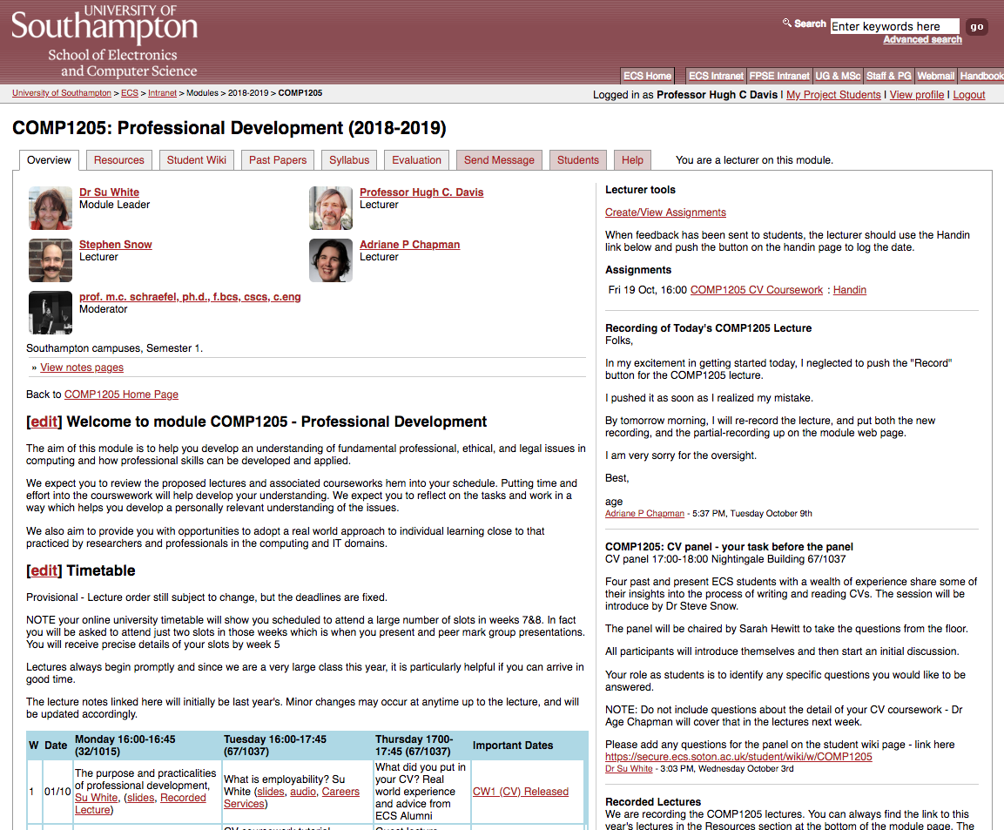
Stay Aware!
Check the web page regularly
Check your emails
Talk to the other members of your groups
https://secure.ecs.soton.ac.uk/module/COMP1205

Slide 17
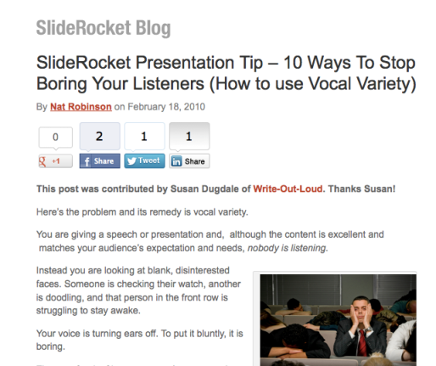
Do your own background reading e.g. SlideRocket

Slide 18
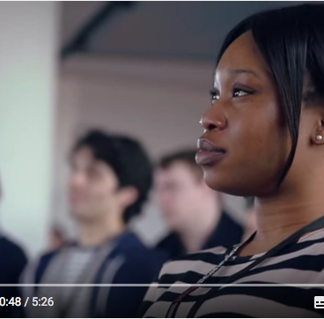
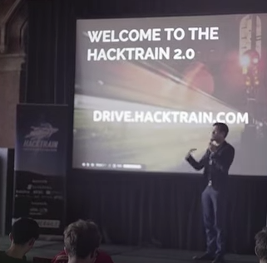
Find some motivation for this task ☺
https://youtu.be/UbCUTtzCic0
https://youtu.be/ek_5FlQdE0I

Slide 19
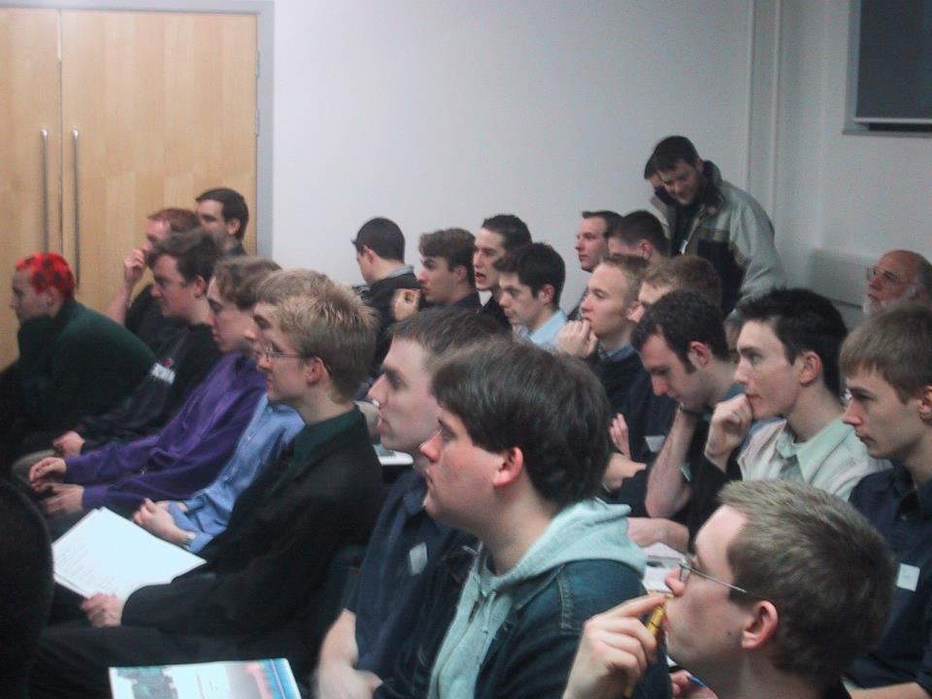
An audience….
Think About Your Audience

Slide 20
Build on what you know already….
As a consumer of presentations
  Think about a memorable presentation
  What made it good?
  Three things….
  That you like to see in presentations
  That make presentations a disaster
Chat with your friends about this
Use this knowledge in your group

Slide 21

Remember its about Teamwork too!
Get your team together asap
Consider best ways of working together
  Who does what (best)?
  When to meet
  How to communicate
Understand that if your team has a weaker member our assessment will not be marking you down for this. Rather it will be marking you up for how well you manage as a team.

Slide 22
AnY Questions?
Thank you!
Next Lectures:
  How to do Presentations and meet the Assessment Criteria
  Organising work in teams
  How to write and Summary

