Slide 1
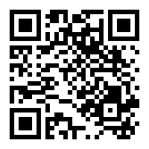
CVs and Online presence
Slides online at: http://edshare.soton.ac.uk/20071/
Lecture 1.3
03/10/2019
Dr Su White
Professional development (COMP1205)
Module home page
https://secure.ecs.soton.ac.uk/module/1920/COMP1205/

Slide 2
Assessed part of the course
Topic & weighting | When | Lead Lecturer | Focus/Rationale
CV | W1-3 | Su White | Learn ‘hands on’ what can make a good CV Prepare and submit a simple assignment Get ready for a careers fair, and maybe submitting an internship application
Group Presentation NB: complex timetable | W4-8 | Hugh Davis | Learn ‘hands on’ about teamwork Make a start at building good research skills Make a presentation before it really matters Prepare for future modules
Technical Report | W4, 6-11,15 | Mark Weal | Learn ‘hands on’ about academic integrity Establish good research and recording practices Practice formal writing Prepare for future modules

Slide 3
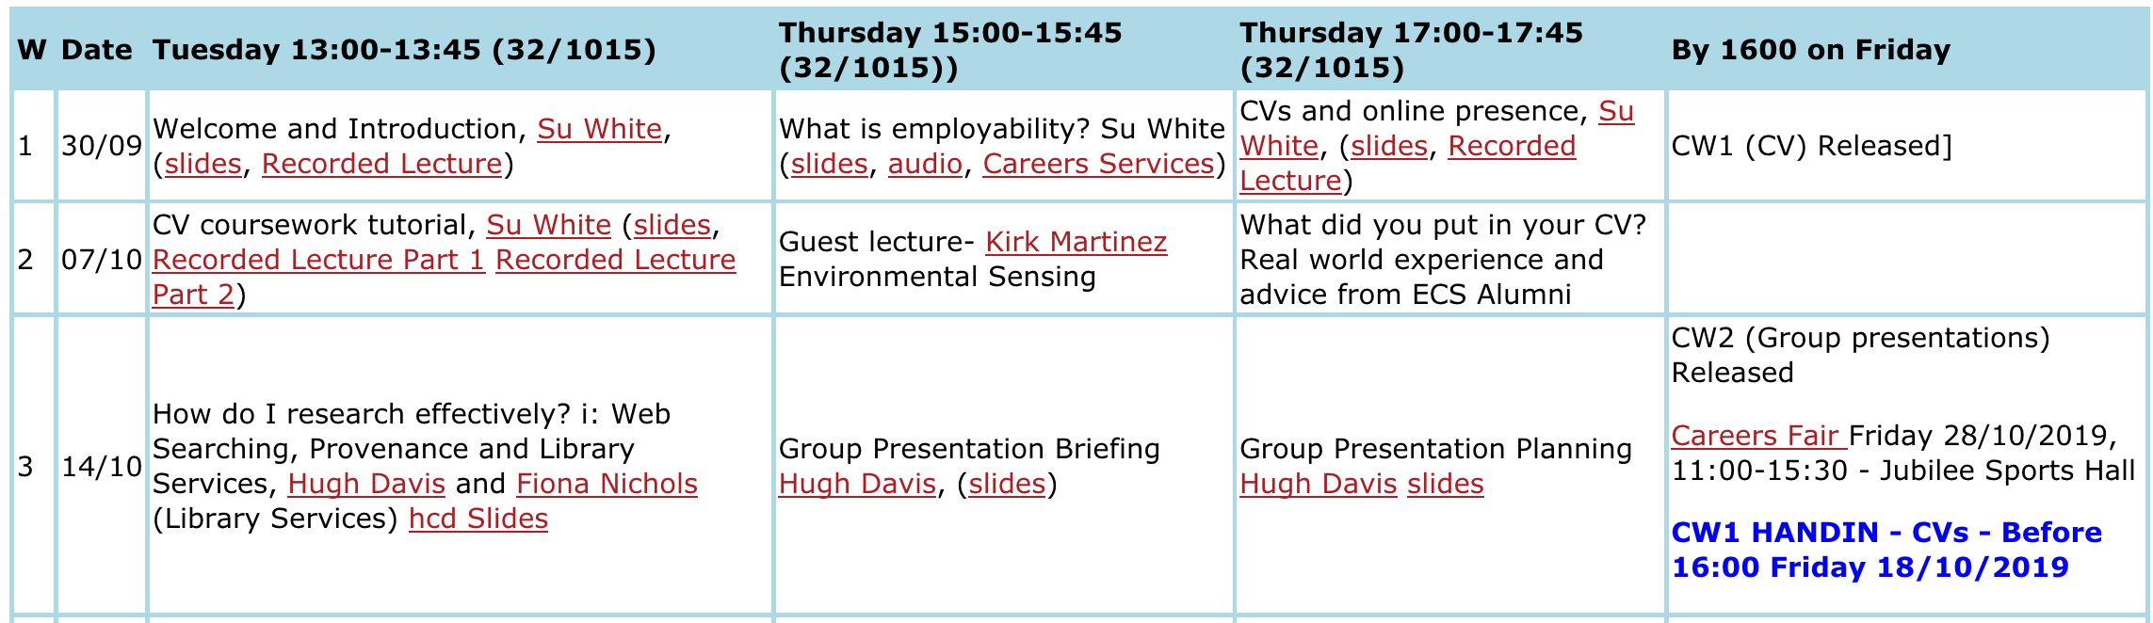
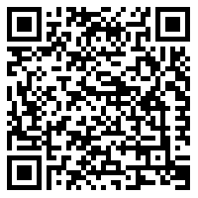
Stage 1 CVs – and careers’ fair
https://www.southampton.ac.uk/careers/students/index.page
Careers fairs
in Jubilee Sports Hall

Slide 4
Assessment
Item | % | Feedback through
CV (due end of Week 3) | 15% | Feedback from teaching staff Based on pre-defined marking scheme Feedback lecture week 6
All coursework have marking schemes that you can use for self-assessment
Why self-assessment?
  To know how you are doing
  To understand how we assess your work and compare yourself with others
  You will learn as much from seriously trying to assess your own grade as from our feedback
  I will show you the marking sheet on the video OHP
Penalties for late handin are harsh – hand in on time!
All deadlines are Friday, 16:00

Slide 5
Coursework: CV
What is the coursework about?
  You will choose between two job openings
  You will prepare a CV
Marking scheme
  See the handin page
Coursework specification
  released end of Week 1
  already on module page
  discussed in week 2 tutorial lecture
Coursework deadline
  End of week 3
Feedback
Week 2 feedback in tutor groups
  Take your draft to the meeting
  Discuss your CV
Week 6 COMP1205 feedback lecture
Week 7 special cases
low grades or no submissions
  Personal feedback via face-to-face meetings with module leader
  referral to personal tutor
Coursework due on Friday Week 3, October18th, 16:00

Slide 6
ECS handing walk-through

Slide 7

I need a volunteer

Slide 8
I will use the video OHP
Talk through the printed module specification

Slide 9
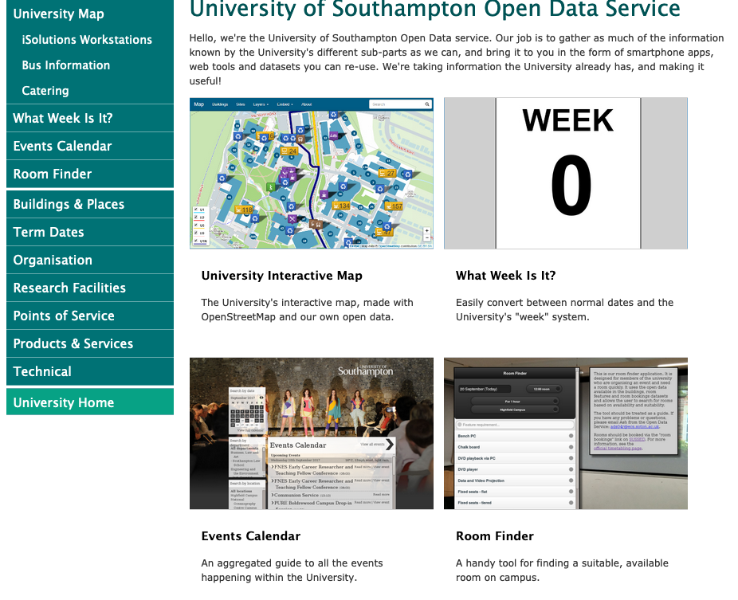
Building 32 Room 1015
Next week’s lectures
Tuesday 13:00
  CV tutorial
Thursday 15:00
  Guest lecture
Thursday 17:00
  Alumni Panel
https://data.southampton.ac.uk/
and while we are looking at it you might be interested in data.southampton.ac.uk/ ….

Slide 10
Online Presence

Slide 11







Managing your online Presence
Projecting What?
Projecting to Whom?
Professional
  Contact details
  Information about you (Informal and Formal)
  Blogs that aim to inform
  What you can offer
Personal
  Tastes and interests (music, hobbies, politics, photos)
  Diary as a blog
  Social Network
Prospective employers
Colleagues at work
Collaborators
Potential Customers
Friends
Family
People
like
you
Notes:
Be aware of what people can find out about you
–Clear cookies
–Search engines
–192.com
•Everything on Twitter is public (including direct messages)
•Separate the professional from the private (e.g., separate Twitter accounts)
•Improving Google rankings e.g., by blogging regularly

Slide 12
Impact of your presence
What do you do if you want find out about someone?
A recent survey from reed.co.uk found that 43% of recruiters check digital profiles often.
Other surveys show the vast majority, upwards of 80%, look at least once at a candidate's online presence.
https://www.bbc.co.uk/news/business-42621920

Slide 13
The Internet doesn’t forget – protect your digital identity!
Strong passwords, changed often
Claiming identifiers
Selective publication
You have no idea who has your data, or why
European Court of Justice ruled in May 2014 that Google must remove certain links –‘inadequate, irrelevant or no longer relevant’, unless there is a ‘preponderant’ public interest
Google isn’t the only access point.
Do you want the hassle of requests?
But GDPR?

Slide 14
What your data says about you
Personality predictions just from Facebook Likes

Slide 15




Create Positive online image of you
Professional Networks
Code Communities
Blogs
Linked-In
  Generic CV. Keep it up to date!
  Connections with other professionals
Professional Societies
  Offers for students
  Association of Computing Machinery (ACM)
  Institute of Electrical and Electronics Engineers (IEEE)
Personal website /Blog/ Twitter
“one stop shop” about you
  Include links to other media
  The more you blog, the more your visibility will improve
Community
  Link to and comment on other peoples’ blogs
Keep it up to date!
QA sites and software repositories
  Be a good member of the community – Engage!
  Learn about a topic
  Build a reputation as an expert
  Promote your work and collaborate
Notes:
Be aware of what people can find out about you
–Clear cookies
–Search engines
–192.com
•Everything on Twitter is public (including direct messages)
•Separate the professional from the private (e.g., separate Twitter accounts)
•Improving Google rankings e.g., by blogging regularly

Slide 16
Before next week
Create a simple draft CV and upload it using the handin
  This will make uploading the actual document feel easier ☺
  It will give you time to read all the instructions carefully
  I will show you my view of the handin page next week

Slide 17
During next week
You may discuss your draft with your personal tutor
Or you may agree to do this in week three
We will discuss appropriate content of CVs in the tutorial lecture on Tuesday
Following up the links from the previous lecture will provide you with some preparation

