Slide 1
EdShareHUB – Connecting and harnessing a distributed network of Open Educational Resources

Slide 2
What is EdShare

Slide 3
EdShare Origins

Slide 4
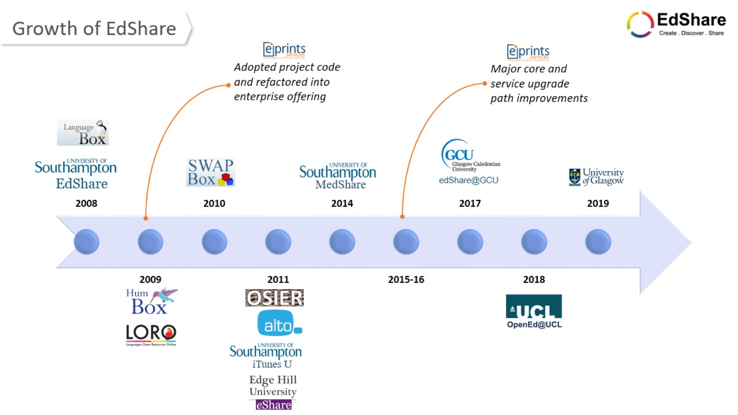
Growth of EdShare

Slide 5
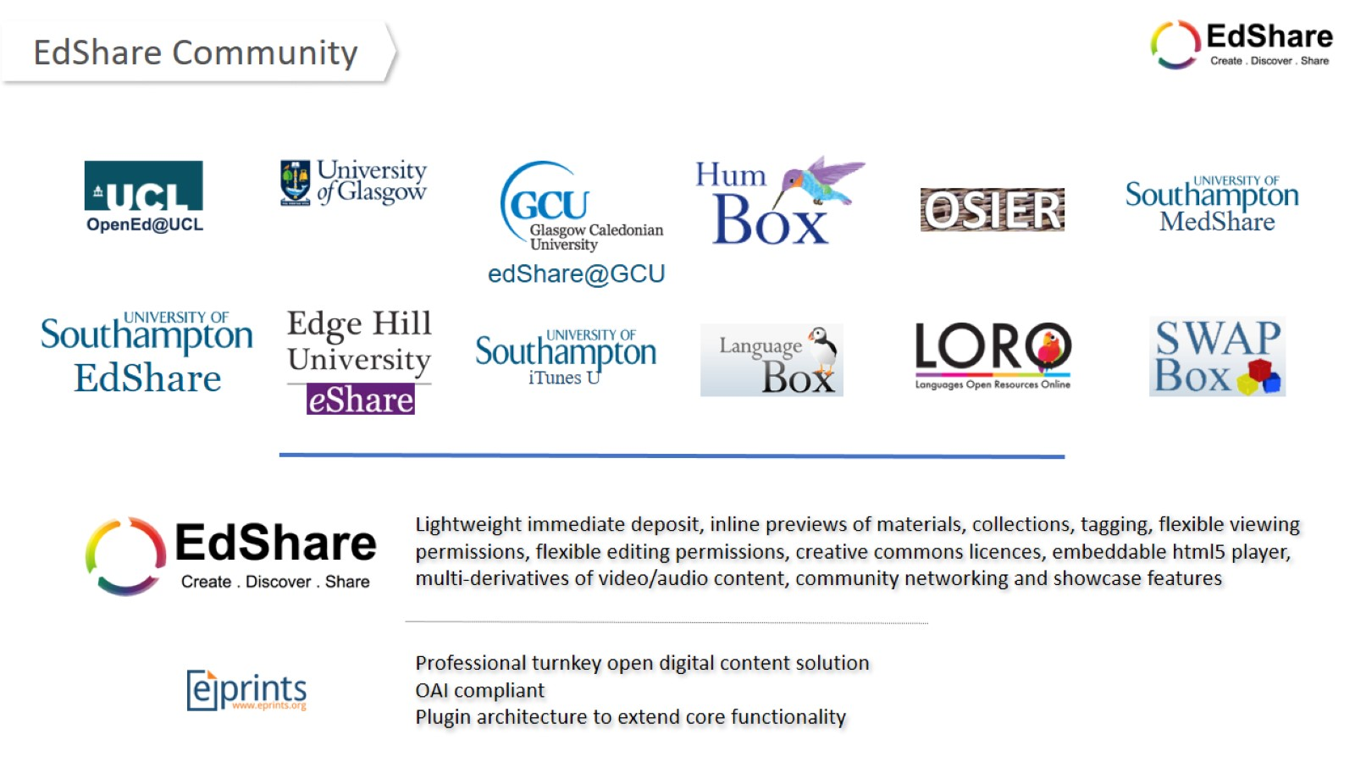
Community

Slide 6
humbox

Slide 7
edShare@GCU

Slide 8
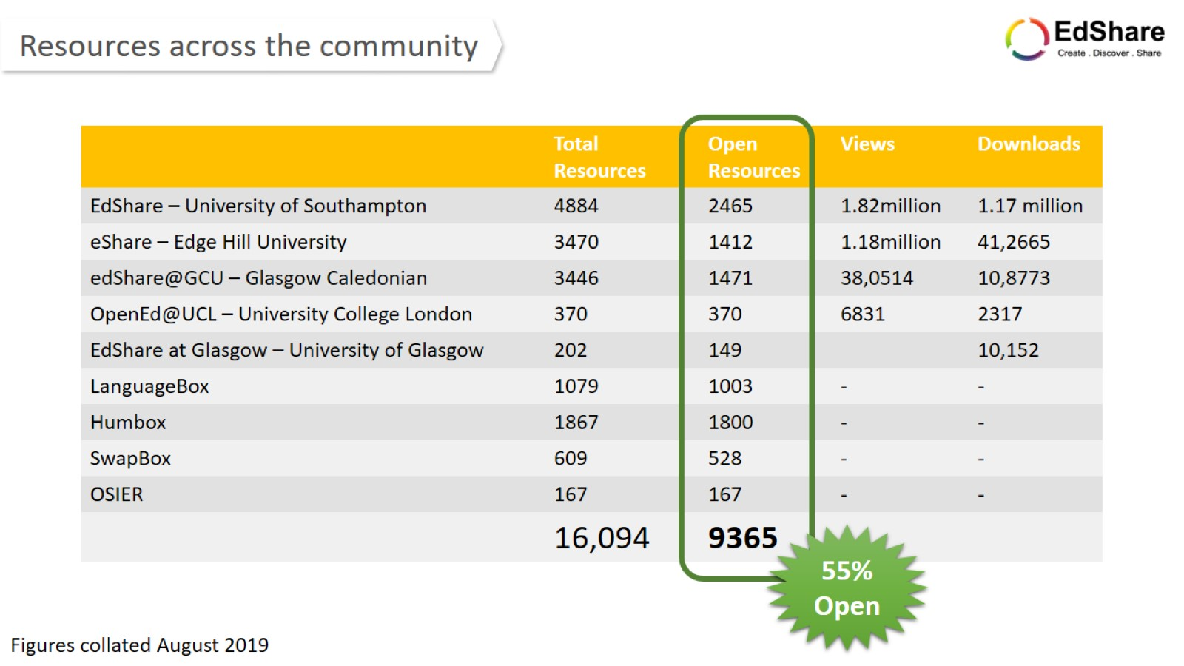
Lots of numbers

Slide 11
EdShareHUB

Slide 12
EdShareHUB

Slide 13
Sustainability

Slide 14
Future

Slide 15
Thank you

