Slide 2
Social Linked Data
COMP6215 Semantic Web Technologies
Dr Nicholas Gibbins
2018-2019

Slide 3
In the beginning was FOAF...
Lightweight RDFS vocabulary for describing yourself and your friends
foaf:Person
foaf:name
Dan Brickley
foaf:knows
foaf:mbox
rdf:type
mailto:dan@danbri.org
foaf:knows
foaf:name
foaf:name
foaf:mbox
Nick Gibbins
mailto:nmg@ecs.soton.ac.uk
Libby Miller

Slide 4
In the beginning was FOAF
Fully decentralised system
Each user writes an RDF file describing themselves and who they know (using the FOAF schema)
Files are harvested and aggregated
Data is presented in a variety of interfaces
Predates many social network systems
First FOAF version published in 2000
Orkut started in 2004
Facebook started in 2003
Bebo started in 2005
Myspace started in 2003
(SixDegrees started in 1997)

Slide 5
In the beginning was FOAF...
FOAF concentrated on doing one thing: describing social networks
No instant messaging
No walls
No likes
No posts or comments
FOAF was quite naïve!
No restrictions on who could read your description! (in 2000, who cared?)
Some attempt to deal with mass harvesting of email addresses for spamming (md5 hashes of email addresses)

Slide 6
Here Comes Everybody
Facebook: 2.3 billion active users (as of Dec 2018)
FOAF: rather fewer...
All of FOAF’s contemporaries were centralized
Walled garden makes it possible to open up private information to some but not others
Walled garden makes it possible to stop your users going elsewhere
Users = eyeballs for adverts = $$$ = growth

Slide 7
Here Comes Everybody
Facebook’s success is down to its monetization of its users and their personal info
If you’re not paying for a service, you’re the product

Slide 8
Fleeing the Centre
Some early reactions to Facebook’s hegemony:
“...our distributed design means no big corporation will ever control Diaspora. Diaspora will never sell your social life to advertisers, and you won’t have to conform to someone’s arbitrary rules or look over your shoulder before you speak.”

Slide 9
Diaspora
Distributed social networking system
Founded in 2010 by four students at NYU
Independently-owned nodes (“pods”) that interoperate to form the network
Users retain ownership of their data and can control who sees what (limited to “aspects”)
Crowdfunded development
Didn’t grow as fast as was hoped...
Notes:
Some tragedy – Ilya Zhitomirisky, one of the founders, killed himself in 2011

Slide 10
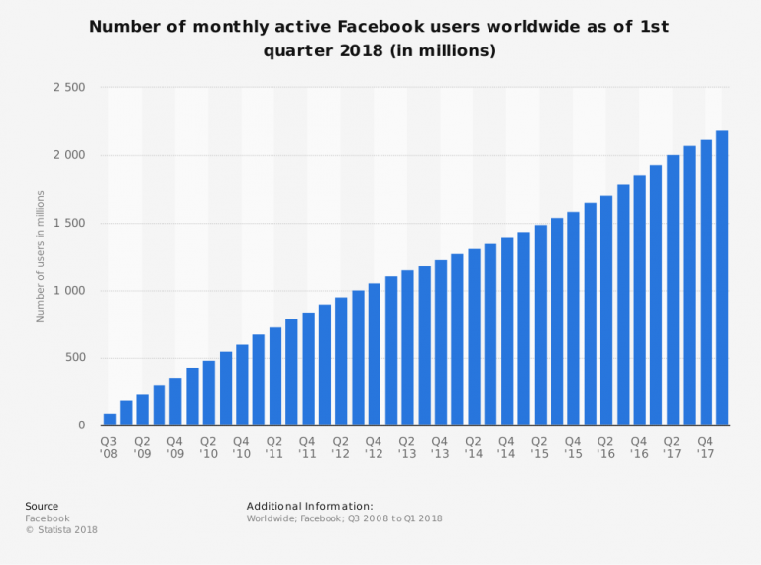

Slide 11
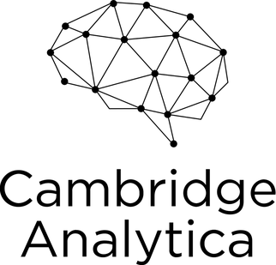

Slide 12
One Small Step for the Web...
I’ve always believed the web is for everyone. That’s why I and others fight fiercely to protect it. The changes we’ve managed to bring have created a better and more connected world. But for all the good we’ve achieved, the web has evolved into an engine of inequity and division; swayed by powerful forces who use it for their own agendas.
Today, I believe we’ve reached a critical tipping point, and that powerful change for the better is possible — and necessary.
Berners-Lee, T (2018) https://medium.com/@timberners_lee/one-small-step-for-the-web-87f92217d085

Slide 13
Solid – Social Linked Data
Project founded by Tim Berners-Lee with others at MIT in 2018
Aims to radically re-decentralise the Web
Aims to restore trust lost through incidents such as Cambridge Analytica
Inspired by Diaspora
Builds on Semantic Web foundations laid down by FOAF et al!

Slide 14
WebID
Mechanism that allows people to control how they are identified on the Web
Foundation for fine-grained access control
A WebID is a HTTP URI which refers to an Agent (person, organization, group, etc)
Distinguishes between a WebID URI and a WebID Profile URI:
WebID URI: https://www.w3.org/People/Berners-Lee/card#i
WebID Profile URI: https://www.w3.org/People/Berners-Lee/card
WebID Profile describes the referent of the WebID
https://www.w3.org/2005/Incubator/webid/spec/identity/

Slide 15
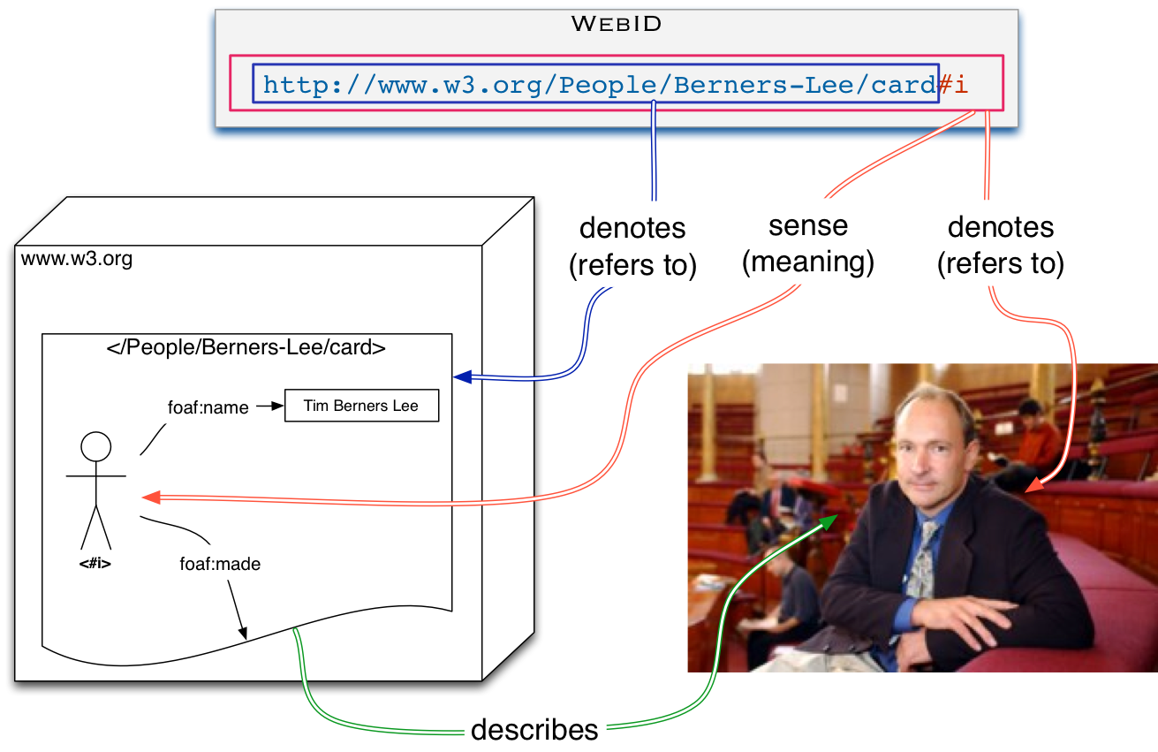
WebID

Slide 16
WebID-TLS
Mechanism for user authentication, based on WebID
WebID Profile contains a WebID Claim
Information about a public key held by the referent of the WebID
Used to verify that a client program is acting for the owner of the WebID
https://www.w3.org/2005/Incubator/webid/spec/tls/

Slide 17
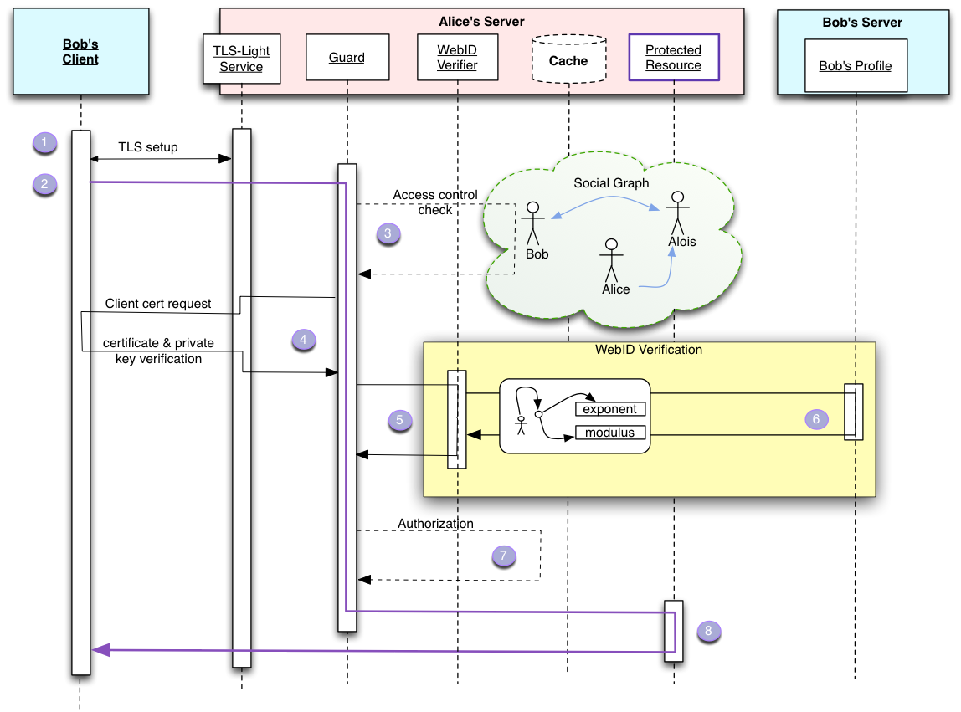

Slide 18
Web Access Control
Convention for associating access control lists with web resources
Link: header for indicating ACL
RDF vocabulary for expressing ACLs
HEAD /docs/file1 HTTP/1.1 Host: example.org HTTP/1.1 200 OK Link: <file1.acl>; rel="acl"

Slide 19
Web Access Control - Individuals
# Contents of https://alice.databox.me/docs/file1.acl @prefix acl: <http://www.w3.org/ns/auth/acl#> .
<#authorization1> a acl:Authorization; acl:agent <https://alice.databox.me/profile/card#me>; # Alice's WebID acl:accessTo <https://alice.databox.me/docs/file1>; acl:mode acl:Read, acl:Write, acl:Control.

Slide 20
Web Access Control - Groups
@prefix acl: <http://www.w3.org/ns/auth/acl#>. @prefix vcard: <http://www.w3.org/2006/vcard/ns#>. <#authorization2> a acl:Authorization; acl:accessTo <https://alice.example.com/docs/shared-file1>; acl:mode acl:Read, acl:Write; acl:agentGroup <https://alice.example.com/work-groups#Accounting>; acl:agentGroup <https://alice.example.com/work-groups#Management>.
<#Accounting> a vcard:Group; vcard:hasMember <https://bob.example.com/profile/card#me>; vcard:hasMember <https://candice.example.com/profile/card#me>.
<#Management> a vcard:Group; vcard:hasMember <https://deb.example.com/profile/card#me>.

Slide 21
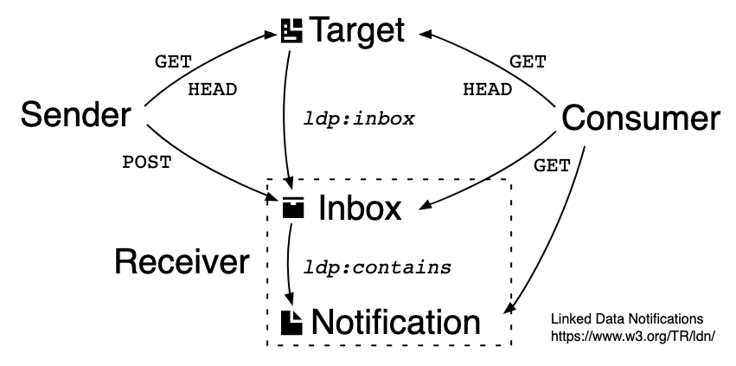
Linked Data Notifications
Protocol for sharing notifications across applications, based on LDP
Sender
Creates body of notification
Sends notification to Inbox via POST
Receiver
Responds to GET to Inbox with list of accepted notifications
Responds to GET to individual notifications
Accepts POST to Inbox to create notifications
Consumer
Retrieves Inbox via GET
https://www.w3.org/TR/ldn/

Slide 22
The Future?
Diaspora wasn’t short of press coverage, but didn’t take off
Perhaps the presence of TimBL will make the difference?

