Slide 1
Processing Text
Data Science for Documents
Leslie Carr, lac@soton.ac.uk
Data analytics in the built environment, Module 1, S3

Slide 2
Learning Outcomes
At the end of this session you will
  Understand how texts are represented and processed
  Understand how machine learning techniques are applied to textual data
  Be able to use ML algorithms to understand collections of text

Slide 3
Understanding Texts
Purpose
  Knowledge management
  Uncover factual information
  Discover relationships
  Understand global conversations
    marketing, business processes
  Interpret sentiment
Opportunities
  Web / Social Media
Methods
  Data Mining /Text Mining
Professor David Barron 1935-2012

Slide 4
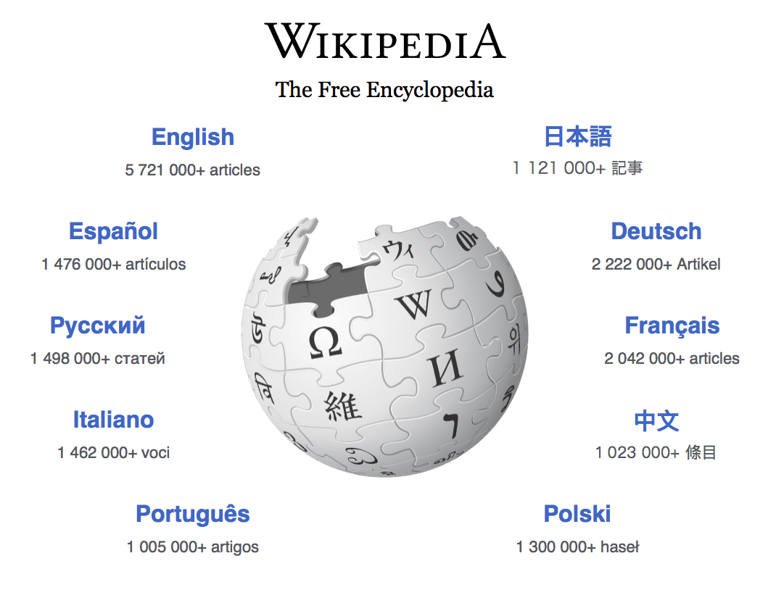
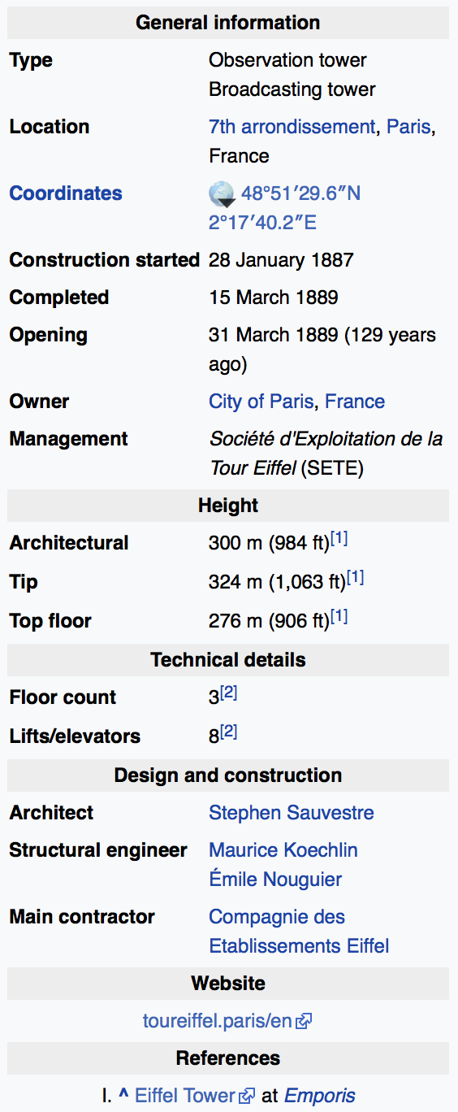
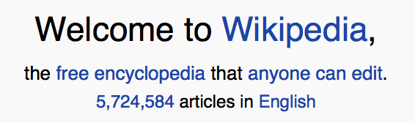
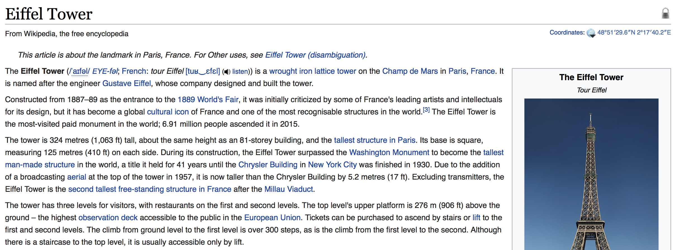
Wikipedia & DBPedia

Slide 5
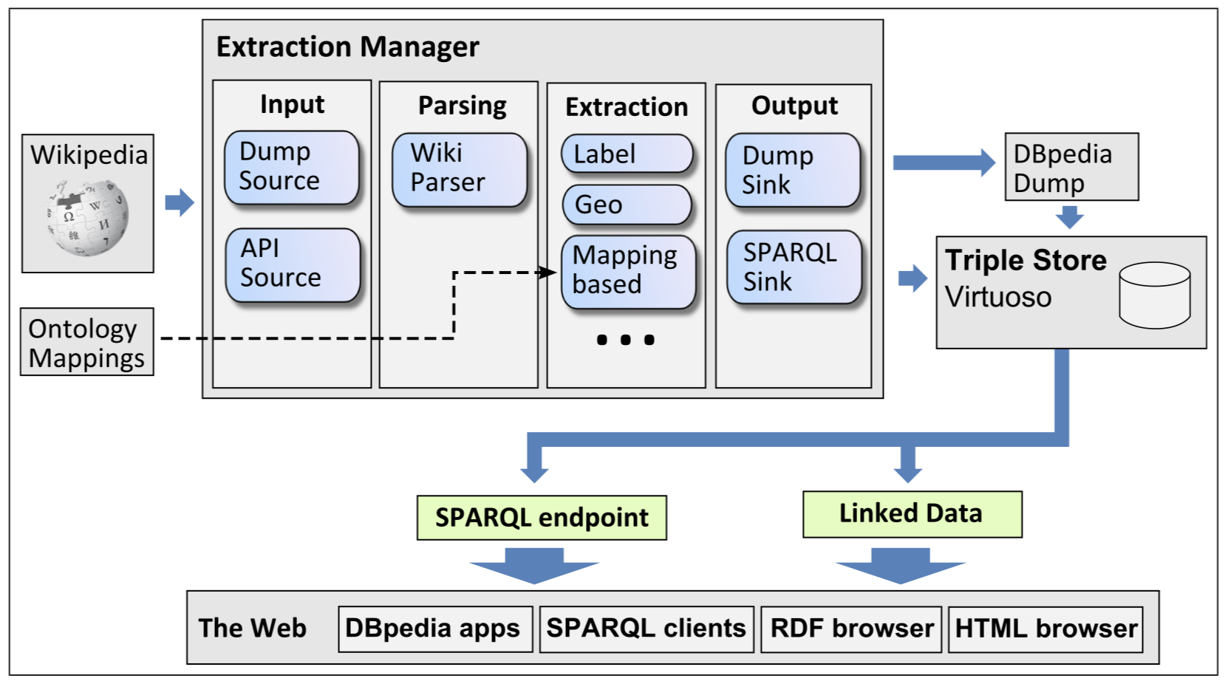
Wikipedia & DBPedia
DBpedia describes 4.58 million things,
  1,445,000 persons
  735,000 places
  411,000 creative works
    123,000 music albums, 87,000 films, 19,000 video games
  241,000 organizations
    58,000 companies and 49,000 educational institutions
  251,000 species
  6,000 diseases

Slide 6
Linked Open Data
Distributed data extracted from distributed texts

Slide 7
Text mining
Text mining refers generally to the process of extracting information from unstructured text
  Explicit interpretation of symbolic meaning: entity recognition, tagging, annotation, metadata
  Interesting and non-trivial knowledge derived from implicit patterns of symbols
Overall methods
  Supervised methods: text classification
  Unsupervised methods: clustering and topic modelling

Slide 8



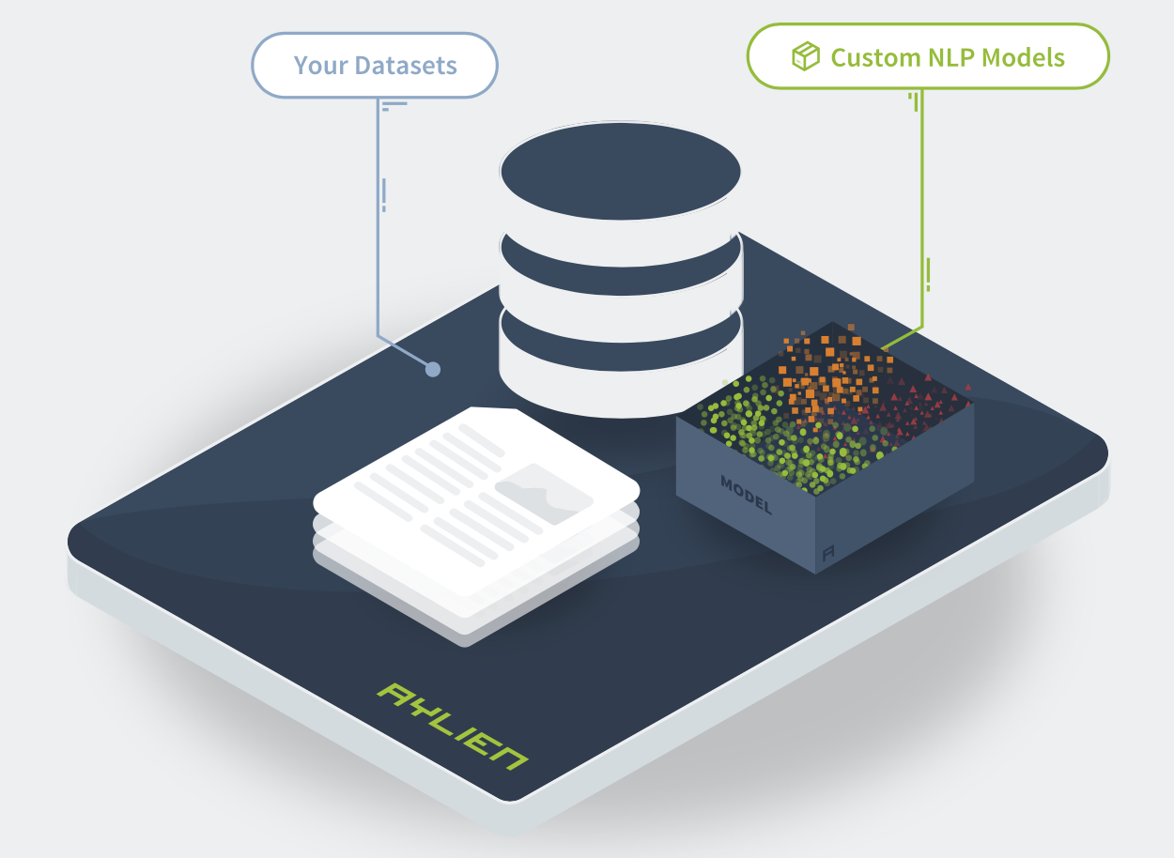


Products
Automate written reports, summaries, & recommendations and add narrative descriptions to dashboards
Agolo uses artificial intelligence to create summaries from your information in real-time
Semantria Storage & Visualization to store, manage & analyze
unstructured text documents
End-to-End Platform for Building Custom NLP Models for Classification, Sentiment Analysis, and Entity Extraction models
The Gavagai Monitor collects data from online sources and creates topic-based executive summaries which give you instant insight.
Interactive technical documents with a conversational interface for hands-free, error-free work experience
Luminoso Compass
Automate your business processes by using Compass to classify, label, predict, and act on your streaming text data. By automatically routing and auto-responding to customer feedback in real-time, your support team can focus on the most critical issues.
Natural Language Generation (NLG) platform to analyze, interpret, and communicate insights from your data in the tone, style, and language of your business
Textio Hire uses real-world hiring outcomes from millions of job posts and recruiting mails to write effective job adverts

Slide 9
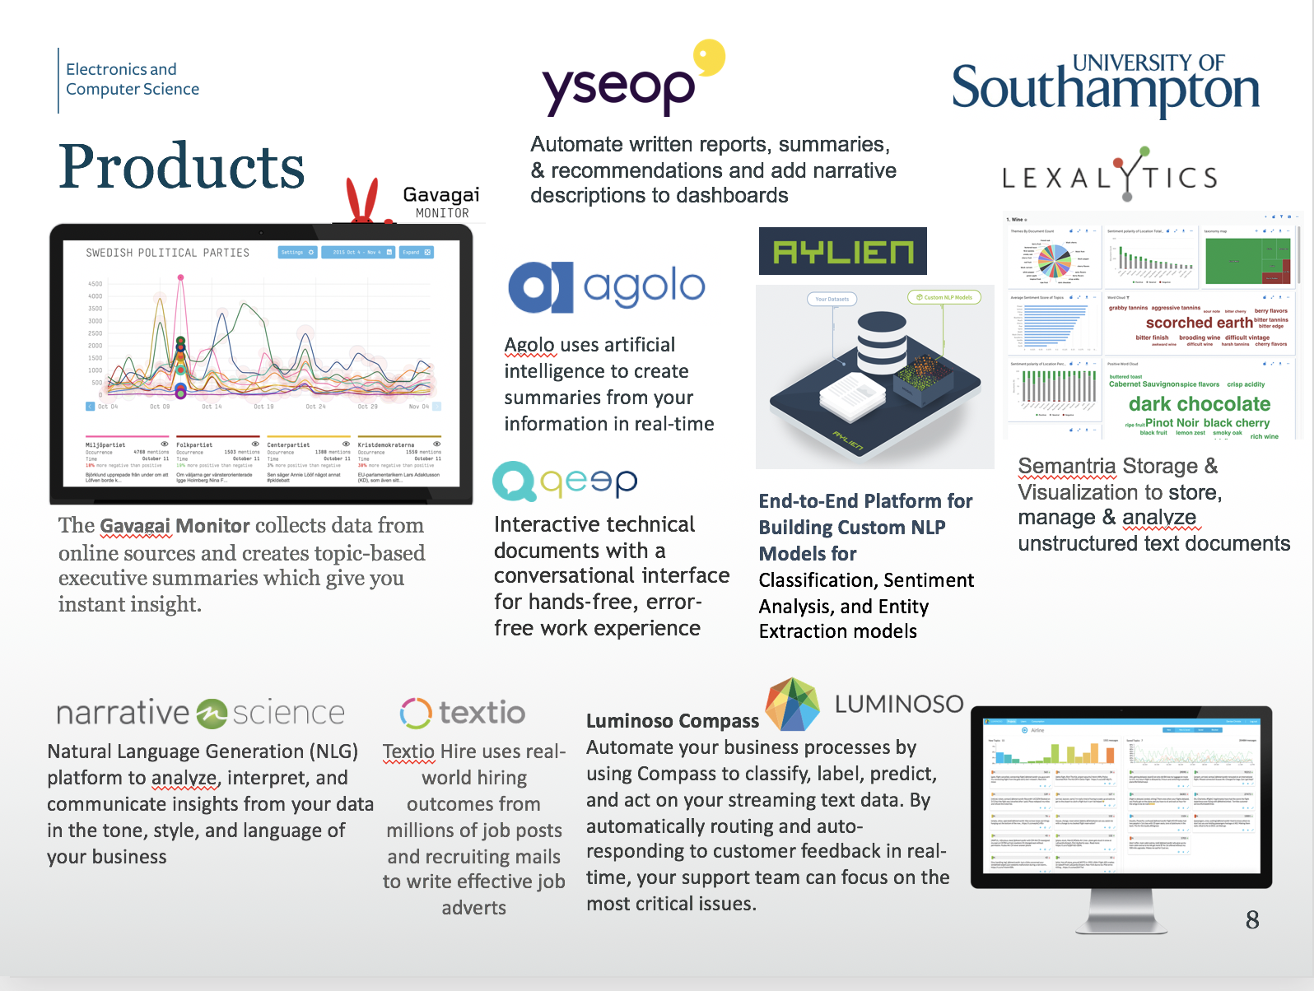
GENERATING REPORTS
READING
EXTERNAL
SUMMARIES
READING FOR ANALYSIS
CONVERSATIONAL INTERFACES
READING
CUSTOMERS
GENERATING REPORTS
WRITING JOB ADS
ANSWERING CUSTOMERS

Slide 10
Pipeline
Collect
  Direct download / API Queries / Web scraper
Clean
  Stopwords
  Stemming
Model
  Bag of words
    Clustering, Classification
  Topic modelling
    LSI, LDA
Choose question
Collect data
Check and clean data
Model data
Communicate results
Act upon results

Slide 11
Data Collection
Direct download / Queries / Web scraper
Internal communications
  Customer document
  Process paperwork
Public information
  Reference sources
  Newspapers
  Social Media
  Research articles
Choose question
Collect data
Check and clean data
Model data
Communicate results
Act upon results
Where is valuable information for your job role and your project?
Evidence of behavior? Expression of attitude? Loyalty to a brand?

Slide 12
“Web Science”
Platform phenomenology
Network of messages between accounts
Social (Media) Practice
Presentation of self
Gadget affordance
Human Behaviour
Action and transaction
Mental states
Social Media Data
Bags of words
Digital (il-) literacies
Political or retail intentions
social computational

Slide 13
Data Cleansing
It's only words
And words are all I have
To take your heart away
Elvis Presley, Rita Coolidge, Bee Gees, Boyzone
Filtering stopwords: remove words that bear little or no content information, like articles, conjunctions, prepositions, etc.
Lemmatization: methods that try to map verb forms to the infinite tense and nouns to the singular form
Stemming: try to build basic forms of words-set
Choose question
Collect data
Check and clean data
Model data
Communicate results
Act upon results

Slide 14
Data Cleansing
1. Original (Peter Pan)
2. Simplified (punctuation stripped, case folded)
5. Index
All children, except one, grow up. They soon know that they will grow up, and the way Wendy knew was this. One day when she was two years old she was playing in a garden, and she plucked another flower and ran with it to her mother. I suppose she must have looked rather delightful, for Mrs. Darling put her hand to her heart and cried, “Oh, why can't you remain like this for ever!” This was all that passed between them on the subject, but henceforth Wendy knew that she must grow up. You always know after you are two. Two is the beginning of the end.
all children except one grow up they soon know that they will grow up and the way wendy knew was this one day when she was two years old she was playing in a garden and she plucked another flower and ran with it to her mother i suppose she must have looked rather delightful for mrs darling put her hand to her heart and cried oh why cant you remain like this for ever this was all that passed between them on the subject but henceforth wendy knew that she must grow up you always know after you are two two is the beginning of the end
always | 1
another | 1
begin | 1
child | 1
cry | 1
darling | 1
delight | 1
except | 1
flower | 1
garden | 1
grow | 3
hand | 1
heart | 1
henceforth | 1
know | 2
like | 1
look | 1
mother | 1
mrs | 1
oh | 1
old | 1
pass | 1
play | 1
pluck | 1
rather | 1
remain | 1
run | 1
subject | 1
suppose | 1
wendy | 2
year | 1
3. Filtered (stopwords removed)
children except grow grow wendy knew years old playing garden plucked another flower ran mother suppose looked rather delightful mrs darling hand heart cried oh remain like passed subject henceforth wendy knew grow always beginning
4. Normalised (lemmatised and stemmed)
child except grow grow wendy know year old play garden pluck another flower run mother suppose look rather delight mrs darling hand heart cry oh remain like pass subject henceforth wendy know grow always begin

Slide 15
Data Modelling (i)
Bag of Words
Full text search
Basic statistical analysis:
  Frequency list (indexes)
  Collocates
  Text comparison
Concordances (KWIC lists)
Choose question
Collect data
Check and clean data
Model data
Communicate results
Act upon results

Slide 16
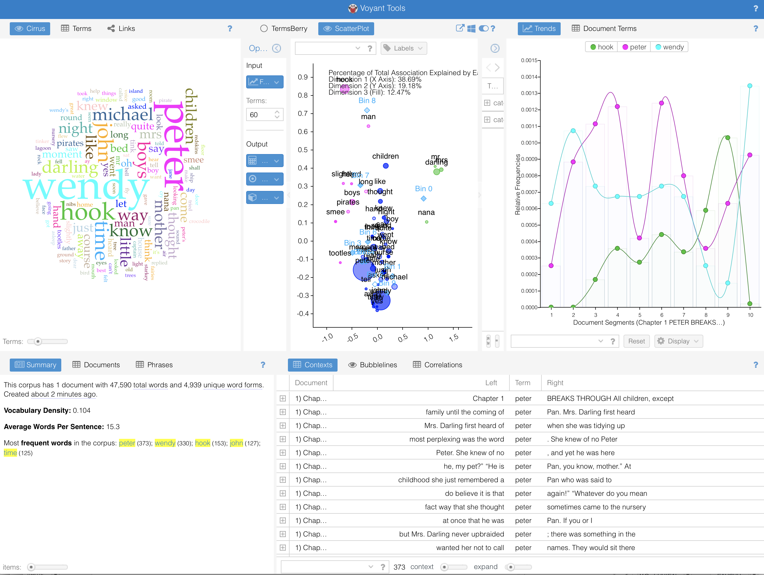
Word Based Analyses
Voyant Tools is a web-based reading and analysis environment for digital texts.
http://voyant-tools.org/

Slide 17
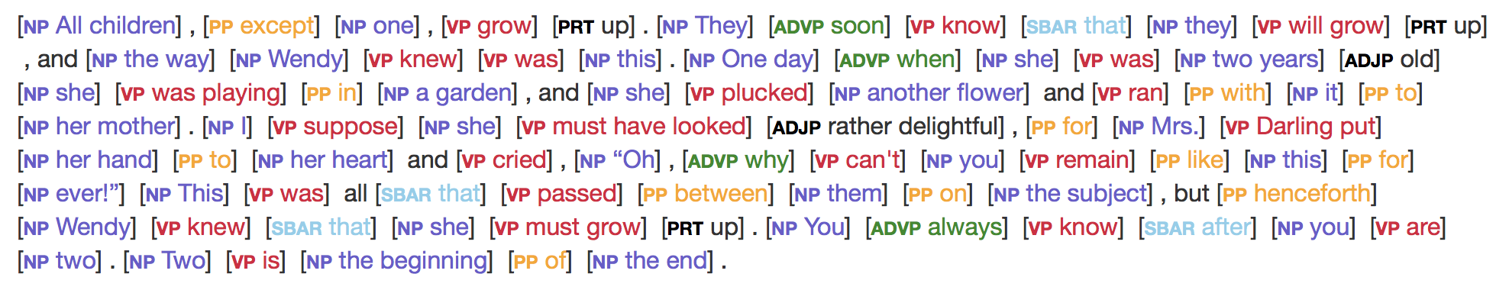
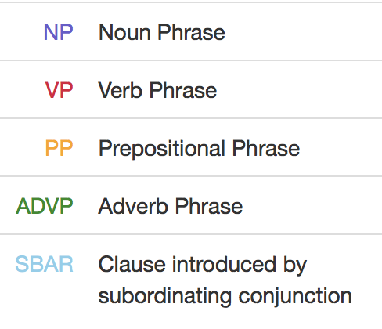
Computational Linguistics
Parsing natural language grammars to understand the role of each word & phrase in a sentence
http://cogcomp.org/page/demos/

Slide 18
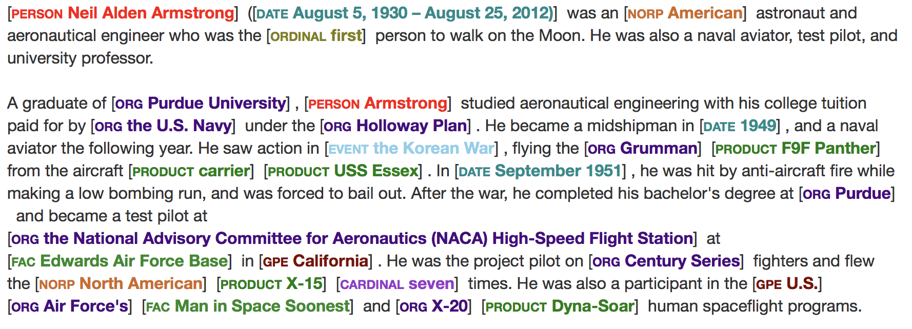
Computational Linguistics
Named Entity Recognition identifies known objects and people
http://cogcomp.org/page/demos/

Slide 19
Semantic Web
Information contained in the text, or about the text is made explicit in formal knowledge models
2001-05
The Semantic Web
date
title
name
Tim Berners-Lee
creator
publishedIn
creator
name
James Hendler
creator
name
Ora Lassila
title
Scientific American

Slide 20
Data Modelling (ii)
A Document Bag of Words becomes a High Dimensional Feature Vector
  Each word is a separate feature in a distinct dimension
  A text becomes a n-dimensional word vector
Index
always | 1
another | 1
begin | 1
child | 1
cry | 1
darling | 1
delight | 1
except | 1
flower | 1
garden | 1
grow | 3
hand | 1
heart | 1
henceforth | 1
know | 2
like | 1
look | 1
mother | 1
mrs | 1
oh | 1
old | 1
pass | 1
play | 1
pluck | 1
rather | 1
remain | 1
run | 1
subject | 1
suppose | 1
wendy | 2
year | 1
Choose question
Collect data
Check and clean data
Model data
Communicate results
Act upon results
grow
child
Wendy

Slide 21
Data Modelling (ii)
A corpus becomes a matrix
grow
Per Document Index
always | 1 | 0 | 2 | 0 | 0 | 1 | 1 | 1 | 0 | 0 | 1 | 0 | 0 | 3
another | 1 | 0 | 0 | 0 | 0 | 0 | 2 | 1 | 0 | 3 | 3 | 0 | 0 | 0
beginning | 1 | 1 | 2 | 0 | 0 | 0 | 0 | 1 | 1 | 1 | 2 | 1 | 0 | 0
children | 1 | 0 | 3 | 2 | 0 | 3 | 0 | 1 | 0 | 2 | 1 | 1 | 1 | 1
cry | 1 | 0 | 0 | 1 | 1 | 0 | 0 | 1 | 0 | 1 | 0 | 0 | 0 | 0
darling | 1 | 2 | 0 | 0 | 1 | 0 | 0 | 1 | 0 | 0 | 0 | 0 | 1 | 0
delightful | 1 | 2 | 2 | 2 | 0 | 0 | 0 | 1 | 2 | 1 | 0 | 0 | 0 | 0
except | 1 | 0 | 0 | 2 | 0 | 0 | 0 | 1 | 1 | 0 | 1 | 0 | 0 | 1
flower | 1 | 0 | 0 | 0 | 1 | 0 | 1 | 1 | 0 | 2 | 0 | 0 | 0 | 0
garden | 1 | 0 | 0 | 0 | 1 | 0 | 2 | 1 | 0 | 0 | 1 | 1 | 0 | 2
grow | 3 | 0 | 0 | 0 | 1 | 0 | 0 | 3 | 0 | 0 | 2 | 0 | 1 | 0
hand | 1 | 0 | 1 | 0 | 1 | 0 | 0 | 1 | 1 | 1 | 2 | 1 | 0 | 0
heart | 1 | 1 | 0 | 2 | 0 | 0 | 0 | 1 | 0 | 2 | 0 | 1 | 0 | 0
henceforth | 1 | 0 | 0 | 0 | 0 | 0 | 0 | 1 | 0 | 1 | 2 | 3 | 0 | 2
know | 2 | 2 | 0 | 0 | 2 | 0 | 2 | 2 | 0 | 0 | 0 | 0 | 0 | 0
like | 1 | 0 | 0 | 0 | 0 | 1 | 0 | 1 | 0 | 0 | 0 | 0 | 1 | 0
look | 1 | 3 | 0 | 0 | 1 | 0 | 0 | 1 | 2 | 0 | 1 | 0 | 0 | 1
mother | 1 | 2 | 0 | 0 | 0 | 0 | 0 | 1 | 2 | 0 | 1 | 0 | 2 | 0
mrs | 1 | 0 | 1 | 0 | 0 | 0 | 0 | 1 | 1 | 0 | 0 | 2 | 0 | 2
oh | 1 | 1 | 1 | 0 | 0 | 0 | 0 | 1 | 2 | 0 | 1 | 0 | 0 | 0
old | 1 | 0 | 0 | 0 | 1 | 0 | 2 | 1 | 0 | 2 | 0 | 0 | 0 | 1
pass | 1 | 0 | 0 | 0 | 1 | 1 | 0 | 1 | 2 | 3 | 0 | 0 | 0 | 0
play | 1 | 1 | 3 | 3 | 0 | 0 | 2 | 1 | 0 | 0 | 0 | 1 | 0 | 0
pluck | 1 | 0 | 0 | 2 | 0 | 1 | 1 | 1 | 0 | 0 | 0 | 2 | 1 | 2
rather | 1 | 0 | 3 | 0 | 2 | 0 | 1 | 1 | 0 | 0 | 0 | 0 | 0 | 0
remain | 1 | 0 | 1 | 2 | 0 | 2 | 0 | 1 | 0 | 1 | 0 | 0 | 0 | 1
run | 1 | 0 | 1 | 0 | 3 | 0 | 0 | 1 | 0 | 1 | 1 | 2 | 0 | 1
subject | 1 | 1 | 0 | 1 | 0 | 0 | 0 | 1 | 1 | 0 | 2 | 1 | 0 | 0
suppose | 1 | 0 | 2 | 0 | 0 | 1 | 0 | 1 | 2 | 0 | 0 | 0 | 0 | 0
wendy | 2 | 0 | 1 | 0 | 0 | 1 | 1 | 2 | 1 | 0 | 0 | 0 | 2 | 1
year | 1 | 1 | 1 | 0 | 0 | 1 | 0 | 1 | 3 | 0 | 0 | 0 | 1 | 0
Choose question
Collect data
Check and clean data
Model data
Communicate results
Act upon results
child
Wendy
grow
child
Wendy
child
grow
Wendy

Slide 22
Data Modelling (ii)
Corpus “bag of words” is huge
  educated adult English
  vocabulary is
  40,000 words
  sparse matrix
  1,000s x 10,000s
Need techniques to
simplify the data
“I’m very highly educated. I know words.
I have the best words.” Donald Trump

Slide 23
Dimensionality Reduction
Two algorithms (PCA & SVD) create a set of "new axes”
constructed from linear combinations of the original
feature space axes in which the dataset is plotted.
  Looking at data from a new direction / projection
These “new axes” are useful because they systematically break down the variance in the data points (how widely the data points are distributed) based on each direction's contribution to the variance in the data
  Finding the best viewpoint to clearly see the data pattern
  Ignore the viewpoints in which everything is compressed together
  and obscured
  Imagine viewing a person – from the top of their head looking down
The result of these processes is a ranked list of "directions" in the feature space ordered from most variance (information) to least.

Slide 24
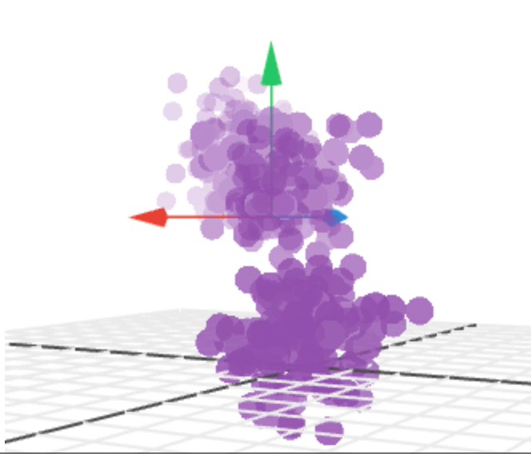
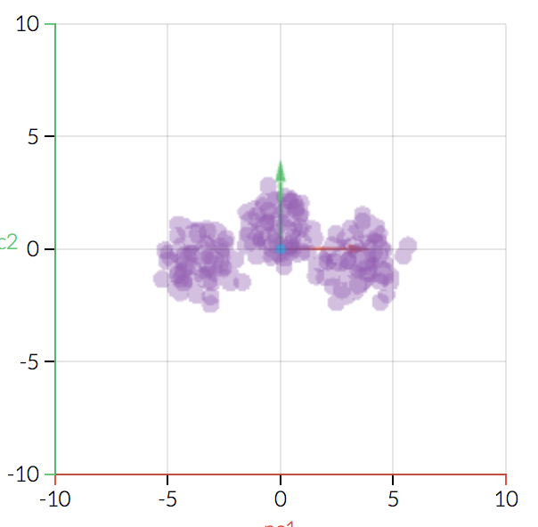
Example Principle Component

Slide 25
The Significance of Singular Values
Singular value decomposition reduces a rank 𝑅 matrix to a rank K matrix.
  A list of 𝑅 unique vectors can be approximated by a linear combination of 𝐾 unique vectors.
400 unique rows of pixels
1st singular value
1st -10th singular values
1st -50th singular values
https://www.quora.com/What-is-an-intuitive-explanation-of-singular-value-decomposition-SVD Jason Liu

Slide 26

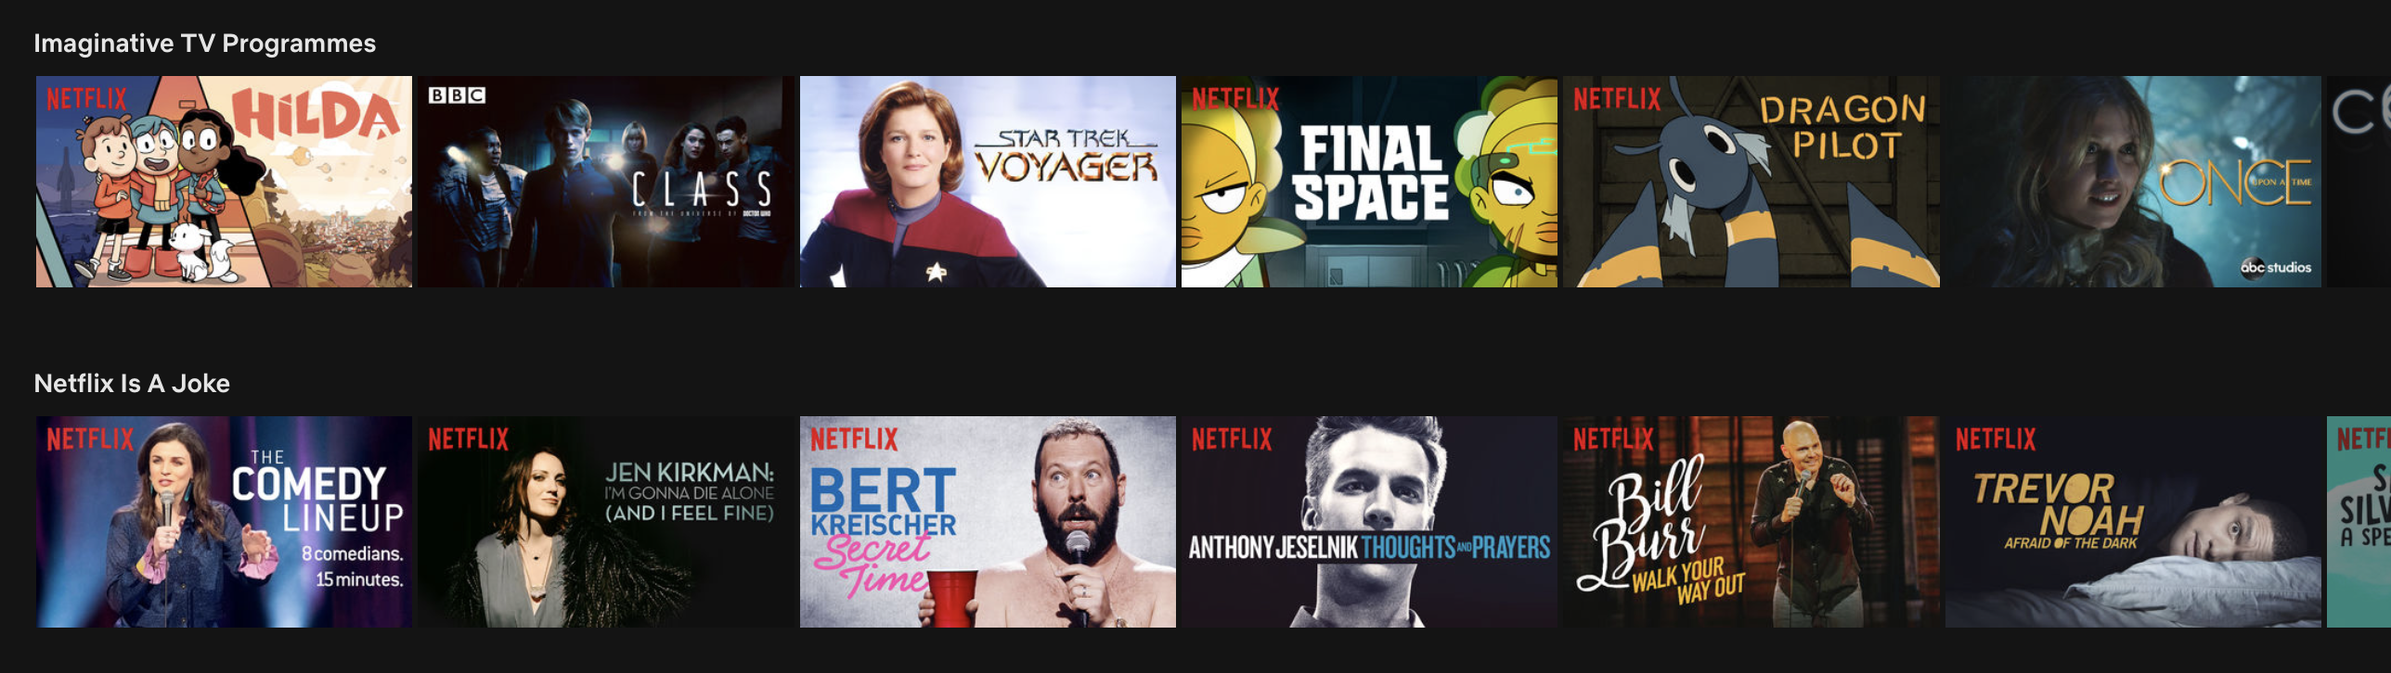
Modelling Netflix Usage

Slide 27
Netflix SVD
Netflix has 100 million users and 5000 shows.
  Each user characterised by a 5000 feature vector
Alternatively, look for top 20 singular values
  𝑢𝑠𝑒𝑟 = Σ₂₀ 𝑐_{𝑖} • 𝑆𝑉_{𝑖} (SV is the singular vectors)
  Each singular value is a type of user
  𝑆𝑉₃ tends to like sports documentaries, 𝑆𝑉₂ prefers horror movies
  Absurd Movies / Imaginative TV Programmes

Slide 28
LSA: Latent Semantic Analysis
Analyses relationships between a set of documents and the terms they contain by producing a set of concepts related to the documents and terms.
LSA assumes that words that are close in meaning will occur in similar pieces of text.
  Construct a word frequency matrix of individual words x texts
  Use SVD to reduce the number of rows while preserving the similarity structure among columns (between documents).
  Words are then compared by taking the cosine of the angle between the two vectors formed by any two rows.
  Values close to 1 represent very similar words while values close to 0 represent very dissimilar words.

Slide 29
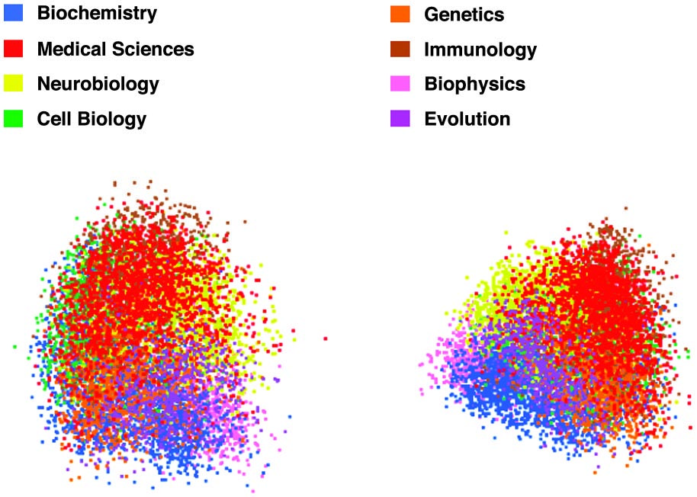
LSA Example
Landauer, Laham & Derr. From Paragraph to Graph. PNAS 2004

Slide 30
Topic Models
Topics uncover latent semantic structures of related collections of words in texts.
If a document is about a particular topic, particular “topic words” will appear more frequently
  ”prince" and ”witch" will appear more often in fairy tales
  ”memory" and ”program" will appear in computer documentation.
A document contains multiple topics in different proportions
  in a document that is 10% about cats and 90% about dogs -> about 9 times more dog words than cat words.

Slide 31
Topic Models
The topics produced by topic modeling techniques are clusters of related words.
A topic model examines the statistics of the words in each document in a corpus
  discovers what the topics might be
  what each document's balance of topics is.
Topic models can help to organize and offer insights for us to understand large collections of unstructured text.

Slide 32
Latent Dirichlet Allocation (LDA)
Tries to regenerate a document assuming
  a document consists of a set of topics
  a topic consists of a set of words
  there are only a small number of topics
  each topic uses a small number of words
In practice, LDA automatically discovers topics in documents.

Slide 33
LDA example
I like to eat kale and feta.
I ate avacado and feta for lunch.
Corgis and labradors are adorable.
My daughter wants to have a corgi.
She can afford an adorable hamster gnawing some kale.

Slide 34
LDA example
I like to eat kale and feta.
I ate avacado and feta for lunch.
Corgis and labradors are adorable.
My daughter wants to have a corgi.
She can afford an adorable hamster gnawing some kale.
Topic ♦️: 30% feta, 20% kale, 10% gnawing, 10% lunch…
Topic ♣️: 20% corgi, 10% labrador, 20% adorable, 10% hamster…

Slide 35
LDA example
I like to eat kale and feta.
I ate avacado and feta for lunch.
Corgis and labradors are adorable.
My daughter wants to have a corgi.
She can afford an adorable hamster gnawing some kale.
Topic ♦️: 30% feta, 20% kale, 10% gnawing, 10% lunch…
Topic ♣️: 20% corgi, 10% labrador, 20% adorable, 10% hamster…
  Sentence 1: 100% ♦️
  Sentence 2: 100% ♦️
  Sentence 3: 100% ♣️
  Sentence 4: 100% ♣️
  Sentence 5: 60% ♦️, 40% ♣️

Slide 36
LDA example
I like to eat kale and feta.
I ate avacado and feta for lunch.
Corgis and labradors are adorable.
My daughter wants to have a corgi.
She can afford an adorable hamster gnawing some kale.
Topic ♦️: 30% feta, 20% kale, 10% gnawing, 10% lunch…
Topic ♣️: 20% corgi, 10% labrador, 20% adorable, 10% hamster…
  Sentence 1: 100% ♦️
  Sentence 2: 100% ♦️
  Sentence 3: 100% ♣️
  Sentence 4: 100% ♣️
  Sentence 5: 60% ♦️, 40% ♣️
You have to decide on the “meaning” of ♦️ and ♣️

Slide 37
How to Write A Document The LDA Way
LDA represents documents as mixtures of topics that spit out words with certain probabilities.
Decide on the number of words N the document will have
Choose a topic mixture for the document.
  perhaps choose 1/3 food and 2/3 cute animals.
Generate each word in the document by:
  First pick a topic; then from the topic pick a word
LDA then backtracks from the documents to find a set of topics that are likely to have generated the collection.

Slide 38
LDA Learning – XXX rewrite
Choose a number of topics
Go through each document, and randomly assign each word in the document to one of the K topics.
Notice that this random assignment already gives you both topic representations of all the documents and word distributions of all the topics (albeit not very good ones).
So to improve on them, for each document d…
  Go through each word w in d…
    And for each topic t, compute two things: 1) p(topic t | document d) = the proportion of words in document d that are currently assigned to topic t, and 2) p(word w | topic t) = the proportion of assignments to topic t over all documents that come from this word w. Reassign w a new topic, where we choose topic t with probability p(topic t | document d) * p(word w | topic t) (according to our generative model, this is essentially the probability that topic t generated word w, so it makes sense that we resample the current word’s topic with this probability). (Also, I’m glossing over a couple of things here, in particular the use of priors/pseudocounts in these probabilities.)
    In other words, in this step, we’re assuming that all topic assignments except for the current word in question are correct, and then updating the assignment of the current word using our model of how documents are generated.
After repeating the previous step a large number of times, you’ll eventually reach a roughly steady state where your assignments are pretty good. So use these assignments to estimate the topic mixtures of each document (by counting the proportion of words assigned to each topic within that document) and the words associated to each topic (by counting the proportion of words assigned to each topic overall).

