Slide 1


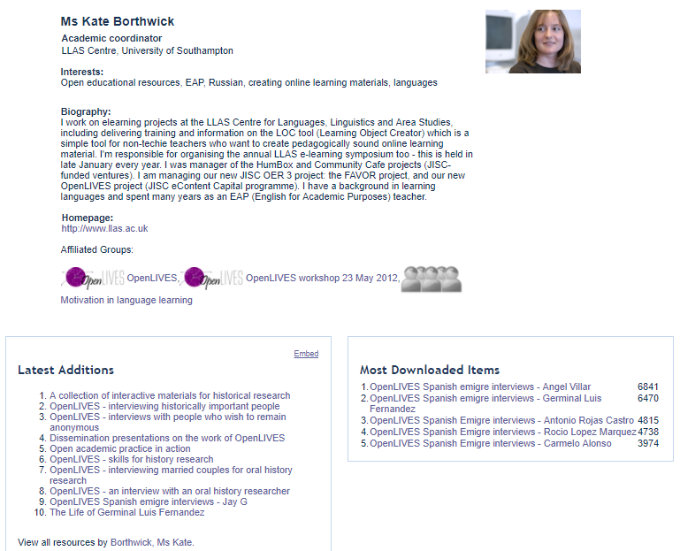
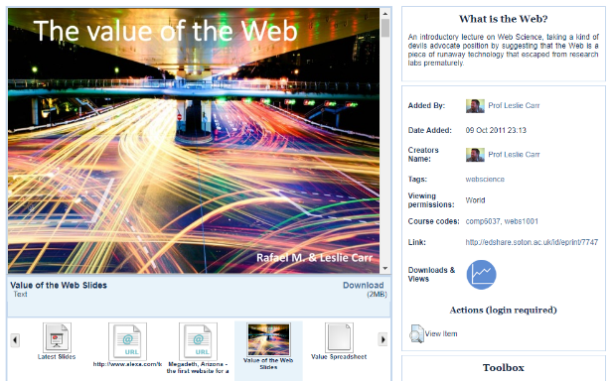
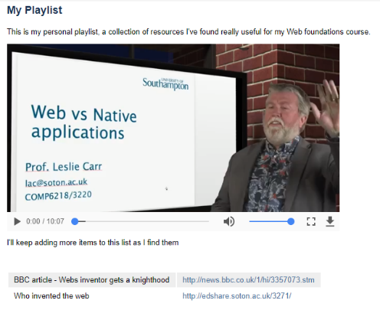
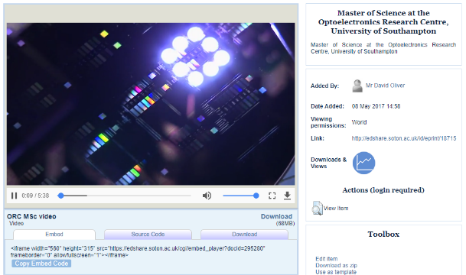
edshare.ac.uk
@EdShare
Creating digital spaces for open education
Share Documents, Video, Podcasts, Presentations, Images, Interactive Packages, Collections, anything
User Community Profiles, Inline previews, Playlists, Course listings, Embeddable content, Shareable editing rights
Kelly Terrell, Open Education & Services Lead, EPrints Services @KellyATerrell

Slide 2

Digital content platform designed for sharing teaching and learning materials
Built on EPrints
Created as part of the University of Southampton EdSpace project (part of Jisc Institutional Exemplars programme)
  “EdSpace was founded on the institutional need for a single, shared, safe, persistent, storage location for all manner of educational resources”
Built for sharing across university but acknowledgement of increasing activity around open educational resources (OERs)
History
2007 – 2009 : EdSpace Project
“This project created an institutional share for educational resources, called EdShare. This share was inspired in functionality and ease of use by web 2.0 sites such as YouTube and Slideshare.”

Slide 3
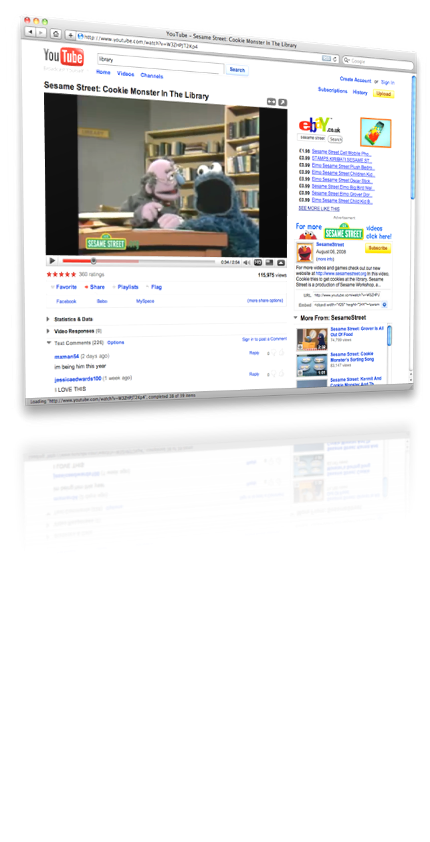
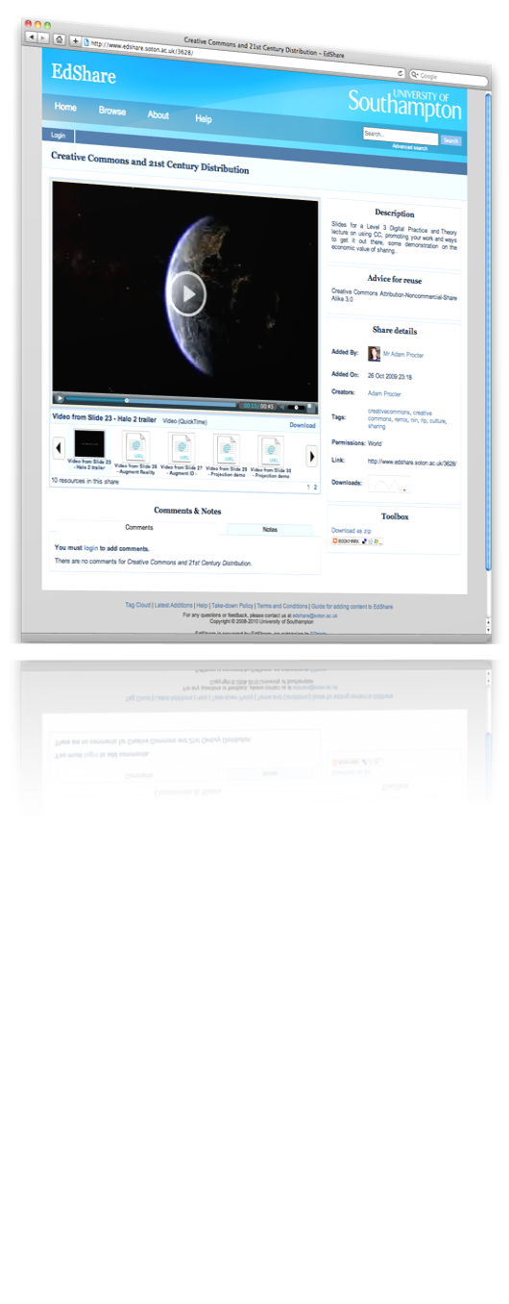
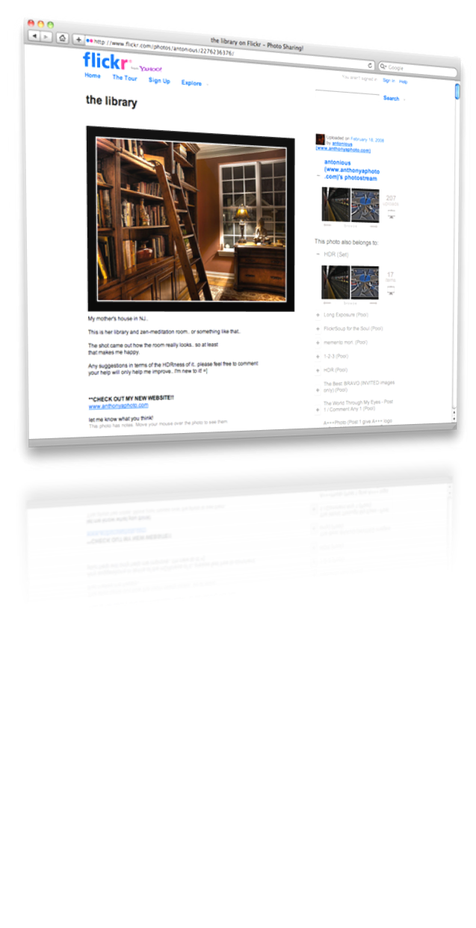
Key influences

Slide 4


Launched in 2008
edshare.soton.ac.uk
Externally
2009 EdShare adopted by EPrints Services
2009-2012 A number of instances as part of Jisc UKOER programme
2011 onwards – larger scale institutional instances on board
Major service upgrades by EPrints Services – continuing growth of the community of EdShares
Establishment of new services
Within the Institution
2009 – 2011 Follow-on projects
2011 Supported institutional service
2011 iTunes U Southampton launched
2012/13 Feed from EdShare to ECS module pages for students
2014 MedShare launched

Slide 5









Community
OpenEd@UCL
MedShare
edShare@GCU
EdShare
Built upon the Open Source
OAI compliant software EPrints
New developments come from multiple directions
Core improvements from other work areas

Slide 6
EdShare features and flexibility
 | EdShare core | Local features
 | Web 2.0 ethos Inline previews Community networking Immediate deposit Collections Tagging Varied viewing permissions Shareable editing permission CC licences Bookmarks OAI – open metadata Version control Permanent URIs | Open registrations Comments Group spaces – projects, research groups Showcasing Remixing
 |  | HTML5 rendered video/audio HTML5 Embeddable player Multiple derivatives
Humanities community
No single institution brand
Institutional
Multiple agendas:
Host permanent resources, OERs, content from partners
edShare@GCU

Slide 7
Community
OpenEd@UCL
MedShare
edShare@GCU
EdShare
Built upon the Open Source
OAI compliant software EPrints
New developments come from multiple directions
Core improvements from other work areas

Slide 8

Reviewing EdShare - Lessons learned, what comes next?
Involving : EPrints Services Enterprise Team (EdShare Lead (me!), EPrints Lead, Developers x 4)
Professor Les Carr, Professor of Web Science, ECS
Professor Hugh Davis, Professor or Learning Technologies, ECS
Dr Lisa Harris, Director of Web Science Institute & Programme Lead Digital Marketing, Business School

Slide 9
Key Outcomes
Learners are currently the primary audience, not staff
From Champion Users
  Frustration at institutional VLEs and their fixed nature
  High appeal of EdShare due to its flexibility and adaptability
  Desire to run courses which are not necessarily formally recognised
Need for more support for day-to-day teaching & learning activities
  Course/Module lists, Lesson plans as well as the individual resources
  More user interactions

Slide 10

Focus areas
UI Improvements
Rendering Modules, Lesson plans or Playlists
Source: Pixabay

Slide 11
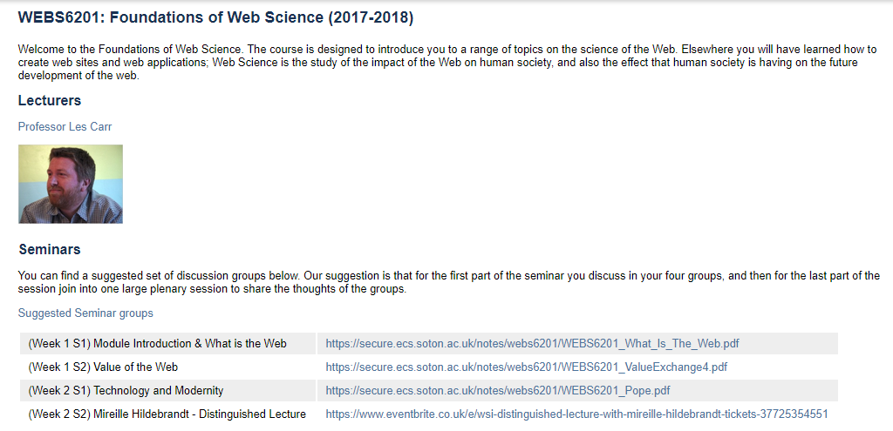
Presentation of modules
The same feature could be used for open courses

Slide 12
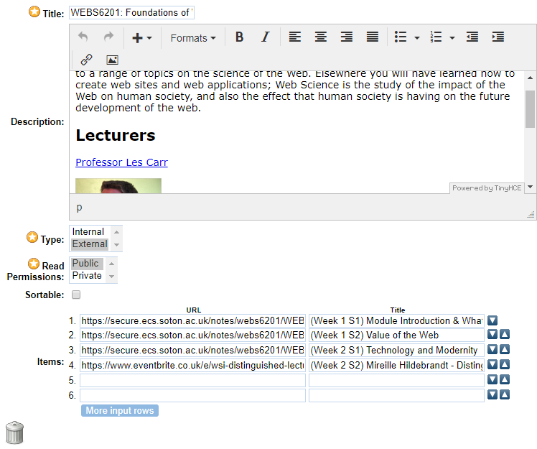
Rich text description with complete flexibility to format and style as you wish, embed media
Private to you only, or share it publicly for others to view
Resources to display – either internal to the EdShare instance or external links
Lists, which can enable >>

Slide 13
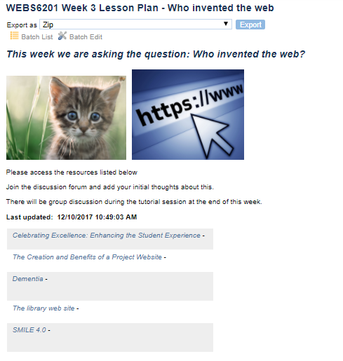

Lesson plans or Playlists

Slide 14
Focus areas
UI Improvements
Rendering Modules, Lesson plans or Playlists
Accessible content (transforming uploaded content)
Video discussions tagging
Source: Pixabay

Slide 15
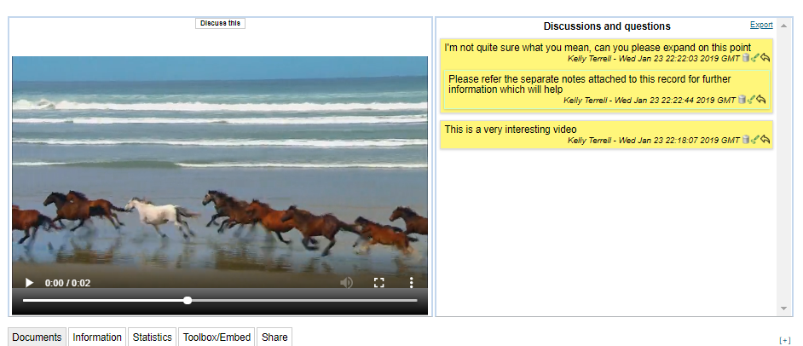
Video tagging
Supporting flipped classroom
Potential analysis of learning metrics

Slide 16
Focus areas
UI Improvements
Rendering Modules, Lesson plans or Playlists
Accessible content (transforming uploaded content)
Video discussions tagging
Community services
Source: Pixabay

Slide 17
EdShareHUB
Current focus is on aggregation of open content
Harvesting metadata from EdShare community
Single point to search and retrieve over 8000 open resources*
Requires the latest version of EdShare
Beta site launched last year via edshare.ac.uk
What’s next: linking in more EdShare instances, exploring deposit options for individuals
* Open resources on EdShare instances running v 3.3+ in May 2018

Slide 18
Thank you! Any Questions?
Kelly Terrell
K.Terrell@soton.ac.uk
@KellyATerrell
@EdShare
www.edshare.ac.uk

