Slide 2
Distributed Databases
COMP3211 Advanced Databases
Dr Nicholas Gibbins – nmg@ecs.soton.ac.uk
2018-2019

Slide 3
Overview
Fragmentation
  Horizontal (primary and derived), vertical, hybrid
Query processing
  Localisation, optimisation (semijoins)
Concurrency control
  Centralised 2PL, Distributed 2PL, deadlock
Reliability
  Two Phase Commit (2PC)
The CAP Theorem

Slide 4
What is a distributed database?
A collection of sites connected by a communications network
Each site is a database system in its own right, but the sites have agreed to work together
A user at any site can access data anywhere as if data were all at the user's own site

Slide 5
DDBMS Principles

Slide 6
Local autonomy
The sites in a distributed database system should be autonomous or independent of each other
Each site should provide its own security, locking, logging, integrity, and recovery. Local operations use and affect only local resources and do not depend on other sites

Slide 7
No reliance on a central site
A distributed database system should not rely on a central site, which may be a single point of failure or a bottleneck
Each site of a distributed database system provides its own security, locking, logging, integrity, and recovery, and handles its own data dictionary. No central site must be involved in every distributed transaction.

Slide 8
Continuous operation
A distributed database system should never require downtime
A distributed database system should provide on-line backup and recovery, and a full and incremental archiving facility. The backup and recovery should be fast enough to be performed online without noticeable detrimental affect on the entire system performance.

Slide 9
Location independence
Applications should not know, or even be aware of, where the data are physically stored; applications should behave as if all data were stored locally
Location independence allows applications and data to be migrated easily from one site to another without modifications.

Slide 10
Fragmentation independence
Relations can be divided into fragments and stored at different sites
Applications should not be aware of the fact that some data may be stored in a fragment of a table at a site different from the site where the table itself is stored.

Slide 11
Replication independence
Relations and fragments can be stored as many distinct copies on different sites
Applications should not be aware that replicas of the data are maintained and synchronized automatically.

Slide 12
Distributed query processing
Queries are broken down into component transactions to be executed at the distributed sites

Slide 13
Distributed transaction management
A distributed database system should support atomic transactions
Critical to database integrity; a distributed database system must be able to handle concurrency, deadlocks and recovery.

Slide 14
Hardware independence
A distributed database system should be able to operate and access data spread across a wide variety of hardware platforms
A truly distributed DBMS system should not rely on a particular hardware feature, nor should it be limited to a certain hardware architecture.

Slide 15
Operating system independence
A distributed database system should be able to run on different operating systems

Slide 16
Network independence
A distributed database system should be designed to run regardless of the communication protocols and network topology used to interconnect sites

Slide 17
DBMS independence
An ideal distributed database system must be able to support interoperability between DBMS systems running on different nodes, even if these DBMS systems are unalike
All sites in a distributed database system should use common standard interfaces in order to interoperate with each other.

Slide 18
Distributed Databases vs. Parallel Databases
Distributed Databases
Local autonomy
No central site
Continuous operation
Location independence
Fragmentation independence
Replication independence
Distributed query processing
Distributed transactions
Hardware independence
Operating system independence
Network independence
DBMS independence
Distributed Databases

Slide 19
Distributed Databases vs. Parallel Databases
Parallel Databases
Local autonomy
No central site
Continuous operation
Location independence
Fragmentation independence
Replication independence
Distributed query processing
Distributed transactions
Hardware independence
Operating system independence
Network independence
DBMS independence
Parallel Databases

Slide 20
Fragmentation

Slide 21
Why Fragment?
Fragmentation allows:
  localisation of the accesses of relations by applications
  parallel execution (increases concurrency and throughput)

Slide 22
Fragmentation Approaches
Horizontal fragmentation
  Each fragment contains a subset of the tuples of the global relation
Vertical fragmentation
  Each fragment contains a subset of the attributes of the global relation
horizontal
fragmentation
global relation
vertical
fragmentation

Slide 23
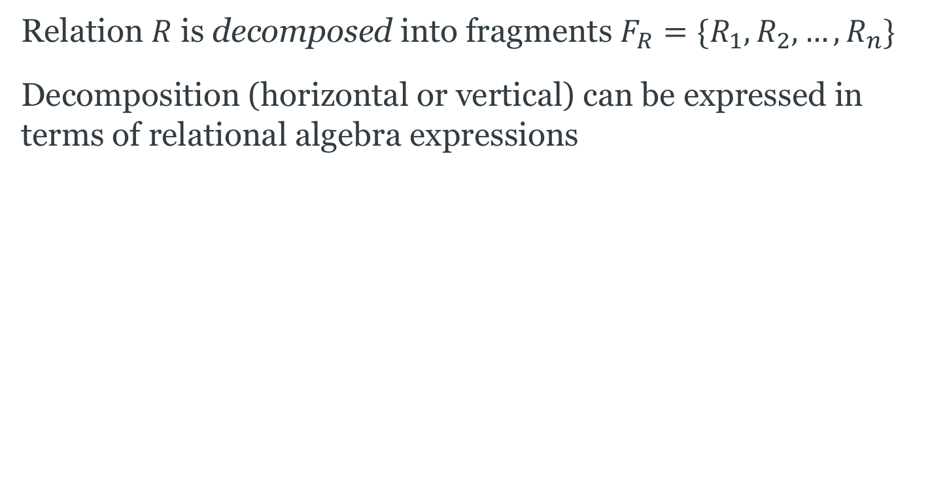
Decomposition
Relation $R$ is decomposed into fragments $F_{R}=\{R_{1},R_{2}, …, R_{n}\}$
Decomposition (horizontal or vertical) can be expressed in terms of relational algebra expressions

Slide 24
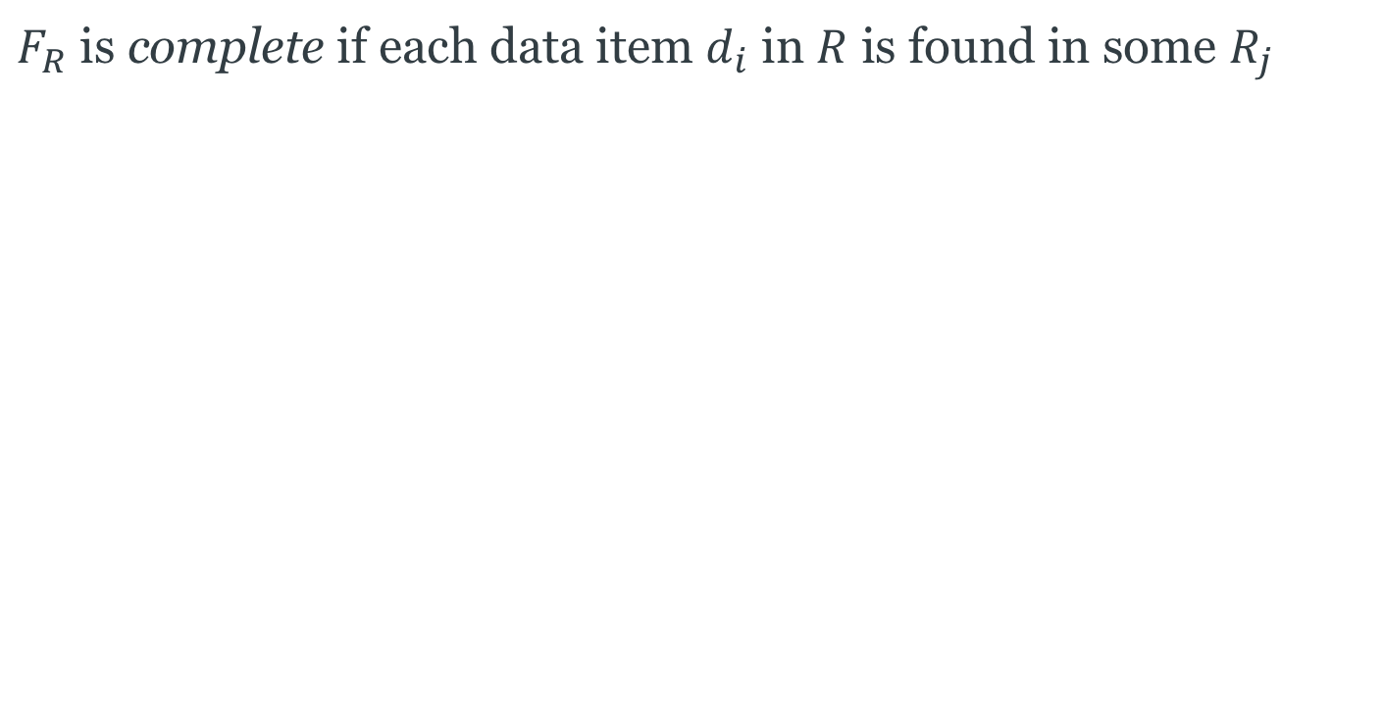
Completeness
$F_{R}$ is complete if each data item $d_{i}$ in $R$ is found in some $R_{j}$

Slide 25

Reconstruction
$R$ can be reconstructed if it is possible to define a relational operator $▽$ such that
$R=▽R_{i}$, for all $Ri∈F_{R}$
Note that $▽$ will be different for different types of fragmentation

Slide 26
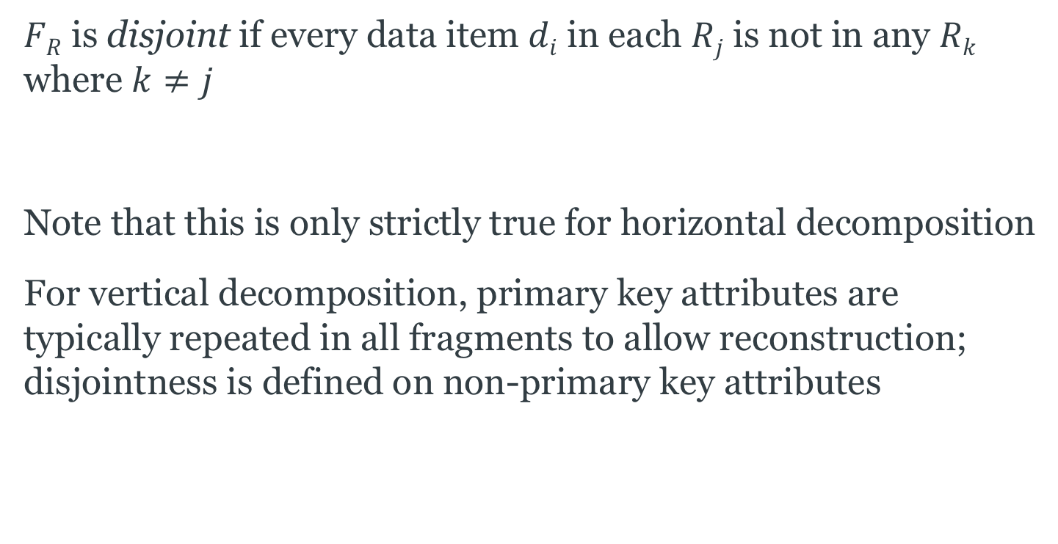
Disjointness
$FR$ is disjoint if every data item $di$ in each $Rj$ is not in any $Rk$
where $k≠j$
Note that this is only strictly true for horizontal decomposition
For vertical decomposition, primary key attributes are typically repeated in all fragments to allow reconstruction; disjointness is defined on non-primary key attributes

Slide 27
Horizontal Fragmentation
Each fragment contains a subset of the tuples of the global relation
Two versions:
  Primary horizontal fragmentation
  performed using a predicate defined on the relation being partitioned
  Derived horizontal fragmentation
  performed using a predicate defined on another relation

Slide 28
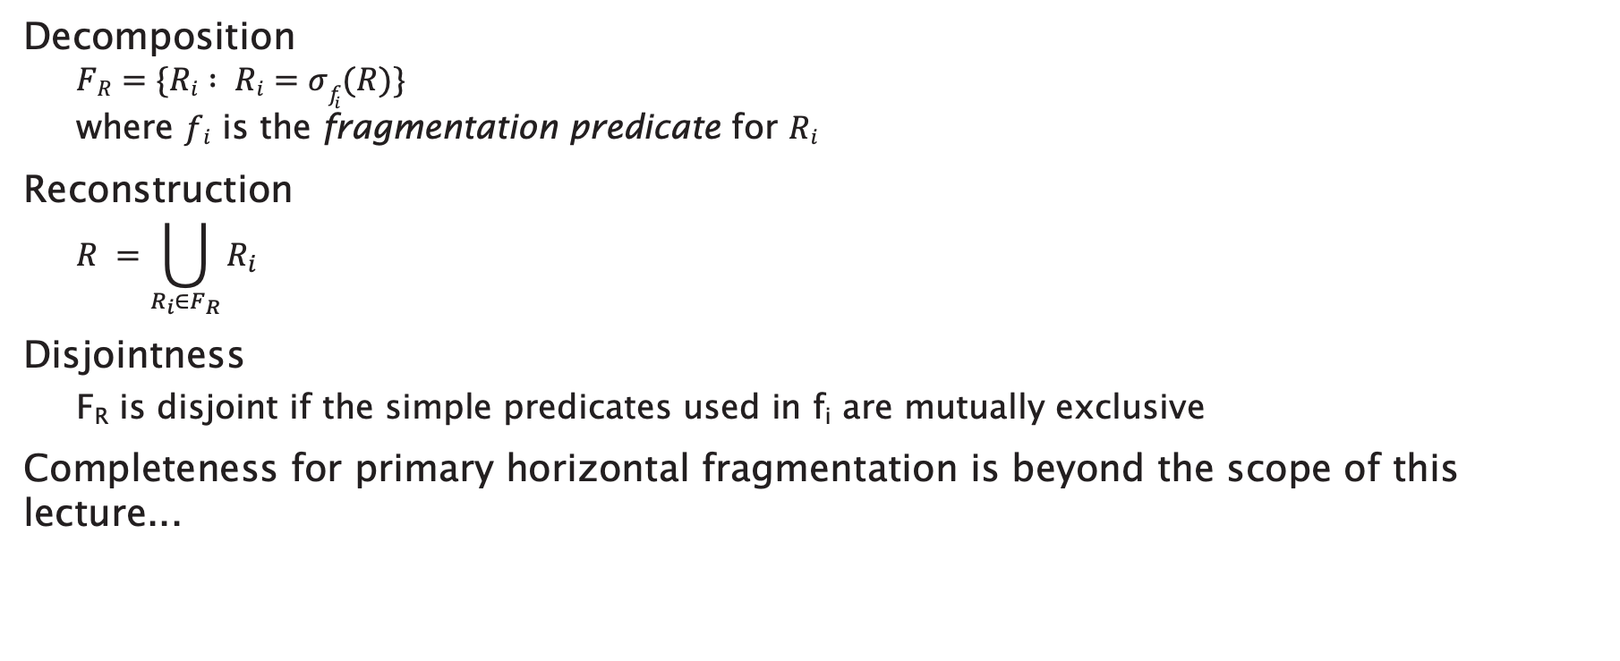
Primary Horizontal Fragmentation
Decomposition
  $$FR=\{Ri : Ri=σf_{i}(R)\}$$
  where $fi$ is the fragmentation predicate for $Ri$
Reconstruction
  $$R =\bigcup_{R_{i}∈F_{R}}{R_{i}}$$
Disjointness
  F_{R} is disjoint if the simple predicates used in f_{i} are mutually exclusive
Completeness for primary horizontal fragmentation is beyond the scope of this lecture...
Notes:
Complete – equal probability of access to any tuple from any fragment
Minimal – all predicates should be relevant (accessed differently by some application)

Slide 29
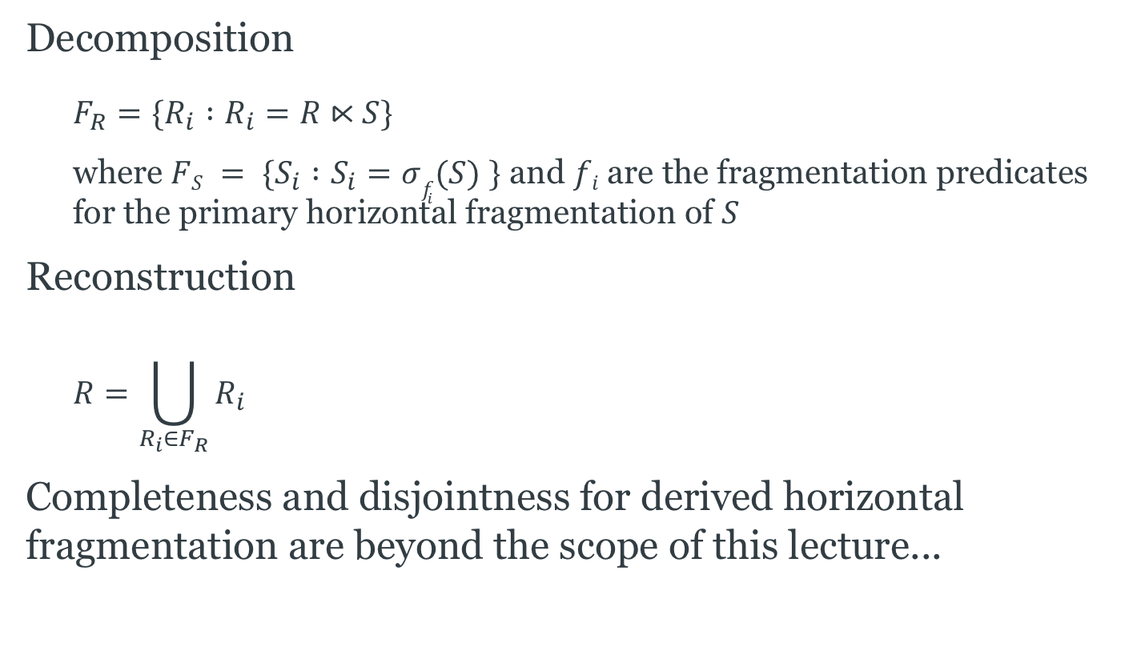
Derived Horizontal Fragmentation
Decomposition
  $$F_{R}=\{R_{i} :R_{i}=R⋉S\}$$
  where $FS = \{S_{i} :S_{i}=σf_{i}(S) \}$ and $fi$are the fragmentation predicates for the primary horizontal fragmentation of $S$
Reconstruction
  $$R=\bigcup_{R_{i}∈F_{R}}{R_{i}}$$
Completeness and disjointness for derived horizontal fragmentation are beyond the scope of this lecture...

Slide 30
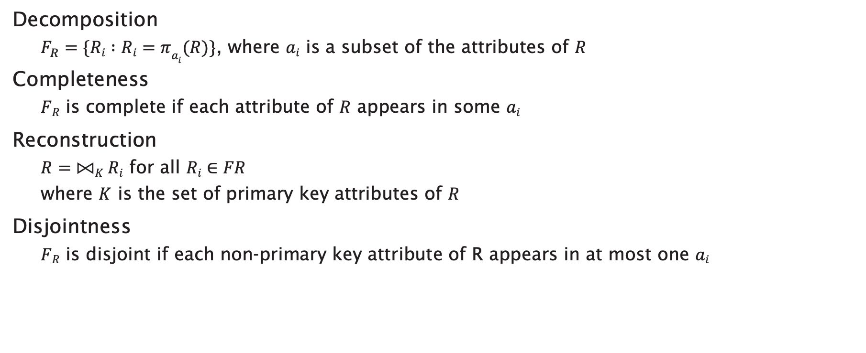
Vertical Fragmentation
Decomposition
  $F_{R}=\{Ri :Ri=πa_{i}(R)\}$, where $ai$ is a subset of the attributes of $R$
Completeness
  $FR$ is complete if each attribute of $R$ appears in some $ai$
Reconstruction
  $R=⨝K Ri$ for all $Ri∈FR$
  where $K$ is the set of primary key attributes of $R$
Disjointness
  $FR$ is disjoint if each non-primary key attribute of R appears in at most one $ai$

Slide 31
Hybrid Fragmentation
Horizontal and vertical fragmentation may be combined
  Vertical fragmentation of horizontal fragments
  Horizontal fragmentation of vertical fragments

Slide 32
Query Processing

Slide 33
Localisation
Fragmentation expressed as relational algebra expressions
Global relations can be reconstructed using these expressions
  a localisation program
Naïvely, generate distributed query plan by substituting localisation programs for relations
  use reduction techniques to optimise queries

Slide 34
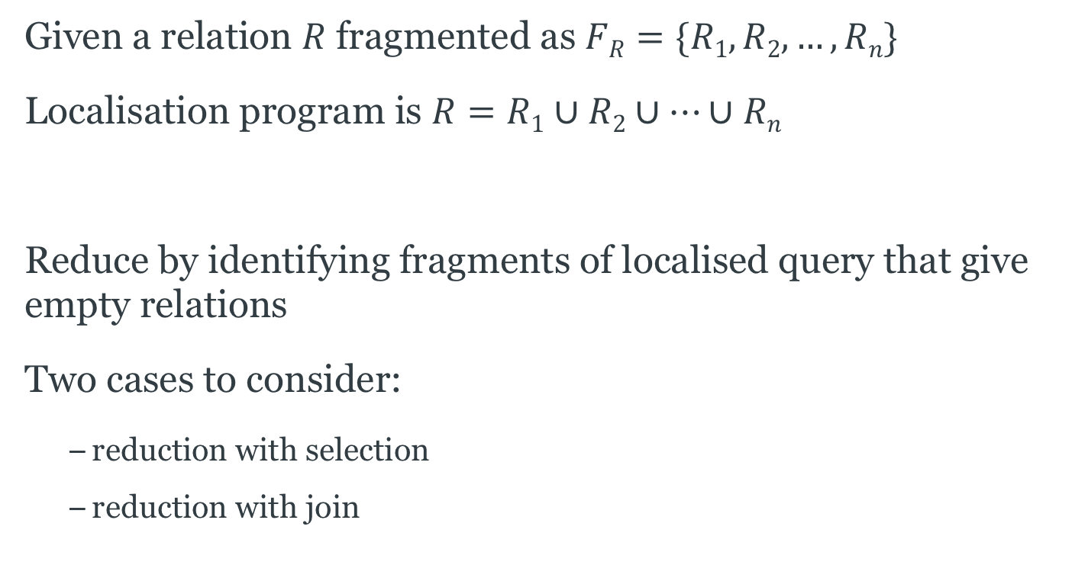
Reduction for Horizontal Fragmentation
Given a relation $R$ fragmented as $FR=\{R1, R2, …, Rn\}$
Localisation program is $R=R1∪R2∪…∪Rn$
Reduce by identifying fragments of localised query that give empty relations
Two cases to consider:
  reduction with selection
  reduction with join

Slide 35



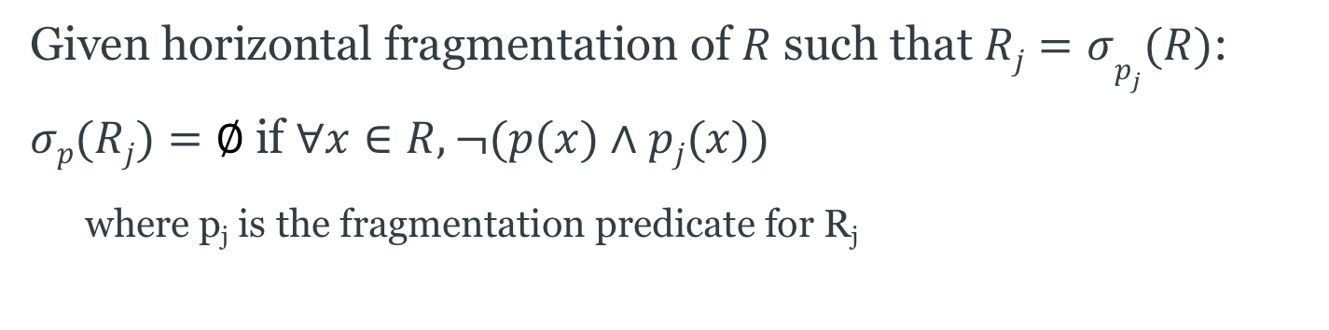





Horizontal Selection Reduction
Given horizontal fragmentation of $R$ such that $Rj=σp_{j}(R)$:
$σp(Rj)=∅$if $∀x∈R, ¬(p(x)∧pj(x))$
  where p_{j} is the fragmentation predicate for R_{j}
$$σp$$
$$σp$$
$$σp$$
∪
$$R$$
$$R1$$
$$R2$$
...
$$Rn$$
$$R2$$
query
localised query
reduced query

Slide 36







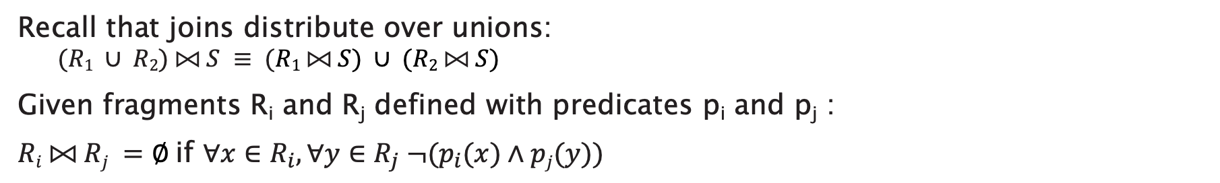










Horizontal Join Reduction
Recall that joins distribute over unions:
  $$(R1 ∪ R2) ⨝ S ≡ (R1 ⨝ S) ∪ (R2 ⨝ S)$$
Given fragments R_{i} and R_{j} defined with predicates p_{i} and p_{j} :
$Ri ⨝ Rj =∅$if $∀x∈R_{i}, ∀y∈R_{j} ¬(p_{i}(x)∧pj(y))$
$$⨝$$
$$⨝$$
$$∪$$
$$∪$$
$$⨝$$
$$⨝$$
$$R$$
$$S$$
$$R1$$
$$R2$$
$$…$$
$$Rn$$
$$S$$
$$R3$$
$$S$$
$$R5$$
$$S$$
query
localised query
reduced query

Slide 37
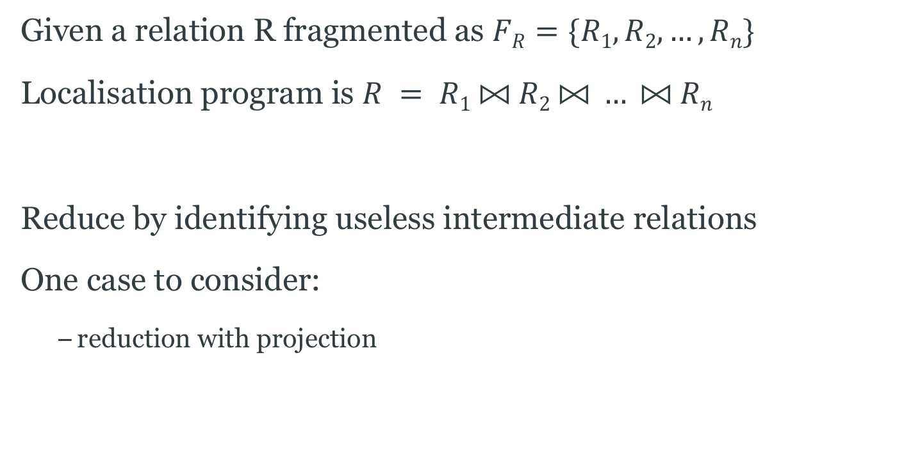
Reduction for Vertical Fragmentation
Given a relation R fragmented as $FR=\{R1, R2, …, Rn\}$
Localisation program is $R = R1 ⨝ R2 ⨝ … ⨝ Rn$
Reduce by identifying useless intermediate relations
One case to consider:
  reduction with projection

Slide 38


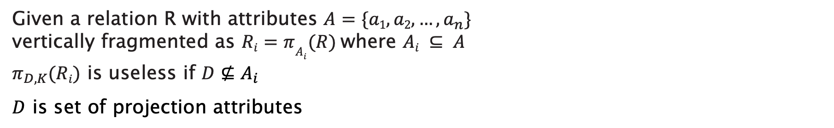

Vertical Projection Reduction
Given a relation R with attributes $A=\{a1, a2, …, a_{n}\}$
vertically fragmented as $Ri=πA_{i}(R)$where $Ai ⊆ A$
$π_{D,K}(Ri)$ is useless if $D⊈A_{i}$
$D$ is set of projection attributes
$$π_{D,K}$$
$$π_{D,K}$$
$$π_{D,K}$$
⨝
$$R$$
$$R1$$
$$R2$$
...
$$Rn$$
$$R2$$
query
localised query
reduced query

Slide 39
Distributed Joins

Slide 40

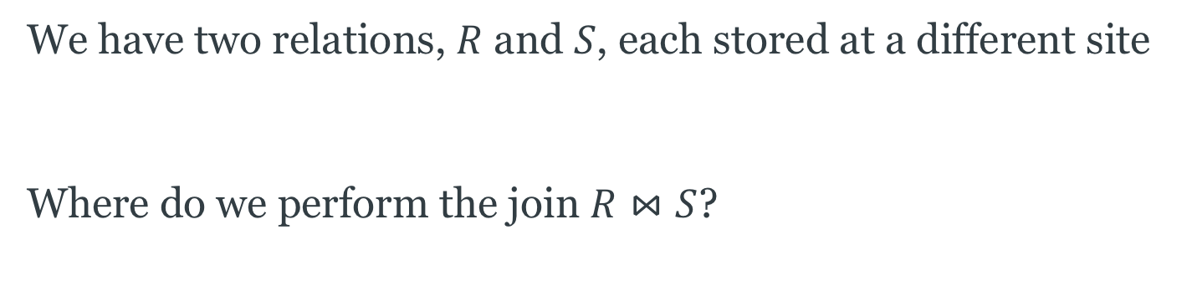


The Distributed Join Problem
We have two relations, $R$ and $S$, each stored at a different site
Where do we perform the join $R⋈S$?
Site 1
Site 2
$$R$$
$$R⋈S$$
$$S$$

Slide 41



The Distributed Join Problem
We can move one relation to the other site and perform the join there
  CPU cost of performing the join is the same regardless of site
  Communications cost depends on the size of the relation being moved
Site 1
Site 2
$$⋈$$
$$R$$
$$S$$

Slide 42
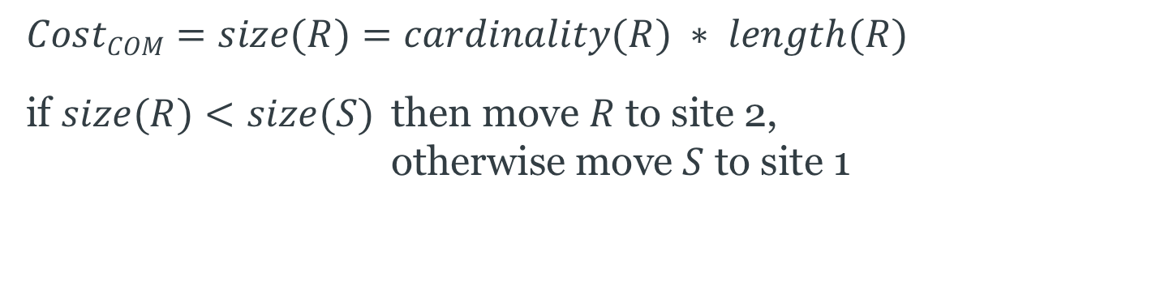
The Distributed Join Problem
$$CostCOM=size(R)=cardinality(R) ∗ length(R)$$
if $size(R)<size(S)$ then move $R$ to site 2,
otherwise move $S$ to site 1
Site 1
Site 2
$$⋈$$
$$R$$
$$S$$

Slide 43
Semijoin Reduction
We can further reduce the communications cost by only moving that part of a relation that will be used in the join
Use a semijoin...
Site 1
Site 2
$$R$$
$$R⋈S$$
$$S$$

Slide 44
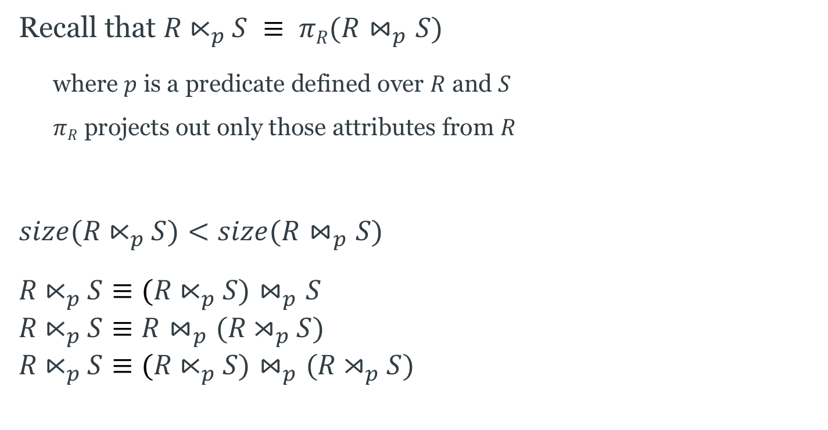
Semijoins
Recall that $R⋉_{p}S ≡ πR(R⋈_{p}S)$
  where $p$ is a predicate defined over $R$ and $S$
  $πR$ projects out only those attributes from $R$
$$size(R⋉_{p}S)<size(R⋈_{p}S)$$
$$R⋉_{p}S≡(R⋉_{p}S)⋈_{p}S \\ R⋉_{p}S≡R⋈_{p}(R⋊_{p}S) \\ R⋉_{p}S≡(R⋉_{p}S)⋈_{p}(R⋊_{p}S)$$

Slide 45
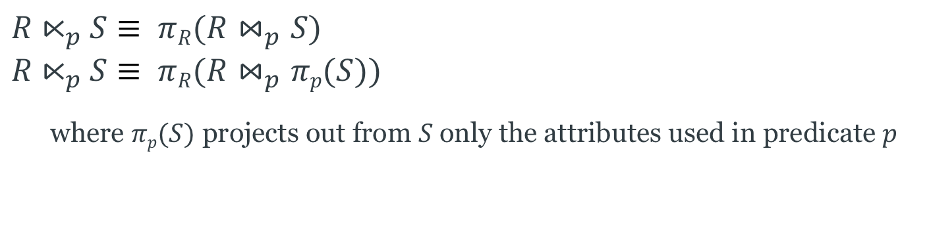
Semijoin Reduction
$$R⋉_{p}S≡ πR(R⋈_{p}S) \\ R⋉_{p}S≡ πR(R⋈_{p}πp(S))$$
  where $πp(S)$ projects out from $S$only the attributes used in predicate $p$
Site 1
Site 2
$$R$$
$$S$$

Slide 46
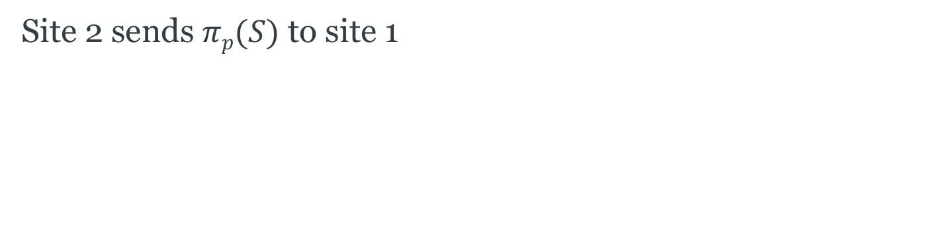

Semijoin Reduction, step 1
Site 2 sends $πp(S)$ to site 1
Site 1
Site 2
$$πp(S)$$
$$R$$
$$S$$

Slide 47
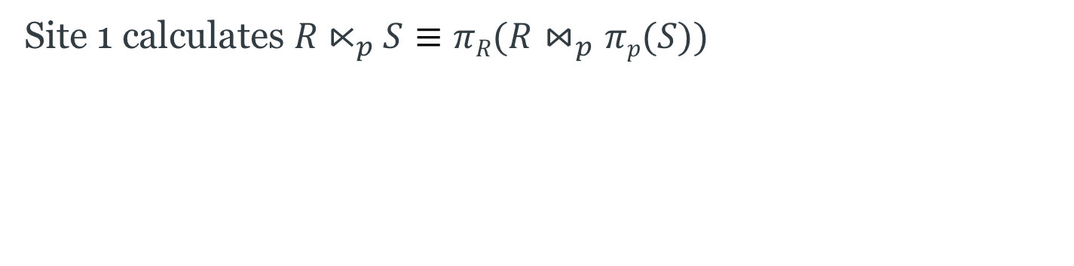

Semijoin Reduction, step 2
Site 1 calculates $R⋉_{p}S≡πR(R⋈_{p}πp(S))$
Site 1
Site 2
$$R$$
$$S$$
$$R⋉_{p}S$$

Slide 48
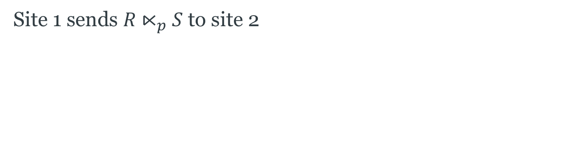

Semijoin Reduction, step 3
Site 1 sends $R⋉_{p}S$ to site 2
Site 1
Site 2
$$R$$
$$R⋉_{p}S$$
$$S$$
$$R⋉_{p}S$$

Slide 49
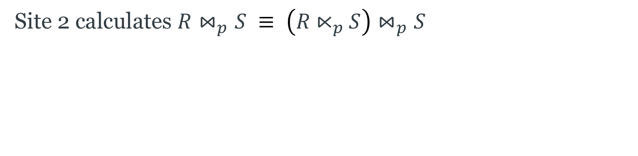

Semijoin Reduction, step 4
Site 2 calculates $R⋈_{p}S ≡ \left(R⋉_{p}S\right)⋈_{p}S$
Site 1
Site 2
$$R$$
$$S$$
$$R⋉_{p}S$$
$$R⋈_{p}S$$

Slide 50
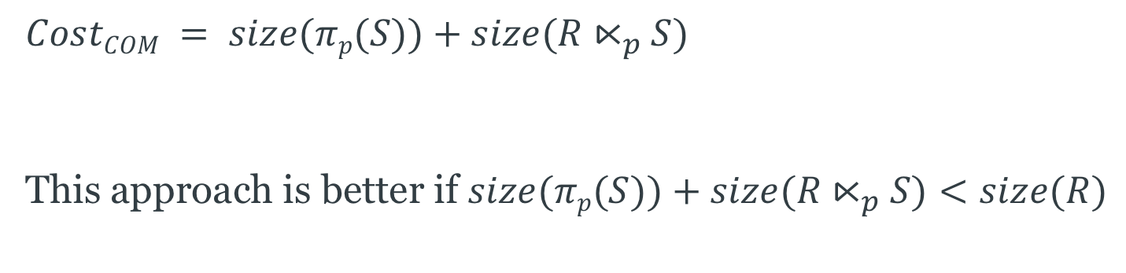
Semijoin Reduction
$$CostCOM = size(πp(S))+size(R⋉_{p}S)$$
This approach is better if $size(πp(S))+size(R⋉_{p}S)<size(R)$
Site 1
Site 2
$$R$$
$$S$$
$$R⋉_{p}S$$
$$R⋈_{p}S$$
Notes:
The semijoin approach is better if a few tuples of R participate in the join.
The join approach is better if almost all tuples of R participate in the join, because the semijoin approach requires an additional transfer of a projection on the join attribute.

Slide 51
Concurrency Control

Slide 52
Distributed Transactions
Transaction processing may be spread across several sites in the distributed database
  The site from which the transaction originated is known as the coordinator
  The sites on which the transaction is executed are known as the participants
P
transaction
C
P
P

Slide 53
Distribution and ACID
Non-distributed databases aim to maintain isolation
  Isolation: A transaction should not make updates externally visible until committed
Distributed databases commonly use two-phase locking (2PL) to preserve isolation
  2PL ensures serialisability, the highest isolation level

Slide 54
Two-Phase Locking
Two phases:
  Growing phase: obtain locks, access data items
  Shrinking phase: release locks
Guarantees serialisable transactions
#locks
LOCK
POINT
BEGIN
END
time
growing phase
shrinking phase

Slide 55
Distribution and Two-Phase Locking
In a non-distributed database, locking is controlled by a lock manager
Two main approaches to implementing two-phase locking in a distributed database:
  Centralised 2PL (C2PL)
  Responsibility for lock management lies with a single site
  Distributed 2PL (D2PL)
  Each site has its own lock manager

Slide 56
Centralised Two-Phase Locking (C2PL)
Coordinating site runs transaction manager TM
Participant sites run data processors DP
Lock manager LM runs on central site
TM requests locks from LM
If granted, TM submits operations to processors DP
When DPs finish, TM sends message to LM to release locks
DP
TM
LM
lock request
operation
lock granted
end of operation
release locks

Slide 57
Centralised Two-Phase Locking (C2PL)
LM is a single point of failure
  less reliable
LM is a bottleneck
  affects transaction throughput
DP
TM
LM
lock request
operation
lock granted
end of operation
release locks

Slide 58
Distributed Two-Phase Locking (D2PL)
Coordinating site C runs TM
Each participant runs both an LM and a DP
TM sends operations and lock requests to each LM
If lock can be granted, LM forwards operation to local DP
DP sends “end of operation” to TM
TM sends message to LM to release locks
DP
LM
TM
operation +
lock request
operation
end of operation
release locks

Slide 59
Distributed Two-Phase Locking (D2PL)
Variant:
DPs may send “end of operation” to their own LM
LM releases lock and informs TM
DP
LM
TM
operation +
lock request
operation
end of operation
+ release locks
end of operation

Slide 60
Deadlock
Deadlock exists when two or more transactions are waiting for each other to release a lock on an item
Three conditions must be satisfied for deadlock to occur:
  Concurrency: two transactions claim exclusive control of one resource
  Hold: one transaction continues to hold exclusively controlled resources until its need is satisfied
  Wait: transactions wait in queues for additional resources while holding resources already allocated

Slide 61
Wait-For Graph
Representation of interactions between transactions
Directed graph containing:
  A vertex for each transaction that is currently executing
  An edge from T1 to T2 if T1 is waiting to lock an item that is currently locked by T2
Deadlock exists iff the WFG contains a cycle
T1
T3
T2

Slide 62
Distributed Deadlock
Two types of Wait-For Graph
  Local WFG
  (one per site, only considers transactions on that site)
  Global WFG
  (union of all LWFGs)
Deadlock may occur
  on a single site
  (within its LWFG)
  between sites
  (within the GWFG)

Slide 63
Distributed Deadlock Example
Consider the wait-for relationship T1→T2→T3→T4→T1
with T1, T2 on site 1 and T3, T4 on site 2
Site 1
Site 2
T1
T4
T2
T3

Slide 64
Managing Distributed Deadlock
Three main approaches:
Prevention
  pre-declaration
Avoidance
  resource ordering
  transaction prioritisation
Detection and Resolution

Slide 65
Prevention
Guarantees that deadlocks cannot occur in the first place
Transaction pre-declares all data items that it will access
TM checks that locking data items will not cause deadlock
Proceed (to lock) only if all data items are available (unlocked)
Con: difficult to know in advance which data items will be
accessed by a transaction

Slide 66
Avoidance
Two main sub-approaches:
Resource ordering
  Concurrency controlled such that deadlocks won’t happen
Transaction prioritisation
  Potential deadlocks detected and avoided

Slide 67
Resource Ordering
All resources (data items) are ordered
Transactions always access resources in this order
Example:
  Data item A comes before item B
  Both transactions need to get locks on A and B
  All transactions must get a lock on A before trying for a lock on B
  No transaction will ever be left with a lock on B and waiting for a lock on A

Slide 68
Transaction Prioritisation
Each transaction has a timestamp that corresponds to the time it was started: ts(T)
  Transactions can be prioritised using these timestamps
When a lock request is denied, use priorities to choose a transaction to abort
  WAIT-DIE and WOUND-WAIT rules

Slide 69
WAIT-DIE and WOUND-WAIT
T_{i} requests a lock on a data item that is already locked by T_{j}
The WAIT-DIE rule:
  if ts(T_{i}) < ts(T_{j})
  then T_{i} waits
  else T_{i} dies (aborts and restarts with same timestamp)
The WOUND-WAIT rule:
  if ts(T_{i}) < ts(T_{j})
  then T_{j} is wounded (aborts and restarts with same timestamp)
  else T_{i} waits
  note: WOUND-WAIT pre-empts active transactions

Slide 70
Detection and Resolution
Study the GWFG for cycles (detection)
Break cycles by aborting transactions (resolution)
Selecting minimum total cost sets of transactions to abort is NP-complete
Three main approaches to deadlock detection:
  centralised
  hierarchical
  distributed

Slide 71
Centralised Deadlock Detection
One site is designated as the deadlock detector (DD) for the system
Each site sends its LWFG (or changes to its LWFG) to the DD at intervals
DD constructs the GWFG and looks for cycles

Slide 72
Hierarchical Deadlock Detection
Each site has a DD, which looks in the site’s LWFG for cycles
Each site sends its LWFG to the DD at the next level, which merges the LWFGs sent to it and looks for cycles
These DDs send the merged WFGs to the next level, etc
deadlock
detectors
site 1
site 2
site 3
site 4

Slide 73
Distributed Deadlock Detection
Responsibility for detecting deadlocks is delegated to sites
LWFGs are modified to show relationships between local transactions and remote transactions
Site 1
Site 2
T1
T4
T2
T3

Slide 74
Distributed Deadlock Detection
LWFG contains a cycle not involving external edges
  Local deadlock, resolve locally
LWFG contains a cycle involving external edges
  Potential deadlock – communicate to other sites
  Sites must then agree on a victim transaction to abort

Slide 75
Reliability

Slide 76
Distribution and ACID
Non-distributed databases aim to maintain atomicity and durability of transactions
  Atomicity: A transaction is either performed completely or not at all
  Durability: Once a transaction has been committed, changes should not be lost because of failure
As with parallel databases, distributed databases use the two-phase commit protocol (2PC) to preserve atomicity
  Increased cost of communication may require a variant approach

Slide 77
Centralised 2PC
Communication only between the coordinator and the participants
  No inter-participant communication
prepare T
vote-commit T
vote-abort T
commit T
abort T
ack
P1
P1
P2
P2
C
P3
C
P3
C
P4
P4
P5
P5
voting phase
decision phase

Slide 78
Linear 2PC
First phase from the coordinator to the participants
Second phase from the participants to the coordinator
Participants may unilaterally abort
voting phase
prepare T
VC/VA T
VC/VA T
VC/VA T
VC/VA T
C
P1
P2
P3
P4
P5
C/A T
C/A T
C/A T
C/A T
C/A T
decision phase

Slide 79
Centralised versus Linear 2PC
Linear 2PC involves fewer messages
Centralised 2PC provides opportunities for parallelism
Linear 2PC has worse response time performance

Slide 80
The CAP Theorem

Slide 81
The CAP Theorem
In any distributed system, there is a trade-off between:
Consistency
  Each server always returns the correct response to each request
Availability
  Each request eventually receives a response
Partition Tolerance
  Communication may be unreliable (messages delayed, messages lost, servers partitioned into groups that cannot communicate with each other), but the system as a whole should continue to function

Slide 82
The CAP Theorem
CAP is an example of the trade-off between safety and liveness in an unreliable system
  Safety: nothing bad ever happens
  Liveness: eventually something good happens
We can only manage two of three from C, A, P
  Typically we sacrifice either availability (liveness) or consistency (safety)

Slide 83
Next Lecture:
Message Queues

