Slide 1
Semantic Web in Depth
Schema.org
RDFa, JSON-LD, Microdata
Professor Steffen Staab s.r.staab@ecs.soton.ac.uk 2019, Many slides courtesy by Dr. Nick Gibbins

Slide 2
Embedding Semantic Web Data
http://www.flickr.com/photos/40472757@N07/4508416502/

Slide 3
Embedded Data
Publishing patterns for linked data that we’ve already considered make the assumption that we’re publishing directly in RDF/OWL
What if the data already exists in a web resource, in some form?

Slide 4
Embedded Data
Republishing the data separately introduces redundancy, and the possibility of inconsistency - embed our SW data in the web resource
Existing approaches:
JSON-LD
RDFa
Microdata
Microformats(2)
GRDDL (W3C recommendation 2007)
Supported by schema.org

Slide 5
Schema.org

Slide 6
Metadata for Search Engine Optimization
Meta tag already available in early versions of HTML
Objective: Indication of relevance
Spammed! ➔ Highly unsuccessful
SearchMonkey (2008)
Metadata to make Yahoo! search results visually more appealing
Turned into schema.org (2011)
Initiative by Google, Bing, Yahoo, later: Yandex

Slide 7
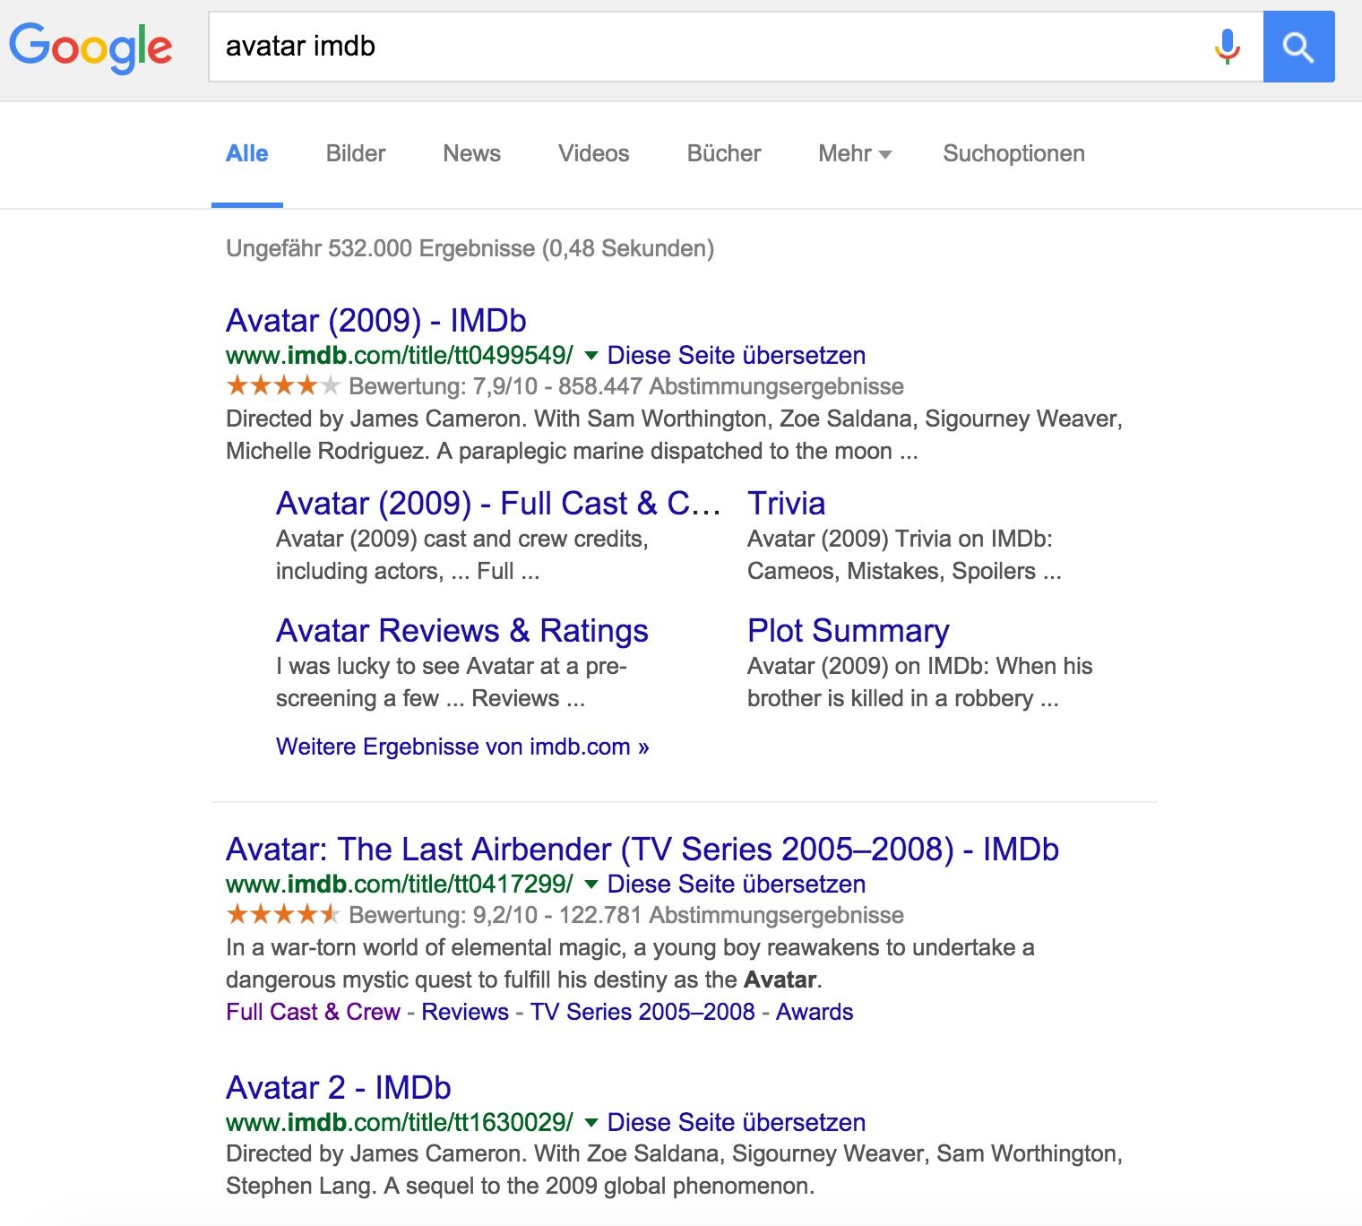
Metadata for Search

Slide 9
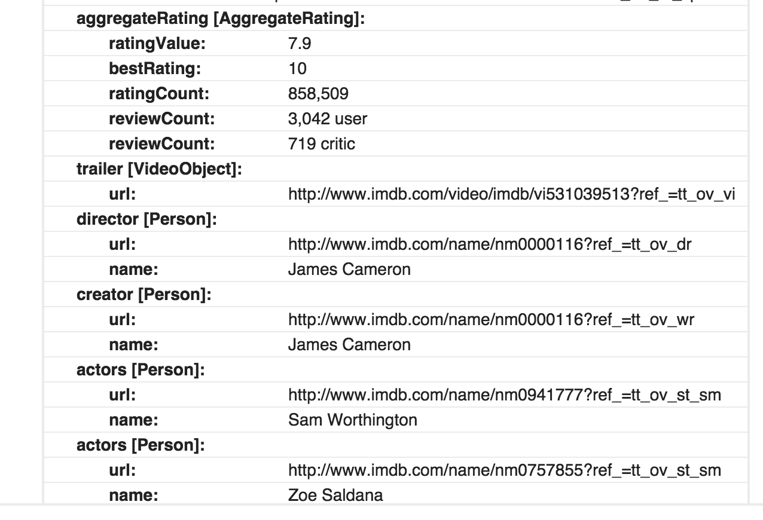

Slide 10
What is in schema.org?
Creative works: CreativeWork, Book, Movie, MusicRecording, Recipe, TVSeries ...
Embedded non-text objects: AudioObject, ImageObject, VideoObject
Event
Organization
Person
Place, LocalBusiness, Restaurant ...
Product, Offer, AggregateOffer
Review, AggregateRating
An open ended list!

Slide 11
Return on Investment
BestBuy early adopter
Launched Semantic Product Web, augmented with GoodRelations and RDFa,
30% increase in traffic to their pages.
(not a scientifically precise experiment!)
Nick Cox@Yahoo!
search results augmented with structured data get 15% higher click-through rate
Cf http://www.chiefmartec.com/2009/12/best-buy-jump-starts-data-web-marketing.html

Slide 12
Microdata

Slide 13
Microdata (W3C Working Group Note 2013)
Core concept: name-value pairs
<div itemscope> <p>My name is <span itemprop=”fname">Steffen</span> <span itemprop=”lname">Staab</span>.
</p><img itemprop="image" src=”steffen.png”>
</div>
<div itemscope> <p>His name is <span itemprop=”fname">Nick</span>. </p></div>

Slide 14
Types, (Global) Identifiers, Dates
<dl itemscope
itemtype="http://vocab.example.net/book"
itemid="urn:isbn:0-330-34032-8">
<dt>Title
<dd itemprop="title">The Reality Dysfunction
<dt>Author
<dd itemprop="author">Peter F. Hamilton
<dt>Publication date
<dd><time itemprop="pubdate" datetime="1996-01-26">26 January 1996</time>
</dl>

Slide 15
Nested Itemscopes
<div itemscope itemtype="http://ex.org/group">
<span itemprop="name">Web and Internet Science</span>
<div itemprop=“member"
itemscope itemtype=http://ex.org/Person
itemid=„steffenstaab“>
<div itemprop=“name" >Steffen Staab</div></div>
</div>

Slide 16
Schema.org example in microdata

Slide 17
RDFa

Slide 18
RDFa
Yet another syntax for RDF…
Designed for embedding structured data in web pages
Stored structure in attributes (the ‘a’ in ‘RDFa’)

Slide 19
RDFa Example
<html> <head><title>Jo's Friends and Family Blog</title></head> <body> <p>I'm holding one last summer Barbecue, on September 16th at 4pm.</p> <p class="contactinfo”>Jo Smith. Web hacker at Example, Inc. You can contact me <a href="mailto:jo@example.org">via email</a>.</p> </body> </html>

Slide 20
Setting namespaces
<html prefix=“cal: http://example.org/ontology/cal# foaf: http://xmlns.com/foaf/0.1/ xsd: http://www.w3.org/2001/XMLSchema#”> <head><title>Jo's Friends and Family Blog</title></head> <body> <p>I'm holding one last summer barbecue, on September 16th at 4pm.</p> <p class="contactinfo”>Jo Smith. Web hacker at Example, Inc. You can contact me <a href="mailto:jo@example.org">via email</a>.</p> </body> </html>

Slide 21
Showing an instance of a class
Class membership is indicated using the typeof attribute:
<p>I'm holding one last summer barbecue, on September 16th at 4pm.</p>

Slide 22
Showing an instance of a class
Class membership is indicated using the typeof attribute:
<p typeof=“cal:Event”>I'm holding one last summer barbecue, on September 16th at 4pm.</p>
_:a rdf:type cal:Event .

Slide 23
Using properties: predicates
The predicate of a triple is indicated using the property attribute:
<p>I'm holding one last summer barbecue, on September 16th at 4pm.</p>

Slide 24
Using properties: predicates
The predicate of a triple is indicated using the property attribute:
<p>I'm holding <span property=“cal:summary”>one last summer barbecue</span>, on September 16th at 4pm. </p>

Slide 25
Using properties: literal objects
The object of a literal-valued triple is given by the content of the element bearing the property attribute
<p>I'm holding <span property=“cal:summary”>one last summer barbecue</span>, on September 16th at 4pm. </p>
_:a cal:summary “one last summer barbecue” .

Slide 26
Using properties: substitute values
The content of an element may be substituted for using the content attribute:
<p>I'm holding one last summer barbecue, on <span property=“cal:start” content=“2007-09-16T16:00:00”>September 16th at 4pm</span>.</p>
_:a cal:start “2007-09-16T16:00:00” .

Slide 27
Using properties: datatypes
The datatype of a literal-value object is indicated using the datatype attribute:
<p>I'm holding one last summer barbecue, on <span property=“cal:start” datatype=“xsd:dateTime” content=“2007-09-16T16:00:00”>September 16th at 4pm</span>.</p>
_:a cal:start “2007-09-16T16:00:00”^^xsd:dateTime .

Slide 28
Using properties: resource objects
The object of a resource-valued triple is given by the content of the resource attribute:
<p class="contactinfo”>Jo Smith. Web hacker at <span property=“foaf:workplaceHomepage” resource=“http://example.org”>Example, Inc</span>. You can contact me <a href="mailto:jo@example.org">via email</a>.</p>
_:b foaf:workplaceHomepage <http://example.org/> .

Slide 29
Identity
The subject of a triple is indicated using the about attribute:
<p class="contactinfo”>Jo Smith. Web hacker at <span property=“foaf:workplaceHomepage” resource=“http://example.org”>Example, Inc</span>. You can contact me <a href="mailto:jo@example.org">via email</a>.</p>
_:b foaf:workplaceHomepage <http://example.org/> .

Slide 30
Identity
The subject of a triple is indicated using the about attribute:
<p class="contactinfo” about=“http://example.org/staff/jo”>Jo Smith. Web hacker at <span property=“foaf:workplaceHomepage” resource=“http://example.org”>Example, Inc</span>. You can contact me <a href="mailto:jo@example.org">via email</a>.</p>
<http://example.org/staff/jo> foaf:workplaceHomepage <http://example.org/> .

Slide 31
Using existing links
Existing links may be used to construct triples with resource-valued objects:
<p class="contactinfo” about=“http://example.org/staff/jo”>Jo Smith. Web hacker at Example, Inc. You can contact me <a href="mailto:jo@example.org">via email</a>.</p>

Slide 32
Using existing links
The rel attribute is used to indicate the predicate:
<p class="contactinfo” about=“http://example.org/staff/jo”>Jo Smith. Web hacker at Example, Inc. You can contact me <a rel=“foaf:mbox” href="mailto:jo@example.org">via email</a>.</p>

Slide 33
Using existing links
The href attribute is used to indicate the object:
<p class="contactinfo” about=“http://example.org/staff/jo”>Jo Smith. Web hacker at Example, Inc. You can contact me <a rel=“foaf:mbox” href="mailto:jo@example.org">via email</a>.</p>
<http://example.org/staff/jo> foaf:mbox <mailto:jo@example.org> .

Slide 34
Original File
<html> <head><title>Jo's Friends and Family Blog</title></head> <body> <p>I'm holding one last summer barbecue, on September 16th at 4pm.</p> <p class="contactinfo”>Jo Smith. Web hacker at Example, Inc. You can contact me <a href="mailto:jo@example.org">via email</a>.</p> </body> </html>

Slide 35
Annotated File
<html prefix=“cal: http://example.org/ontology/cal# foaf: http://xmlns.com/foaf/0.1/ xsd: http://www.w3.org/2001/XMLSchema#”> <head><title>Jo's Friends and Family Blog</title></head> <body> <p typeof=“cal:Event”>I'm holding <span property=“cal:summary”>one last summer barbecue</span>, on <span property=“cal:start” content=“2007-09-16T16:00:00” datatype=“xsd:dateTime”>September 16th at 4pm</span>.</p> <p class="contactinfo” typeof=“foaf:Person” about=“http://example.org/staff/jo”> <span property=“foaf:name”>Jo Smith</span>. Web hacker at <span property=“foaf:workplaceHomepage” resource=“http://example.org”>Example, Inc</span>. You can contact me <a rel=“foaf:mbox” href="mailto:jo@example.org">via email</a>.</p> </body> </html>

Slide 36
Contained Triples
_:a rdf:type cal:Event ; cal:summary “one last summer barbecue” ; cal:start “2007-09-16T16:00:00”^^xsd:dateTime .
<http://example.org/staff/jo> rdf:type foaf:Person ; foaf:name “Jo Smith” ; foaf:workplaceHomepage <http://example.org> ; foaf:mbox <mailto:jo@example.org> .

Slide 37
Schema.org example in RDFa

Slide 38
Annotating Visible vs Unvisible Content
Visible annotated content
Less likely to be spam
More likely to be up-to-date
Officially encouraged by search engines
Invisible annotated content
Separation of concerns: content vs annotations
Easier to code
Easier to convert from other data sources
With support for JSON-LD accepted now

Slide 39
JSON-LD

Slide 40
JSON
Rationale
Readable format for data exchange
Has overtaken XML in app development
Less verbose
More readable
Easy to parse
JSON-LD
Build on the success of JSON
Basically: JSON-LD = JSON + global identifiers
Every JSON-LD document is a valid JSON document

Slide 41
JSON Document
{
"name": “Steffen Staab",
"homepage": “http://www.uni-koblenz.de/~staab/",
"image": "http://userpages.uni-koblenz.de/~staab/images/steffen2013-06.png"
}

Slide 42
JSON-LD
{
"http://schema.org/name": “Steffen Staab",
"http://schema.org/url": { "@id": „http://www.uni-koblenz.de/~staab/" },
← The '@id' keyword means 'This value is an identifier that is an IRI‘
"http://schema.org/image": { "@id": "http://userpages.uni-koblenz.de/~staab/images/steffen2013-06.png" }
}

Slide 43
Context in JSON-LD
{ "@context":
{ "name": "http://schema.org/name", ← shorthand
"image": { "@id": "http://schema.org/image", ← shorthand "@type": "@id" ← IRI },
"homepage": { "@id": "http://schema.org/url", ← shorthand "@type": "@id" ← string value associated with 'homepage' should be interpreted as IRI
} } }

Slide 44
Referencing a JSON-LD context
{
"@context": "http://json-ld.org/contexts/person.jsonld",
"name": “Steffen Staab",
"homepage": “http://www.uni-koblenz.de/~staab/",
"image": "http://userpages.uni-koblenz.de/~staab/images/steffen2013-06.png"
}

Slide 45
Identifying a node
{
"@context":
{ "name": "http://schema.org/name“ },
"@id": „http://www.uni-koblenz.de/~staab/#me",
"name": “Steffen Staab",
...
}

Slide 46
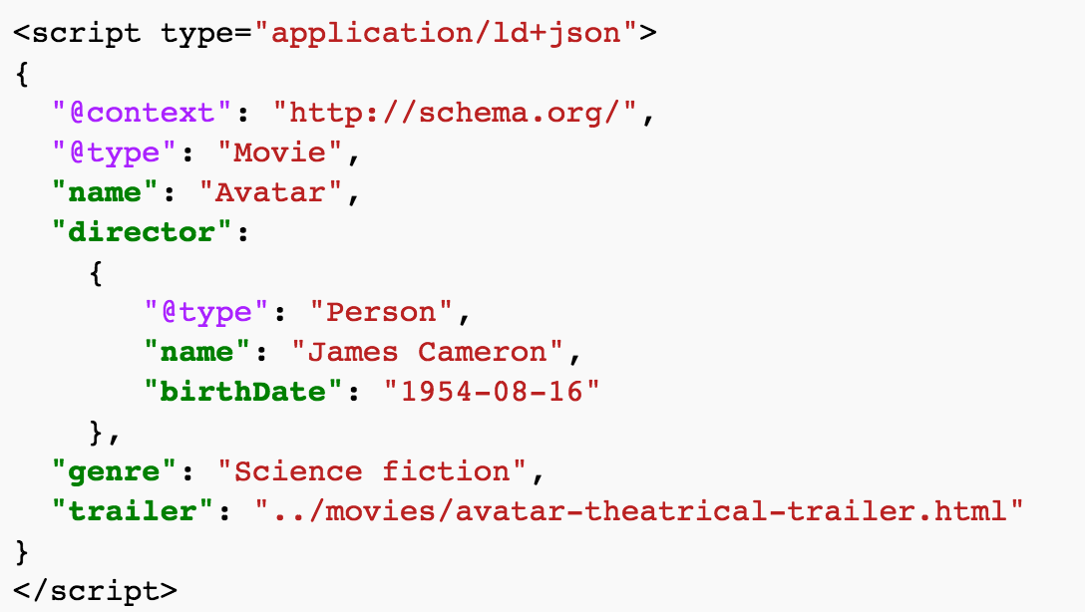
Schema.org example in JSON-LD
I would suggest to avoid blank nodes, i.e. nodes without identifiers

Slide 47
Microformats

Slide 48
Microformats
Predefines syntax
Predefines and freezes vocabulary
Not officially supported by schema.org, but understood quite a bit by search engines
Vocabularies
h-adr
h-card
h-entry
h-event
h-geo
h-item
h-product
h-recipe
h-resume
h-review
h-review-aggregate

Slide 49
GRDDL

Slide 50
GRDDL
Given a document in some XML format, how can we extract the relevant portions and make them available to SW agents?
GRDDL (Gleaning Resource Descriptions from Dialects of Languages) uses XSLT stylesheets to transform documents
XSLTstyle sheet
XML
doc
RDF/XML
GRDDL Processor

Slide 51
Further Reading
RDFa Core 1.1 W3C Recommendation 22 August 2013 http://www.w3.org/TR/rdfa-syntax/
RDFa 1.1 Primer (essential reading!) W3C Working Group Note 22 August 2013 http://www.w3.org/TR/xhtml-rdfa-primer/

