Slide 1
Trust
David Millard
dem@soton.ac.uk

Slide 2
This country has a dark future unless we can attract better people into politics

Slide 3
It is safe to believe that in spite of what people say most people are primarily interested in their own welfare

Slide 4
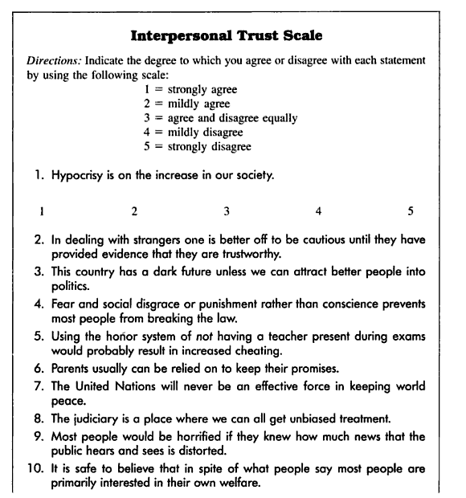
ROTTER’s Interpersonal Trust Scale
The ITS measures an individual’s general tendency to trust different groups of people
  E.g. teachers, parents, politicians, physicians, classmates, and friends
The survey measures the individual’s “general optimism regarding the society”
Rotter, J. B. 1967. A new scale for the measurement of inter- personal trust. Journal of Personality. 35; 615-665

Slide 5
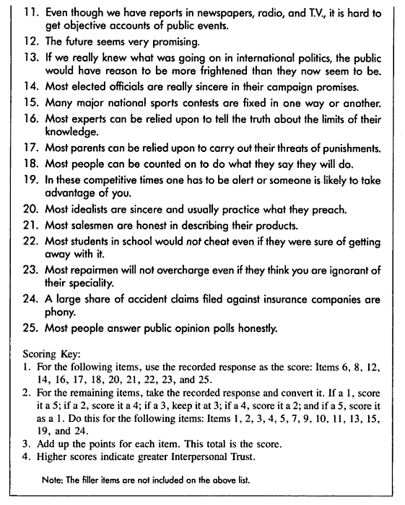
ROTTER’s Interpersonal Trust Scale
Rotter summarised his 13 years of findings in 1980
Subjects that are high in interpersonal trust tend to be:
  more trustworthy
  better liked
  happier
Subjects low in interpersonal trust tend to exhibit untrustworthy behavior (self-reported cheating and lying)
Rotter, J. B. 1967. A new scale for the measurement of inter- personal trust. Journal of Personality. 35; 615-665

Slide 6
Trust
  “Trust is a psychological state comprising the intention to accept vulnerability based upon positive expectations of the intentions or behavior of another.”
- Roussau et al. (1998)
Rousseau et al. Not so different after all: a cross-discipline view of trust. Academy of Management Review (1998) vol. 23 pp. 393-404

Slide 7
Trust
  “Trust is a psychological state comprising the intention to accept vulnerability based upon positive expectations of the intentions or behavior of another.”
- Roussau et al. (1998)
Risk
"Risk is the perceived probability of loss, as interpreted by a decision maker "
Interdependence
"where the interests of one party cannot be achieved without reliance upon another.”
Rousseau et al. Not so different after all: a cross-discipline view of trust. Academy of Management Review (1998) vol. 23 pp. 393-404

Slide 8
Part 1
Calculating INTERPERSONAL TRUST Online

Slide 9
HOW MIGHT WE CALCULATE TRUST?
Policy-Based Trust
Provenance-Based Trust
Reputation-Based Trust

Slide 10
Dan
HOW MIGHT WE CALCULATE TRUST?
Bob
Clare
Alice

Slide 11
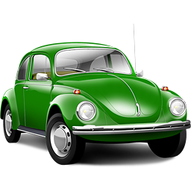
Dan
HOW MIGHT WE CALCULATE TRUST?
Bob
Registration Info
…………
…………
Clare
Alice
Bob is selling Clare a car that used to belong to Alice
Dan has bought stuff from Bob before
Can Clare trust the info Bob gives her about the car?

Slide 12
HOW MIGHT WE CALCULATE TRUST?
Policy-Based Trust
Provenance-Based Trust
Reputation-Based Trust

Slide 13

Dan
HOW MIGHT WE CALCULATE TRUST?
Bob
Registration Info
…………
…………
Clare
Alice
Registration Info
…………
…………
Commute responsibility to a trusted 3rd party
Use security protocols to verify credentials

Slide 14
Dan
HOW MIGHT WE CALCULATE TRUST?
Bob
Registration Info
…………
…………
Clare
Alice
Token
Registration Info
…………
…………
Commute responsibility to a trusted 3rd party
Use security protocols to verify credentials

Slide 15
Dan
HOW MIGHT WE CALCULATE TRUST?
Token
Bob
Registration Info
…………
…………
Clare
Alice
Registration Info
…………
…………
Commute responsibility to a trusted 3rd party
Use security protocols to verify credentials

Slide 16
Dan
HOW MIGHT WE CALCULATE TRUST?
Bob
Registration Info
…………
…………
Clare
Alice
Token
?
Registration Info
…………
…………
Commute responsibility to a trusted 3rd party
Use security protocols to verify credentials

Slide 17
HOW MIGHT WE CALCULATE TRUST?
Policy-Based Trust
Provenance-Based Trust
Reputation-Based Trust

Slide 18
Dan
HOW MIGHT WE CALCULATE TRUST?
Bob
Registration Info
…………
…………
Clare
Alice
The provenance of a piece of data is the process that led to that piece of data.

Slide 19
Dan
HOW MIGHT WE CALCULATE TRUST?
Bob
Registration Info
…………
…………
Clare
Alice
Sold to Bob
2010
…………
………
The provenance of a piece of data is the process that led to that piece of data.

Slide 20

Sold to Alice
2008
…………
………
Dan
HOW MIGHT WE CALCULATE TRUST?
Bob
Registration Info
…………
…………
Clare
Alice
Sold to Bob
2010
…………
………
The provenance of a piece of data is the process that led to that piece of data.

Slide 21
Imported and Registered
2007
Sold to Alice
2008
…………
………
Dan
HOW MIGHT WE CALCULATE TRUST?
Bob
Registration Info
…………
…………
Clare
Alice
Sold to Bob
2010
…………
………
The provenance of a piece of data is the process that led to that piece of data.

Slide 22
Imported and Registered
2007
Dan
HOW MIGHT WE CALCULATE TRUST?
Sold to Alice
2008
…………
………
Sold to Bob
2010
…………
………
Bob
Registration Info
…………
…………
Clare
Alice
Because provenance data is transparent, Clare is free to check with anyone named in the process.
The provenance of a piece of data is the process that led to that piece of data.

Slide 23
HOW MIGHT WE CALCULATE TRUST?
Policy-Based Trust
Provenance-Based Trust
Reputation-Based Trust

Slide 24
Dan
HOW MIGHT WE CALCULATE TRUST?
Bob
Registration Info
…………
…………
Clare
Alice
Trust based on personal experience or the experiences of others – their reputation

Slide 25
Bob is 80% trustworthy
Dan
HOW MIGHT WE CALCULATE TRUST?
Bob is 100% trustworthy
Bob
Registration Info
…………
…………
Clare
Alice
Trust based on personal experience or the experiences of others – their reputation

Slide 26
Bob is 80% trustworthy
Dan
HOW MIGHT WE CALCULATE TRUST?
Weight = 5
Bob is 100% trustworthy
Bob
Registration Info
…………
…………
Clare
Weight = 0
Alice
Weight = 2
Trust based on personal experience or the experiences of others – their reputation

Slide 27
Bob is 80% trustworthy
Dan is 60% trustworthy
Dan
HOW MIGHT WE CALCULATE TRUST?
Weight = 5
Weight = 5
Bob is 100% trustworthy
Bob
Registration Info
…………
…………
Clare
Weight = 0
Alice
Weight = 2
Trust based on personal experience or the experiences of others – their reputation

Slide 28
Bob is 80% trustworthy
Dan is 60% trustworthy
Dan
HOW MIGHT WE CALCULATE TRUST?
Weight = 5
Weight = 5
Bob is 100% trustworthy
Bob
Registration Info
…………
…………
Clare
Weight = 0
Alice
Weight = 2
So how do we combine these in a meaningful way?!
Trust based on personal experience or the experiences of others – their reputation

Slide 29
Bob is 80% trustworthy
Dan is 60% trustworthy
Dan
HOW MIGHT WE CALCULATE TRUST?
Weight = 5
Weight = 5
Bob is 100% trustworthy
Bob
Registration Info
…………
…………
Clare
Weight = 0
Alice
Weight = 2
Global Trust means the whole network is used to calculate a single trust value for each node

Slide 30
Bob is 80% trustworthy
Dan is 60% trustworthy
Dan
HOW MIGHT WE CALCULATE TRUST?
Weight = 5
Weight = 5
Bob is 100% trustworthy
Bob
Registration Info
…………
…………
Clare
Weight = 0
Alice
Weight = 2
Global Trust means the whole network is used to calculate a single trust value for each node
(5 * 0.8) + (2 * 1.0)
6
=
=
85%
(5 + 2)
7

Slide 31
Bob is 80% trustworthy
Dan is 60% trustworthy
Dan
HOW MIGHT WE CALCULATE TRUST?
Weight = 5
Weight = 5
Bob is 100% trustworthy
Bob
Registration Info
…………
…………
Clare
Weight = 0
Alice
Weight = 2
Global Trust means the whole network is used to calculate a single trust value for each node
Resnick et al. show buyers will pay a STRONG-reputation seller 8.1% more on average than a NEW seller
A Pretty Poor system that is easy to exploit - Example of Yhprum’s Law?
Resnick et al. The value of reputation on eBay: A controlled experiment. Experimental Economics (2006) vol. 9 (2) pp. 79-101

Slide 32
Bob is 80% trustworthy
Dan is 60% trustworthy
Dan
HOW MIGHT WE CALCULATE TRUST?
Weight = 5
Weight = 5
Bob is 100% trustworthy
Bob
Registration Info
…………
…………
Clare
Weight = 0
Alice
Weight = 2
Local Trust means Trust is held from the view of a particular person – it is thus personalised

Slide 33
Bob is 80% trustworthy
Dan is 60% trustworthy
Dan
HOW MIGHT WE CALCULATE TRUST?
Weight = 5
Weight = 5
Bob is 100% trustworthy
Bob
Registration Info
…………
…………
Clare
Weight = 0
Alice
Weight = 2
Local Trust means Trust is held from the view of a particular person – it is thus personalised
(5 * 0.6)
(5 * 0.8)
3
4
*
=
*
=
48%
5
5
5
5

Slide 34
Bob is 80% trustworthy
Dan is 60% trustworthy
Dan
HOW MIGHT WE CALCULATE TRUST?
Weight = 5
Weight = 5
Bob is 100% trustworthy
Bob
Registration Info
…………
…………
Clare
Weight = 0
Alice
Weight = 2
Local Trust means Trust is held from the view of a particular person – it is thus personalised
Relies on Transitivity
If A trusts B
and B trusts J
then A will also trust J
Assumes Asymmetry
If A trusts B
it doesn’t follow that
B trusts A

Slide 35
Part 2
FAKE NEWS – A CRISIS OF TRUST?

Slide 36
Fake News
Homophily
Tendency to create connections to similar people (gender, age, class, politics, religion, etc.)

Slide 37
Fake News
Homophily
Filter Bubbles
Tendency to create connections to similar people (gender, age, class, politics, religion, etc.)
Algorithms designed to please, will learn from this network and reflect your views back to you

Slide 38
Fake News
Homophily
Filter Bubbles
Echo Chambers
Tendency to create connections to similar people (gender, age, class, politics, religion, etc.)
Algorithms designed to please, will learn from this network and reflect your views back to you
Reflected views reinforce existing beliefs and normalise extreme views

Slide 39
Fake News
Homophily
Filter Bubbles
Echo Chambers
Fake News
Tendency to create connections to similar people (gender, age, class, politics, religion, etc.)
Algorithms designed to please, will learn from this network and reflect your views back to you
Reflected views reinforce existing beliefs and normalise extreme views
Articles designed to propagate in this environment (clickbait) – with monetary or political aims

Slide 40
The Post-Truth World
Homophily
Filter Bubbles
Echo Chambers
Fake News
Tendency to create connections to similar people (gender, age, class, politics, religion, etc.)
Algorithms designed to please, will learn from this network and reflect your views back to you
Reflected views reinforce existing beliefs and normalise extreme views
Articles designed to propagate in this environment (clickbait) – with monetary or political aims
  Public narrative is disconnected from science or policy, and instead framed emotionally or ideologically

Slide 41
Notes:
2011 book

Slide 42
FILTER BUBBLES?
Bakkshy et al. 2015 study into exposure to diverse views on Facebook
10.1 million active US users with self-declared affiliation
7 million links shared over a 6 month period
Eytan Bakkshy, Solomon Messing, Lada Adamic (2015). Exposure to ideologically diverse news and opinion on Facebook. Science. May 2015

Slide 43
FILTER BUBBLES?
Bakkshy et al. 2015 study into exposure to diverse views on Facebook
10.1 million active US users with self-declared affiliation
7 million links shared over a 6 month period
This is a study by Facebook
Eytan Bakkshy, Solomon Messing, Lada Adamic (2015). Exposure to ideologically diverse news and opinion on Facebook. Science. May 2015

Slide 44
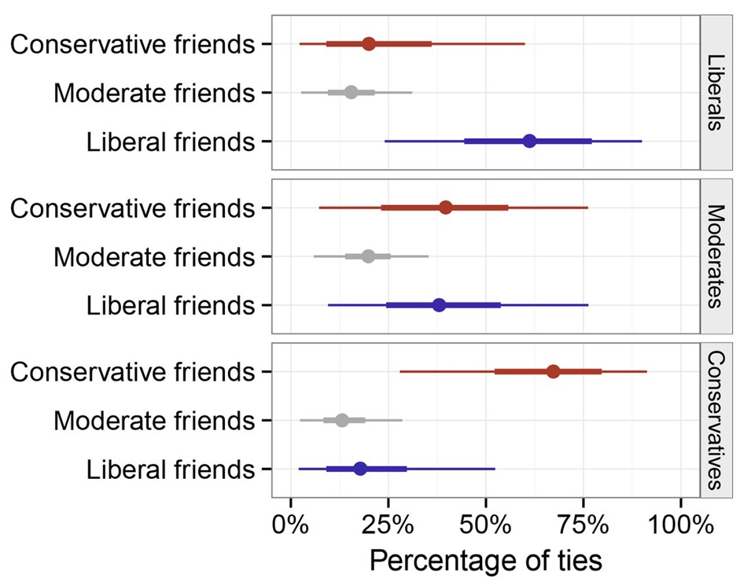
FILTER BUBBLES?
Bakkshy et al. 2015 study into exposure to diverse views on Facebook
10.1 million active US users with self-declared affiliation
7 million links shared over a 6 month period
Eytan Bakkshy, Solomon Messing, Lada Adamic (2015). Exposure to ideologically diverse news and opinion on Facebook. Science. May 2015

Slide 45
FILTER BUBBLES?
Bakkshy et al. 2015 study into exposure to diverse views on Facebook
10.1 million active US users with self-declared affiliation
7 million links shared over a 6 month period
  Clear evidence of political homophily
Eytan Bakkshy, Solomon Messing, Lada Adamic (2015). Exposure to ideologically diverse news and opinion on Facebook. Science. May 2015

Slide 46
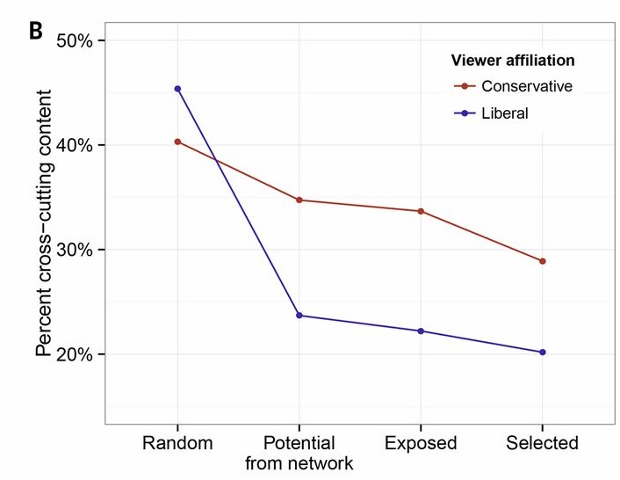
FILTER BUBBLES?
Bakkshy et al. 2015 study into exposure to diverse views on Facebook
10.1 million active US users with self-declared affiliation
7 million links shared over a 6 month period
Eytan Bakkshy, Solomon Messing, Lada Adamic (2015). Exposure to ideologically diverse news and opinion on Facebook. Science. May 2015

Slide 47
  Filter Bubble
FILTER BUBBLES?
Bakkshy et al. 2015 study into exposure to diverse views on Facebook
10.1 million active US users with self-declared affiliation
7 million links shared over a 6 month period
  Clear evidence of filter bubble – but filter bubble is smallest effect
Eytan Bakkshy, Solomon Messing, Lada Adamic (2015). Exposure to ideologically diverse news and opinion on Facebook. Science. May 2015

Slide 48
ECHO CHAMBERS?
Dubois & Blank (2018) a study of exposure to different opinions, based on a 2000 person UK sample.
Disagree
Different
Confirm
Offline
Change
Elizabeth Dubois & Grant Blank (2018) The echo chamber is overstated: the moderating effect of political interest and diverse media,
Information, Communication & Society, 21:5, 729-745

Slide 49
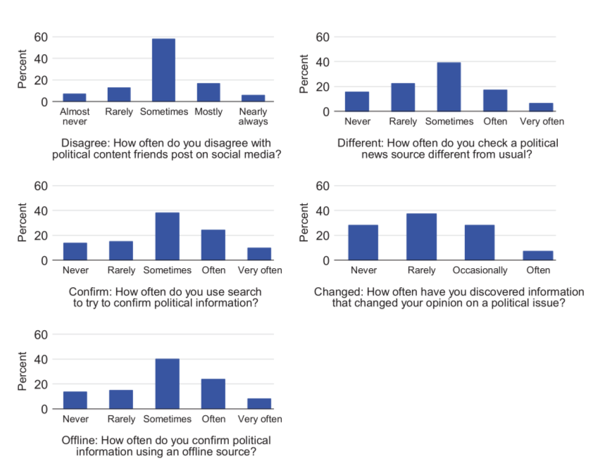
ECHO CHAMBERS?
Dubois & Blank (2018) a study of exposure to different opinions, based on a 2000 person UK sample.
Disagree
Different
Confirm
Offline
Change
Elizabeth Dubois & Grant Blank (2018) The echo chamber is overstated: the moderating effect of political interest and diverse media,
Information, Communication & Society, 21:5, 729-745

Slide 50
ECHO CHAMBERS?
Dubois & Blank (2018) a study of exposure to different opinions, based on a 2000 person UK sample.
Disagree
Different
Confirm
Offline
Change
  Significant numbers report exposure to multiple opinions
Elizabeth Dubois & Grant Blank (2018) The echo chamber is overstated: the moderating effect of political interest and diverse media,
Information, Communication & Society, 21:5, 729-745

Slide 51
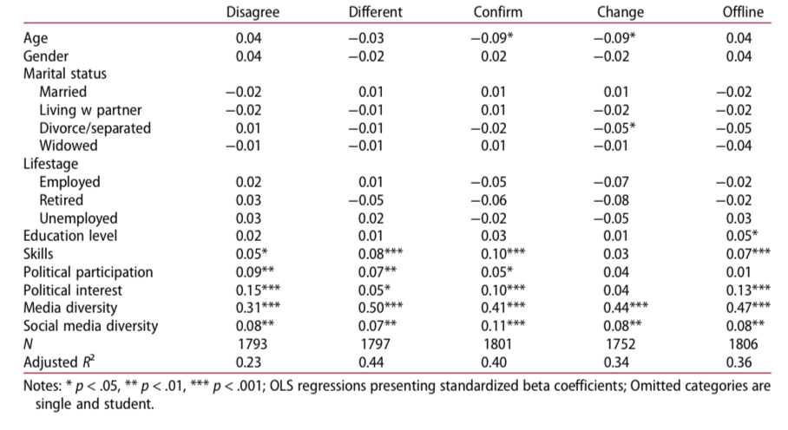
ECHO CHAMBERS?
Dubois & Blank (2018) a study of exposure to different opinions, based on a 2000 person UK sample.
Disagree
Different
Confirm
Offline
Change
Elizabeth Dubois & Grant Blank (2018) The echo chamber is overstated: the moderating effect of political interest and diverse media,
Information, Communication & Society, 21:5, 729-745

Slide 52
ECHO CHAMBERS?
Dubois & Blank (2018) a study of exposure to different opinions, based on a 2000 person UK sample.
Disagree
Different
Confirm
Offline
Change
  Media Diversity correlates strongly with high exposure
Elizabeth Dubois & Grant Blank (2018) The echo chamber is overstated: the moderating effect of political interest and diverse media,
Information, Communication & Society, 21:5, 729-745

Slide 53
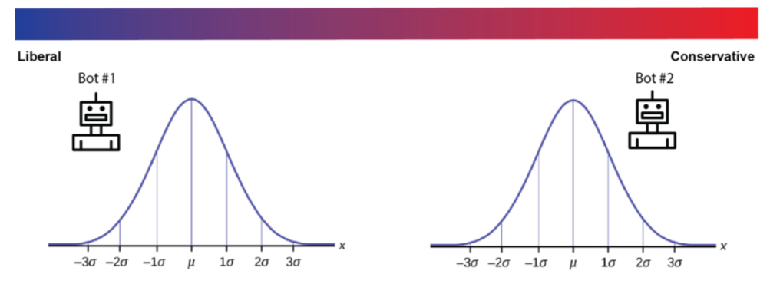
ECHO CHAMBERS?
Bail et al. (2018) paid a sample of 697 Democrats and 542 Republicans to follow a political bot that counter retweeted political messages into their Twitter feeds – and measure the impact on their views
Bail et al. (2018) Exposure to Opposing Views can Increase Political Polarization: Evidence from a Large-Scale Field Experiment on Social Media, SocARXiv

Slide 54
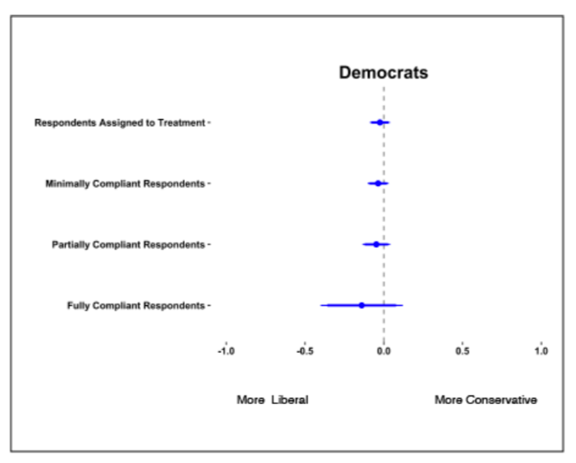
ECHO CHAMBERS?
Bail et al. (2018) paid a sample of 697 Democrats and 542 Republicans to follow a political bot that counter retweeted political messages into their Twitter feeds – and measure the impact on their views
Bail et al. (2018) Exposure to Opposing Views can Increase Political Polarization: Evidence from a Large-Scale Field Experiment on Social Media, SocARXiv

Slide 55
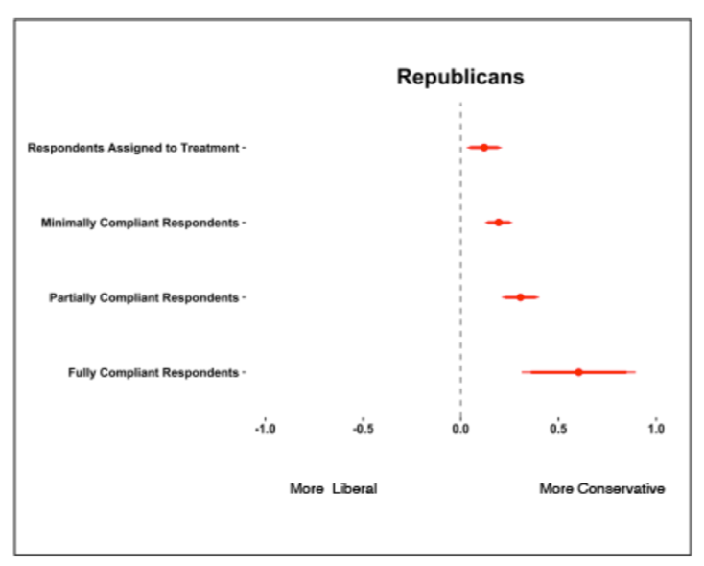
ECHO CHAMBERS?
Bail et al. (2018) paid a sample of 697 Democrats and 542 Republicans to follow a political bot that counter retweeted political messages into their Twitter feeds – and measure the impact on their views
Bail et al. (2018) Exposure to Opposing Views can Increase Political Polarization: Evidence from a Large-Scale Field Experiment on Social Media, SocARXiv

Slide 56
The backfire effect
“our study indicates that well- intentioned attempts to introduce people to opposing political views on social media might not only be ineffective, but counter-productive—particularly if they are initiated by Democrats.”
Bail et al. (2018) Exposure to Opposing Views can Increase Political Polarization: Evidence from a Large-Scale Field Experiment on Social Media, SocARXiv

Slide 57
Part 3
CREDIBILITY – HOW DO PEOPLE MAKE TRUST JUDGEMENTS?

Slide 58
Credibility
Trust is typically framed as a quality between individuals (interpersonal)
Credibility is a measure of how “believable” a piece of information is
Fogg, B. J. and Tseng, H. (1999). The elements of computer credibility. In ACM CHI ’99, pg 80–87, New York, NY, USA.

Slide 59
SOURCE,
MESSAGE,
AND MEDIA
CREDIBILITY
Hellmueller, L. and Trilling, D. (2012). The credibility of credibility measures: A meta- analysis in leading communication journals, 1951 to 2011. In WAPOR 65th Annual Conference in Hong Kong.
Metzger, et al. (2003). Credibility for the 21st century: integrating perspectives on source, message, and media credibility in the contemporary media environment. In Communication Yearbook 27

Slide 60
SOURCE,
MESSAGE,
AND MEDIA
CREDIBILITY
  Where it comes from.
  Influenced by:
    Perceived competence
    Trustworthiness
    Goodwill
Hellmueller, L. and Trilling, D. (2012). The credibility of credibility measures: A meta- analysis in leading communication journals, 1951 to 2011. In WAPOR 65th Annual Conference in Hong Kong.
Metzger, et al. (2003). Credibility for the 21st century: integrating perspectives on source, message, and media credibility in the contemporary media environment. In Communication Yearbook 27

Slide 61
SOURCE,
MESSAGE,
AND MEDIA
CREDIBILITY
  The quality.
  Influenced by:
    Information quality
    Language intensity
    Message discrepancy
Hellmueller, L. and Trilling, D. (2012). The credibility of credibility measures: A meta- analysis in leading communication journals, 1951 to 2011. In WAPOR 65th Annual Conference in Hong Kong.
Metzger, et al. (2003). Credibility for the 21st century: integrating perspectives on source, message, and media credibility in the contemporary media environment. In Communication Yearbook 27

Slide 62
SOURCE,
MESSAGE,
AND MEDIA
CREDIBILITY
  The media type.
  Influenced by:
    by perception of media type
Hellmueller, L. and Trilling, D. (2012). The credibility of credibility measures: A meta- analysis in leading communication journals, 1951 to 2011. In WAPOR 65th Annual Conference in Hong Kong.
Metzger, et al. (2003). Credibility for the 21st century: integrating perspectives on source, message, and media credibility in the contemporary media environment. In Communication Yearbook 27

Slide 63
SOURCE,
MESSAGE,
AND MEDIA
CREDIBILITY
  The media type.
  Influenced by:
    by perception of media type
  Assumes difference between types if greater than differences within
within type
Online
Offline
Guardian Online
Guardian Paper
Broadsheet
between type
The Sun
Online
The Sun
Paper
Tabloid
Hellmueller, L. and Trilling, D. (2012). The credibility of credibility measures: A meta- analysis in leading communication journals, 1951 to 2011. In WAPOR 65th Annual Conference in Hong Kong.
Metzger, et al. (2003). Credibility for the 21st century: integrating perspectives on source, message, and media credibility in the contemporary media environment. In Communication Yearbook 27

Slide 64
The Core of the Problem
Elaboration Likelihood Model (ELM) (Petty and Cacioppo, 1986):
  Central cues – careful and thoughtful consideration of the content of the message (high effort)
  Peripheral cues – surface-level features such as design and usability (low effort)
Examining central cues results in stable, long-term changes to attitude.
In cases where users interact with topics where they lack the requisite interest or knowledge, they are more likely to rely on peripheral cues.
Petty, R. E. and Cacioppo, J. T. (1986). The elaboration likelihood model of persuasion. Adv in Experimental Social Psychology, 19(C):123–205.

Slide 65
Combatting Fake News
Emine Saner, From Wikitribune to StopFake: the battle against fake news, The Guardian, 25 Apr 2017

Slide 66
Combatting Fake News
Google
  Modified their algorithm to foreground more reliable sources
  New tools for users to report problems with infoboxes and autocomplete
Emine Saner, From Wikitribune to StopFake: the battle against fake news, The Guardian, 25 Apr 2017

Slide 67
Combatting Fake News
Google
  Modified their algorithm to foreground more reliable sources
  New tools for users to report problems with infoboxes and autocomplete
Facebook
  Users can tag stories as ‘disputed’
  Sent to independent fact checkers (e.g. Snopes)
  Other users are warned if they try to share a disputed story
Emine Saner, From Wikitribune to StopFake: the battle against fake news, The Guardian, 25 Apr 2017

Slide 68
Combatting Fake News
Google
  Modified their algorithm to foreground more reliable sources
  New tools for users to report problems with infoboxes and autocomplete
Facebook
  Users can tag stories as ‘disputed’
  Sent to independent fact checkers (e.g. Snopes)
  Other users are warned if they try to share a disputed story
WikiTribune
  Professional Journalists producing transparent stories (with sources)
  Augmented by community members
Emine Saner, From Wikitribune to StopFake: the battle against fake news, The Guardian, 25 Apr 2017

Slide 69
Combatting Fake News
Google
  Modified their algorithm to foreground more reliable sources
  New tools for users to report problems with infoboxes and autocomplete
Facebook
  Users can tag stories as ‘disputed’
  Sent to independent fact checkers (e.g. Snopes)
  Other users are warned if they try to share a disputed story
WikiTribune
  Professional Journalists producing transparent stories (with sources)
  Augmented by community members
Reputation
Policy
Provenance
Emine Saner, From Wikitribune to StopFake: the battle against fake news, The Guardian, 25 Apr 2017

Slide 70
The Liar’s Dividend
  “When nothing is true then the dishonest person will thrive by saying what’s true is fake.”
- Danielle Citron
https://www.theguardian.com/technology/2018/nov/12/deep-fakes-fake-news-truth
Chesney, R. and Citron, D., Deep Fakes: A Looming Challenge for Privacy, Democracy, and National Security (July 14, 2018). 107 California Law Review (2019)
Notes:
Where truth goes to die

Slide 71
Questions…
?
David Millard | @hoosfoos | davidmillard.org

