Slide 1
Power
David Millard
dem@soton.ac.uk

Slide 2
Part 1
POWER WITHIN

Slide 3
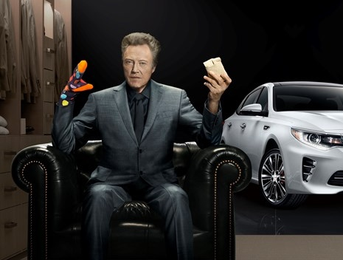
Kia advert 2016 Superbowl IBM/influential analysed over 10k social media influencers 100 key accounts Send them a pair of colourful socks and asked them to post picture using #AddPizzazz

Slide 4
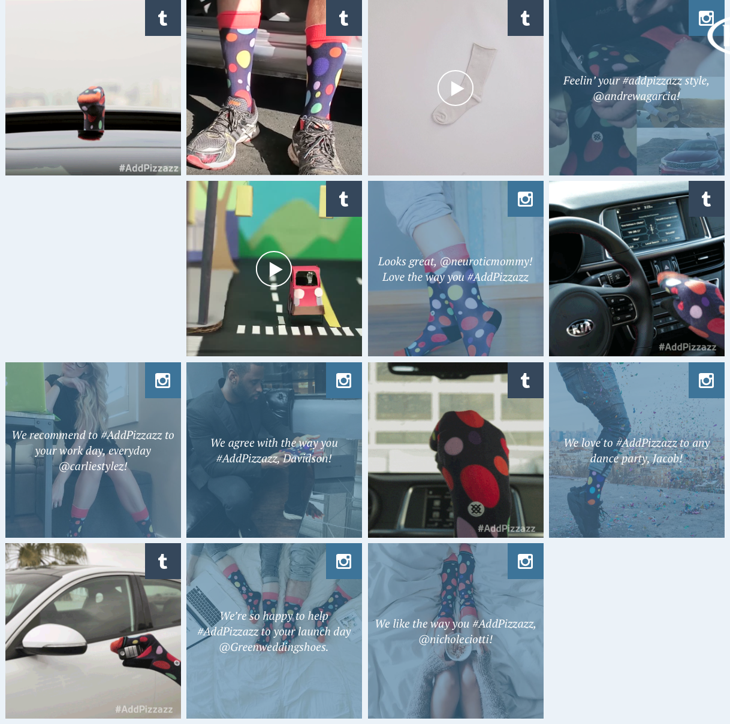
$1000
interactions
$5 million
Notes:
30% Increase

Slide 5
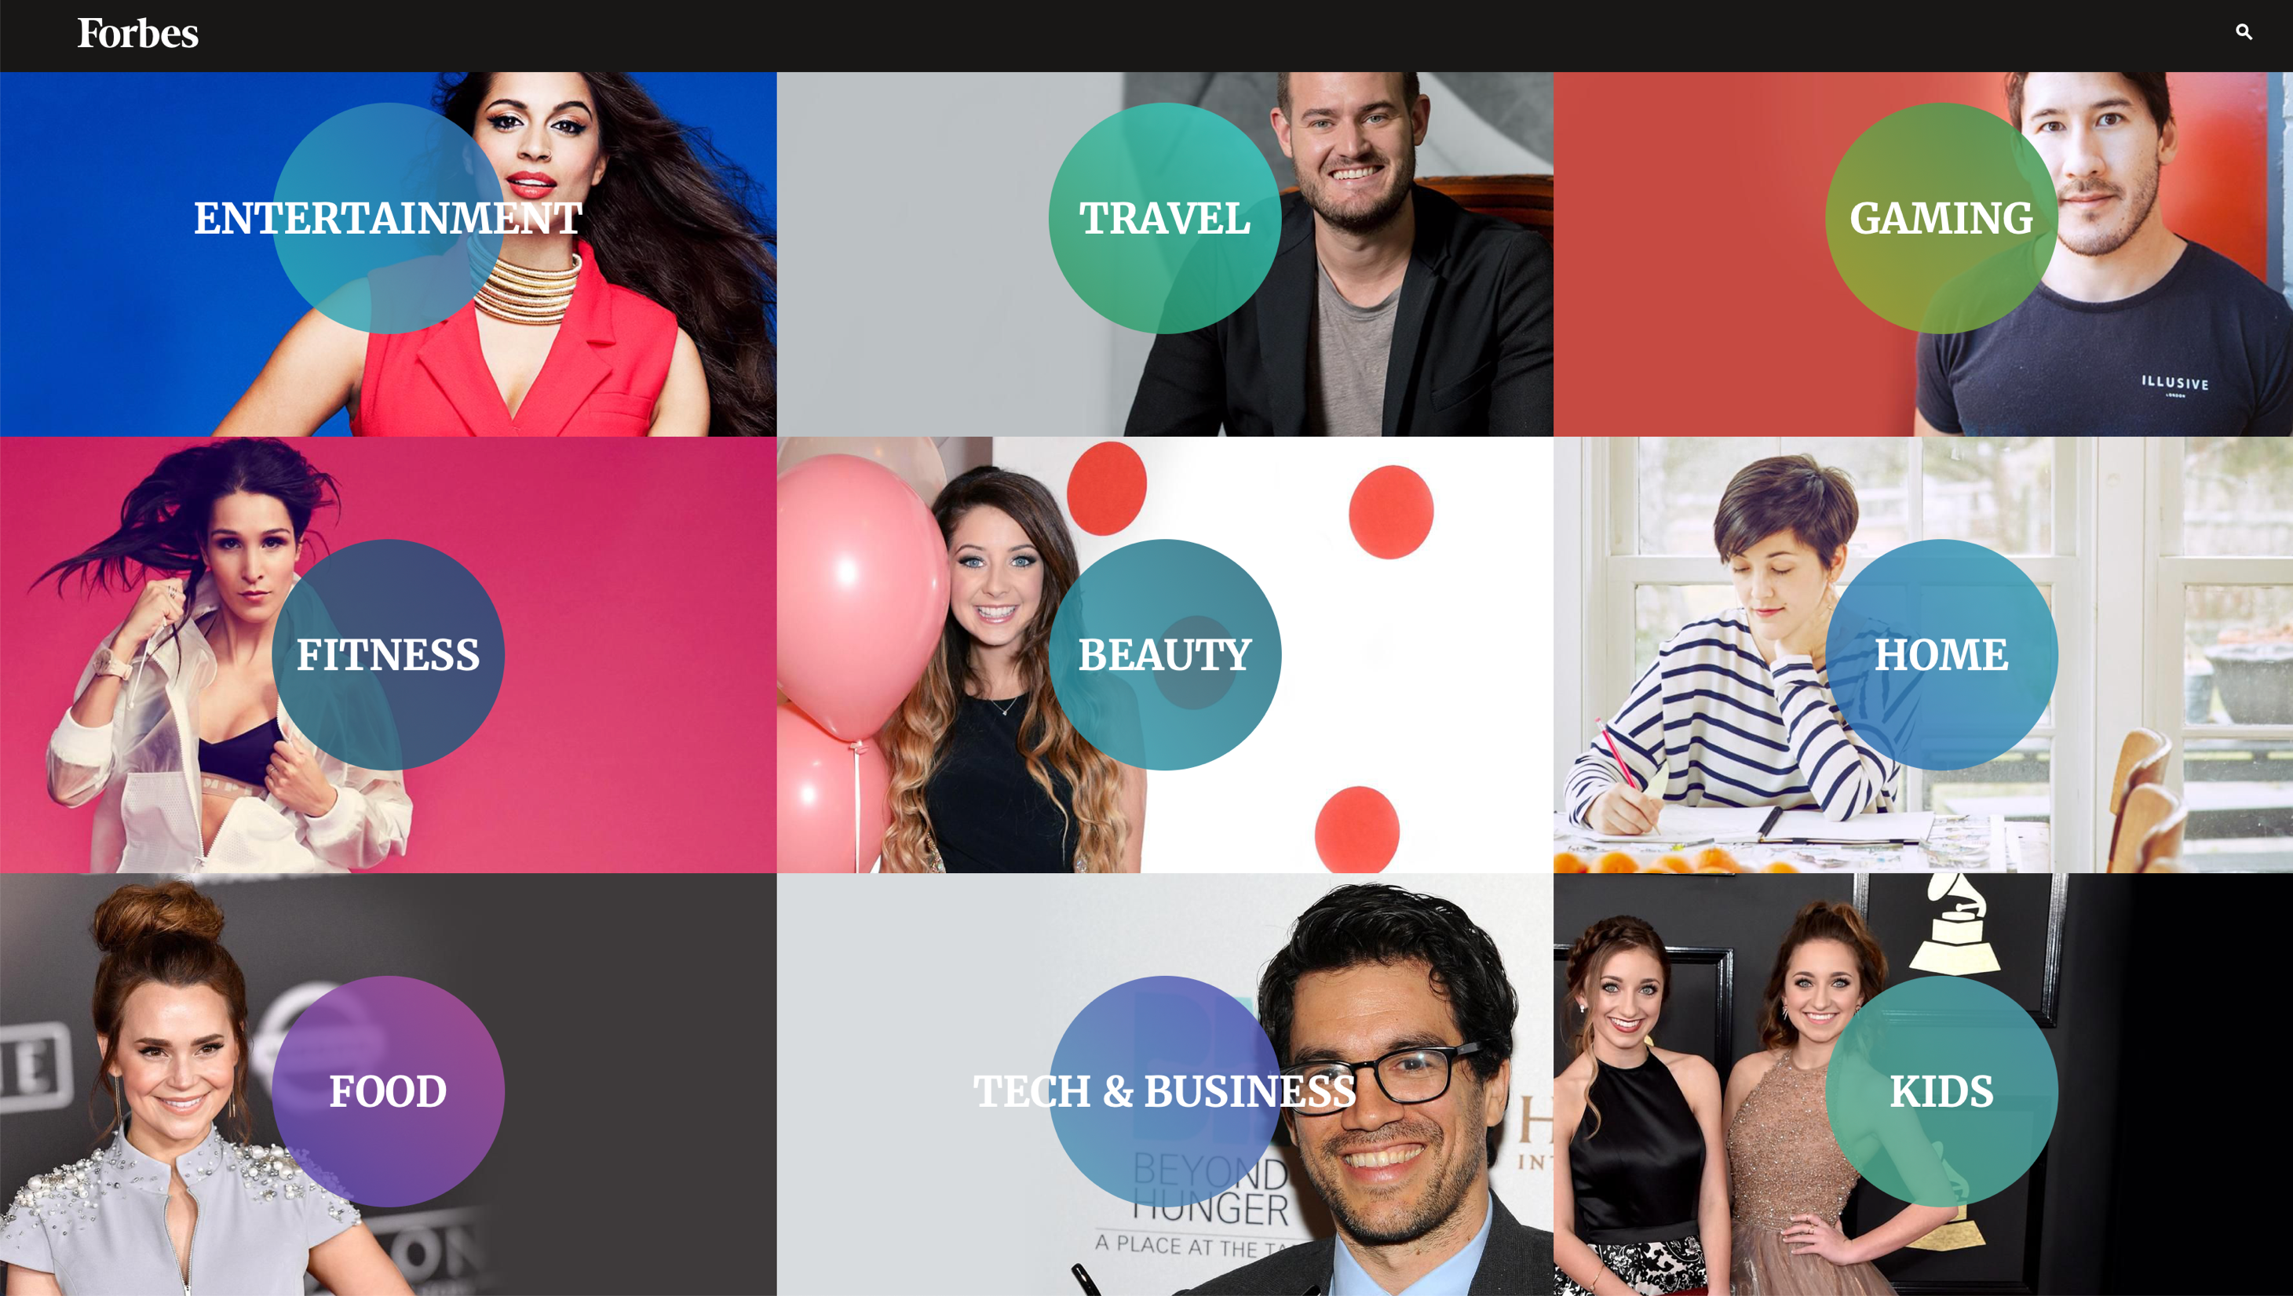

Slide 6
“Influencer marketing is going to look a lot different in 2017. Up until now, the term strictly applied to so-called influencers—ranging from A-list celebrities all the way down to niche Instagram stars with a few thousand followers—being paid to subtly promote or endorse products to followers. It’s part of the broader shift from mass media to individualized, highly contextual marketing. In 2017, based on new research from Columbia University, HEC Paris, and Amplero, customer-obsessed brands will take it one step further and identify the everyday spheres of influence within their customer or prospect networks based on behavioral data.”
- https://www.amplero.com/influencer-optimization/

Slide 7
How would you Identify The Most Powerful People In a social network?
?

Slide 8
MEASURING POWER
In Political Philosophy:
Power is “the production of intended effects”
Russell, B., 1948. Power - A New Social Analysis Sixth., London: Unwin Brothers
Power as Action

Slide 9
MEASURING POWER
In Communication Theory:
Power is "relational capacity that enables a social actor to influence asymmetrically the decisions of other social actor(s) in ways that favour the empowered actor's will, interests, and values.”
Castells, M., 2009. Communication Power, OUP Oxford
Critical people: Connectors, Mavens and Salesmen
Gladwell, M. 2002. The Tipping Point: How Little Things Can Make a Big Difference. Back Bay Books.
Power as Action
Power as Influence

Slide 10
MEASURING POWER
In Social Networks we might interpret power as connection
We can use network characteristics like Betweenness, Centrality and Hops to analyse a persons ability or potential to influence
Power as Action
Power as Influence
Power as Connection

Slide 11
MEASURING POWER
Or we might interpret power as propagation
Propagation of Content (URIs) – we can trace a URI through Social Media and identify sources (originating posts)
Power as Action
Power as Influence
Power as Connection
Power as Propagation
URI
Notes:
Information cascades

Slide 12
MEASURING POWER
Or we might interpret power as propagation
Propagation of Content (URIs) – we can trace a URI through Social Media and identify sources (originating posts)
Propagation of Content (Concepts) – we can trace concepts (terms) through Social Media and identify key sources whose concepts survive and are passed on the most
Power as Action
Power as Influence
Power as Connection
Power as Propagation
URI
Concept
Notes:
Information cascades

Slide 13
MEASURING POWER
In Social Networks we might interpret power as interaction
we can look at audience reaction and can discover who engages most with others
replies, messages, sharing, joint activities, etc…
Power as Action
Power as Influence
Power as Connection
Power as Propagation
Power as Interaction
URI
Concept

Slide 14
Audience Response
Public Figures and News Sources
Indegree
Indegree influence, the number of followers of a user
Directly indicates the size of the audience for that user.
Retweet influence, the number of retweets containing one’s name
Indicates the ability of that user to generate content with pass-along value
Mention influence, the number of mentions containing one’s name
Indicates the ability of that user to engage others in a conversation.
27.4%
Retweets
Mentions
3%
5.6%
7.1%
26.4%
23.8%
6.7%
Content Aggregators
Celebrities
Cha et al. Measuring user influence in twitter: The million follower fallacy. Proceedings of the Fourth International AAAI Conference on Weblogs and Social Media (2010) pp. 10-17

Slide 15
Who is being influenced?

Slide 16
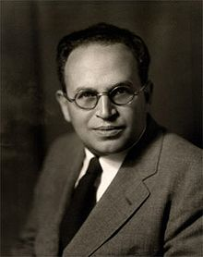
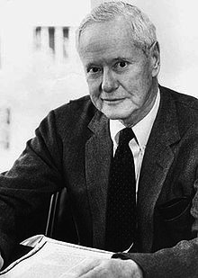
Homophily (love of the same)
The degree to which pairs (or groups) of individuals are alike
Similarity (dissimilarity)
Segregation
Social Closeness (Distance)
Complementarity
Lazarfeld and Merton coined the term Homophily in 1954
Status Homophily
Value Homophily
Paul Lazarsfeld
Robert K. Merton
Lazarsfeld and Merton. Friendship as a social process: A substantive and methodological analysis. Freedom and control in modern society (1954)

Slide 17
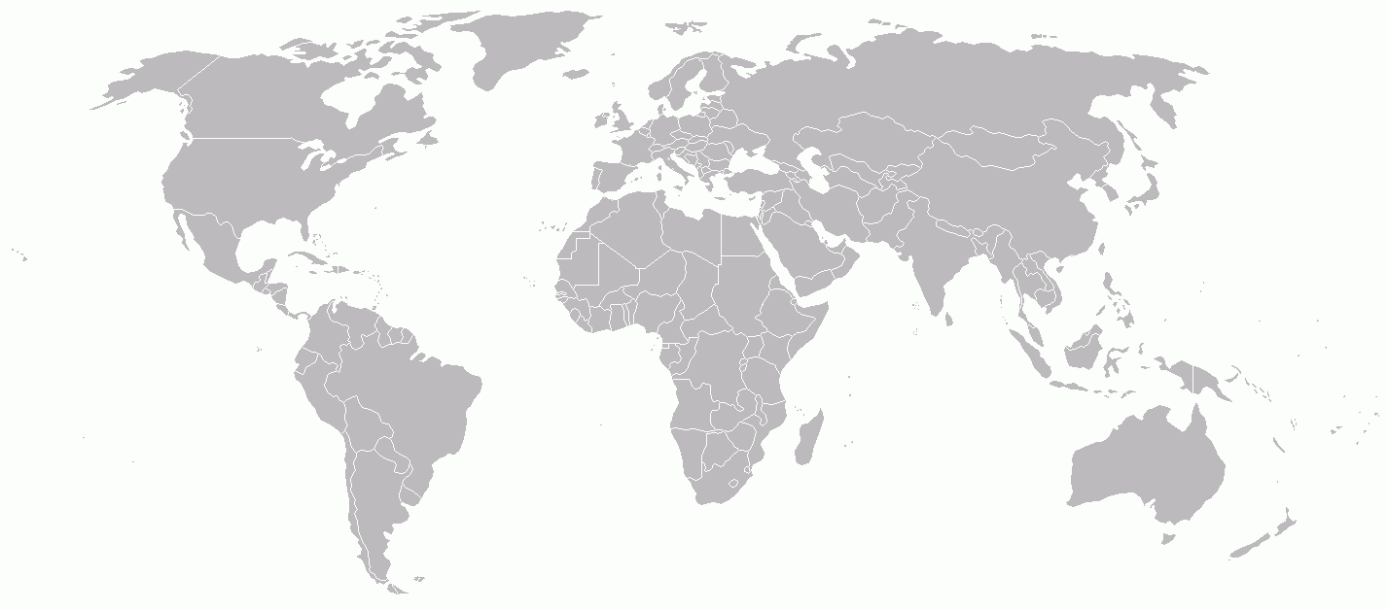
Homophily in Action

Slide 18
Local Networks

Slide 19
Local Networks

Slide 20
The Global Village

Slide 21
The Global Village

Slide 22
CyberBalkanization
Nathaniel Buckley and Brynjolfsson. Global Village or CyberBalkans: Modeling and Measuring the Integration of Electronic Communities . Journal Management Science (2005) vol. 51 (6)

Slide 23
Part 2
POWER WITHOUT

Slide 24
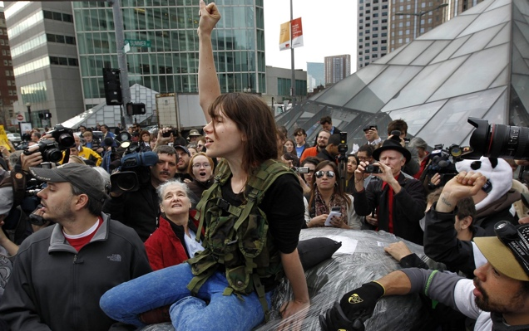
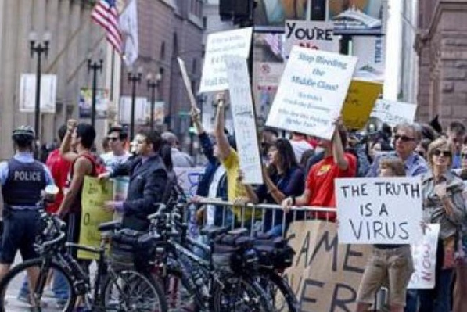
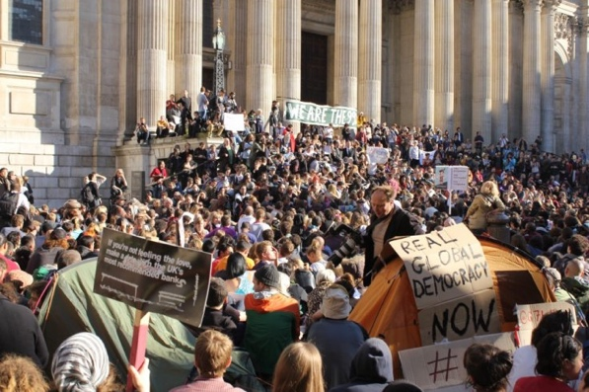
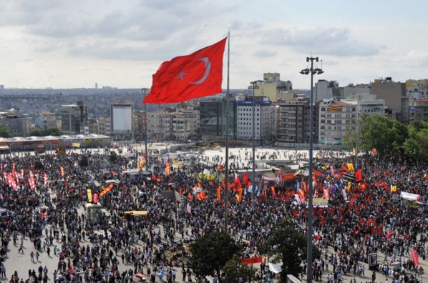
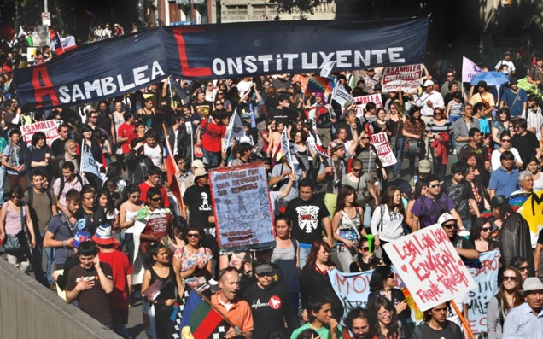
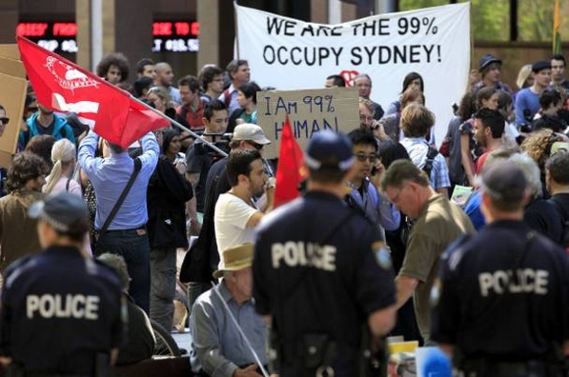
Case 1: Occupy
Left wing protest movement in 2011 against the economic inequality caused by global capitalism
NEW YORK
BOSTON
CHICAGO
ROME
MADRID
LONDON
ISTANBUL
SANTIAGO
SYDNEY

Slide 25
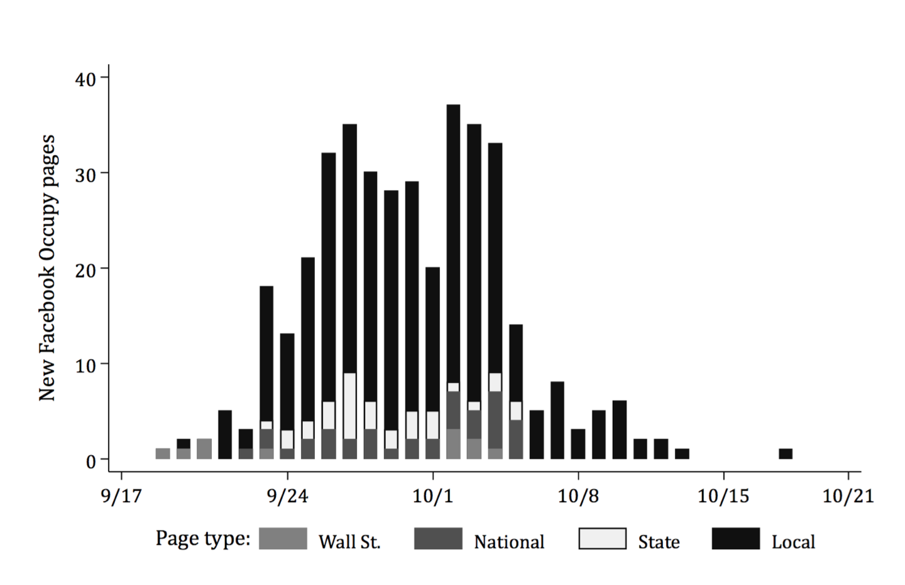
Case 1: Occupy
Left wing protest movement in 2011 against the economic inequality caused by global capitalism
Caren, N., & Gaby, S. (2011). Occupy Online: Facebook and the Spread of Occupy Wall Street. SSRN Electronic Journal.

Slide 26
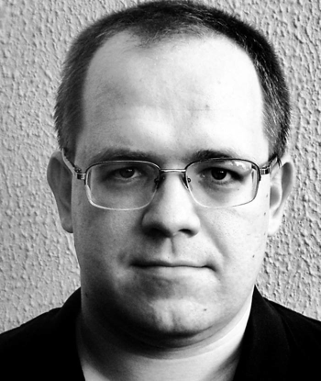
Slacktivism
Case 1: Occupy
Left wing protest movement in 2011 against the economic inequality caused by global capitalism
Where online activity (like clicking a petition, or liking a Facebook page) takes the place of real world activism
Morozov E. The Net Delusion: How not to liberate the world. Penguin (5 April 2012)

Slide 27
Slacktivism
Case 1: Occupy
Left wing protest movement in 2011 against the economic inequality caused by global capitalism
Where online activity (like clicking a petition, or liking a Facebook page) takes the place of real world activism
Facebook Group
Save the Children of Africa
1.7 million members
$12,000
Morozov E. The Net Delusion: How not to liberate the world. Penguin (5 April 2012)

Slide 28
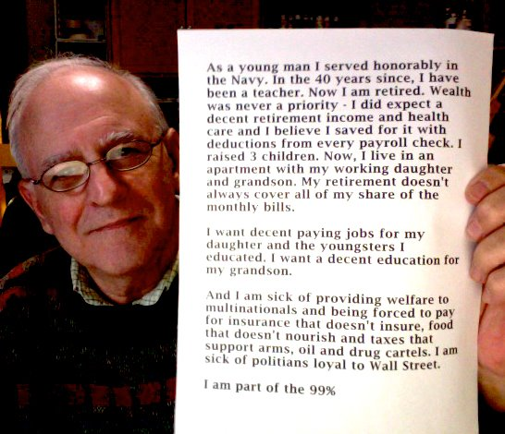
170,000 participants across more than 400 Facebook pages
A recruiting tool
Compiling and sharing news stories
Requests for resources
E.g. “Urgent: We really need tarps, tents, and sleeping bags. It's going to rain soon and we're low. Thank you!”
Sharing experiences
Instant communication
Case 1: Occupy
Left wing protest movement in 2011 against the economic inequality caused by global capitalism
Caren, N., & Gaby, S. (2011). Occupy Online: Facebook and the Spread of Occupy Wall Street. SSRN Electronic Journal.

Slide 29
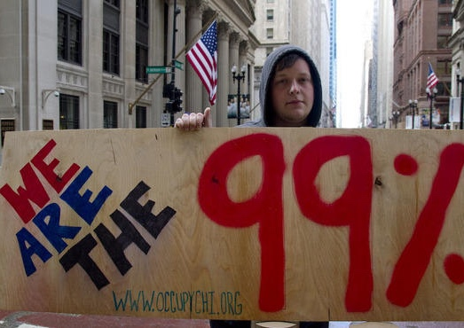
Case 1: Occupy
Left wing protest movement in 2011 against the economic inequality caused by global capitalism
Notes:
Millennial Bashing – The Overton Window

Slide 30
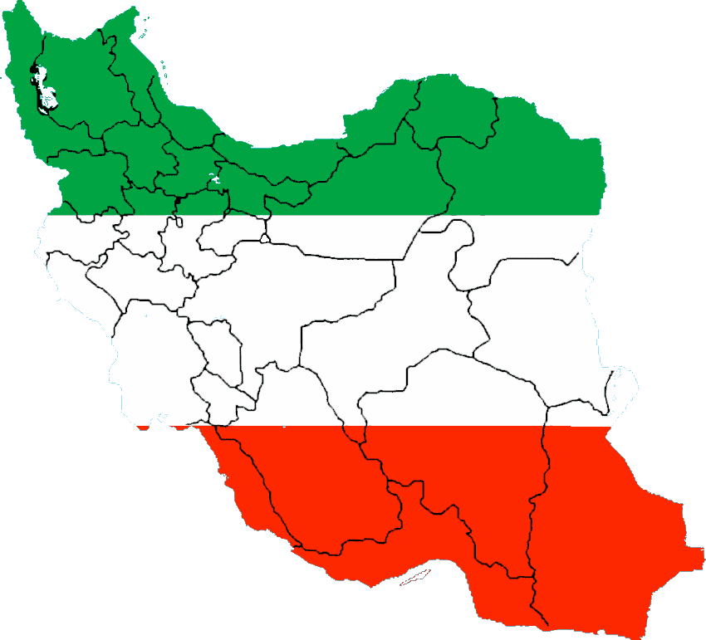
“[Iran’s] is the first revolution that has been catapulted onto a global stage and transformed by social media.” - Clay Shirky
Case 2: Arab Spring
A series of pro-democracy movements in several largely Muslim countries in the Spring of 2011
Earlier examples, including the Iranian election protests of 2009

Slide 31
The Tweets that Cut Both Ways
“both Twitter and Facebook give Iran’s secret services superb platforms for gathering open source intelligence about the future revolutionaries, revealing how they are connected to each other”
“foreign supporters of the Twitter Revolution managed to do what the Iranian government couldn’t: make the Internet unusable for activists”
“Twitter accounts that looked “suspicious”—that is, appeared to be spreading “misinformation” about the venues and times of the protests”
Case 2: Arab Spring
A series of pro-democracy movements in several largely Muslim countries in the Spring of 2011
Earlier examples, including the Iranian election protests of 2009
Morozov. Iran: Downside to the "Twitter Revolution". Dissent (9) vol. 56 (4) pp. 10-14

Slide 32
A Western Lens?
Case 2: Arab Spring
A series of pro-democracy movements in several largely Muslim countries in the Spring of 2011
Earlier examples, including the Iranian election protests of 2009
Approx 9000 Twitter users in Iran
Homophily in Action (young, educated, technology literate)
Less than 1% of Iranian Internet users
A multitude of technologies used for communication
SMS and Word-of-mouth more important that Social Media
Western reporters lack access to Iran
Many tweets with #iranelection are retweets (3:1 ratio)
Most tweets with #iranelection are not from Iran
(40% outside, 35% unknown)
Schectman, J. Iran's Twitter Revolution? Maybe Not Yet. Bloomberg Businessweek, June 17, 2009.
Burns and Eltham. Twitter Free Iran: An Evaluation of Twitter's Role in Public Diplomacy and Information Operations in Iran's 2009 Election Crisis. Communications Policy & Research Forum 2009

Slide 33
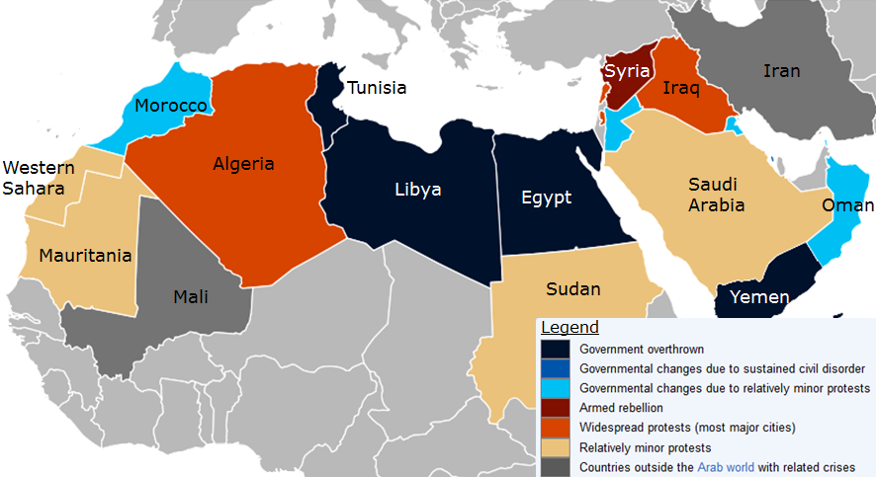
The Arab Spring?
Case 2: Arab Spring
A series of pro-democracy movements in several largely Muslim countries in the Spring of 2011
Earlier examples, including the Iranian election protests of 2009

Slide 34
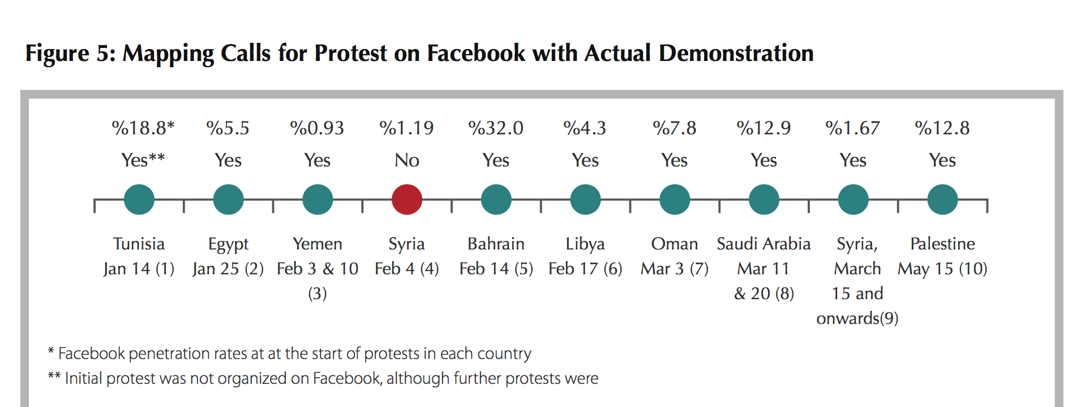
Did Facebook Precede ‘Real’ Protests?
Case 2: Arab Spring
A series of pro-democracy movements in several largely Muslim countries in the Spring of 2011
Earlier examples, including the Iranian election protests of 2009
The Arab Social Media Report, Dubai School of Government, Vol 1, No. 2, May 2011
Notes:
Reletively Low penetration rates

Slide 35
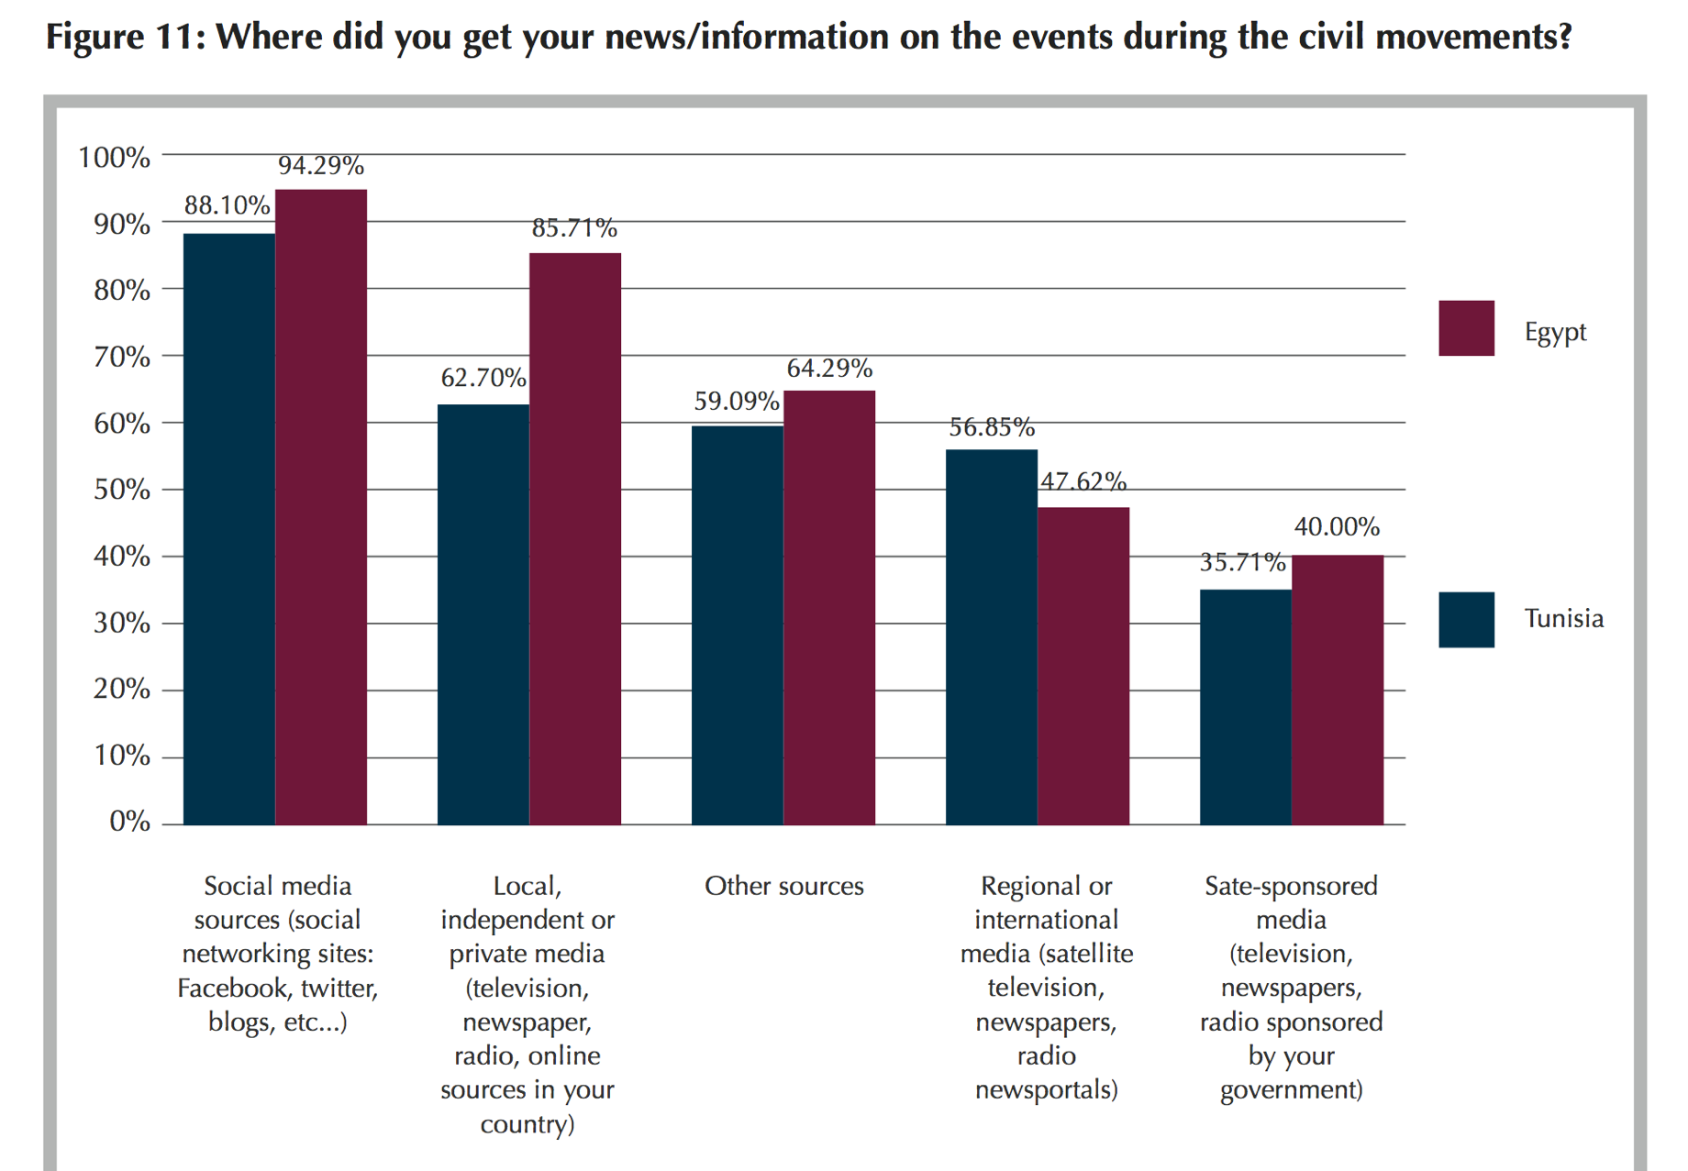
Case 2: Arab Spring
A series of pro-democracy movements in several largely Muslim countries in the Spring of 2011
Earlier examples, including the Iranian election protests of 2009
The Arab Social Media Report, Dubai School of Government, Vol 1, No. 2, May 2011
Notes:
Even for Social Media users other sources of news very important

Slide 36
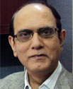
Social Media as a Catalyst
Case 2: Arab Spring
A series of pro-democracy movements in several largely Muslim countries in the Spring of 2011
Earlier examples, including the Iranian election protests of 2009
“There is no question that social media played a significant role in the political movements in Tunisia and Egypt, but one should not overstate the role. The role of conventional media, especially television (e.g. Al Jazeera), was crucial. However, the most important underlying factor was the presence of revolutionary conditions and the inability of the state apparatus to contain the revolutionary upsurge. In this schema, social media was a vital tool—a necessary condition—especially in the face of a muzzled conventional local media, but a tool nevertheless. It was not a sufficient condition.”
^{HABIBUL HAQUE KHONDKER}
Zayed University, Abu Dhabi, UAE
Khondker, H. H. (2011). Role of the New Media in the Arab Spring. Globalizations, 8(5), 675–679
Notes:
Even for Social Media users other sources of news very important

Slide 37
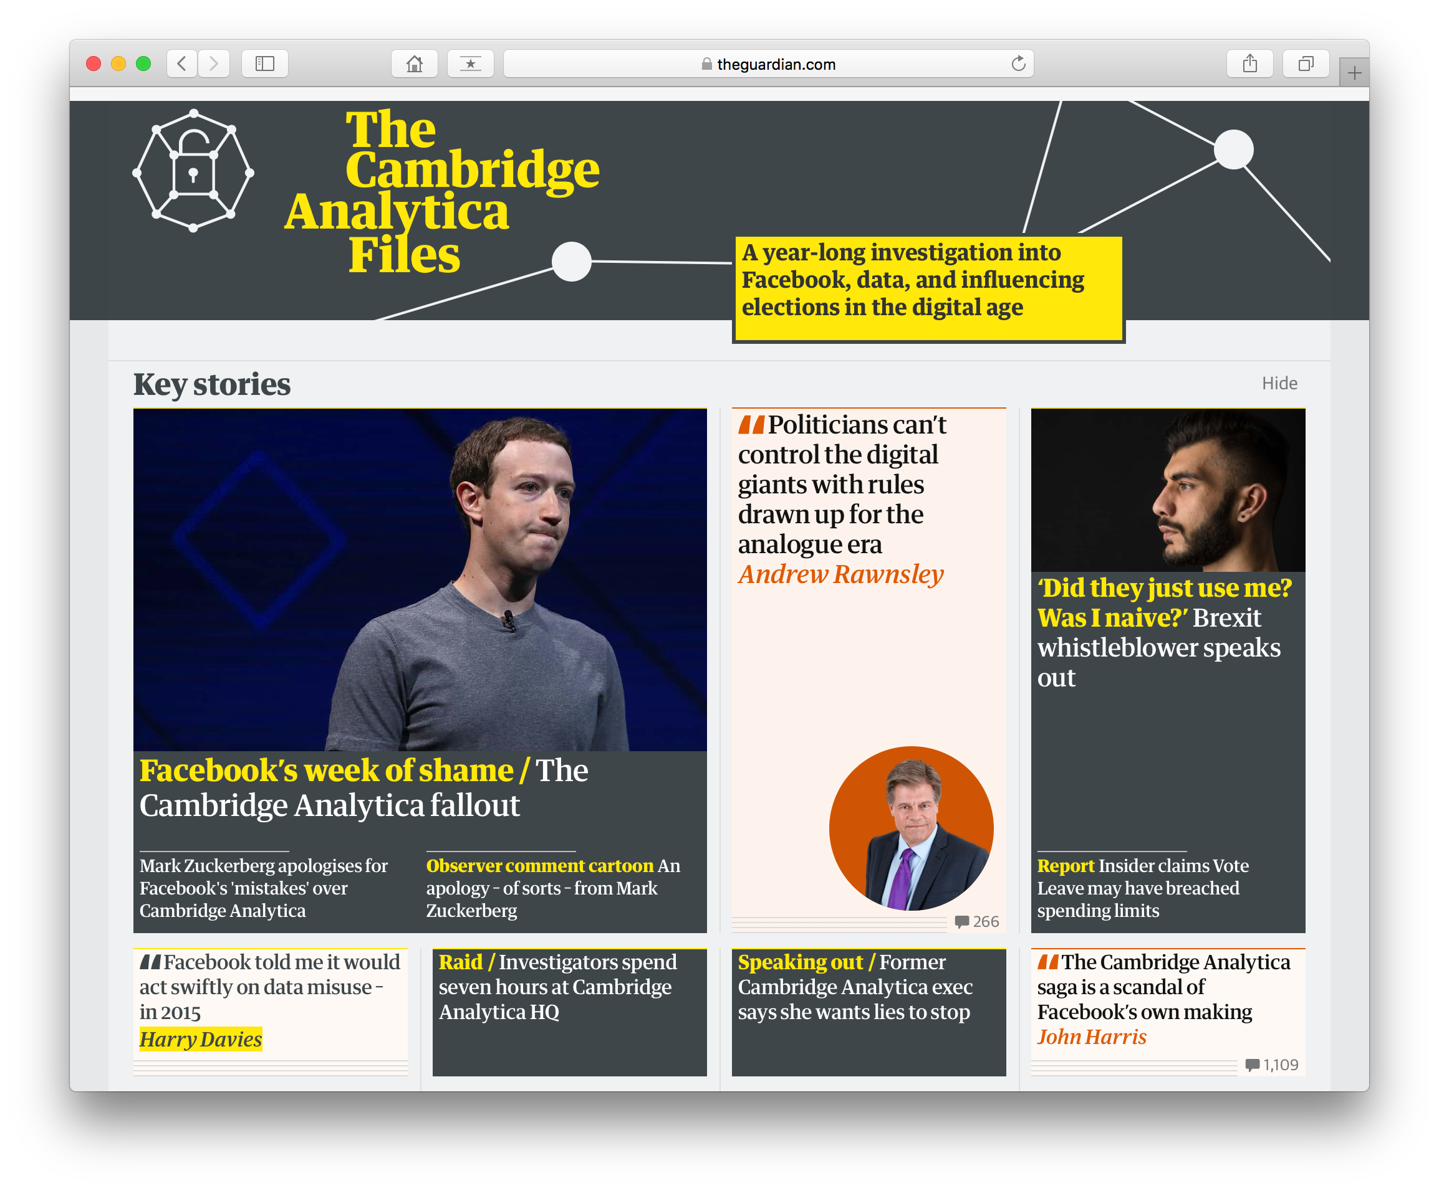
Case 3: The West
Are democratic processes in the West being strongly influenced by individuals through social media?

Slide 38
Micro-Segmentation
Divide the audience
Identify valuable groups
Spent effort (money) on targeting those groups
With specific messages designed for them
Case 3: The West
Are democratic processes in the West being strongly influenced by individuals through social media?

Slide 39
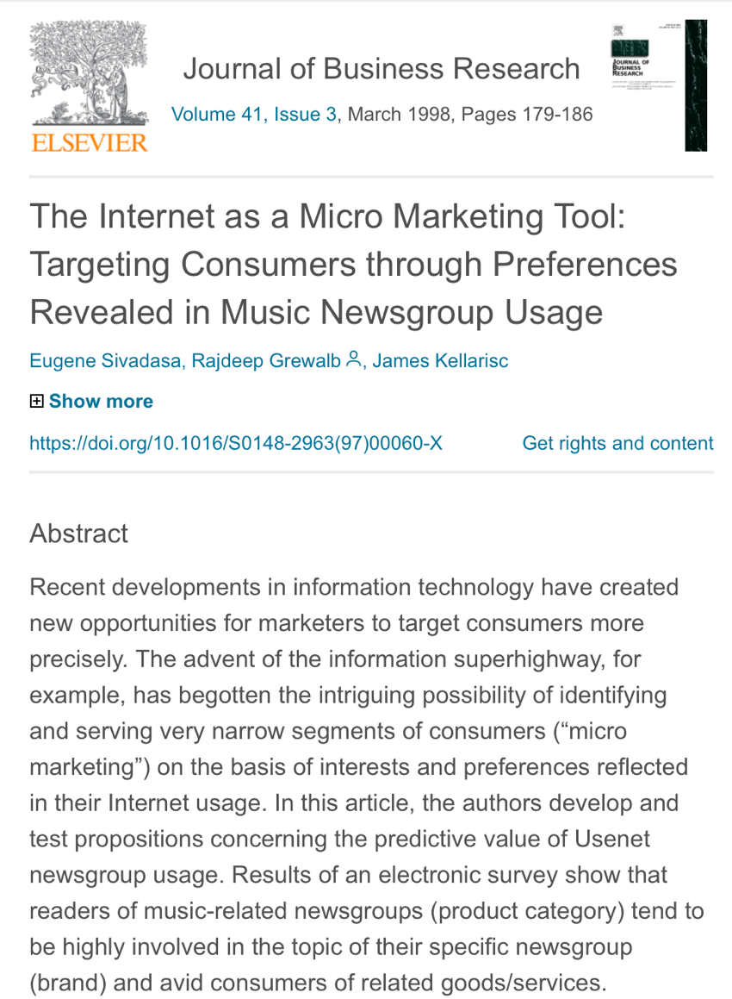
Case 3: The West
Are democratic processes in the West being strongly influenced by individuals through social media?
1998

Slide 40
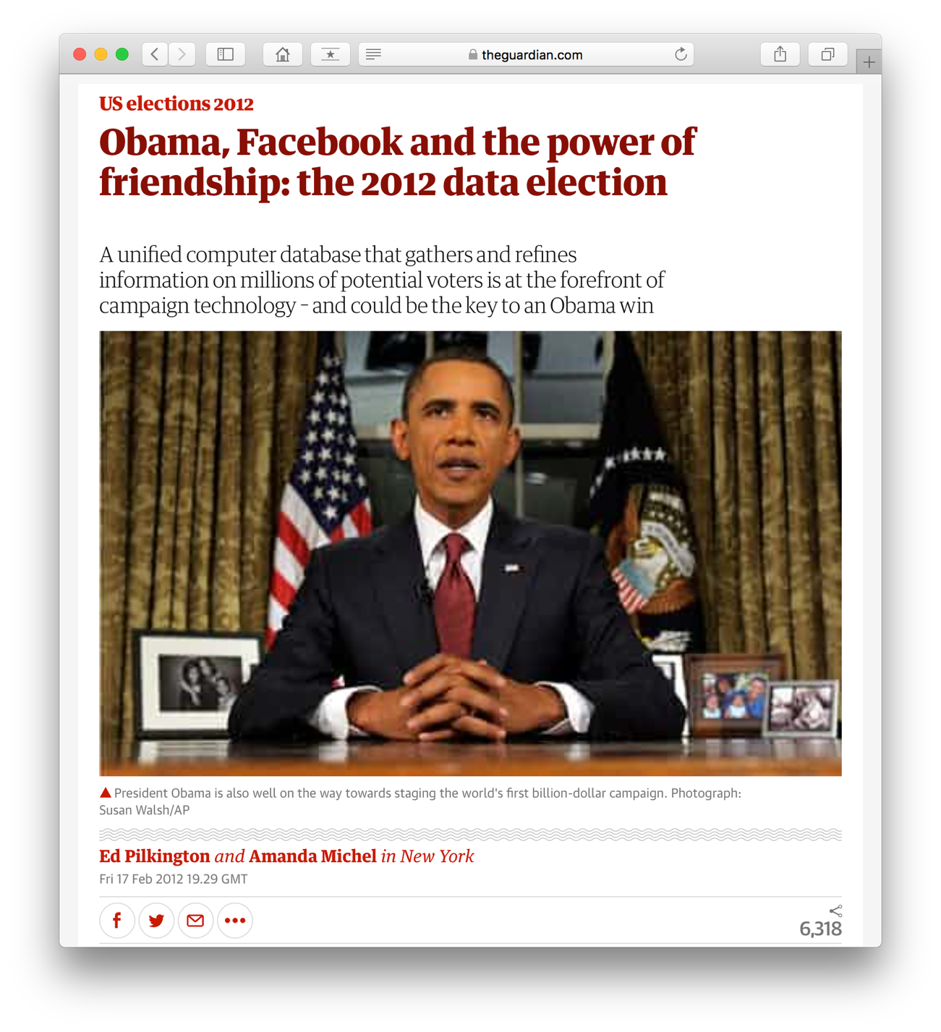
Obama 2012
The Norm:
Conservatives 2015
able to serve ads to 80% of Facebook users in key marginal seats
Trump 2016
Project Alamo – purchased profiles of 220 million US voters
Ran both conversion and suppression ads
Vote Leave
2016 Brexit Referendum
98% of budget on digital media
Case 3: The West
Are democratic processes in the West being strongly influenced by individuals through social media?

Slide 41
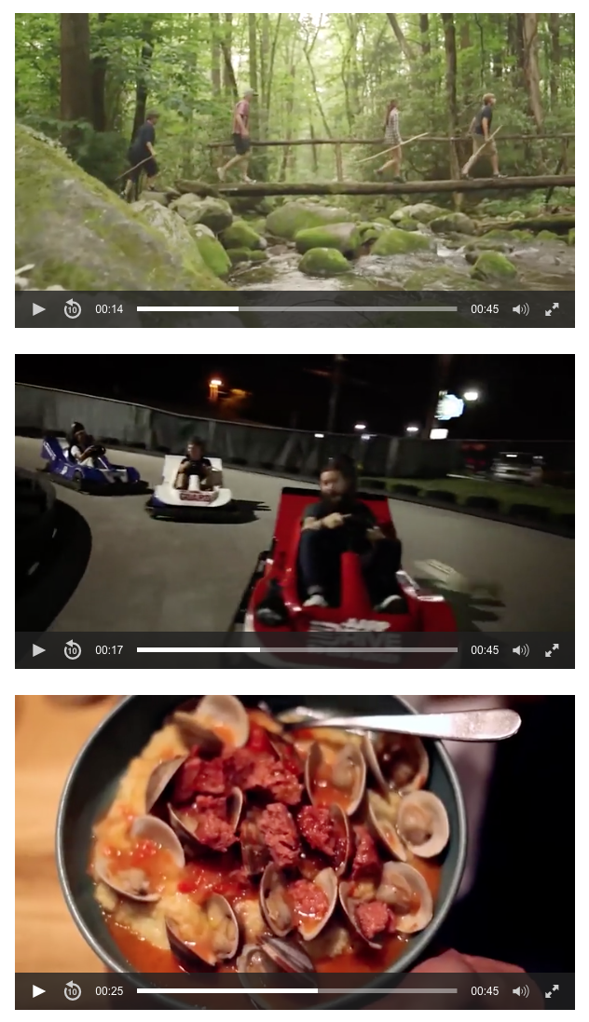
The Future
Case 3: The West
Are democratic processes in the West being strongly influenced by individuals through social media?
What if 1 million customers need 1 million adverts?
Tennessee Tourism template based video ad, 2016
A video mix of different activities and environments
Over 2000 combinations – with shared titles and music
Delivered according to location, interests, hobbies
Nano-Segmentation?

Slide 42
“Influencer marketing is going to look a lot different in 2017. Up until now, the term strictly applied to so-called influencers—ranging from A-list celebrities all the way down to niche Instagram stars with a few thousand followers—being paid to subtly promote or endorse products to followers. It’s part of the broader shift from mass media to individualized, highly contextual marketing. In 2017, based on new research from Columbia University, HEC Paris, and Amplero, customer-obsessed brands will take it one step further and identify the everyday spheres of influence within their customer or prospect networks based on behavioral data.”
- https://www.amplero.com/influencer-optimization/

Slide 43
Work on Social Media Power has focused on which participants are powerful But the real power lies with the people who are doing the analysis And the people selling the data…

Slide 44
“Power is the production of intended effects”
- Bertrand Russell

Slide 45
Questions…
?
David Millard | @hoosfoos | davidmillard.org

