Slide 2
Algorithmic Complexity and Computability
COMP6221 Computational Thinking
Dr Nicholas Gibbins – nmg@ecs.soton.ac.uk
2018-2019

Slide 3
Learning Outcomes
At the end of this lecture, you should have an basic intuitive understanding of the following:
  Algorithmic complexity
  Tractable/Intractable
  Decidable/Undecidable
  Computable/Noncomputable
  Turing Machines

Slide 4
What is an algorithm?
Definition: an effective method for solving a problem, expressed as a sequence of steps
By an effective method, we mean that an algorithm will:
  always give some answer
  always give the correct answer
  always be completed in a finite number of steps
  work for all instances of problems of the class

Slide 5
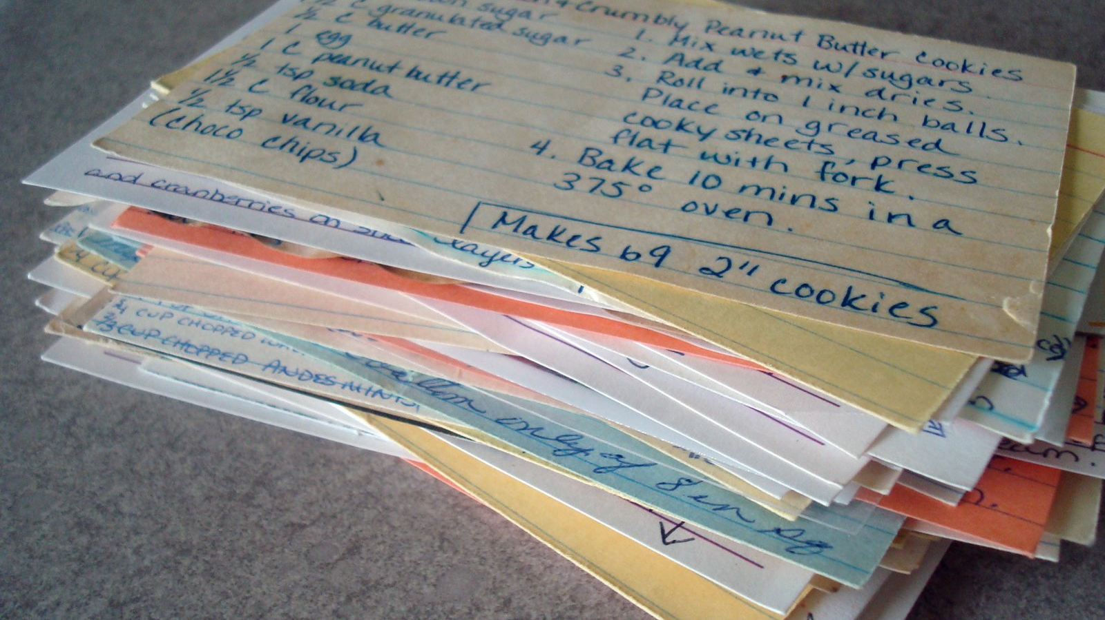
Put simply, an algorithm is a recipe

Slide 6
Algorithmic Complexity
If all algorithms are effective (always produce a correct answer), what makes one algorithm better than another?
How long does the algorithm take to complete?
(how many steps are in the recipe)
  Time complexity
How many resources does the algorithm take to complete?
(how big a kitchen do you need)
  Space complexity

Slide 7
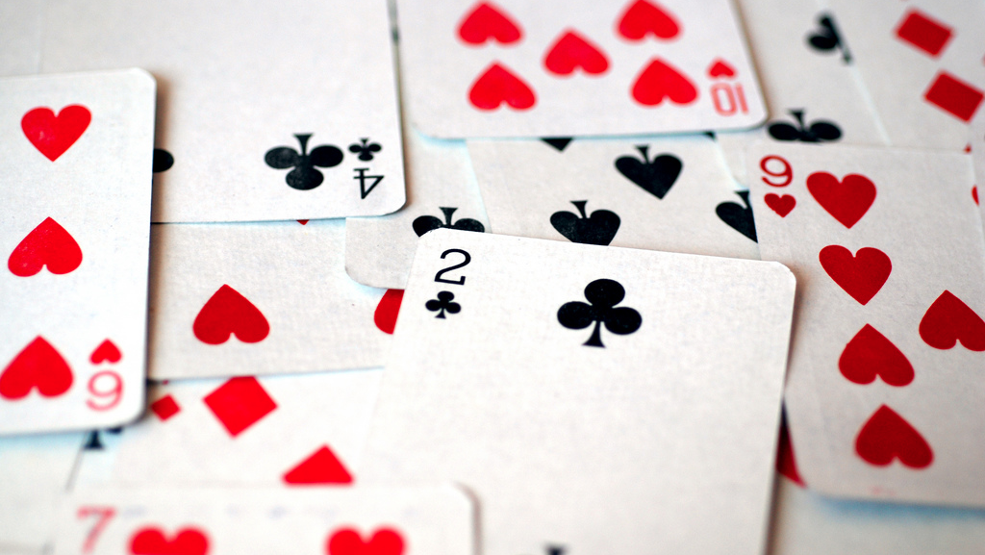
Exercise 1: Searching
http://www.flickr.com/photos/hippie/2562630928/

Slide 8
Searching
If the deck is unsorted, we must search the cards in order
  Exhaustive Search
If the deck is sorted, we can jump ahead to ‘the right area’
  Interpolation Search
Exhaustive search takes longer – but how much longer?
If the deck contains N cards, then on average we’ll have to examine N/2 cards (i.e. search halfway through)

Slide 9
Interpolation Search
In an interpolation search, we have enough knowledge of the data to be able to guess roughly where the target ought to be
What if we only know that the data is sorted?

Slide 10
Binary Search
Examine the middle item of the sorted list
If the item comes before the target, repeat on the first half
Else, repeat on the second half of the list
Repeatedly divides the problem in two (hence binary)
Takes log₂ n steps for a list of n items
(i.e. a list of 32 items would take log₂ 32 = 5 steps)
Much better than an exhaustive search

Slide 11
Exercise 2: Sorting
http://www.flickr.com/photos/hippie/2562630928/

Slide 12
Exercise 2: Sorting
Sort your deck of cards following the provided instructions
Sort order: A 2 3 4 5 6 7 8 9 10 J Q K
First attempt is a practice run
Second run will be timed

Slide 13





Selection Sort
Repeatedly look through the input deck for the lowest card and move it to the output deck
top input card
input deck
(unsorted)
lowest card
discard pile
output deck
(sorted)

Slide 14
Selection Sort
repeat
move the top input card to the lowest card
repeat
if the top input card is lower than the lowest card
then swap the top input card and the lowest card
move the top input card to the discard pile
until the input deck is empty
move the lowest card to the output deck
move the discard pile to the input deck
until the input deck is empty

Slide 15

Selection Sort Animation

Slide 16
Insertion Sort
Repeatedly take the top card from the input deck and insert it into the right place in the output deck
input deck
(unsorted)
insert card
working pile
output deck
(sorted)

Slide 17
Insertion Sort
repeat
move the top input card to the insert card
move the output deck to the working pile
repeat
if the insert card is lower than the top of the working pile
then move the insert card to the output deck
move the top of the working pile to the output deck
until the working pile is empty
until the input deck is empty

Slide 18
Insertion Sort Animation

Slide 19
Bubble Sort
Work through the input deck from top to bottom, swapping adjacent cards if they’re out of order
input deck
(unsorted)
left card
right card
output deck
(sorted)

Slide 20
Bubble Sort
repeat
move top of input deck to right card
repeat
move top of input deck to left card
if the left card is lower than the right card
then swap left card and right card
move right card to output deck
move left card to right card
until input deck is empty
move output deck to input
until no swaps performed

Slide 21
Bubble Sort Animation

Slide 22
Merge Sort
Divide deck into two roughly equal sub-decks, sort each separately, then merge the subdecks
input deck
(unsorted)
Merge
left deck
right deck
output deck
(sorted)

Slide 23
Merge Sort
To merge sort:
if the input deck contains more than one card
then
split the input deck into a left deck and a right deck
merge sort the left deck
merge sort the right deck
merge the left deck and the right deck
Notes:
l

Slide 24
Merge Sort
To merge:
repeat
if the left deck top is lower than the right deck top
then move the top of the left deck to the output deck
else move the top of the right deck to the output deck
until both the left deck and the right deck are empty
Notes:
l

Slide 25
Merge Sort Animation

Slide 26
Quicksort
Another divide and conquer algorithm
Divide deck into two sub-decks, sort subdecks separately, combine
input deck
(unsorted)
left deck
pivot card
right deck

Slide 27
Quicksort
To quicksort:
move the top of the input deck to the pivot card
repeat
if the top of the input deck is lower than the pivot card
then move the top of the input deck to the left deck
else move the top of the input deck to the right deck
until the input deck is empty
move the pivot card to the left deck
quicksort the left deck
quicksort the right deck
append the right deck to the left deck

Slide 28
Quicksort Animation

Slide 29
Shuffle Sort
It is possible to come up with a sort that’s worse than the worst we’ve looked at
  Shuffle the deck
  If the deck is not yet sorted, repeat the previous step
For a full deck of 52 cards, and at ten seconds per shuffle, you might be here for a very long time
A very, very long time – roughly 10⁶⁹ seconds
10⁶⁹ seconds = 1,000,000,000,000,000,000,000,000,000,000,000,000,000,000,000,000,000,000,000,000,000,000,000 seconds
The universe is only 435,000,000,000,000,000 seconds old

Slide 30
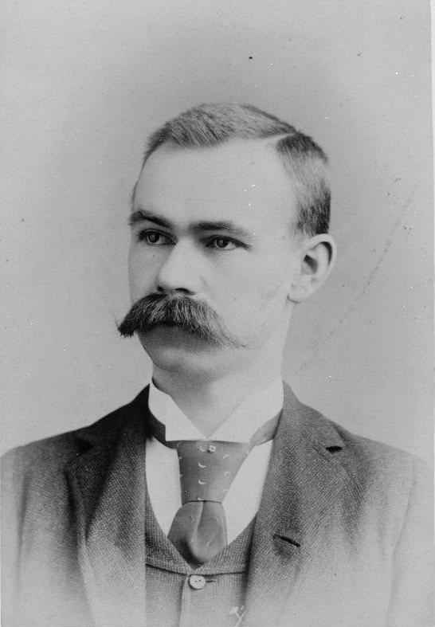
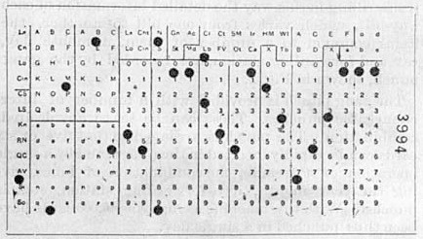
Radix Sort
It’s also possible to do much better if you cheat (sort of)
Radix sort relies on being able to select
(= compare) many cards at once
Herman Hollerith, 1887
(see also Dewdney’s Spaghetti Sort)
Notes:
1880 US Census took 7 years to tabulate
Given rate of population growth, it was estimated that the 1890 US Census would take 13 years, based on existing methods

Slide 31
Divide and Conquer
Binary Search, Quicksort and Merge Sort are all recursive algorithms
The algorithms break the larger problem into more manageable sub-problems, and deal with those separately
  Sub-problems are of the same kind as the original problem
  Deal with the sub-problems in the same way as the original
Notes:
Towers of Hanoi

Slide 32
Complexity

Slide 33
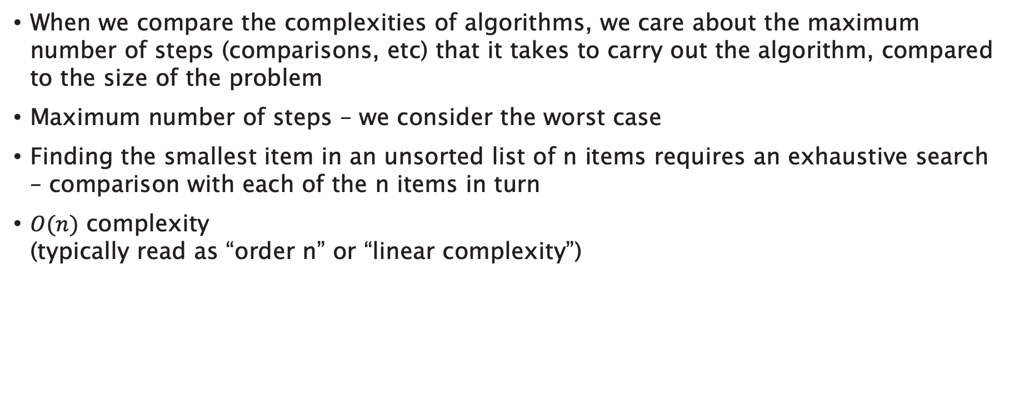
Big O Notation
When we compare the complexities of algorithms, we care about the maximum number of steps (comparisons, etc) that it takes to carry out the algorithm, compared to the size of the problem
Maximum number of steps – we consider the worst case
Finding the smallest item in an unsorted list of n items requires an exhaustive search – comparison with each of the n items in turn
$O(n)$ complexity
(typically read as “order n” or “linear complexity”)

Slide 34
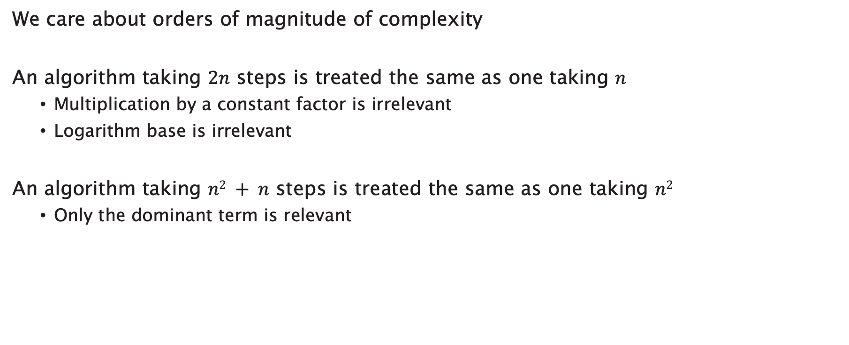
Orders of Magnitude
We care about orders of magnitude of complexity
An algorithm taking $2n$ steps is treated the same as one taking $n$
  Multiplication by a constant factor is irrelevant
  Logarithm base is irrelevant
An algorithm taking $n2 + n$ steps is treated the same as one taking $n2$
  Only the dominant term is relevant

Slide 35
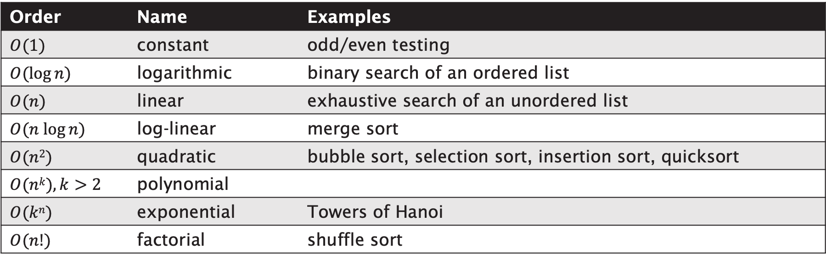
Orders of Magnitude
Order | Name | Examples
$$O(1)$$ | constant | odd/even testing
$$O(log⁡n)$$ | logarithmic | binary search of an ordered list
$$O(n)$$ | linear | exhaustive search of an unordered list
$$O(n log⁡n)$$ | log-linear | merge sort
$$O(n2)$$ | quadratic | bubble sort, selection sort, insertion sort, quicksort
$$O(nk), k>2$$ | polynomial
$$O(kn)$$ | exponential | Towers of Hanoi
$$O(n!)$$ | factorial | shuffle sort

Slide 36
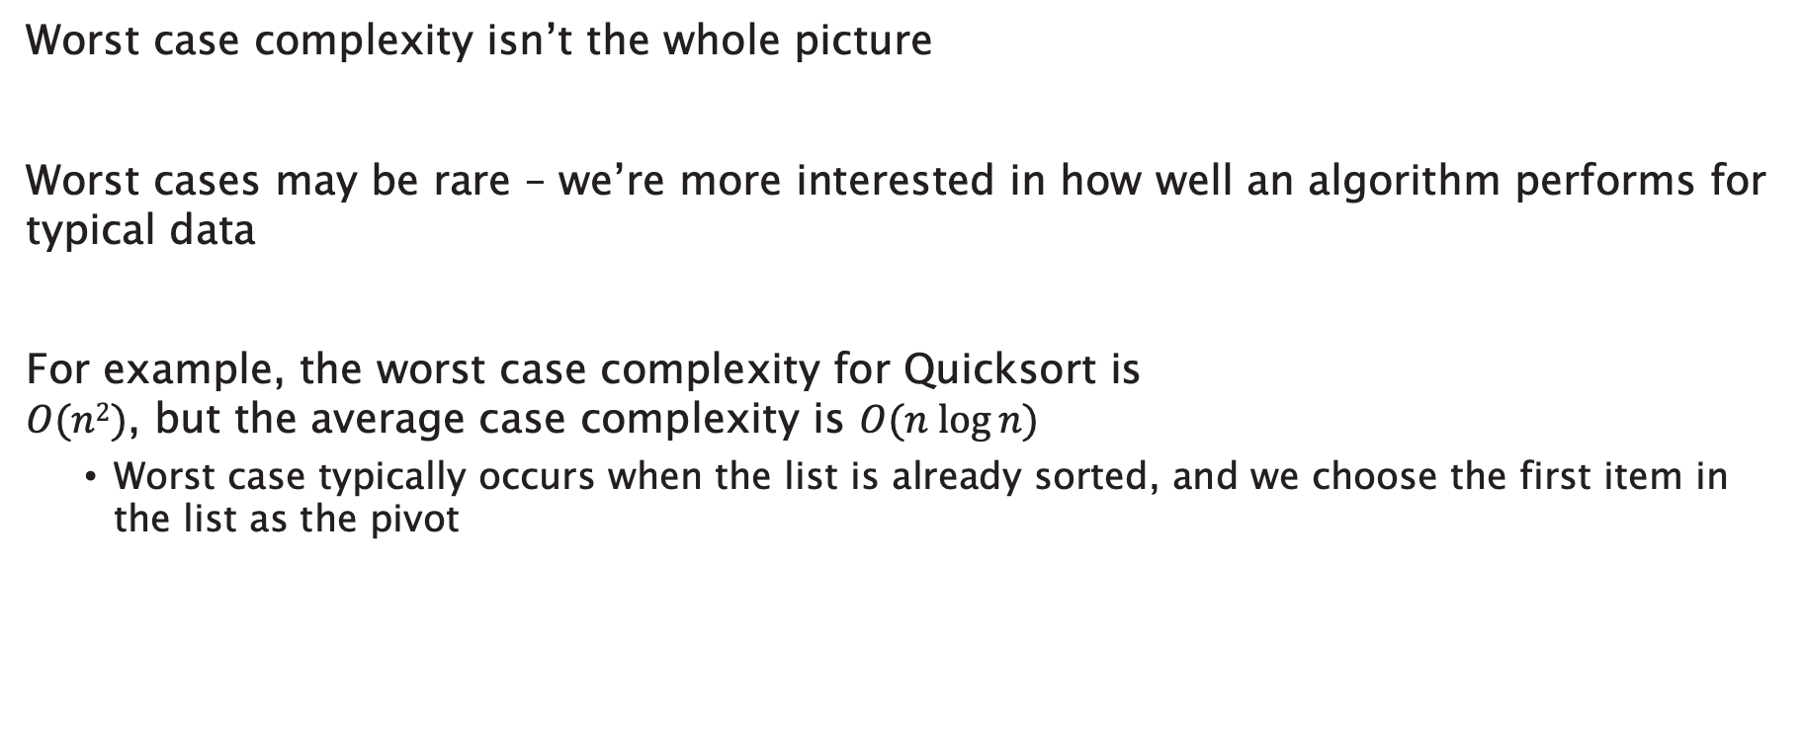
Average Case
Worst case complexity isn’t the whole picture
Worst cases may be rare – we’re more interested in how well an algorithm performs for typical data
For example, the worst case complexity for Quicksort is
$O(n2)$, but the average case complexity is $O(n log⁡n)$
  Worst case typically occurs when the list is already sorted, and we choose the first item in the list as the pivot

Slide 37
Brute Force and Ignorance
Can’t we just buy a bigger computer?
Complexity | Size of problem solvable in one hour
 | Standard computer | 1000 x faster | 1000,000 x faster
O(n) | A | 1000A | 1000000A
O(n²) | B | 31.6B | 1000B
O(2^{n}) | C | C + 9.97 | C + 19.93

Slide 39
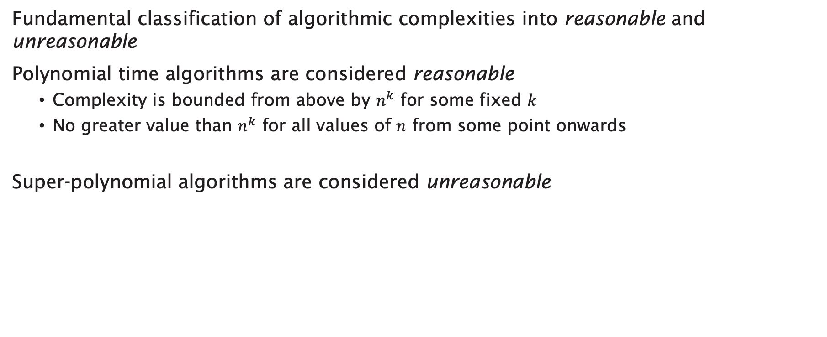
Reasonable
Fundamental classification of algorithmic complexities into reasonable and unreasonable
Polynomial time algorithms are considered reasonable
  Complexity is bounded from above by $n^{k}$ for some fixed $k$
  No greater value than $n^{k}$ for all values of $n$ from some point onwards
Super-polynomial algorithms are considered unreasonable

Slide 40
Unreasonable
Reasonable

Slide 41
Tractability
We classify algorithms as reasonable or unreasonable
We classify problems as tractable or intractable
A problem that admits a reasonable (polynomial time) solution is said to be tractable
A problem that admits only unreasonable (super-polynomial time) solutions is said to be intractable

Slide 42
Beyond Tractability
There’s worse to come…
Even a super-polynomial algorithm completes in finite time
What if our algorithm requires infinite time?
Notes:
If a problem has a finite set of inputs, it will always admit a solution
Finite problem – hard-wired set of inputs and outputs

Slide 43
Noncomputability and Undecidability
A problem that admits no solutions (no algorithms that run in finite time) is said to be noncomputable
A noncomputable decision problem (a problem for which the only possible outputs are “yes” and “no”) is said to be undecidable

Slide 44
The Halting Problem
Given an algorithm and an input, determine whether the algorithm will eventually halt when run with that input, or will run forever
An undecidable problem!

Slide 45
The Halting Problem
Can we tell if this algorithm will terminate?
while x != 1 do
x = x – 2
end
Notes:
Halts for positive odd x.

Slide 46
The Halting Problem
Can we tell if this algorithm will terminate?
while x != 1 do
if x is even
then x = x/2
else x = 3x + 1
end
Notes:
Seems to terminate for all positive x, but has not been proved.

Slide 47
The Halting Problem
We can’t produce an answer to the halting problem by simply executing the algorithm
If execution terminates, we can answer “yes”
When do we decide that the algorithm is not going to terminate?
(do we wait an infinite amount of time?)

Slide 48
The Halting Problem
Does the decidability of the Halting Problem depend on the expressiveness of our programming language?
if algorithm R halts on input X
then return “yes”
else return “no”
We can’t correctly implement this in any effectively executable programming language
The notion of computability is central to the Church-Turing Thesis

Slide 49
But first, some background
Early C20th attempts to clarify the foundations of mathematics were riven by paradoxes and inconsistencies
In the 1920s, David Hilbert proposed a programme to ground all existing theories to a finite, complete set of axioms: a decision procedure for all mathematics

Slide 50
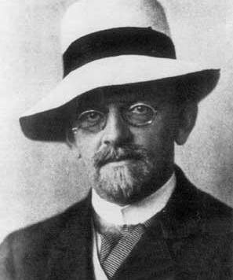
David Hilbert
The entscheidungsproblem is solved when we know a procedure that allows for any given logical expression to decide by finitely many operations its validity or satisfiability.
Notes:
entscheidungsproblem = decision problem

Slide 51
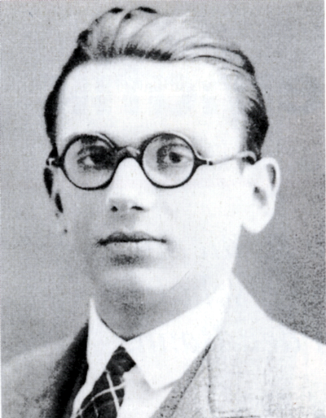
Kurt Gödel
For any computable axiomatic system that is powerful enough to describe the arithmetic of the natural numbers:
If the system is consistent, it cannot be complete
The consistency of the axioms cannot be proven within the system
Notes:
Godel‘s Incompleteness Theorems: the entscheidungsproblem is unsolvable

Slide 52
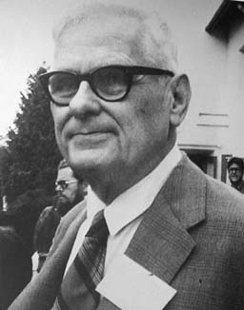
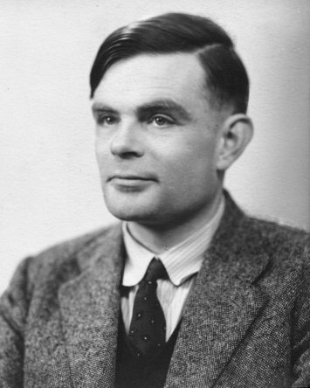
The Church-Turing Thesis
Formulated independently by Alonzo Church and Alan Turing in the mid-1930s
Any computable problem can be solved by a Turing machine
A response to David Hilbert’s Entscheidungsproblem, via the Halting Problem
Notes:
Computable problem: a problem for which there is an effective method
Church defined the lambda calculus
Turing defined Turing machines

Slide 53
The Turing Machine
An abstraction of a computing device
A grounding for considerations of complexity and computability

Slide 54
The Turing Machine
A tape of infinite length, divided into cells, each of which may contain a symbol from some finite alphabet
A head that can move the tape left and right, and read from and write to the cell under head
A record of the state of the machine
A table of instructions that control the behaviour (writing, moving) of the machine in response to the current state and the symbol under the head

Slide 55
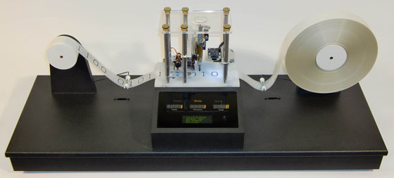

Slide 56
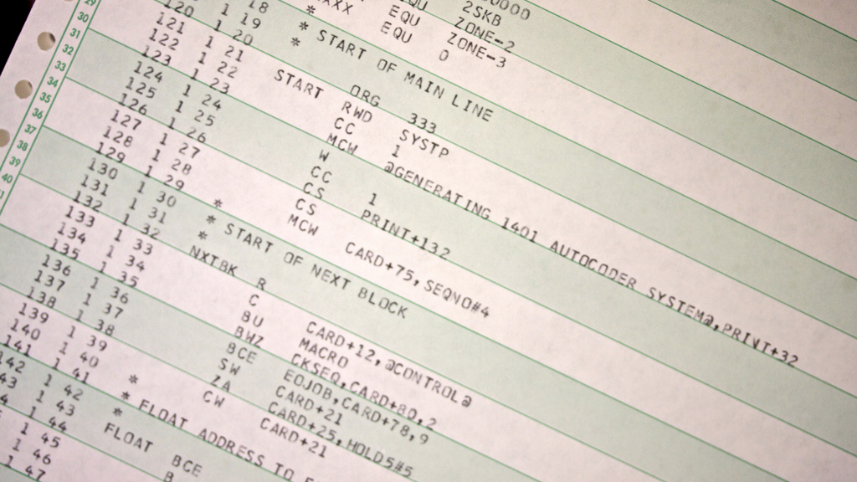
Example Program: Palindrome Detection
http://www.flickr.com/photos/mwichary/3368836377/

Slide 57
State | Read | Write | Move | Next
mark | a | # | R | move-a
mark | # | # | L | YES
mark | b | # | R | move-b
move-a | a | a | R | move-a
move-a | b | b | R | move-a
move-a | # | # | L | test-a
move-b | a | a | R | move-b
move-b | b | b | R | move-b
move-b | # | # | L | test-b
test-a | # | # | L | YES
test-a | b | b | L | NO
test-a | a | # | L | return
test-b | # | # | L | YES
test-b | a | a | L | NO
test-b | b | # | L | return
return | a | a | L | return
return | b | b | L | return
return | # | # | R | mark

Slide 59
Universal Turing Machines
A Turing machine that can simulate an arbitrary Turing machine on arbitrary input
Reads a description of the machine to be simulated from the tape (in addition to the input)

Slide 60
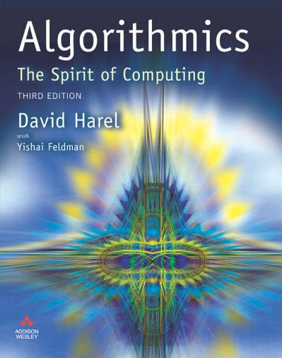
Further Reading
David Harel and Yishai Feldman (2004) Algorithmics: The Spirit of Computing,
Boston: Addison-Wesley.
  Ch.6 covers complexity
  Ch.7 covers tractability
  Ch.8 covers computability
  Ch.9 covers universality

Slide 61
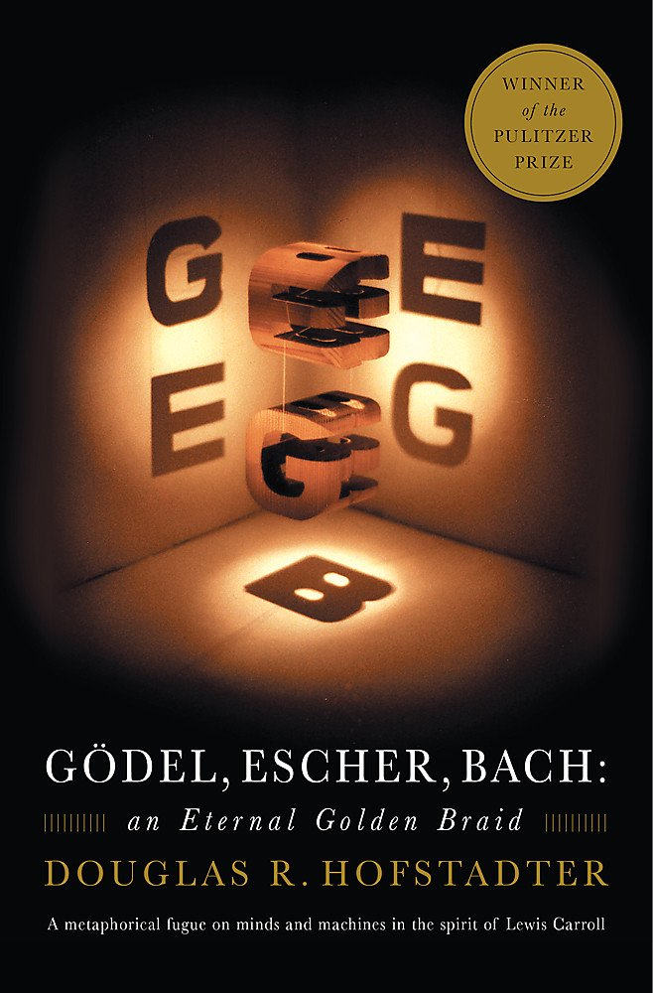
Further Reading
Douglas Hofstadter (1979) Gödel, Escher, Bach: An Eternal Golden Braid, New York: Basic Books.

