Slide 1
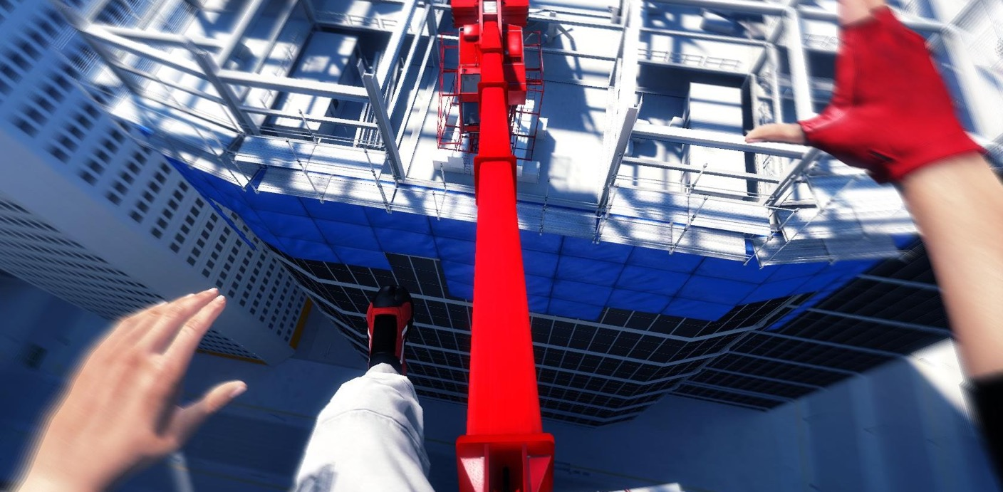
Balance and Difficulty
(Or, How I Learnt to Stop Punishing Players and Love Flow)
Notes:
Image from: https://bitbybitvideogameblog.wordpress.com/2014/10/19/my-first-thoughts-on-mirrors-edge/

Slide 2
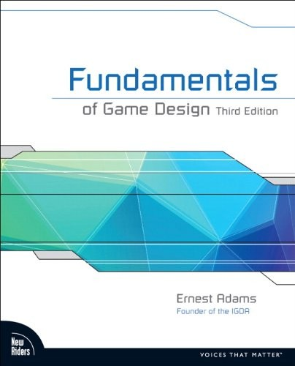
In This Lecture
Balancing Mechanics
Difficulty
Exercise to Rebalance a Game
Notes:
A lot of the structure and formal stuff from Adams, with a sprinkling of Fullerton and Extra Credits. There is LOTS out there about balance and difficulty.
My notes are in the notes bit of slides.
image: http://images.shorturlblog.com/userimg/view/image/cache/data/p/1095000000/1095592508-500x500.jpg

Slide 3
In This Lecture
Balancing Mechanics
Difficulty
Exercise to Rebalance a Game
Nothing replaces good old fashioned play testing.
Watch someone else play!
Notes:
A lot of the structure and formal stuff from Adams, with a sprinkling of Fullerton and Extra Credits. There is LOTS out there about balance and difficulty.
My notes are in the notes bit of slides.
image: http://images.shorturlblog.com/userimg/view/image/cache/data/p/1095000000/1095592508-500x500.jpg

Slide 4
TrapAdventure 2

Slide 5
What is Balance?
PvP
Player vs Player
PvE
Player vs Environment
Mario Cart

Slide 6
What is Balance?
PvP
Player vs Player
PvE
Player vs Environment
Game Provides Meaningful Choices
Players perceive the game to be fair
Chance does not outweigh player skill
Mario Cart

Slide 7
What is Balance?
PvP
Player vs Player
PvE
Player vs Environment
Game Provides Meaningful Choices
Players perceive the game to be fair
Chance does not outweigh player skill
Players can catch up before game end
Seldom results in stalemate
Mario Cart

Slide 8
What is Balance?
PvP
Player vs Player
PvE
Player vs Environment
Game Provides Meaningful Choices
Players perceive the game to be fair
Chance does not outweigh player skill
Players can catch up before game end
Level of difficulty should be consistent*
*does not mean it never changes
Seldom results in stalemate
Mario Cart

Slide 9
PvP fairness
Equal chance of winning (excepting skill)
Symmetry
starting player
Asymmetry
harder to balance
test permutations
Point assignment - for asymmetry
let player choose
orthogonally related
Chess
Notes:
competitive multiplayer - conflicting objectives, interaction between players
symmetric games can still have dominant strategy, they’re just open to all players so confer no advantage - just make it boring! (tic-tac-toe)
rules give equal chance of winning
rules should not advantage players unequally
Chess - could get player to write down moves.

Slide 10
PvE fairness
No sudden spikes in difficulty
Avoid learn-by-dying (TrapAdventure 2!)
Enough (in-game) information to make decisions
Challenges should be genre-relevant
Avoid challenges that are non-sequiturs for this type of game
E.g. Critical path Racing Game in RPG
Prince of Persia
Notes:
Single player
Some games thrive on die by trying, with quick enough iteration cycles (Super Meat Boy) or interesting meta-mechanics (Rogue Legacy)
Both information about the state of the game, and facts needed to solve puzzles.

Slide 11
Depth vs Complexity
Depth: amount of experiences possible from mechanics
Complexity: mental burden put on player
data to remember
rules to process
calculations to make
(function of mechanics and interface)
Complexity enables depth, but…
Too much complexity limits depth
Dwarf Fortress
Notes:
What are we aiming for?
Why do we need to consider balancing and tuning our mechanics?
It’s about scope!
https://www.youtube.com/watch?v=jVL4st0blGU

Slide 12
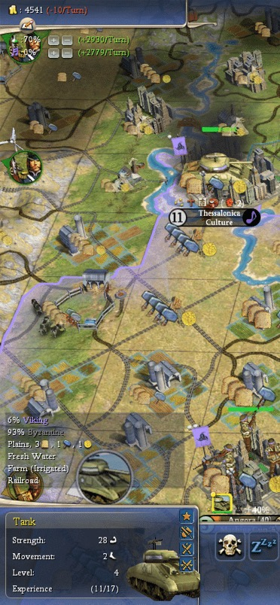
Depth vs Complexity
Aim for maximum depth, minimum complexity
Can avoid by re-using/combining mechanics
Or slowing down the pace of play
Avoid Irreducible Complexity
Otherwise is impossible to learn
Can the player compartmentalize the system?
James Portnow: “Elegance is a high depth to complexity ratio – e.g. Go”
Civilization 4
Notes:
What are we aiming for?
Why do we need to consider balancing and tuning our mechanics?
It’s about scope!
https://www.youtube.com/watch?v=jVL4st0blGU

Slide 13
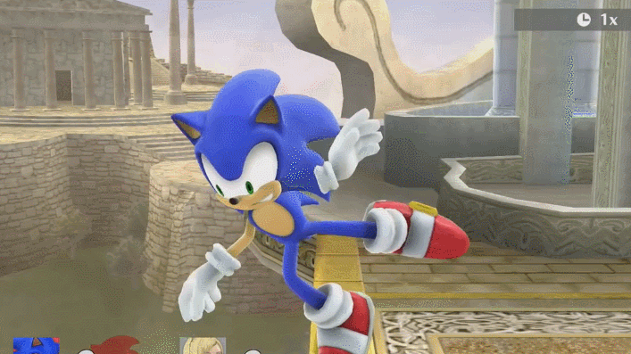
Part I - Balancing Mechanics
Notes:
First we’re going to talk about the techniques commonly considered for balancing the rules and parameters that form the basis of your game.
Avoiding dominant strategies
Controlling feedback
Use of chance
image from http://knowyourmeme.com/photos/945634-super-smash-brothers

Slide 14
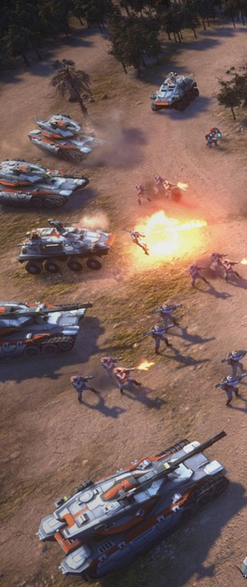
Dominant Strategies
A clearly superior strategy that will win
E.g. Tank Rush!!!
Removes meaningful choice -> boring
Can completely break asymmetric PvP games
How to avoid?
Test to avoid unstoppable exploits
In live games -> buffs and nerfs
In design, depends on whether you have
Transitive or Intransitive relationships
Command and Conquer
Notes:
Come from providing many actions that can surmount many challenges.
Examples?! real time STRATEGY
Red Alert - Soviet tank rush
Starcraft - zergling rush
Basketball shot clock
Football offside modifications

Slide 15
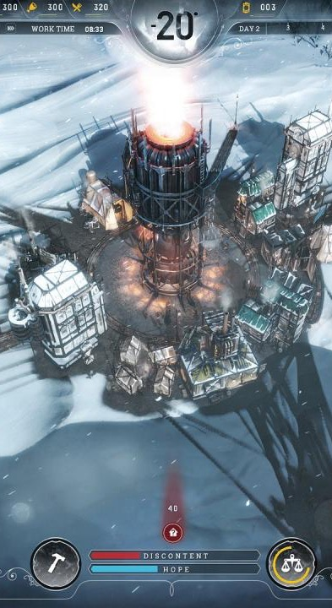
Transitive Relationship
Problem:
If A > B and B>C
Then A > C
Strategies: why ever use C!?
Solution:
Impose direct cost (A costs more than C)
Impose shadow cost (a hidden cost, or consequence, of that decision)
Frostpunk
Notes:
A is dominant strategy over C!
Make direct costs proportional.
e.g. cost of cars in racing game.
Direct costs: If the Porsche is faster than the Ford, then make the Porsche cost more money to acquire.
Shadow costs: If the Porsche is faster than the Ford, then make its fuel consumption higher or tank smaller.
(Shadow costs can be completely hidden in the mechanics, or reflected subtly in the interface but not explicitly referenced in the manual or the tutorial).
Orthogonal - possess capabilities that other units do not.

Slide 16
Intransitive Relationship
A
B
C
Notes:
Trope “Tactical Rock-Paper-Scissors”: http://tvtropes.org/pmwiki/pmwiki.php/Main/TacticalRockPaperScissors

Slide 17
Intransitive Relationship
Rock-Paper-Scissors(-Lizard-Spock)
A
B
C
http://www.samkass.com/theories/RPSSL.html
Notes:
Trope “Tactical Rock-Paper-Scissors”: http://tvtropes.org/pmwiki/pmwiki.php/Main/TacticalRockPaperScissors

Slide 18
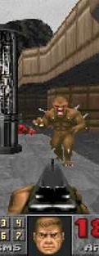
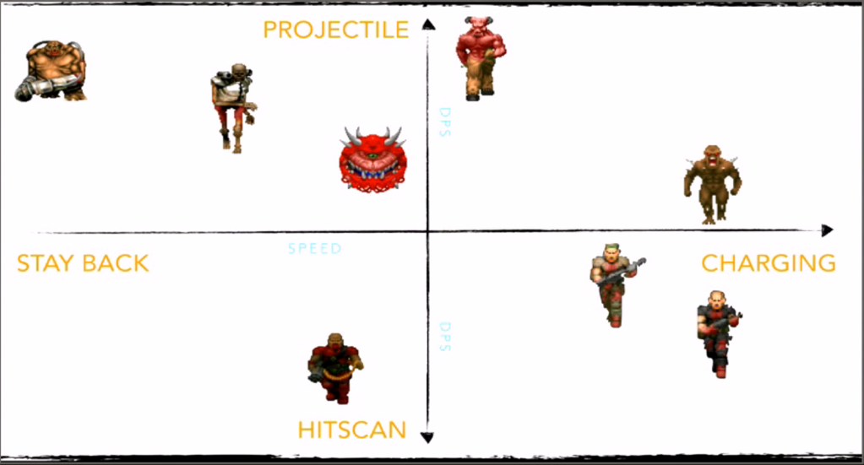
Balancing the Environment
Orthogonal Unit Differentiation
(Same for weapons/equipment)
Doom
Harvey Smith, GDC 2003
Notes:
e.g. Chess, RPGs, RTSs, Tower Defence
Discussion: http://forums.rpgmakerweb.com/index.php?/topic/33889-orthogonal-unit-differentiation-what-the-what/
OUD: http://www.gdcvault.com/play/1020570/Level-Design-in-a-Day at 32:00
Original presentation? http://slideplayer.com/slide/4321830/ - Harvey Smith, GDC 2003
Image screencapped from Level Design in a Day video
Pokemon radar: http://www.gamerguides.com/pokemon-oras/introduction/advanced-trainer-info/effort-values-evs

Slide 19
Balancing Player Competition
Feedback is when the state of the system is an input into the system
Positive Feedback
Advantages to the winning player
E.g. FPS: weapons, equipment
Negative feedback
Advantages to the losing player
E.g. FPS: random respawn, full health
Need to tune feedback carefully!

Slide 20
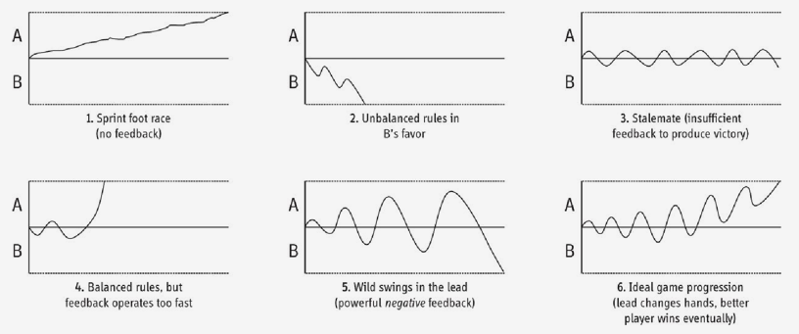
Imbalanced and Ideal Feedback Loops
Notes:
Wild swings example
Risk
Mario Kartblue shell
Ideal example
rubber banding? (this is also an example of cheating AI, players tend not to like this)

Slide 21
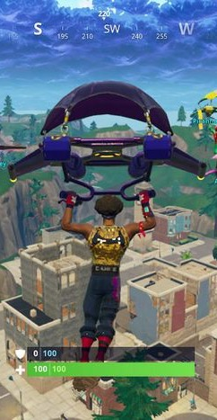
Controlling Positive Feedback
Tune the reward of power
Artificially limit the player’s power
Associate costs
Allow players to collaborate against leader
Raise difficulty of challenges
Use chance!
Fortnite
Notes:
Do not provide too much power for success (e.g. gaining opponent piece in shogi).
Artificial limit: NFL salary caps and only 1 gun at a time in shooters.
Converting enemy creatures in Dungeon Keeper or gaining territory in warfare, increases costs of food, supply lines and the front line to defend.

Slide 22
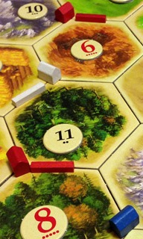
Use of Chance
Randomness
Can moderate positive feedback
Use sparingly, and rules-of-thumb
Small risk & reward
Let player play the odds
Let player choose their stake
Settlers of Catan
Notes:
(not infrequent challenges with large risk & reward)
CAN FEEL UNFAIR
examples
Settlers of Catan
Snakes and Ladders

Slide 23
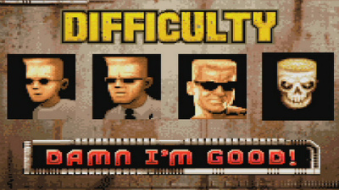
Part II - Difficulty
Notes:
image from http://grandgeekgathering.com/2015/12/doing-difficulty-correctly/

Slide 24
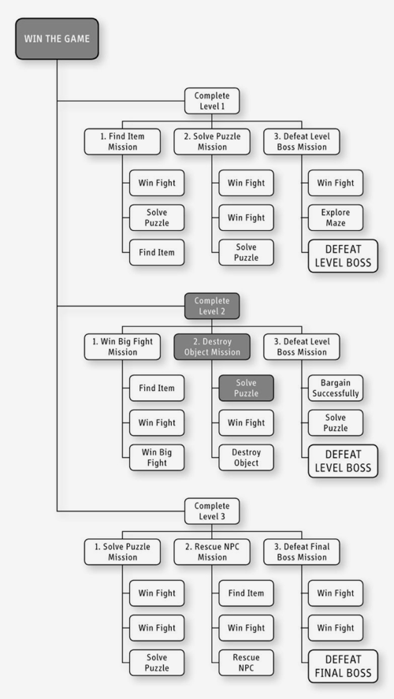
Challenge Hierarchy
PvE is a series of predefined challenges
Balancing is selecting the level and order of these!
Notes:
Adams, Chapter 13
Through your level design you are going to construct a series of challenges for the player.
Balancing a PvE game to seem fair is a matter of selecting, ordering and tuning these challenges to provide a satisfying experience.

Slide 25
Challenge Hierarchy
PvE is a series of predefined challenges
Balancing is selecting the level and order of these!
Overlap levels
Give breathing space
Get back in the zone after a break from game
Notes:
Adams, Chapter 13
Through your level design you are going to construct a series of challenges for the player.
Balancing a PvE game to seem fair is a matter of selecting, ordering and tuning these challenges to provide a satisfying experience.

Slide 26
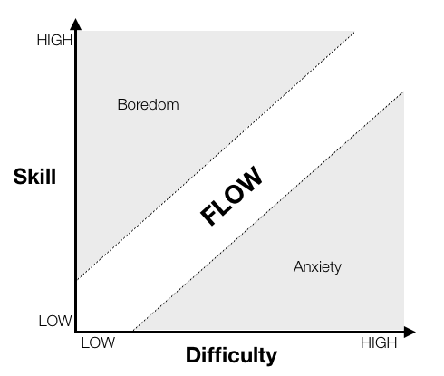
Flow
Mihaly Csikszentmihalyi
flOw
Notes:
Me-Hi-Cheek-Sent-Mi-Hi
flow graph from: http://gamasutra.com/view/feature/166972/cognitive_flow_the_psychology_of_.php
Also see, Jenova Chen’s MSc thesis about Flow in Games, and his game flOw:
http://www.jenovachen.com/flowingames/thesis.htm
flOw image from: http://thatgamecompany.com/games/flow/
difficulty image: http://gamasutra.com/blogs/DavidMaletz/20120913/177683/Four_Tricks_to_Improve_Game_Balance.php

Slide 27
Flow
Mihaly Csikszentmihalyi
A challenging activity requiring skill;
A merging of action and awareness;
Clear goals;
Direct, immediate feedback;
Concentration on the task at hand;
A sense of control;
A loss of self-consciousness; and
An altered sense of time.
flOw
Notes:
Me-Hi-Cheek-Sent-Mi-Hi
flow graph from: http://gamasutra.com/view/feature/166972/cognitive_flow_the_psychology_of_.php
Also see, Jenova Chen’s MSc thesis about Flow in Games, and his game flOw:
http://www.jenovachen.com/flowingames/thesis.htm
flOw image from: http://thatgamecompany.com/games/flow/
difficulty image: http://gamasutra.com/blogs/DavidMaletz/20120913/177683/Four_Tricks_to_Improve_Game_Balance.php

Slide 28
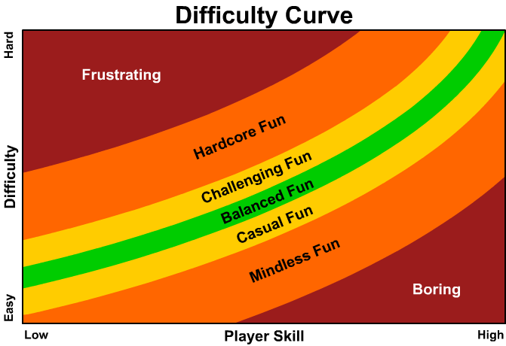
Flow
Know your audience
Underestimate the player's learning curve.
Don't reward skilled players by making the game easier!
Allow players to change the game's difficulty.
“No matter how well you balance the game yourself, unless you are the sole audience of the game, you will need to know what it's like for others”
Four Tricks to Improve Game Balance, David Maletz, Gamesutra Sept 12
Notes:
flow graph from: http://gamasutra.com/view/feature/166972/cognitive_flow_the_psychology_of_.php
Also see, Jenova Chen’s MSc thesis about Flow in Games, and his game flOw:
http://www.jenovachen.com/flowingames/thesis.htm
flOw image from: http://thatgamecompany.com/games/flow/
difficulty image: http://gamasutra.com/blogs/DavidMaletz/20120913/177683/Four_Tricks_to_Improve_Game_Balance.php

Slide 29
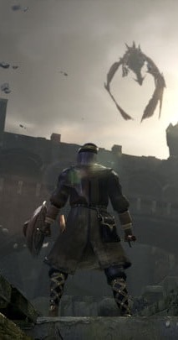
Estimating Difficulty
Absolute Difficulty
versus trivial baseline challenge
Power
player or avatar’s strength and stats
Relative Difficulty
absolute difficulty adjusted for power
In-game experience
amount of practice at this type of challenge
Dark Souls (Remastered)
Notes:
Measures
What you cannot control:
“previous experience” (of similar games)
“native talent” (hand-eye coordination, reasoning, etc)
Experience will depend somewhat on how much practice you give them through the game (if they’ve not done any pit jumping for 5 levels, don’t expect them to be as good at it as before).

Slide 30
Perceived Difficulty
We want to tune Perceived Difficulty
= relative difficulty - in-game experience
= (absolute difficulty - power) - in-game experience
= absolute difficulty - (power + in-game experience)
Notes:
The important measure to be aware of is perceived difficulty. This is how difficult a challenge feels to a player at the point they encounter.
It is a function of absolute difficulty, avatar power and player experience.

Slide 31
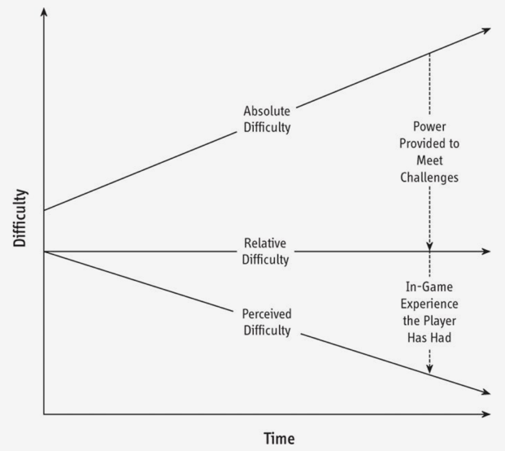
Static Relative Difficulty
Static Relative Difficulty
means
Perceived Difficulty
must drop
Notes:
Players expect games to get harder.
And you are in control of making the challenge harder, and you know how much power (positive feedback) you have given them.
But remember that they get more practiced over time.

Slide 32
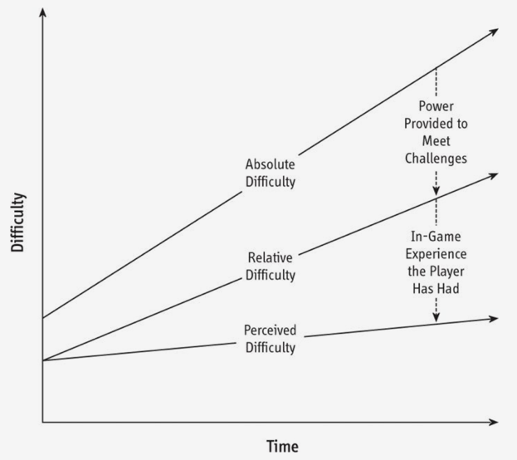
Rising Relative Difficulty
Rising Relative Difficulty
means
Perceived Difficulty
can rise
Notes:
Players expect games to get harder.
And you are in control of making the challenge harder, and you know how much power (positive feedback) you have given them.
But remember that they get more practiced over time.

Slide 33
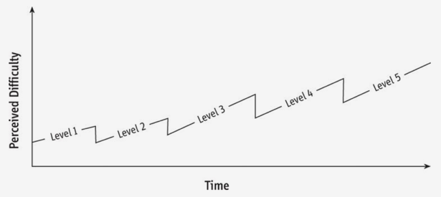
Sawtooth levels
Overlap levels
Give breathing space
Get back in the zone after a break from game
Notes:
Don’t increase difficulty between levels. Player may have gone away from the game for some time between the levels, and so lost some of their experience.
Should not fluctuate wildly. Gradually increase difficulty.

Slide 34
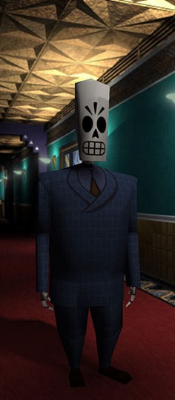
Difficulty vs Punishing
Punishing Games
Make players repeatedly do the same thing with small chance of success
Or worse: Contain uninformed choices
Even worse: Have inconsistent rules (play tricks)
Be less punishing
Usable controls, logical rules
Lower iteration times help (respawn!)
(TrapAdventure 2: 12 attempts in 90 sec)
Good Designers – design to challenge
Bad Designers – design to win!
Grim Fandango
Notes:
https://www.youtube.com/watch?v=ea6UuRTjkKs
Punishing examples
Mario: 10% of pits being hidden secrets cannot be predicted by player skill
Balanced difficult examples
Dark Souls (consistent rules)
Super Meat Boy and Hotline Miami (quick iteration)

Slide 35
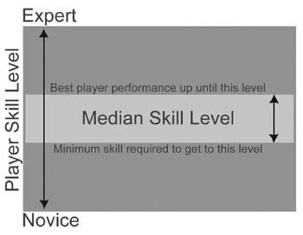
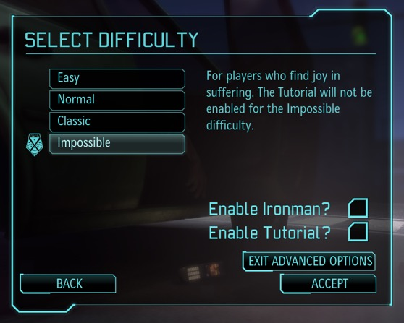
Tuning for Median Skill
Test with hardcore
Test with casual
Aim in between
Notes:
Image from Fullerton
Test with hardcore players and tune the parameters to suit the best player.
Then test with casual players and tune the parameters to suit the inexperienced player.
Your final parameter values should lie somewhere in this range - where depends on your intended audience or…
… provide a variety of difficulty levels within this range!
Difficult modes
Easy mode means easy!

Slide 36
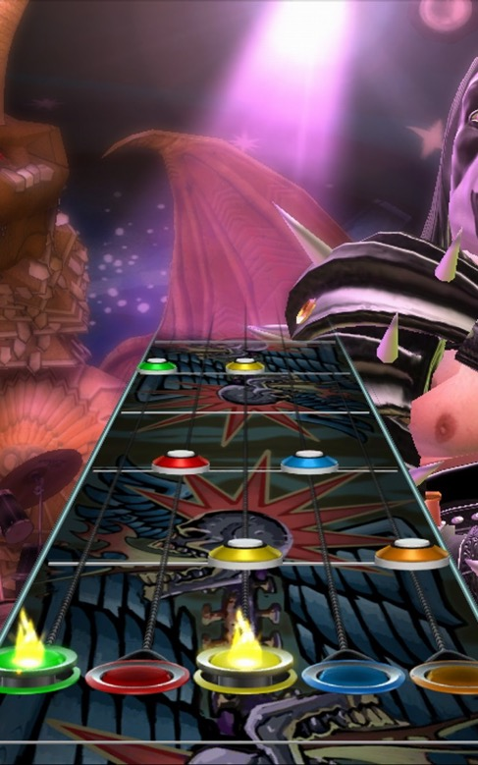
Practicalities of Tuning
Design your code to make tuning easy
load rules parameters from an external source (public properties in Unity)
fix the random seed
Change 1 parameter at a time
Binary search
Keep records
Grim Fandango
Notes:
Make code modular, so you can isolate mechanics to tune.

Slide 37
Questions
?

Slide 38
Break
Don’t just sit there, get up, stretch, wander off (then come back)

Slide 39
Part III - Exercise
Balancing an Asymmetric Game
Notes:
image: http://www.museumofplay.org/online-collections/3/41/107.2831

Slide 40
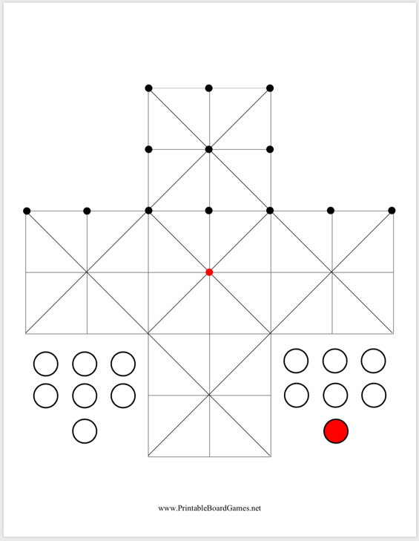
Fox and 13 Geese
In 2-3s
English solitaire board
1 fox, 13 geese
Fox and geese can move to any empty adjacent space
Geese cannot move backwards
Fox can also jump over and capture
Chain jumps
Doesn’t have to jump
Game is unbalanced in favour of fox. Fix it!
Notes:
https://en.wikipedia.org/wiki/Fox_games
https://boardgamegeek.com/thread/500778/anyone-know-anything-about-classic-game-fox-and-ge
http://www.mastersgames.com/rules/fox-geese-rules.htm
image: https://commons.wikimedia.org/wiki/File:Peg_Solitaire_game_board_shapes.svg

Slide 41
Fox and 13 Geese
In 2-3s
English solitaire board
1 fox, 13 geese
Fox and geese can move to any empty adjacent space
Geese cannot move backwards
Fox can also jump over and capture
Chain jumps
Doesn’t have to jump
Game is unbalanced in favour of fox. Fix it!
What could we vary?
Notes:
https://en.wikipedia.org/wiki/Fox_games
https://boardgamegeek.com/thread/500778/anyone-know-anything-about-classic-game-fox-and-ge
http://www.mastersgames.com/rules/fox-geese-rules.htm
image: https://commons.wikimedia.org/wiki/File:Peg_Solitaire_game_board_shapes.svg

Slide 42
Fox and 13 Geese
This is a two-player game. One person plays the red circle (the “Fox”) and the other player plays the thirteen white circles (the “Geese”). The two players have different objectives for winning.
Cut out the white and red pieces. Place the Geese on the black circles along the points of the board. Place the Fox in the red circle in the middle of the board (or anywhere else on the board, for more variation).
The Geese move first. Players alternate turns after that.
During their respective turns, the Fox and the Geese may move along the lines in any direction, but only to the next available point.
The Fox captures the Geese by jumping over them to a vacant spot beyond them. The Fox can jump over multiple Geese if possible.
Geese cannot jump over each other or the Fox.
The Geese win if they hem in the Fox and make it unable to move. The Fox wins if it captures enough Geese so that they cannot do this

Slide 43
Discussion
What did you change first?
What did you hope to achieve?
Which changes:
made play time longer/shorter?
made fox win more?
made geese win more?
Fox and Geese

Slide 44
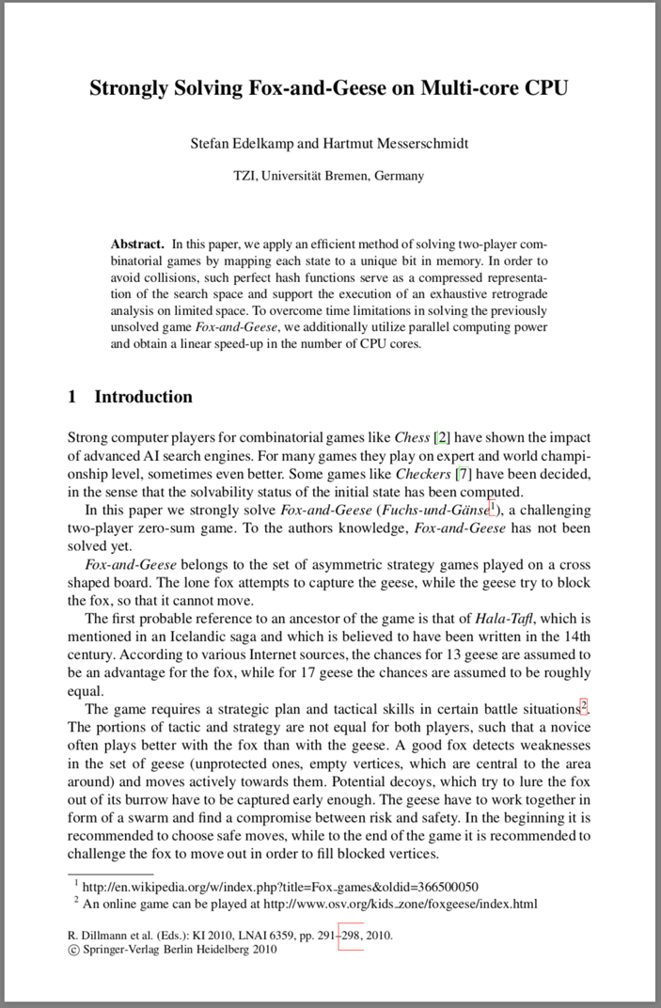
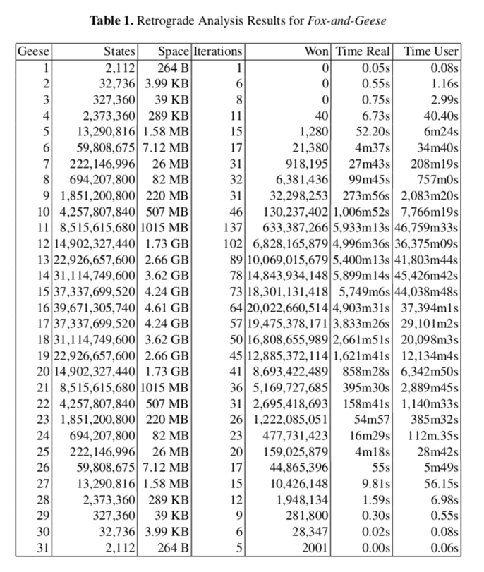
Solved

Slide 45
Reading List
Chapter 15 and 13 of “Fundamentals of Game Design”
Chapter 10 of “Game Design Workshop”

Slide 46
Play List
Play (or Let’s Play) a hard game:
Anything by FromSoftware
Demon’s Souls
Dark Souls
Bloodborne
Super Meat Boy
Hotline Miami
Consider:
How does it avoid being punishing?
How does it remain feeling fair?
Super Meat Boy

Slide 47
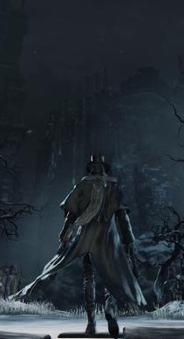
Summary
Depth is not Complexity
Avoid Dominant Strategies
Do you have Transitive or Intransitive relationships
Are your Feedback Loops working?
Use Chance sparingly and carefully
Create a Challenge Hierarchy
Aim for Flow (balance of difficulty and skill)
Aim for rising Perceived Difficulty
Aim for Difficulty not Punishment
Playtest and Tune (a lot!)
Bloodborne

Slide 48
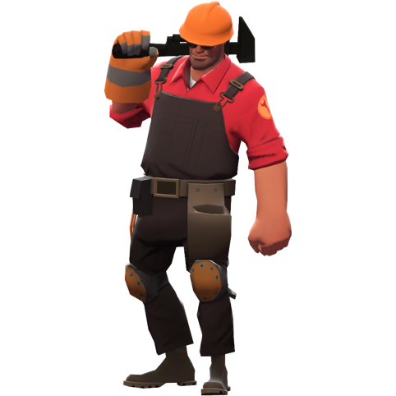
Thank You
COMP3218 Website: https://secure.ecs.soton.ac.uk/module/COMP3218/
David Millard
@hoosfoos | davidmillard.org | dem@soton.ac.uk

